Slide 1
Sectionalism

Slide 2
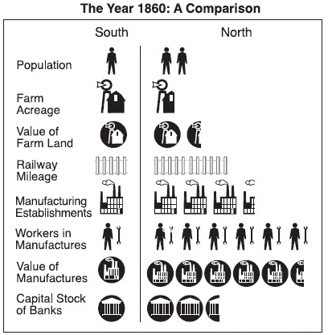
Notes:
SECTIONALISM

Slide 3
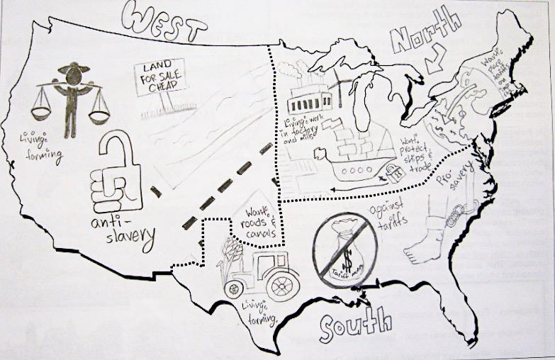
Notes:
SECTIONALISM

Slide 4
The Impending Crisis of the South, Hinton R. Helper (1857)
If the value of all the property... of eight entire slave States…--with all their hordes of human merchandise--were put up at auction, New York could buy them all, and then have one hundred and thirty-three millions of dollars left in her pocket!... When we come to compare the North with the South in regard to literature, general intelligence, inventive genius, moral and religious enterprises, the discoveries in medicine, and the progress in the arts and sciences, we shall in every instance, find the contrast equally great on the side of Liberty.
Non-slaveholders of the South!... we take this occasion to assure you that the slaveholding politicians whom you have elected to offices of honor and profit, have hoodwinked [tricked] you… and used you as mere tools for the consummation of their wicked designs. They have purposely kept you in ignorance, and have, by molding your passions and prejudices to suit themselves, induced you to act in direct opposition to your dearest rights and interests… Now, as one of your own number, we appeal to you to join us in our earnest and timely effort to rescue the generous soil of the South from the usurped and desolating control of these political vampires. Once and forever, at least so far as this country is concerned, the infernal question of slavery must be disposed of; a speedy and absolute abolishment of the whole system is the true policy of the South--and this is the policy which we propose to pursue. Will you aid us, will you assist us, will you be freemen, or will you be slaves!...
Notwithstanding the fact that the white non-slaveholders of the South are the majority, as five to one, they have never yet had any part or lot in framing the laws under which they live. There is no legislation except for the benefit of slavery, and slaveholders. As a general rule, poor white persons are regarded with less esteem and attention than Negroes, and though the condition of the latter is wretched beyond description, vast numbers of the former are infinitely worse off....
Notes:
In 1857, Hinton Rowan Helper (1829-1909), the son of a western North Carolina farmer, published The Impending Crisis of the South. The book argued that slavery was incompatible with economic progress. Using statistics drawn from the 1850 census, Helper maintained that by every measure the North was growing far faster than the South and that slavery was the cause of the South's economic backwardness.
Helper's thesis was that slavery was inefficient and wasteful, that it impoverished the South, degraded labor, inhibited urbanization, thwarted industrialization, and stifled progress. A rabid racist, Helper accompanied his call for abolition with a demand for colonization. He concluded with a call for nonslaveholders to overthrow the South's planter elite. During the 1860 presidential campaign, the New York Tribune distributed 500 copies of the book a day, considering it the most effective propaganda against slavery ever written. Many Southerners burned it, fearful that it would divide the white population.

Slide 5
George Fitzhugh, The Blessings of Slavery from Cannibals All! Or Slaves Without Masters, 1857
We are all, North and South, engaged in the White Slave Trade, and he who succeeds best is esteemed most respectable. It is far more cruel than the Black Slave Trade, because it exacts more of its slaves, and neither protects nor governs them…
When the day’s labor is ended, he [the free-laborer] is free, but is overburdened with the cares of family and household, which makes his freedom an empty and delusive mockery…The Negro slave is free, too, when the labors of the day are over, and free in mind as well as body; for the master provides food, raiment, house, fuel and everything else necessary to the physical well-being of himself and his family.
The Negro slaves of the South are the happiest, and, in some sense, the freest people in the world. The children and the aged and infirm work not at all, and yet have all the comforts and necessaries of life provided for them. They enjoy liberty, because they are oppressed neither by care nor labor. The women do little hard work, and are protected from the despotism of their husband by their masters. The Negro men and stout boys work, on the average, in good weather, not more than nine hours a day. The balance of their time is spent in perfect abandon. The free laborer must work or starve. He is more a slave than the Negro because he works longer and harder for less allowance than the slave, and has no holiday, because the cares of his life with him begin when its labors end. He has no liberty, and not a single right.
Notes:
SECTIONALISM

Slide 6
The House Divided Speech was an address given by Abraham Lincoln, later President of the United States, on June 16, 1858 at what was then the Illinois State Capitol in Springfield, after he had accepted the Illinois Republican Party's nomination as that state's US senator. The speech became the launching point for his unsuccessful campaign for the seat, held by Stephen A. Douglas; the campaign would climax with the Lincoln-Douglas debates of 1858.
"A house divided against itself cannot stand." I believe this government cannot endure, permanently, half slave and half free. I do not expect the Union to be dissolved; I do not expect the house to fall; but I do expect it will cease to be divided. It will become all one thing, or all the other. Either the opponents of slavery will arrest the further spread of it and place it where the public mind shall rest in the belief that it is in the course of ultimate extinction, or its advocates will push it forward till it shall become alike lawful in all the states, old as well as new, North as well as South.

Slide 7
Westward Expansion and States’ Rights

Slide 8
The Compromise of 1850
Legislative Item | Victory For?
California admitted to the Union as a free state | Clear victory for the North
Popular sovereignty to determine slavery issue in Utah and New Mexico territories (popular sovereignty: the people of each territory vote on whether to accept slavery or not) | Moderate victory for both sides
Texas border dispute with New Mexico resolved; Texas receives $10 million | Moderate Southern victory
Slave trade, but not slavery itself, abolished in Washington D.C. | Moderate Northern victory
Strong federal enforcement of new Fugitive Slave Act | Clear victory for the South
Notes:
POLITICS

Slide 9
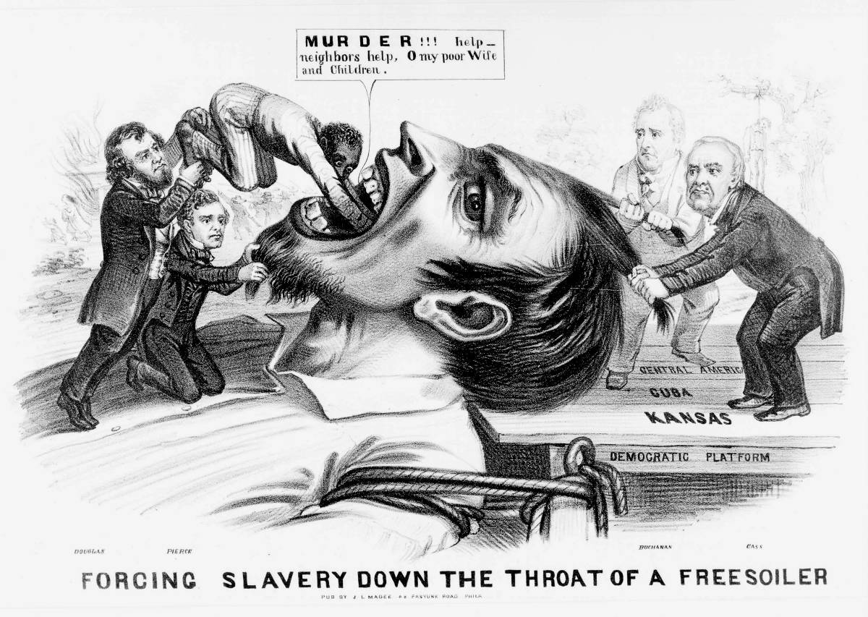
Notes:
POLITICS

Slide 10
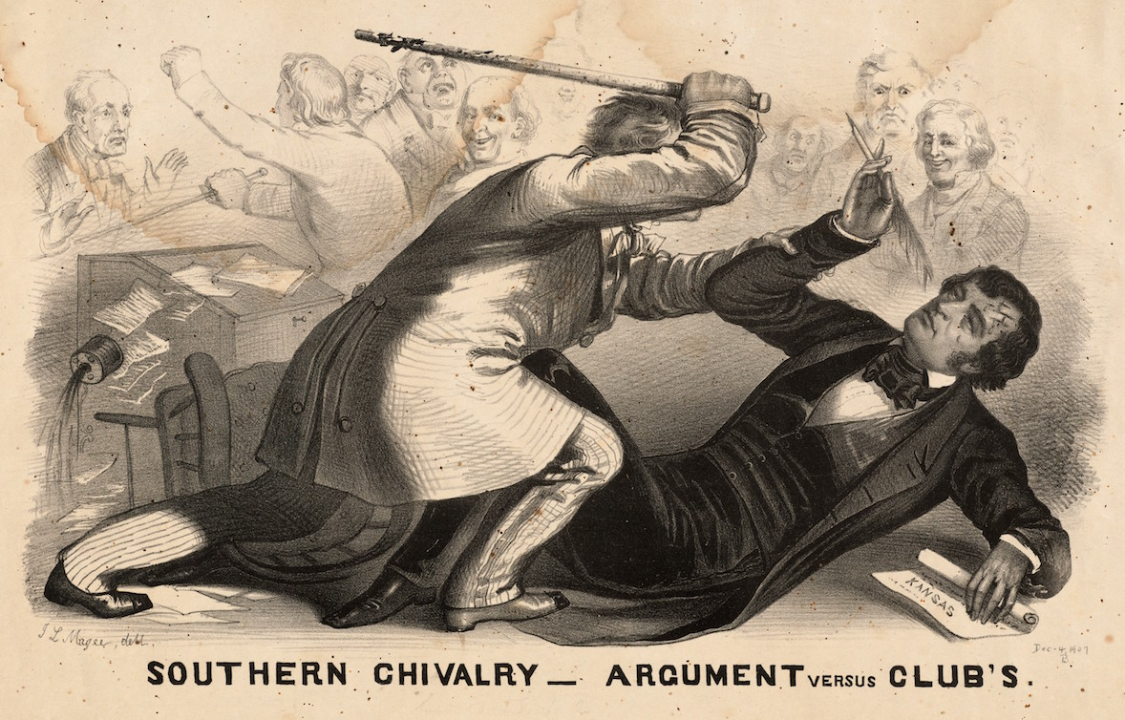

Slide 11
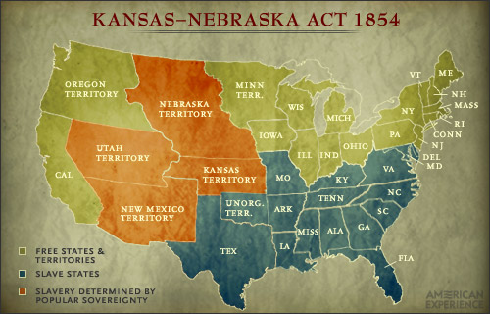
By a narrow vote of 113 to 100, the House of Representatives approved the Kansas–Nebraska Act. The act repealed the Missouri Compromise of 1820, undercut the Compromise of 1850, and greatly complicated hopes for a peaceful resolution to the problem of balancing the ratio of free and slave states in the U.S. Congress. Proponents favored the bill because it offered the territories “popular sovereignty”—giving voters a choice of determining free or slave status—instead of using the geographical boundary line set by the Missouri Compromise. The law precipitated violent unrest in the Kansas Territory and deepened abolitionist fervor in the northern states.
Notes:
POLITICS

Slide 12
Dred Scott v. Sanford, Majority opinion, Chief Justice Roger B. Taney, 1858
“The question before us is whether the class of persons described in the plea… compose a portion of this people, and are constituent members of this sovereignty? We think they are not, and that they are not included, and were not intended to be included, under the word “citizens” in the Constitution, and can therefore claim none of the rights and privileges which that instrument provides for and secures to citizens of the United States. On the contrary, they were at that time considered as a subordinate and inferior class of beings who had been subjugated by the dominant race, and, whether emancipated or not, yet remained subject to their authority, and had no rights or privileges but such as those who held the power and the Government might choose to grant them….
The general words [of the Declaration of Independence] would seem to embrace the whole human family, and if they were used in a similar instrument at this day would be so understood. But it is too clear for dispute that the enslaved African race were not intended to be included, and formed no part of the people who framed and adopted this declaration, for if the language, as understood in that day, would embrace them, the conduct of the distinguished men who framed the Declaration of Independence would have been utterly and flagrantly inconsistent with the principles they asserted…
Upon these considerations, it is the opinion of the court that the act of Congress which prohibited a citizen from holding and owning property of this kind in the territory of the United States north of the [Missouri Compromise line] is not warranted by the Constitution, and is therefore void, and that neither Dred Scott himself nor any of his family were made free by being carried into this territory, even if they had been carried there by the owner with the intention of becoming a permanent resident….
Upon the whole, therefore, it is the judgment of this court that it appears by the record before us that the plaintiff in error is not a citizen of Missouri in the sense in which that word is used in the Constitution.”

Slide 13
Abolition

Slide 14
Uncle Tom’s Cabin, Harriet Beecher Stowe, 1852
"And now," said Legree, "come here, you Tom. You see, I telled ye I didn't buy ye jest for the common work; I mean to promote ye, and make a driver of ye; and to-night ye may jest as well begin to get yer hand in. Now, ye jest take this yer gal and flog her; ye've seen enough on't to know how."
I beg Mas'r's pardon," said Tom; "hopes Mas'r won't set me at that. It's what I an't used to, -- never did, -- and can't do, no way possible."
"Ye'll larn a pretty smart chance of things ye never did know, before I've done with ye!" said Legree, taking up a cowhide, and striking Tom a heavy blow cross the cheek, and following up the infliction by a shower of blows.
"There!" he said, as he stopped to rest; "now, will ye tell me ye can't do it?"
"Yes, Mas'r," said Tom, putting up his hand, to wipe the blood, that trickled down his face. "I'm willin' to work, night and day, and work while there's life and breath in me; but this yer thing I can't feel it right to do; -- and, Mas'r, I never shall do it, -- never!"
… "the poor crittur's sick and feeble; 't would be downright cruel, and it's what I never will do, nor begin to. Mas'r, if you mean to kill me, kill me; but, as to my raising my hand agin any one here, I never shall, -- I'll die first!"…
"Well, here's a pious dog, at last, let down among us sinners!... Here, you rascal, you make believe to be so pious, -- didn't you never hear, out of yer Bible, 'Servants, obey yer masters'? An't I yer master? Didn't I pay down twelve hundred dollars, cash, for all there is inside yer old cussed black shell? An't yer mine, now, body and soul?" he said, giving Tom a violent kick with his heavy boot; "tell me!"
…[Tom] suddenly stretched himself up, and, looking earnestly to heaven, while the tears and blood that flowed down his face mingled, he exclaimed,
"No! no! no! my soul an't yours, Mas'r! You haven't bought it, -- ye can't buy it! It's been bought and paid for, by one that is able to keep it; -- no matter, no matter, you can't harm me!"
"I can't!" said Legree, with a sneer; "we'll see, -- we'll see! Here, Sambo, Quimbo, give this dog such a breakin' in as he won't get over, this month!"
The two gigantic negroes that now laid hold of Tom, with fiendish exultation in their faces, might have formed no unapt personification of powers of darkness. The poor woman screamed with apprehension, and all rose, as by a general impulse, while they dragged him unresisting from the place.

Slide 15
The Liberator, William Lloyd Garrison, 1831
During my recent tour for the purpose of exciting the minds of the people by a series of discourses on the subject of slavery, every place that I visited gave fresh evidence of the fact, that a greater revolution in public sentiment was to be effected in the free states… than at the south. I found contempt more bitter, opposition more active, detraction more relentless, prejudice more stubborn, and apathy more frozen, than among slave owners themselves… Till every chain be broken, and every bondman set free! Let southern oppressors tremble -- let their secret abettors tremble -- let their northern apologists tremble -- let all the enemies of the persecuted blacks tremble… I am aware, that many object to the severity of my language; but is there not cause for severity? I will be as harsh as truth, and as uncompromising as justice. On this subject, I do not wish to think, or speak, or write, with moderation. No! no! Tell a man whose house is on fire, to give a moderate alarm; tell him to moderately rescue his wife from the hand of the ravisher; tell the mother to gradually extricate (remove) her babe from the fire into which it has fallen; -- but urge me not to use moderation in a cause like the present. I am in earnest -- I will not equivocate -- I will not excuse -- I will not retreat a single inch -- AND I WILL BE HEARD. The apathy of the people is enough to make every statue leap from its pedestal, and to hasten the resurrection of the dead. It is pretended, that I am retarding the cause of emancipation by the coarseness of my invective (criticism), and the precipitancy (urgency) of my measures. The charge is not true. On this question my influence, -- humble as it is, -- is felt at this moment to a considerable extent, and shall be felt in coming years -- not perniciously (maliciously), but beneficially -- not as a curse, but as a blessing; and posterity will bear testimony that I was right.

Slide 16
During the 1850s, Frederick Douglass typically spent about six months of the year travelling extensively, giving lectures. During one winter -- the winter of 1855-1856 -- he gave about 70 lectures during a tour that covered four to five thousand miles. And his speaking engagements did not halt at the end of a tour. From his home in Rochester, New York, he took part in local abolition-related events. On July 5, 1852, Douglass gave a speech at an event commemorating the signing of the Declaration of Independence, held at Rochester's Corinthian Hall. It was biting oratory, in which the speaker sharply criticized his audience.
“What, to the American slave, is your 4th of July? I answer; a day that reveals to him, more than all other days in the year, the gross injustice and cruelty to which he is the constant victim. To him, your celebration is a sham; your boasted liberty, an unholy license; your national greatness, swelling vanity; your sound of rejoicing are empty and heartless; your denunciation of tyrants brass fronted impudence; your shout of liberty and equality, hollow mockery; your prayers and hymns, your sermons and thanks-givings, with all your religious parade and solemnity, are to him, mere bombast, fraud, deception, impiety, and hypocrisy -- a thin veil to cover up crimes which would disgrace a nation of savages. There is not a nation on the earth guilty of practices more shocking and bloody than are the people of the United States, at this very hour.
"This Fourth of July is yours, not mine. You may rejoice, I must mourn."
Notes:
ABOLITIONISM

Slide 17
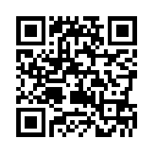
John Brown: Bleeding Kansas and Harper’s Ferry Raid
Notes:
ABOLITIONISM

Slide 18
Massachusetts Personal Liberty Act, 1855
Sec. 6. If any claimant shall appear to demand the custody or possession of the person for whose benefit such writ [of habeas corpus*] is sued out, such claimant shall state in writing the facts on which he relies, with precision and certainty… Upon every question of fact involved in the issue, the burden of proof shall be on the claimant…
Sec. 7. If any person shall remove from the limits of this Commonwealth… any person… on the pretense that such person is so held or has so escaped, or that his "service or labor" is so "due," or with the intent to subject him to such "service or labor," he shall be punished by a fine of not less than one thousand, nor more than five thousand dollars, and by imprisonment in the State Prison not less than one, nor more than five years...
Sec. 9. No person, while holding any office of honor… shall issue any warrant… or shall in any capacity, serve any such warrant or other process…
Sec. 15. Any sheriff… or other officer of this Commonwealth… who shall hereafter arrest...any person for the reason that he is claimed or adjudged to be a fugitive from service or labor, shall be punished by fine...and by imprisonment...
Sec. 16. The volunteer militia of the Commonwealth shall not act in any manner in the seizure . . . of any person for the reason that he is claimed or adjudged to be a fugitive from service or labor...
Sec. 19. No jail, prison, or other place of confinement… shall be used for the detention or imprisonment of any person accused or convicted of any offence created by [the Federal Fugitive Slave Acts]...
*habeas corpus: a judicial order to determine if a state's detention of a prisoner is valid

Slide 19
Politics

Slide 20
Senator Stephen Douglas, debate against Abraham Lincoln for the Illinois Senate seat, 1858. During the debates, Douglas advocated "popular sovereignty," which maintained the right of the citizens of a territory to permit or prohibit slavery. It was, he said, a sacred right of self-government.
“The next question propounded to me by Mr. Lincoln is, can the people of a Territory in any lawful way, against the wishes of any citizen of the United States, exclude slavery from their limits prior to the formation of a State Constitution? I answer emphatically, as Mr. Lincoln has heard me answer a hundred times from every stump in Illinois, that in my opinion the people of a Territory can, by lawful means, exclude slavery from their limits prior to the formation of a State Constitution. Mr. Lincoln knew that I had answered that question over and over again. He heard me argue the Nebraska bill on that principle all over the State in 1854, in 1855, and in 1856, and he has no excuse for pretending to be in doubt as to my position on that question. It matters not what way the Supreme Court may hereafter decide as to the abstract question whether slavery may or may not go into a Territory under the Constitution, the people have the lawful means to introduce it or exclude it as they please, for the reason that slavery cannot exist a day or an hour anywhere, unless it is supported by local police regulations. Those police regulations can only be established by the local legislature, and if the people are opposed to slavery they will elect representatives to that body who will by unfriendly legislation effectually prevent the introduction of it into their midst. If, on the contrary, they are for it, their legislation will favor its extension. Hence, no matter what the decision of the Supreme Court may be on that abstract question, still the right of the people to make a slave Territory or a free Territory is perfect and complete under the Nebraska bill. I hope Mr. Lincoln deems my answer satisfactory on that point.”
In what became known as the FREEPORT DOCTRINE, Douglas replied that whatever the Supreme Court decided was not as important as the actions of the citizens. If a territory refused to have slavery, no laws, no Supreme Court ruling, would force them to permit it. This sentiment would be taken as betrayal to many southern Democrats and would come back to haunt Douglas in his bid to become President in the election of 1860.
Notes:
REPUBLICAN PARTY

Slide 21
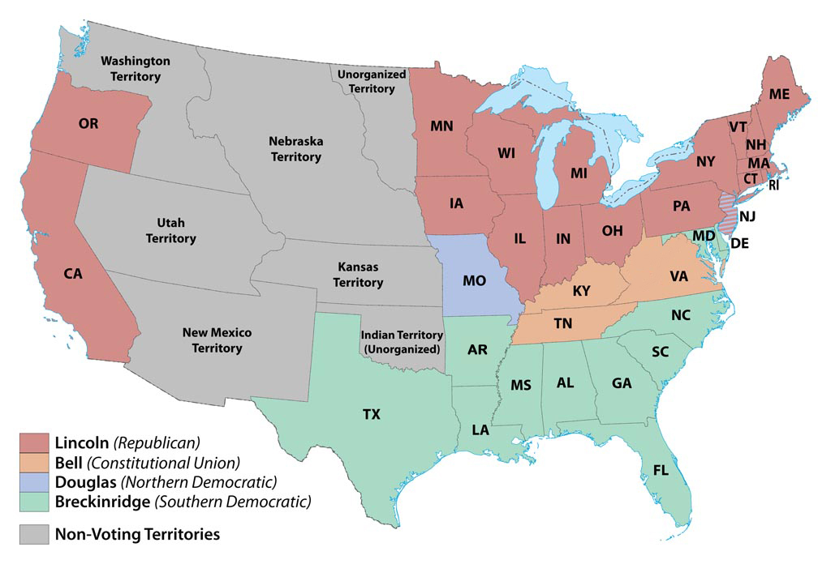
Election of 1860
Notes:
REPUBLICAN PARTY

Slide 22
Declaration of the Immediate Causes Which Induce and Justify the Secession of South Carolina from the Federal Union, December 24, 1860
“For twenty-five years this agitation [Northern anti-slavery] has been steadily increasing, until it has now secured to its aid the power of the common Government. Observing the forms of the Constitution, a sectional party has found within that Article establishing the Executive Department, the means of subverting the Constitution itself. A geographical line has been drawn across the Union, and all the States north of that line have united in the election of a man to the high office of President of the United States, whose opinions and purposes are hostile to slavery. He is to be entrusted with the administration of the common Government, because he has declared that that "Government cannot endure permanently half slave, half free," and that the public mind must rest in the belief that slavery is in the course of ultimate extinction.
“This sectional combination for the submersion of the Constitution, has been aided in some of the States by elevating to citizenship, persons who, by the supreme law of the land, are incapable of becoming citizens; and their votes have been used to inaugurate a new policy, hostile to the South, and destructive of its beliefs and safety…
“We, therefore, the People of South Carolina, by our delegates in Convention assembled, appealing to the Supreme Judge of the world for the rectitude of our intentions, have solemnly declared that the Union heretofore existing between this State and the other States of North America, is dissolved, and that the State of South Carolina has resumed her position among the nations of the world, as a separate and independent State; with full power to levy war, conclude peace, contract alliances, establish commerce, and to do all other acts and things which independent States may of right do.”
Notes:
REPUBLICAN PARTY

Slide 23
Whig Party Platform (1856) | Free-Soil Party Platform (1848) | Republican Party Platform (1856)
Resolved, That the Government of these United States was formed by the conjunction in political unity of widespread geographical sections, materially differing not only in climate and products, but in their social and domestic institutions, and that any cause that shall permanently array these sections in political hostility and organized parties, founded only on geographical distinctions must inevitably prove fatal to the continuance of the National Union... Resolved, That all who revere the Constitution and Union, must look with alarm at the parties in the field in the present Presidential campaign—one claiming only to represent sixteen Northern States, and the other appealing to the passions and prejudices of the Southern States—that the success of either faction must add fuel to the flame which now threatens to wrap our dearest interest in a common ruin. Resolved, That the only remedy for an evil so appalling is to support the candidate pledged to neither geographical section nor arrayed in political antagonism, but holding both in just and equal regard; that we congratulate the friends of the Union that such a candidate exists in Millard Fillmore. | Resolved, That slavery in the several states of this Union which recognize its existence depends upon the state law alone, which cannot be repealed or modified by the federal government, and for which laws that government is not responsible. We therefore propose no interference by Congress with slavery within the limits of any state. Resolved, That the… actual exclusion of slavery from the Northwestern Territory, by the Ordinance of 1787… clearly show that it was the settled policy of the nation not to extend, nationalize, or encourage, but to limit, localize, and discourage slavery; and to this policy… the government ought to return. Resolved, That our fathers… expressly denied to the federal government, which they created, a constitutional power to deprive any person of life, liberty, or property, without due legal process… Resolved, That it is the duty of the federal government to relieve itself from all responsibility for the existence or continuance of slavery wherever the government possesses constitutional power to legislate on that subject… Resolved, That… the only safe means of preventing the extension of slavery into territory now free is to prohibit its extension in all such territory by an act of Congress… | 3. That… we hold in abhorrence all schemes for disunion, come from whatever source they may… and we denounce those threats of disunion, in case of a popular overthrow of their ascendency as denying the vital principles of a free government, and as an avowal of contemplated treason, which it is the imperative duty of an indignant people sternly to rebuke and forever silence… 7. That the new dogma that the Constitution… carries slavery into any or all of the territories of the United States, is a dangerous political heresy… and subversive of the peace and harmony of the country. 8. That the normal condition of all the territory of the United States is that of freedom… and we deny the authority of Congress, of a territorial legislature, or of any individuals, to give legal existence to slavery in any territory of the United States… 10. That in the recent vetoes, by their Federal Governors, of the acts of the legislatures of Kansas and Nebraska, prohibiting slavery in those territories, we find a practical illustration of the boasted Democratic principle of Non-Intervention and Popular Sovereignty, embodied in the Kansas-Nebraska Bill, and a demonstration of the deception and fraud involved therein.

Slide 24
