Slide 1
New World Beginnings
Contact: Europeans and Amerindians

Slide 2
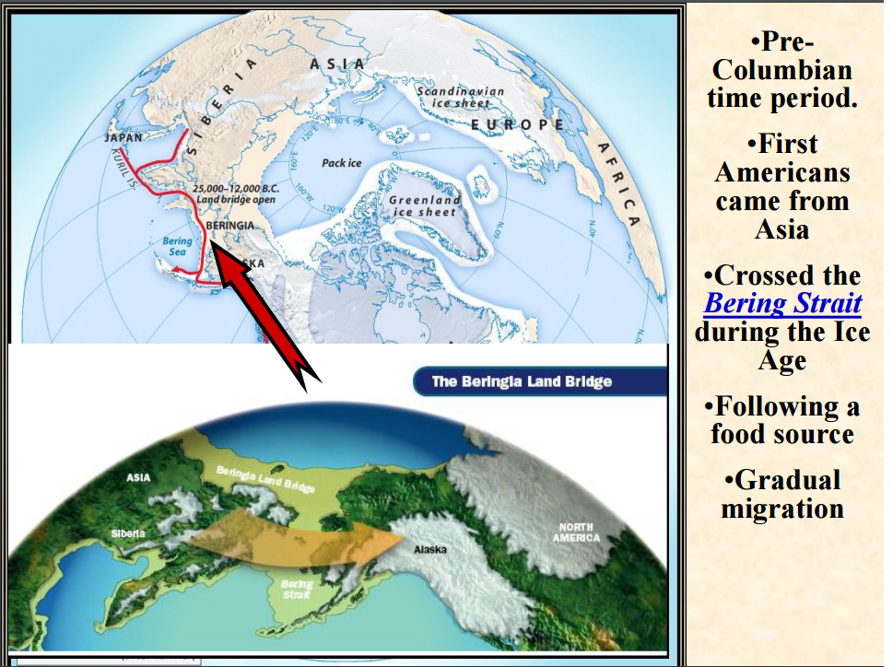

Slide 3
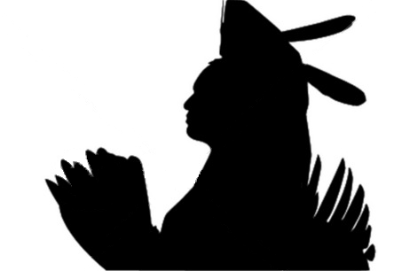
The First Americans
The Amerindians

Slide 4
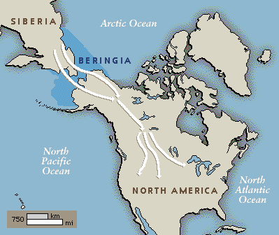
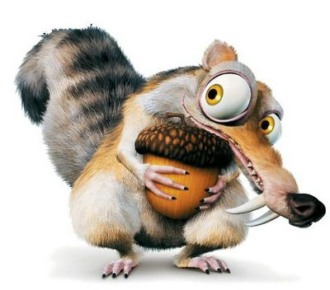
Coming to America
First nomads 35,000 years ago
Around 50-100 million inhabitants
Over 2,000 languages and widely differing cultures.
Pueblo (adobe houses)
  SW Region, NM
  Pueblo Revolt (1680)
  AKA Popé's Rebellion
Cahokia (Mound Builders)
  Maize
Iroquois Confederacy
  Alliance of five tribes consisting of the Mohawk, Seneca, Oneida, Onondaga, and Cayuga.
  When else has USA formed this type of government?
Notes:
also known as Popé's

Slide 5
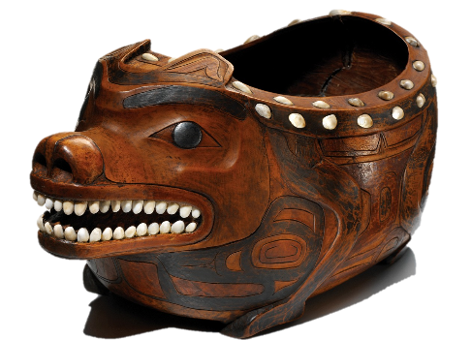
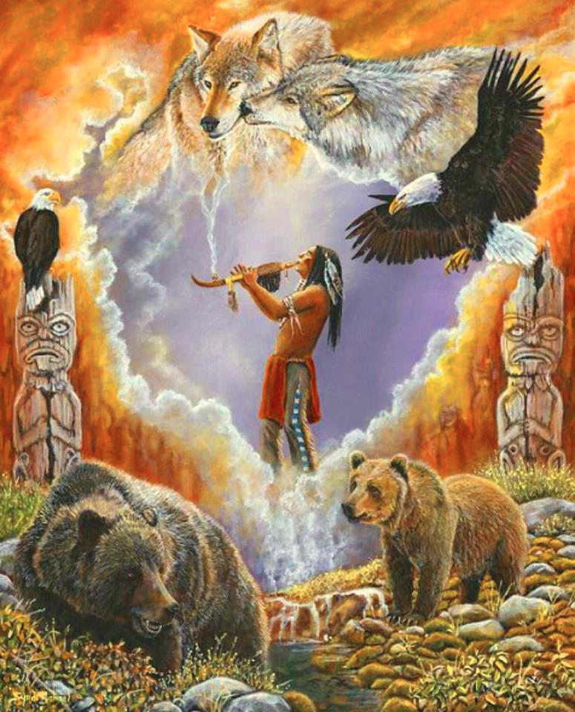
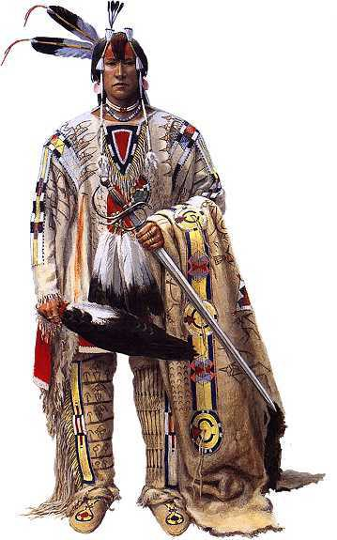
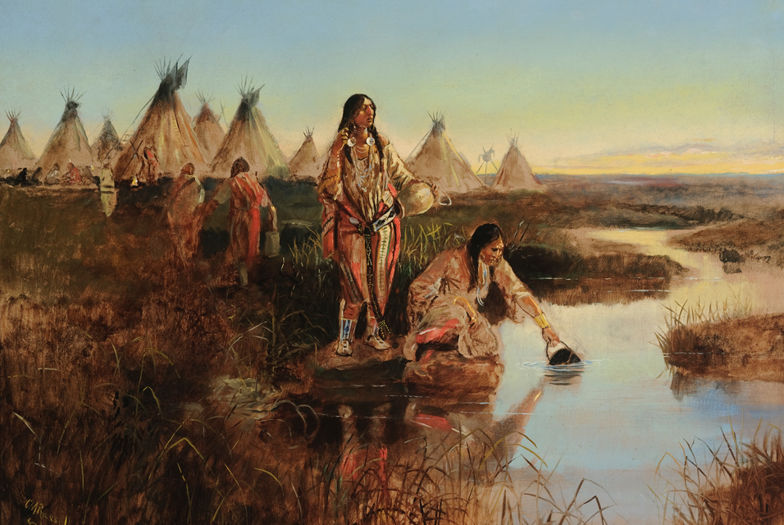
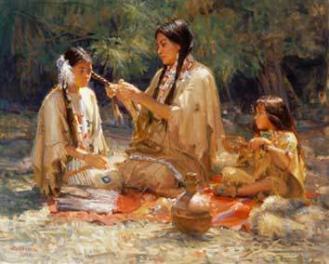
Northern Amerindian Society
Small semi-sedentary societies
Matrilineal and matrilocal
No personal ownership of land
Generosity and authority
Warfare
Pageantry and symbolism
Animism
Notes:
Regional trade networks – Trade goods included food and raw materials, tools, ritual artifacts, and decorative goods; regional trade networks allowed groups to exchange their specialized products for another groups’ resources (e.g., Navajos and Apaches exchanged meat with Pueblos to acquire maize, pottery, and blankets) to enrich diets and enhance economies; sometimes groups conducted regional trade in war captives as well.
Long-distance trade – Rare and valuable objects (e.g., copper, mica, seashells, grizzly bear claws, eagle feathers) traveled through networks that spanned the continent.
Generosity and authority – Powerful leaders who controlled wealth redistributed it to prove their generosity and strengthen authority; generosity was a mark of good leadership. Gift-giving was a staple of native culture.
Warfare – Wars were fought for geopolitical reasons but also to provide crucial rites of passage for young men.
Animism: Belief that nature has a soul

Slide 6
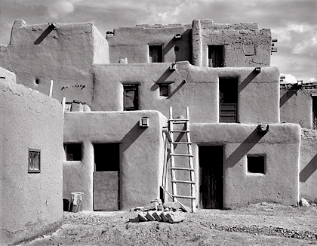
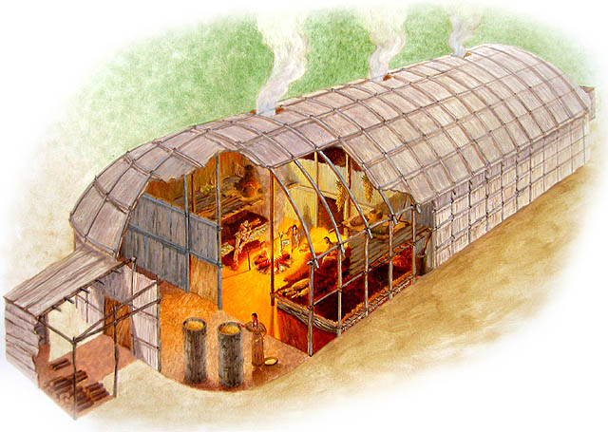
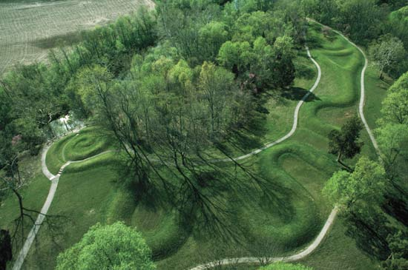
Northern Amerindians
Civilized societies (exception to the rule):
  Pueblo Indians in Southwest – agriculture, intricate architecture, and elaborate irrigation systems
  Mound Builders in Mississippi and Ohio Valleys – largest city north of Mexico, extensive trade system, Central mound (world’s largest earthen work)
  Iroquois in eastern woodlands – built a strong military confederacy of five nations

Slide 7
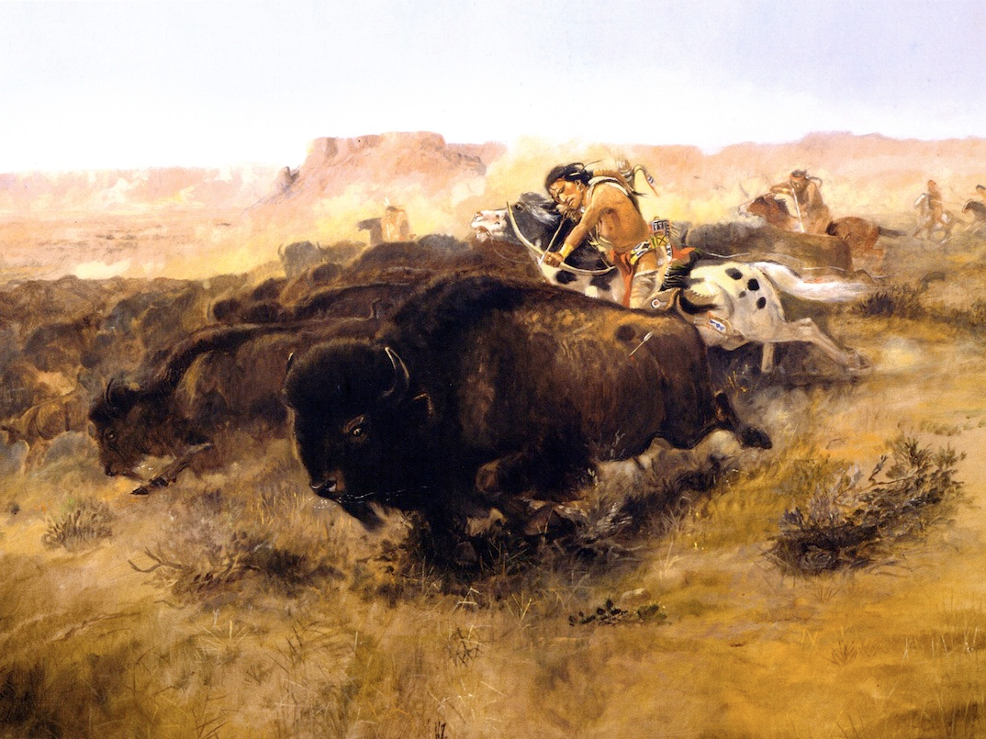
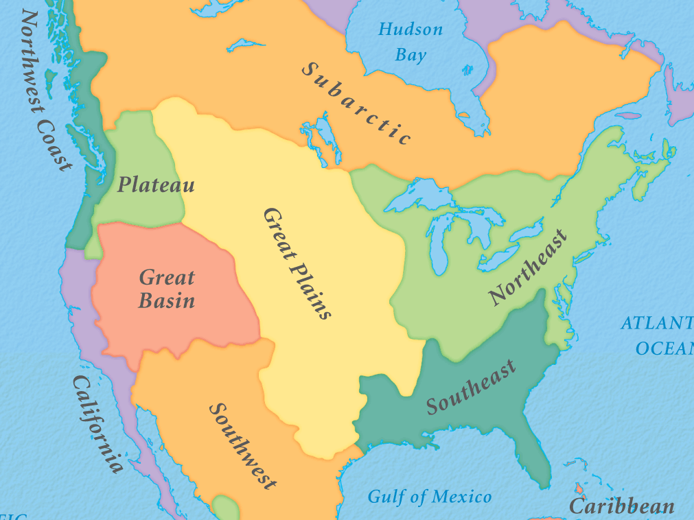
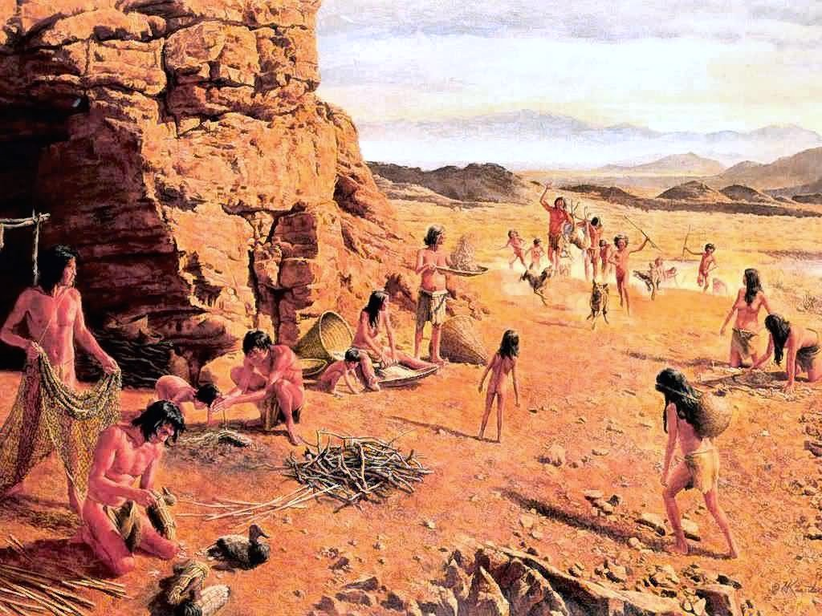
Great Plains:
Arid landscape ➔ hunter-gatherer/semi-nomadic (buffalo hunters)
Highly influenced by European horses
Notable tribes: Sioux
Great Basin:
Arid landscape ➔ hunter-gatherer/semi-nomadic
Last to be conquered by Europeans ➔ maintained strong culture
Notes:
Picture: Paiute Indians

Slide 8
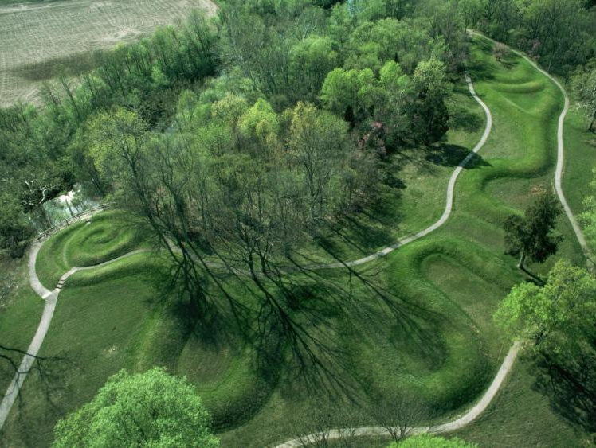
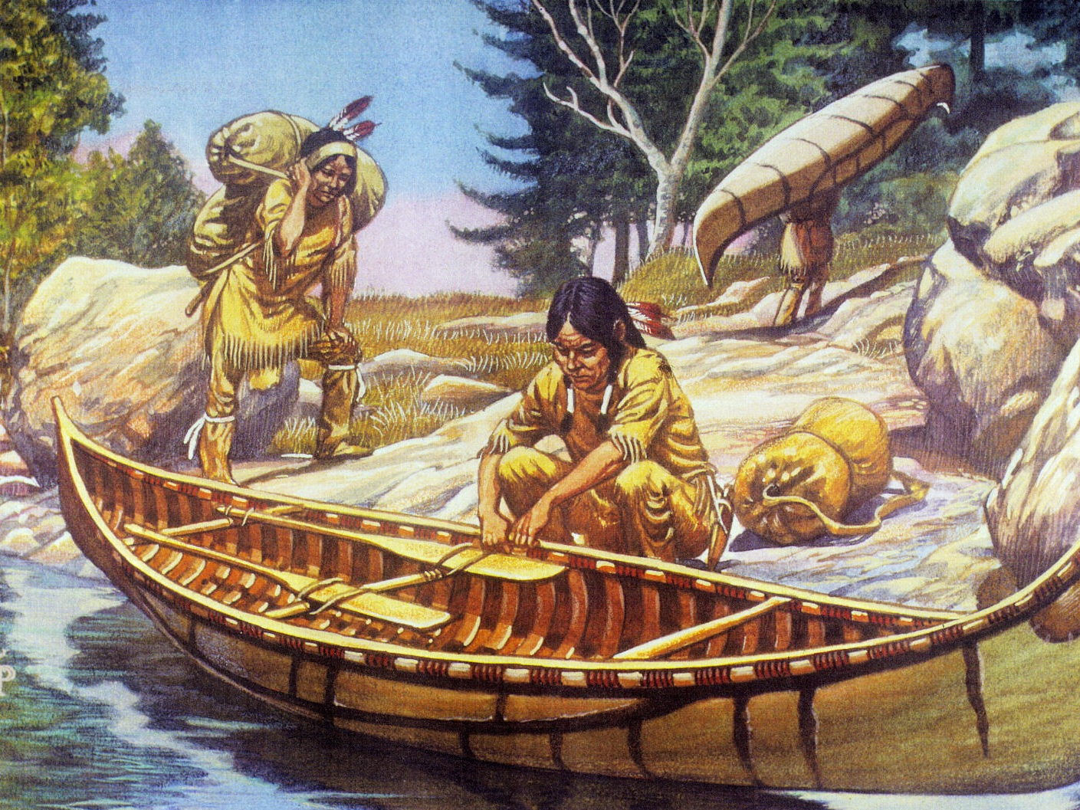
Northeast and Atlantic Seaboard:
Sedentary societies; agriculture, hunting, fishing
Waterways allowed for trade
Powhatans; Iroquois Confederation
Mississippi River Valley:
Sedentary societies; agriculture, hunting, fishing
Waterways allowed for trade
Cahokia, Mound builders
Notes:
The Cahokia Mounds State Historic Site /kəˈhoʊkiə/ (11 MS 2)[2] is located on the site of a pre-Columbian Native American city (c. 600–1400 CE) situated directly across the Mississippi River from modern St. Louis, Missouri. This historic park lies in southern Illinois between East St. Louis and Collinsville.[3] The park covers 2,200 acres (890 ha), or about 3.5 square miles (9 km2), and contains about 80 mounds, but the ancient city was much larger. In its heyday, Cahokia covered about 6 square miles (16 km2) and included about 120 human-made earthen mounds in a wide range of sizes, shapes, and functions.[4]
Cahokia was the largest and the most influential urban settlement in the Mississippian culture which developed advanced societies across much of what is now the central and southeastern United States, beginning more than 1000 years before European contact.[5] Cahokia's population at its peak in the 13th century, an estimated 40,000, would not be surpassed by any city in the United States until the late 18th century. Today, Cahokia Mounds is considered the largest and most complex archaeological site north of the great pre-Columbian cities in Mexico.

Slide 9
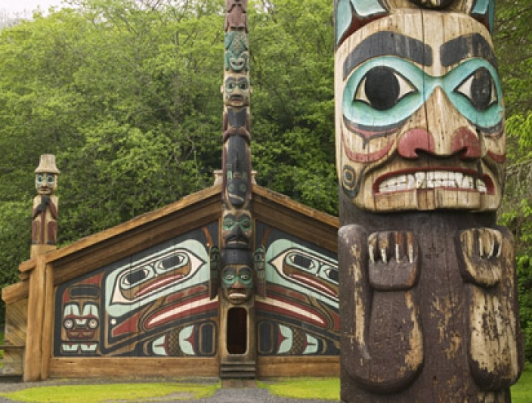
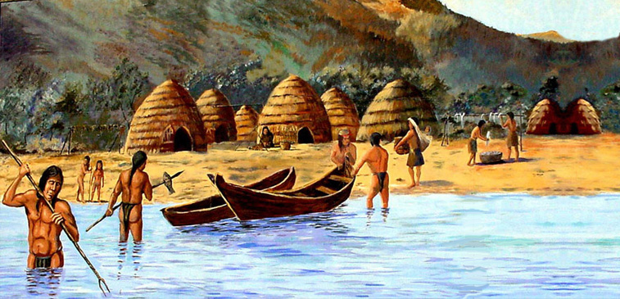
Pacific Northwest:
Sedentary societies
Vast trade networks (ocean and river travel via canoe)
Intricate culture (e.g. potlatch)
Notable tribe: Chinook
California:
Semi-sedentary (wild agriculture plentiful)
Trade possible via sea and rivers; raiding other tribes
Notable tribe: Chumash
Notes:
Chinook: salmon as a resource and spiritual symbol. Mild climate allowed them to obtain a good living without much effort. They had time and energy to devote to the development of fine arts and crafts and to religious and social ceremonies.
Potlach ceremonies: the confirmation of a new chief; coming of age; tattooing or piercing ceremonies; initiation into a secret society; marriages; the funeral of a chief; battle victory.
California has the largestNative American population and the most distinct tribes of any US state. Californian tribes are characterized by linguistic and cultural diversity. Because of the temperate climate and easy access to food sources, approximately one-third of all Native Americans in the United States were living in the area of California

Slide 10
Southwest:
Sedentary
Trade maize with Plains/Basin hunters
Permanent housing complexes
Pueblo: agriculture, architecture, irrigation
Notes:
Pueblo Indians in Southwest – agriculture, intricate architecture, and elaborate irrigation systems

Slide 11
Who Really Discovered America?
Europe competes for domination of the New World

Slide 12
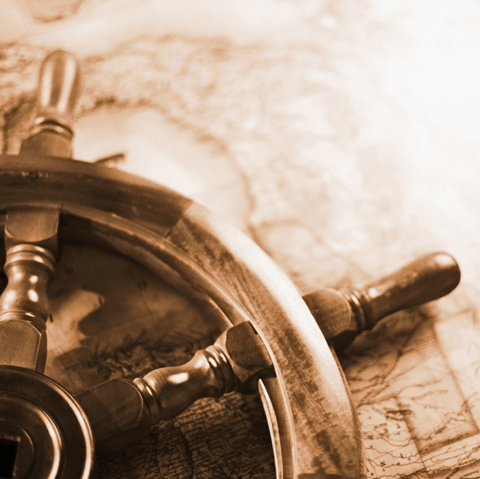
European Motives for Exploration
Motives can be linked to either the quest for God, Gold, or Glory:
Desire to Christianize
Needed a faster and cheaper method of acquiring goods from Asia and the Middle East.
Power and influence, rivalries with other nation-states
Aided by new technologies and a rebirth of exploration during the Renaissance

Slide 13
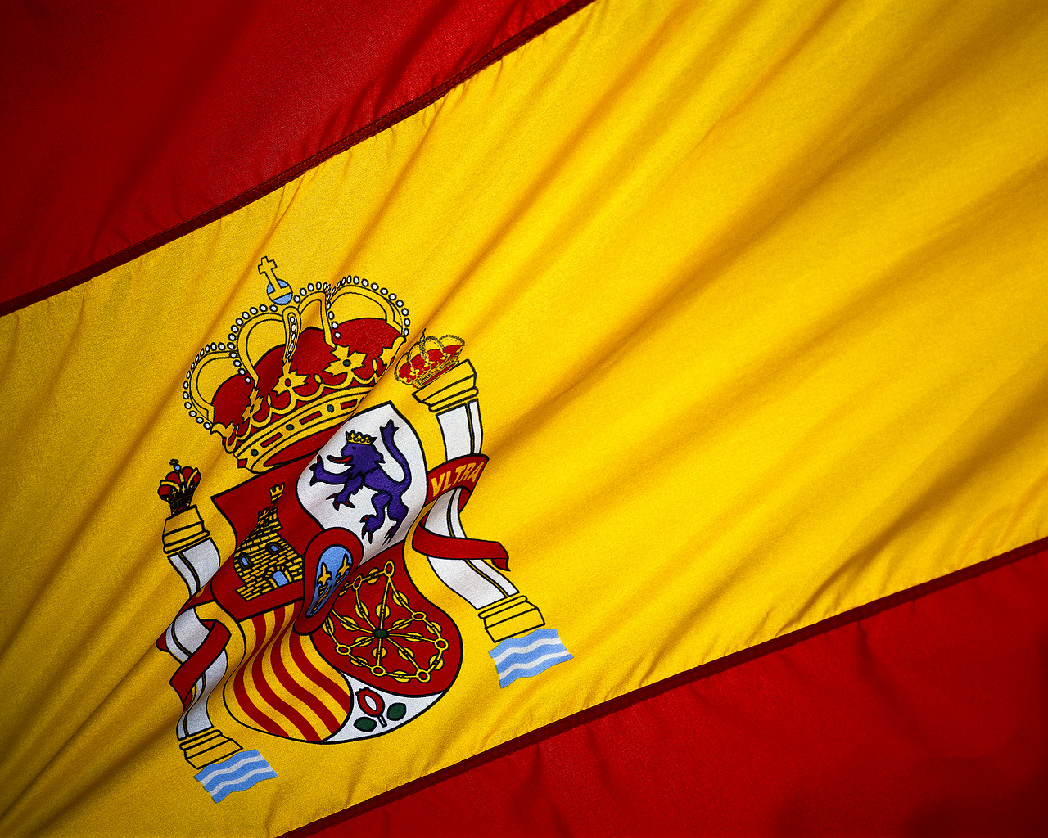
Spanish
Colonization

Slide 14
LIES MY TEACHER TOLD ME
Christopher Columbus
Did Columbus really think he was in India?

Slide 15
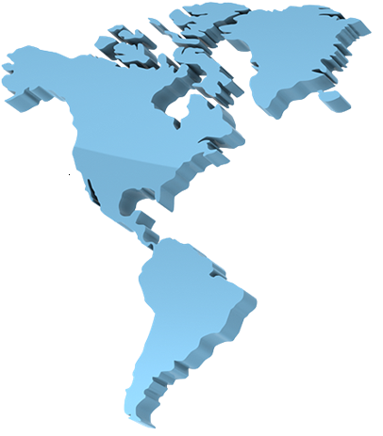
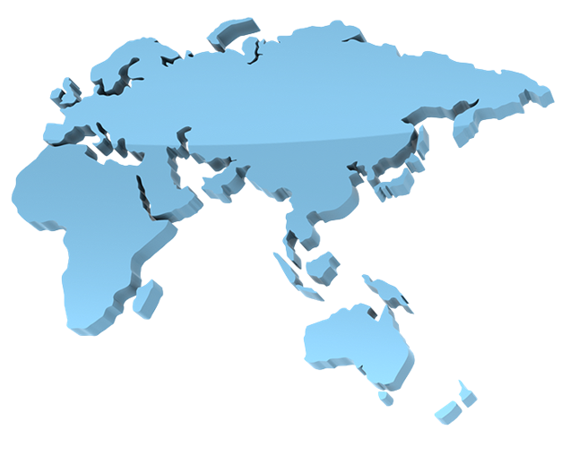

“How to Get to India”: European Edition
How was Columbus able to conquer the New World?

Slide 16
European Motivations for Exploration
Europe’s motives for exploration can be linked to either the quest of God, Gold, or Glory:
Desire to Christianize
Needed a faster and cheaper method of acquiring goods from Asia and the Middle East.
Power and influence, rivalries with other nation-states
Aided by new technology:

Slide 17
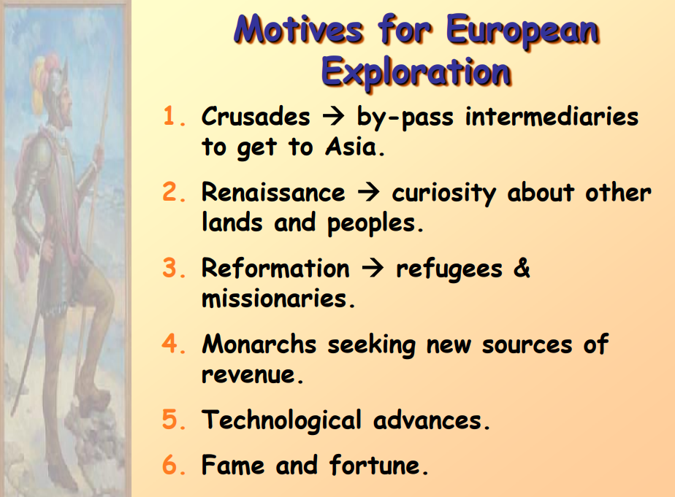

Slide 18
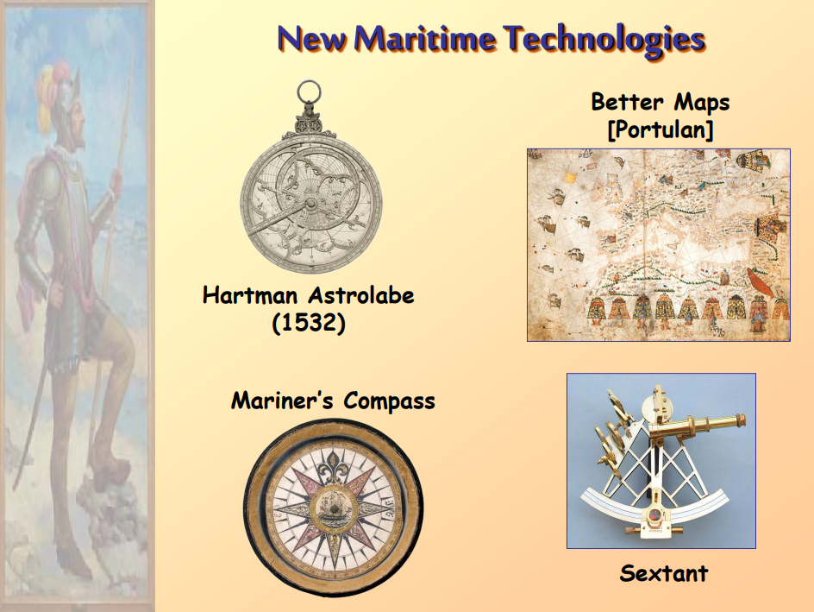

Slide 19
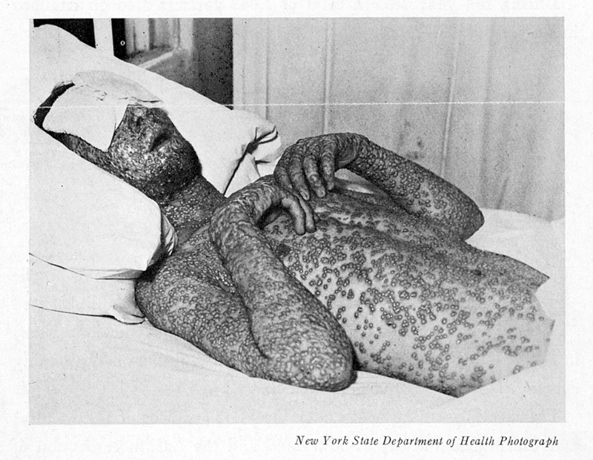
SMALLPOX!
Columbus’ men purposefully infected the blankets with diseases to make the natives easier to conquer.
Why do you think diseases like smallpox affected the natives to such a great degree?
The natives contracted these diseases from the blankets the Europeans gave them as “gifts”
An estimated 90% of Native Americans
were killed due to European diseases

Slide 20
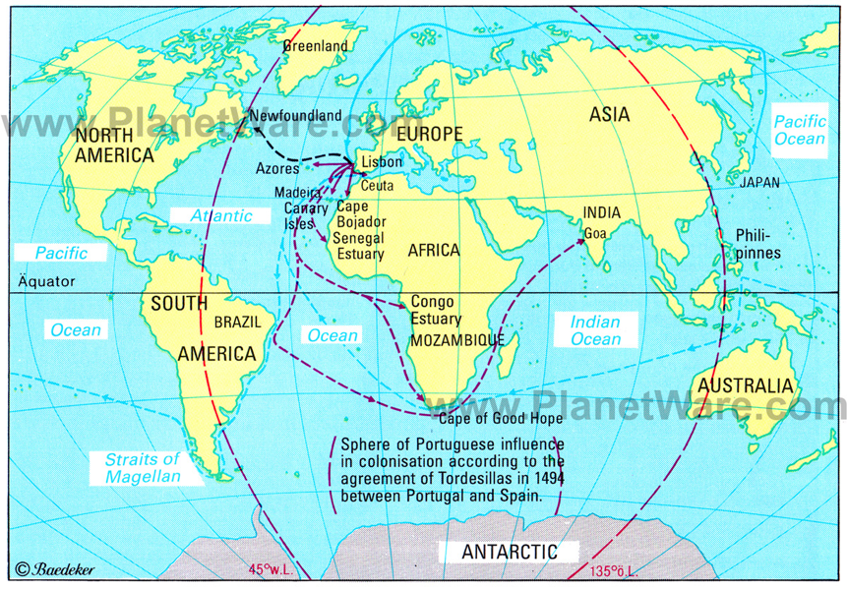
The Treaty of Tordesillas was an agreement between Portugal and Spain regarding each country’s sphere of influence in the world for exploration.
The treaty also opened doors for others to begin exploring the New World as well.
Treaty of Tordesillas, 1494

Slide 21
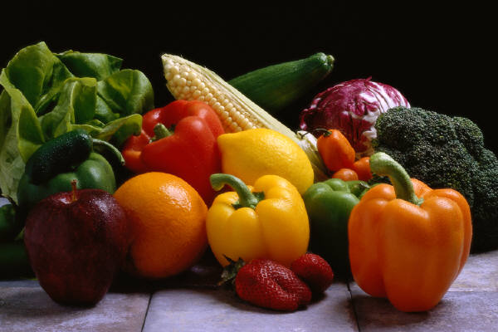
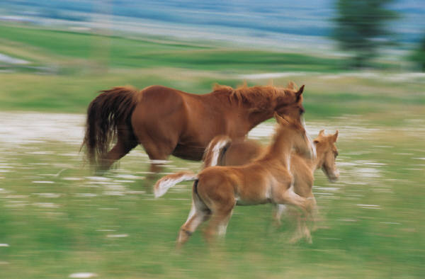
The Columbian Exchange
The Columbian Exchange: The widespread exchange of plants, animals, food, ideas, and diseases between the Old World (Europe) and the New World (Americas).

Slide 22
 | Old World |  | New World
Animals | bee cat chicken cow | goat horse pig sheep | alpaca guinea pig llama turkey
Plants | almond apple banana black pepper carrot coffee citrus garlic lettuce | olive onion peach pea pear sugarcane tea turnip wheat watermelon | avocado bean bell pepper blueberry cashew chicle (chewing gum base) chili pepper cocoa maize (corn) peanut | pineapple potato rubber squash (incl. pumpkin) sunflower strawberry sweet potato tobacco tomato vanilla
Diseases | bubonic plague cholera influenza malaria measles | scarlet fever smallpox tuberculosis typhoid | syphilis yaws (disfiguring bone bacteria) yellow fever
Notes:
https://www.agclassroom.org/gan/timeline/crops_livestock.htm
History of Agriculture in America

Slide 23
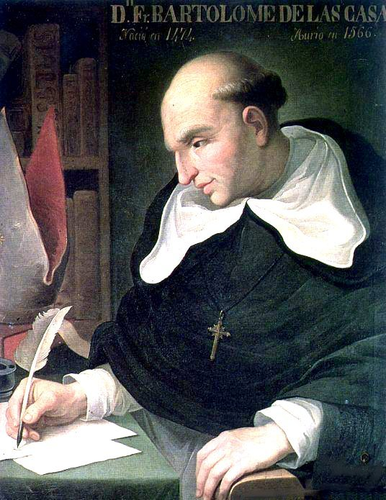
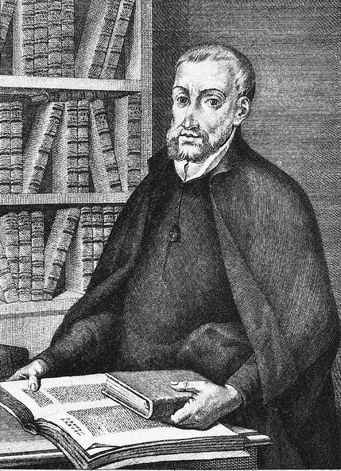
Debate Over Treatment
Bartolomé de las Casas
Juan de Sepúlveda
Agreed with “savage” interpretation of Native Americans
Supported encomienda system
Supported “noble savage” belief
Helped end encomienda system
“Black Legend”
Notes:
Juan de Sepulveda:
Advocated harsh treatment of Natives
Claimed slavery for Natives was justified under Christianity
Suggested Natives may not even be human
A Second Democritus: on the just causes of the war with the Indians
Bartolome de Las Casas:
Argued that Natives deserved the same treatment as all other men
Played an instrumental role in the ending of the encomienda system
Contributed to the “Black Legend”
A Short Account of the Destruction of the Indies

Slide 24
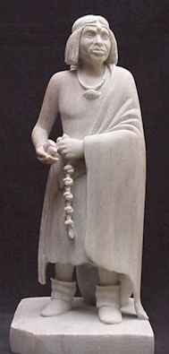
Popé’s Rebellion, 1680
(Pueblo Revolt)
Pueblo Indians rebelled against Spanish rule in New Mexico
Most successful uprising against colonial authority in the New World
Maintained control for almost 50 years

Slide 25
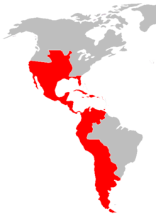
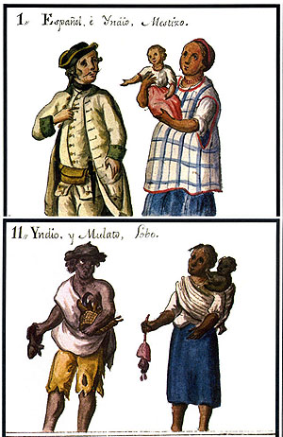
Impact of Spanish Conquest
Mestizo culture
Mission system: Forced conversion
Encomienda system: Native forced labor; given as a gift by Spain in exchange for Christianizing natives.
“Black Legend”

Slide 26
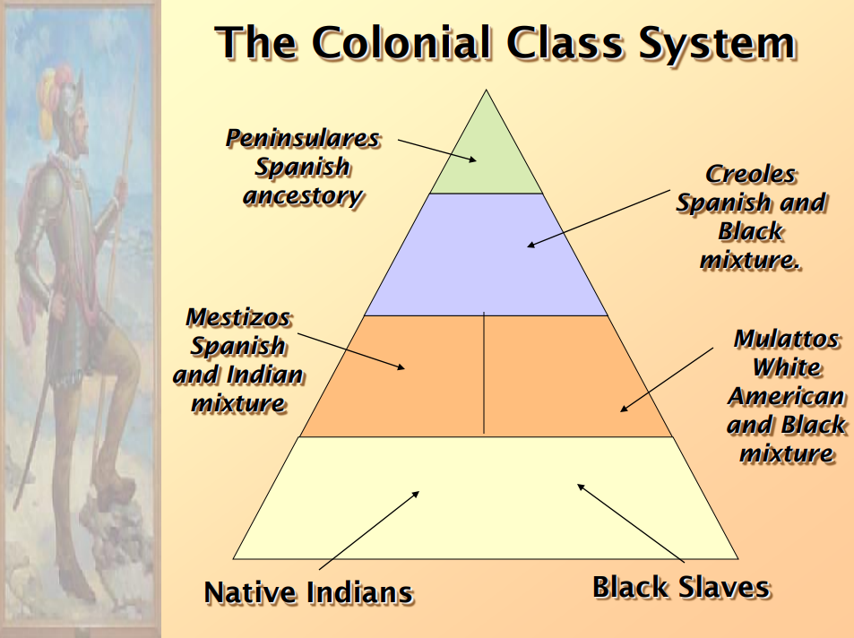

Slide 27
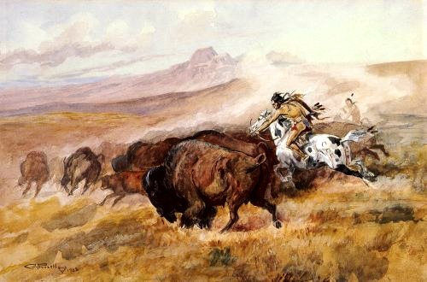
Results of contact between Native-Americans and Europeans
For Native Americans
Mass death and genocide: By 1600, nearly 90% of Native American population perished due to disease.
European impact on culture: farm animals horses, and firearms.

Slide 28
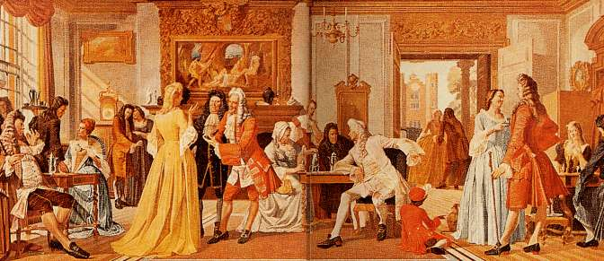
Results of contact between Native-Americans and Europeans
For Europeans
Global empires for 1st time in human history.
Explosion of capitalism (Commercial Revolution)
Improved diet = higher mortality = higher population = bigger push for emigration.
  Stimulants: coffee, cocoa, and tobacco

Slide 29
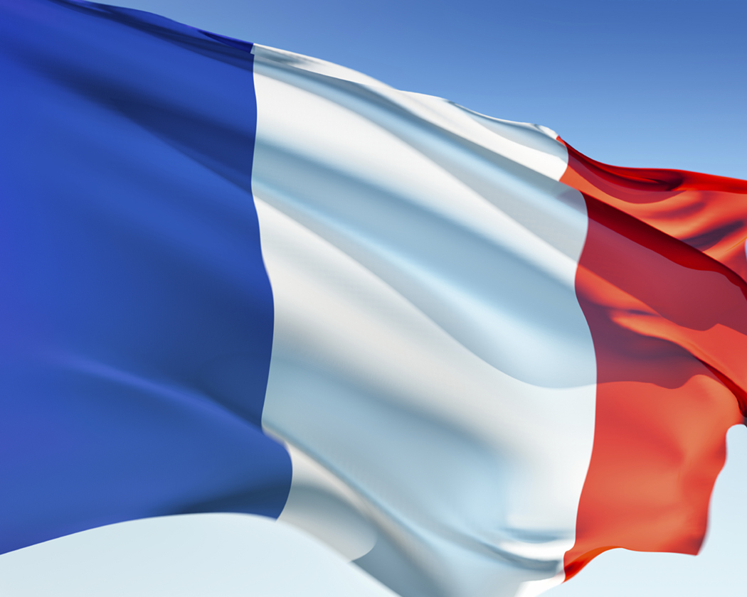
The French

Slide 30
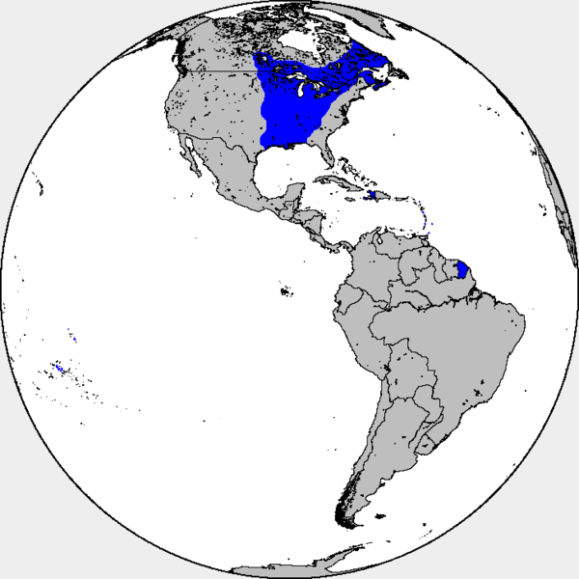
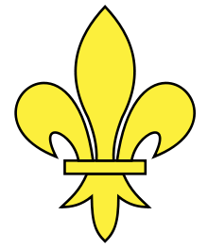
Settlements in Canada, the Mississippi River Valley, the port of New Orleans, and the Caribbean

Slide 31
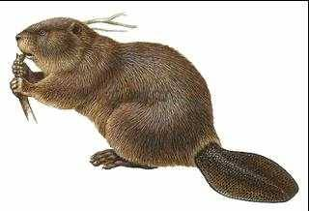
French Settlement
Samuel de Champlain - “Father of New France”, founded Quebec
Most settlers were young, single men
Known as great gift-givers to the Indians
Focus was on fur trade, especially beaver pelts
  Coureurs de bois
  Voyageurs
Jesuits: Catholic missionaries who sought to convert the natives.

Slide 32
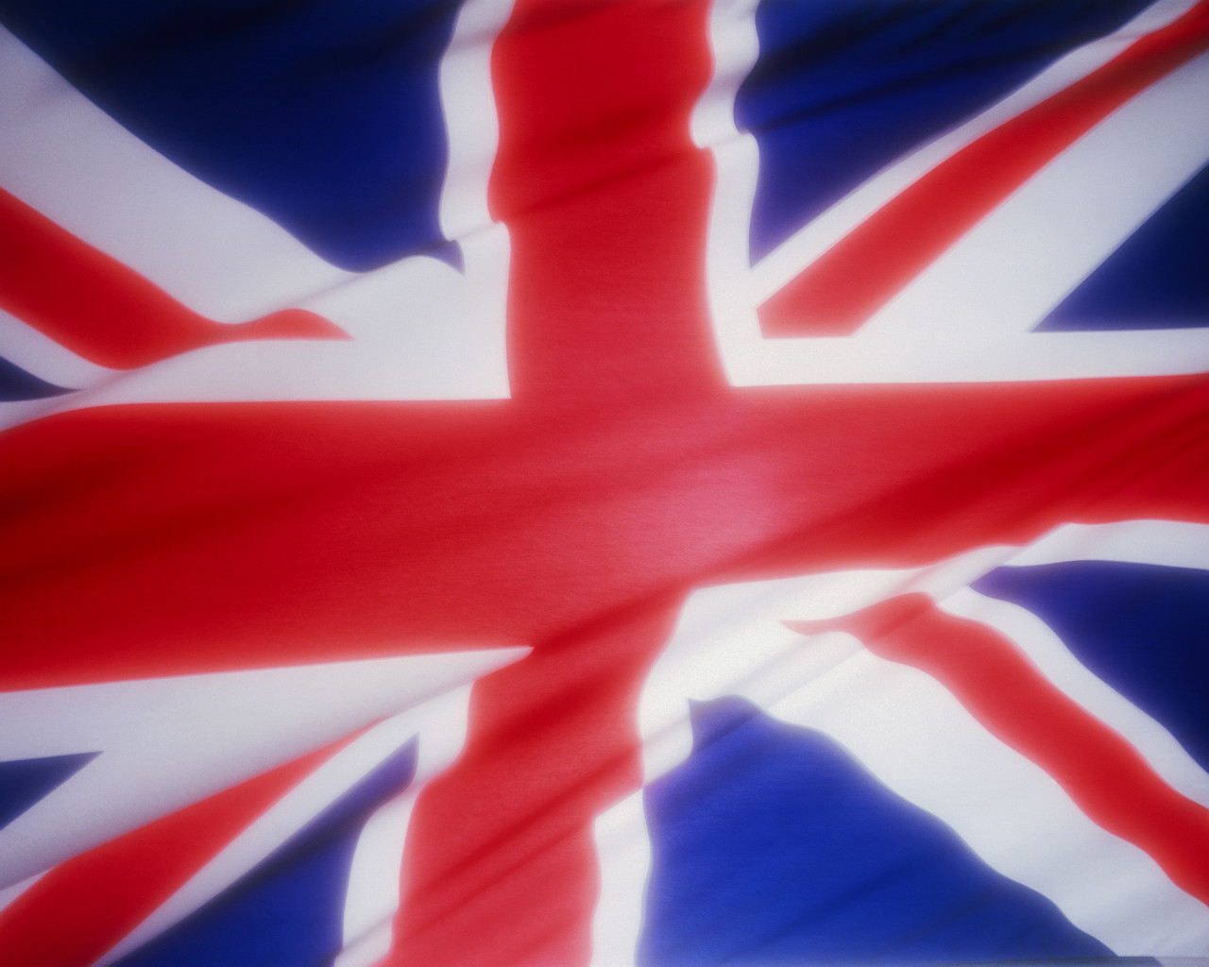
The English

Slide 33

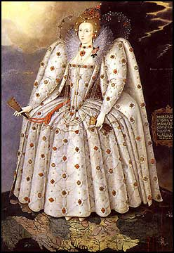
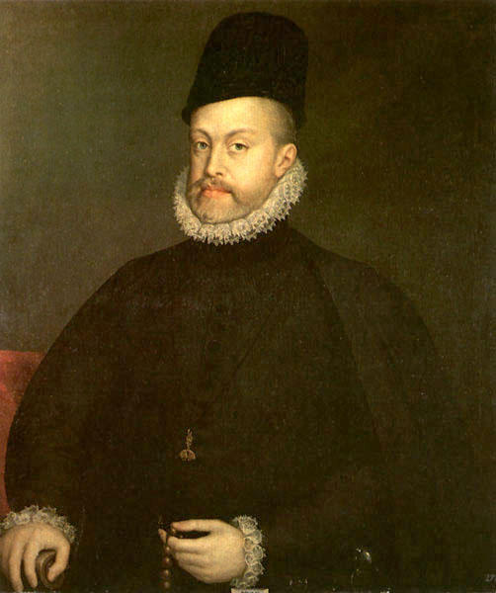
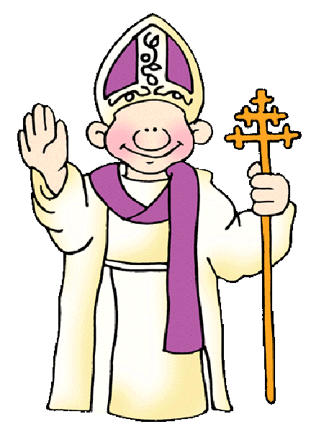
Protestant England was in competition with Catholic Spain.
Whichever country proved to be more powerful, it implied that their religion was God’s preferred religion

Slide 34
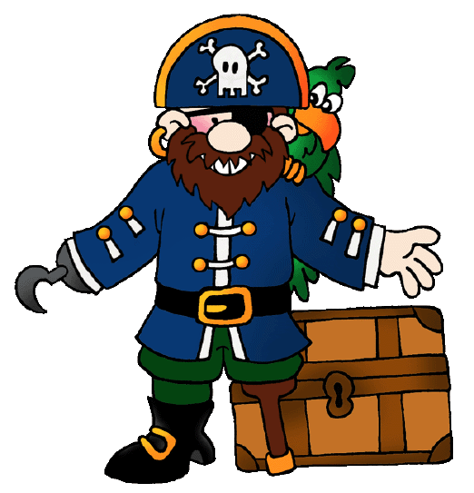
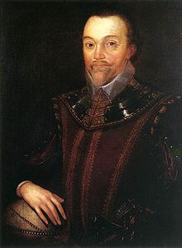
Yarrr!!! – Pirates vs. Privateers
Pirates attack ships of any origin for their own personal benefit
Privateers are given permission to attack ships of enemy nations on behalf of their home country; often had a background in piracy and brought to work for a king or queen.
  Sir Francis Drake: a "sea dog" the pirated Spanish ships on the high seas; netted heavy profits to his financial backers including Queen Elizabeth.
  Would later lead an exploration of the New World and name it “Virginia”

Slide 35
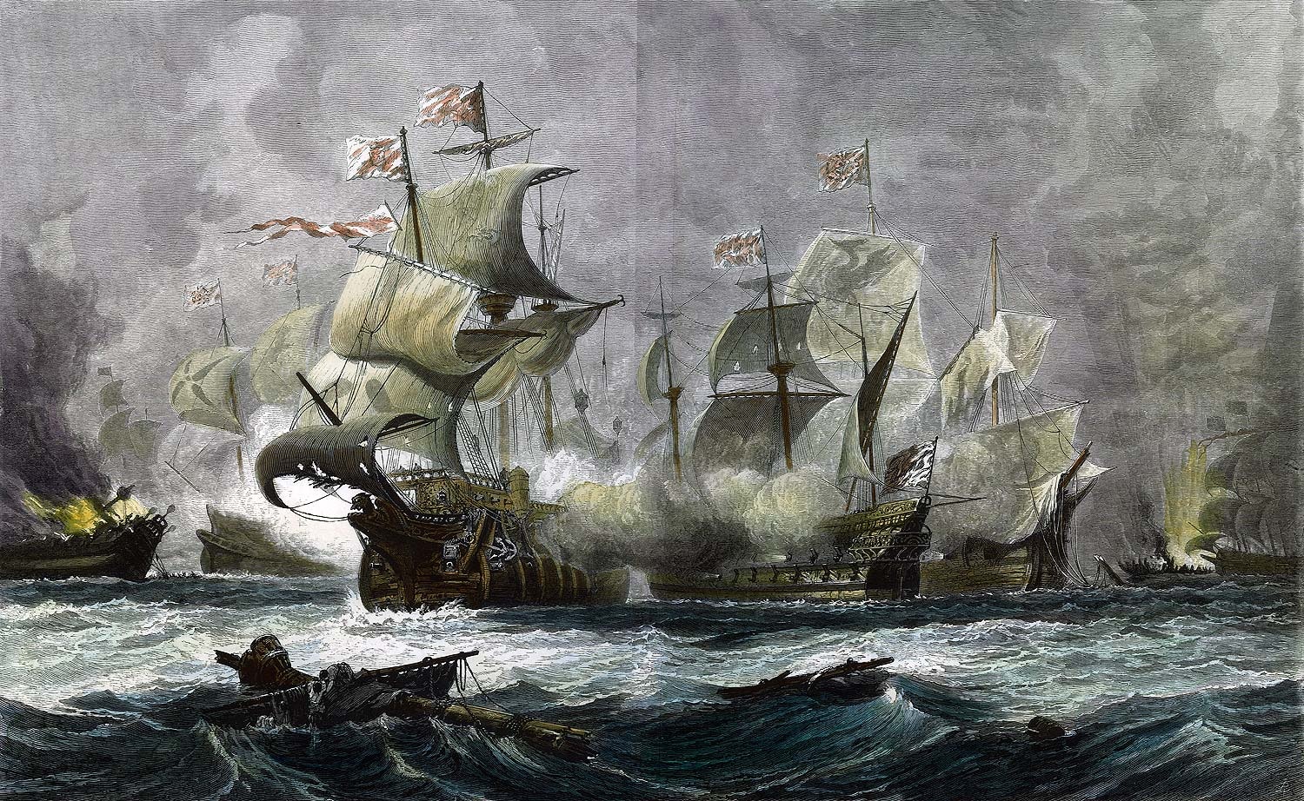
The Invincible Spanish Armada
King Philip II of Spain had the largest and most formidable fleet that existed at the time.
After the execution of Mary Queen of Scots, he waged a holy war against Elisabeth I.
England was not only outnumbered but outmatched by the ultra modern fleet.
Severe English storms and military planning allowed England to destroy the Spanish.
This changed the power structure of Europe.

Slide 36
Causes for British Colonization
Eventual peace with Spain provided opportunities overseas without harassment
Population growth provided workers/ potential colonists
Unemployment (economic opportunity, especially for second sons), farm land, adventure, markets, political freedom, religious freedom, social change.
Joint-stock companies provided financial means: investors pooled resources for sea expeditions.

Slide 37
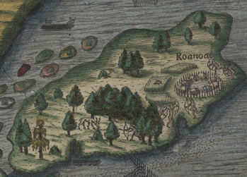
The Lost Colony of Roanoke
Between 1585 – 1587, Sir Walter Raleigh funded the colonization of the New World in the name of England.
90 men, 17 women, and 9 children established the colony of Roanoke on an island just off the coast of present-day North Carolina

Slide 38
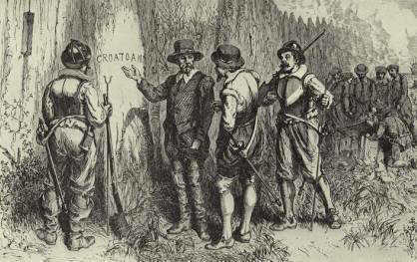
The Lost Colony of Roanoke
The colonists were discovered to be missing in 1590, just months after their last contact with English sailors
Nothing was found, but for the word "Croatoan" carved on a post.
The principal hypothesis is that the colonists were absorbed by one of the local indigenous populations, although the colonists may possibly have been massacred, by the Spanish or by the Powhatan Confederacy.

Slide 39

The First English Colony
joint-stock company: A group of investors who pool their money to support big projects
  The Virginia Company
Jamestown (1607): the first English settlement in the New World.

Slide 40
LIES MY TEACHER TOLD ME
Pocahontas

Slide 41

Once upon a time, there was a beautiful Indian princess

Slide 42

A handsome explorer landed nearby

Slide 43

They met and fell in love

Slide 44

She saved him from certain death at the hands of her father

Slide 45

And they lived happily ever after.

Slide 46
LIES!

Slide 47

The REAL Pocahontas
She was in adolescence when Jamestown was founded
Was around 12 years old when she supposedly “saved” John Smith
Married John Rolfe, NOT John Smith
Died at the age of 22 in England of Small Pox

Slide 48

The REAL John Smith
Captain John Smith organized the colony beginning in 1608:
"He who will not work shall not eat."
Smith kidnapped in Dec. 1607 by Chief Powhatan
Smith perhaps "saved" by Pocahantas, Powhatan's daughter, but evidence is shaky at best.

Slide 49


John Rolfe
The Disney Version
The REAL John Rolfe

Slide 50

Pocahontas saving Smith’s life

