Slide 1
Bell Ringer
What problems arose as a result of industrialization in the first half of the 19th century?

Slide 2
Religious, Social, and Moral Reform
Becoming “Better” Americans

Slide 3
Fixing Our Faith
Religious Revival and Reform

Slide 4
Religious Rebels
Church attendance still common
  ¾ attending regularly; most Protestant
Deism : Rejected the divinity of Christ; evidence of a Supreme Being found in nature
  Sprung from the ideals of the Enlightenment (reason rather than faith)
Unitarianism: Believed that God existed in only one personage (not in the orthodox Trinity).
  Believed people were essentially good, not born under “original sin”, and saved through good works, not faith in Christ.
  Appealed to mostly intellectuals (e.g. Ralph Waldo Emerson).

Slide 5
Reviving Religion
  The Second Great Awakening: A Protestant religious revival during the 1830s-40s
    Reaction to religious liberalism and industrialization
    More widely spread than the First Great Awakening, both geographically and by variety of participants
    Spread by “camp meetings”
    Attempted to appeal to people’s emotions
    Believed the second coming of Christ was near
    Encouraged vivacious evangelicalism
    Led to reform of several areas of life: prison reform, temperance, abolition, women’s suffrage, etc.

Slide 6
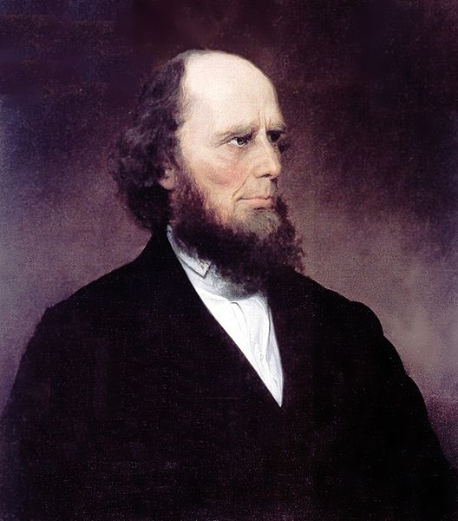
Meet the Preacher
Charles Grandison Finney- considered the greatest of the revivalist preachers
  “Sinners Bound to Change Their Own Hearts”
  Denounced both alcohol and slavery
  “Burned over district”: Nickname given to area of Western NY that had been so heavily evangelized as to have no "fuel" (unconverted population) left over to "burn" (convert)

Slide 7
Denominational Diversity
The gap between the classes and regions were widened by religion
  Poor, rural, less-educated, Southern or Western became Baptist or Methodist
  Wealthier, urban, more-educated, Eastern became/stayed Episcopalians, Presbyterians, Congregationalists, and Unitarians
The issue of slavery split the churches apart
New religious groups evolved to fill in the gaps left from old churches and ideals left from the First Great Awakening.

Slide 8


Slide 9
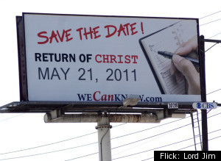
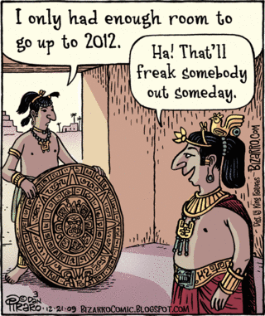
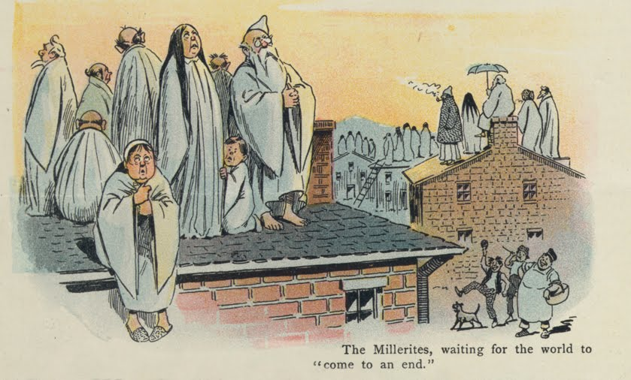
THE END IS NEAR!
“Millerites”: Predicted the second coming of Christ would occur on October 22, 1844
  Lost credibility when it didn’t happen
  Rebuilt and reformed it into the Seventh-day Adventist Church

Slide 10
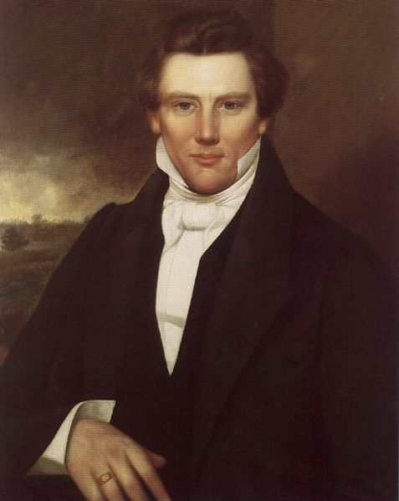
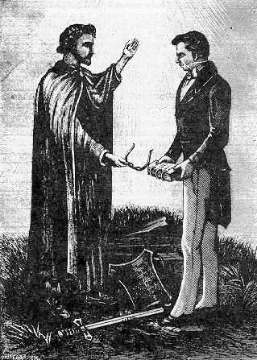
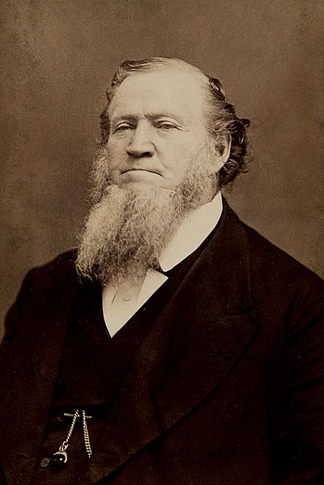
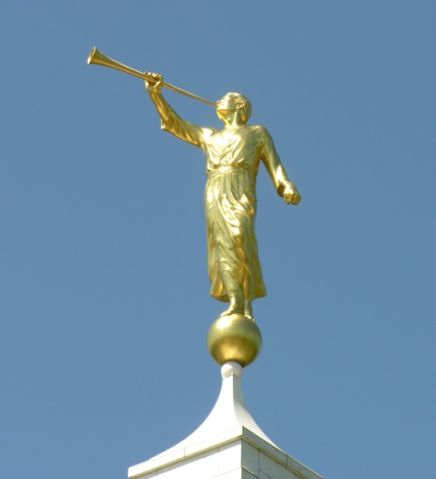
Latter Day Saints (AKA: LDS, Mormons)
Founded by Joseph Smith
Ran into trouble with their neighbors
  Drilled a militia
  Voted as a block
  Practiced polygamy
Smith murdered in a skirmish in IL; Brigham Young leads Mormons to Utah

Slide 11

A Desert Zion
The State of Deseret was proposed in 1849 by Latter-day Saint settlers in Salt Lake City.
  Never recognized by the U.S. government
  Wanted to enter as a free state, but was delayed over the issue of polygamy
  More and more land in the proposed state was absorbed into other Western States (would have been the largest state in the Union)

Slide 12

Wilderness Utopias
Utopia: An ideal community or society possessing a perfect socio-politico-legal system
  Inspired by the book Utopia by Sir Thomas Moore
Many were tied to religion; all were a reaction to the problems created through industrialization

Slide 13
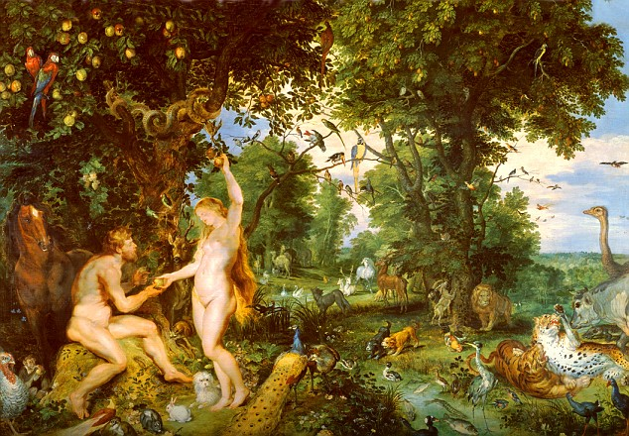

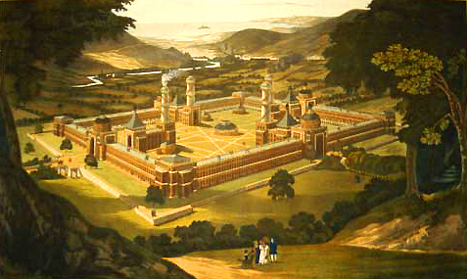
Rediscovering Eden
New Harmony, Indiana
The Garden of Eden
Notes:
New Harmony: Established by the Harmony Society in 1814, revived by Robert Owen in 1825; New Harmony became known as a center for advances in education and scientific research. New Harmony's residents established the first free library, a civic drama club, and a public school system open to men and women.

Slide 14
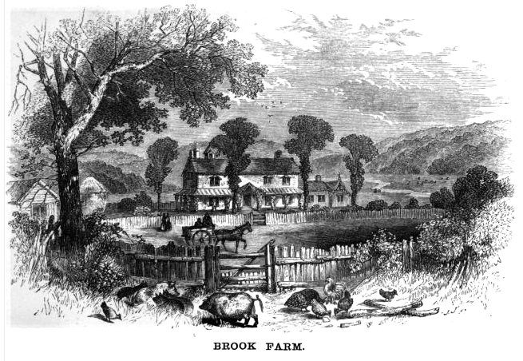



Wilderness Utopias
Notes:
Brook Farm: Founded by former Unitarian minister George Ripley in 1841; Founded as a joint stock company, it promised its participants a portion of the profits from the farm in exchange for performing an equal share of the work. Brook Farmers believed that by sharing the workload, ample time would be available for leisure activities and intellectual pursuits. Nathaniel Hawthorne was an original resident. It failed when a major building burnt down and the community fell into debt.
Oneida Community: started in NY in 1848; Communal, embraced free love, birth control, and selecting parents to have planned children. Started communal, saved by capitalism: sold baskets, later sold cutlery

Slide 15



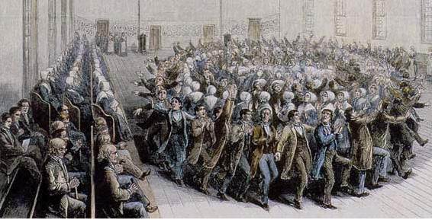
The Shakers
United Society of Believers in Christ’s Second Appearing (AKA: Shakers): religious sect created by Mother Ann Lee
  Emphasis on social equality and rejection of sexual relations
  Known for cleanliness, prosperity, honesty, and quality of products

Slide 16

Transcendentalism
Transcendentalism: A religious and philosophical movement of the 1820s/30s
  One should learn to “transcend” their animal instinct and social norms to reach the “Oversoul” (akin to Enlightenment)
  Believed in the inherent goodness and godliness of both people and nature, thus no need for churches or adherence to the Bible
  Believed that society and its institutions—particularly organized religion and political parties—ultimately corrupt the purity of the individual
  Believed people are at their best when truly "self-reliant,“ self-disciplined, and independent
  Human “intuition” (conscience/truth) is strengthened through nature, as it is uncorrupted by society; Poets speak the language of nature, and thus are the most “religious”

Slide 17
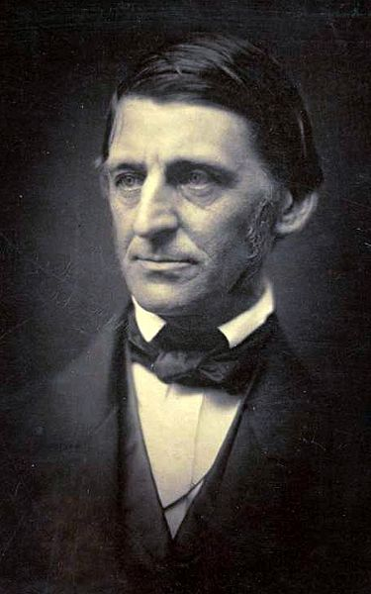
Ralph Waldo Emerson
“Founder” of Transcendentalism
Best known for writing “Self-Reliance,” which stressed the need for individuals to avoid conformity and false consistency, and follow his or her own instincts and ideas
  "A foolish consistency is the hobgoblin of little minds, adored by little statesmen and philosophers and divines.”
      “To laugh often and much;
      To win the respect of intelligent people
      and the affection of children;
      To earn the appreciation of honest critics
      and endure the betrayal of false friends;
      To appreciate beauty;
      To find the best in others;
      To leave the world a bit better,
      whether by
      a healthy child, a garden patch
      or a redeemed social condition;
      To know even one life has breathed
      easier because you have lived;
      This is to have succeeded.”

Slide 18
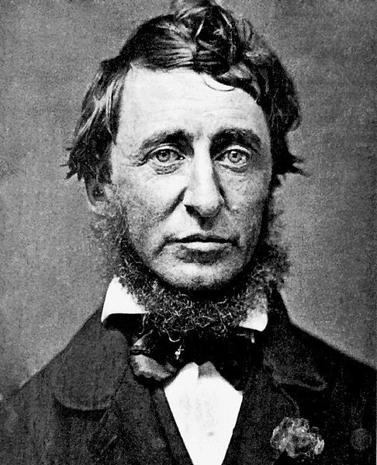
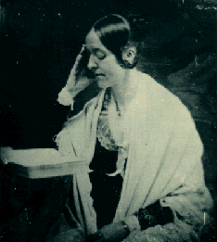
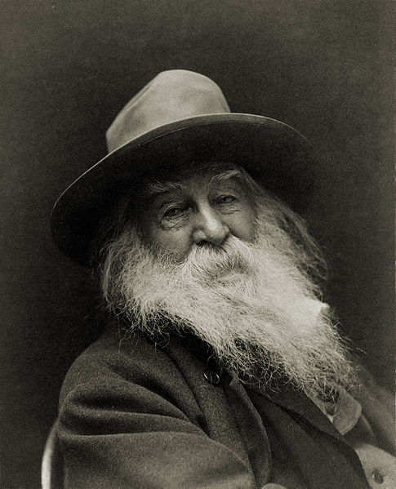
Henry David Thoreau: Believed that one should reduce his bodily wants so as to gain time for a pursuit of truth through study and meditation
  Spent two years living in the woods living off only what he could produce (“Walden: Or Life in the Woods”).
    “I went to the woods because I wished to live deliberately, to front only the essential facts of life, and see if I could not learn what it had to teach, and not, when I came to die, discover that I had not lived.”
  On the Duty of Civil Disobedience – greatly influenced Gandhi and MLK
Margaret Fuller: Applied the ideals of transcendentalism to women, esp. the need for social and psychological independence
Walt Whitman: Leaves of Grass; encouraged people to holler out a “barbaric yawp”

Slide 19
Social Reform Movements

Slide 20
Educational Reform
Readin’, ‘Ritin, and ‘Rithmetic

Slide 21
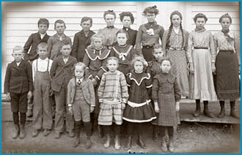
Public Education
One-room schoolhouse in Idaho
Free public education not popular in the early 1800s (why should I pay for someone else’s kid?)
Jacksonian Democracy began to change opinions
  More people could vote, so children needed education to be knowledgeable voters
  Cheaper to educate now than rehabilitate prisoners
Teachers were ill-educated and ill-trained themselves
African Americans were largely ignored

Slide 22
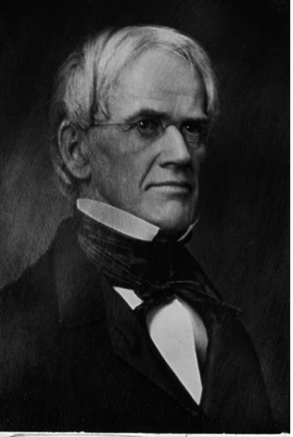
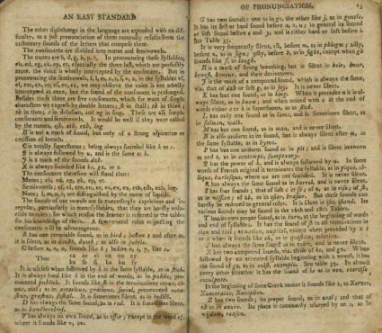
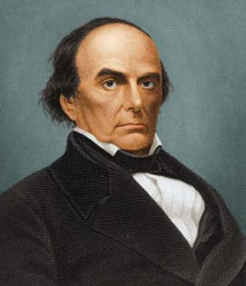
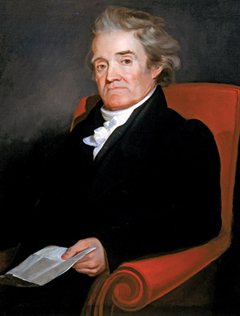
Educational Reformers
Horace Mann – “Father of Public Education”
  Pushed for free compulsory education
  Focus on hands on education and the 3R’s, remove “dead languages”
Noah Webster’s Blueback Speller and dictionary
  Most textbooks came from England; Webster thought that Americans should learn from American books
  Grammar and moral lessons
William H. McGuffey’s McGuffey’s Reader
  Patriotic and moral lessons

Slide 23
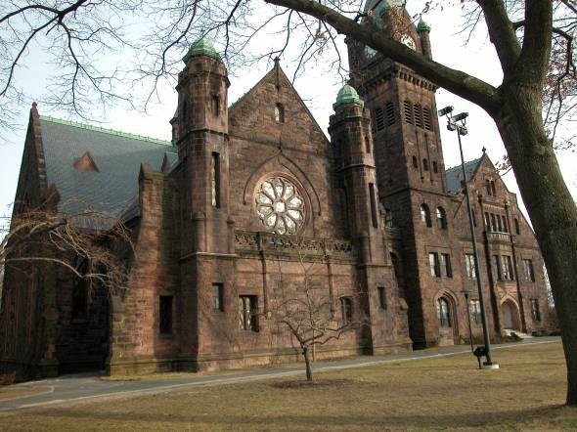
Changes to Higher Education
Higher education for women had been taboo
  Were afraid it would corrupt women, and therefore corrupt children and families
  New colleges for women began opening; Mount Holyoke Seminary (1837)
Working class Americans found less formal education in libraries, lyceums (public lectures), and magazines.

Slide 24
Bell Ringer
How might the Second Great Awakening inspire other social movements of the early 19th century?

Slide 25
Moral Reform
Becoming Better Americans

Slide 26
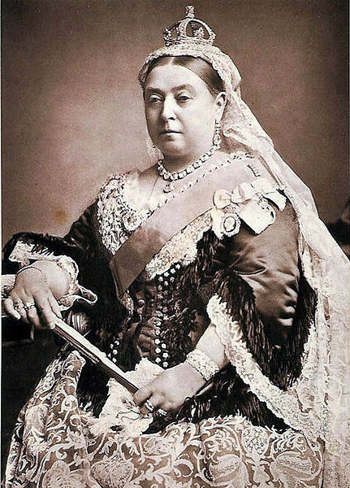
The Victorian Era
The “Victorian Era” refers to the period of the reign of Queen Victoria.
It was a period of peace, prosperity, refined sensibilities, and nationalism, that spread far beyond the borders of Great Britain.

Slide 27
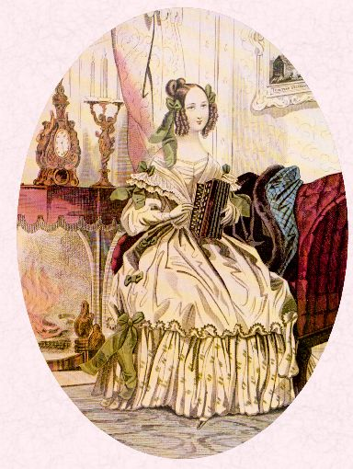
The Reform Movement
The reform movement sought to eliminate a multitude of sins:
  Cruelty, war, alcohol, discrimination, and slavery
Middle-Class women were often the motivation behind these movements
Felt it their duty as rulers of morality in the home to rid society of these vices.

Slide 28



An Age of Reform
Gradual abolishment of debtors’ prisons
Criminal codes and penalties were softened – reform, not punish
  Reduction of capital offenses
  Penitentiaries

Slide 29
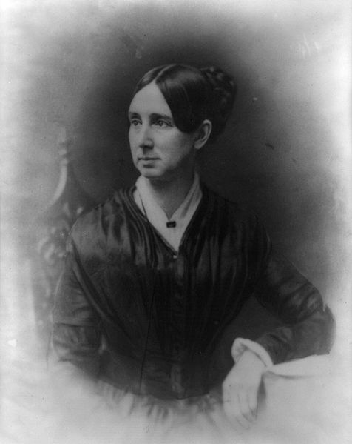
Dorothea Dix
Brought attention to abuse within the system in caring for the insane
Traveled the country, visiting different asylums; her protests resulted in improved conditions for the mentally ill.
“I proceed, Gentlemen, briefly to call your attention to the present state of Insane Persons confined within this Commonwealth, in cages, stalls, pens! Chained, naked, beaten with rods, and lashed into obedience."

Slide 30

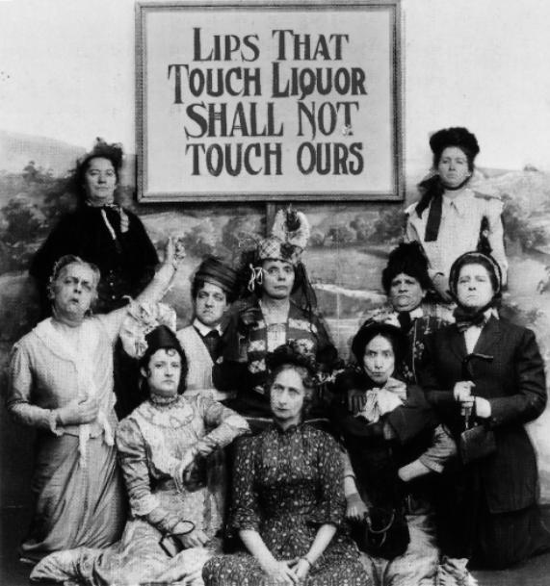
Demon Rum – The “Old Deluder”
Reformers wanted to ban alcohol and end drunkenness
  Mostly women, clergymen, and members of Congress
The American Temperance Society (1826)
  Remove the desire to drink (temperance over teetotalism)
  Punish those who did drink – strengthening laws
Maine Law of 1851 which prohibited alcohol's sale or manufacture. Other states followed suit

Slide 31
Social Reform

Slide 32
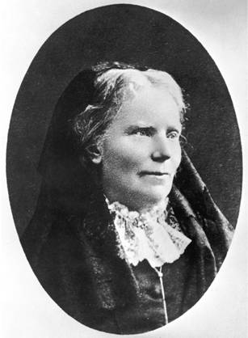
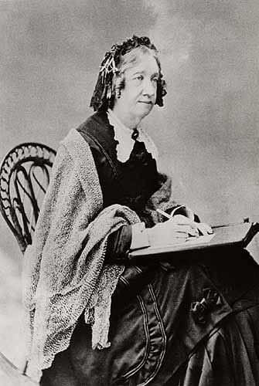
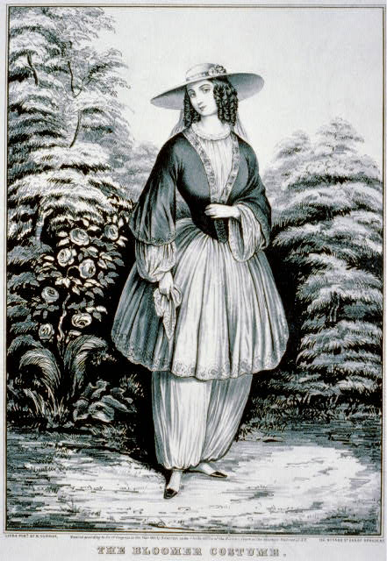
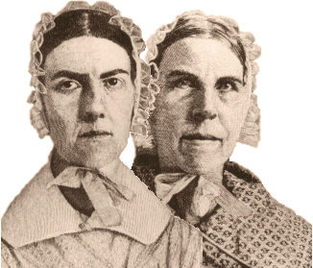
Women in Revolt
Catharine Beecher encouraged women to become teachers (until they married), and advocated the benefits of kindergarten (a German tradition).
Dr. Elizabeth Blackwell became the first female doctor
The Grimke sisters pushed for abolition of slavery
Amelia Bloomer wore short skirts
Scandalous!

Slide 33
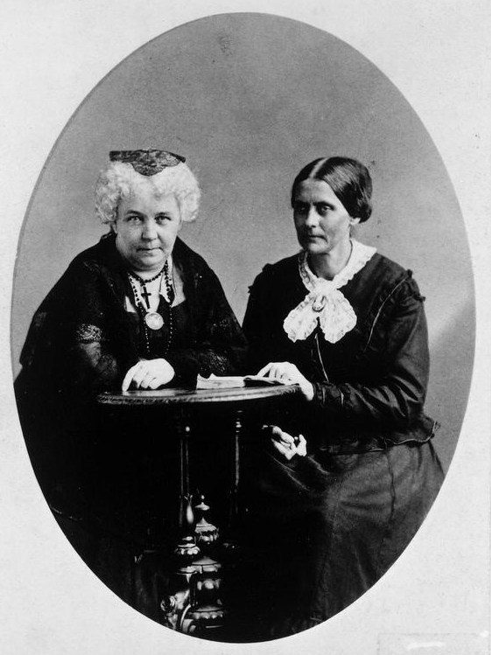

Women in Revolt
Feminists met at Seneca Falls, New York in a Woman's Rights Convention in 1848.
  Lucretia Mott, Susan B. Anthony, and Elizabeth Cady Stanton
“The Declaration of Sentiments” argued that all men and women were created equal
It demanded female suffrage

Slide 34
Scientific Advancement
Modernizing Science and Technology

Slide 35
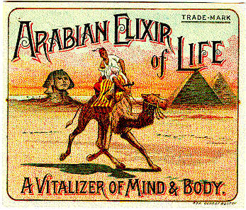

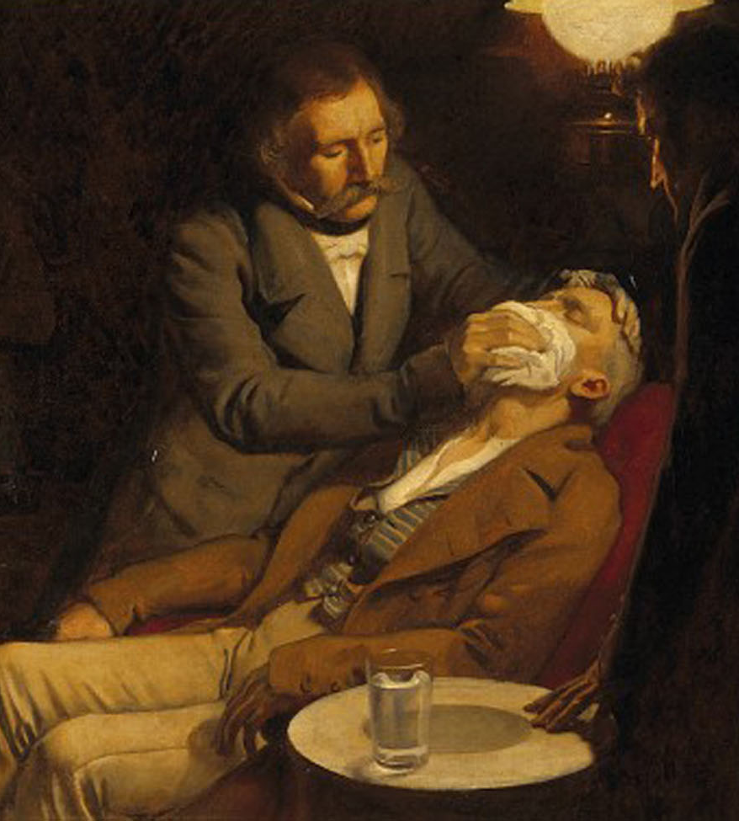

Dawn of Scientific Achievment
Medicine in America was still primitive by modern standards
  Bleeding, purging, “cure-all” medicines
  Barber or butcher as surgeon
  Sanitation was lacking
  Ether and laughing gas used as anesthesia in 1840s

Slide 36
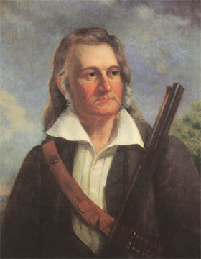


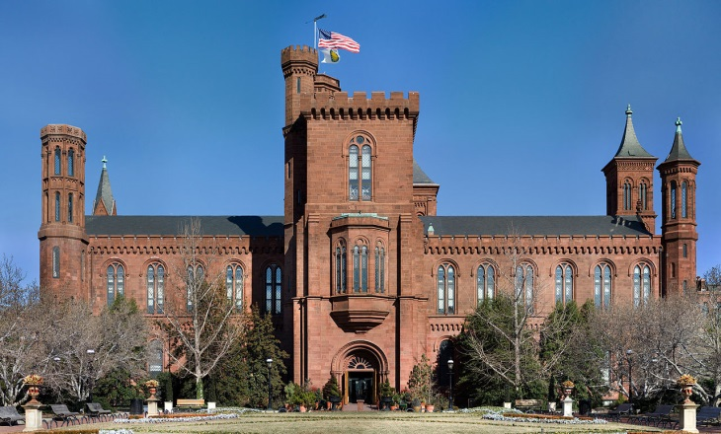
Studying Our World
John Audubon: An early naturalist who painted birds with precise details
  Audubon Society: environmental organization dedicated to conservation that gets its name from the ornithologist
Smithsonian Institution created (1846)

Slide 37
Defining American Culture
Philosophy, Art, and Literature

Slide 38
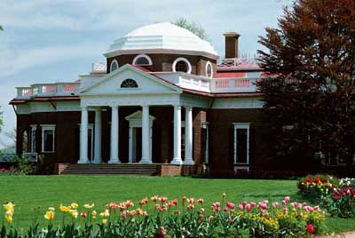
Artistic Achievments
Art
  Not copies of European styles of art
  Hudson River School: A group of painters whose works portrayed American landscapes
  Greek Revival in architecture. e.g. Monticello
Music
  American folks songs emerge
  Stephen Foster’s “Old Folks At Home” (AKA: Swannee River)
  "Dixie" written in 1859
“Way down upon the Swanee River,
Far, far away,
There's where my heart is turning ever,
There's where the old folks stay.
All up and down the whole creation,
Sadly I roam,
Still longing for the old plantation,
And for the old folks at home."

Slide 39
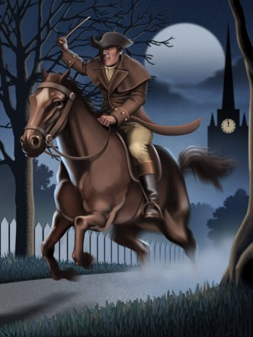
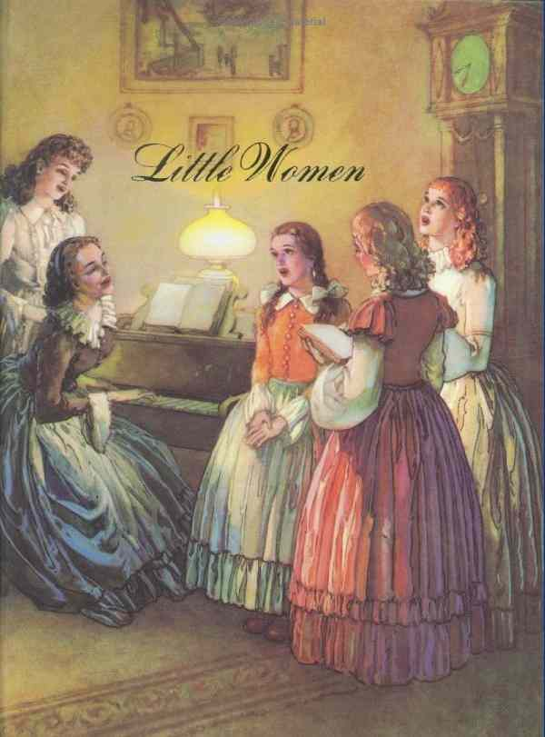
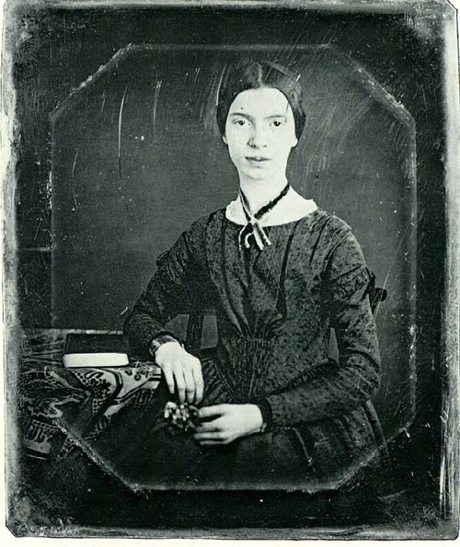
National Literature
Henry Wadsworth Longfellow, Ride of Paul Revere
Louisa May Alcott, Little Women
Nathaniel Hawthorne, The Scarlet Letter
Herman Melville, Moby Dick
Emily Dickinson - Poetry

Slide 40

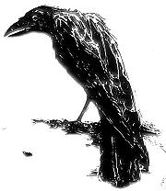
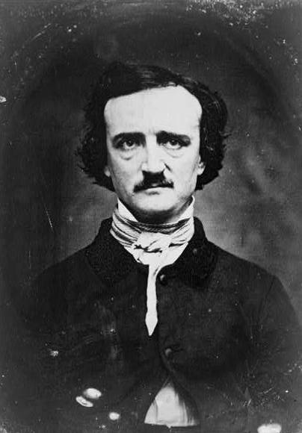
Edgar Allen Poe
“Nevermore”
Notes:
40

