Slide 1
Bell Ringer
What is your family’s ethnic heritage? What ethnicity do you think most Americans share?

Slide 2
Bell Ringer
Have you ever moved before? _____
If yes, how many times have you moved and from where?_______
What would be the most difficult part of moving to a new country? What would be the most exciting part?

Slide 3
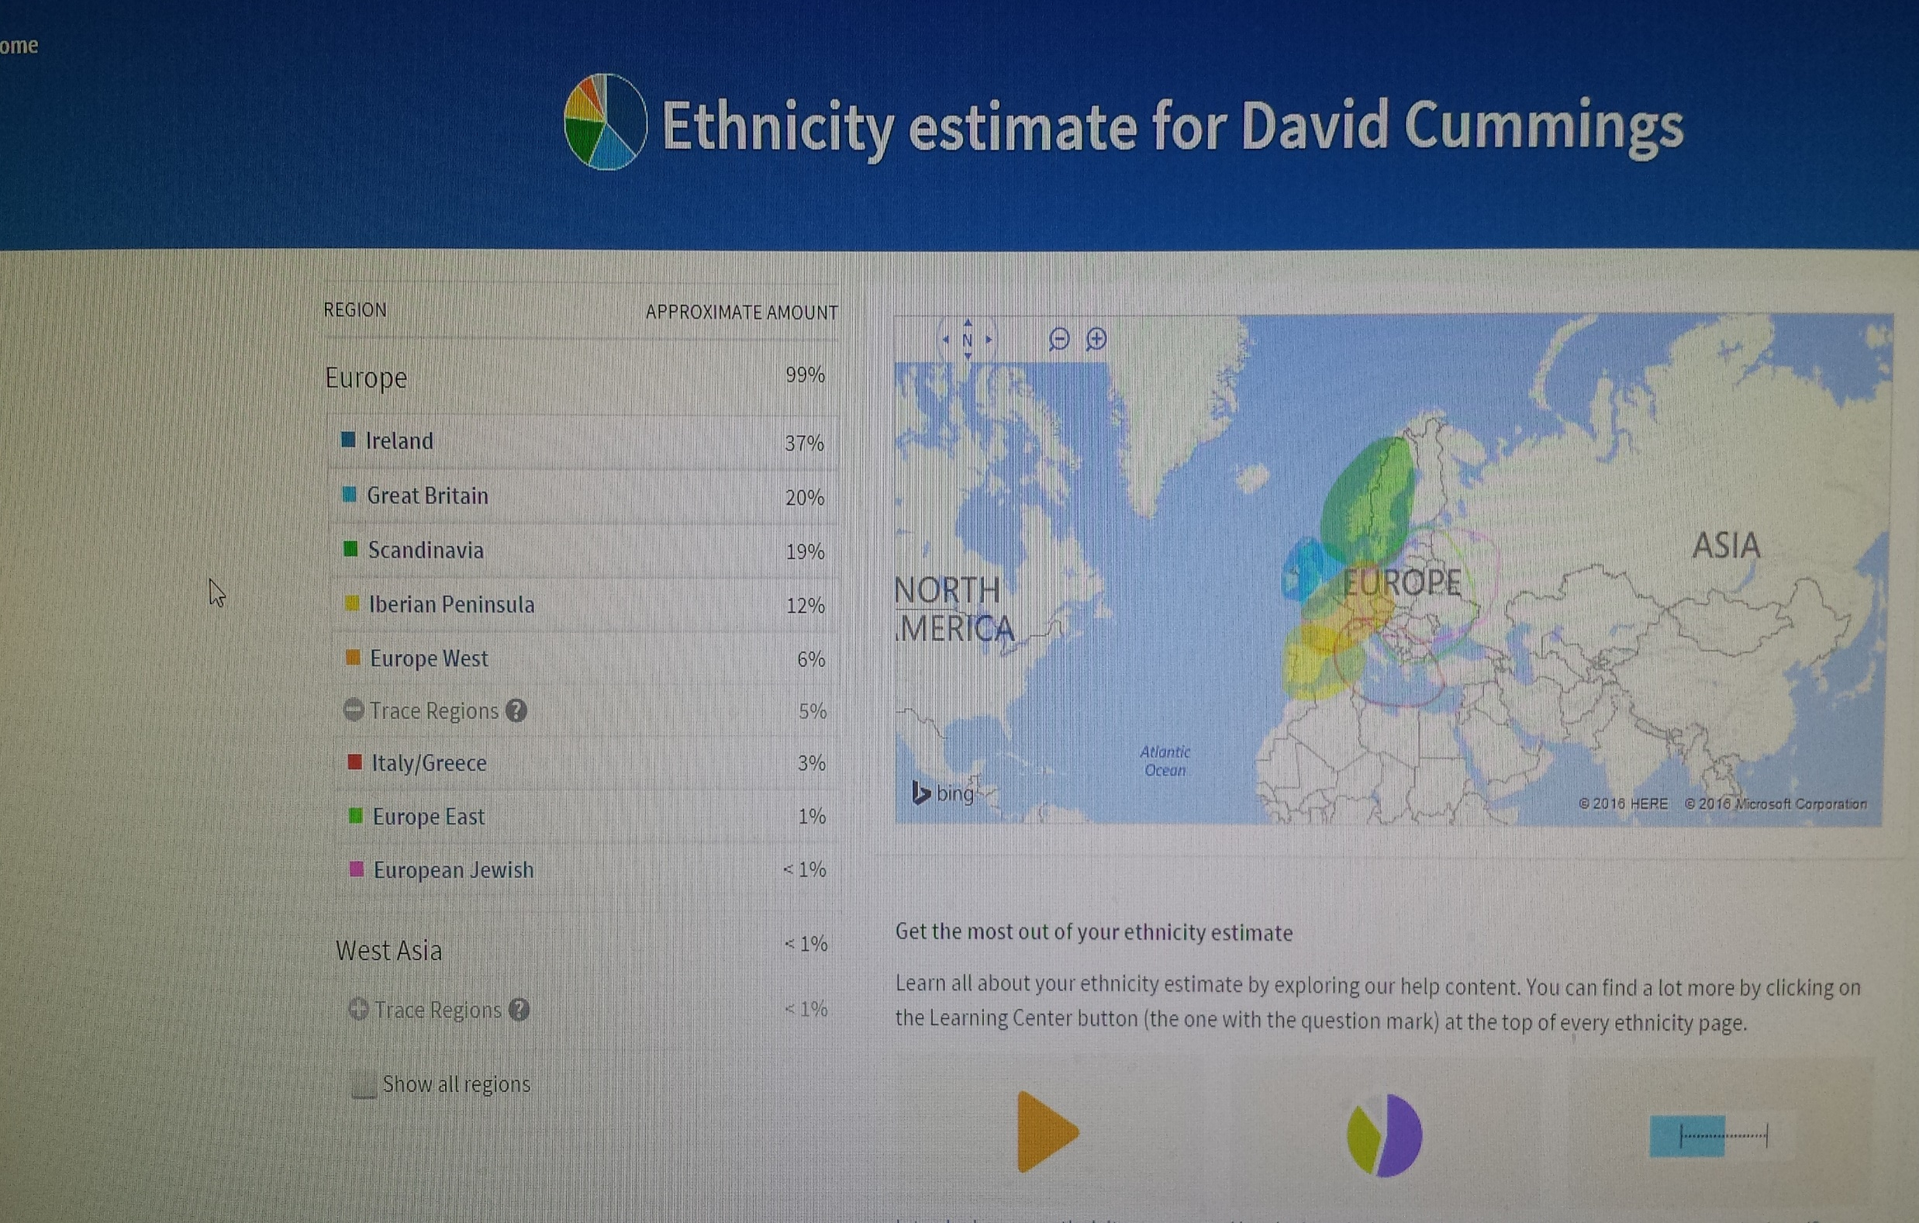

Slide 4
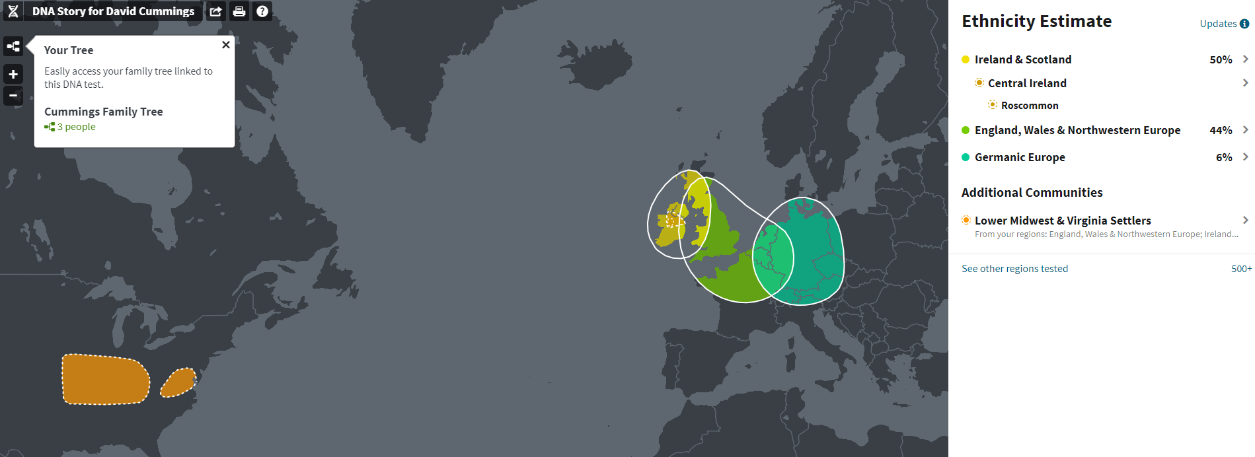

Slide 5
The Making of America
Immigration and the Market Revolution

Slide 6
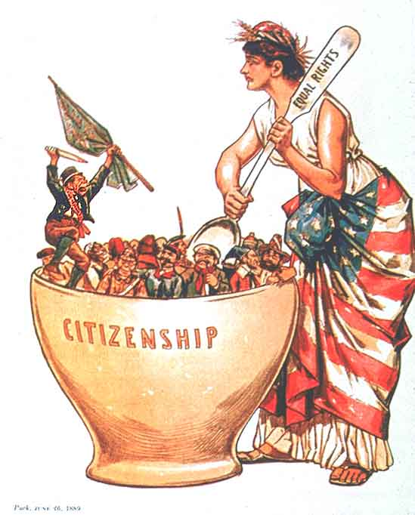
Coming to America
America’s First Mass Migrants

Slide 7

The March of the Millions
By the mid 1800's the population continued to double every 25 years
  High birthrate and immigration
4th largest nation in the world
Why America?
  Land
  Religious freedom
  Safety from war
  Opportunity
Notes:
4th largest nation in the world
33 states
1790: only two cities had more than 20,000 people; 1860: 43 cities with 20,000+

Slide 8
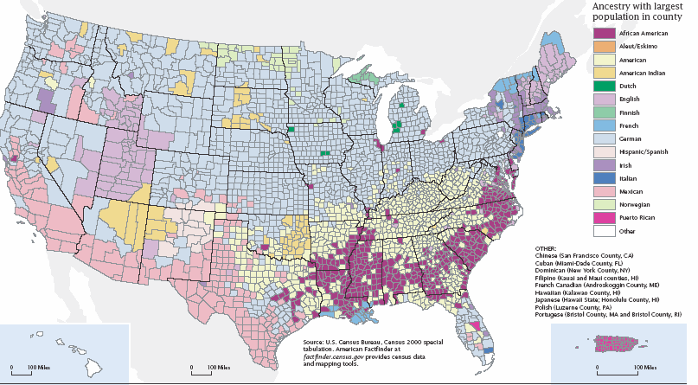
Where do Americans Come From?

Slide 9
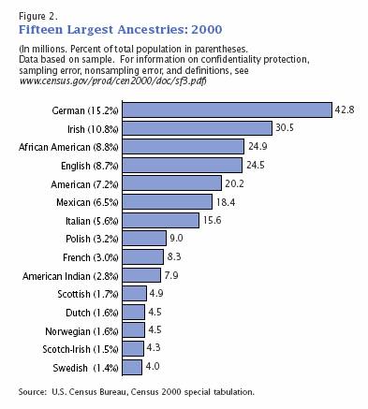
Where do Americans Come From?
German: 3/20
Irish: 1/10
Many people are beginning to list themselves as “American”

Slide 10
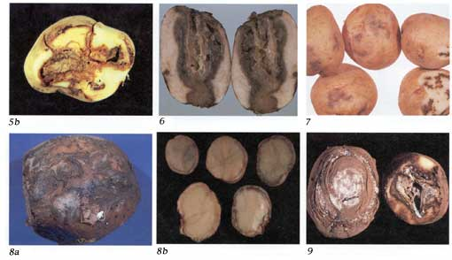
The Blight

Slide 11
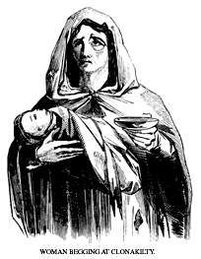
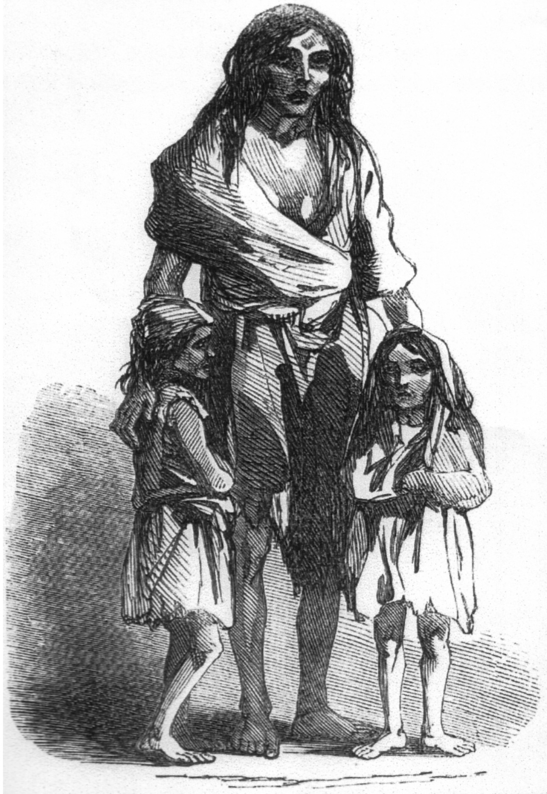
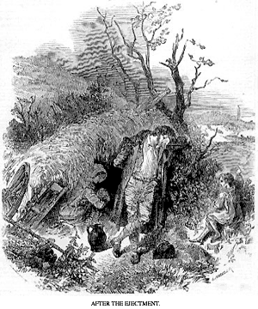

Slide 12

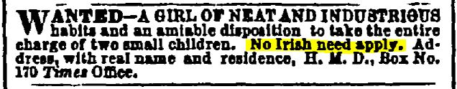
The Emerald Isle Moves West
Potato blight ⇨ famine and death (2m.) ⇨ migration (forced and voluntary, 2m)
  Unwanted in America: Uneducated, poor, Catholic, drank a lot!
Irish largely stayed in the cities on the east coast
  Worst, low-paying jobs
  “No Irish Need Apply”
Irish determined to assimilate
  Politicians harness the power of the Irish vote

Slide 13

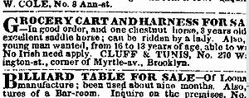
No Irish Need Apply
I'm a decent boy just landed
From the town of Ballyfad;
I want a situation, yes,
And want it very bad.
I have seen employment advertised,
"It's just the thing," says I,
“But the dirty spalpeen ended with
'No Irish Need Apply.’”
"Whoa," says I, "that's an insult,
But to get the place I'll try,
So I went to see the blackguard
With his "No Irish Need Apply.
Some do count it a misfortune
To be christened Pat or Dan,
But to me it is an honor
To be born an Irishman.
I started out to find the house,
I got it mighty soon;
There I found the old chap seated,
He was reading the Tribune.
I told him what I came for,
When he in a rage did fly,
"No!" he says, "You are a Paddy,
And no Irish need apply.”
Then I gets my dander rising
And I'd like to black his eye
To tell an Irish gentleman "No Irish Need Apply.“
I couldn't stand it longer
So a hold of him I took
And gave him such a welting
As he'd get at Donnybrook.
He hollered, "Milia murther,“
And to get away did try,
And swore he'd never write again
"No Irish Need Apply.“
Well he made a big apology,
I told him then goodbye,
Saying, "When next you want a beating,
Write `No Irish Need Apply.' "

Slide 14
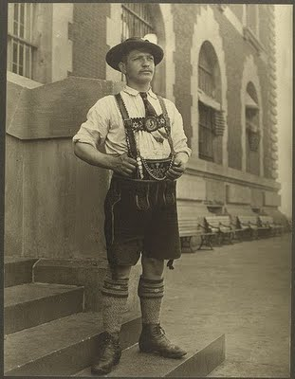
The German Forty-Eighters
Crop failure + war ⇨ 1 million Germans immigrate to America.
More accepted by Americans
  Lutheran (Protestant)
  Moved to the Mid-West (frontier)
  Exceptions: Clung to their native culture, outspoken against slavery, drank lots of beer
Notes:
Gave America the Conestoga wagon, the Kentucky rifle, the Christmas tree, and kindergarten

Slide 15
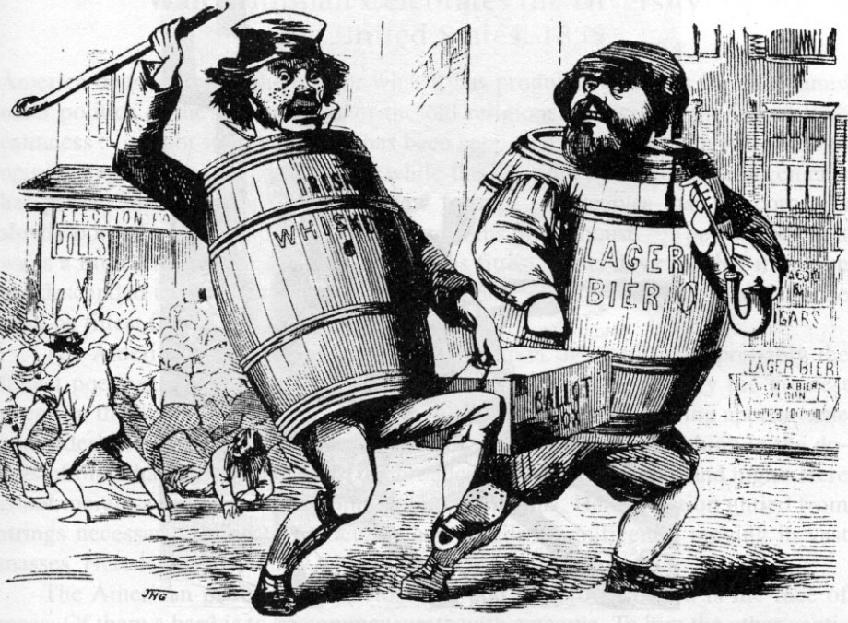
Flare-ups of Anti-foreignism
“Nativists”: Native-born Americans who did not like immigration and sought to ensure that immigrants were not allowed to hold public office.
  Believed newcomers would cause the downfall of America
The American Party (AKA: The "Know-Nothings”): A nativist anti-immigration secret society; directed hatred mainly at Irish Catholics.
  Attacked immigrant businesses, homes, and intimidated them at the polls.

Slide 16
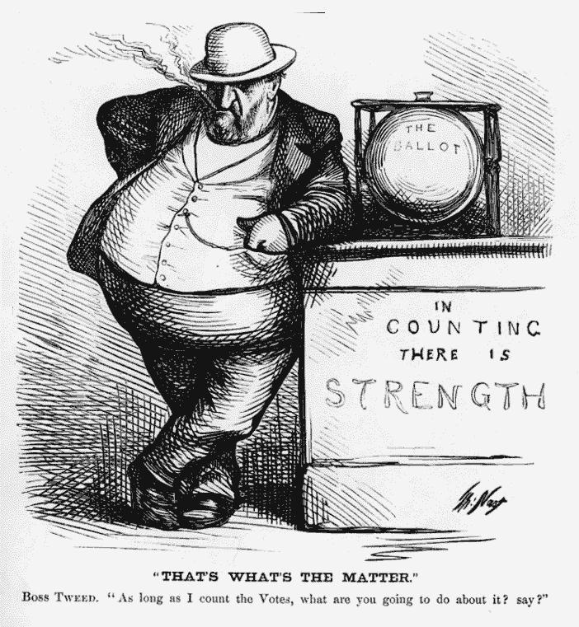
Political Machines
Cities/politics could not keep up with population growth
Political machine: A political organization in which a ”boss” gains the support of individuals and businesses, who receive rewards (usually jobs) for getting out the vote
  Relied on immigrant voter-base
  Corrupt
  Improved infrastructure
  Increased voter turn-out

Slide 17
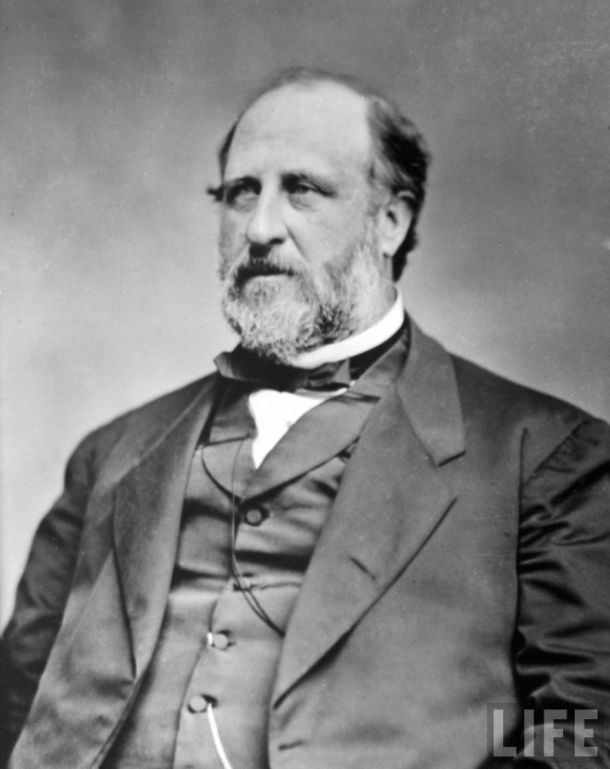
Political Machines
Tammany Hall: A Democratic political machine in New York City; held political control from 1854-1932.
  Notorious for graft (use of authority for personal gain) and political corruption
  Irish immigrants as voter-base
  Helped Irish assimilate and gain power
William “Boss” Tweed: Leader of Tammany Hall between the 1850s-70s
  Able to dole out city jobs and projects to his supporters
  Found guilty of stealing $45 million from taxpayers through graft.
  Lampooned by Thomas Nast

Slide 18
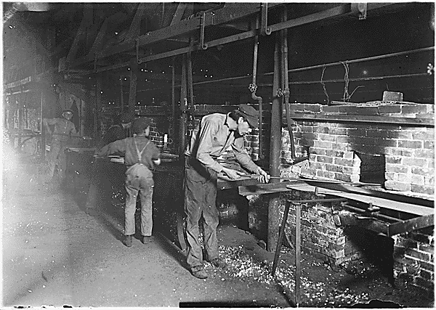
The Market Revolution

Slide 19
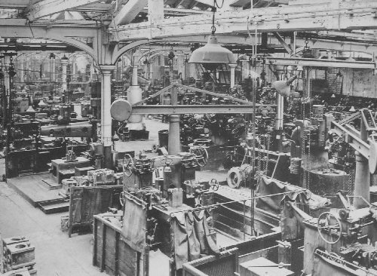
Industrial Review
Change from human labor to machines
Development of new energy sources
Increased use of natural resources
Standardization of products
Effects on environment
Effects on politics and economics

Slide 20
Origins of American Industrialism
Characteristics spurring industrialization:
  Increasing population
  Cheap immigrant labor
  Abundance of raw materials
  Wars in Europe + blockades
  Improved transportation
Struggled to compete with the British in manufacturing

Slide 21
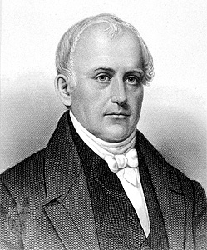
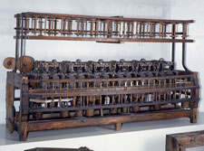
The Father of the Factory System
Samuel Slater (“Father of the Factory System”)
Built the first spinning machine in America
Slater’s machine created a shortage of cotton fiber

Slide 22
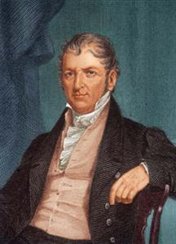
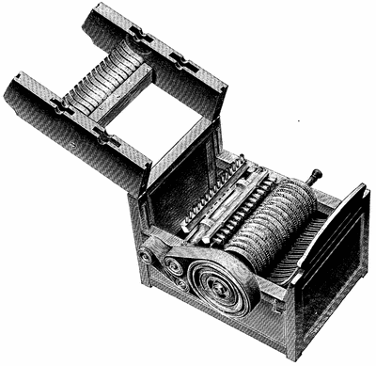
Eli Whitney: The Cotton Gin
Eli Whitney invented the cotton gin which separated the fiber from the seed (1793).
  Caused the South to expand its cotton producing land and increase its desire for slaves
  The cotton gin caused the North to expand its factories for spinning and weaving cloth.

Slide 23
Crowning “King Cotton”
Samuel Slater’s thread spinning machine
Increased demand for cotton
Eli Whitney’s Cotton Gin
Increased profit in cotton farming
Increased demand for slaves

Slide 24
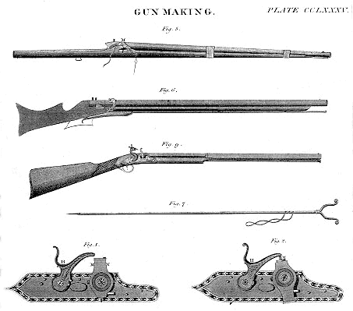
Eli Whitney: Interchangeable Parts
Eli Whitney created “interchangeable parts” while on contract for the US Army
  Industrialism flourished in the North using this method

Slide 25
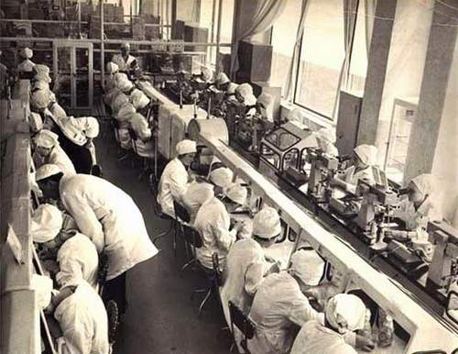
Mass Production
The method of production of large amounts of standardized products efficiently and cheaply.
  Interchangeable parts
  Machine tools
  Division of labor

Slide 26
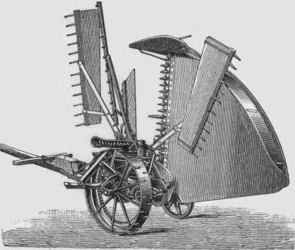
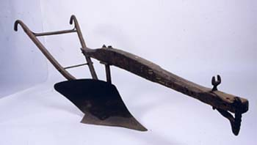
Midwest Farming
Major Inventions
    John Deere steel plow
    Cyrus McCormick’s mechanical reaper
Problem: How to get crops to the markets (cities) back East

Slide 27

Changes to Business
“Limited Liability Corporation” (LLC): Ensured that if the company went bad, an investor could lose only what he'd invested (not everything he owned).
This assurance caused more people to invest in business and thus for businesses to grow.

Slide 28
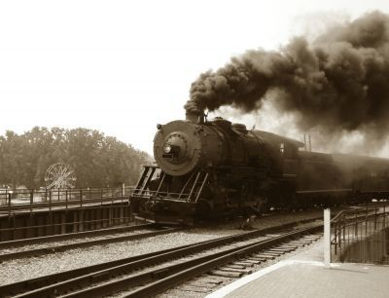
Bell Ringer
What invention is most valuable to your daily life? What invention do you think has done the most damage to our lives/society?

Slide 29
Building America’s Infrastructure
Roads, canals, and steamboats, oh my!

Slide 30
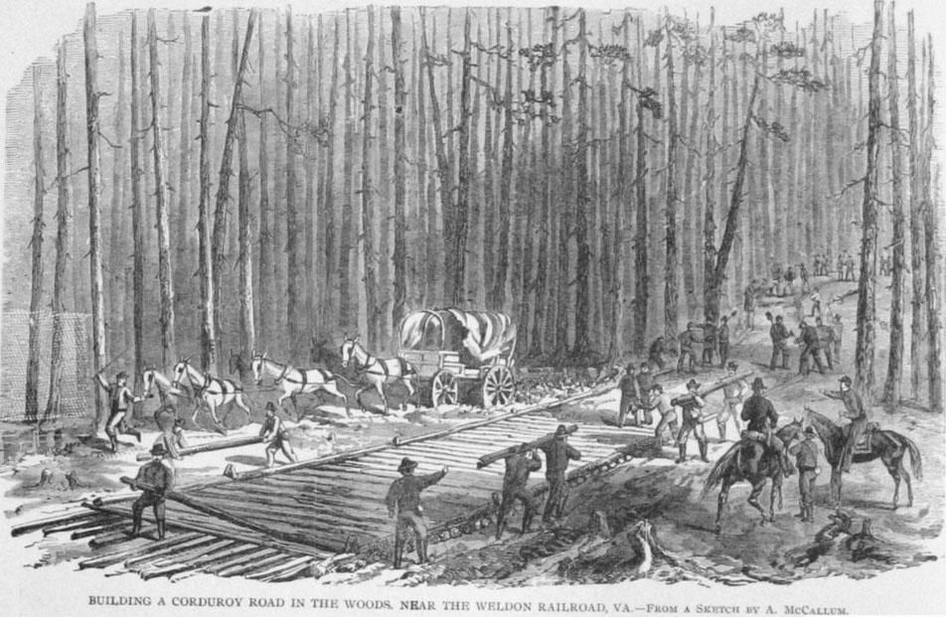
Roadways
Economic growth of the western states dependent on improving transportation
Cumberland Road
The Lancaster Turnpike (a hard-surfaced highway)

Slide 31
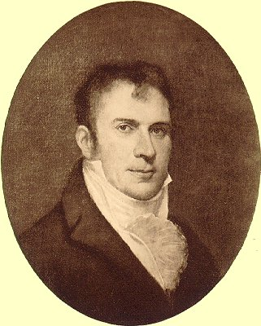
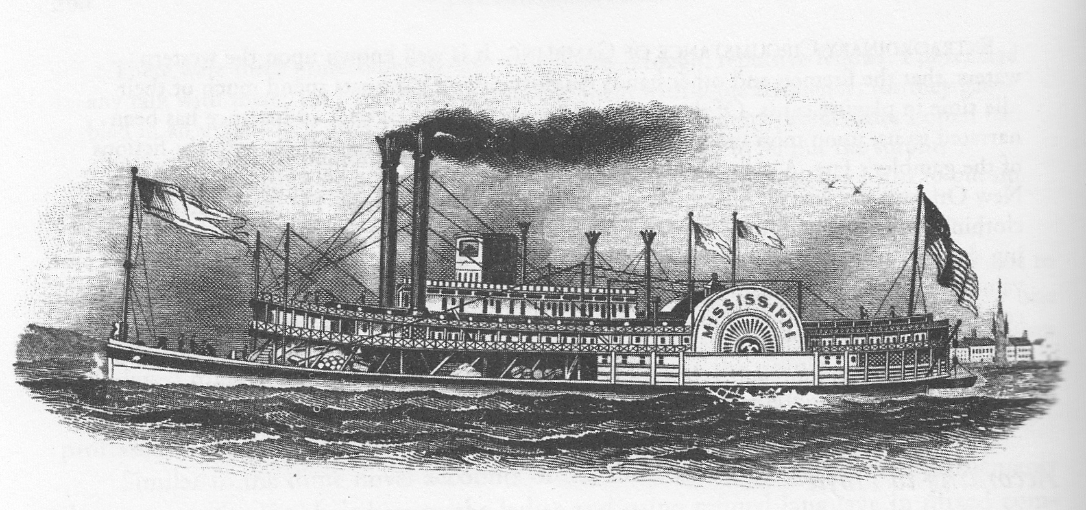
The Steamboat
First steamboat built by Robert Fulton (1807)
  Rivers were now two-way streets
  The South and West benefitted most

Slide 32
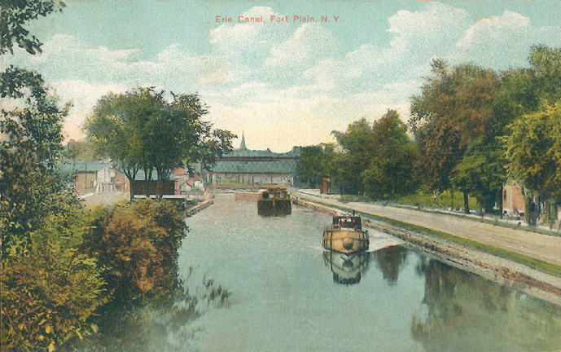
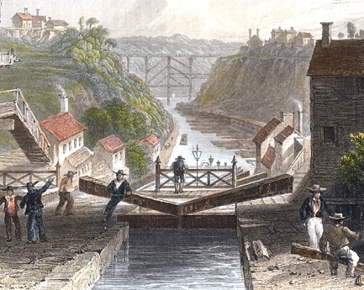
Erie Canal
Headed by NY governor Dewitt Clinton
  Built using only state money
  “Clinton’s Big Ditch”
Effects:
  Shipping costs from the West to the East dropped 20x ($100 became only $5).
  Stole most of the trade from the Mississippi River.
  "Western" cities boomed, like Cleveland, Detroit, and Chicago

Slide 33
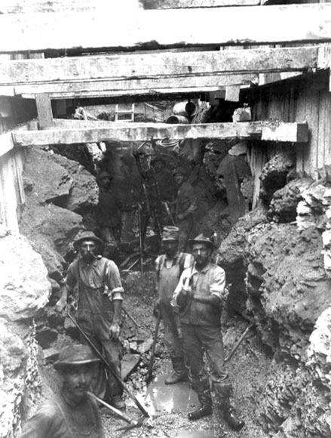
Erie Canal
A three-man team with mules could build a mile in a year.
Mostly built by poor immigrants
Construction, surveying, and engineering by amateurs
Over 1,000 workers died of swamp fever at Montezuma Marsh, stopping construction

Slide 34
Erie Canal
We better get along on our way ol'gal,
15 miles on the Erie Canal
'Cause you bet your life I'd never part with Sal,
15 miles on the Erie Canal.
Git up there mule, here comes a lock,
We'll make Rome about 6 o'clock
One more trip and back we'll go, right back home to Buffalo.
I've got a mule, her name is Sal,
15 miles on the Erie Canal
She's a good old worker and a good old pal,
15 miles on the Erie Canal
We've hauled some barges in our day
filled with lumber, coal and hay
And we know every inch of the way from Albany to Buffalo.
Chorus:
Low bridge, everybody down
Low bridge for we're coming to a town
And you'll always know your neighbor, you'll always know your pal
If you've ever navigated on the Erie Canal.

Slide 35
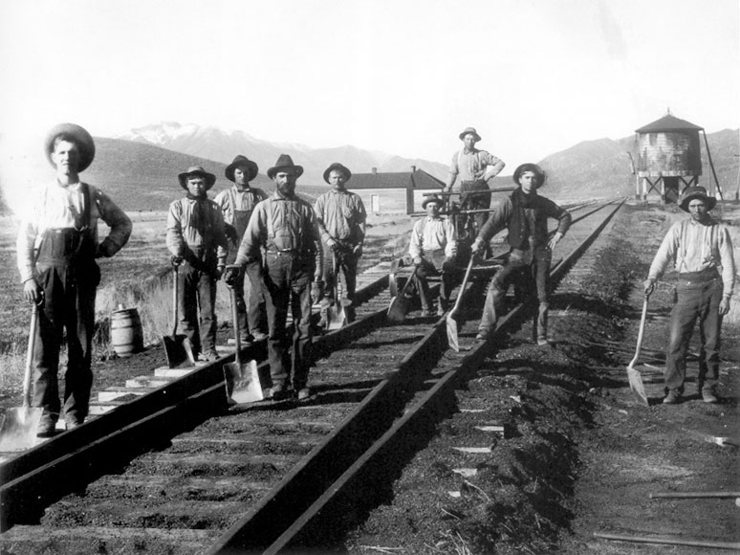
I’ve Been Working On The Railroad
Invention of the “iron horse”
30,000 miles of track by 1860
  ¾ of railroad tracks were in the North
Early railroads were unreliable
New inventions lead to safer, more efficient, and more reliable transport (e.g. Westinghouse air-brakes)

Slide 36
Well John Henry was a little baby
Sittin' on his daddy's knee
He picked up a hammer and
a little piece of steel
And cried, "Hammer's gonna
be death of me, Lord, Lord
Hammer's gonna be the death of me"
Now the captain he said to John Henry
"I'm gonna bring that steam drill around
I'm gonna bring that steam drill
out on these tracks
I'm gonna knock that
steel on down, God, God
I'm gonna knock that steel on down"
John Henry told his captain
"Lord a man ain't noth' but a man
But before I let that steam drill
beat me down
I'm gonna die with a hammer
in my hand, Lord, Lord
I'll die with a hammer in my hand"
John Henry driving on the right side
That steam drill driving on the left
Says, "Fore I let your
steam drill beat me down
I'm gonna hammer
myself to death, Lord, Lord,
I'll hammer my fool self to death"
Well captain said to John Henry
"What is that storm I hear?"
John Henry said, "That
ain't no storm captain
That's just my hammer
in the air, Lord, Lord
That's just my hammer in the air"
John Henry he hammered
in the mountains
His hammer was striking fire
But he worked so hard;
it broke his heart
John Henry laid down his hammer
and died, Lord, Lord
John Henry laid down his hammer and died
Ballad of John Henry

Slide 37
Paddy Works on the Railway
In eighteen hundred and forty-one
My corduroy britches I put on
My corduroy britches I put on
To work upon the railway, the railway
I'm weary of the railway
Poor Paddy works on the railway
I was wearing corduroy britches
Digging ditches, pulling switches
Dodging pitches
I was working on the railway
In eighteen hundred and forty-three
I broke the shovel across me knee
I went to work for the company
and work upon the railway
In eighteen hundred and forty-four
I landed on Columbia’s shore
My belly was empty me hands were raw
With working on the railway, the railway
I'm sick to my guts of the railway
Poor paddy works on the railway
In eighteen hundred and forty-six
I made my trade to carrying bricks
I made my trade to carrying bricks
For working on the railway
I'm weary of the railway
Poor Paddy works on the railway
I was wearing corduroy britches
Digging ditches, pulling switches
Dodging pitches
I was working on the railway
In eighteen hundred and forty-seven
Poor Paddy was thinking of going to Heaven
If he left one kid, well he left eleven
To work upon the railway, the railway
I'm weary of the railway
Poor Paddy works on the railway
I was wearing corduroy britches
Digging ditches, pulling switches
Dodging pitches
I was working on the railway

Slide 38
Analysis of American Labor Songs
What is a common theme within the working songs presented? Why do you think this theme is repeated so often?
Why do you believe so many songs of this era have survived?
Are there any recent songs that illustrate the same themes as the songs from the 19th century? Why or why not?
Notes:
Work songs are typically sung for two reasons: to coordinate the labor of a group of people working together, which improves the efficiency of the work, and to relieve the boredom of a tedious job, which improves the lives of the workers.

Slide 39
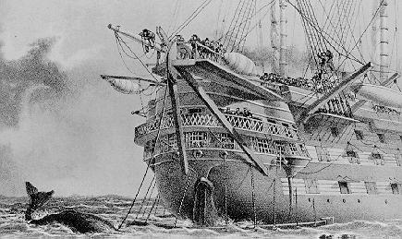
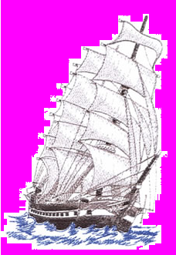
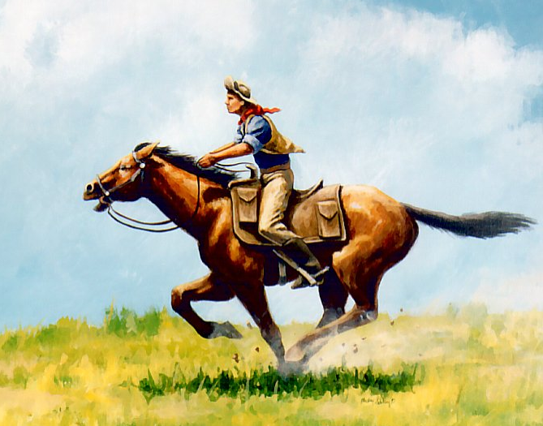
Other Milestones
Telegraph cable laid between Newfoundland and Ireland
  Allowed nearly instantaneous communication with Europe
American "clipper ships" to haul cargo to foreign nations
The Pony Express
  Could travel 2,000 miles in 10 days
  Lasted only 2 years; replaced by the trans-continental telegraph wire and RR

Slide 40
Connection Leads to Disconnection
The "transportation revolution" wanted to link the West with the rest of the nation, and it did... In the North. The South was largely left to use its rivers.
Sectional "division of labor" emerged – The North: manufacturing; the South: cotton for export; the West: grain and livestock
Legal issues usually sided with businesses, rather than workers.
Real rags-to-riches stories were rare, but you had a better chance of it than back in Europe.

Slide 41
Working in America
The Market Revolution Gains Steam

Slide 42
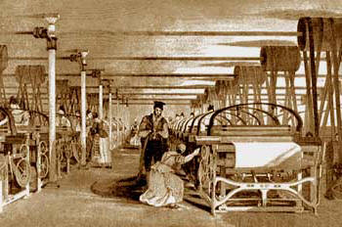
Working Conditions
Exploitation of workers = “wage slaves”
Typical factory conditions:
  They were unsafe
  They were unhealthy
  Hours were long and wages were low
  Child labor was common
Unionization was illegal – seen as “criminal conspiracy”

Slide 43
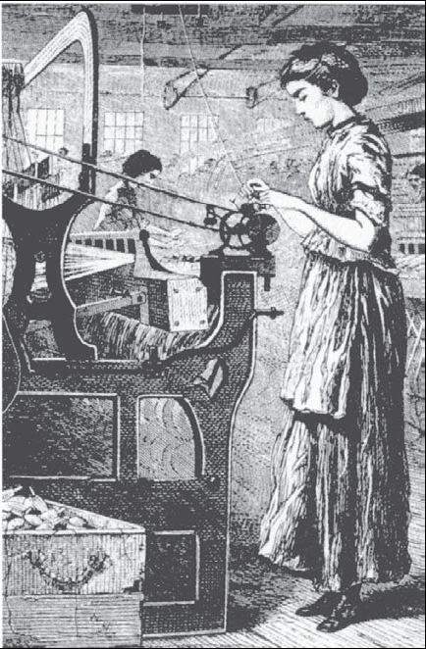
Women Go to Work
Preindustrial society:
  Women were responsible for helping out on farms as well as producing textiles and clothing in the home.
Industrial society:
  Women were being replaced by machines, but were needed to run and maintain the machines
  Provided greater economic independence

Slide 44
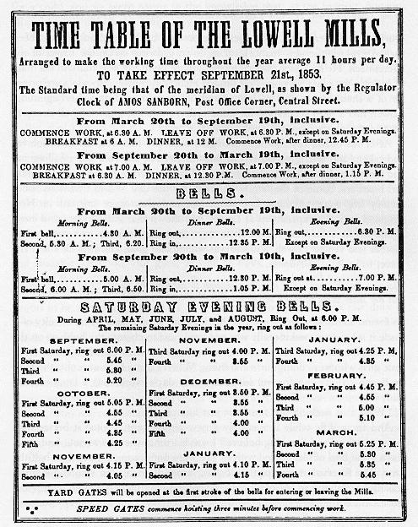
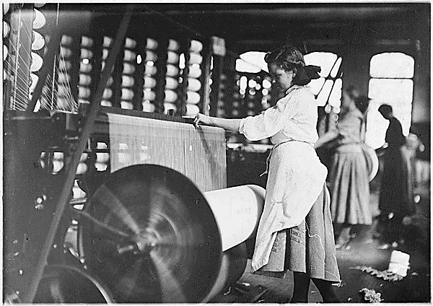
The Lowell Mill Girls
Lowell, Mass. was well-known for employing young women to work in its textile factories.
  Mainly farm girls who came to the cities for better job opportunities
  System designed to control every aspect of the girls’ lives to ensure efficiency (dress, curfews, homes, etc.)
Notes:
Lowell, Mass. was well-known for employing young women to work in its textile factories.
The women worked, bunked in dorms, were escorted to church by overseers, were able to take classes, and were carefully guarded over.
Employees worked from 5-7 pm, for an average 73 hours per week. Each room usually had 80 women working at machines, with two male overseers managing the operation. Windows were often kept closed during the summer so that conditions for thread work remained optimal. The air, meanwhile, was filled with particles of thread and cloth
A curfew of 10 pm was common, and men were generally not allowed inside. About 25 women lived in each boardinghouse, with up to six sharing a bedroom
Newcomers were mentored by older women in areas such as dress, speech, behavior, and the general ways of the community. Workers often recruited their friends or relatives to the factories, creating a familial atmosphere.

Slide 45
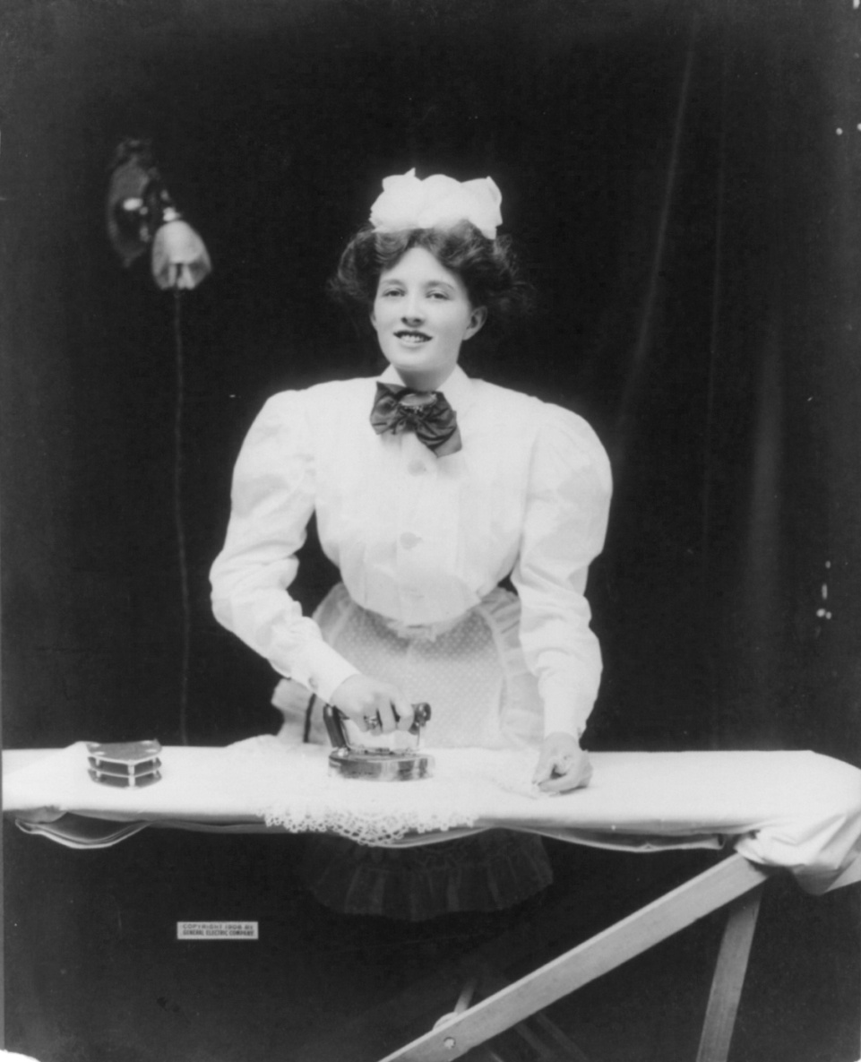
Other Occupations
Other opportunities: Nursing, domestic service, and teaching
  Young, single women
  Once married, expected to quit work
Domestic service was common; 1 in 10 white families employed at least one servant

Slide 46

Unions: The Struggle to Organize
Unions unite workers to achieve three basic goals:
  Better working conditions
  Better hours
  Better pay
Many factory owners were against unionization because it hurt their profits.
  Goals were the 10-hour workday, higher wages, better conditions, public education, and humane imprisonment for debt
    The results were only fair, at best. This was due to high immigration and courts siding with businesses.

Slide 47
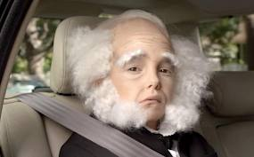
A “Wage Slave” no more!
President Van Buren set a 10-hour work day for government employees.
Commonwealth v. Hunt (1842) – Massachusetts Supreme Court ruling that legalized labor unions, provided that they were organized for a legal purpose and used legal means to achieve their goals.

Slide 48
Home Sweet Home
Women and The Industrial Family

Slide 49
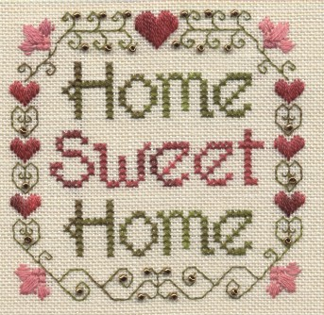
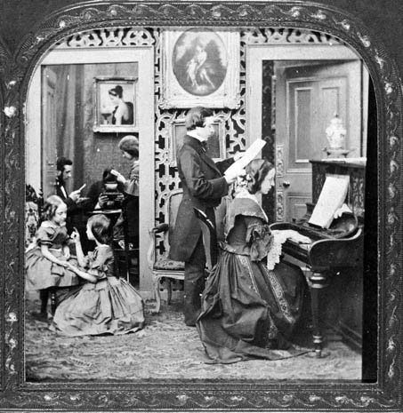
The Industrial Home*
Marriages increasingly based on love, rather than parental “arrangement”
The desire for romance in relationships becomes common
  Rise of celebrating St. Valentine’s Day
Family size shrinks
  Farm = workers; City = mouths to feed
Families became more closely knit and affectionate
  Guide and shape children, rather than “break” them
  Longer “childhood”
  The home changed from a place of work (like on the farm) to a place of rest (away from the factory).
    "Home Sweet Home"
*Mainly middle class

Slide 50
Separate Spheres Ideology
Women were seen as inferior to men based upon physical observations:
  Physically smaller than men
  Belief that women had less physical stamina than men because they seemed to faint so frequently
  Incapacitated every month due to menstruation; caused fatigue and temporary insanity
  Female nervous system more delicate; easier to irritate, overwhelm, overstimulate, and fatigue (b/c of reproductive system)
  Women had smaller brains than men

Slide 51
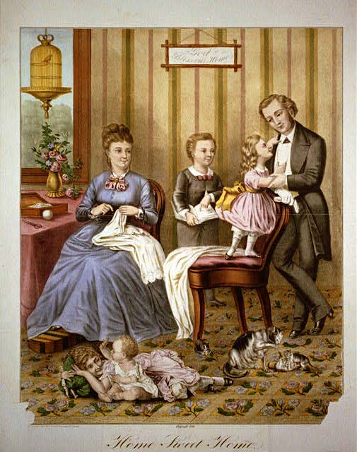
The Industrial Home
“Cult of Domesticity”/ “Cult of True Womanhood”: The cultural value system for women during the 19th century that glorified the customary functions of the homemaker
  Piety, Purity, Submissiveness, Domesticity
  Working class and colored women not included
Middle class women focused on bettering the moral lives of others (temperance movement, child labor, etc.)

Slide 52
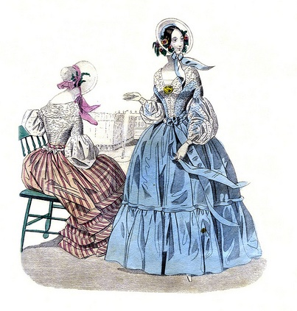
Godey’s Lady’s Book
Most widely circulated magazine in the period before the Civil War
Each issue contained poetry, articles, and engravings created by prominent writers and other artists of the time
  Best known for the hand-tinted fashion plate at the start of each issue
  Included an illustration and sewing pattern with measurements
  Included a sheet of piano music

Slide 53
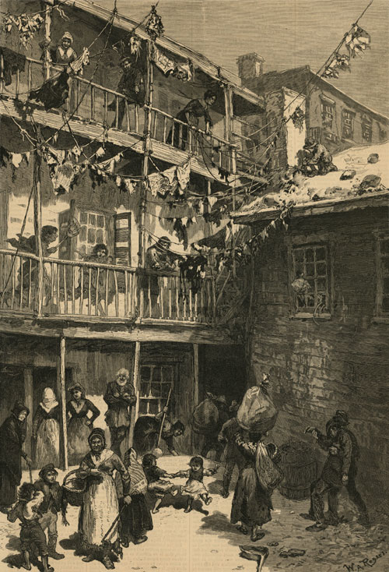
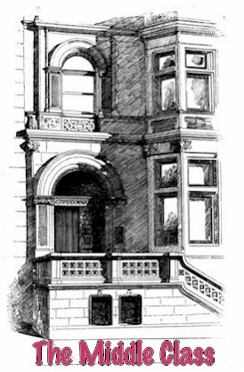
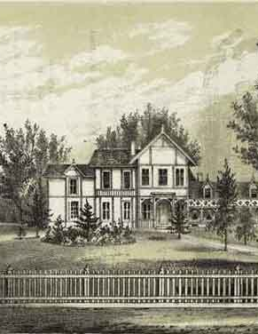
Living Conditions of the Social Classes
Dramatic rise in the standard of living for all Americans
Uneven division of income between the working class and the wealthy
Division of living conditions:
  Poor in oldest part of the city – tenements in downtown area
  Middle lived away from downtown center in brownstone row houses
  Rich lived in outside the city - large homes with big lawns which had lots of trees

Slide 54
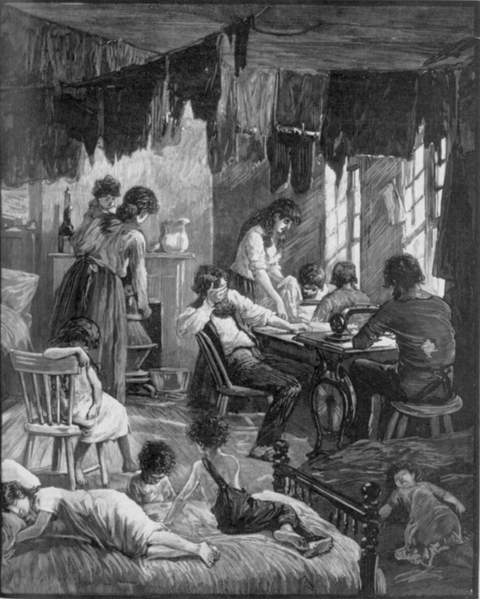
Lower-Class Living
The poor families struggled to survive in crowded slums.
  Tenements
  Quickly and poorly built to meet demand
Problems:
  Overcrowded
  Dangerous
  Filthy
  Disease (cholera and typhoid)

Slide 55

Middle-Class Living
Included doctors, lawyers, and skilled crafts people
Lived just outside the inner city in row houses, or new apartment buildings; often had a patch of lawn
Joined social clubs, bowling leagues and charity groups

Slide 56

Upper Class Living
The very rich built mansions in the most prime parts of the city or in the countryside
Lived like royalty
Filled their homes with priceless art and gave lavish parties

