Slide 1
Bell Ringer
The Maryland Act of Toleration
  Was a way to suppress rebellions such as the one led by Nathaniel Bacon
  Extended voting rights to non-Protestants in New England
  Protected Catholic rights in Maryland after the influx of Protestant colonists
  Improved the conditions of indentured servants in the middle colonies
New York became a British colony
  When it was chartered by the Duke of York
  After it had been explored by the French
  After the area had been annexed by the Dutch
  When it was bought from the natives for trinkets
Preachers of the Great Awakening focused on the importance of all of the following except
  The consequences of leading a sinful life
  The sovereignty and power of God
  Looking to the Bible as the final source of authority
  Economic independence
John Winthrop referred to Massachusetts Bay as a “city upon a hill” because
  Its views of religious freedom made it a safe haven for the oppressed
  The colony’s fair treatment of Native Americans was to be an example for others
  The colony was to serve as an example of Christian virtue and charity
  The term distinguished Massachusetts from the lower colonies that practiced slavery.
A majority of the early English migrants to the Chesapeake Bay area were
  Families with young children
  Wealthy gentlemen
  Indentured servants
  Disenfranchised Catholics
Notes:
C, A, D, C, C

Slide 2
Creating A Nation
Defining America

Slide 3
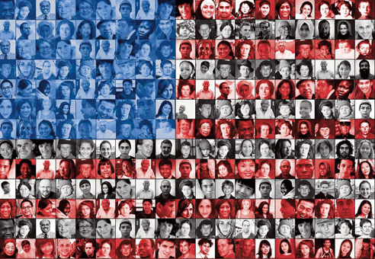
The Pursuit of Equality

Slide 4
“All Men Are Created Equal”
Jefferson’s famous phrase prompted a series of cultural changes in the new nation.
  Title of Mr. and Mrs.
  “boss” replaces “master”
  Freedom for some slaves and indentured servants
  Disposed of primogeniture
  Separation of church and state

Slide 5
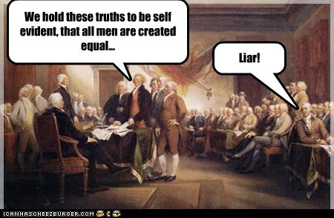
“All Men Are Created Equal?”
Slavery was not abolished for another 89 years
Women were not included in Jefferson’s statement of equality.
  “civic virtue”: Notion that democracy depended on the unselfish commitment of each citizen to the public good.
  “Republican motherhood”: women became the keepers of the nation’s conscience and virtuous citizenry

Slide 6

You’ve got your independence…

Slide 7
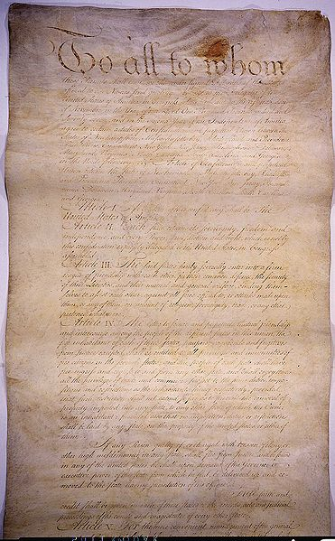
Articles of Confederation
Confederation: Independent states that are united for common purposes
Adopted by 2ndCC (1777)
Americans were afraid of surrendering too much power to a central government (like Britain’s)

Slide 8

Weaknesses of the Articles of Confederation
Congress
Congress has no power to tax

Slide 9
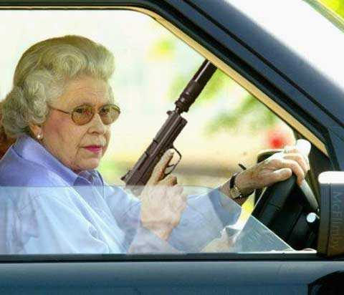
Weaknesses of the Articles of Confederation
Congress has no power to enforce treaties

Slide 10
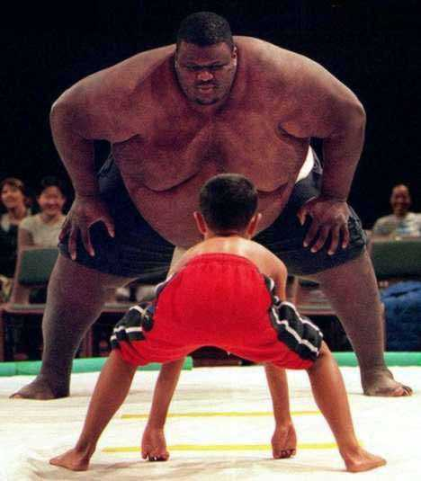
Weaknesses of the Articles of Confederation
Every state, despite size, has one vote

Slide 11
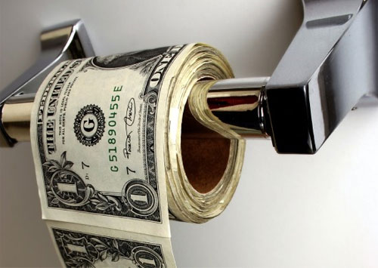
Weaknesses of the Articles of Confederation
Congress has no power to regulate commerce

Slide 12
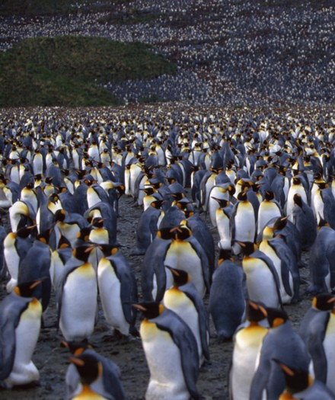
Weaknesses of the articles of confederation
Weaknesses of the Articles of Confederation
Where are we going?
No executive branch

Slide 13
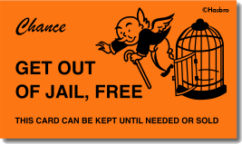
Weaknesses of the Articles of Confederation
No national courts

Slide 14
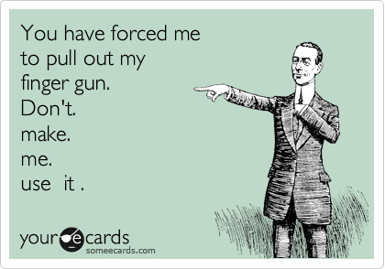
Weaknesses of the Articles of Confederation
No national military

Slide 15
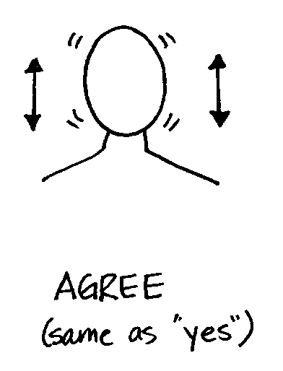
Weaknesses of the Articles of Confederation
Amendment requires unanimous vote of states

Slide 16
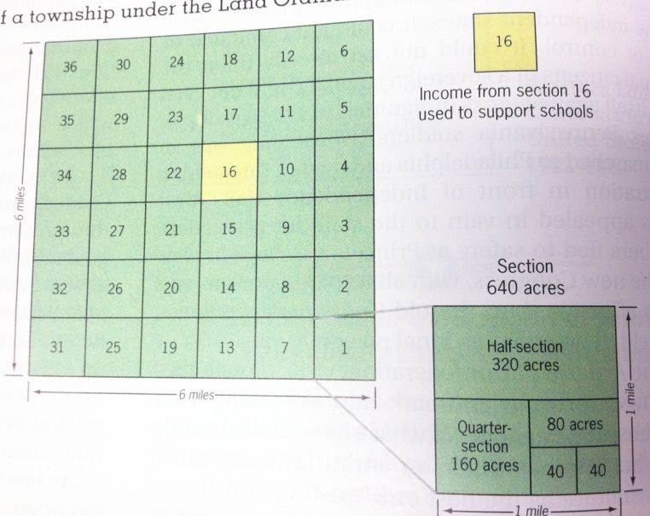
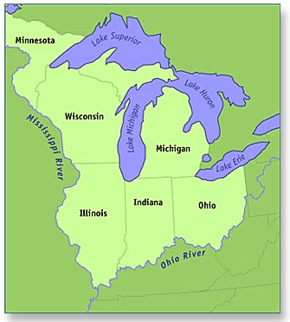
Landmarks in Land Laws
Land Ordinance of 1785: Money from land sold in Ohio R. Valley would help pay off the national debt and provide funds for public education
Land Ordinance of 1787: Determined how territories in the Old Northwest would apply for statehood (still used today!)

Slide 17
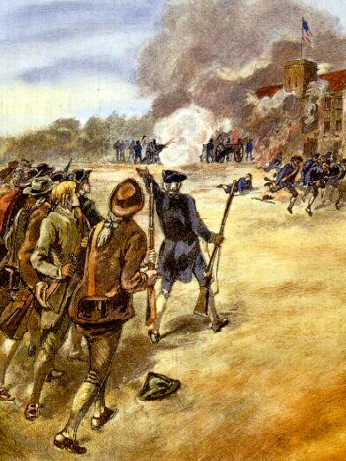
Shays’ Rebellion
Poor backcountry farmers (many of them Revolutionary War veterans) were losing their farms due to high taxes.
  Led by Daniel Shays
  Demanded state issued money, lower taxes, and the suspension of property takeovers
The National government couldn’t stop it, and it had to be put down by the Massachusetts militia.
Showed the weakness of the Articles of Confederation

Slide 18
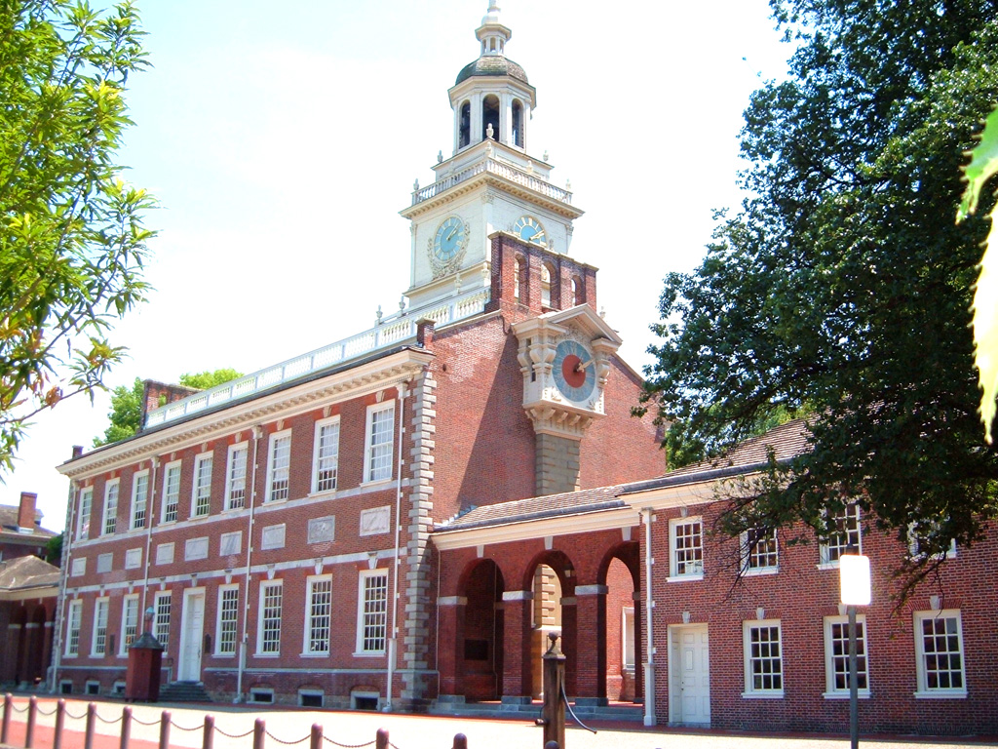
Back to Philly!

Slide 19
Who wasn’t there?
Thomas Jefferson – in France
John Adams – in Great Britain
Thomas Paine – in Europe
Samuel Adams – Not elected
John Hancock – Not elected
Patrick Henry – “smelt a rat in Philadelphia, tending toward the monarchy”
Rhode Island

Slide 20
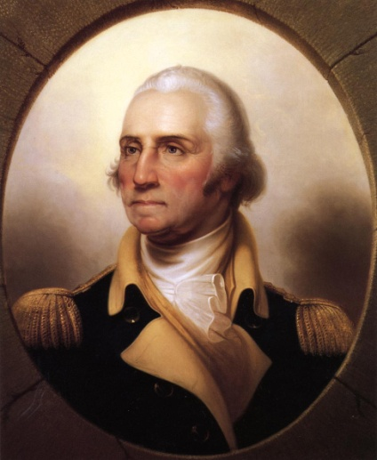
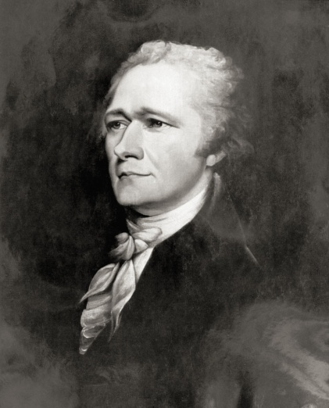
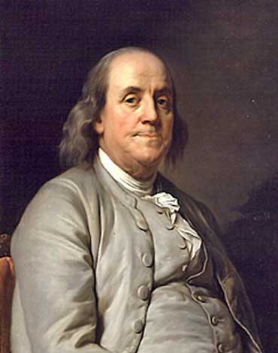
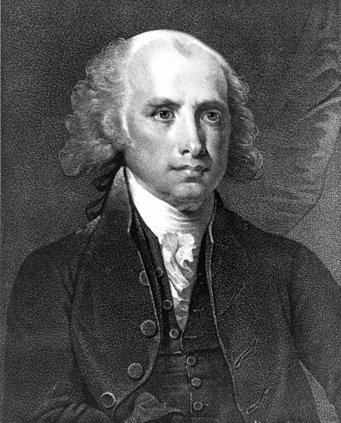
So who is going to fix it?
Thomas Jefferson characterized the delegates as an assembly of "demi-gods."
The goal was to improve the Articles of Confederation
Delegates decided to create a new U.S. Constitution.
  This angered many colonists who felt the delegates had overstepped their bounds, much like King George III.
Notes:
George Washington
Alexander Hamilton
Ben Franklin
James Madison

Slide 21
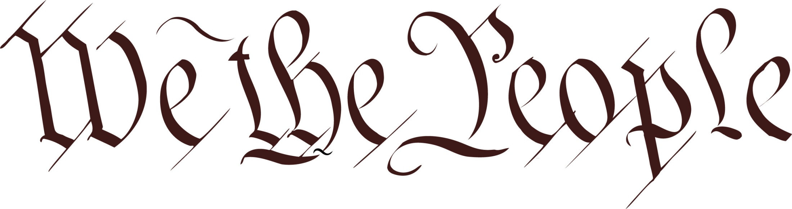
The Three Most Important Words In American History:
of the United States, in Order to form a more perfect Union, establish Justice, insure domestic Tranquility, provide for the common defense, promote the general Welfare, and secure the Blessings of Liberty to ourselves and our Posterity, do ordain and establish this Constitution for the United States of America.

Slide 22
Constitutional Principles
Republican system
  The people elect representatives to speak and vote on their behalf.
Separation of Powers
  Way of dividing power among three branches of government.
Checks and Balances
  Gives each of the three branches of government some degree of oversight and control over the actions of the others.
Federal System
  Plan of government in which power is divided between the national government and the state governments.

Slide 23
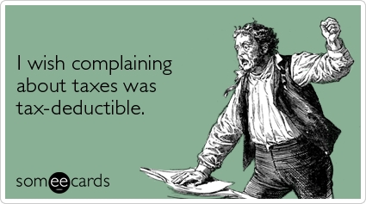
Solving the problems of the AOC
Congress has the power to tax

Slide 24

Solving the problems of the AOC
Congress has the power to enforce treaties

Slide 25
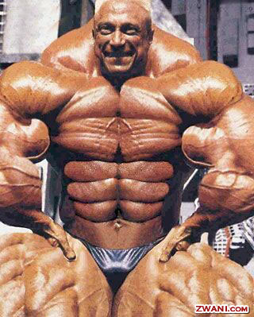
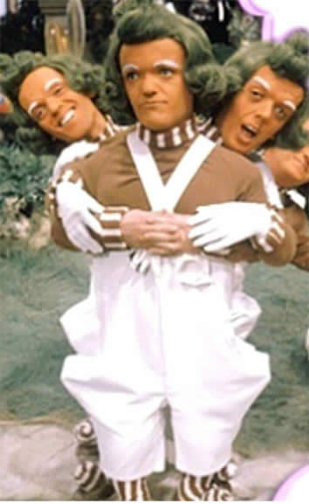
Compromise is the name of the game
The Virginia Plan: gave large states more representation because it was based on population
The New Jersey Plan: gave small states equal representation with large states

Slide 26

The Great Compromise
The Great Compromise resolved the issue with a bicameral (two-house) legislature
An upper house— the Senate —provided for two representatives from each state.
A lower house— the House of Representatives —provided for representation based on state population.
AKA the Connecticut Compromise because it connected both plans.

Slide 27
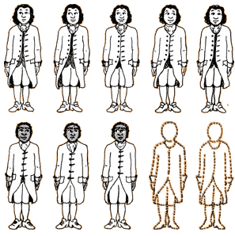
How to count population
Southern states wanted their slaves to count for representation
Northern states stated that as slaves were considered property, the North might as logically demand additional representation based on its horses.
Result: Three-Fifths Compromise
  Representatives and direct Taxes shall be apportioned among the several States which may be included within this Union, according to their respective Numbers, which shall be determined by adding to the whole Number of free Persons, including those bound to Service for a Term of Years, and excluding Indians not taxed, three fifths of all other Persons.

Slide 28
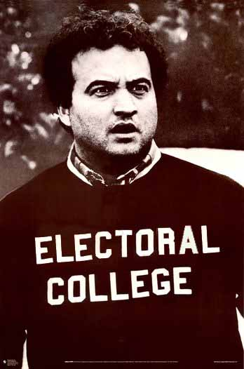
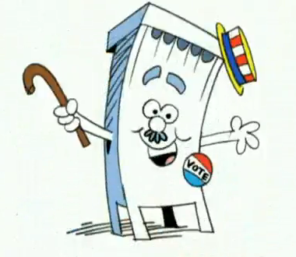
The Electoral College
Another compromise was the method of electing the president indirectly using the electoral college, rather than by direct means.

Slide 29
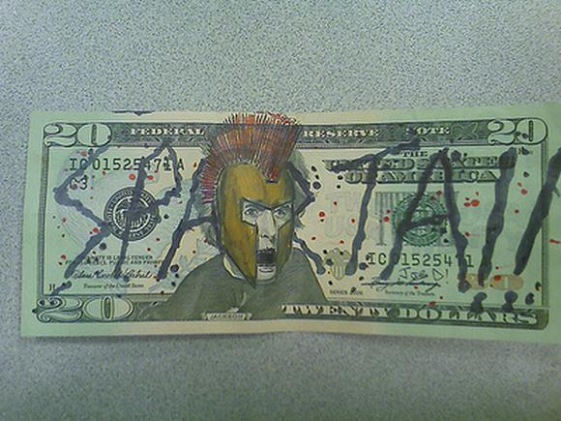
Solving the problems of the AOC
Congress has the power to regulate commerce

Slide 30
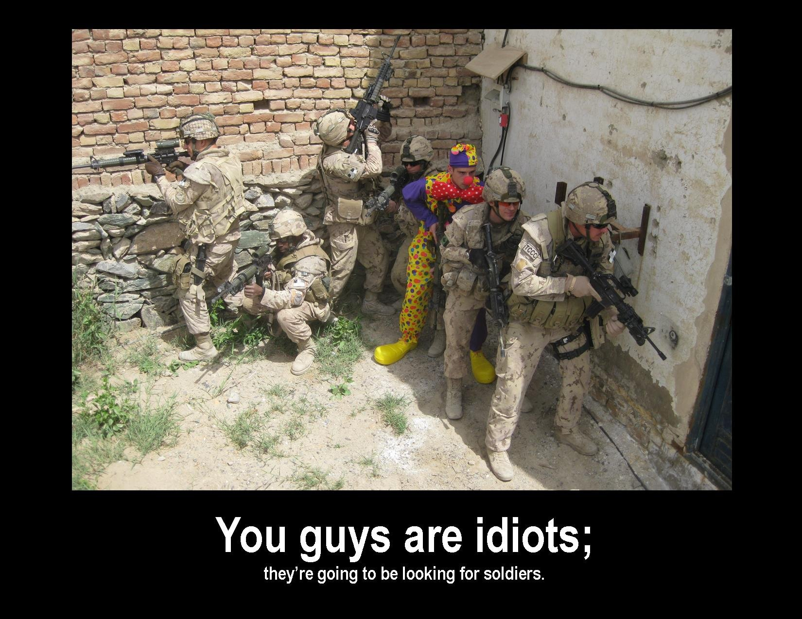
Solving the problems of the AOC
Congress may raise a national military

Slide 31
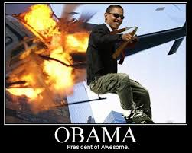
Solving the problems of the AOC
Has an Executive Branch with a President as its leader

Slide 32
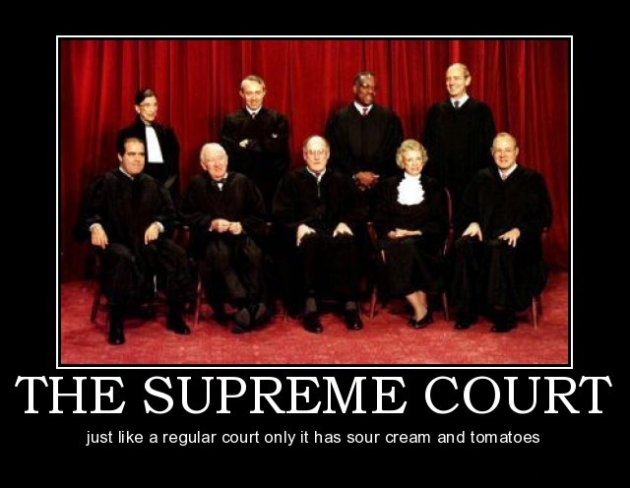
Solving the problems of the AOC
National court system created with the Supreme Court at the top

Slide 33
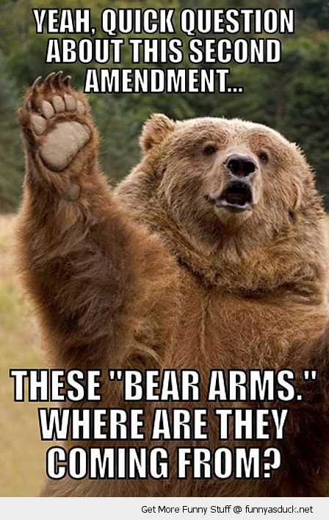
Solving the problems of the AOC
Amendments pass with 2/3 vote of Congress and ¾ of states

Slide 34
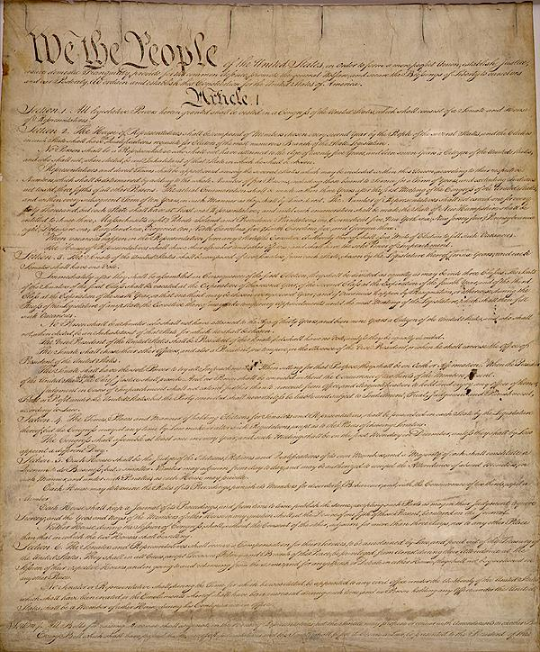
The Brilliance of the Constitution

Slide 35
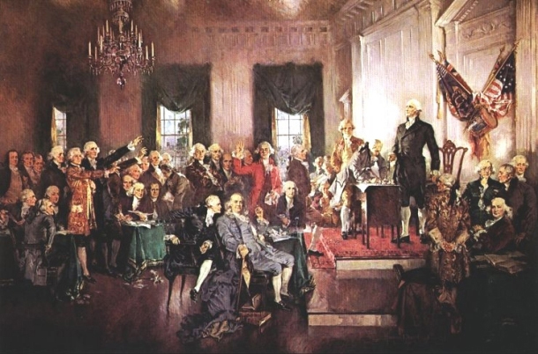
Ratification
Before the Constitution could be considered official, it had to be ratified by conventions of nine states.
An intense debate between federalists and anti-federalists emerged, almost dooming the newborn document.

Slide 36
Next on Iron Chef America - Battle: Ratification
Federalists
Anti-Federalists
Support ratification
George Washington, Benjamin Franklin, Alexander Hamilton
Favored a strong central government
Leaders should be rich, well-born, and able (as most supporters were)
Do not support ratification
Patrick Henry, Samuel Adams, Richard Henry Lee
Favored a loose central government, more state’s rights.
Mostly states rights devotees, backcountry dwellers, and one horse farmers (poorest classes)

Slide 37
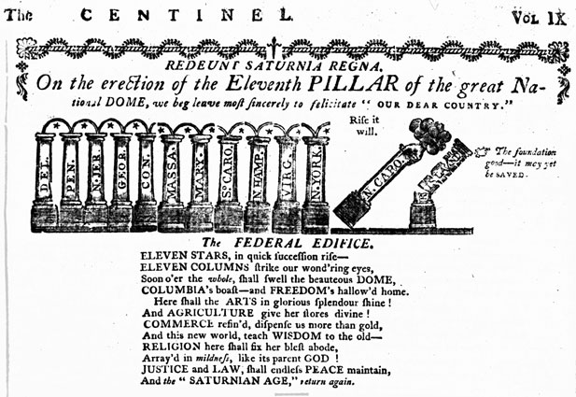
What do the pillars represent? Why are N. Carolina and R. Island shown in their current state? How does the cartoon show they can still be “saved”?

Slide 38
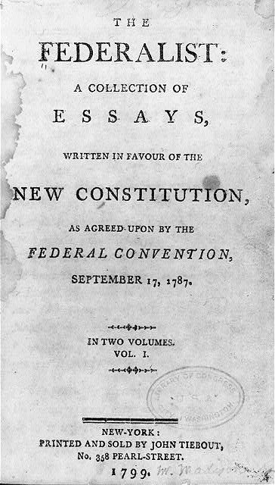
Federalist Papers
A series of 85 articles or essays advocating the ratification of the United States Constitution
The authors of The Federalist wanted both to influence the vote in favor of ratification and to shape future interpretations of the Constitution.
The authors used the pseudonym "Publius"

Slide 39
The Bill of Rights
Amendment I
Congress shall make no law respecting an establishment of religion, or prohibiting the free exercise thereof; or abridging the freedom of speech, or of the press; or the right of the people peaceably to assemble, and to petition the Government for a redress of grievances.
Amendment II
A well regulated Militia, being necessary to the security of a free State, the right of the people to keep and bear Arms, shall not be infringed.
Amendment III
No Soldier shall, in time of peace be quartered in any house, without the consent of the Owner, nor in time of war, but in a manner to be prescribed by law.
Amendment IV
The right of the people to be secure in their persons, houses, papers, and effects, against unreasonable searches and seizures, shall not be violated, and no Warrants shall issue, but upon probable cause, supported by Oath or affirmation, and particularly describing the place to be searched, and the persons or things to be seized.
Amendment V
No person shall be held to answer for a capital, or otherwise infamous crime, unless on a presentment or indictment of a Grand Jury, except in cases arising in the land or naval forces, or in the Militia, when in actual service in time of War or public danger; nor shall any person be subject for the same offence to be twice put in jeopardy of life or limb; nor shall be compelled in any criminal case to be a witness against himself, nor be deprived of life, liberty, or property, without due process of law; nor shall private property be taken for public use, without just compensation.
Amendment VI
In all criminal prosecutions, the accused shall enjoy the right to a speedy and public trial, by an impartial jury of the State and district wherein the crime shall have been committed, which district shall have been previously ascertained by law, and to be informed of the nature and cause of the accusation; to be confronted with the witnesses against him; to have compulsory process for obtaining witnesses in his favor, and to have the Assistance of Counsel for his defense.
Amendment VII
In Suits at common law, where the value in controversy shall exceed twenty dollars, the right of trial by jury shall be preserved, and no fact tried by a jury, shall be otherwise re-examined in any Court of the United States, than according to the rules of the common law.
Amendment VIII
Excessive bail shall not be required, nor excessive fines imposed, nor cruel and unusual punishments inflicted.
Amendment IX
The enumeration in the Constitution, of certain rights, shall not be construed to deny or disparage others retained by the people.
Amendment X
The powers not delegated to the United States by the Constitution, nor prohibited by it to the States, are reserved to the States respectively, or to the people.

Slide 40

What does it all mean????
RAPPS!
Right to own guns
Quartering of soldiers
Search and seizure: PRIVACY
Self-incrimination and double jeopardy
Rights of the accused
Trial by jury
Cruel or unusual punishment
Not all rights are listed
States rights

Slide 41
ACTION
1. A police officer walking down the street decides to search a home.
2. A president up for re-election orders that no opponent’s signs can be placed in yards.
3. A man is arrested on suspicion of stealing a car and jailed for three years.
4. A woman is accused of murder. During the trial her lawyer is forbidden to question any of her accusers or see any evidence.
5. A man makes a speech critical of a senator and the next day a law is passed making criticism of federal officials a crime. The man is arrested and convicted of breaking that law.
6. A man is found “not guilty” in a criminal trial of killing a judge. The next day he is arrested to face another trial for the same charge.
7. A man is arrested for littering and the judge, who is a longtime enemy, will not release him until he can post $1 million bail.
8. All members of a church are arrested and accused of being enemies of the state. They refuse to swear an oath of allegiance to the U.S. because such an oath violates their religious beliefs.
9. A man is arrested for using a handgun to threaten a burglar who broke into his home.
10. Due to cutbacks, soldiers are now being housed in civilian’s homes, rather than in overcrowded barracks.

