Slide 1
Bell Ringer
“It is dangerous to be right when the government is wrong.”
Explain this quote in your own words.

Slide 2
The American Revolution
Seceding from the Empire

Slide 3
Philosophical Stirrings
The Ideas that Shaped the Revolution

Slide 4
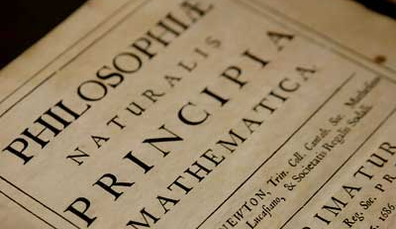
The Enlightenment
The Enlightenment was a cultural movement of intellectuals in 18th century Europe and the United States, whose purpose was to reform society and advance knowledge through reason and logic.

Slide 5
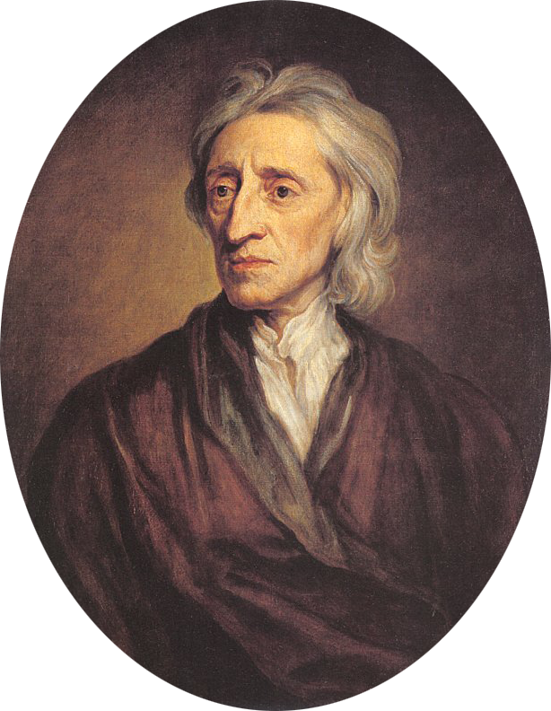

Locke
Humans are all born free and equal, with three natural rights: life, liberty, and property.

Slide 6
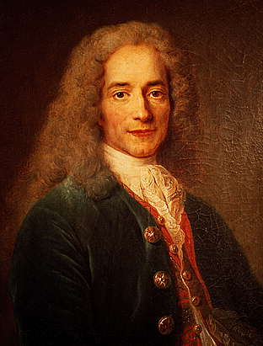

Voltaire
“I may not agree with a thing you say, but I will defend to the death your right to say it.”
Man’s right to freedom of religion and speech must be protected, oui?

Slide 7
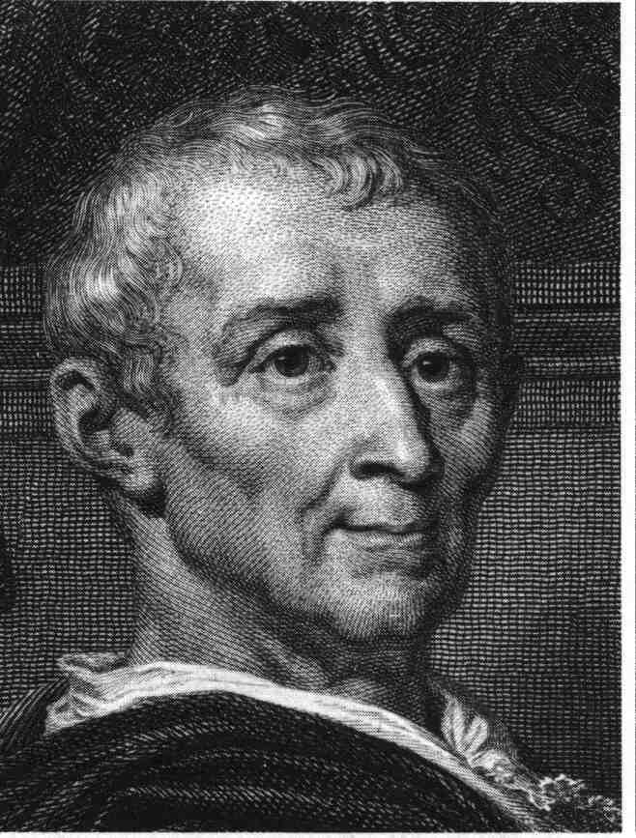
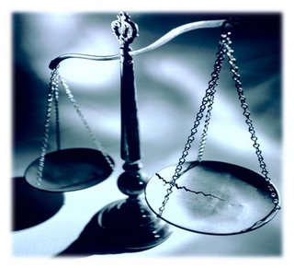
Montesquieu
Power should not be held by one man alone, but separated amongst several branches. Power should be a check to power.

Slide 8
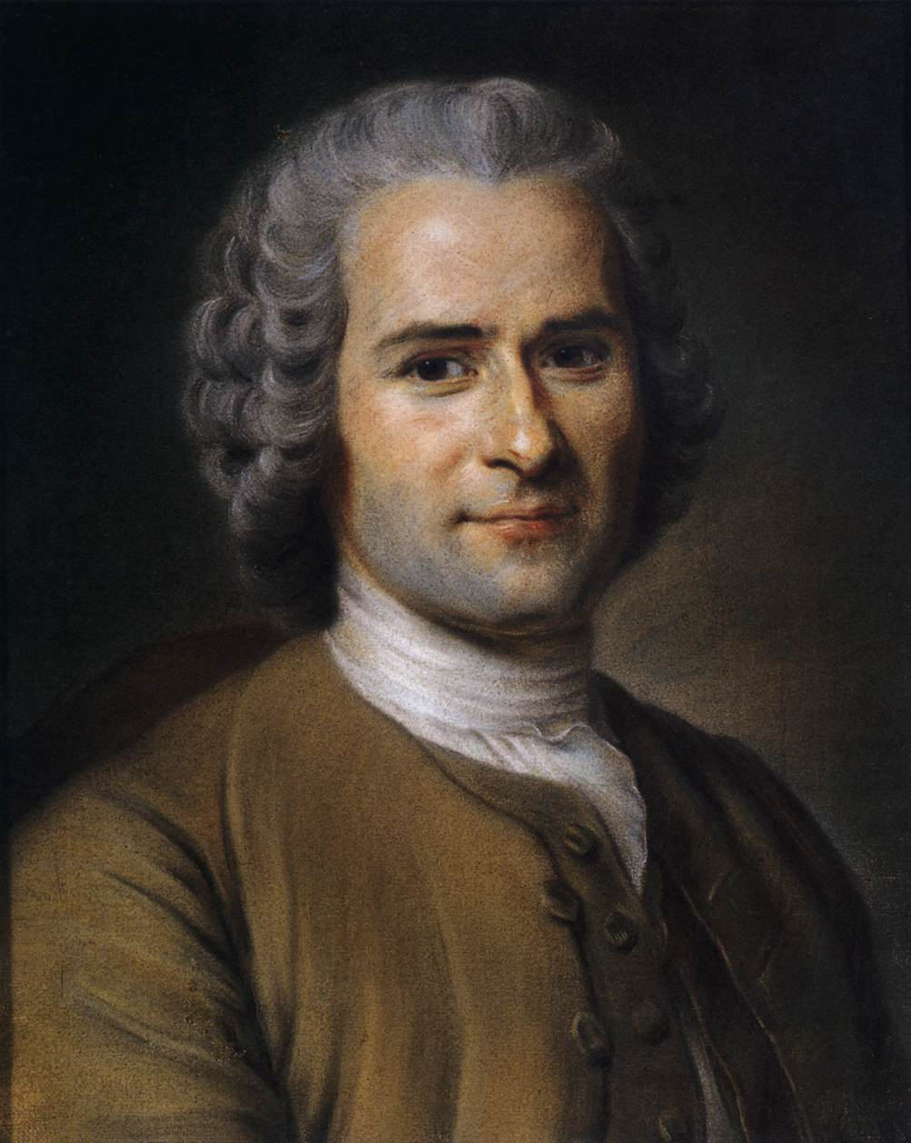
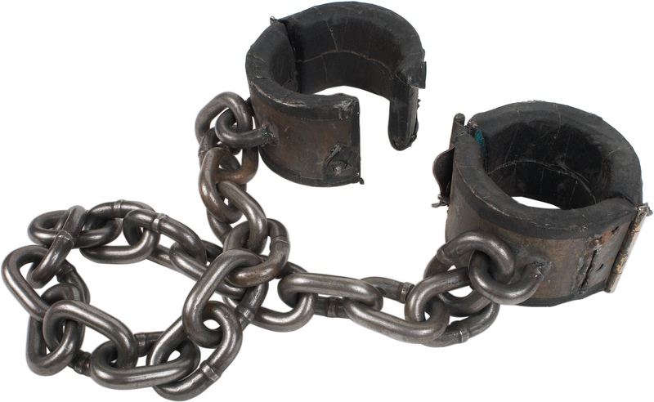
Rousseau
Man is born free, and everywhere he is in chains. The sovereignty of the people is essential to the creation of a just government.

Slide 9
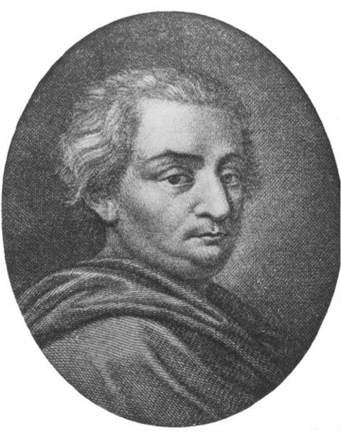
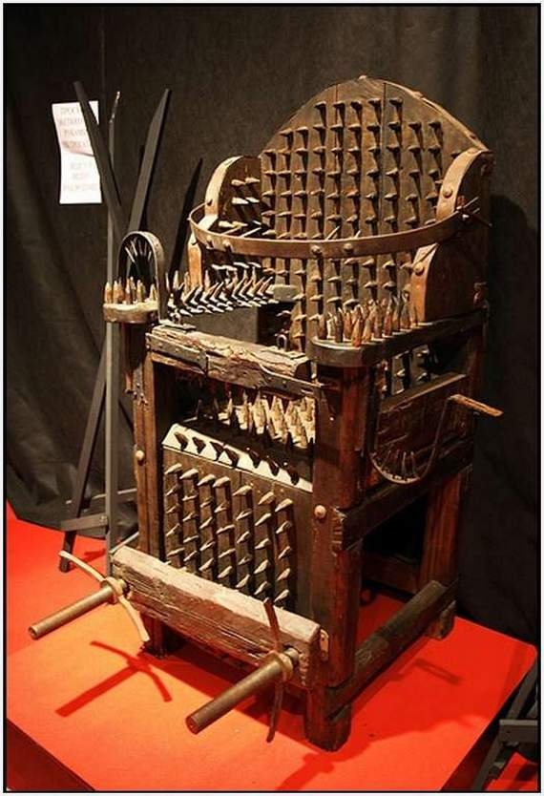
Beccaria
Just because you have been accused of a crime does not mean you shouldn’t be treated humanely. Torture should never be used. You should have a speedy trial and your punishment should fit the crime.

Slide 10
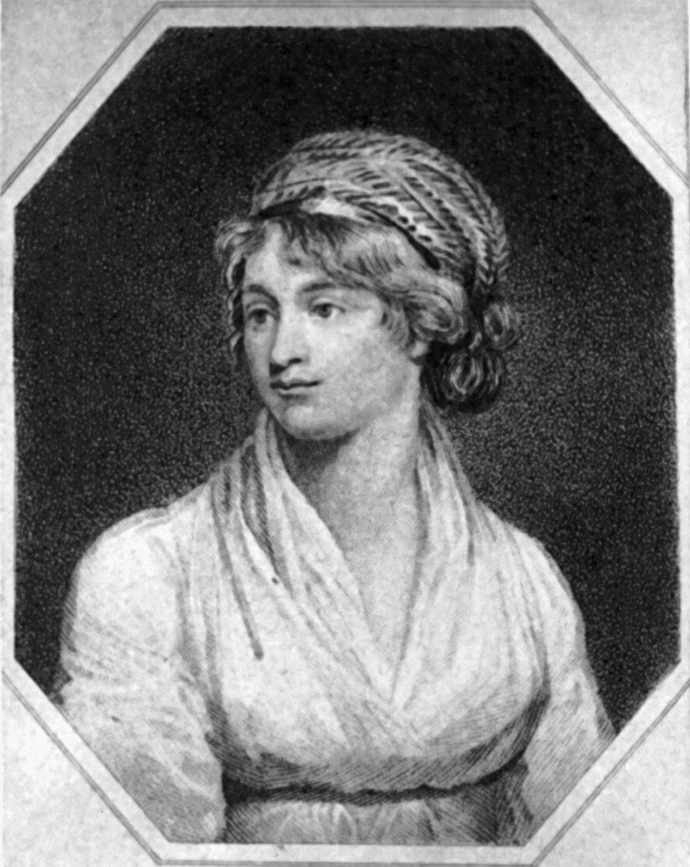

Wollstonecraft
If all men are born free, how is it that all women are born slaves?
Welcome to Stepford!

Slide 11
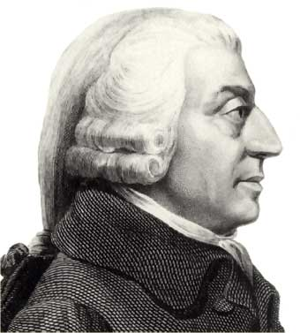
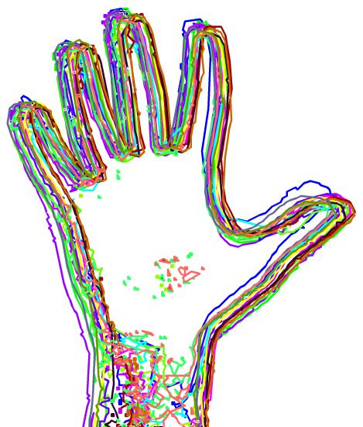
Smith
If humans freely follow their own self interest, government will be guided by an invisible hand. This is laissez faire.

Slide 12
The Road to Revolution

Slide 13
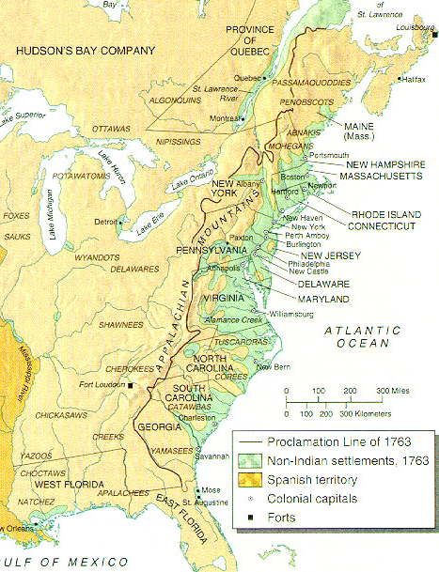
Proclamation of 1763
Prohibited colonists from moving west of the Appalachians; only intended to be temporary
  British aim: Protect colonists from Indian attacks
  Colonists’ view: infuriated; saw the law as being permanent.
Colonists generally ignored the Proclamation

Slide 14
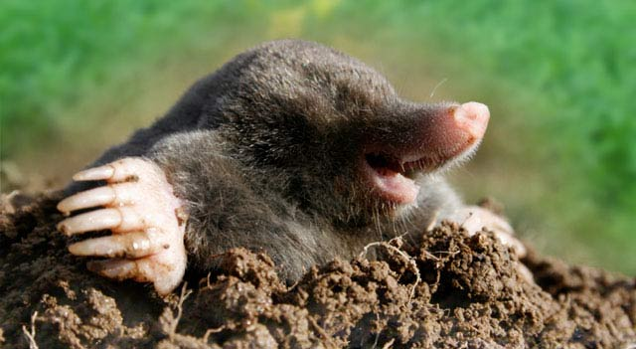

War and Money
Mercantilism: Colonies existed for the benefit of the mother country
  Act as both suppliers and consumers for the empire.
  Navigation Acts: Restricted commerce to and from the colonies to English or American vessels
  Molasses Act: imposed heavy duties on all molasses, rum, and sugar imported from the French Caribbean.
Salutary neglect: An unofficial British policy of avoiding enforcement of navigation laws to promote American business.
Writs of Assistance: Gave customs agents permission to search American vessels for smuggled goods
Hey guys, these taxes are no fun!

Slide 15
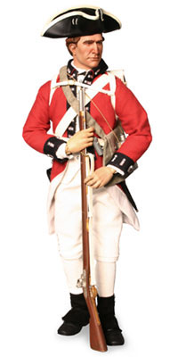

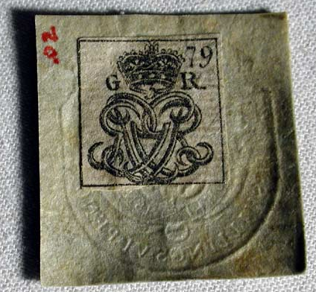



The Acts that Broke the Camel’s Back
Proclamation of 1763
Sugar Act
Stamp Act
  Declaratory Act
Intolerable Acts
  Boston Port Act
  Quartering Act
  Quebec Act
Townshend Acts
  Letters from a Farmer in Pennsylvania
  MA Circular Letter
Tea Act

Slide 16
America’s Separation Issues
Colonists felt physically separated from England
  Led to support of republicanism
Colonists felt economically separated
  Colonial money not accepted for taxes
  Felt used under mercantilism (salutary neglect)
Colonists felt philosophically separated
  Support of Enlightenment ideas

Slide 17
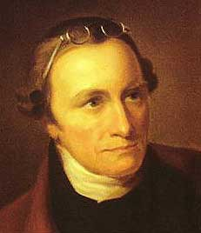
Virginia Resolves
PH introduces the VA Resolves in the HoB
  Rejected the Stamp Act because the colonists were not fully represented in Parliament
Stamp Act Congress
  First intercolonial conference; only 9 show up
  “No taxation without representation!”
British PM claimed colonists had “virtual representation”
Patrick Henry
“If this be treason, make the most of it!”

Slide 18
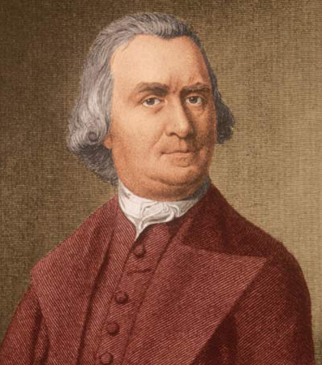
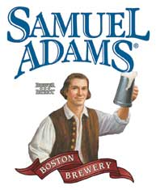
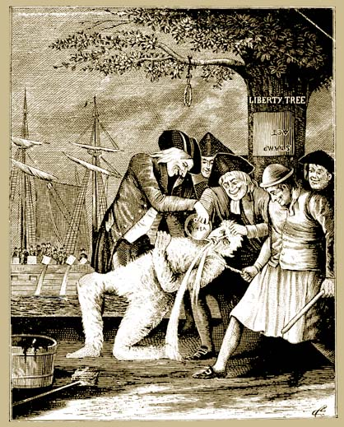
Sons of Liberty
Led by Samuel Adams
Violently enforced boycotts of British goods
  Tar and feathering
Caused all local Stamp Act agents to resign

Slide 19
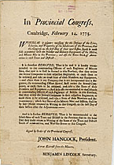
Revolutionary Twitter
Massachusetts Circular Letter: Created by S. Adams; written in response to the Townshend Acts; sent to other colonial legislatures to organize resistance
Committees of Correspondence: A letter-writing network in MA created to organize resistance between colonies
Acted as colonial governing groups, ignoring or overriding the rulings of colonial legislatures
Grew into the first American congresses (would send the delegates to Continental Conventions)

Slide 20
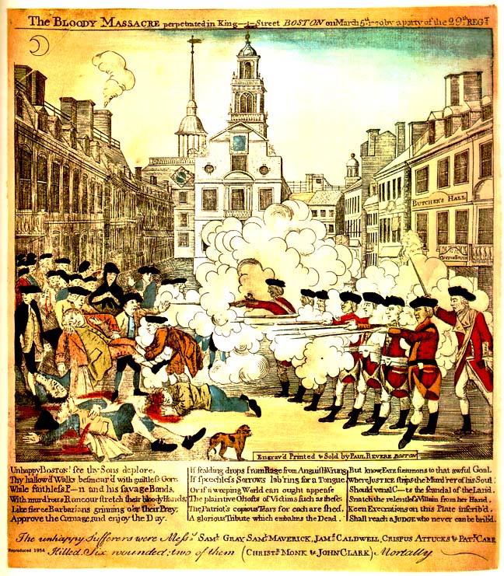
Boston
Massacre
What’s wrong with this picture?

Slide 21
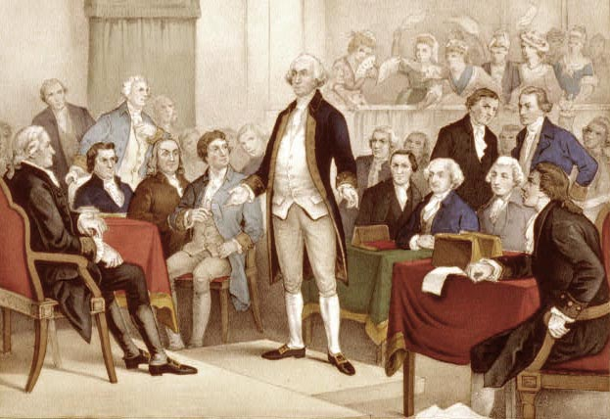
First Continental Congress (1774)
Philadelphia; 12 colonies present (GA absent)
Did NOT desire independence
Declaration of Rights and Grievances: Raised fourteen points of colonial protest.
  Only the colonial assemblies had a right to tax the colonies. (no taxation without representation).
  Trial by jury was a right, and the use of Admiralty Courts was abusive.
  Colonists possessed all the Rights of Englishmen.
  Without voting rights, Parliament could not represent the colonists.

Slide 22
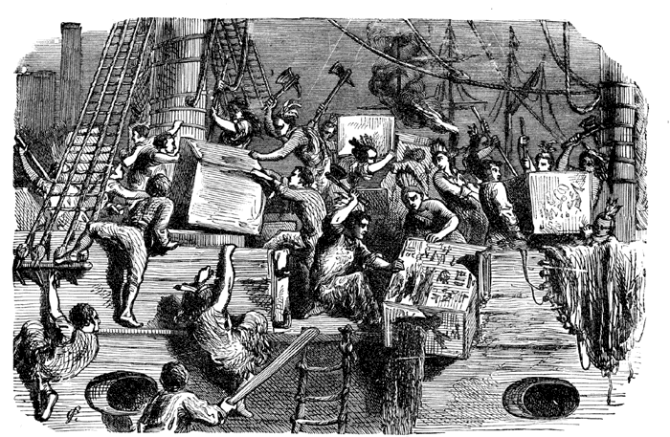
Boston Tea Party

Slide 23
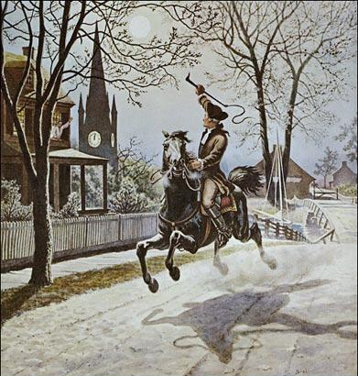
The Ride of Paul Revere…. Sorta.
Listen my children and you shall hear
Of the midnight ride of Paul Revere,
On the eighteenth of April, in Seventy-five;
Hardly a man is now alive
Who remembers that famous day and year.
He said to his friend, "If the British march
By land or sea from the town to-night,
Hang a lantern aloft in the belfry arch
Of the North Church tower as a signal light,
One if by land, and two if by sea;
And I on the opposite shore will be,
Ready to ride and spread the alarm
Through every Middlesex village and farm,
For the country folk to be up and to arm.“
-- Henry Wadsworth Longfellow
Paul Revere,
William Dawes, &
Dr. Samuel Prescott

