Slide 1
The Colonies Before War

Slide 2
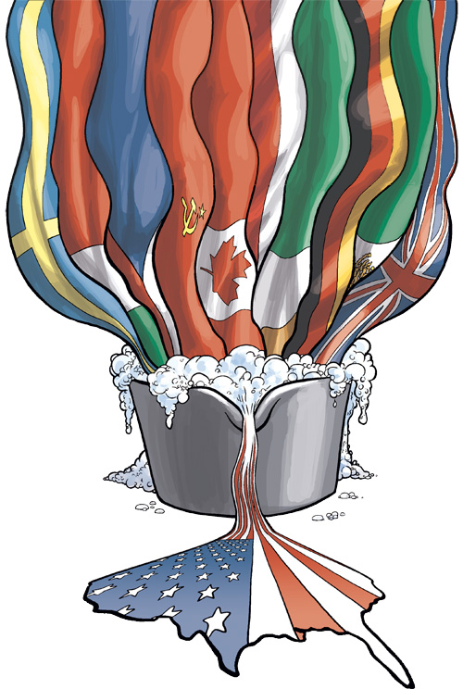
Characteristics of 18th Century Colonial America
Enormous population growth
  Higher mortality rate, increase in immigrants
  Largest colonies: VA, MA, PN, NC, MD
The American melting pot
  66% English, 20% African
  Remaining: Scots Irish, German, Dutch, Irish, French, Welsh, Jews

Slide 3
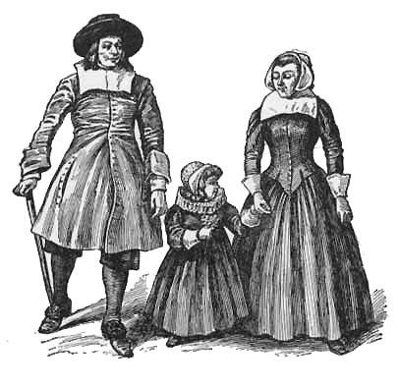
Colonial Lifestyle
Traditional family roles
Colonial Occupations
  Clergy most respected
  Agriculture most common
  Politics growing as an occupation
Highest standard of living
  Generally lower mortality rates than Europe
  Land was cheap, although less available in southern plantation system
  Wages were about three times that of Europe

Slide 4
Class Struggle
Structure of Colonial Society
Stratification mild compared to Europe
  Small upper class
  Most were yeoman farmers
  Small merchants, laborers
  Indentured servants and jailbirds
  Slaves
Frontier
  Few class distinctions
  Those with upper-class pretensions were resented
Attempt to recreate European stratification failed
  Emerging middle class
  Democratic traditions protected against complete upper class control

Slide 5
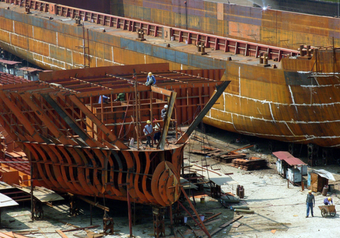



Colonial Economy
Land Speculation – Made many investors wealthy
Manufacturing
  Small industries
  Lumbering most important: shipbuilding
  Cottage industry
Trade
  High demand for British goods
  Once British demand for American products peaked Americans sought other markets
Transportation
  Inland transportation poor by road
  Waterways most important: Population located near rivers

Slide 6
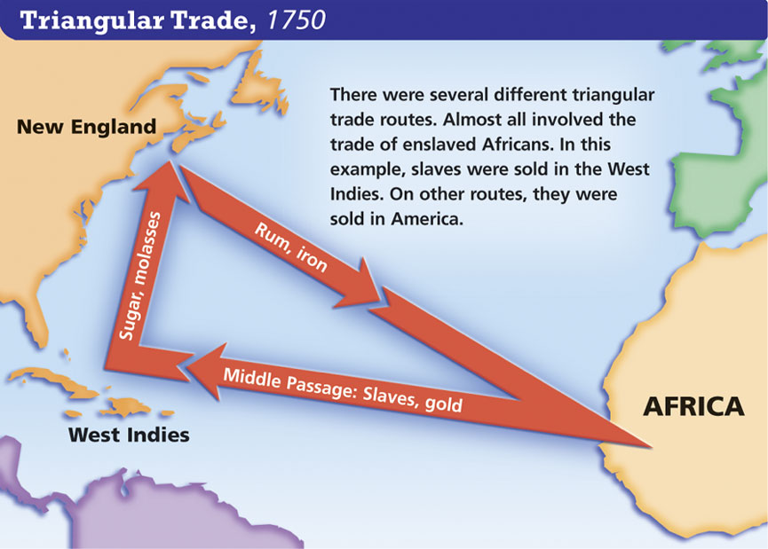
The Triangular Trade that emerged in the mid-eighteenth century was not designed with the same purpose as the century before. This new triangle was used by colonists to circumvent the Navigation Acts passed by Great Britain in the 1680s.

Slide 7
Colonial Religion
Most common religions
  Anglican Church: Official faith in several colonies
  Congregational Church
  Presbyterian Church
  Quakers
  Jews
Religious toleration
  Toleration came about in large part due to non-church members.
  Eventually led to separation of church and state (except for New England)

Slide 8
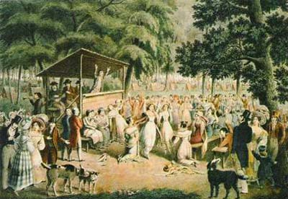
The 1st Great Awakening
The Great Awakening was a spiritual revival that swept the colonies in the 1730s and 1740s.
Led by powerful “New Light” preachers
Appealed to emotion, encouraged introspection, and commitment to personal morality

Slide 9
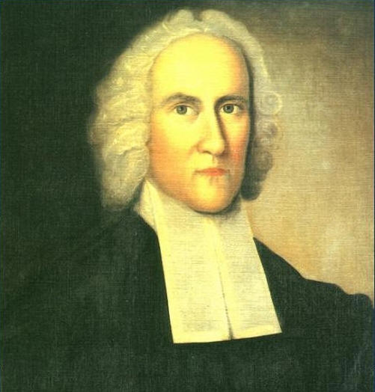
The Great Awakening
Jonathan Edwards
  Most influential theological writer and thinker of the movement
  Blasted the idea of salvation through good works; dependence on God's grace is paramount
  Emphasized eternal damnation (“fire and brimstone” sermons)
  “Sinners In the Hands of an Angry God”

Slide 10
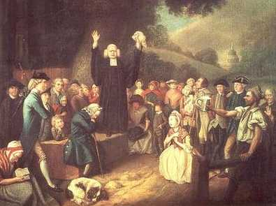
The Great Awakening
First mass social movement in American History
Mainly in Middle/Southern colonies
Reaction to the elaborate theological doctrines and emotional stagnation of established churches
Results
  Created schisms and new denominations (e.g. Baptist, Methodist, Congregationalist, etc.)
  Brought religion to many who had lost touch with it
  Undermined the older clergy
  Encouraged a new wave of missionary work among the Indians and slaves
New vs. Old Light
Old Lights: Orthodox clergymen deeply skeptical of emotionalism and theatrical antics of the revivalists.
New Lights: Supported the Awakening for revitalizing American religion and used emotionalism to move followers.

Slide 11
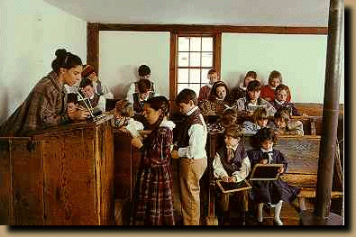
Education
New England
  Strongest; for Bible Reading
  Primary and secondary schools established early
  Communities of 50 families or more required to build public schools
Middle
  Some public education
  Many well-to-do families sent their sons to colleges in England
South
  Privileged; hired tutors to teach their children
  Plantation living made cities, schools, and churches spread out
College
  Primary focus on the training of new clergy, not academics
  Eventually move towards secular subjects

Slide 12
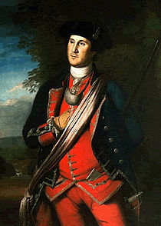
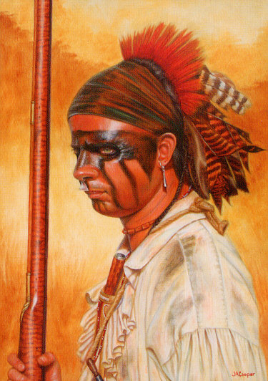
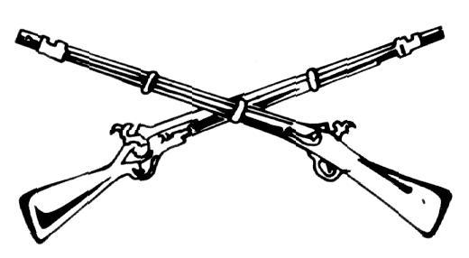
The French and Indian War
1754-1763

Slide 13



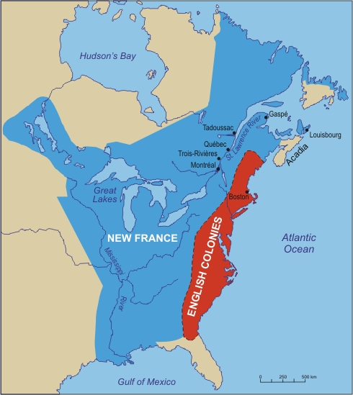
A Clash of Empires
Wars originated in Europe and spilled over to the New World
Conflict over settlement of the Ohio River Valley
  Expansion of British settlement
  Fertile land
  Access to Mississippi River and Great Lakes

Slide 14
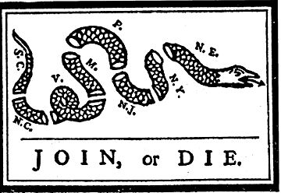
Albany Plan of Union
Albany Congress: Nine colonies met to discuss defense and Indian affairs
Albany Plan: First plan to create a unified government in the colonies
  Drafted by Benjamin Franklin
  The colonial governments were to select members of a ‘Grand Council,’ while the British Government would appoint a ‘president General.’
  Adopted by delegates. Individual colonies rejected it: not enough independence. British rejected it: too much independence
The First American
Political Cartoon
Drawn and published by Benjamin Franklin

Slide 15
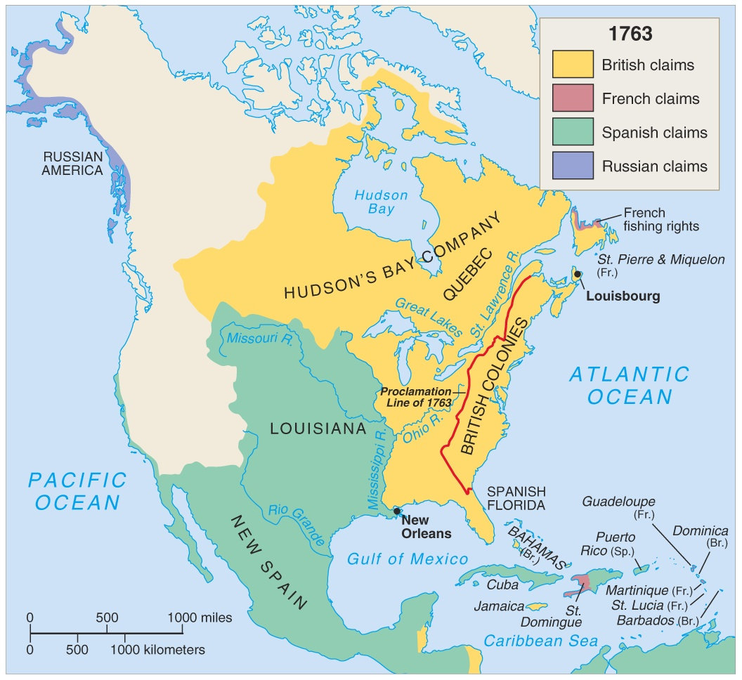
North America in 1753

Slide 16
Effects of the War
Britain
Colonies
It increased her colonial empire in the Americas
It greatly enlarged England’s debt
Britain’s contempt for the ungrateful colonials created bitter feelings
United them under a common enemy for the first time
It created bitter feelings towards the pompous British that would only intensify
No longer could avoid British taxes

Slide 17
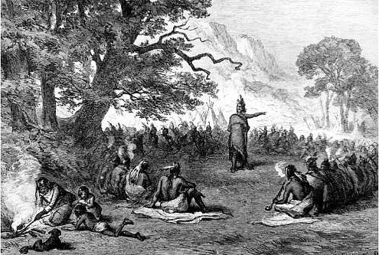
Tensions Along the Frontier:
Pontiac’s Rebellion
Chief Pontiac, Ottawa chief, refused to surrender his lands to the British
Led an Indian alliance against whites in the Ohio Valley & Great Lakes region in 1763
British retaliated with germ warfare: blankets infected with smallpox distributed among the Amerindians (sound familiar?)
Rebellion subdued in October, 1763

Slide 18
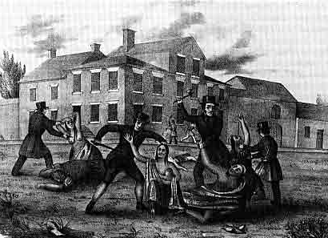
The Paxton Boys
Scots-Irish in E. Penn weary of the colonial assembly’s inattention to their vulnerability to Indian attack
Requests for soldiers, guns, etc. were ignored by the legislators, many of whom were Quakers
A group of Paxton men raided local tribes (even those at peace)
Tribes placed under protection of the gov’t.
Paxton Boys march on Philadelphia; meeting between Paxton leaders and colonial officials set up by Benjamin Franklin

Slide 19
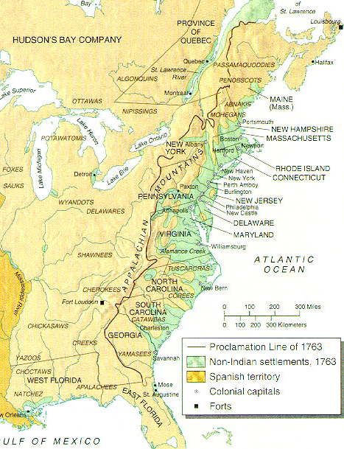
British Backlash!
Proclamation of 1763
  Reaction to Pontiac’s Rebellion
  Prohibited colonists to move west of the Appalachians; only intended to be temporary
British aim: Protect colonists from Indian attacks
Colonists’ view: Infuriated; felt they were being denied their spoils
Colonials generally ignored the Proclamation

Slide 20
LEQ Intro Paragraph Practice
How should you categorize your when presented with the following essay prompt?:
Evaluate the extent to which the Seven Years’ War (French and Indian War), 1754-1763) marked a turning point in American relations with Great Britain.
Analyze what changed and what stayed the same from the period before the war to the period after it. (Historical Thinking Skill: Periodization)
Context (3 sentences)- Describe what was happening before AND after the timeframe provided (1754-1763)?
Thesis statement (2)- A.P. – Answer the prompt. The French and Indian War marked a _________ turning point in American relations with Great Britain BECAUSE (BASD) – (Before/After/Similar/Different)

