Slide 1
Colonial Society in the 18th Century
Creating the American Spirit

Slide 2
Life in the chesapeake

Slide 3
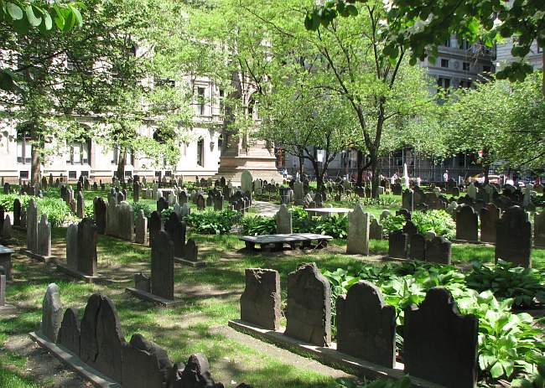
Population
Life expectancy: 10 years less than England; 50% not living past 20 y/o
Most immigrants young, single men; women extremely scarce
Stabilized with the increase in female settlers and increased immunities to diseases.

Slide 4
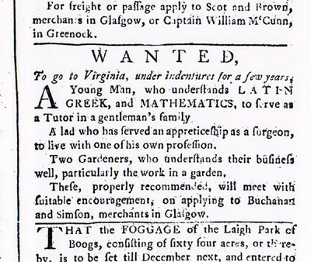
Headright System
Headright System: Got 50 acres for each person whose passage they paid (VA)
Indentured servants agreed to years of 4-7 years labor in exchange for transatlantic passage
Promised “freedom dues” [land, money]
1610-1614: 1:10 outlived their contracts
Leads to large numbers of young, poor, unhappy men with little access to land or women for marriage.
England’s overpopulation led to high unemployment. There was a labor shortage in the colonies. The problem? No money to immigrate!

Slide 5
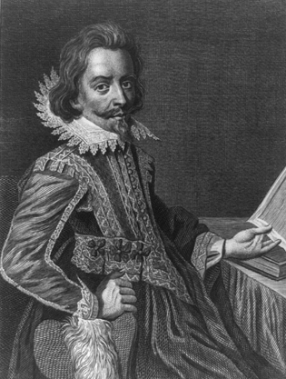
Bacon’s Rebellion
VA HoB disenfranchised most landless men in 1670
Nathaniel Bacon led landless former indentured servants in violent attacks against local tribes for their land
VA Governor William Berkeley ordered Bacon and his men to stop, and refused to retaliate for previous Indian attacks on white settlers.
Bacon’s men turn on the governor
Rebels resented Berkeley’s close relations with Indians.
Burn Jamestown
Ends when Bacon suddenly dies of fever.
Berkeley brutally crushed the rebellion and hanged 23 rebels.
The Powhatans lost their remaining lands

Slide 6
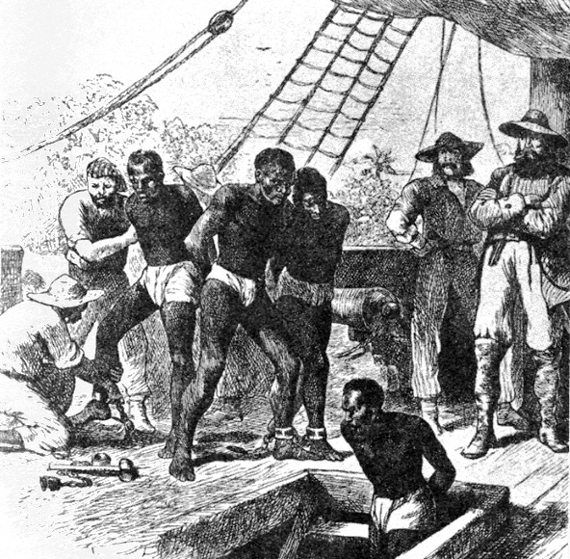
Effects of the Rebellion
Exposed resentments between inland frontiersmen/landless former servants against gentry on coastal plantations.
Socio-economic class differences/clashes would continue throughout American history.
Upper class planters searched for laborers less likely to rebel → BLACK SLAVES!!

Slide 7
The Triangular Trade, Part 1

Slide 8
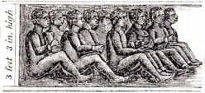
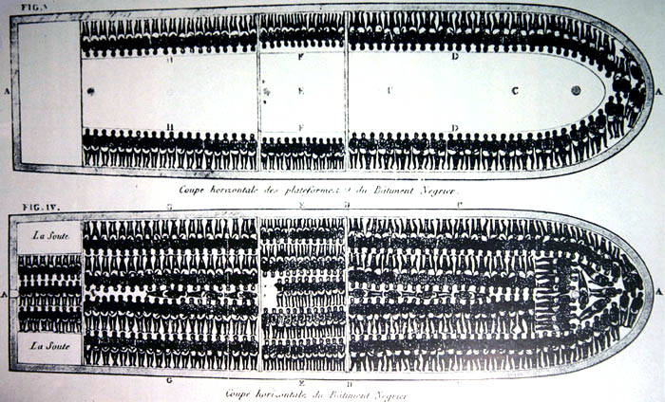
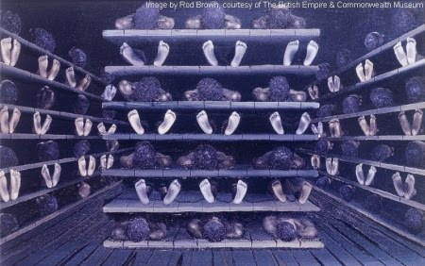
The “Middle Passage”

Slide 9
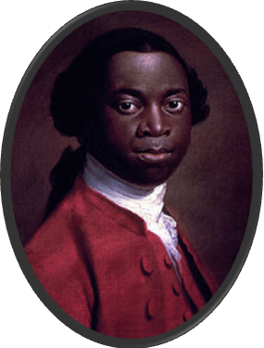
Roots of Slavery
First Africans arrived in Jamestown in 1619.
Unclear status
Slavery unimportant until the end of 17c.
As the number of slaves increased, white colonists reacted to put down perceived racial threat.
Slavery transformed from economic to racial institution.
By the mid-1680s, black slaves outnumbered white indentured servants.
Olaudah Equiano

Slide 10
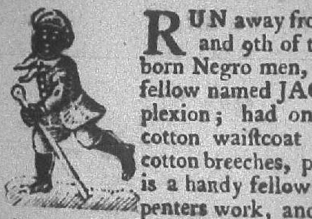
Roots of Slavery
Beginning in 1662 → “Slave Codes”
Made blacks [and their children] property, or chattel for life of white masters.
In some colonies, it was a crime to teach a slave to read or write.
Conversion to Christianity did not qualify the slave for freedom.

Slide 11
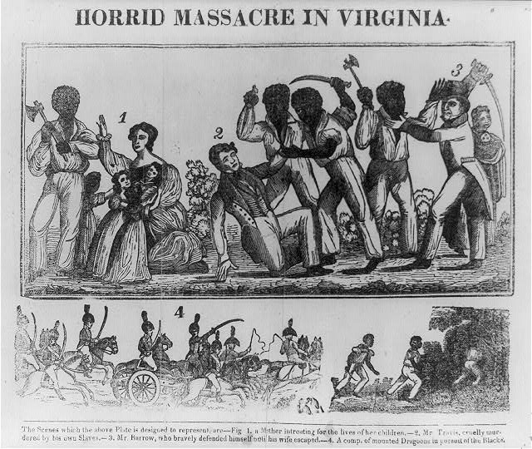
Stono Rebellion (AKA: Cato's Conspiracy ), 1739
Largest slave revolt in colonial American history
Jemmy (AKA: Cato), led 20 slaves in an armed march to freedom in Spanish Florida
Killed 22–25 whites before being intercepted by a South Carolina militia.
Rebellion was suppressed.
South Carolina passes the Negro Act of 1740
Restricts slave assembly, education and movement

Slide 12
Life in New England

Slide 13
The Half-Way Covenant, 1662
Puritan leaders worried religious passion was dying down
“jeremiads” (stern, old-fashioned scolding) used to corral “wandering souls”
Half-way Covenant: Eased qualifications for joining the church
Full membership = Needed an account of a conversion experience; could be baptized
Partial membership = For children and grandchildren of church members; could partake in the Lord's supper, only children of members could be baptized

Slide 14
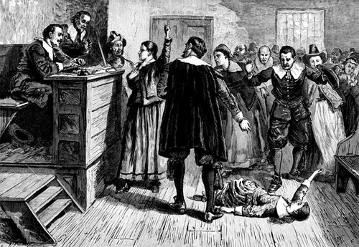
Salem Witch Trials
In 1692, a few girls claimed to have been bewitched by a Caribbean woman practicing voodoo.
Names were named, rumors spread, and innocent people were accused of being witches. Hysteria took hold and twenty people were executed.
By 1693, the Salem residents saw the recklessness for what it was and called it off.

Slide 15
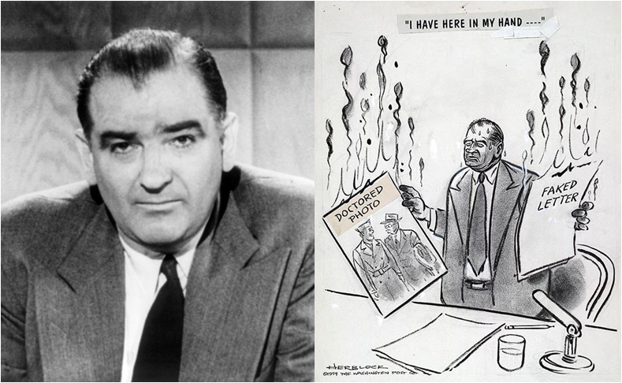
America’s Witch Hunts

Slide 16
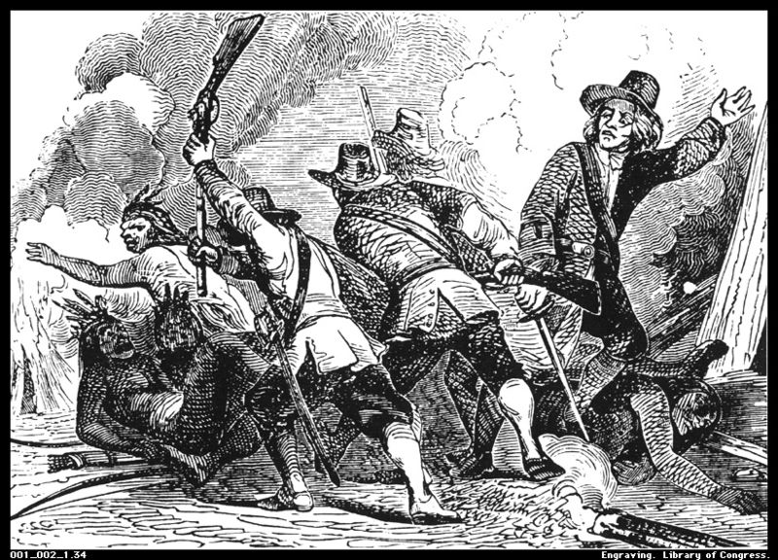
The Pequot Wars: 1636-1637
Pequots → very powerful tribe in CT river valley.
Pequot War (1637)
Whites, with Narragansett Indian allies, attacked Pequot village on Mystic River.
Whites set fire to homes & shot fleeing survivors!
Pequot tribe virtually annihilated→ an uneasy peace lasted for 40 years.

Slide 17
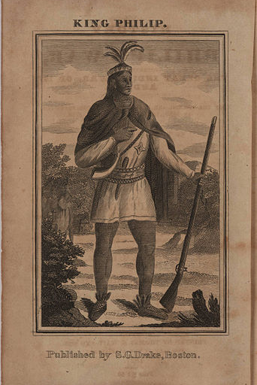
King Philip’s War: 1675-1676
Metacom (known as King Philip by English) tried to unite local tribes to protect themselves against attacks
Attacked English settlements on the frontier – lasted two years
Eventually defeated; was drawn and quartered and his head displayed on a pike in Plymouth for years

Slide 18
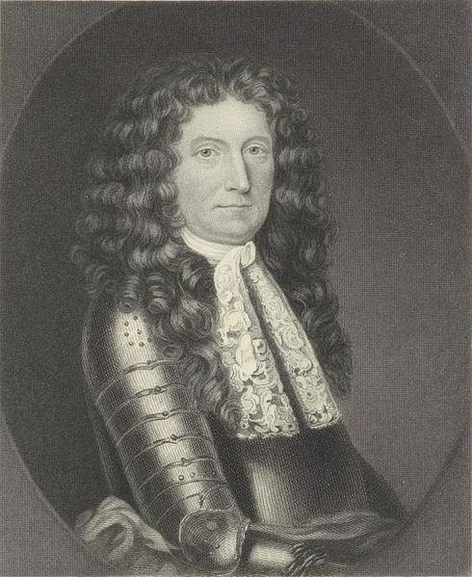
Seeds of Colonial Unity
New England Confederation
Consisted of 4 Puritan colonies (MA Bay, Plymouth, New Haven, Connecticut) for the purpose of defense against natives
Dominion of New England
Meant to regain English control over the colonies
New England ignoring the Navigation Acts
Didn’t like colonies defending themselves
Led by Sir Edmund Andros; despised by colonists
Epic failure

