Slide 1
Breaking the Color Barrier
The Civil Rights Movement

Slide 2
The Civil Rights Movement Begins
Early Struggles for Equality

Slide 3
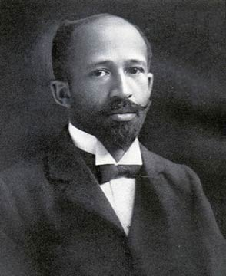
Origins of the Civil Rights Movement: Review
Plessy v. Ferguson (1896)
Jim Crow laws
De facto segregation: Segregation through custom and tradition where no laws have been passed.
NAACP
KKK
Notes:
Jim Crow Laws- state and local laws enforcing racial segregation in the Southern United States. Enacted after the Reconstruction period, these laws continued in force until 1965.
De Facto Segregation- Racial segregation, especially in public schools, that happens “by fact” rather than by legal requirement. For example, often the concentration of African-Americans in certain neighborhoods produces neighborhood schools that are predominantly black, or segregated in fact (de facto), although not by law (de jure).
KKK info- http://www.history.com/topics/ku-klux-klan

Slide 4
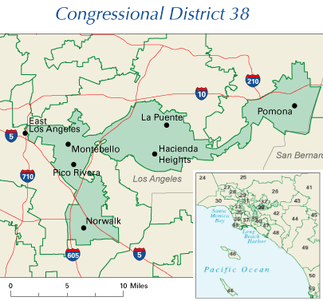
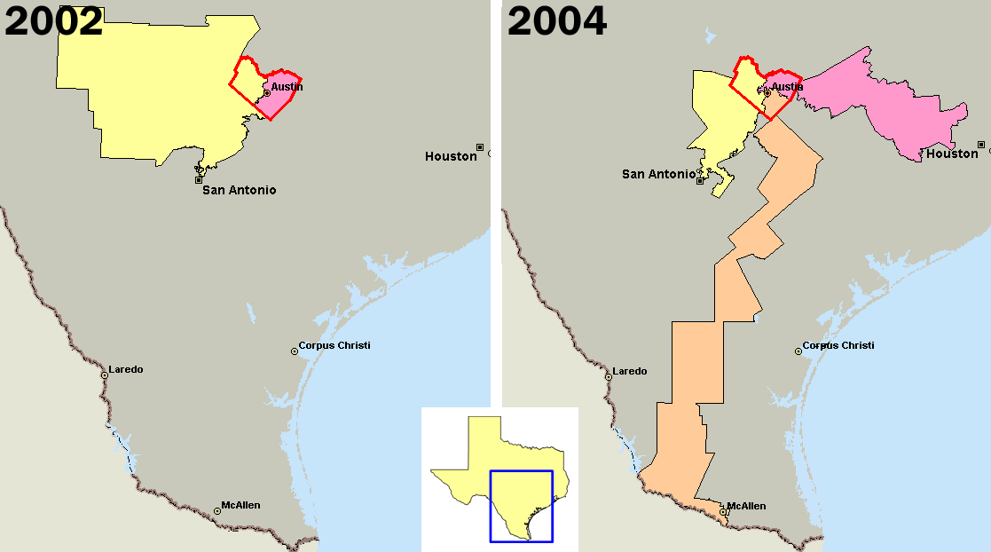
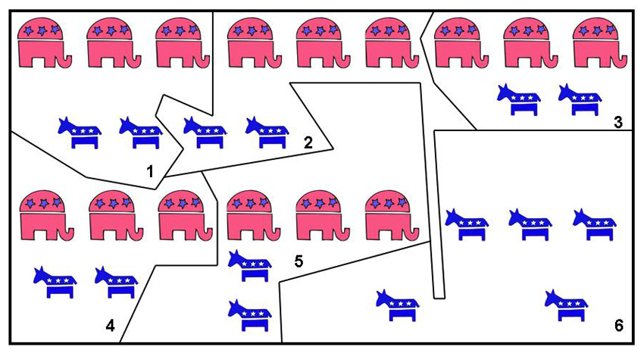
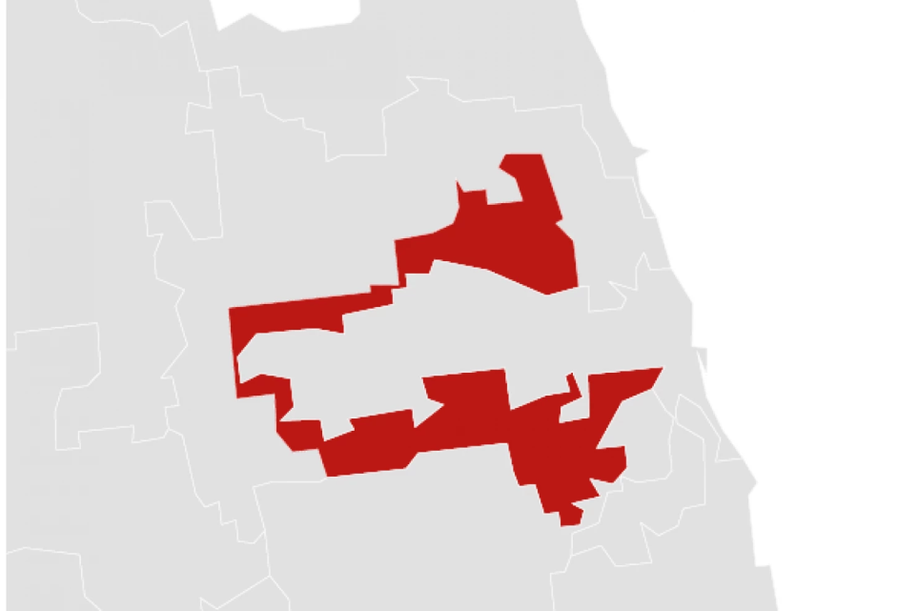
Political Districting

Slide 5
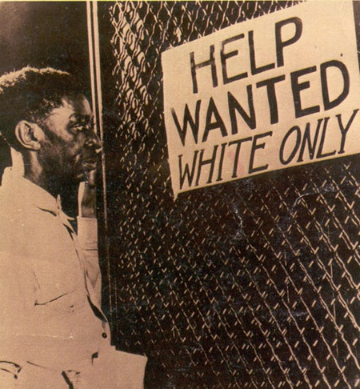
Life Under Jim Crow
African Americans did not have equal access to public facilities, and the conditions of separate facilities was anything but equal.
Gerrymandering, poll taxes, and literacy tests left most Southern blacks without a political voice
Lynching (killing people through mob violence) was a common practice

Slide 6
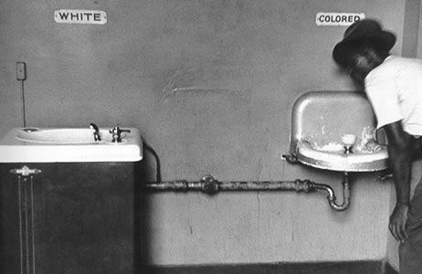
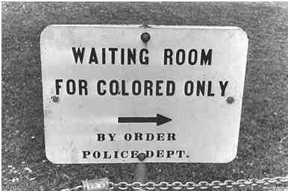
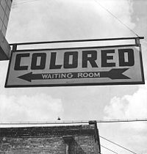
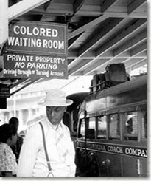
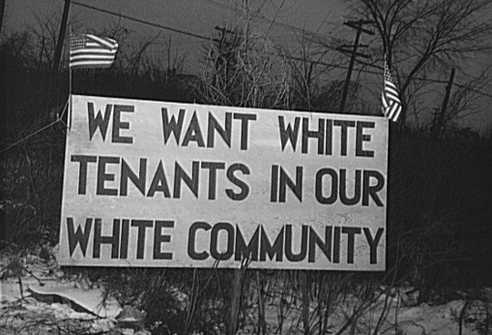
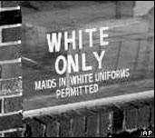
Separate Ain’t Equal

Slide 7
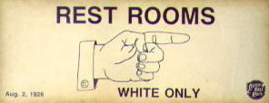
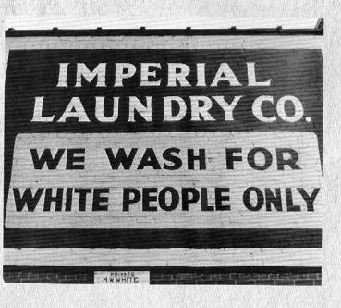
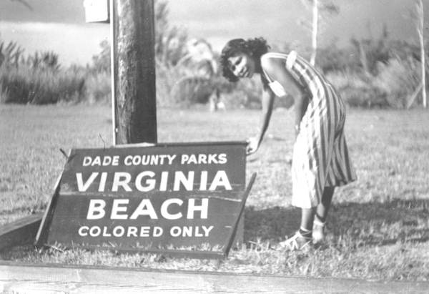
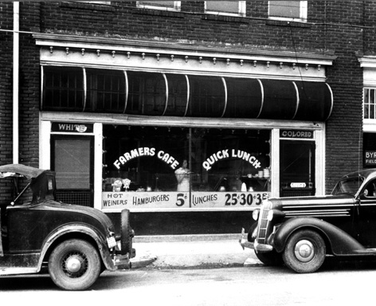
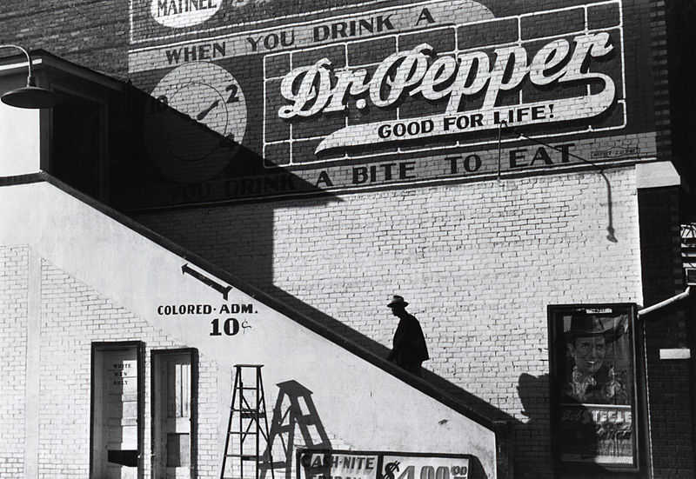

Slide 8
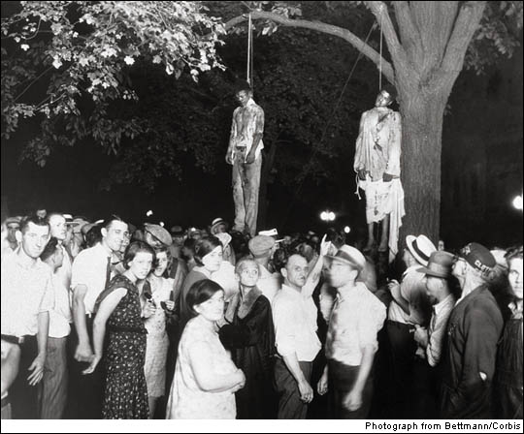
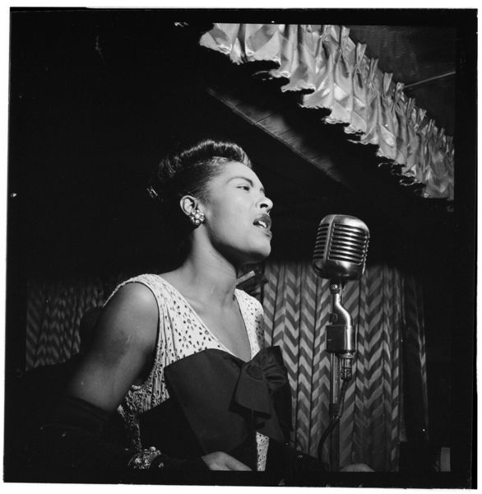
Jim Crow and Lynching
Strange Fruit – Billie Holiday
--------------------------------------------------------- Southern trees bear strange fruit, Blood on the leaves and blood at the root, Black bodies swinging in the southern breeze, Strange fruit hanging from the poplar trees. Pastoral scene of the gallant south, The bulging eyes and the twisted mouth, Scent of magnolias, sweet and fresh, Then the sudden smell of burning flesh. Here is the fruit for the crows to pluck, For the rain to gather, for the wind to suck, For the sun to rot, for the trees to drop, Here is a strange and bitter crop.

Slide 9
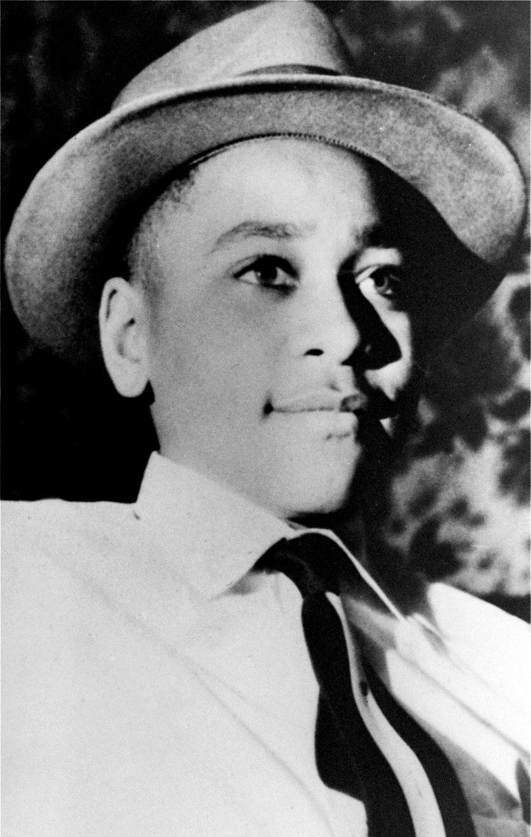
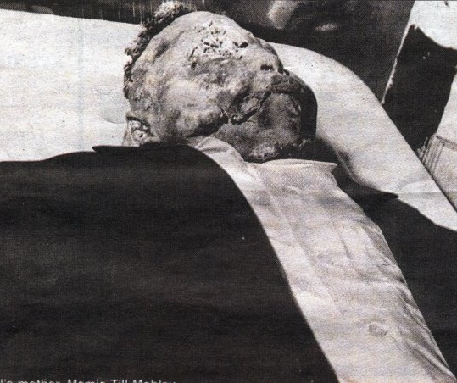
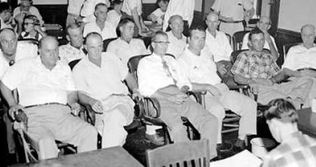
Emmett Till

Slide 10
Breaking the Color Barrier
Early Battles to End Segregation

Slide 11
Groups You Need to Know:
National Association for the Advancement of Colored People (NAACP)
Congress of Racial Equality (CORE)
Southern Christian Leadership Conference (SCLC)
Student Non-Violent Coordinating Committee (SNCC)

Slide 12
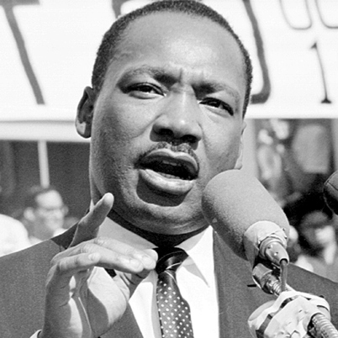
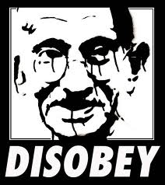
Martin Luther King Jr.
Martin Luther King Jr. was an American clergyman, activist, and leader in the Civil Rights Movement.
He is best known for his role in the advancement of civil rights using nonviolent civil disobedience.
Nonviolent civil disobedience: the refusal to obey certain laws considered to be unjust or immoral.
Popularized by Thoreau, which inspired the works of Gandhi, and later, MLK.
He led the 1955 Montgomery Bus Boycott and helped found the Southern Christian Leadership Conference (SCLC) in 1957, serving as its first president.

Slide 13
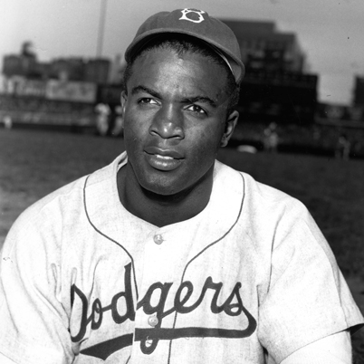
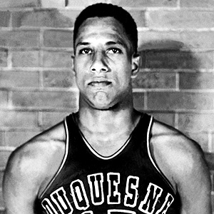
Breaking the Color Barrier
Jackie Robinson
Charles (Chuck) Cooper
Notes:
Jackie Robinson: Branch Rickey signs 27 year old Jackie Robinson to the Brooklyn Dodgers (1946)
Robinson faced severe racism from players, fans, and the press
Gained acceptance through friendship with Pee Wee Reese
Chuck Cooper: In 1950, Cooper was the first black player to be drafted by an NBA team
Cooper was signed by Boston Celtics coach Red Auerbach, who said he didn't care whether Cooper was "striped, plaid, or polka dot.“
Two other black players were drafted that year, giving the players a support base against racist fans, players, etc.

Slide 14
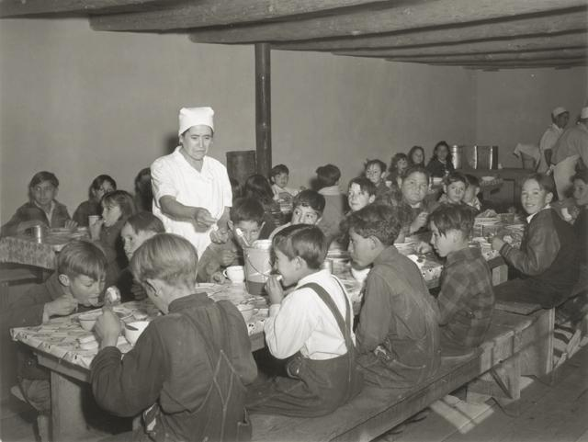
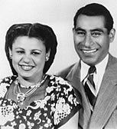
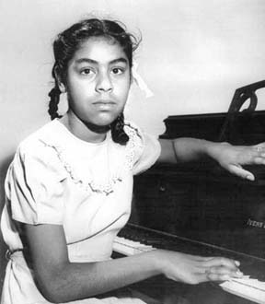
Mendez v. Westminster (1946)
Sylvia Mendez and her brothers were not admitted to their local public school in the Westminster school district based on their race
The U.S. Court of Appeals held that the segregation into separate "Mexican schools" was unconstitutional under the 14th Amendment of “equal protection.”
CA Governor Earl Warren, who would later become Chief Justice of the US Supreme Court, signed into law the repeal of remaining segregationist provisions in the California statutes
Notes:
Five Mexican-Americans fathers claimed that their children, along with 5,000 other children of "Mexican" ancestry, were victims of unconstitutional discrimination by being forced to attend separate "schools for Mexicans” in the Westminster School District in Orange County, CA.
The U.S. Court of Appeals for the Ninth Circuit held that the segregation of Mexican and Mexican American students into separate "Mexican schools" was unconstitutional under the 14th Amendment of “equal protection.”
CA Governor Earl Warren, who would later become Chief Justice of the US Supreme Court, signed into law the repeal of remaining segregationist provisions in the California statutes.

Slide 15
Separate, but Equal?
Black children were denied admission to public schools attended by white children under laws requiring or permitting segregation according to the races.
The white and black schools were supposed to be equal in terms of buildings, curricula, qualifications, and teacher salaries.

Slide 16
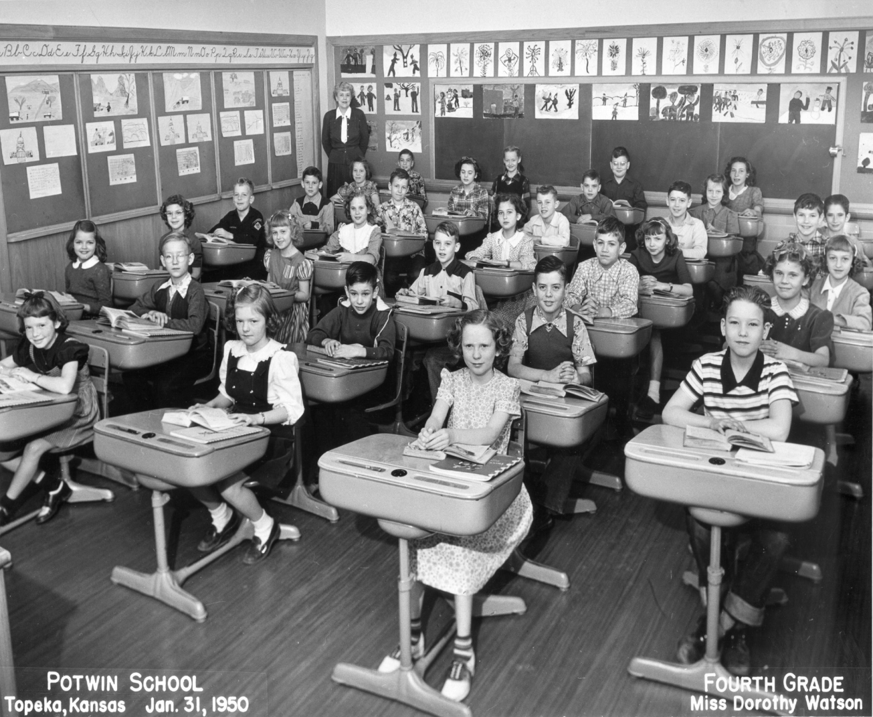
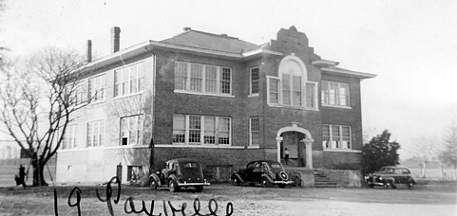
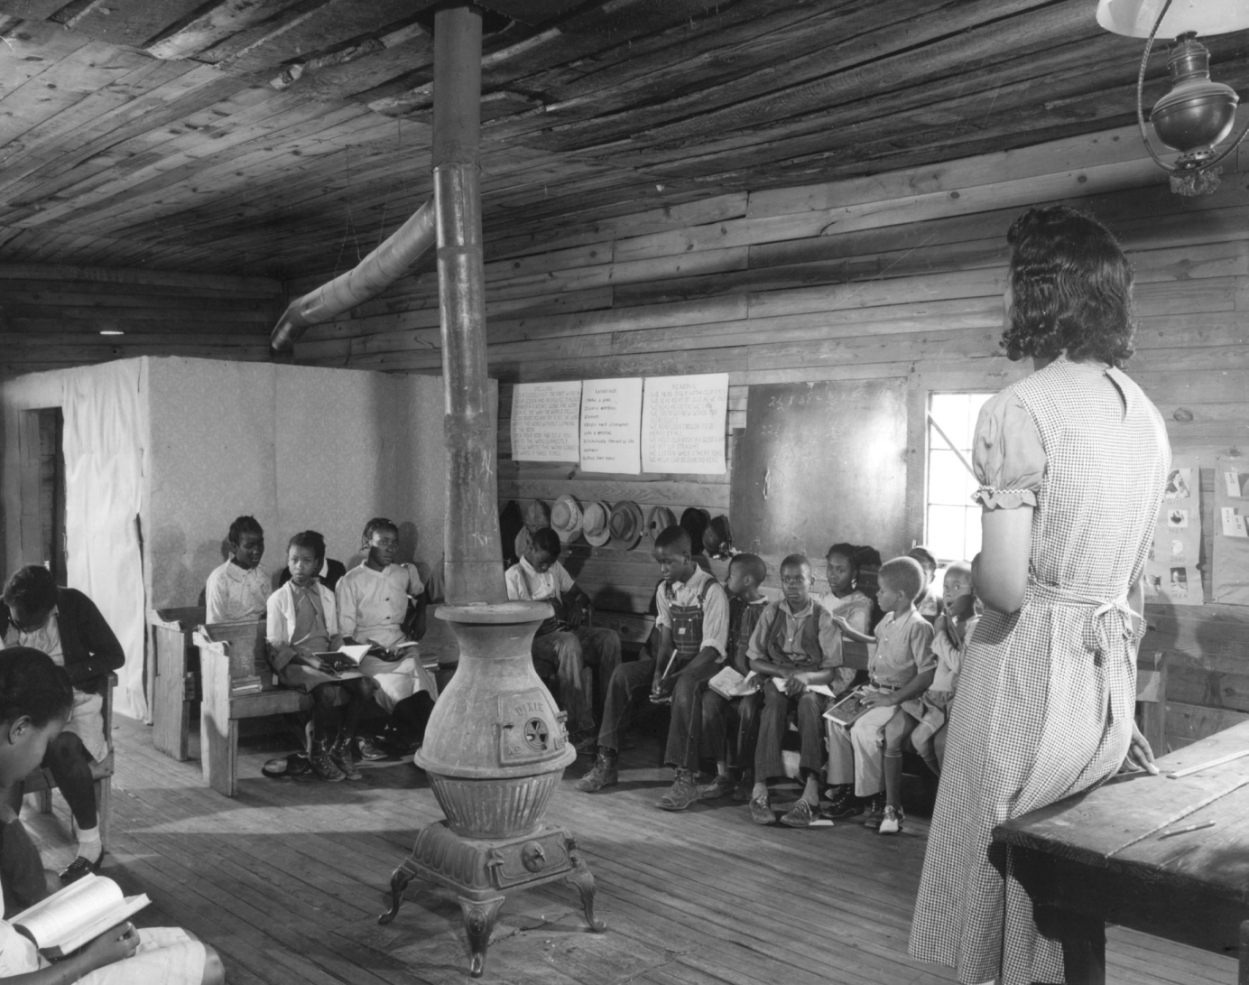
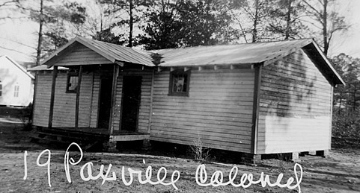
White
School
Colored
School

Slide 17
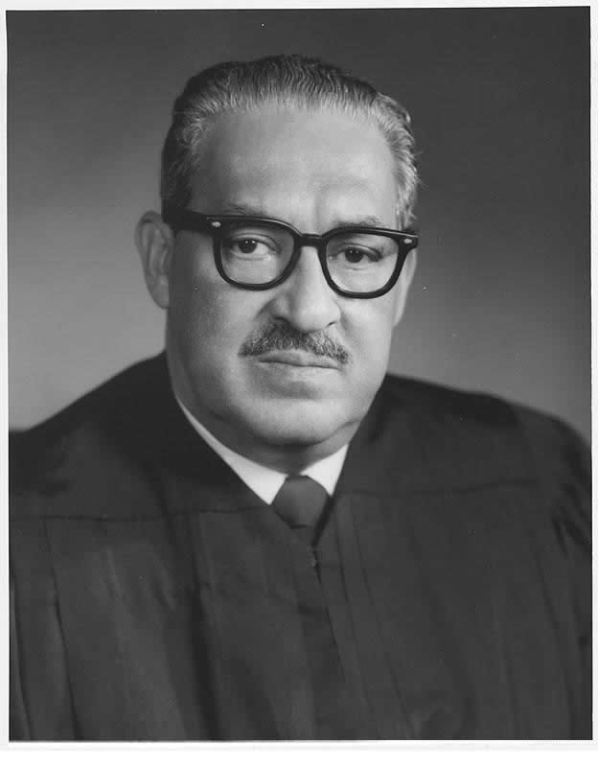
Thurgood Marshall
Chief counsel for the NAACP
Argued Brown v. Board of Education
Appointed as a judge for the United States Court of Appeals for the Second Circuit by JFK
Was the first African American Supreme Court Justice

Slide 18
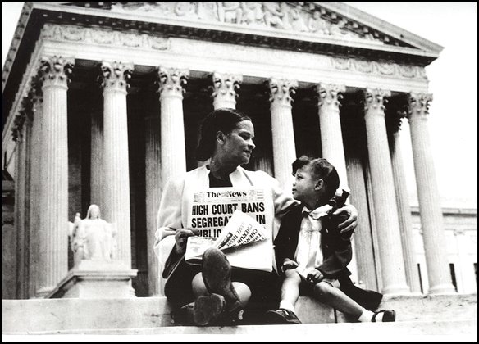
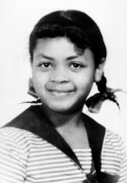
Brown v. Board of Education (1954)
Challenged the doctrine of “separate but equal”
14th Amendment
Desegregated American public schools

Slide 19
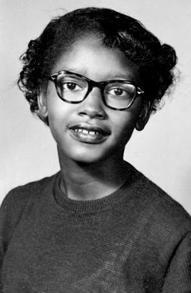
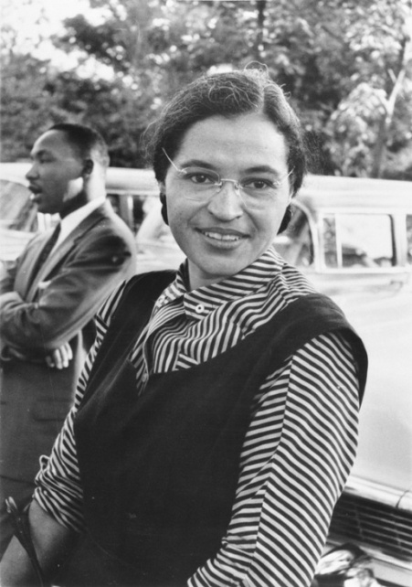
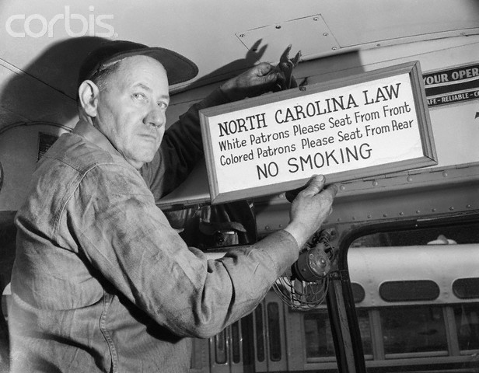
The Back of the Bus
Segregated busses
Blacks forced to ride at the back of the bus
AA made up 75% of bus patrons
Claudette Colvin
Rosa Parks
Notes:
1955

Slide 20
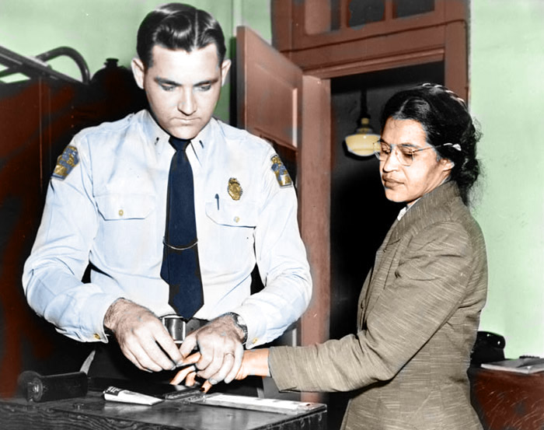
Rosa Parks
Secretary in the NAACP
December 1, 1955 - Rosa Parks refused to give up her seat to a White man on a bus
Arrested and charged with violation of segregation laws
Inspired the Montgomery Bus Boycott
“People always say that I didn't give up my seat because I was tired, but that isn't true. I was not tired physically, or no more tired than I usually was at the end of a working day. I was not old, although some people have an image of me as being old then. I was forty-two. No, the only tired I was, was tired of giving in.”
-Rosa Parks Autobiography

Slide 21
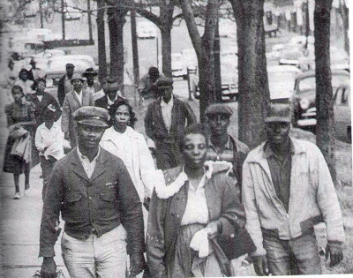
Montgomery Bus Boycott
December 5, 1955 – December 20, 1956
African Americans boycotted the Montgomery bus system
40,000 black commuters
Walked, carpooled, rode bikes, etc.
Bus companies refused to desegregate until Browder v. Gayle decision
Notes:
during the Boycott that the most famous Civil Rights leader, Dr. Martin Luther King. Jr., emerged as an important figure. It was also an example of how nonviolent protest could achieve success.
It rained that day but the African American community Boycotted anyway. People would carpooled while others rode in African American operated cabs. Most of the 40,000 commuters walked. After 382 days the law was finally lifted.

