Slide 1
Bell Ringer
Why were Americans so obsessed with their cars during the 1950s? What other businesses arose as a result of this obsession?

Slide 2
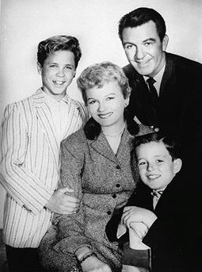
The Nifty Fifties!
Living in a “Beaver Cleaver” World

Slide 3
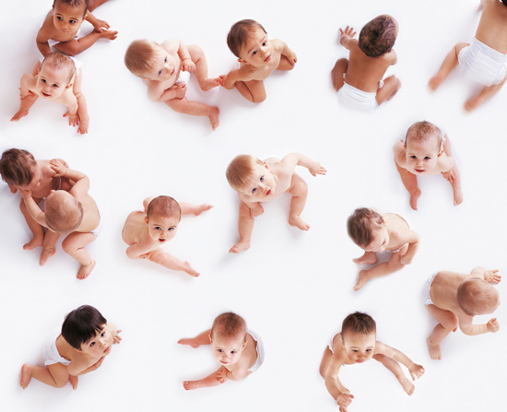
Social Conformity – The 1950s Family
Marriage rates soared, marriage ages dropped, and divorce rates
The end of WWII led to a surge in the U.S. population, known as the “baby boom” (1946-1964)
Largest “generation” in U.S. history, 77.3 million babies, peaked in 1957
The Common Sense Book of Baby and Child Care – Dr. Benjamin Spock
It seems to me that every other young housewife I see is pregnant. -- British visitor to America, 1958

Slide 4
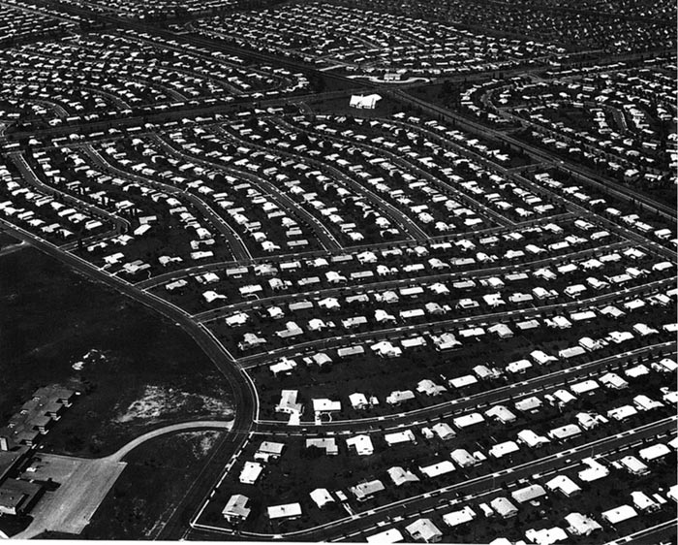
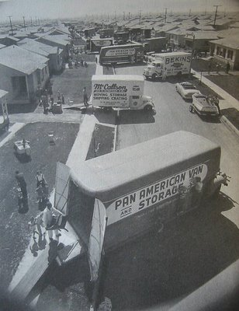
Little Boxes
The surge in marriage and birth rates, coupled with the benefits of the GI Bill, created a desperate need for housing
Levittown was the first mass-produced housing tract, with standardized homes, an efficient community model, and strict guidelines on conduct
Produced 150 houses per week; $7,990 or $60/month with no down payment.

Slide 5
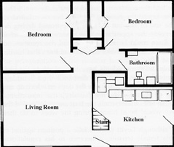
Levittown
All six models had the following design concepts:
Open Floor Plan design marked by a minimum of interior walls.
Picture Windows and natural light wherever possible.
Expandable Attic and/or Carport
Modern Kitchen with Built-In Appliances
Indoor/Outdoor Living with Common Open Spaces

Slide 6
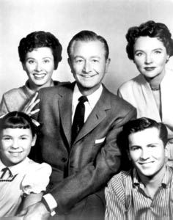
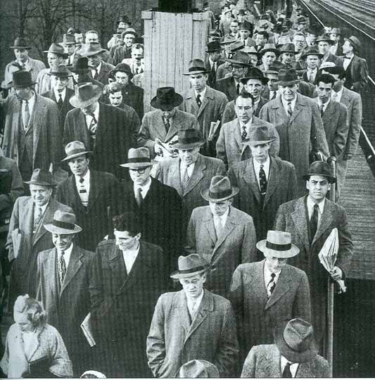
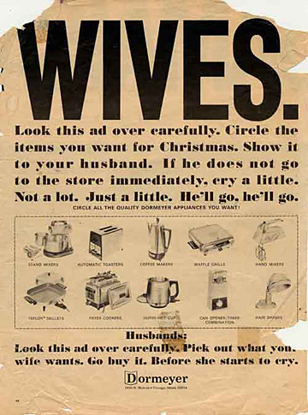
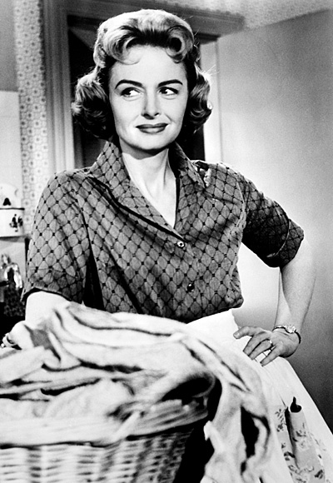
Social Conformity – Men and Women
Americans reverted back to traditional gender roles in the wake of WWII
Men were the breadwinners in the family, head of the household, and increasingly worked in white-collar professions
Women were to be homemakers and child-rearers – reverting back to a modern version of the 19th c. “Cult of Domesticity”
Reiterated through television and advertising

Slide 7
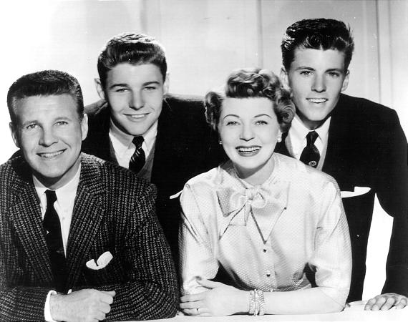
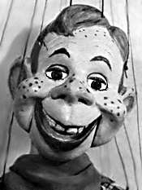
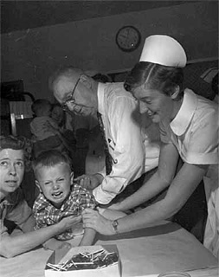
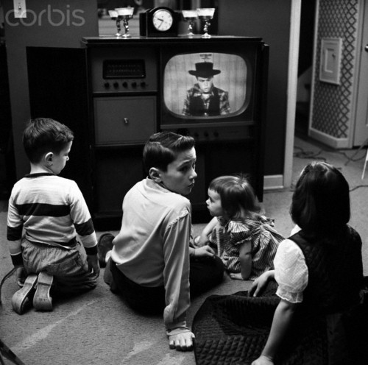
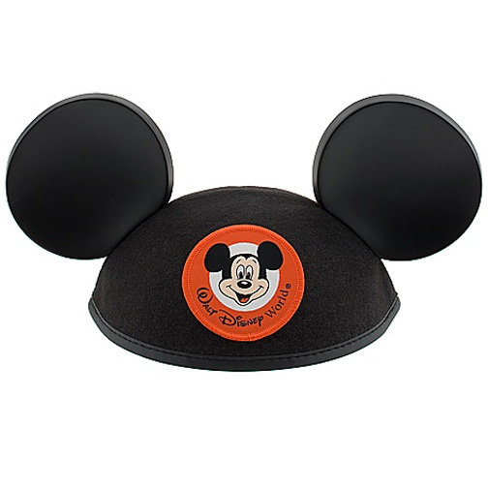
Social Conformity – Kids in the ‘50s
The baby boom led to a new focus on children; each stage of life the “boomers” reached, introduced new items
First time the majority of Americans had access to a TV; children's programming taught morals and behavior
Spock’s Baby book and Salk’s polio vaccine homogenized American childhood experiences

Slide 8
It’s Great to Be A Kid!
1950
Silly putty
Peanuts
1951
Topps sells it first complete Baseball Card set
Alice in Wonderland released
1952
Mr. Potato Head
Sugar Frosted Flakes
1954
Play Doh
Bazooka Joe Comics
1955
McDonalds starts
Disneyland opens
1956
Wizard of Oz appears on TV
1957
Barbie
Sleeping Beauty
Frisbee is nationally marketed
1958
HULA Hoop rolls out
Cocoa Krispies comes out(43% sugar)

Slide 9
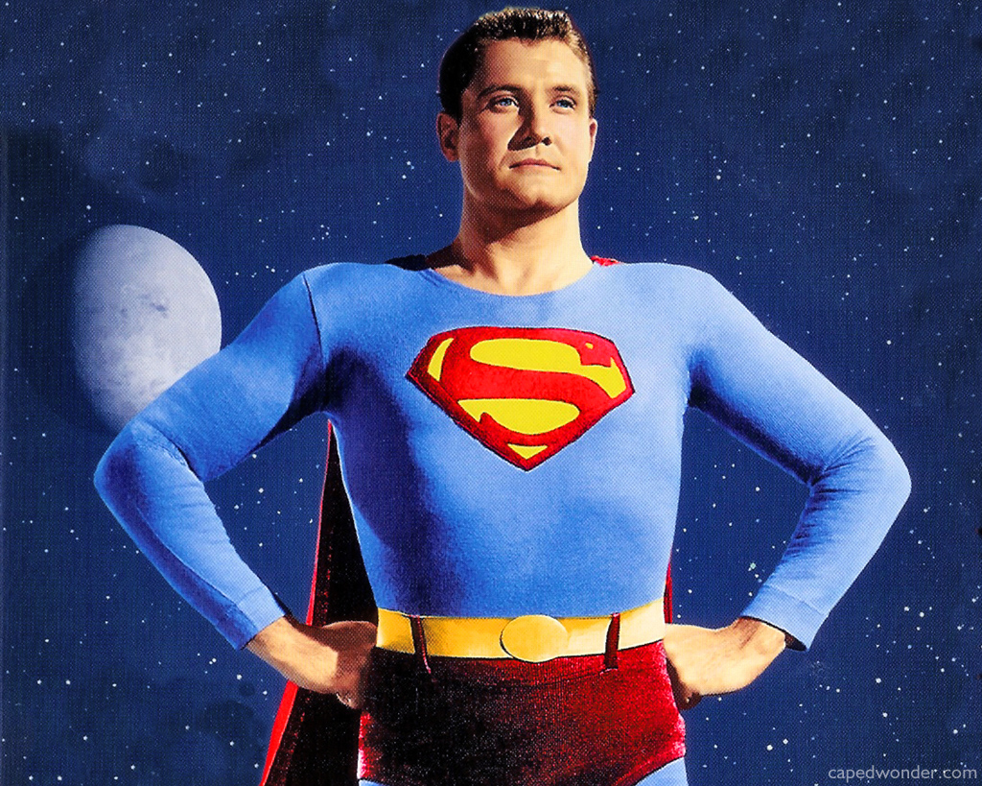
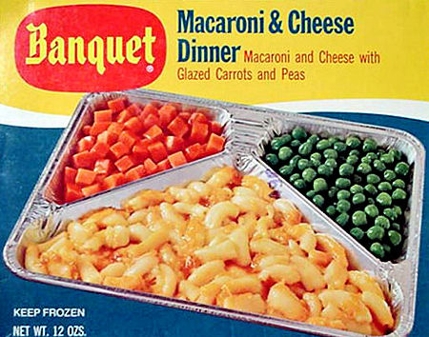
Television
First time the majority of Americans had access to a TV
1946 → 7,000 TV sets in the U. S. 1950 → 50,000,000 TV sets in the U. S.
TV celebrated traditional American values.
Further homogenized American cultural and speech patterns
Rise of TV Dinners and advertising
Popular genres: Westerns, sit-coms, variety shows, and children’s programs.

Slide 10
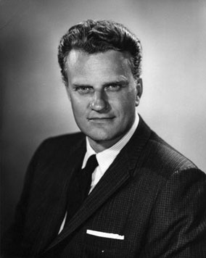
Television
Postwar religious revival
Church membership nearly doubled in the postwar world.
Tradition, conformity, not godless communists
Television preachers denounced communism and promoted patriotism as much as their religious messages.
Reverend Billy Graham

Slide 11
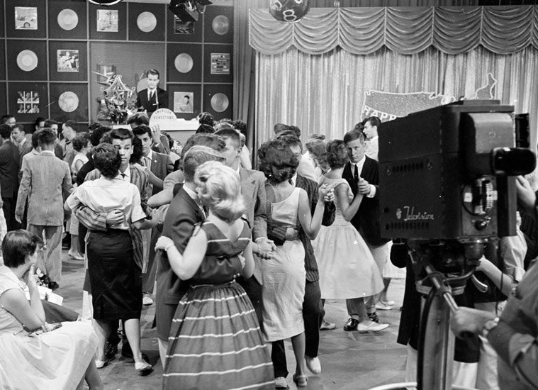
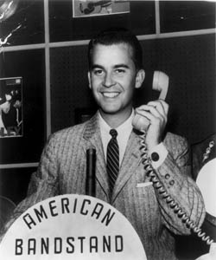
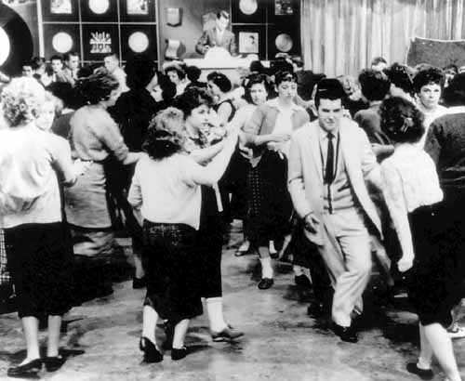
Television
American Bandstand: Started off as a local dance show in Philadelphia; became the most watched TV program for teens.
Bandstand was where America's teens went to learn what was cool
New songs, new styles, new dances.
The most popular musicians performed their top hits on the show
Notes:
Begin in 1952 as a local show in Philadelphia
1956 ABC picks it up as a national show Dick Clark becomes the host
Bandstand was where America's teens went to learn - not just the new songs but the new styles and the new dances.
“Regulars” became celebrities in their own right, sometimes creating new dances for the show that became fads across the nation (e.g. The Stroll)
Jerry Lee Lewis performs the first song on the national edition- “Whole Lotta Shaking Going On”
Dick Clark’s podium that he stood at, is now in the Smithsonian.

Slide 12
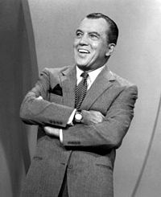
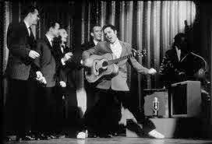
Television
The Ed Sullivan Show: A variety show; one of the most popular shows on TV during the 1950s.
Most popular musicians and comedians introduced themselves to the country.
82% of TV viewers watched Elvis Presley’s first appearance on the show

Slide 13
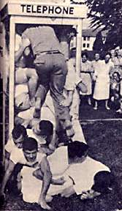
Telephone Cramming
Starts in South Africa, goes to England, and then comes to California in 1959.
Record of 25 people set in S.Africa 22 in America
VW Beetle cramming also was a short-lived fad.

Slide 14
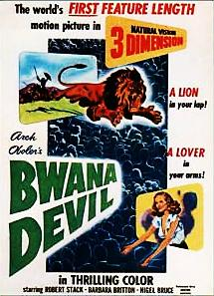
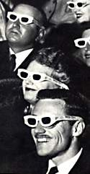
3-D Movies
Reemerge during the 1950’s
Images appear to be coming out at you
Moviegoers are giving the 3-D glasses
Most films were sci-fi or monster movies

Slide 15
