Slide 1
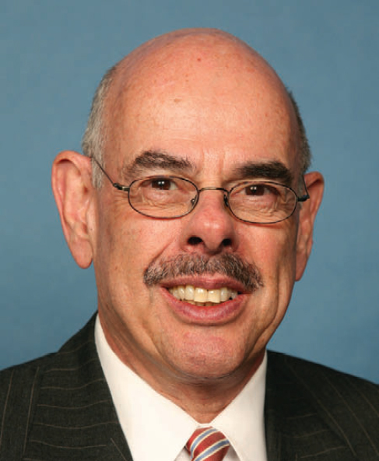
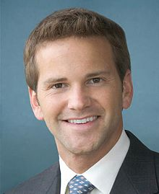
Bell Ringer: Who would you vote for, and why?
Candidate A
Candidate B

Slide 2
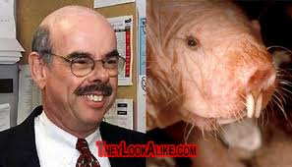
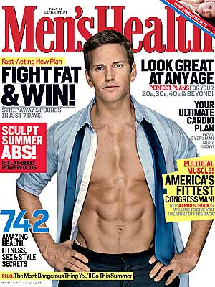
Bell Ringer: Who would you vote for, and why?
Henry Waxman – (D,CA)
Aaron Schock – (R, IL)
The media can be mean, can’t they?
Notes:
Henry Waxman: Considered to be one of the most intelligent, influential liberal members of Congress. Influential in legislation for reducing air pollution, AIDS research, and the Affordable Care Act (ObamaCare) Retired in January, 2015.
Aaron Schock: Youngest member of Congress when elected (30 years old), resigned last week due to alleged misuse of taxpayer funds

Slide 3
Camelot and Crisis
John F. Kennedy’s Administration

Slide 4
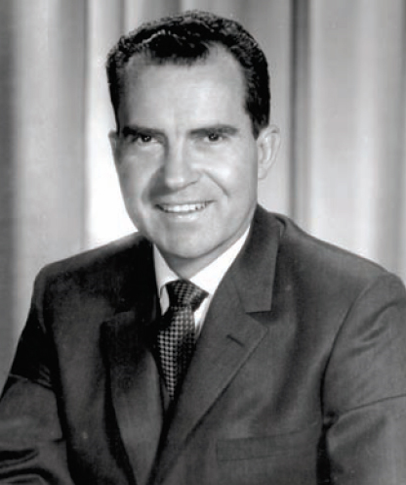
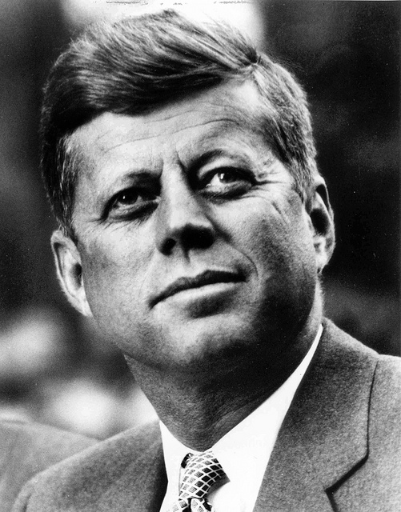
Election of 1960
Richard Nixon (R-CA)
John F. Kennedy (D-MA)
Incumbent VP under Eisenhower.
Emphasized his experience.
Wasted energy by campaigning in all 50 states instead of concentrating on the swing states.
Young Senator from Massachusetts.
Used his large, well-funded campaign organization to gain endorsements and get out the vote.
Battled discrimination from the media due to his Roman Catholic faith.

Slide 5
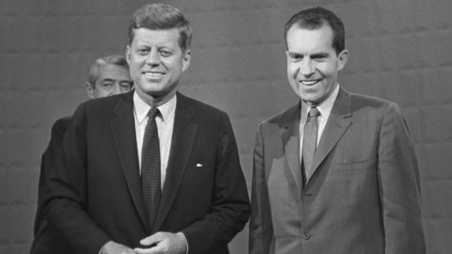
Kennedy-Nixon Debates
First televised presidential debates
  70 million viewers
  Nixon: pale, sickly, sweating
  Kennedy: tan, well-rested, relaxed
Radio: Nixon won; TV: Kennedy won

Slide 6
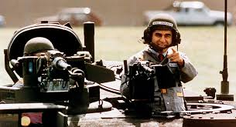
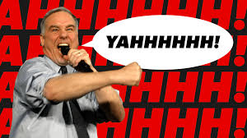
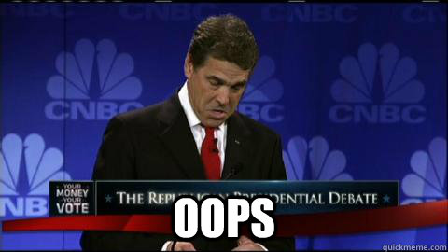
Presidential Debate Gaffes

Slide 7
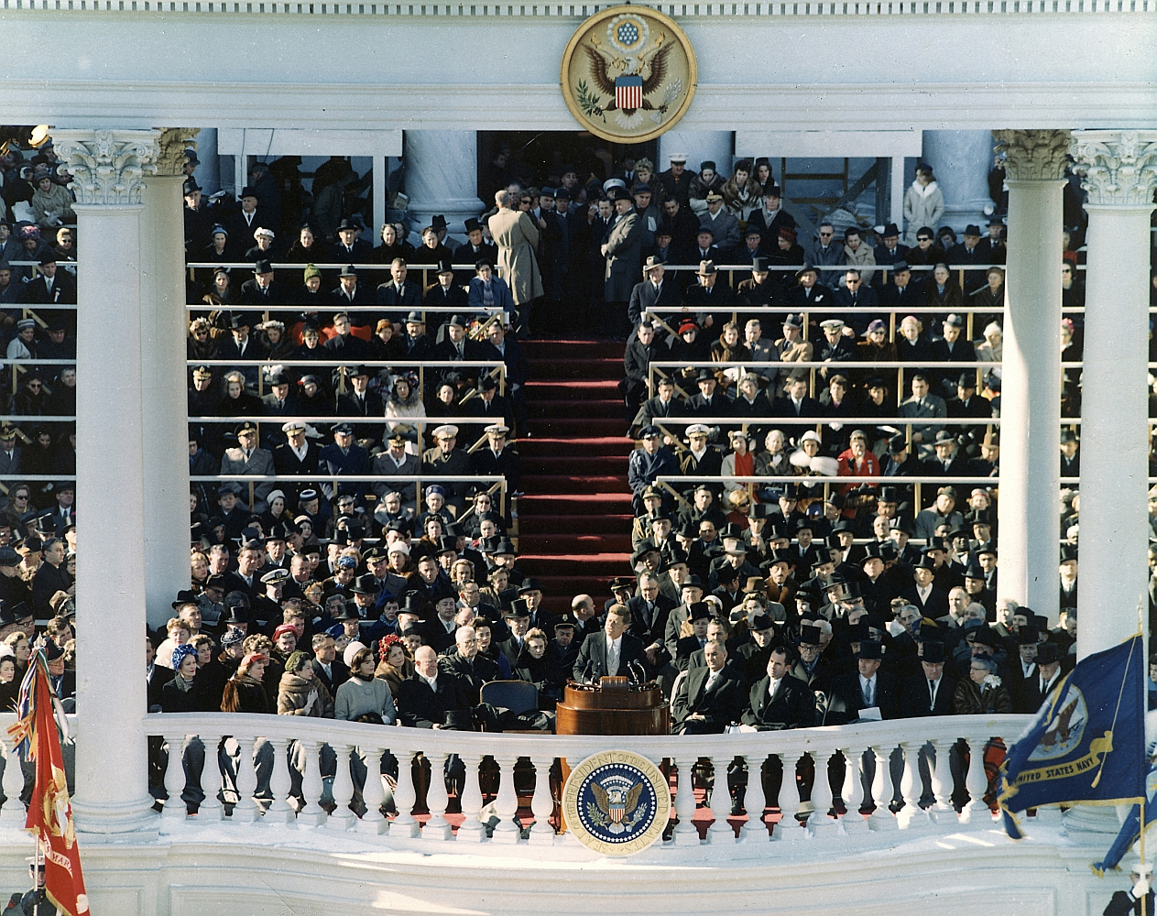
Kennedy’s Inauguration
First inaugural address delivered to a televised audience in color.
The “New Frontier”
  Regular public service
  Eradicate poverty
  Environmental conservation
  Cooperation with Latin America
  An increased emphasis on manned space exploration.
“ask not what your country can do for you, but what you can do for your country.”

Slide 8
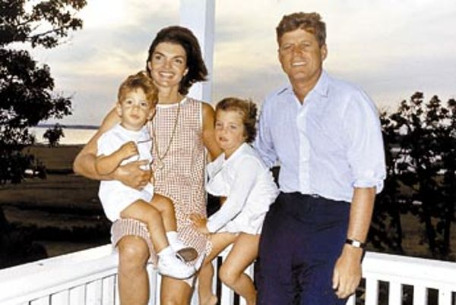
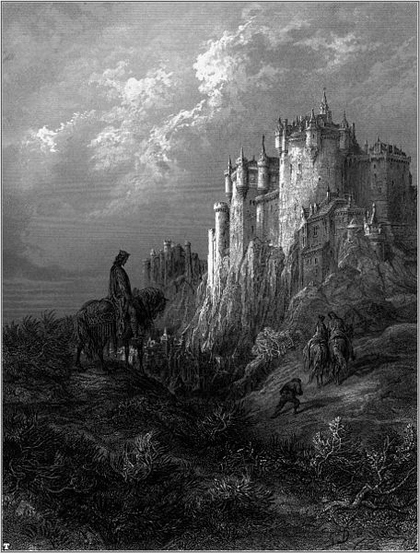
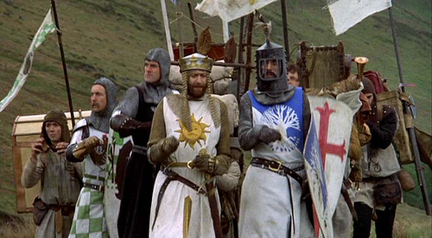
Welcome to Camelot!

Slide 9
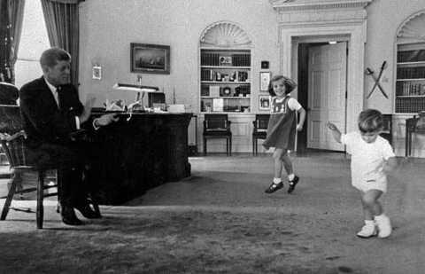
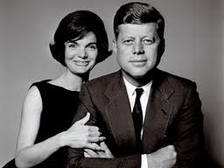
Welcome to Camelot!

Slide 10
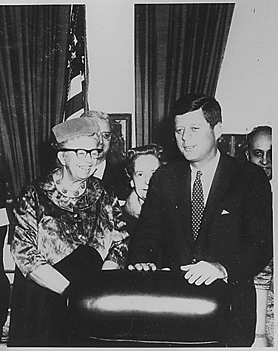
JFK’s New Frontier
Presidential Commission on the Status of Women: Created to advise the President on issues concerning the status of women.
Appointed Eleanor Roosevelt as its chairperson.

Slide 11
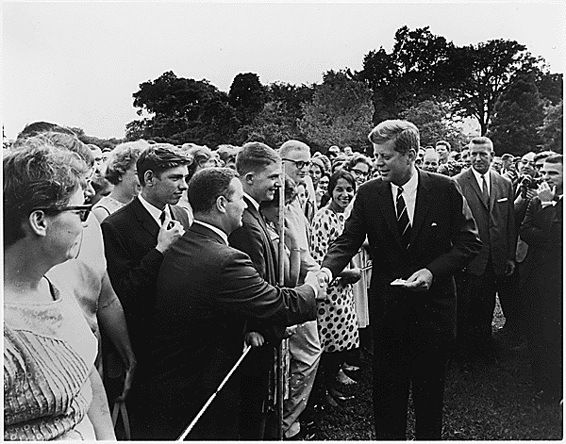

The New Frontier
Peace Corps: Established by Executive Order 10924, 1961
  Provide technical assistance/improve skills
  Help people of other nations understand American culture and vice versa
  Show third world countries that there was a better way than communism

Slide 12
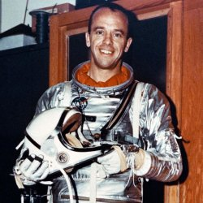
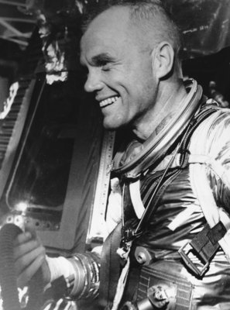
The Final Frontier
In May of 1961, JFK challenged the nation to commit itself to landing a man on the moon within the decade.
  Alan Shepard – 1st American in space
  John Glenn – 1st American to orbit the Earth
Apollo Program: The NASA program aimed at landing a man on the moon.

Slide 13
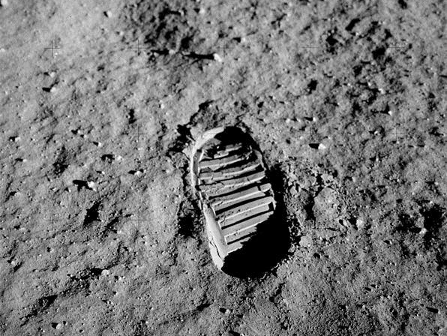
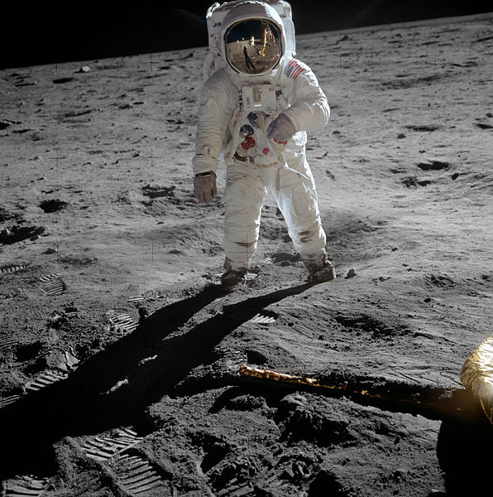

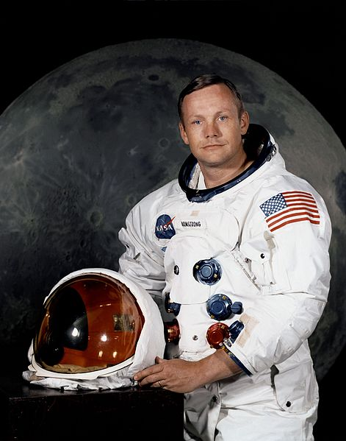
One Small Step…
Apollo 11 - Neil Armstrong and Buzz Aldrin landed their Lunar Module on the Moon on July 20, 1969.
The moon landing was broadcast on television, and millions of people around the world witnessed the momentous event.
“That’s one small step for man… one giant leap for mankind.”

Slide 14
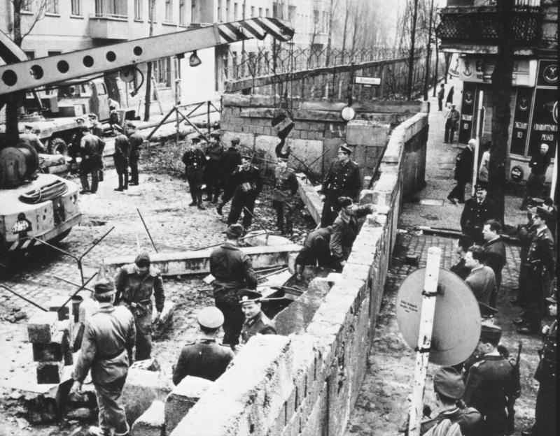
Berlin Wall - 1961

Slide 15
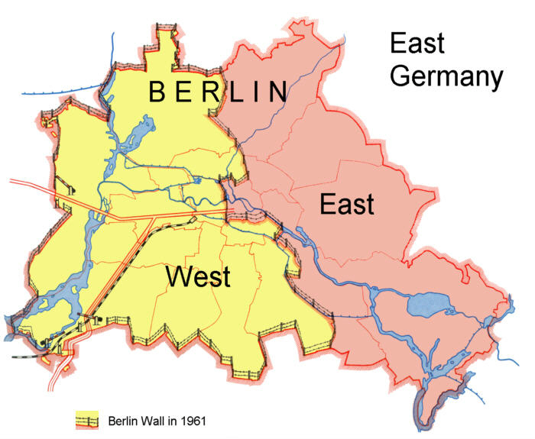
Built in 1961
Notes:
To explain why the closing of West Berlin was a big deal, tell students to imagine a division down Hamner, and any of them who live on the Eastern side of Hamner (by the 15 fwy), would be unable to attend this school, see any of their friends, or travel anywhere west of Hamner street. That means no beach, no San Diego, no Disneyland. For Western Eastvale students, remind them that they would not be able to see or contact their friends on the East side of Hamner either.

Slide 16
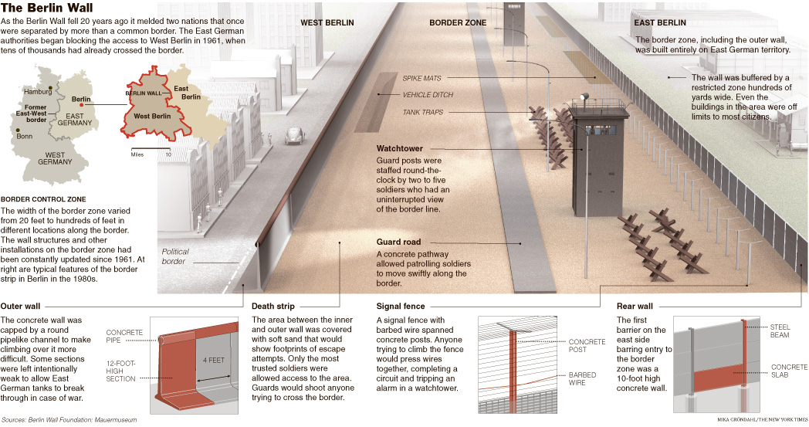
THE IRON CURTAIN BECOMES REAL:
The Berlin Wall

Slide 17
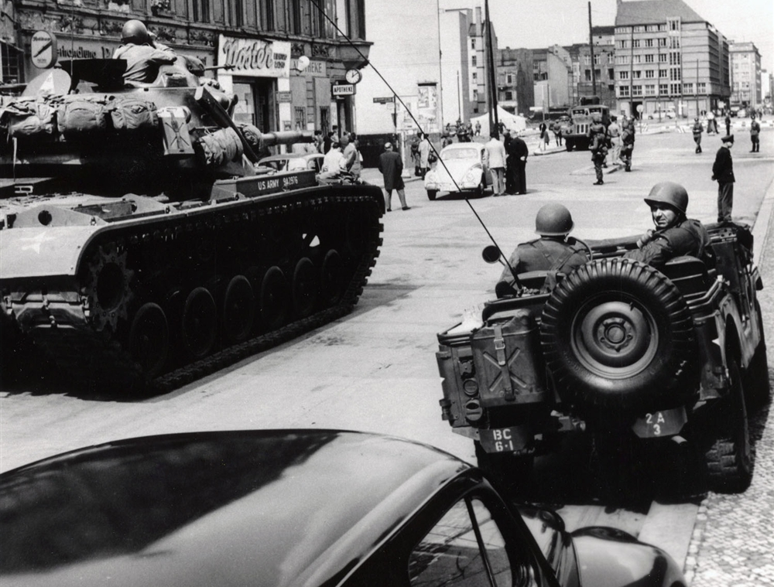
BERLIN CRISIS OF 1961
Over 15 million defect between 1945-50
  Border becomes more restricted
Soviets demanded Westerners out of Berlin (1958)
  Reiterated by Kruschev to JFK in 1961who refuses
  Berlin Wall is begun a few months later
Standoff at Checkpoint Charlie between US and Soviet forces (1961)
    Checkpoint Charlie: The best-known crossing point between East and West Berlin during the Cold War – served as a symbol for the division of East and West.
Notes:
This is where new information begins!
Main Idea: The existence of democratic West Berlin within Eastern Germany caused many to defect, making Communism look bad to the public eye.

Slide 18
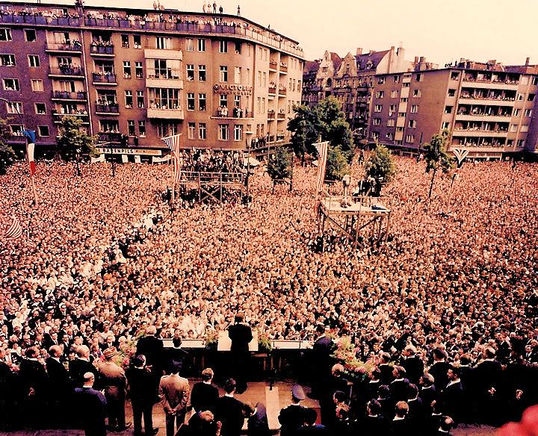
JFK and Foreign Policy
JFK visits citizens of Western Berlin at the Wall
“Ich bin ein Berliner”
Morale boost and warning to the Soviets
“Flexible response”: JFK’s foreign policy; developing an array of military “options” that could be matched to the gravity of the crisis at hand.

Slide 19
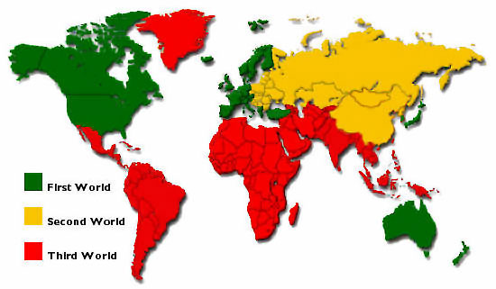


FIGHTING IN THE 3RD WORLD
Third world nations: Latin America, Asia, and Africa
  Economically poor and politically unstable
  Lacked education and technology
US & USSR fight over influence in these areas
  Proxy Wars (fighting each other without actually fighting each other)

Slide 20
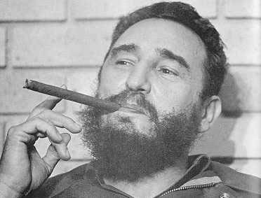

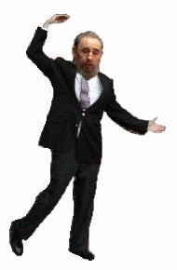
FIDEL CASTRO AND THE CUBAN REVOLUTION
U.S. backed unpopular dictator Fulgencio Bautista
Overthrown by Communist leader, Fidel Castro.
  Suspended elections, jailed or executed opponents, and censored press and media.
  Took over U.S. owned sugar mills and refineries
President Eisenhower orders a trade embargo

Slide 21
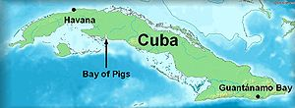

The Bay of Pigs Invasion*
Castro turns to U.S.S.R. for military aid
Eisenhower orders CIA to plan to overthrow Castro
  Trains Cuban exiles for an invasion of the island
  Invasion okayed by JFK when he takes over
  Initially successful, but quickly overpowered by Cuban forces
  Failed because JFK pulled air support at the last minute to prevent hostilities with the USSR
*No actual pigs were harmed in the making of this invasion.
What could possibly go wrong?
Uh-oh.

Slide 22
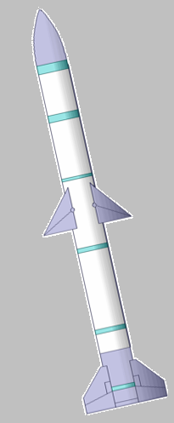
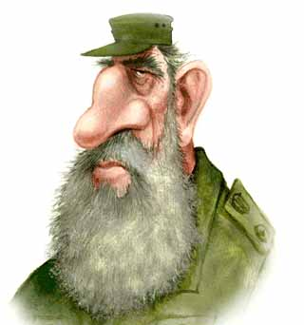
Thirteen Days in October: The Cuban Missile Crisis
Missiles? What missiles?
Nuclear missile sites are discovered on the island of Cuba by an American spy plane
Provided for by the USSR for “defense against aggressor nations”
Some missiles were fully operational, and were pointed at the United States.

Slide 23
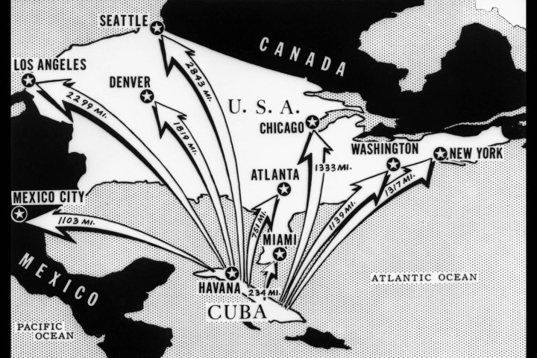

Slide 24
You are President Kennedy. What do you do about the growing danger in Cuba?
Do nothing: American vulnerability to Soviet missiles was not new. America was still more powerful than Cuba.
Diplomacy: Use diplomatic pressure to get the Soviet Union to remove the missiles.
Warning: Send a message to Castro to warn him of the grave danger he, and Cuba were in.
Blockade: Use the US Navy to block any missiles from arriving in Cuba.
Air strike: Use the US Air Force to attack all known missile sites.
Invasion: Full force invasion of Cuba and overthrow of Castro.
Notes:
Have the students decide which option they’d choose. If you would like, have each group congregate in a different part of the room, discuss their reasons why they chose that option, and then share the options with the class. You can then go over some of the potential pros/cons of each decision. The next slide will explain why Kennedy decided on a blockade.

Slide 25
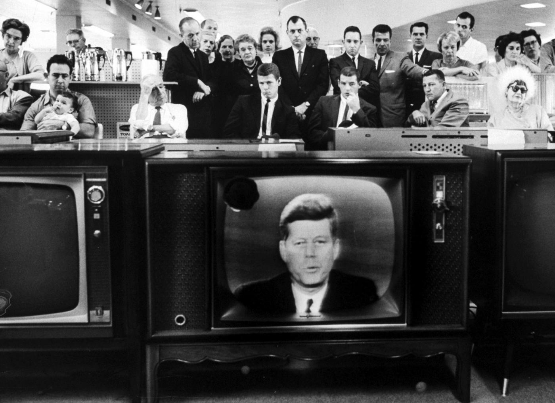
Thirteen Days in October: The Cuban Missile Crisis
Forms a blockade around Cuba
Goes on air to inform the public and issue a warning to the USSR
US is heightened to DEFCON 2
Soviet ships approached the blockade, hesitate, and then turn back around.
Kennedy agrees to remove all missiles set in southern Italy and in Turkey, in exchange for Khrushchev removing all missiles in Cuba.
“It shall be the policy of this nation to regard any nuclear missile launched from Cuba against any nation in the Western Hemisphere as an attack by the Soviet Union on the United States, requiring a full retaliatory response upon the Soviet Union”
Notes:
The picture is linked to his speech, if you want to show it. It’s about 3 minutes long.
DEFCON 2: (Air Force made ready for air strikes and nuclear interception on 15 minutes' notice)

Slide 26
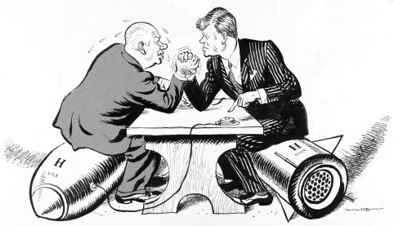
“Eye to eye, they blinked first.”
Notes:
Have students analyze the cartoon. What is going on? What is the author trying to say in the cartoon?

Slide 27
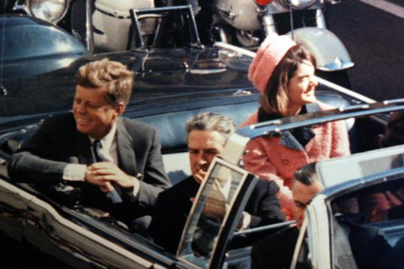
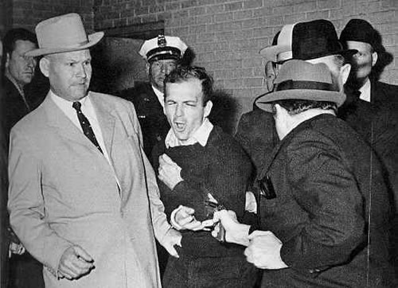
November 22, 1963
JFK assassinated by Lee Harvey Oswald while campaigning in Dallas, TX
Two days later, Oswald was himself shot and killed by businessman Jack Ruby.

Slide 28
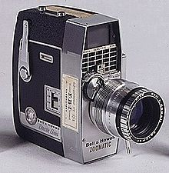
The Zapruder Film
Abraham Zapruder unexpectedly captured the assassination of the President with a home-movie camera. It is the only complete film of the event.
Notes:
The film camera is linked to the actual Zapruder film. It’s 33 seconds long, and clearly shows him being shot. Show it if you feel comfortable and that the class can handle it. The still shot of JFK and Jackie is linked to a documentary that debunks one of the largest conspiracy theories about the assassination, using digital imaging. That clip is about 10 minutes long. Show as much or as little as you want.

Slide 29
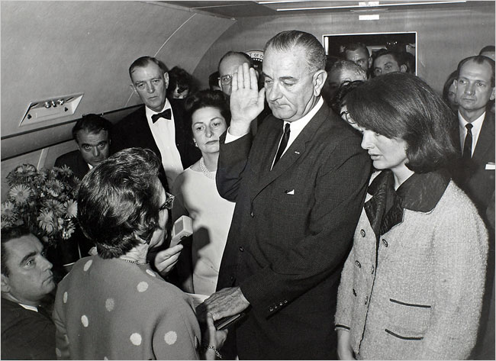
The Warren Commission
Created specifically to investigate the assassination of President Kennedy and Lee Harvey Oswald
  Still controversial, with inconsistencies and oversights becoming the obsession of conspiracy theorists
Johnson is sworn in on Air Force One right after JFK’s body arrives from the hospital.

Slide 30
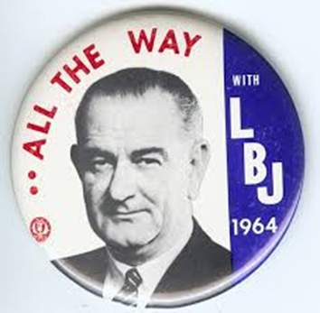
Living up to Camelot
LBJ serves out the remainder of JFK’s term
  Signs the Civil Rights Act of 1964
  Passage of the 24th Amendment
LBJ runs for the presidency in his own right later that year, winning by a landslide.
Baker v. Carr: Congressional districts should be drawn based upon population, not size
The “Great Society”: A set of economic and welfare measures pushed through by LBJ
  Focused on eliminating poverty, medical care for those in need, and equality in education, urban problems, transportation, and racial injustice

Slide 32
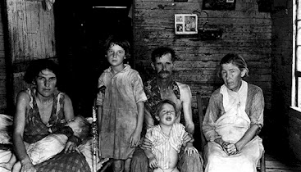
Johnson’s “Great Society”
Medicare and Medicaid
Immigration and Nationality Services Act
Extension of constitutional protections to Native Americans on reservations
Job Corps
Federal Food Stamp Program
Head Start and federal funding for public schools and universities
National Endowment for the Arts, Public Broadcasting Act (PBS) and National Public Radio (NPR), Kennedy Center for the Arts
Endangered Species Preservation Act, Clean Air Act
Notes:
Information is behind the picture.
Medicare and Medicaid provided medical care to those who needed it most. Medicare = Old people who need CARE; Medicaid = Injured and poor people who need AID
Immigration and Nationality Services Act – Got rid of the 1924 quotas that had limited immigration
Extension of constitutional protections to Native Americans on reservations
Job Corps – provided training and jobs for America’s youth
Federal Food Stamp Program – providing assistance to low-income families to provide food
Head Start and federal funding for public universities
National Endowment for the Arts, Public Broadcasting Act (PBS) and National Public Radio (NPR), Kennedy Center for the Arts
Endangered Species Preservation Act, Clean Air Act

Slide 33
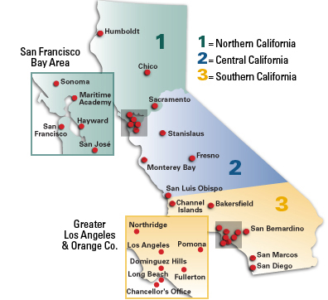
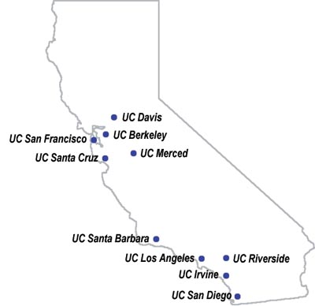
What six UC Schools were created in between 1944 and 1965?
What four CSU schools were created in the 1960s?
Notes:
Santa Barbara (1944)
Riverside (1954)
Davis (1959)
San Diego (1960)
Irvine (1965)
Santa Cruz (1965)
Los Angeles1947
Sacramento1947
Long Beach1949
Fullerton1957
Stanislaus1957
East Bay1957
Northridge1958
Dominguez Hills1960
Sonoma1960
San Bernardino1965
Bakersfield1965

