Slide 1
Bell Ringer
What does it mean to conform? What are the benefits of conformity?

Slide 2
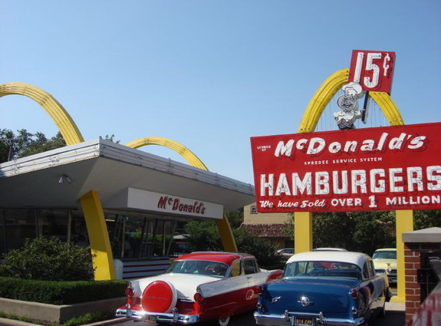
The Affluent Society
Making America the Best Place to Live

Slide 3
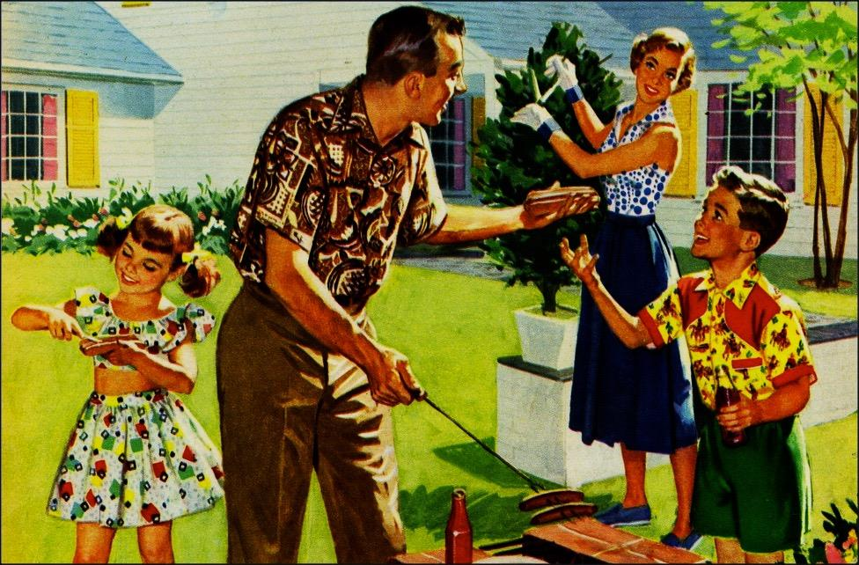
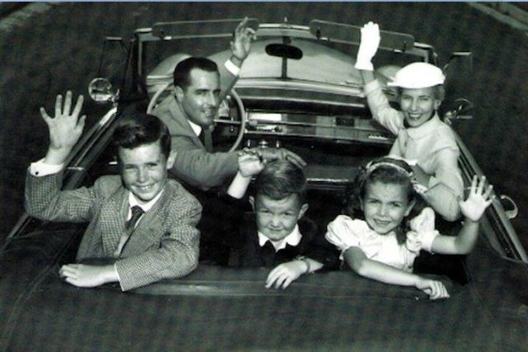
Conformity as the new “normal”
Reaction to upheaval of WWII
Fears of communist infiltration
Conformity = unity
American Dream
Nuclear Family
Ideal, not necessarily reality
A New Normalcy

Slide 4
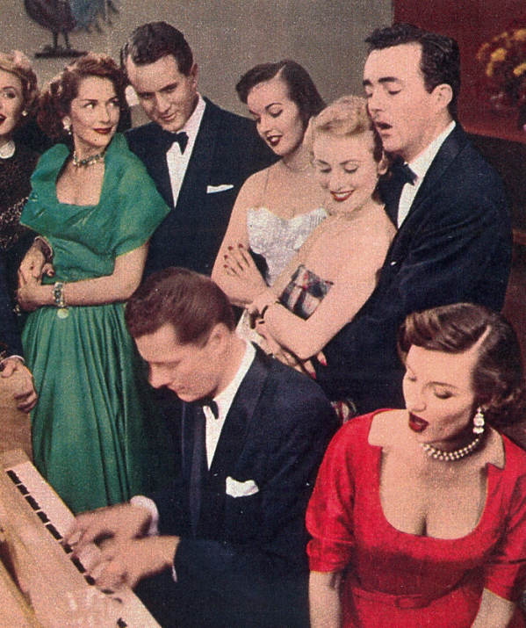
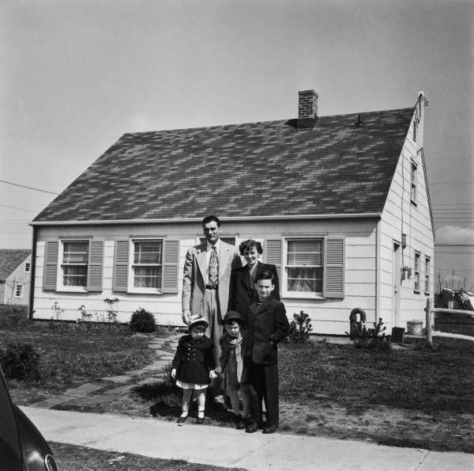
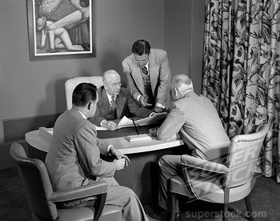
The Affluent Society
Average income triples between 1940-60
Home ownership increases (GI Bill)
Americans move to white collar and service jobs

Slide 5
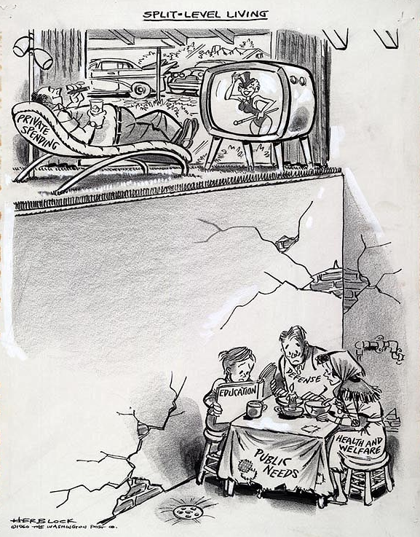
The Affluent(?) Society
30 million in poverty, mostly minorities
Most prevalent in inner cities
“White Flight”
Racial discrimination was prominent
Discrimination in schools, housing, and hiring (only earned an average 51% of what whites earned)

Slide 6
“Red-lining, white flight”

Slide 7
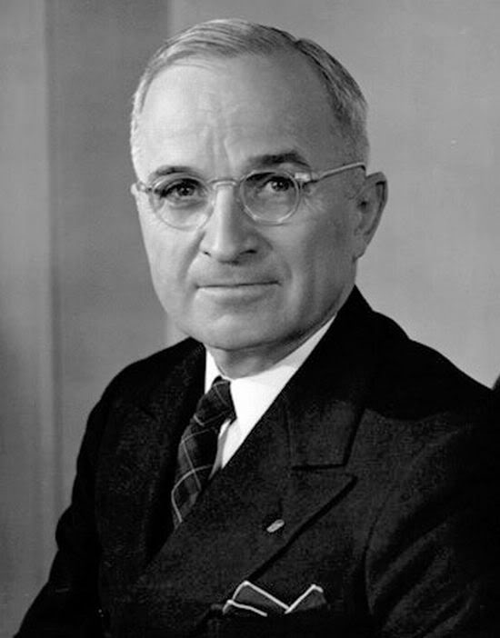
“The Buck Stops Here”
Presidents of the 1950s

Slide 8
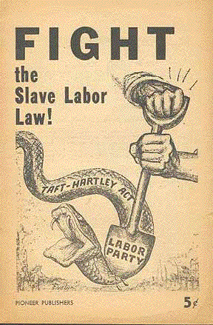
Labor Issues
Labor unrest post-WWII
Taft-Hartley Act: Restricts the activities and power of labor unions.
Prohibited certain kinds of strikes and boycotts, closed shops, and monetary donations by unions to federal political campaigns.
Required union officers to sign non-communist affidavits with the government.
Vetoed by Truman; overridden by Congress
“Slave labor bill”
Notes:
After World War II, 25 percent of the workforce was unionized, and with the war now over, their promise not to strike so as not to impede the war effort had expired.

Slide 9
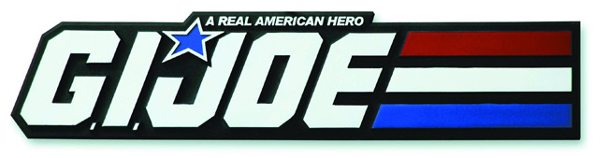
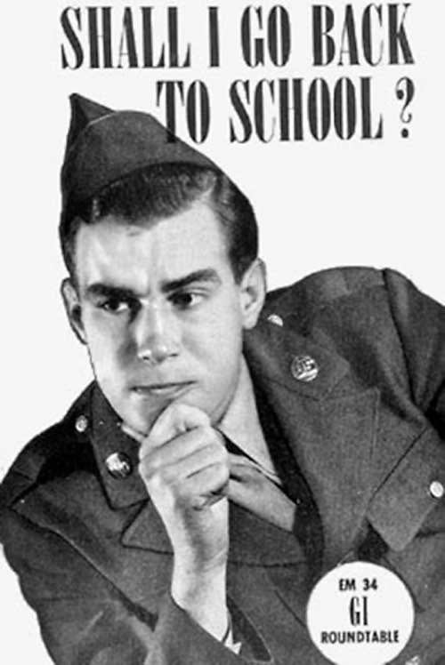
Changes for
The Servicemen’s Readjustment Act (AKA: the GI Bill), 1944: Provided a range of benefits for returning World War II veterans (commonly referred to as G.I.s).
Low-cost mortgages & loans, college/vocational education tuition, unemployment compensation.
Executive Order 9981: Abolished racial discrimination in the armed forces and eventually led to the desegregation of the armed services.

Slide 10
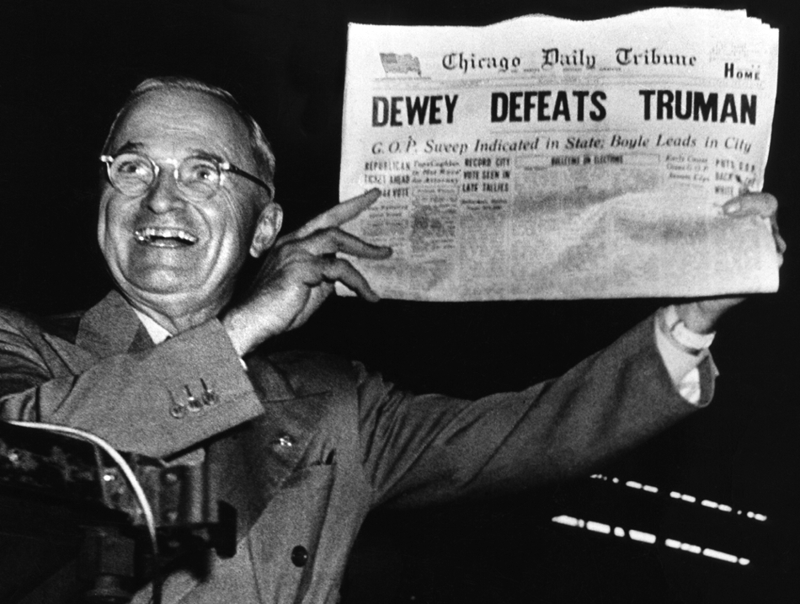
Election of 1948
Attacked the Republican “do nothing” Congress
Supported by labor, African Americans, and farmers
Won by a narrow margin

Slide 11
Truman’s Fair Deal
"Every segment of our population, and every individual, has a right to expect from his government a fair deal."
His plan focused on civil rights, health, welfare, labor, education, housing, veterans, and agriculture.
Federal aid to education
Tax cuts for low-income earners
Abolition of poll taxes and an anti-lynching law
Farm-aid programs
Increased public housing
New TVA-style public works projects
New Department of Welfare
Repeal of the Taft-Hartley Act
Increase in the minimum wage from 40¢ to 75¢/hr.
Universal health insurance
Expanded Social Security coverage

Slide 12
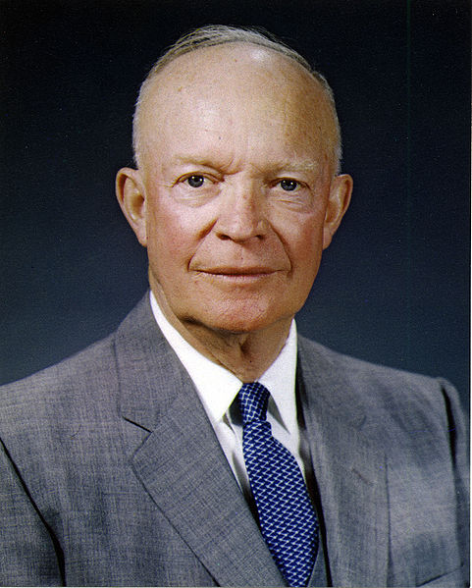
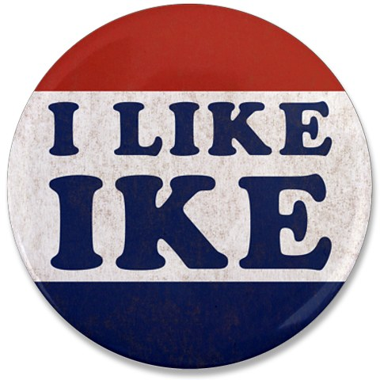
Election of 1952
Truman not nominated
WWII General Dwight D. Eisenhower runs via a grassroots campaign
CA Sen. Richard Nixon as VP
“Checkers Speech”
Sweeps the election

Slide 13
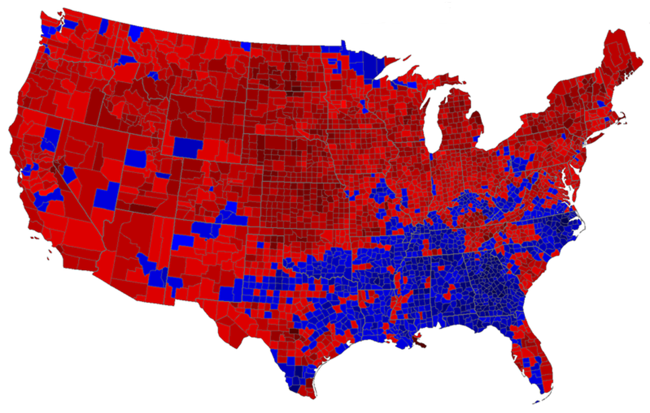
442 Electoral votes to
89 Electoral votes

Slide 14
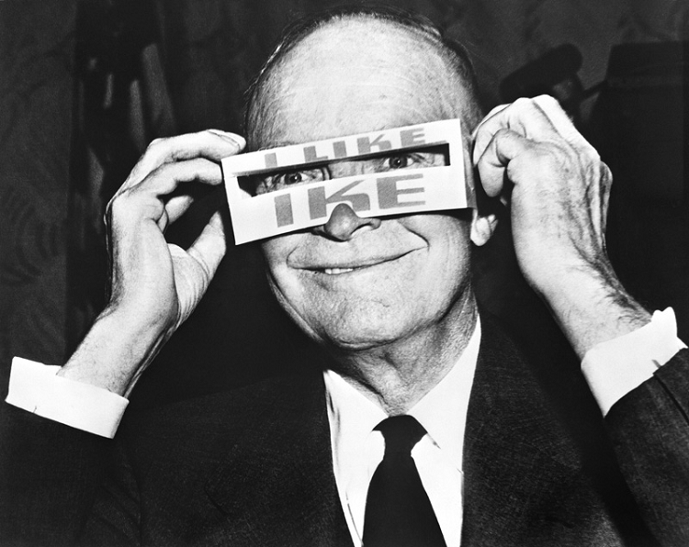
Dynamic Conservatism
Pro-business
Cut social programs
Modest tax reductions
Anti-Communist
Increased military spending

Slide 15
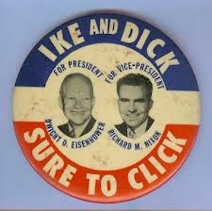
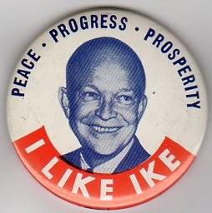
Election of 1956
The 1956 election was a re-match of 1952
Eisenhower wins in another landslide
Had ended the Korean War
Nation was prosperous
Continued use of TV ads – this time directed at housewives

Slide 16
457 Electoral votes to
73 Electoral votes

Slide 17
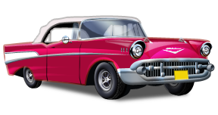
Life Is A Highway
The Golden Age of Cars

Slide 18
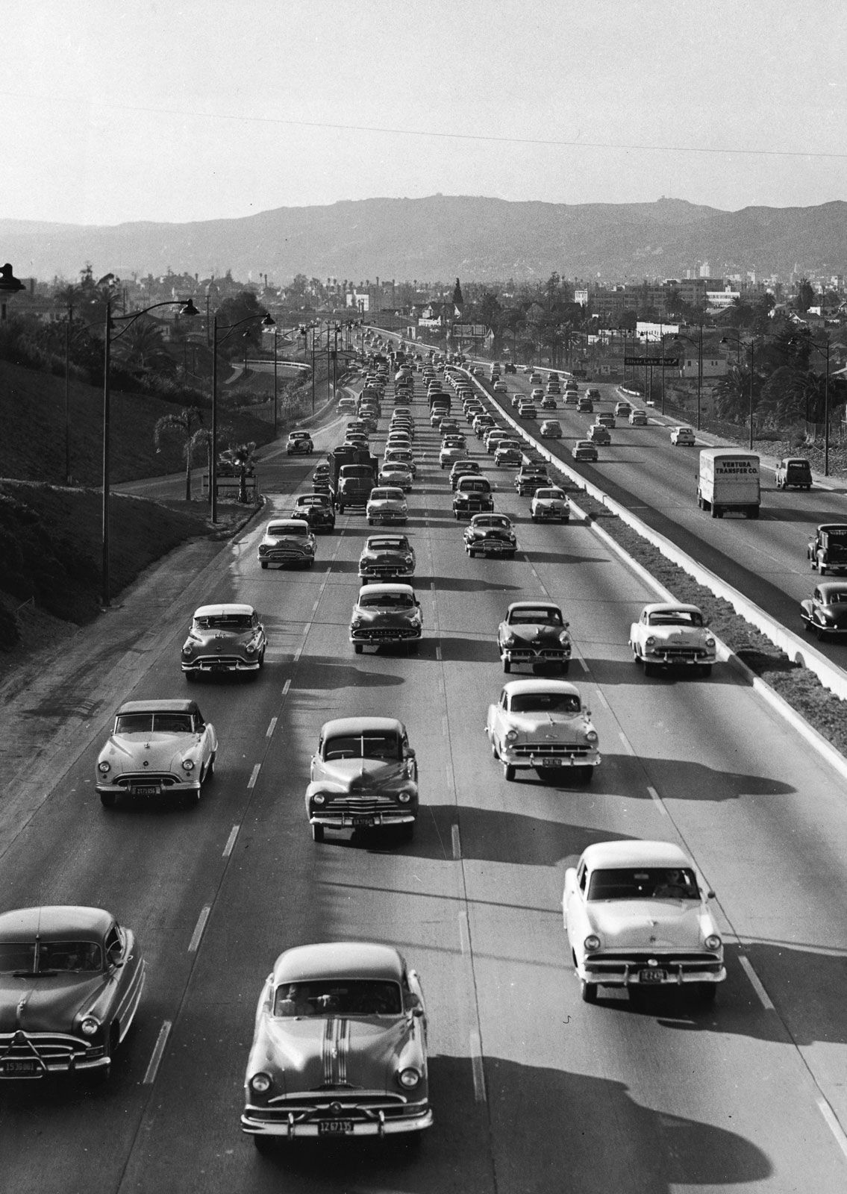
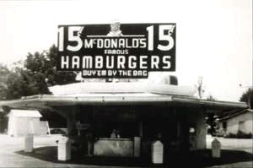
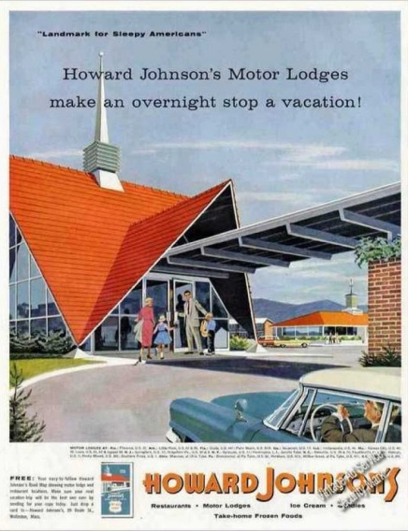
The Culture of the Car
Automobile boom post-WWII
Materials no longer rationed
National affluence
2-car homes doubles from 1951-1958
Created a new desire for driving-related businesses (e.g. drive-thru’s)

Slide 19
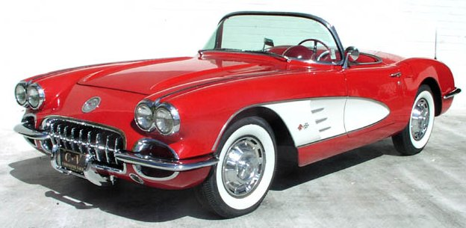
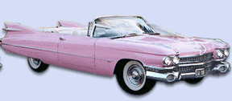
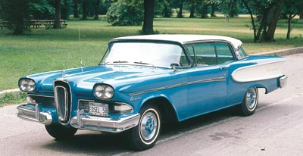
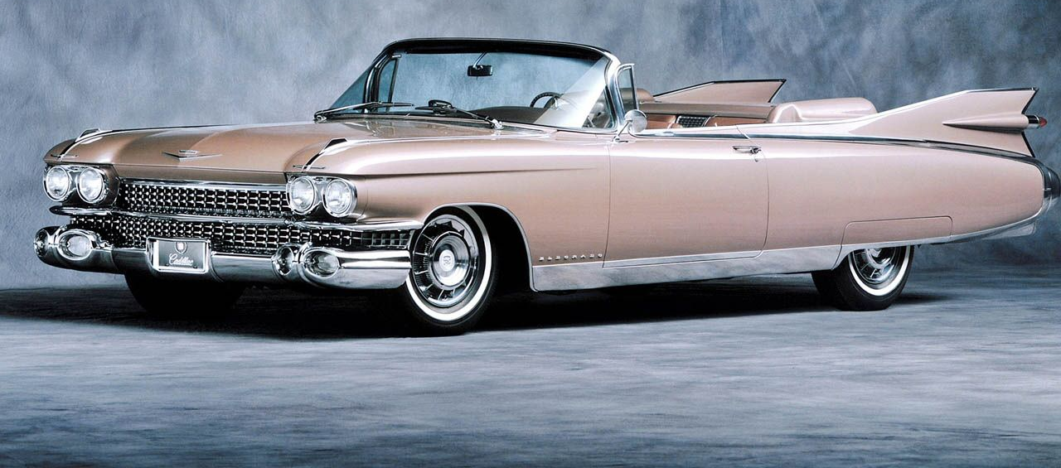
The Culture of the Car

Slide 20
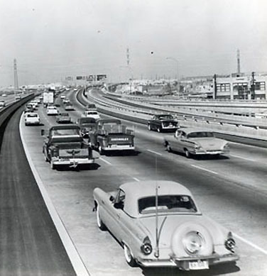
Federal Highway Act
Federal Highway Act: Authorized the construction of 41,000 miles of the Interstate Highway System
Purpose was to allow military vehicles to move quickly across the country in the event of national emergency.
More efficient distribution of goods
Suburbanization and urban sprawl
Speed/ease of travel
New road culture
Notes:
It was expected that the money would be generated through new taxes on fuel, automobiles, trucks, and tires.

Slide 21
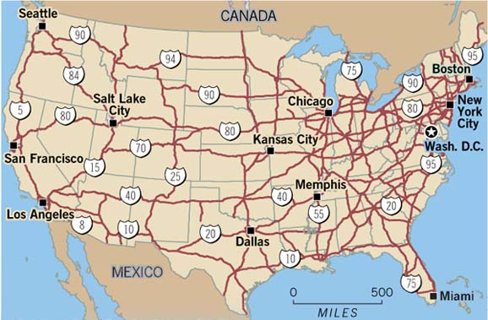
Odd Numbered
Highways
Even Numbered Highways

Slide 22
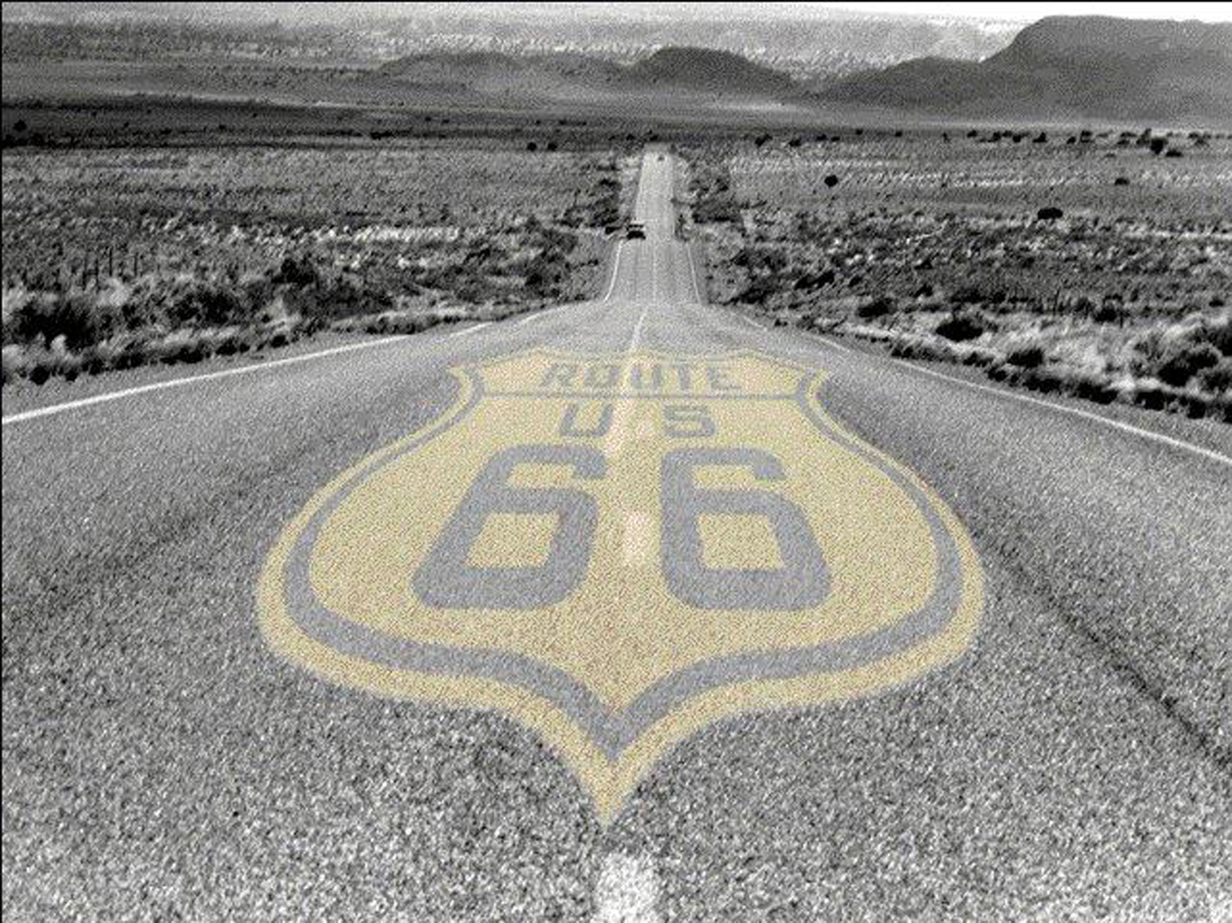
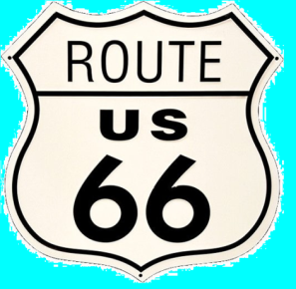
Route 66
Well if you ever plan to motor west Travel my way that the highway that’s the best Get your kicks on Route 66 Well it winds from Chicago to L.A. More than 2000 miles all the way Get your kicks on Route 66
Well it goes from St Louis, Joplin, Missouri And Oklahoma City looks mighty pretty You’ll see Amarillo and Gallup, New Mexico Flagstaff, Arizona don't forget Winona Kingman, Barstow, San Bernardino
Would you get hip to this kindly tip And go take that California trip Get your kicks on Route 66
Well it goes from St Louis, Joplin, Missouri And Oklahoma City looks mighty pretty You’ll see Amarillo and Gallup, New Mexico Flagstaff, Arizona don't forget Winona Kingman, Barstow, San Bernardino Would you get hip to this kindly tip And go take that California trip Get your kicks on Route 66 Get your kicks on Route 66?

Slide 23
Route 66
Route 66 (AKA: Main Street USA and the Mother Road)
Ran from Chicago to Los Angeles
Only direct route linking east and west before the Interstate Highway System
The road created and supported entire cities along the route
Communities relied on commuting traffic to support their economy
Quirky shops, restaurants, hotels, and attractions dotted along the way – the road was part of the trip itself

Slide 24
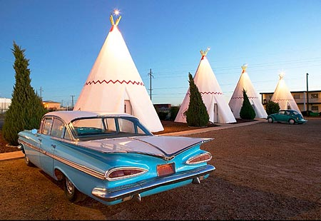
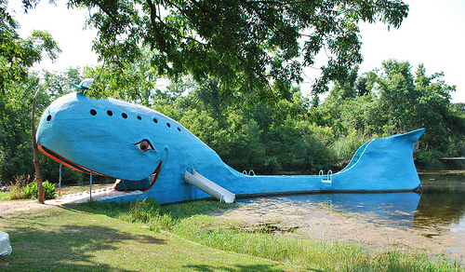
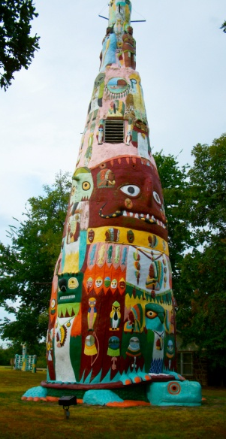
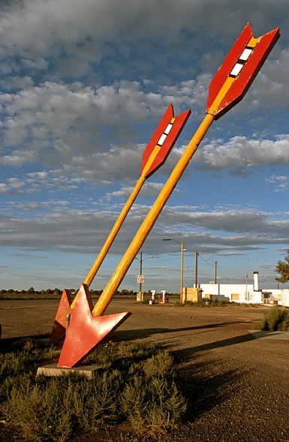
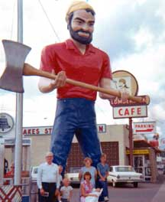
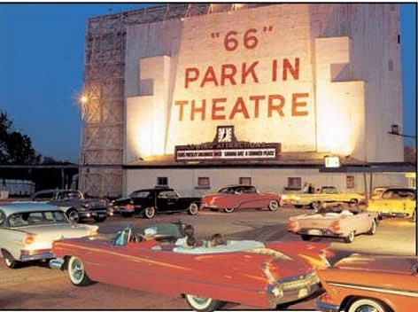
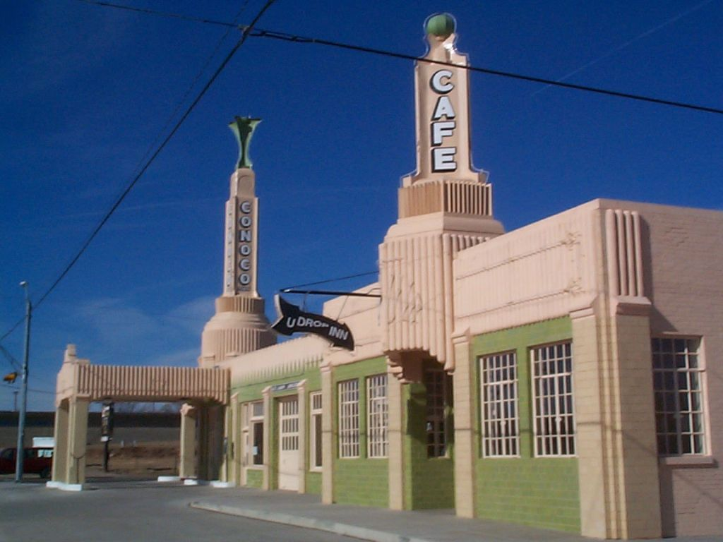
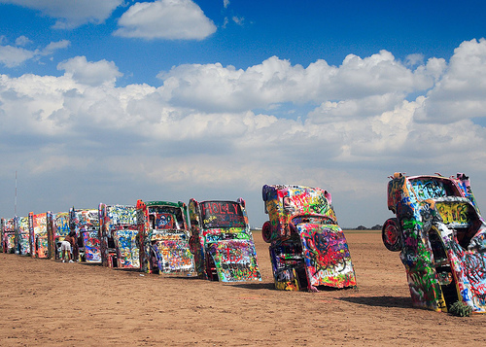
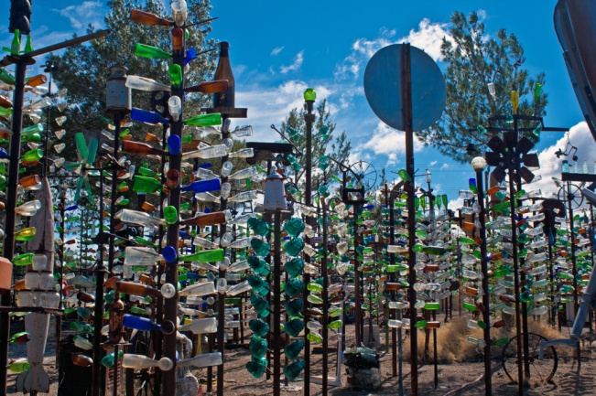
Catoosa, OK
Flagstaff,
AZ
Rogers County,
OK
Carthage, MO
Barstow, CA
Shamrock,
TX
Amarillo, TX

Slide 25
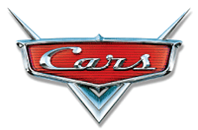
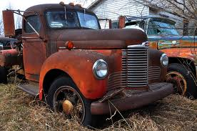
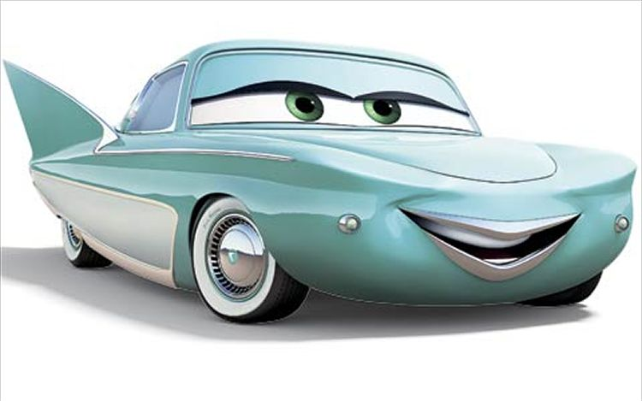
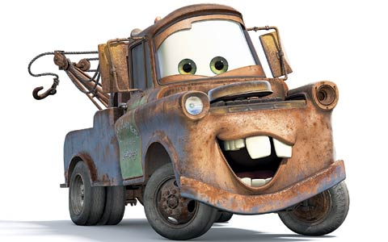
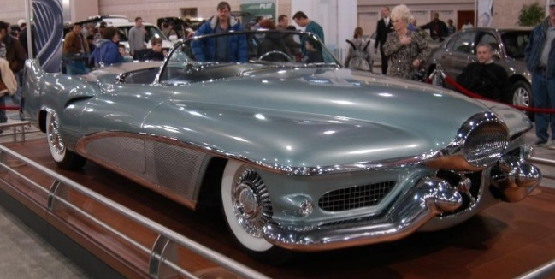
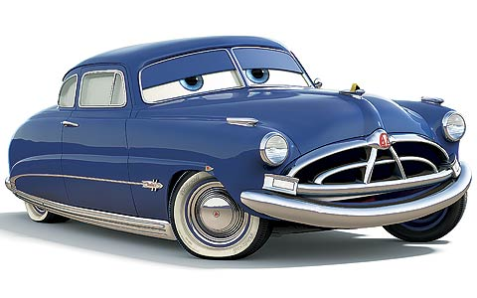
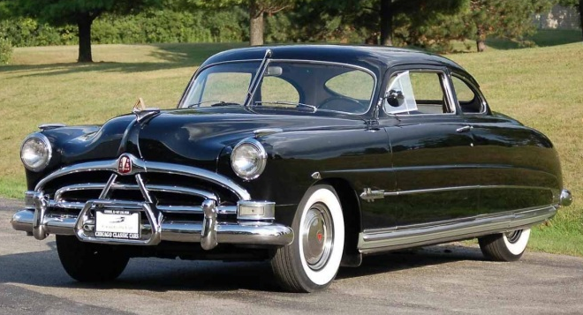
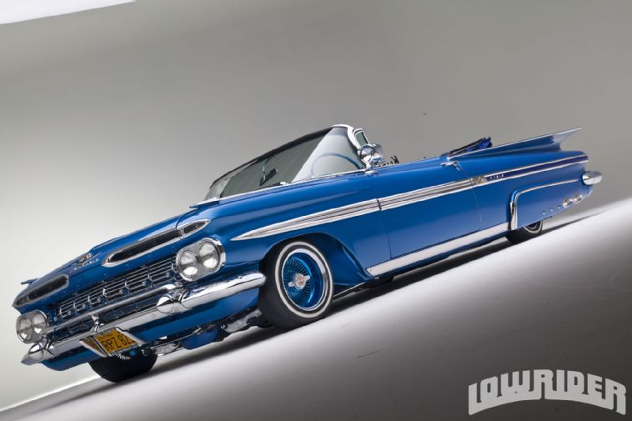
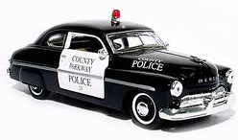
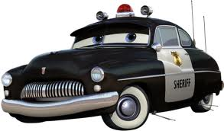
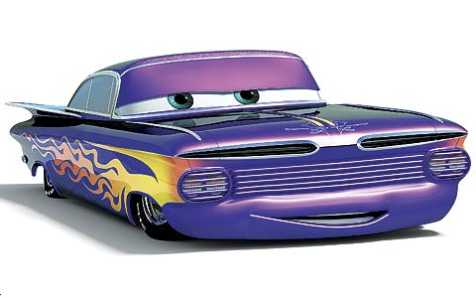
Flo: 1951 Le Sabre
Mater: 1951 International Harvester boom truck
Doc: 1951 Hudson Hornet
Sheriff: 1949 Mercury police car
Ramone: 1959 Chevrolet Impala Lowrider
Luigi: 1959 Fiat 500

Slide 26
THE REAL
The 1950s Workplace

Slide 27
The 1950s Workplace
Chain store: Stores share a brand and central management; have standardized business practices
Franchise: A supplier allows an operator to use the supplier’s trademark in return for a fee.
Uniformity
Consistency

Slide 28
The 1950s Workplace
“The Organization/Company Man”: A man completely and totally dedicated to his company
His identity and worth is directly linked to the company, its reputation, and its success
The Man in the Gray Flannel Suit, by Sloan Wilson (1956) – showed the secret discontentment of American businessmen

Slide 29
Postwar Consumerism
Keeping up with the Joneses

Slide 30
Post-War Consumerism
“Keeping up with the Joneses”
Supported by “Fordism” and Consumerism
Diner’s Club Card
More wealth=more luxury items
Consumer and household items
Ease
Comfort
Effort
Highly influenced by print and television advertising

