Slide 1
Bell Ringer
Why do you think there was such paranoia about Communist infiltration during the 1950s?

Slide 2
The Cold War Comes Home

Slide 3
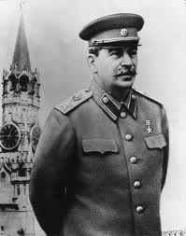
Life After Stalin
Stalin dies (1953) of a stroke (?)
Succeeded by Nikita Khrushchev
De-Stalinization: the removal of all remnants of Stalin’s regime
E.g. Stalin's body was moved from Lenin's Mausoleum in Red Square to a location near the Kremlin wall; the "hero city" Stalingrad was renamed to Volgograd; the gulag labor-camp system was repealed, etc.

Slide 4
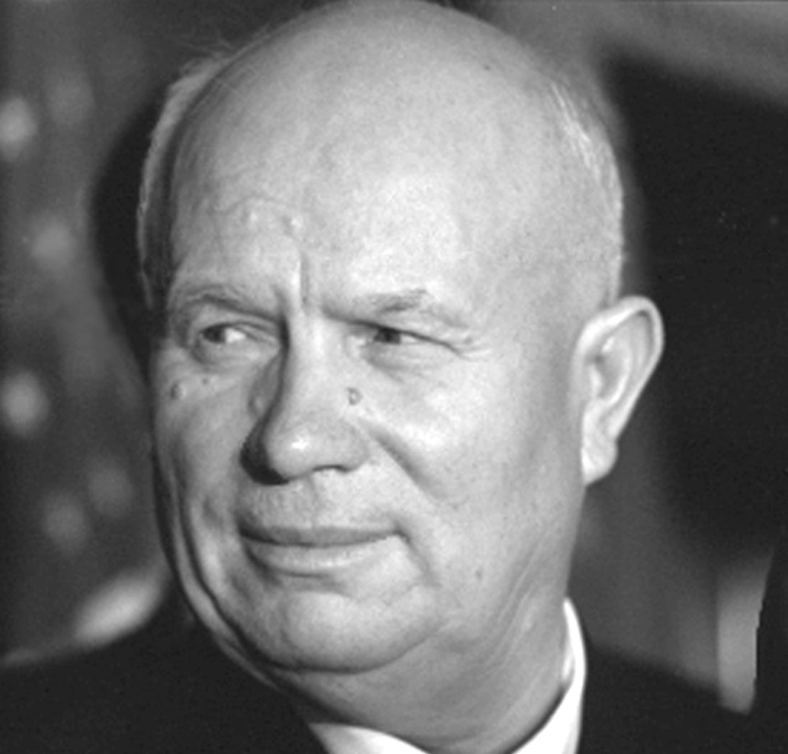
Rising Tensions
Khrushchev determined to prove superiority of communism
Began wooing new nations of Asia and Africa with promises and aid, even if they were not communist
Geneva Summit: US meets with USSR, Britain, & France to begin discussions on European security and disarmament; no agreements made
Berlin Ultimatum: Khrushchev demands Allies leave Berlin within 6 months; nothing happens
“We will bury you.”

Slide 5
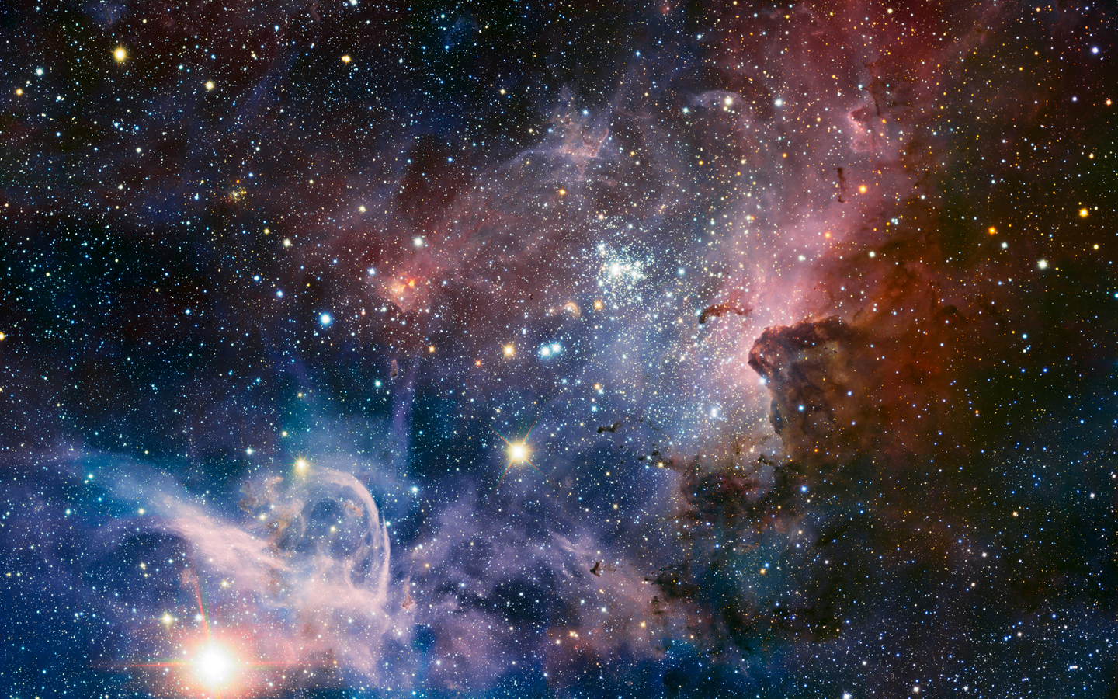
The Space Race

Slide 6
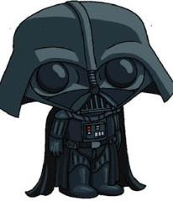
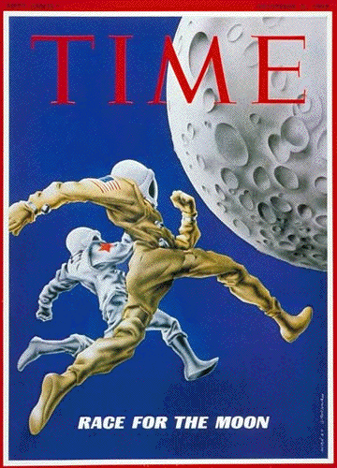
The Space Race
The Space Race: The competition of space exploration between the Us and USSR as part of the Cold War competition to achieve technological superiority.
Used by government leaders to instill hope in the future of their country and their people

Slide 7
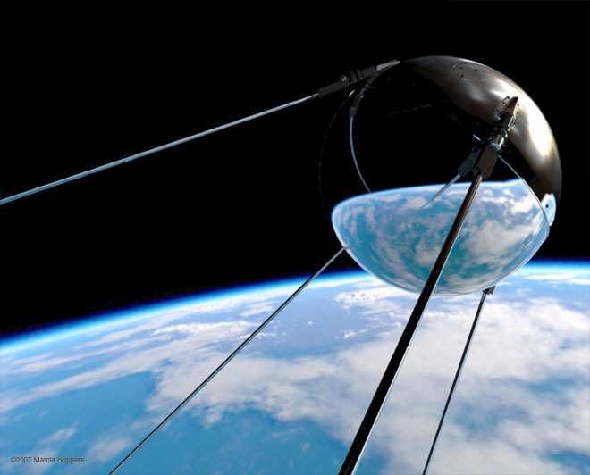
Sputnik Launches the Space Race
Sputnik: The first man-made satellite; launched by USSR in 1957
Was visible all around the Earth and its radio pulses detectable
US fearful Soviets could now launch a nuclear missile into space and then down to U.S.
Resulted in development of ICBMs

Slide 8
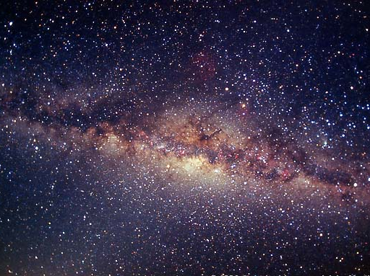
America Freaks Out
NASA (National Aeronautics Space Administration) created as a reaction to Sputnik; meant to push America further in the space race
National Defense Education Act (NDEA): Authorized funding for four years to get US schools up to speed in math and science

Slide 9
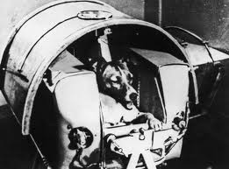
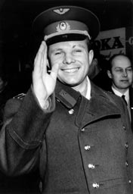
The Soviets Skyrocket Past the US
Laika – The first living being in space (1957); proved that living beings could withstand the launch and weightlessness of space.
Yuri Gagarin – the first man in space and to orbit the earth (1961); increased American fears they were falling behind the Soviets.

Slide 10
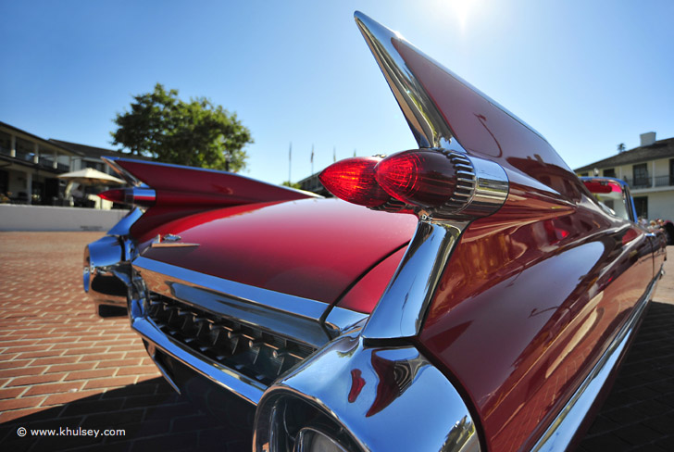
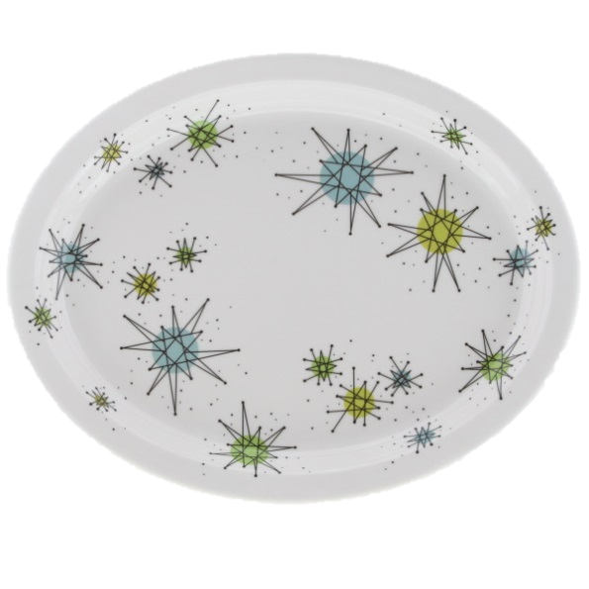
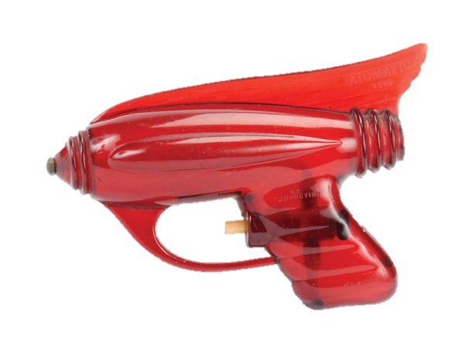
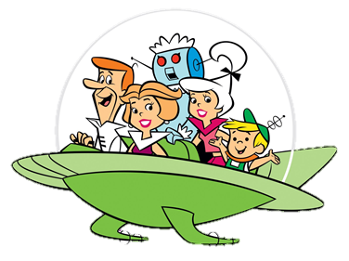
Atomic Design

Slide 11
The Red Scare

Slide 12
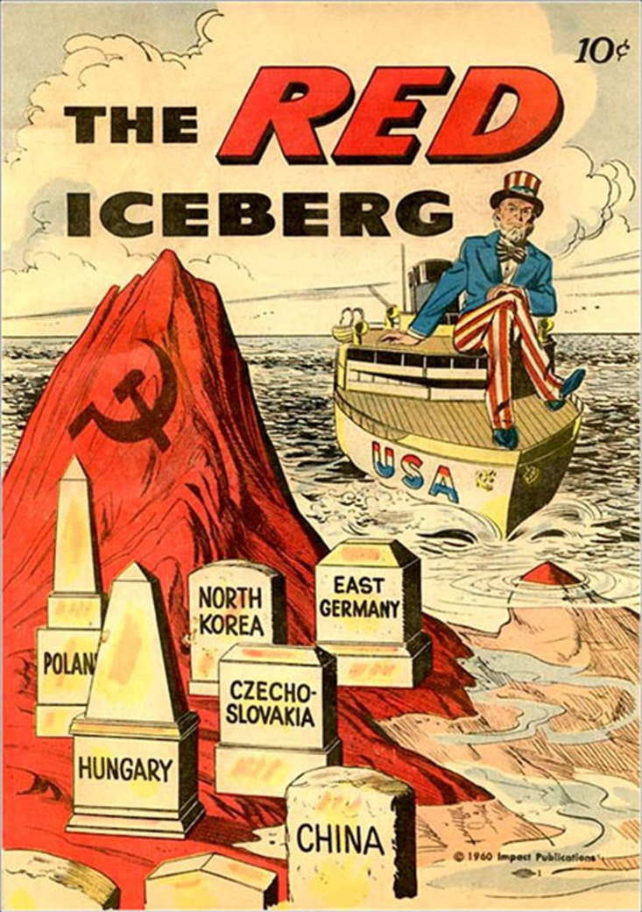
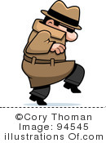
The Second Red Scare
Fears of Communist infiltration after WWII
Distrust between US and USSR during war
USSR’s failure to enter the war in the Pacific until the very end
Fears of Soviet spies (e.g. “Joe One”)
General fear of Communist subversion—an effort to secretly weaken a society and overthrow its government

Slide 13
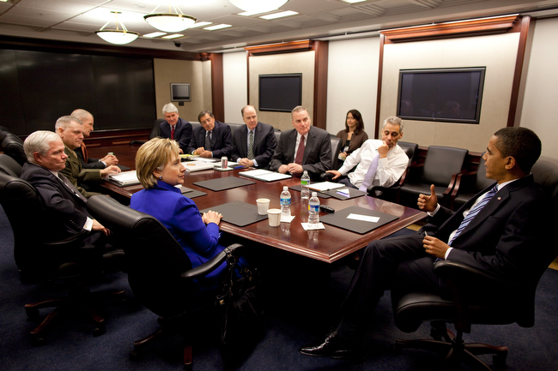
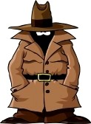
National Security Council
Created by the National Security Act (1947)
The National Security Council: Advises the President on national security and help organize cooperation among various agencies
POTUS, VP, SoS, SoD, Joint Chiefs, CIA Director, NSA, Attorney General, etc.

Slide 14
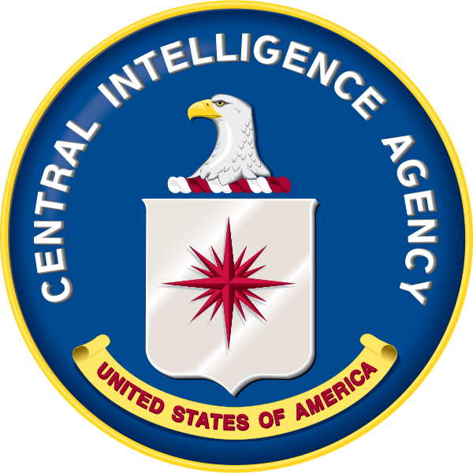
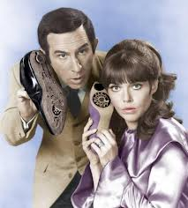
The CIA is Born
Created by the National Security Act (1947)
Central Intelligence Agency (CIA): Carries out covert operations against hostile foreign states or groups
Highly active during the Cold War, flushing out Soviet spies and administering covert operations against the Soviets

Slide 15
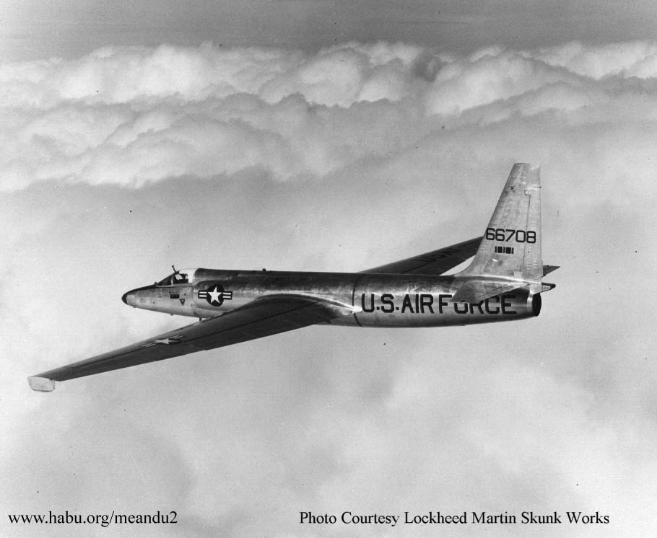
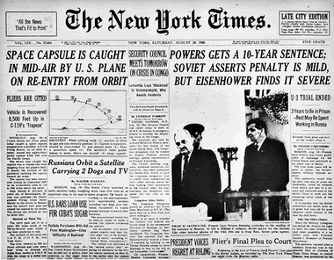
U-2 Affair
A United States U-2 spy plane was shot down over the airspace of the Soviet Union (1960)
US government denies spying; eventually is forced to admit the plane’s purpose
USSR convicts pilot Francis Gary Powers of espionage and sentences him to 10 years hard labor
Embarrassing to the U.S.
Relations with USSR deteriorate even more

Slide 16
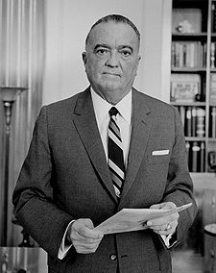
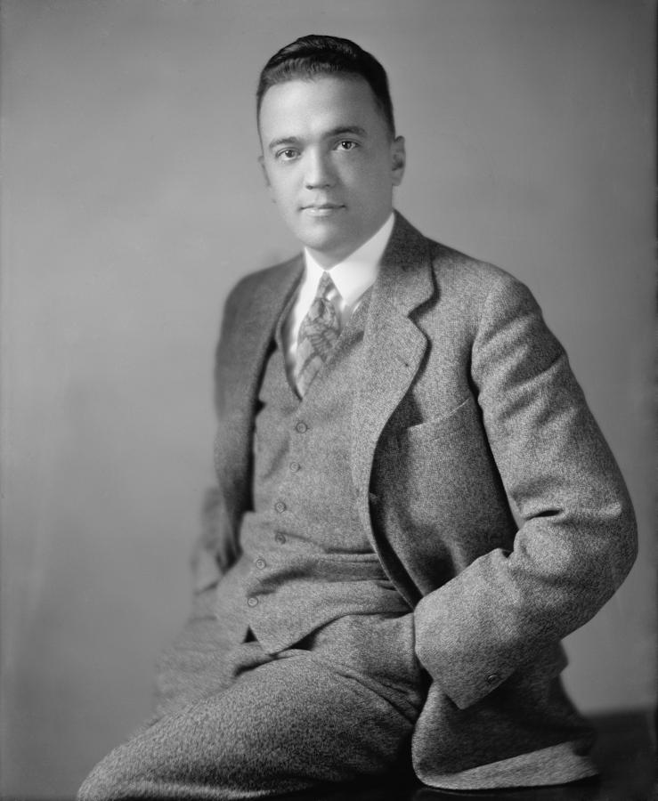
Loyalty Review Program and HUAC
"Are you now or have
you ever been a member
of the Communist Party
of the United States?"
Loyalty Review Program (1947): Screened all federal employees for loyalty
Meant to calm people’s fears; only increased fear that communists had infiltrated the government
House Un-American Activities Committee (HUAC, 1938): An Congressional committee who investigated alleged disloyalty and subversive activities in the U.S.
Encouraged by FBI Director, J. Edgar Hoover
FBI investigated suspected groups, tapped phone lines, etc.

Slide 17
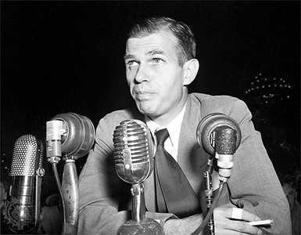
Alger Hiss
Top ranking U.S. official to be accused by HUAC
One of FDR’s top advisors (Yalta Conference; helped organize U.N.)
Accused of secretly being a Communist while in federal service
Later accused of helping others spy for the Soviets
Hiss denied the accusation; convicted of perjury

Slide 18
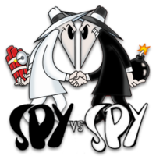
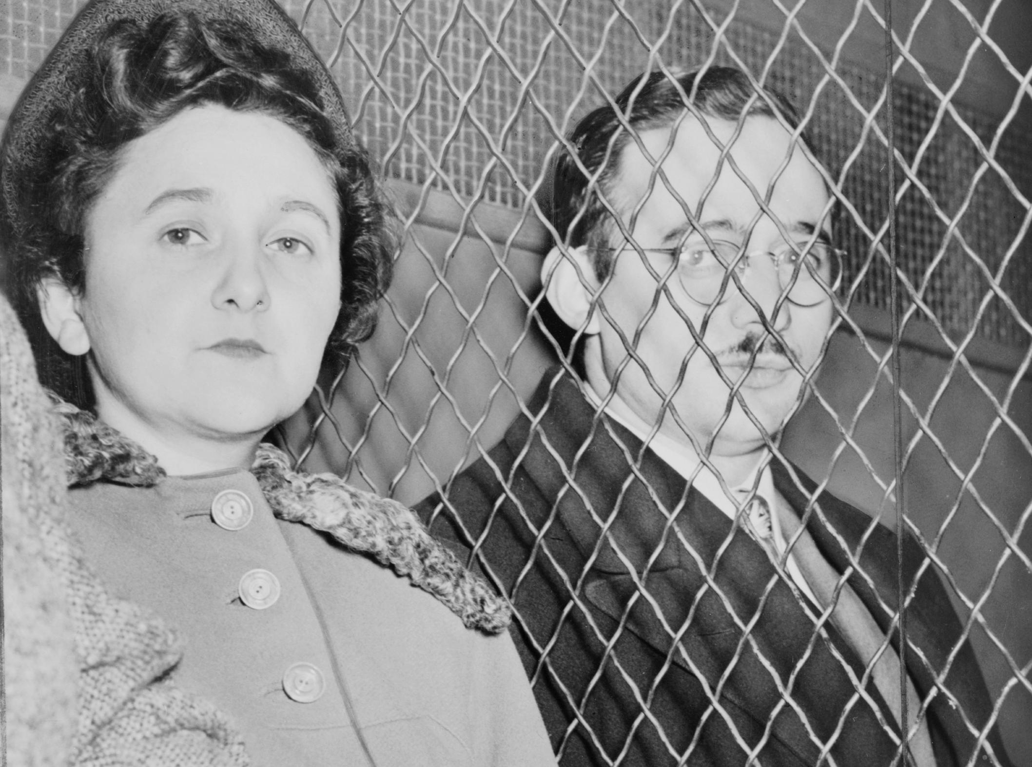
The Rosenbergs
The search for spies intensified when the Soviet Union produced an atomic bomb (“Joe One”)
Julius and Ethel Rosenberg, a New York couple who were members of the Communist Party, were charged with heading a Soviet spy ring
The Rosenbergs were convicted of conspiracy to commit espionage during a time of war
Executed by electric chair (1953)
Increased public fear; caused backlash
Notes:
In 1995, the U.S. government released a series of decoded Soviet cables, codenamed VENONA, which confirmed that Julius acted as a courier and recruiter for the Soviets but which were unclear about Ethel's involvement

Slide 19
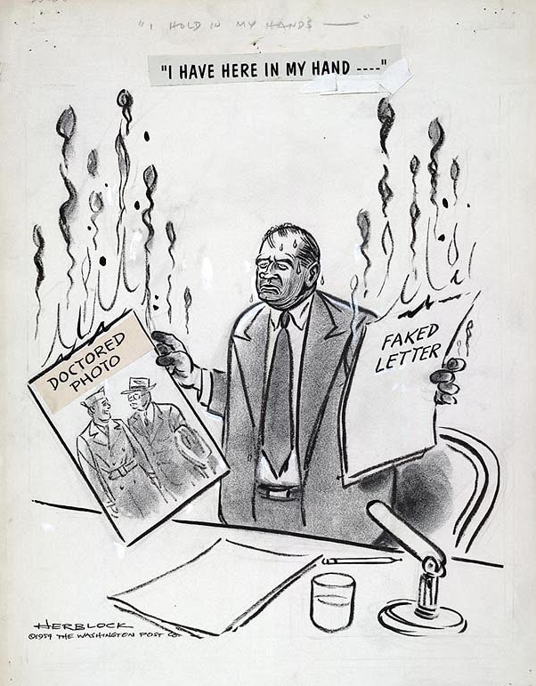
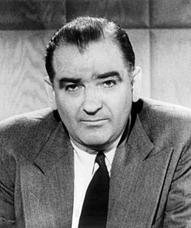
McCarthyism
Senator Joseph R. McCarthy (R) claimed that there were large numbers of Communists and Soviet spies and sympathizers inside the U.S. government
McCarthyism: A Communist witch hunt based on poor evidence and fear
Army-McCarthy Hearings (1954): Televised hearings of military troops and leaders accused of subversion
McCarthy especially aggressive during hearings
Anchorman Edward R. Murrow attacks McCarthy's tactics on television
Popularity quickly declined
Later censured by Senate for his actions

Slide 20
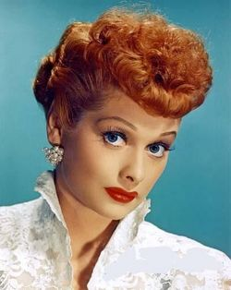
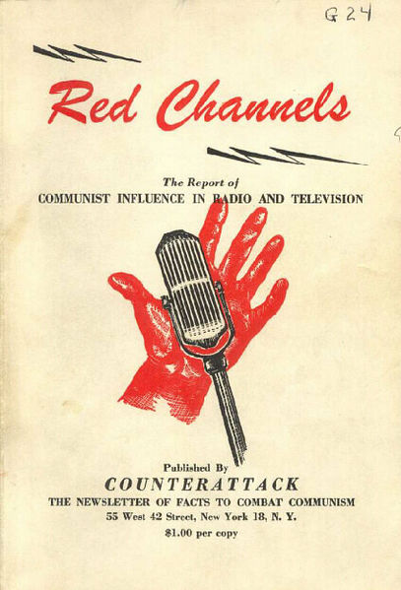
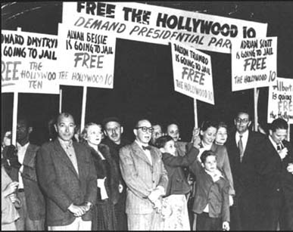
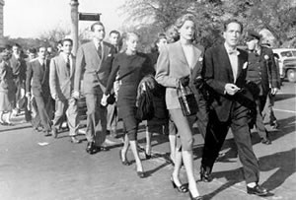
Hollywood Blacklist
Hollywood Blacklist: A list of people in the entertainment industry who were denied employment because of their political beliefs or associations, real or suspected.
E.g. Humphrey Bogart, James Cagney, Arthur Miller, Lucille Ball, etc.
Red Channels – pamphlet that focused on the impact of broadcasting in the spread of Communist propaganda
“Hollywood 10” publicly denounced HUAC’s tactics; received jail sentences and were banned from working for the major Hollywood studios

Slide 21
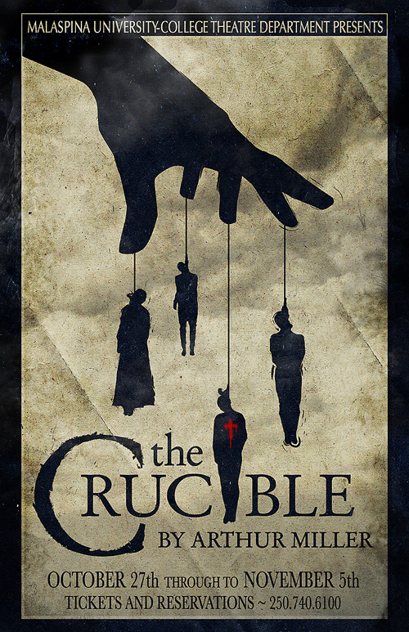
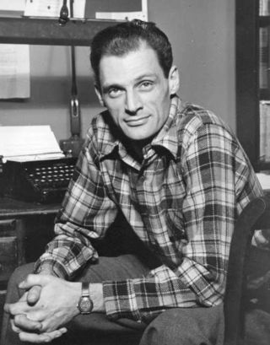
The Crucible
The Crucible, Arthur Miller: A play that dramatizes the Salem witch trials
Written as an allegory of McCarthyism, comparing the events in Salem to the hysteria of the modern day “witch hunt.”
Miller himself was questioned by the HUAC in 1956 and convicted of "contempt of Congress" for refusing to identify others present at meetings he had attended

