Slide 1
Bell Ringer
What are some of the benefits to nonviolent civil disobedience? Are there any drawbacks or consequences to using this method of protest?

Slide 2
Changing Laws Doesn’t Always Change Minds
The Successes and Failures of Civil Rights Legislation

Slide 3
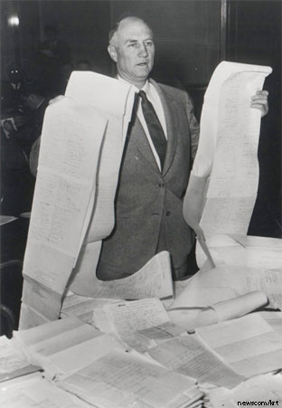
Civil Rights Act of 1957
The Civil Rights Act of 1957: Prohibited any interference with the rights of a person to vote in a federal election
The first civil rights legislation since Reconstruction
Filibustered by Senator Strom Thurmond (SC)
Longest filibuster in history
Notes:
Longest filibuster in U.S. history - over 24 hours
Passed anyway
he began with readings of every state‘s election laws in alphabetical order. Thurmond later read from the Declaration of Independence, the Bill of Rights, and George Washington's Farewell Address.
Served as a senator until his retirement in 2003 at the age of 100

Slide 4
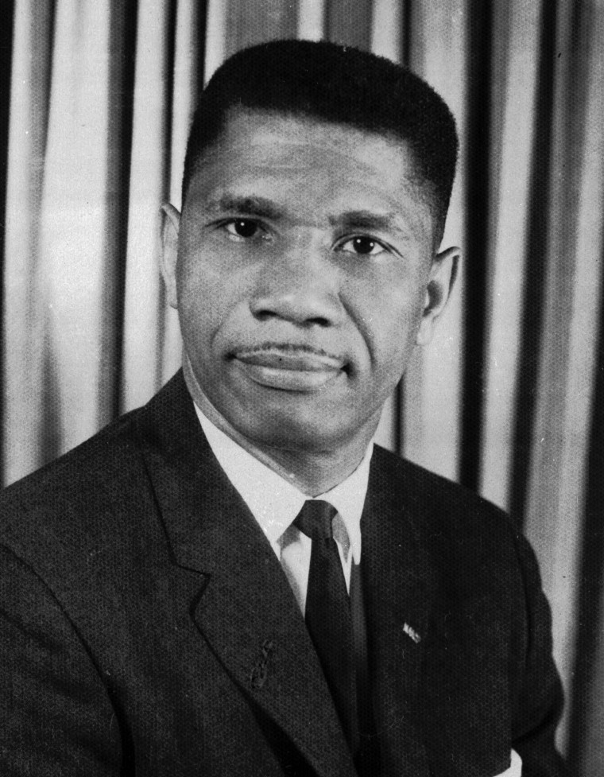
Medgar Evers (1963)
Field secretary for the NAACP in Mississippi
Murdered in his own driveway after a meeting with the NAACP; mourned nationally
He was 38 years old.
Notes:
Killed by Byron De La Beckwith
Killer charged; all-white male jury deadlocked on his guilt
Convicted based on new evidence in 1994

Slide 5
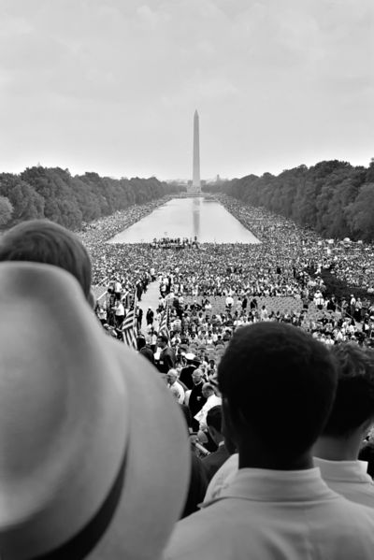
March on Washington 1963
Organized by civil rights, labor, and religious organizations
March for “Jobs and freedom”
Over 200,000 people participated
Martin Luther King’s “I Have a Dream” speech

Slide 6
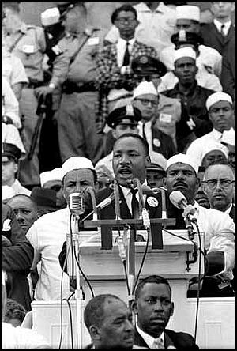
I Have a Dream!
Free at last! Free at last!
Thank God Almighty,
we are free at last!

Slide 7
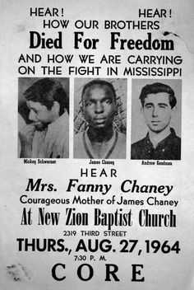
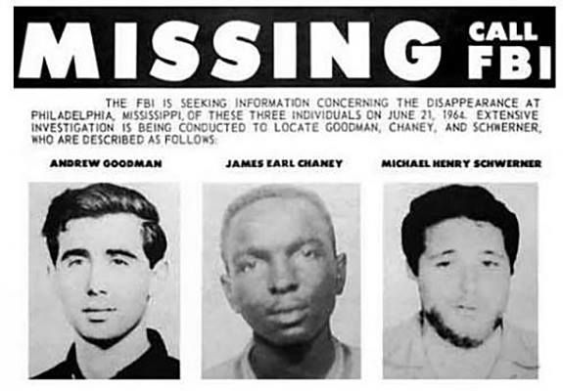
Mississippi Civil Rights Workers' Lynching (1964)
Notes:
James Earl Chaney, Andrew Goodman, and Michael “Mickey” Schwerner
Three voting rights activists were threatened by the local Klan in Mississippi after speaking at a church and urging the congregation to register to vote
Later, Klansmen attacked the congregation and burned the church in order to lure the activists back to town
The three men were brutally beaten, shot, and buried by members of the Klan and local police
Resulted in the largest televised search in history
Bodies found 44 days later

Slide 8
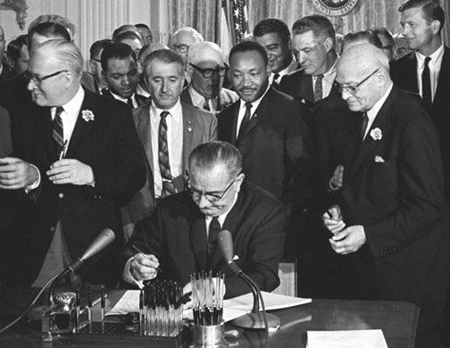
Civil Rights Successes
Civil Rights Act of 1964: Outlawed major forms of discrimination against minorities and women
Ended unequal voter registration requirements and segregation in schools, work, and the public
24th Amendment: Outlawed poll taxes
Voting Rights Act of 1965: Outlawed literacy tests

Slide 9
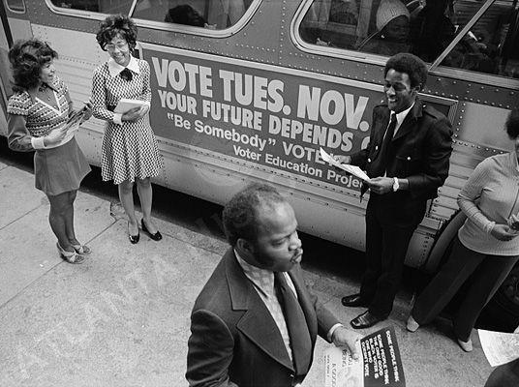
Voter Education Project
Raised funds for voter education and registration in Southern states
Developed by RFK
Voter Mobilization Tours: Campaigned from town to town and from door to door, encouraging southerners to register to vote

Slide 10
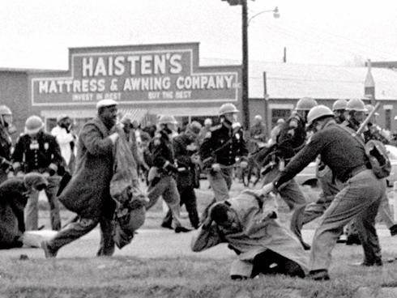
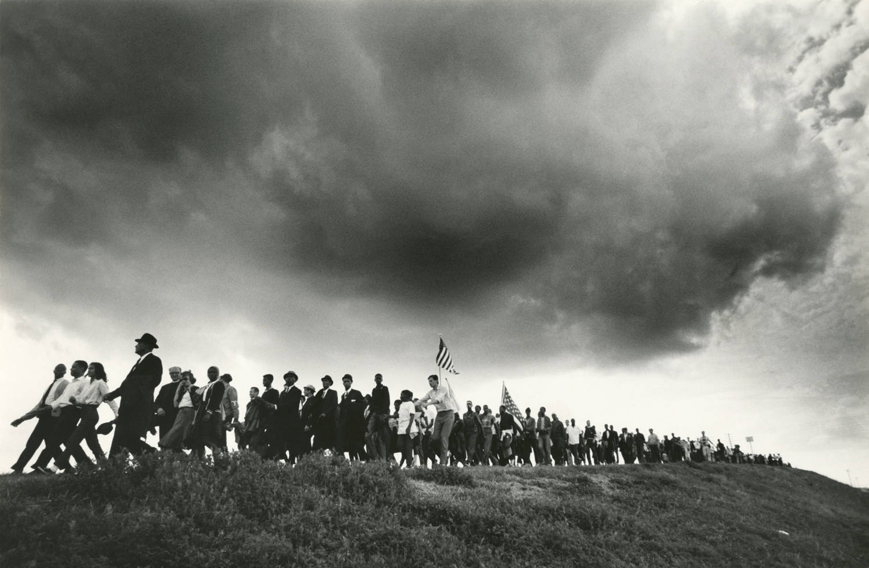
Selma to Montgomery Marches
Organized by SNCC and the SCLC under MLK
Determined to march from Selma to the capitol in Montgomery in support of African American voting rights
"Bloody Sunday“: 600 marchers were attacked by state and local police with billy clubs and tear gas
The second march was turned around halfway because of a court injunction
The third march successfully reached Montgomery under the protection of almost 4,000 U.S. soldiers

Slide 11
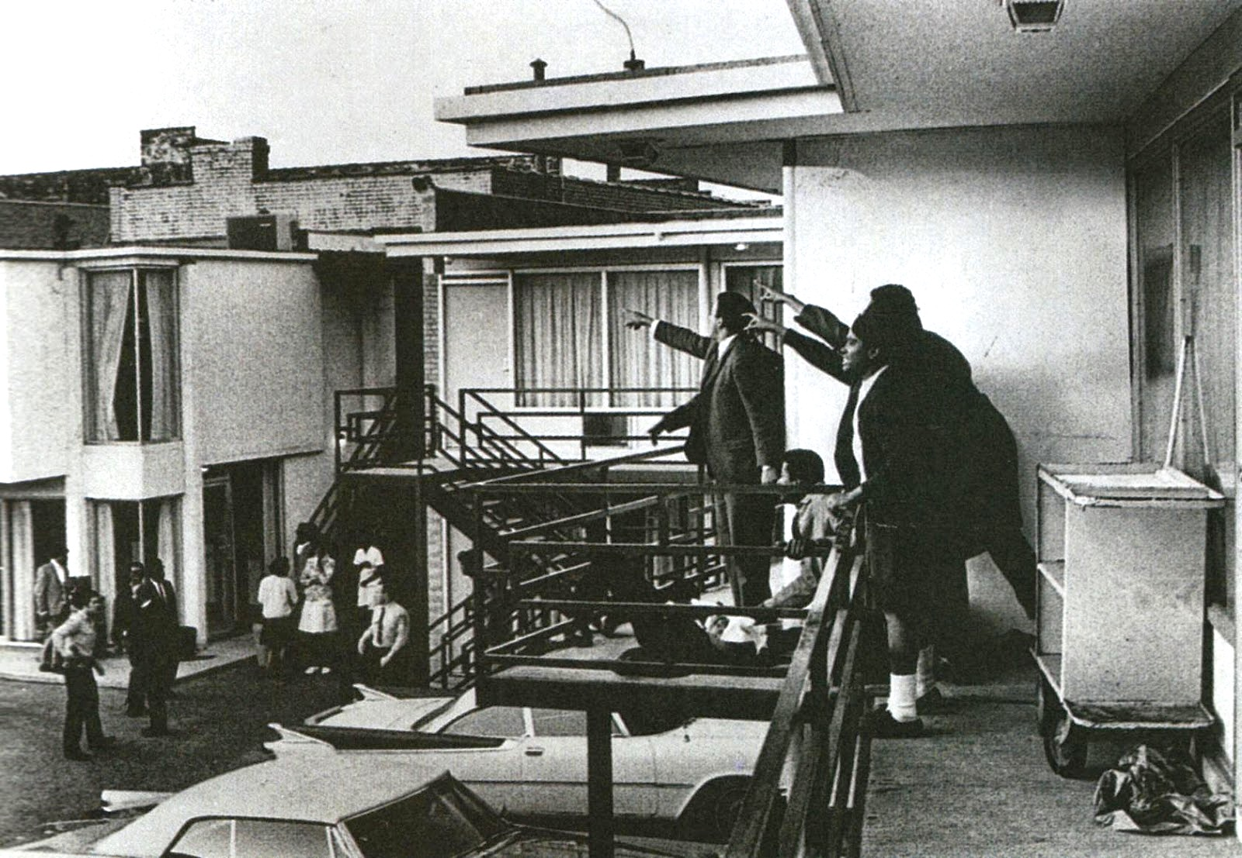
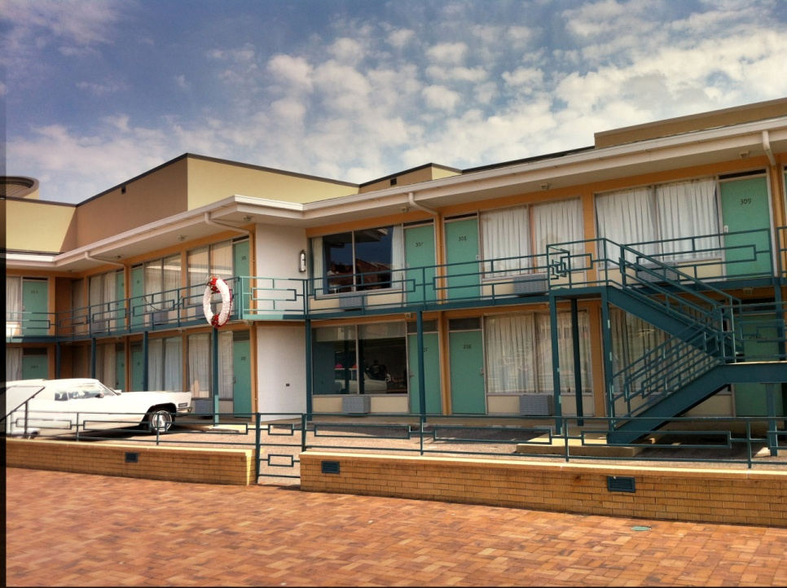
Notes:
April 4, 1968
Killed by James Earl Ray

Slide 12
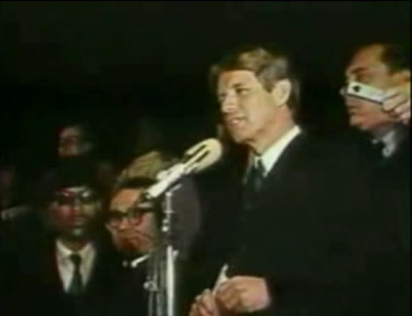
Effects of MLK’s Death

Slide 13
…Divided We Fall
Divisions Destroy the Civil Rights Movement

Slide 14
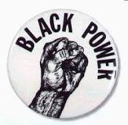
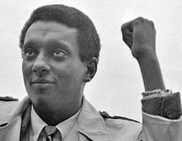
Black Power Movement and Stokely Carmichael
Former leader of SNCC
Unhappy with the slow progress of MLK’s nonviolent civil disobedience
Coined the term “black power”; emphasized racial pride and the desire to create black political and cultural institutions to promote black interests and values

Slide 15
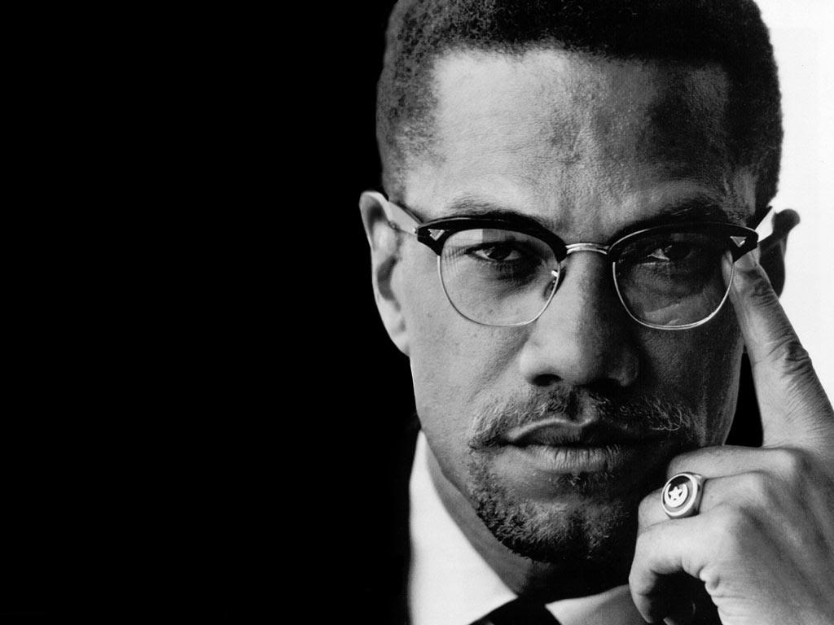
Malcolm X
Followed the Nation of Islam
Preached complete separation from whites
Demanded violent actions of self-defense
“Be peaceful, be courteous, obey the law, respect everyone; but if someone puts his hand on you, send him to the cemetery.”
Notes:
Born Malcolm Little; father killed by white supremacists

Slide 16
Malcolm X
Became disillusioned with militant Islam
Reformed after a pilgrimage to Mecca, calling for blacks and whites to work together
Assassinated by a former follower in 1965

Slide 17
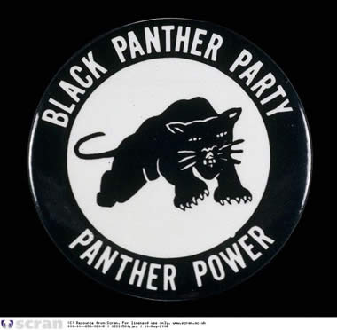
Black Panthers
The Black Panther Party for Self-Defense was founded in Oakland, California by Huey Newton and Bobby Seale in 1966
The organization initially aimed at the protection of African-American neighborhoods from police brutality
Most known for armed citizens patrols
Created social programs to alleviate poverty

Slide 18
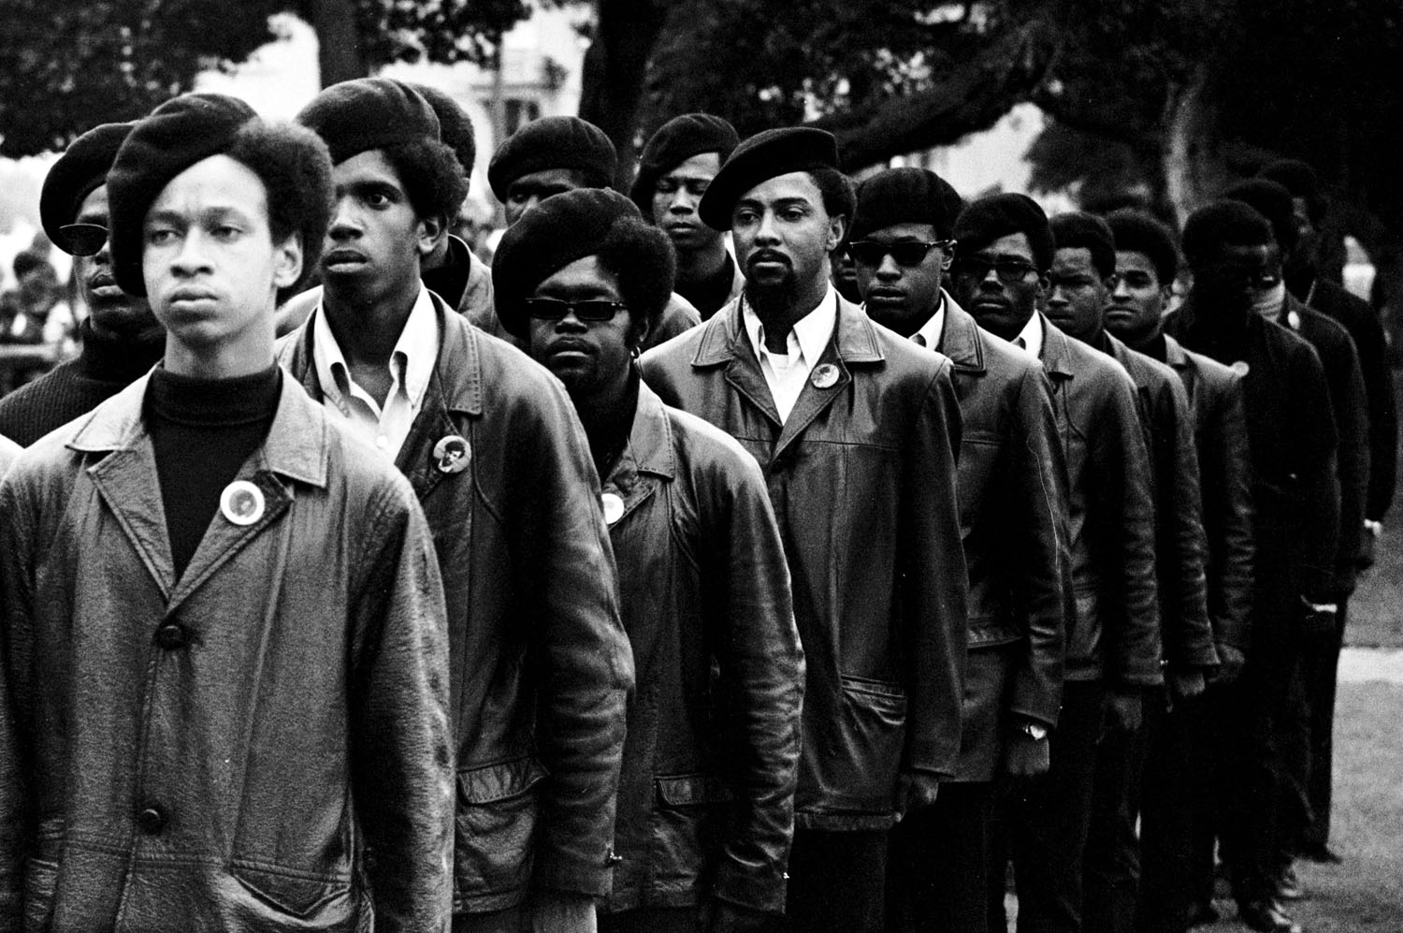
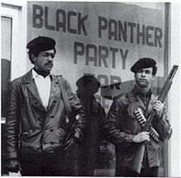

Slide 19
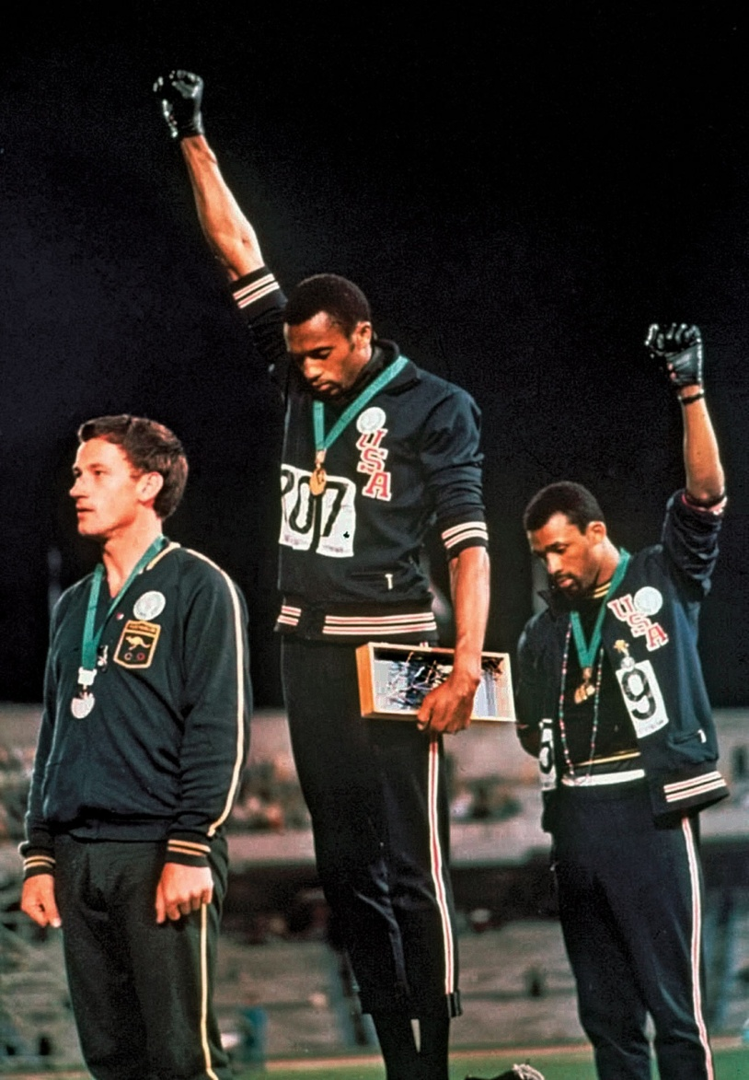
Black Power at the Olympics
Tommie Smith and John Carlos raised the Black Power salute at the medal ceremony at the 1968 Olympics
Was one of the most overtly political statements in the history of the modern Olympic Games
Drew intense criticism and scrutiny in regards to America’s continuing struggle with civil rights

Slide 21
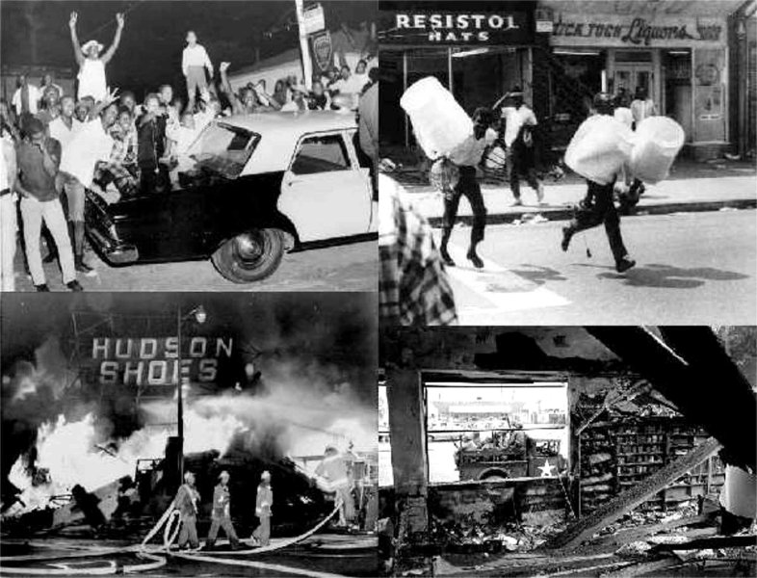
Watts Riots (1965)
Long term causes: residential segregation, police discrimination, and brutality
Immediate cause: Brutal arrest of 21-year old Marquette Frye
Riot lasted five days, with 34 deaths, thousands of injuries and arrests, and $40 million in damage
"The streets of Watts resembled an all-out war zone in some far-off foreign country, it bore no resemblance to the United States of America.”
-LAPD Sergeant Ben Dunn
Mainstream white America saw rioters as criminals destroying their own neighborhood
Black community saw themselves as fighting against oppression
Notes:
Martial law declared; eventually put down by CA National Guard
https://vimeo.com/229325605

Slide 22
The Kerner Commission
"Our nation is moving toward two societies, one black, one white—separate and unequal."
Kerner Commission: Created by LBJ to investigate the causes of race riots in the United States and to provide recommendations for the future
Kerner Report: Determined that recent race riots resulted from black frustration at lack of economic opportunity
Blamed federal government for failed policies and not enforcing laws
Blamed media for reporting “with white men's eyes and white perspective.”
Called to create new jobs, construct new housing, hire more diverse police forces, and put a stop to de facto segregation
Notes:
Became an instant best-seller (over 2 million sold)

