Slide 1
Bell Ringer
What was the court case that inspired the Brown v. Board of Education case? What law was used to argue against segregation in both cases?

Slide 2
Young People Take On Jim Crow
Sit-ins, Marches, and Boycotts

Slide 3
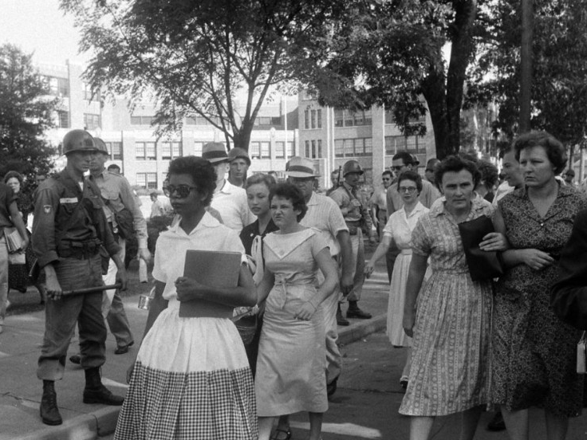
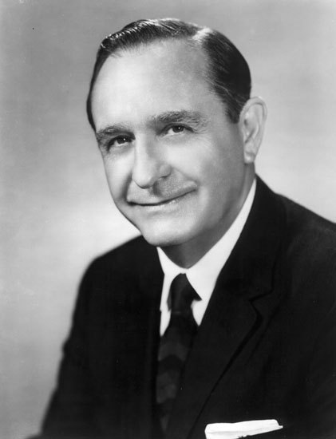
Little Rock Nine
The Little Rock Nine was a group of African-American students enrolled at Little Rock Central High School in 1957
Registered by NAACP to test Brown v. Board decision
Selected specifically because they were model students
Gov. Orval Faubus had troops from the National Guard block the entrance to the school
Mobs gathered, threatening to lynch
President Eisenhower ordered the United States Army to Little Rock, ordering them to escort the students to school

Slide 4
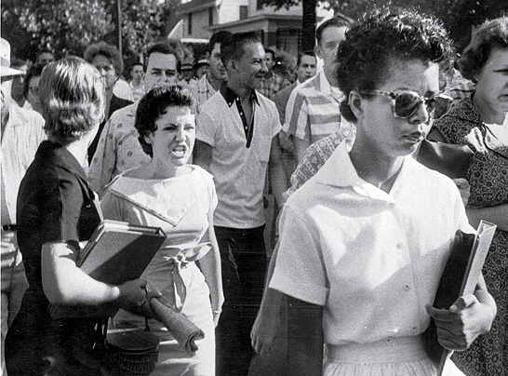
Little Rock, Arkansas, 1957

Slide 5
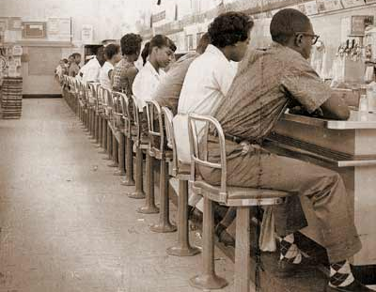
Standing Up
By Sitting Down

Slide 6
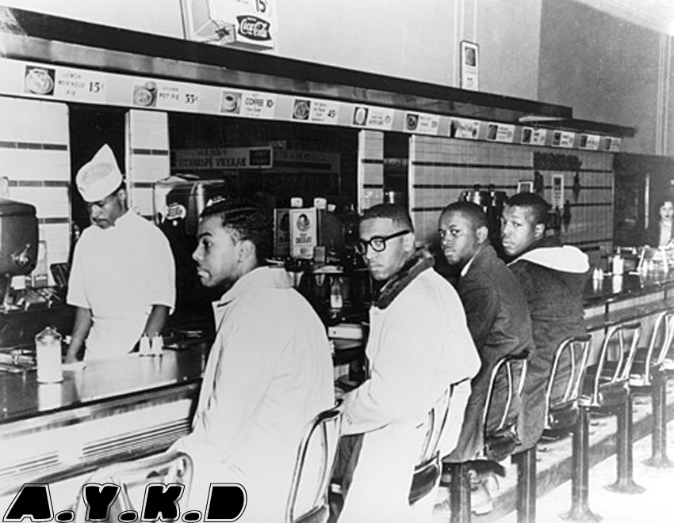
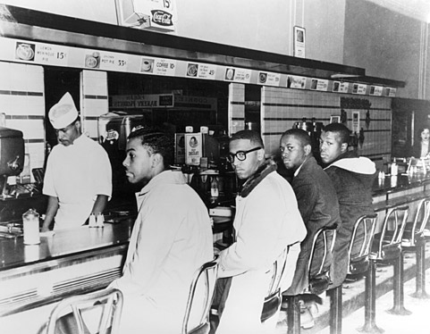
The Woolworth’s Sit-in (1960)
Four black college students sat down at the segregated lunch counter inside the Woolworth's store in Greensboro, North Carolina
Students not served; refused to leave
The group returned the following day, and it grew and grew over the following months
July 26, 1960, the entire Woolworth's chain was desegregated, serving blacks and whites alike.
Notes:
On February 1, 1960, four black students from the Agricultural and Technical College of North Carolina sat down at the lunch counter inside the Woolworth's store in Greensboro, North Carolina and ordered coffee
Following store policy, the lunch counter staff refused to serve the African American men at the "whites only" counter and the store's manager asked them to leave; the four men stayed until the store closed.
The group came back the following days with more and more participants, and then the movement began to spread to other store locations in the South.
July 26, 1960, the entire Woolworth's chain was desegregated, serving blacks and whites alike.

Slide 7
Sit-in Tactics
Dress in your Sunday best.
Be respectful to employees and police.
Do not resist arrest!
Do not fight back!
Remember, journalists are everywhere!

Slide 8
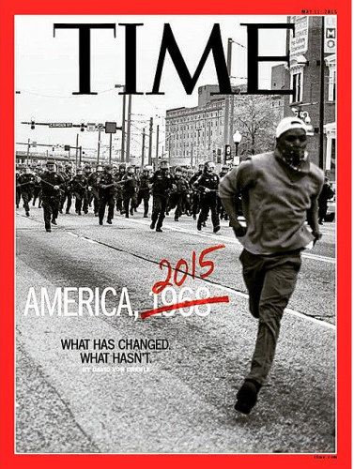
Through the lens

Slide 9
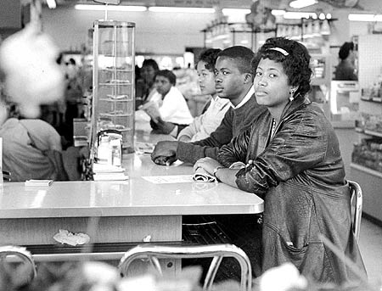
Students were ready to take your place if you had a class to attend.

Slide 10
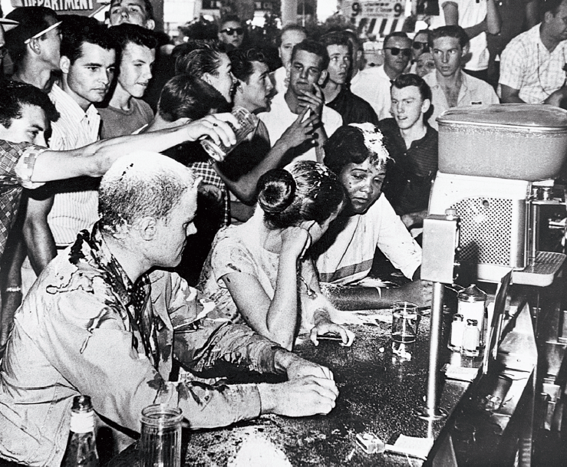
Who looks like
the bad guy?

Slide 11
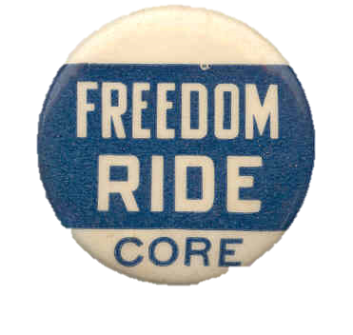
Freedom Rides (1961)
Freedom Rides: CORE volunteers, white and black, aimed to desegregate the interstate bus lines, waiting rooms, and lunch counters from Washington D.C. to Birmingham
Arrested by police for breaking local segregation laws and other minor offenses
Provoked violent reactions throughout the South, often supported by police
Caught national attention to the disregard of federal law and violence towards blacks in the South
Notes:
May 4, 1961

Slide 12
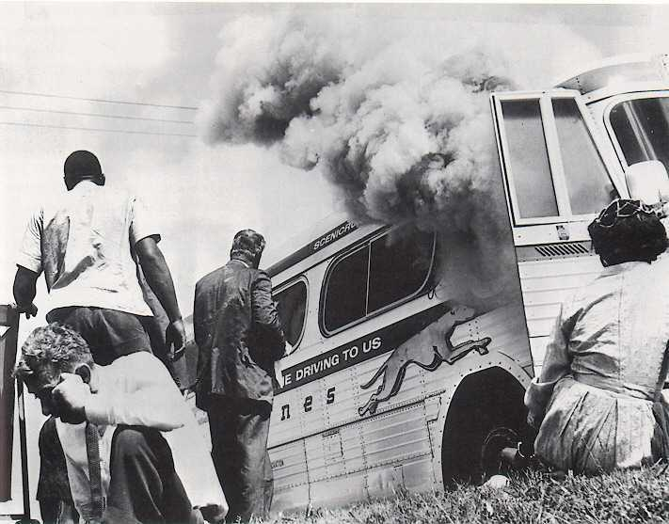
Freedom Riders Attacked!
Notes:
May 14, 1961, Anniston, Alabama.
An angry mob of about 200 white people surrounded the bus, causing the driver to continue past the bus station. The mob followed the bus in automobiles, and when the tires on the bus blew out, someone threw a bomb into the bus. The Freedom Riders escaped the bus as it burst into flames, only to be brutally beaten by members of the surrounding mob.
The second bus, a Trailways vehicle, traveled to Birmingham, Alabama, that day, and those riders were also beaten by an angry white mob, many of whom brandished metal pipes. Birmingham Public Safety Commissioner Bull Connor (1897-1973) stated that, although he knew the Freedom Riders were arriving and violence awaited them, he posted no police protection at the station because it was Mother’s Day.

Slide 13
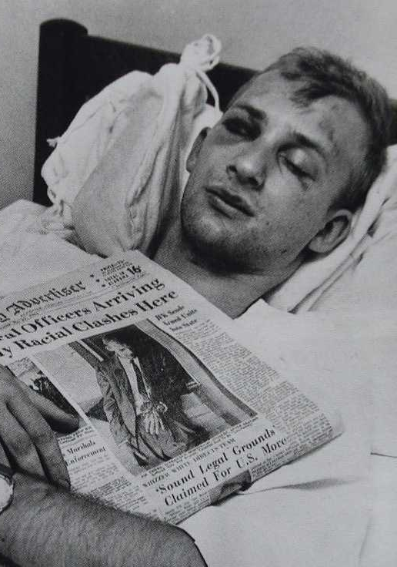
Jim Zwerg
Notes:
Jim Zwerg-

Slide 14
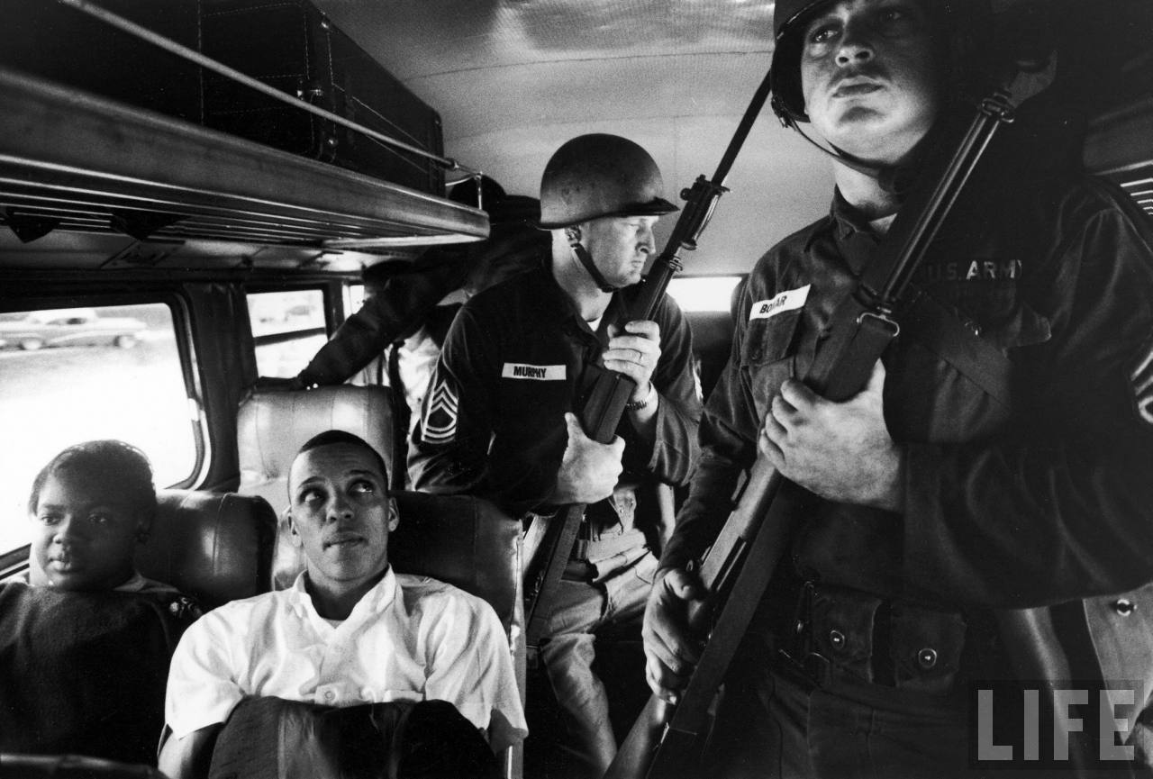
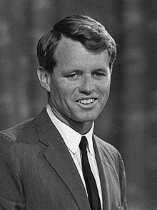
Bobby Kennedy and Civil Rights
Robert F. “Bobby” Kennedy, Attorney General
Sent one of his personal aides to join the Freedom Riders after the initial attacks to show the White House’s support for the riders; were attacked when they arrived in Birmingham
White mobs attacked the First Baptist Church in Montgomery while they held a service for those attacked in Anniston and Birmingham
Mob aimed to kill MLK if he left the church
Put down by federal marshals sent by RFK
RFK ensures safe passage for the remainder of the ride
Freedom Riders arrested when they arrived in Jackson
RFK offers to post bail, but they refused

Slide 15
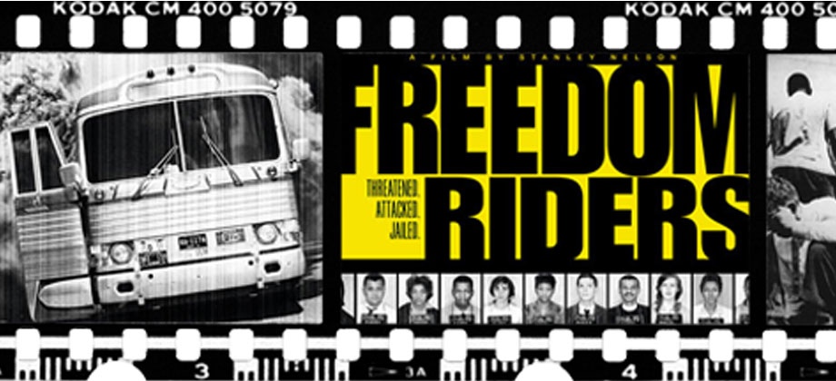
Freedom Riders Trailer
http://www.pbs.org/wgbh/americanexperience/freedomriders/

Slide 16
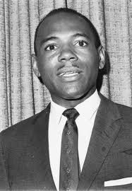
James Meredith and Ole Miss (1961)
James Meredith was the first African American to attend the University of Mississippi (“Ole Miss”)
NAACP filed a suit; SCOTUS determined that he had the right to be admitted to the public/state school
Riots ensued; hundreds injured
Riot ended by U.S. Marshals called in by RFK
Notes:
Denied enrollment twice
Mississippi Governor, Ross Barnett, tried to block him by having the Legislature pass a law that “prohibited any person who was convicted of a state crime from admission to a state school.” The law was directed at Meredith, who had been convicted of “false voter registration” under Mississippi State law.
The student protests turned violent. In the ensuing riot, two people died, 160 US Marshals were injured, and 40 soldiers and National Guardsmen were wounded.

Slide 17
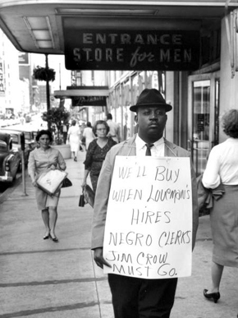
The Birmingham Campaign - 1963
Organized by MLK and the SCLC
Created to bring attention to the unequal treatment (segregation, job discrimination, violence) that black Americans endured in Birmingham, Alabama
Used nonviolent demonstrations: boycotts, marches, sit-ins, etc.
Intended to provoke mass arrests

Slide 18
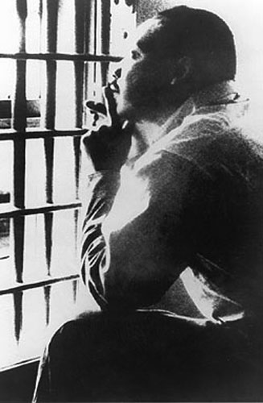
A Letter from Birmingham Jail, 1963
Written by MLK after being arrested during the Birmingham Campaign
Response to an open letter by eight white clergymen (“A Call for Unity”)
Solve it in the courts, not the streets
Called MLK a rabble-rouser who caused the trouble in Birmingham
A Letter from Birmingham Jail
The conflict existed before he arrived
Nonviolent disobedience was necessary for change
“one has a moral responsibility to disobey unjust laws."
"Injustice anywhere is a threat to justice everywhere."

Slide 19
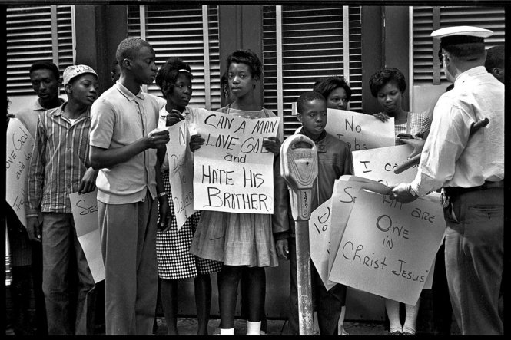
The Children’s Crusade
Children begin taking over for adults after the mass arrests of the Birmingham Campaign
Elementary to college-age
Trained by the SCLC
Non-violent demonstrations (marches, walk-outs, etc.)
Drew national attention
Police used high-pressure water jets and police dogs on protesters
Students taken to jail (and later the livestock pens at the fairgrounds)
Notes:
led by Eugene "Bull" Connor

Slide 20
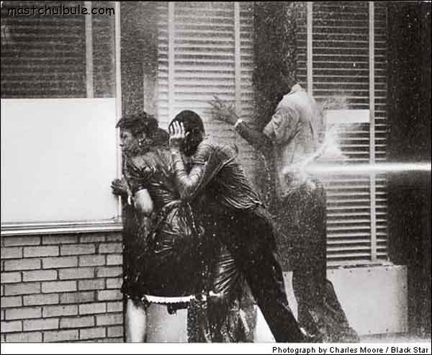

Slide 21
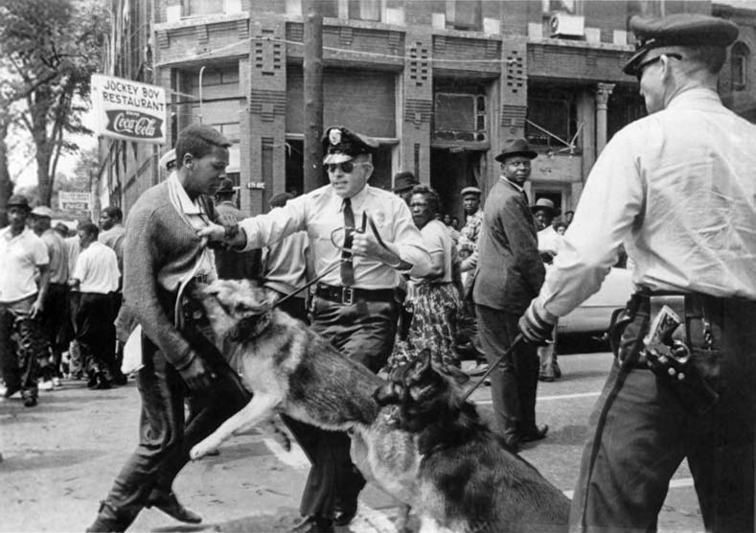
Parker High School student Walter Gadsden had been attending the demonstration as an observer for a local newspaper, but was arrested for "parading without a permit.”
Bill Hudson's image of Gadsden was published in The New York Times on May 4, 1963

Slide 22
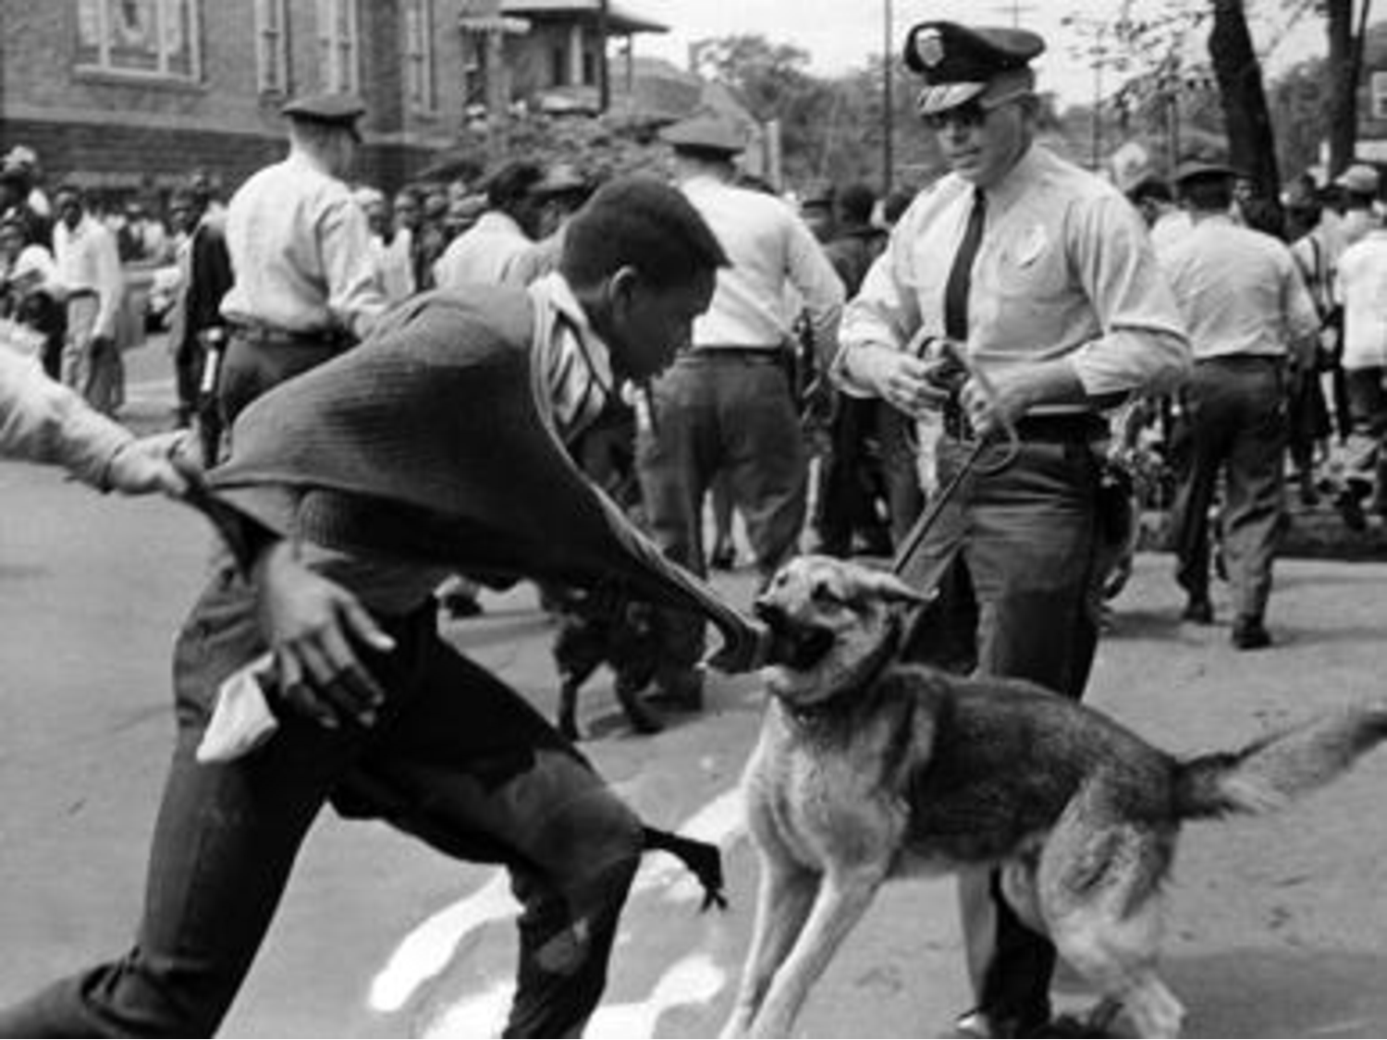
After witnessing Gadsden’s arrest, Commissioner Connor remarked to the officer, "Why didn't you bring a meaner dog; this one is not the vicious one.”
JFK called the scenes "shameful”, and said the photo made him “sick.”

Slide 23
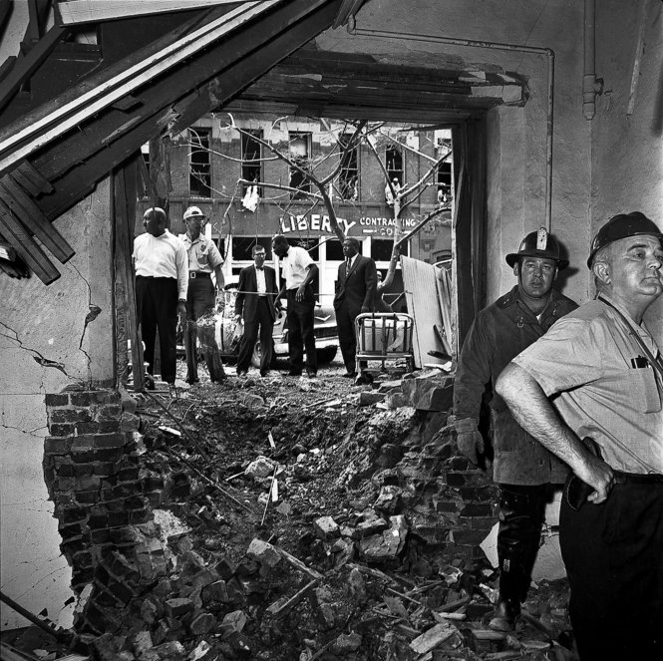
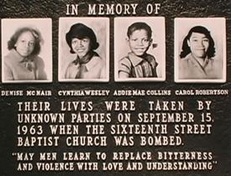
16th Street Baptist Church Bombing
The 16th Street Baptist Church had been a rallying point during the Birmingham Campaign
A box of dynamite exploded as children walked into the basement for their Sunday School class
Destroyed an entire wall of the church
Four girls were killed (ages 10-14)
A local Klansman was arrested for the crime
Acquitted of murder, but convicted of possessing dynamite
Tried and convicted by the FBI in 1977
Three others were tried and convicted in 2000
Notes:
Sunday, September 15, 1963
entitled “The Love That Forgives,” when the bomb exploded. Four girls, Addie Mae Collins (age 14), Denise McNair (age 11), Carole Robertson (age 14), and Cynthia Wesley (age 14), were killed.

