Slide 1
Bell Ringer
What is the main difference between the Truman Doctrine and the Marshall Plan?

Slide 2
Communism Spreads in Asia
Problems in China and Korea

Slide 3
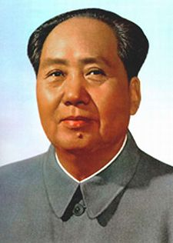
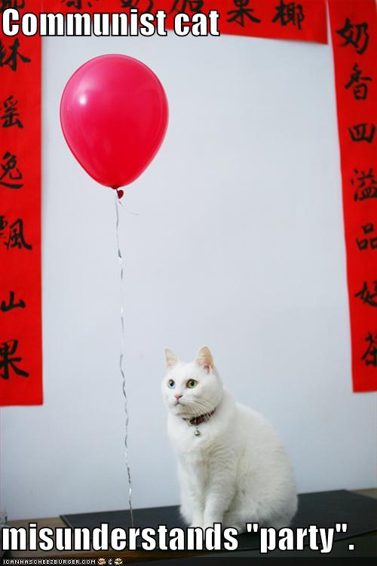
Communism Spreads to Asia
Chinese Civil War (1927-1950)
Democratic Nationalists – led by Chiang Kai-Shek
Communists – led by Mao Zedong
Nationalists defeated due to poor leadership and lack of aid of US
Communists set up the People’s Republic of China (PRC) under the leadership of Mao Zedong.
Nationalists escape to Taiwan

Slide 4
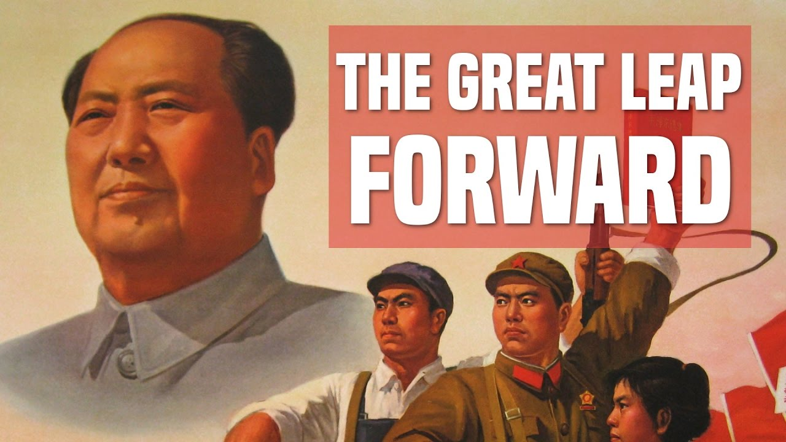
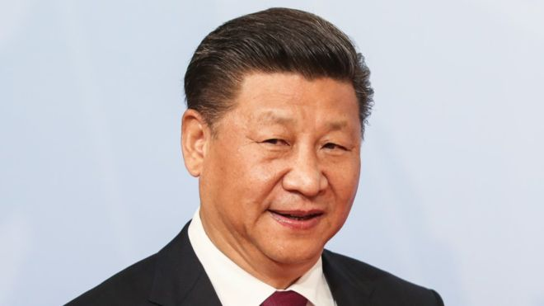
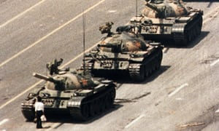
Great Leap Forward: The People's Republic of China (PRC) was an economic and social campaign by the Communist Party of China (CPC) from 1958 to 1962.
Up to 45 million killed, 2.5million tortured or killed.
Tiananmen Square Protests (1989)
Estimates range from a couple hundred to thousands killed
Tank Man →
China Today: XI Jingping
March 2018 President for Life

Slide 5
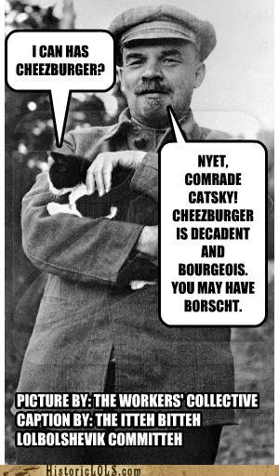
A Dangerous Friendship
PRC and USSR sign a treaty of friendship and alliance (1950)
US allows Nationalists from Taiwan to keep China’s seat on the Security Council (UN)
USSR boycotts the UN in protest
US selects Japan as new Asian ally
Adopted policies to encourage rapid economic recovery

Slide 6
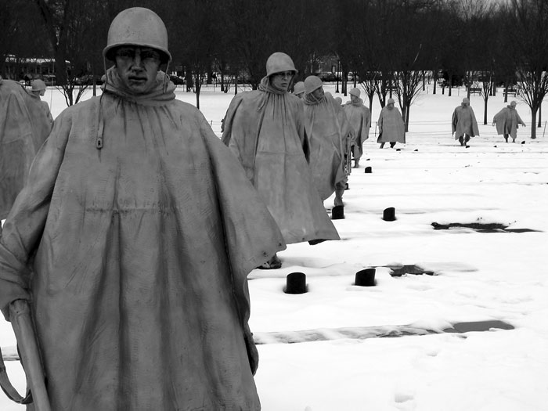
The Korean War
America’s Forgotten War

Slide 7
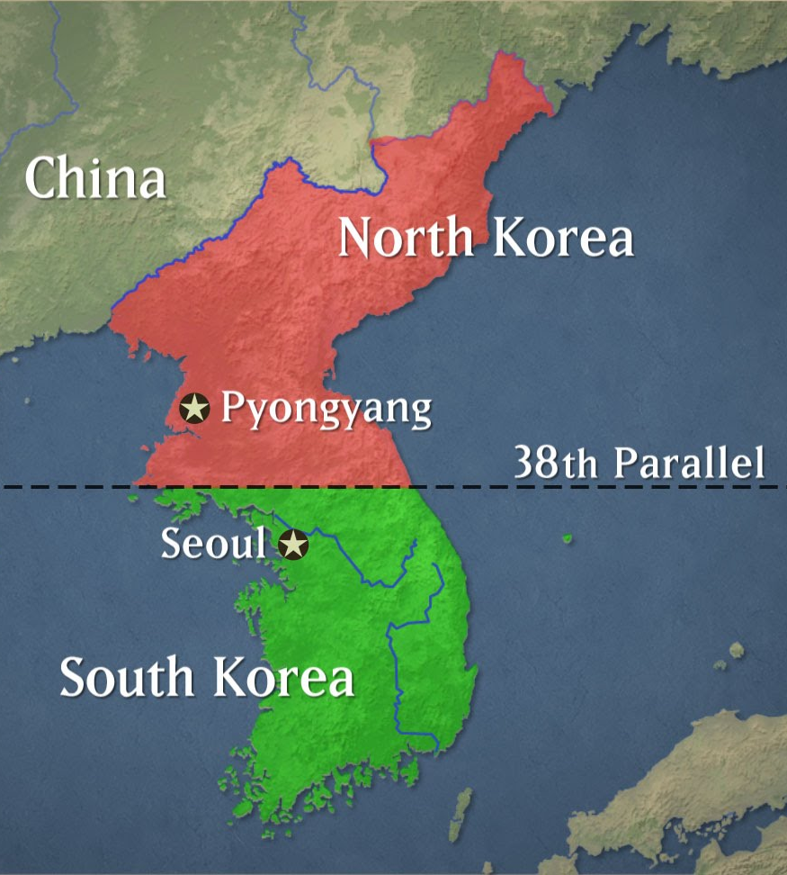
Origins of the War
US and USSR occupy Korea after defeating Japan in WWII
Korea divided at the 38th parallel
Soviets control the North, US controls the South
June 1950, North Korean troops invaded South Korea

Slide 8
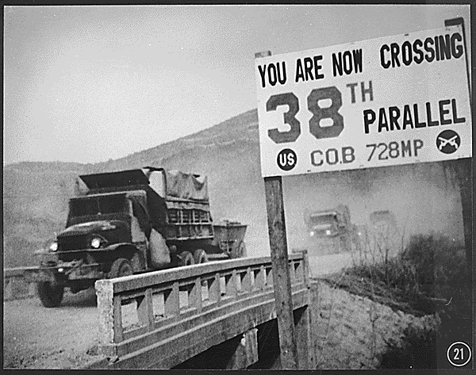
Standoff at the 38th parallel
Truman sees N. Korea’s actions as similar to Axis actions prior to WWII
S. Korea asks for UN intervention
UN forces led by Gen. Douglas MacArthur
Because the USSR boycotted the Security Council, they were unable to veto the UN’s action against their ally N. Korea

Slide 9
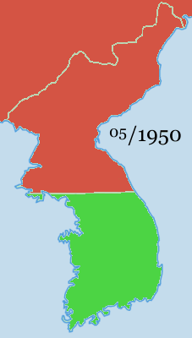
Battling for Control of the Peninsula
By September, N. Korea takes control of entire peninsula
MacArthur launches a surprise attack and pushes the N. Koreans back across the 38th parallel
UN troops push N. Koreans to the border of China
Chinese feel threatened and send troops to aid N. Korea

Slide 10
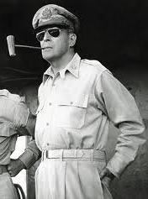
The Korean War: 1950-1953
General MacArthur calls for a nuclear attack against China for interfering
Truman disagrees – “We are trying to prevent a world war, not start one.”
MacArthur takes his case to Congress and the press instead
Truman fires MacArthur for insubordination (the President is Commander in Chief)

Slide 11
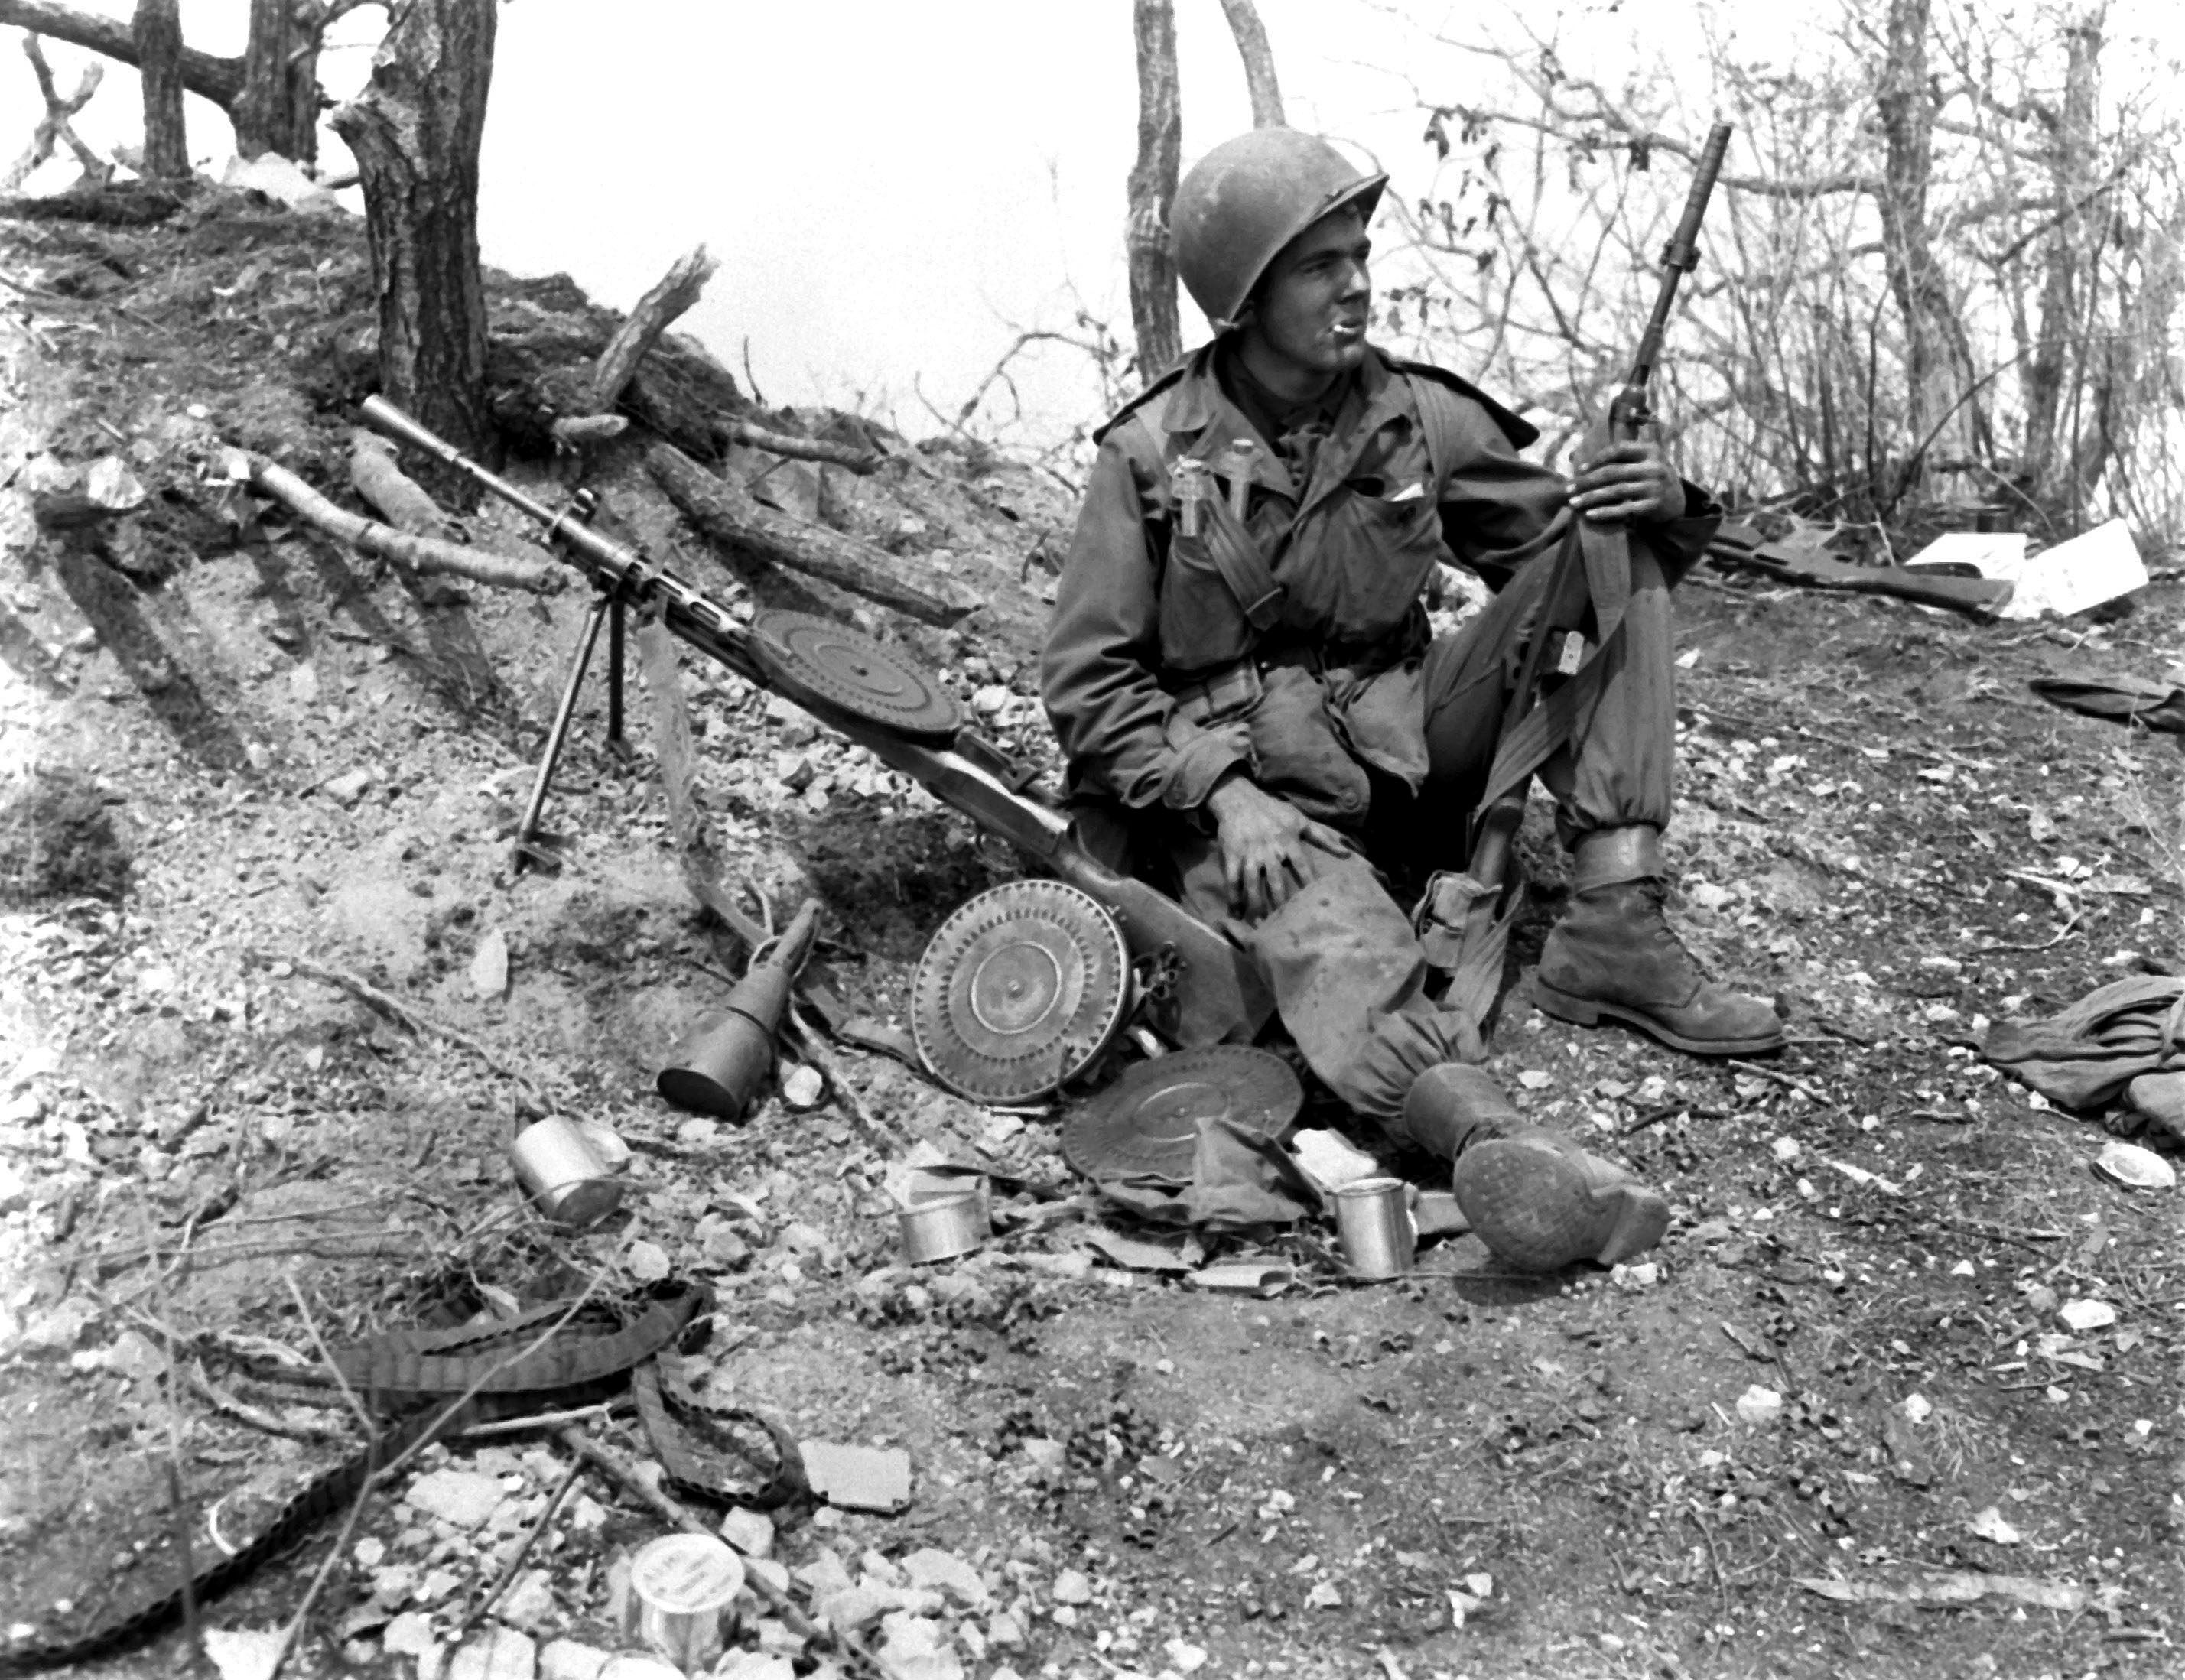
THE END OF THE WAR
UN troops pushed out of N. Korea by Jan. 1951
War of attrition continues at the 38th parallel
Cease-fire declared almost where the war began, July 1953
5 million soldier and civilian deaths
DMZ (Demilitarized Zone): A narrow strip of land that serves as a buffer zone between North and South Korea
Most heavily militarized border in the world

Slide 12
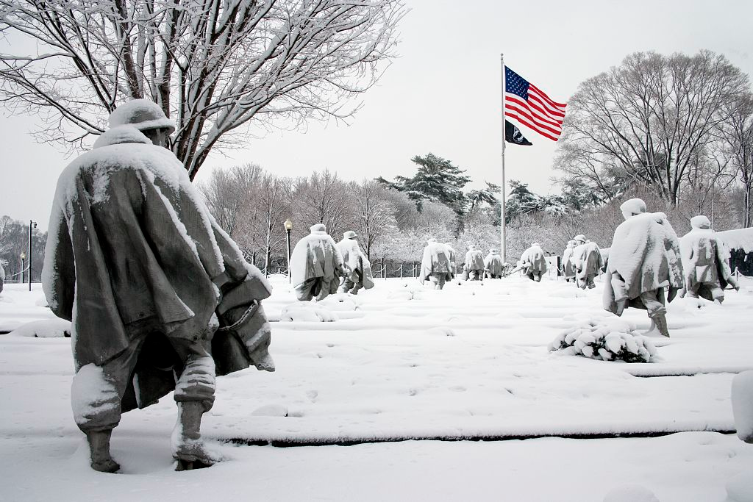
IMPORTANCE OF THE KOREAN WAR
The Korean War was an important turning point in the Cold War. Instead of just using political pressure and economic aid to contain communism, the United States began a major military buildup. The Korean War expanded the Cold War beyond Europe and into Asia.

Slide 13
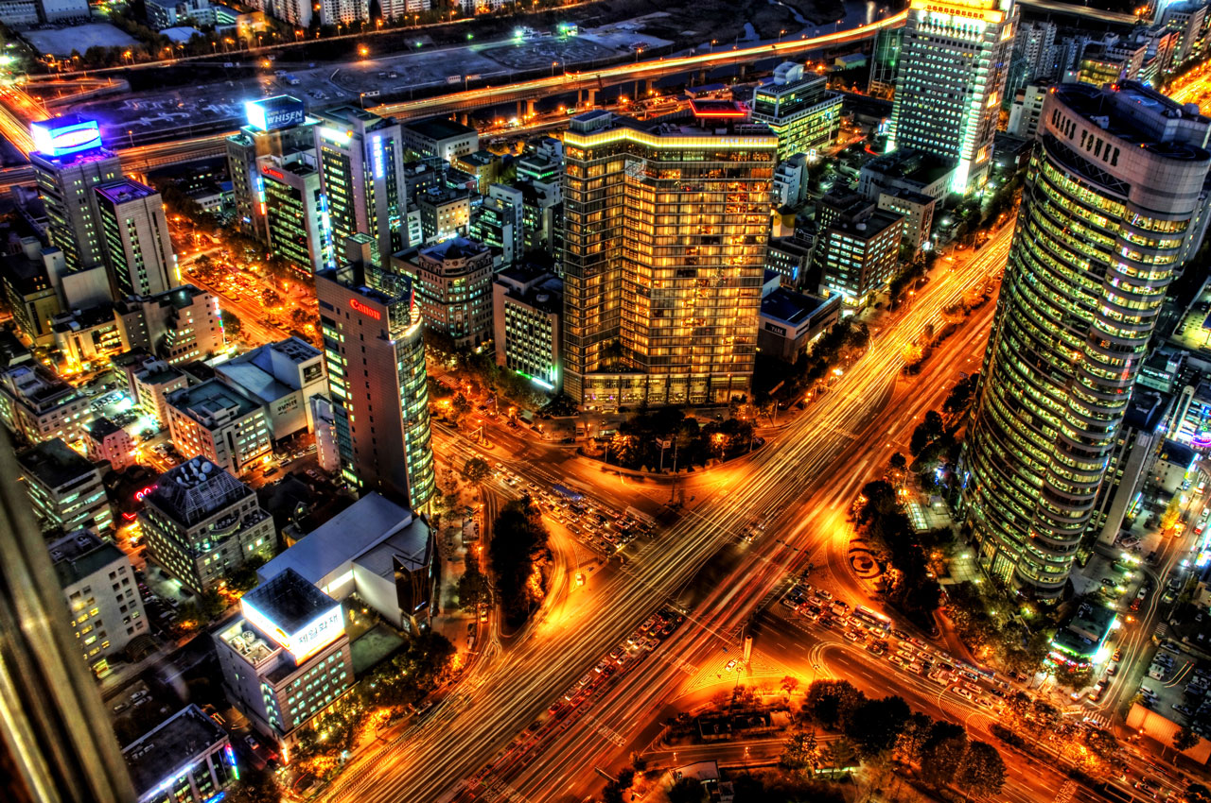
South Korea After the War
Adopts a democratic constitution and established free elections (1987)
claimed one of the highest economic growth rates in the world (1980s/90s)
The US has maintained Army and Air Force personnel to help South Korea defend itself against external aggression

Slide 14
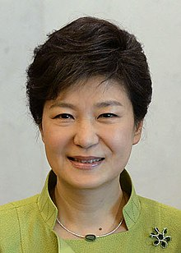
Current President Moon Jae-in
Former South Korea President Park

Slide 15
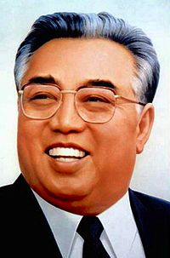
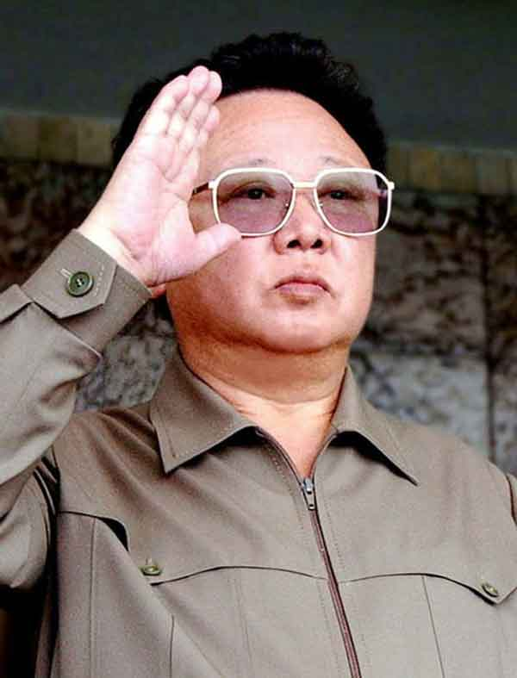
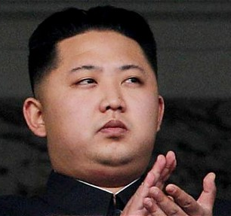
North Korea After the War
Kim Il Sung
First Communist dictator of N. Korea; established collective farms, developed heavy industry, and built up the country’s military power.
Kim Jong Il
Took control in 1994; developed nuclear weapons
Kim Jong Un
Took control in 2011; has recently attempted to launch ICBMs and has threatened warfare against South Korea
The country continues to struggle with shortages of energy and food

Slide 16
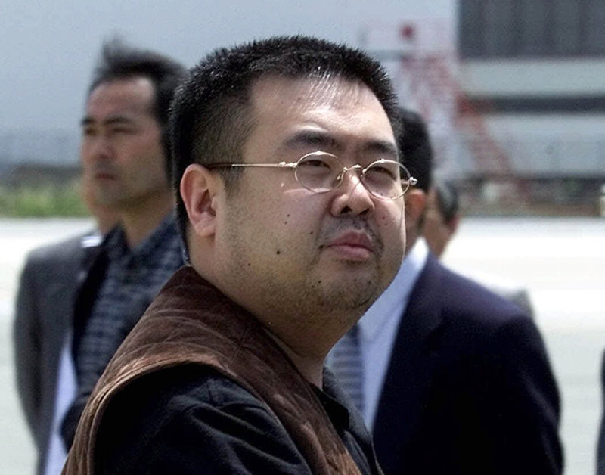
Kim Jong Nam

Slide 17
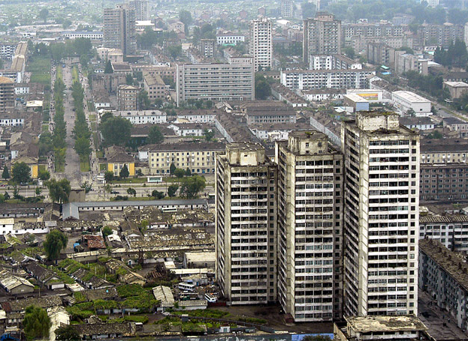
Pyongyang

Slide 18
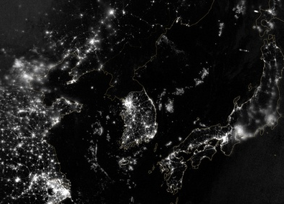
North Korea at night

Slide 19
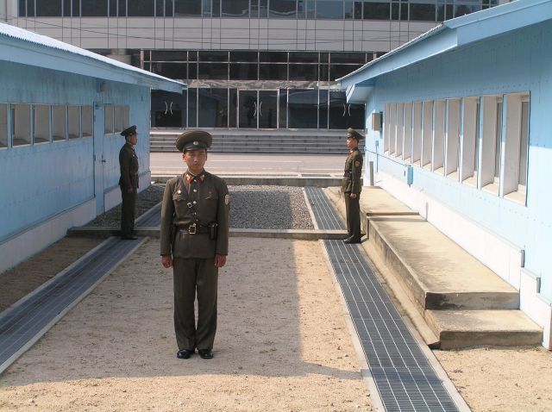
DMZ Today

Slide 20
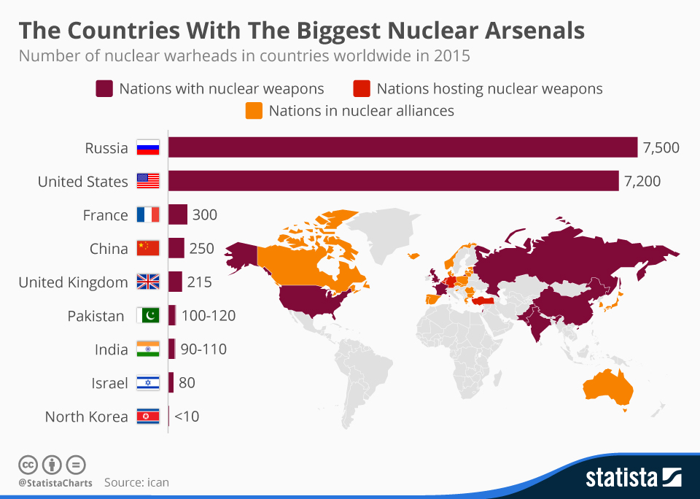
Who has nukes today and how much do they have?

Slide 21
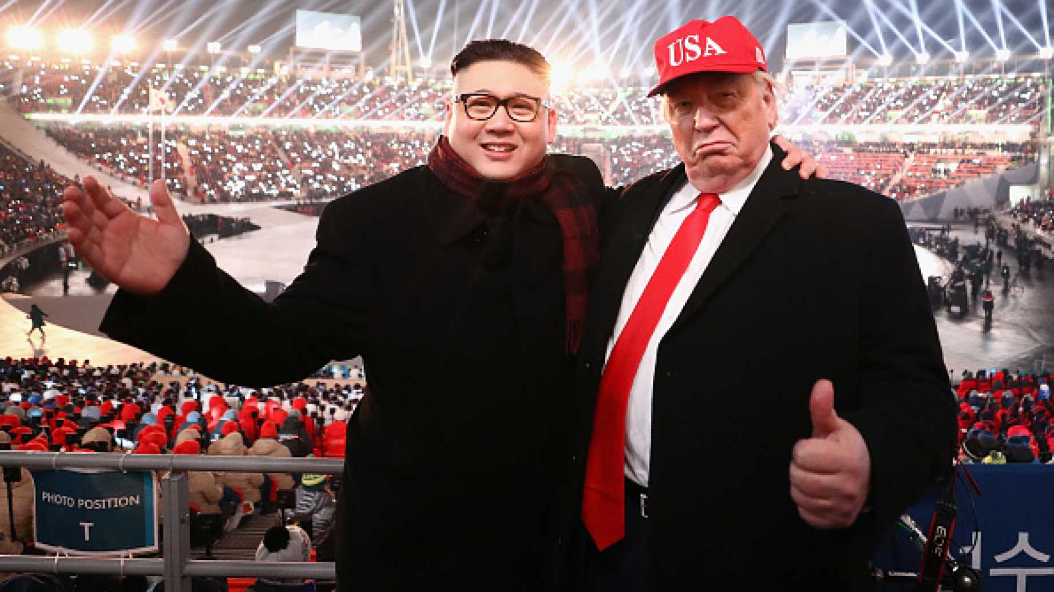
Impersonators 2018 Winter Olympics South Korea

Slide 22
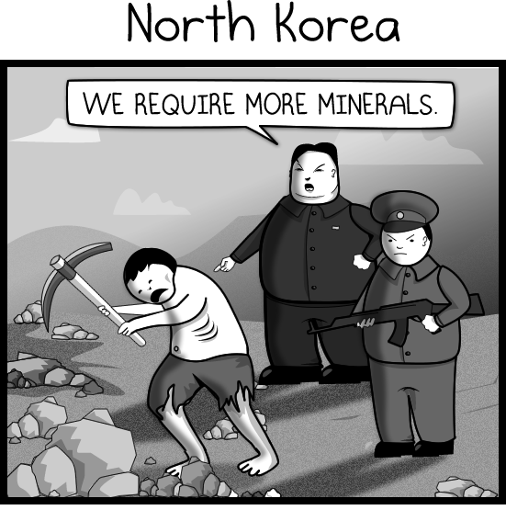
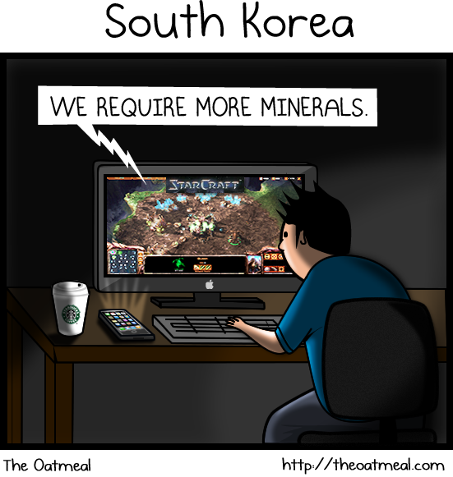

Slide 23
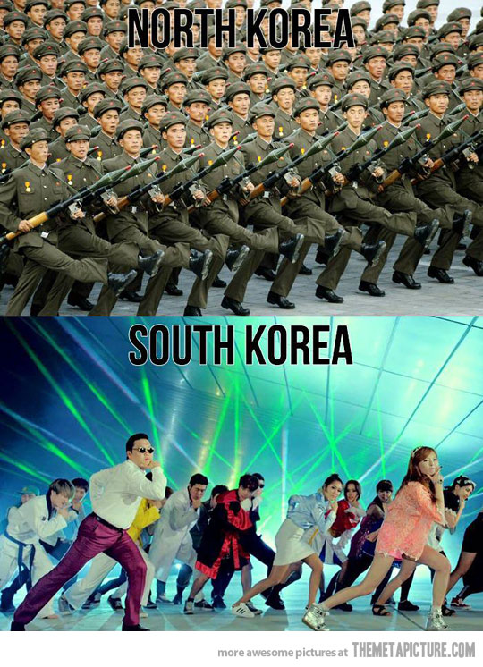
“All hail the
Dear Leader!”
“Heyyyyy,
Sexy lady!”

