Slide 1
The Stagnant Seventies
America Screeches to a Halt

Slide 2
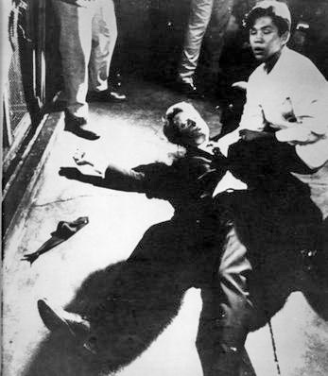
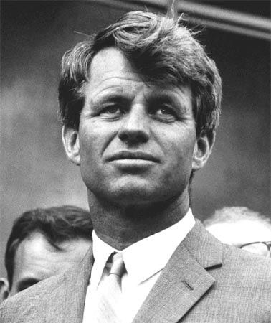
Election of 1968
JFK’s younger brother, Bobby, ran for the Democratic Party’s Presidential nomination.
At a campaign rally in Indianapolis, Bobby had the unfortunate duty to inform the crowd of the assassination of MLK
Two months later, he too would be fatally shot after winning the CA primary.

Slide 3
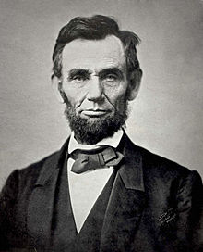
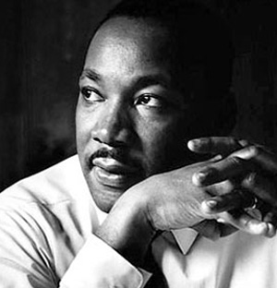
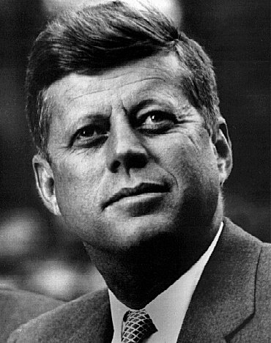
Abraham, Martin, and John - Dion

Slide 4
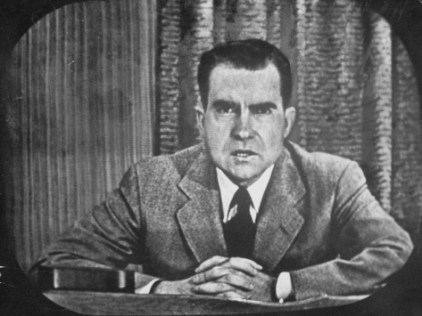
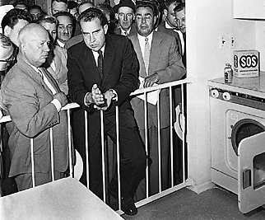
“Tricky Dick” before the White House
Checkers Speech:
As VP nominee, accused of misusing political funds
Defended himself on TV
Misdirection of attention by referring to their dog “Checkers” that had been given as a gift
Kitchen Debate:
Intense discussion between VP Nixon and Khrushchev over which ideology was superior
Held in American Exhibition in Moscow – illustrated American (capitalist) luxuries not available in USSR
Notes:
The “Checkers Speech”: Senator Nixon was accused of misusing funds established by his backers to reimburse him for his political expenses. He delivered a half-hour television address in which he defended himself and attacked his opponents in hopes of remaining on the ticket for VP. During the speech, he stated that regardless of what anyone said, he intended to keep one gift: a black-and-white dog who had been named Checkers by the Nixon children, thus giving the address its popular name.
The Kitchen Debate was an intense discussion between VP Nixon and Nikita Khrushchev at the opening of the American National Exhibition in Moscow in 1959. For the exhibition, an entire house was built that the American exhibitors claimed anyone in America could afford. It was filled with labor-saving and recreational devices meant to represent the fruits of the capitalist American consumer market. The debate was recorded on color videotape, a new technology pioneered in the U.S., and Nixon made reference to this fact; it was subsequently rebroadcast in both countries.

Slide 5
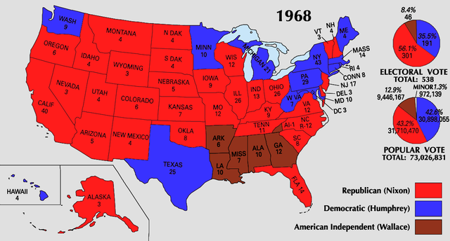
Election of 1968
“Silent Majority”: Nixon’s reference to voters whose voices were drowned out by protests by liberal youth.
Made up of WWII vets, young people in the Midwest, South, and West, suburbs, blue-collar whites
Not particularly conservative politically, but resented what they saw as disrespect for American institutions
“Southern Strategy”: Designed to appeal to conservative white southerners, who traditionally voted Democratic, but were against the civil rights movement
Notes:
The “Silent Majority”: Nixon’s reference to the older WWII generation, conservatives living in the Midwest, West, and South, and blue collar white workers
Did not take an active part in politics but supported Nixon’s actions in Vietnam, or resented what they saw as disrespect for American institutions (e.g. “Okie From Muskogee”).
Nixon’s “Southern Strategy”
The "Solid South" had voted Democrat since before the Civil War (slavery and segregation)
Disillusioned after Civil Rights Act of 1964
Nixon exploited racial conflict to get the Southern vote

Slide 6
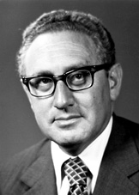
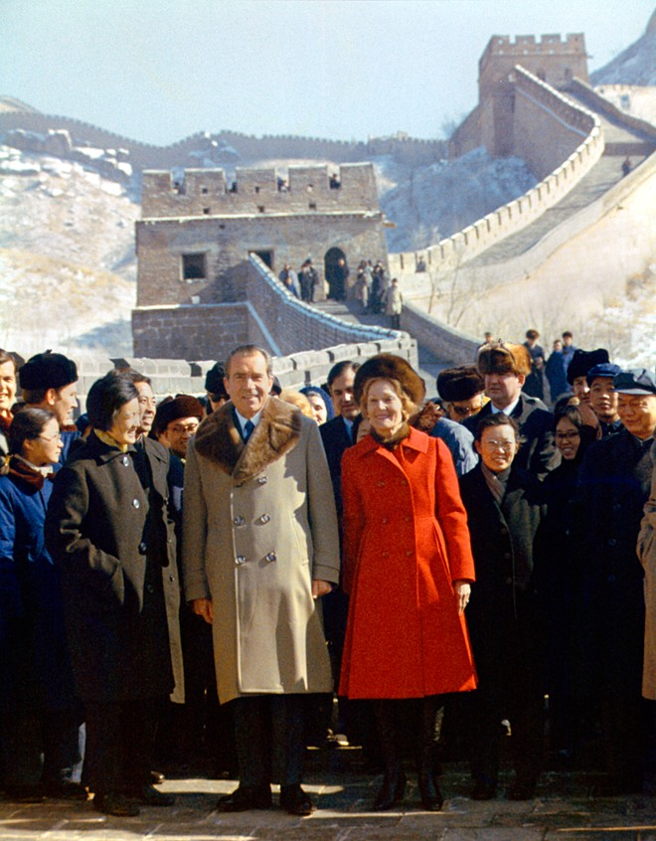
Détente
Détente: A lessening of tensions between the US, China, and the USSR
Promoted by national security adviser, Henry Kissinger
Improved relations for nearly a decade
“We want the Chinese with us when we sit down and negotiate with the Russians.”
Notes:
Nixon was the first American to visit China in 25 years

Slide 7
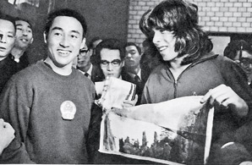
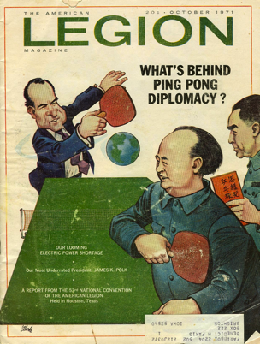
Ping Pong Diplomacy
April 1971 - Accidental meeting of Zhuang Zedong and Glenn Cowan
August 1971 - Journalists and table tennis players from the US become the first Americans to step foot in China since 1949

Slide 8
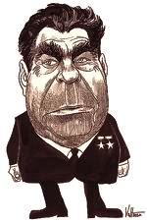
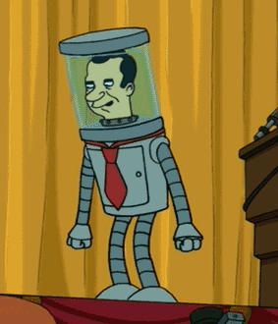
Détente
Strategic Arms Limitation Treaty (SALT, 1969) – a series of arms-reduction negotiations between the US and USSR
SALT I signed by Nixon and Brezhnev
Congress refused to sign the SALT II treaty after the Soviets invaded Afghanistan
Tensions arose as many countries began stockpiling nuclear weapons
=

Slide 9
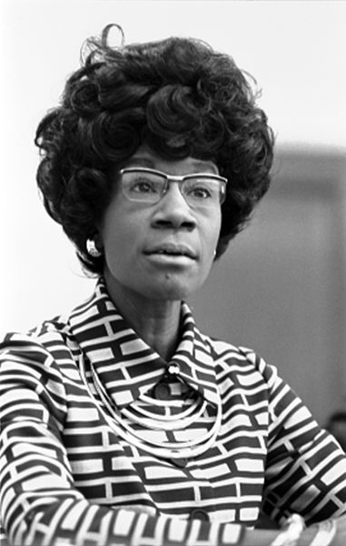
Election of 1972
Richard Nixon (R) v. George McGovern (D)
McGovern ran an anti-war campaign, but was handicapped by his outsider status and firing of VP nominee
Shirley Chisolm – First African American to run for a major party nomination

Slide 10
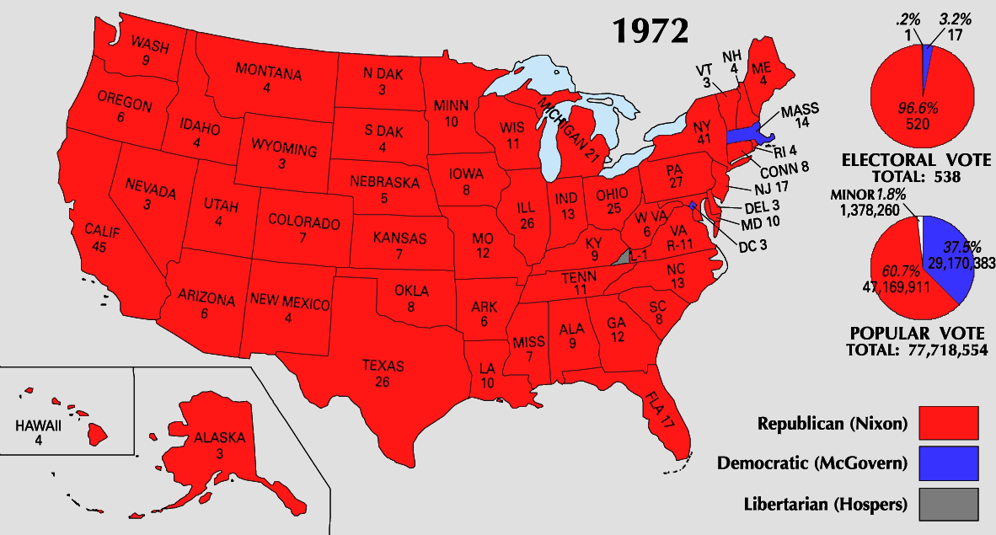
Election of 1972
Nixon won 520 to 17 Electoral votes
Notes:
Nixon won 520 to 17 Electoral votes

Slide 11
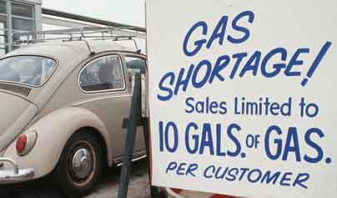
Oil Embargo
Six-Day War and Yom Kippur War: Soviet-backed Syrians and Egyptians vs. U.S.-backed Israel
Organization of the Petroleum Exporting Countries (OPEC) places an embargo on the U.S.
Alaska Pipeline
Drive 55
Gas rotation

Slide 12
1973 Oil Embargo
Soviet-backed Syrians and Egyptians attacked Israel for land lost in the Six-Day War
Nixon approves of $2 billion in war materials to protect Israel
In response, Arab nations placed an embargo on oil to the United States, causing an energy crisis
Alaska Pipeline
Drive 55
Gas rotation
New focus on MPG

Slide 13
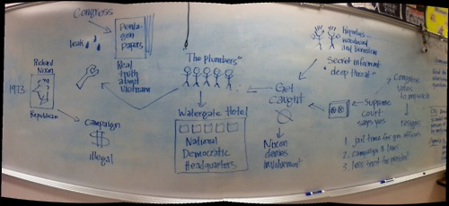

Slide 14
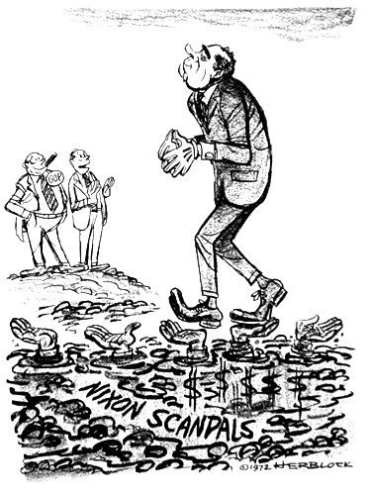
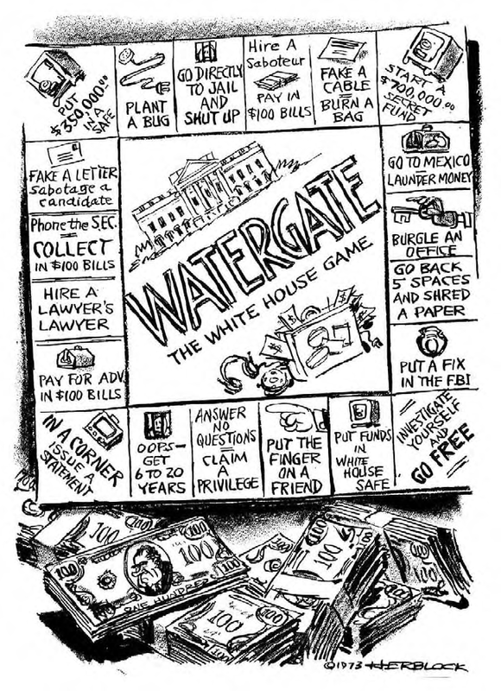
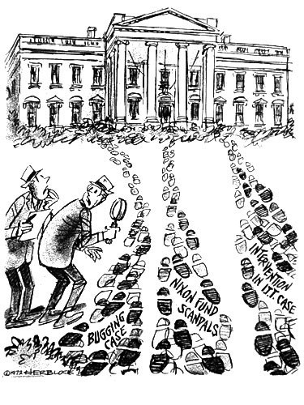
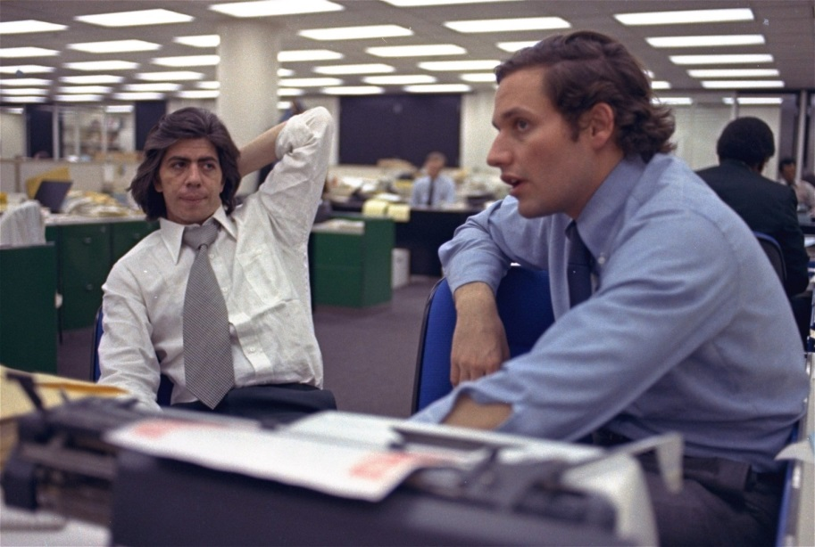
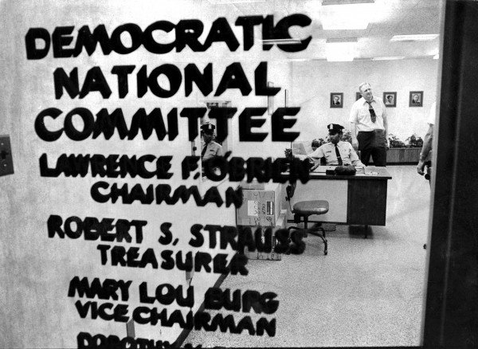
Watergate
Break in at DNC Headquarters at Watergate Hotel
Committee to Re-Elect the President (CREEP)
Woodward and Bernstein; Washington Post
“Deep Throat”
Most of Nixon’s cabinet implicated, VP Spiro Agnew
“You must pursue this investigation of Watergate even if it leads to the president. I'm innocent. You've got to believe I'm innocent. If you don't, take my job.”

Slide 15
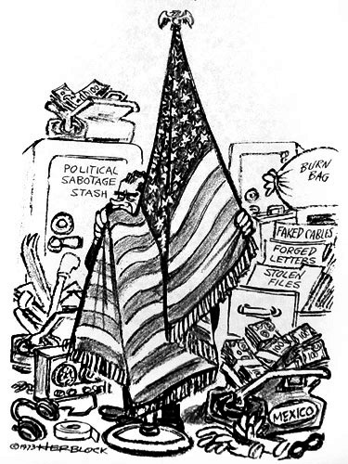
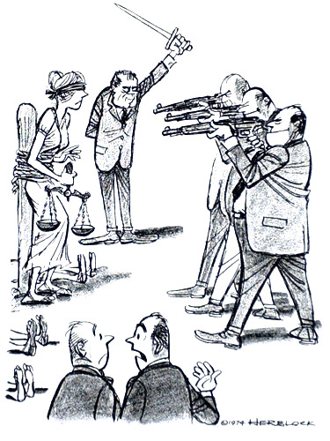
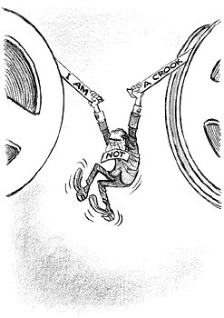
Watergate
Nixon recorded telephone conversations before and during the investigation.
Implicated the president in a cover up of the break-in.
Refused to turn over the tapes, citing “presidential privilege” and “national security”
U.S. v. Nixon: Nixon required to hand over the tapes; unauthorized taping not included under “presidential privilege”
Suspicious 18 minute blank spot on tapes
Led to Nixon’s resignation in 1974
Pardoned by Gerald Ford
Nixon criticized by political cartoonist Herb Block (“Herblock”)

Slide 16
Richard Nixon
Dates in Office: 1968-1974
Nickname: Tricky Dick
Political Party: Republican
Major Events:
Vietnamization
My Lai Massacre
Drug War 1971
Kent State Massacre
Détente
Ping pong diplomacy
SALT Treaty
Oil Embargo
Watergate
Resignation

Slide 17
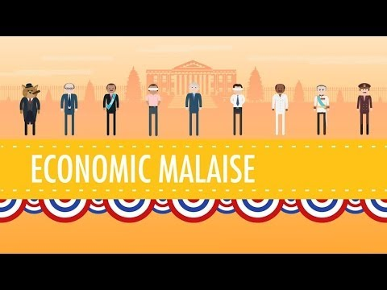

Slide 18
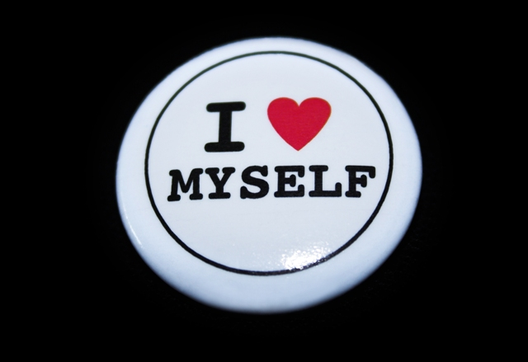
The “Me” Generation
Life in the 1970s

Slide 19
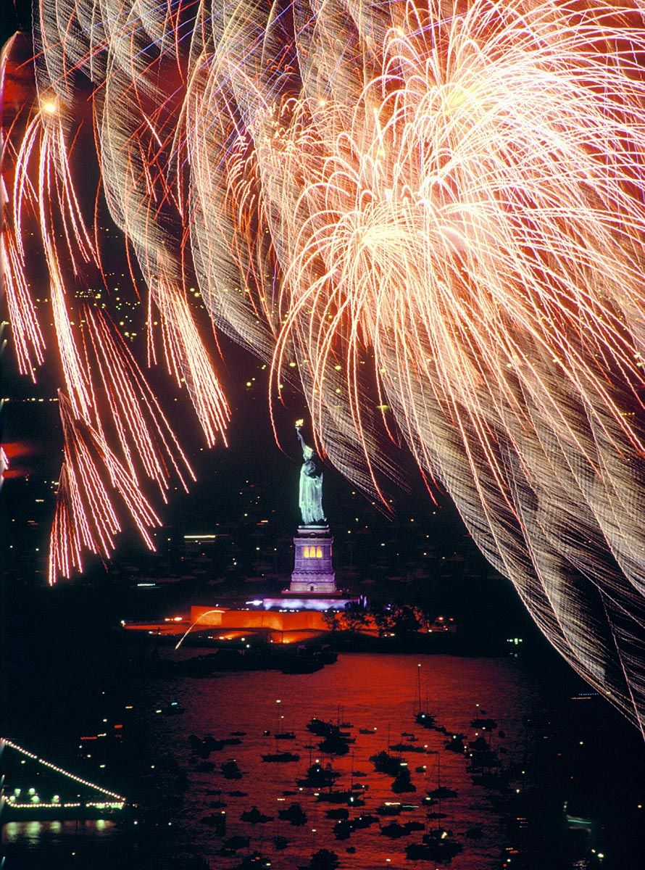
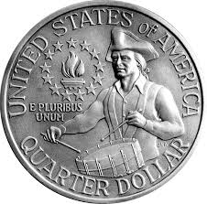
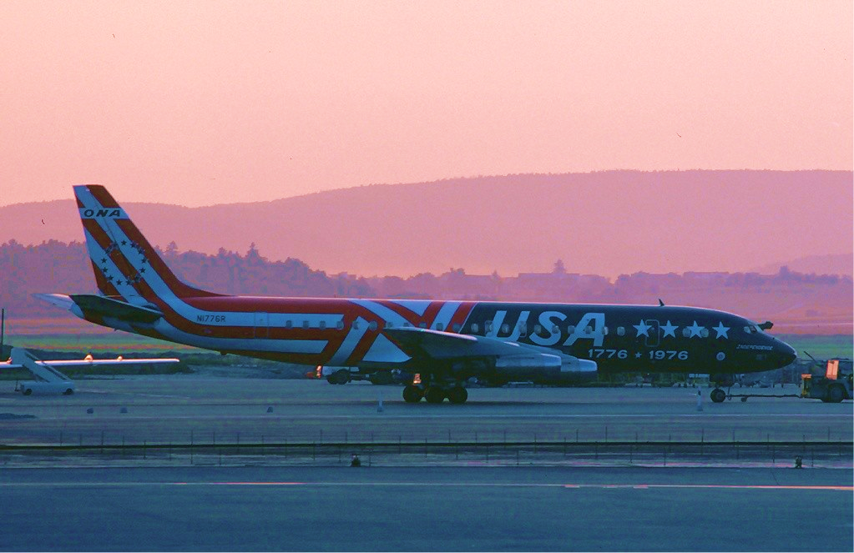
Happy Birthday, America!
The United States celebrates its Bicentennial on July 4, 1976
Focus on traditional values, renewal, and rebirth

Slide 20
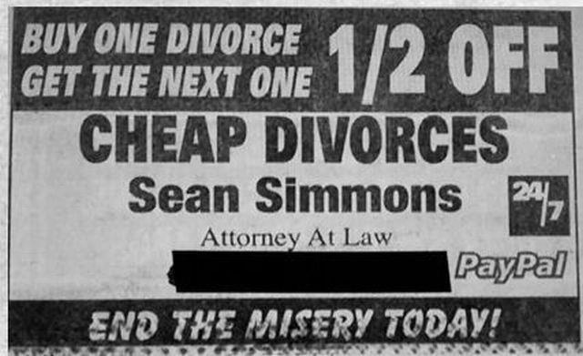
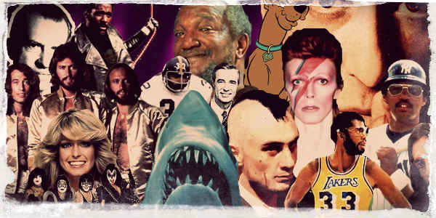
The “Me” Generation
Refers to the “boomer” generation that came of age in the 1970s that was self-indulgent and self-involved
Caused by economic prosperity, disillusionment in traditional authority, lack of social movements (e.g. civil rights), and deaths of unifying social leaders (e.g. MLK, JFK, RFK)
“Self-realization" and "self-fulfillment"
Divorce rates soar; birthrates drop

Slide 21
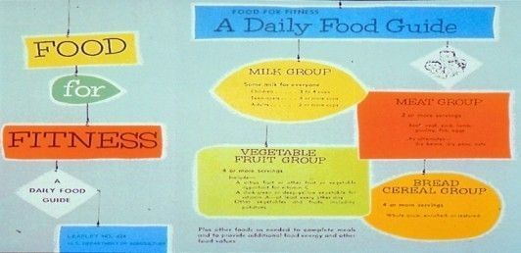
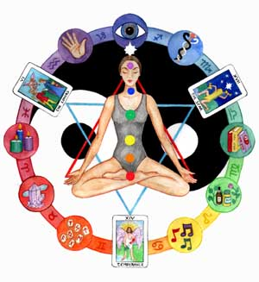
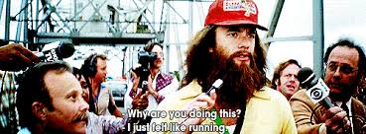
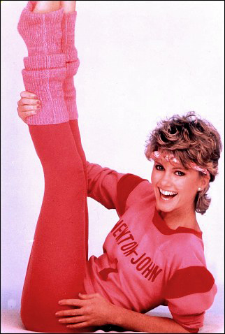
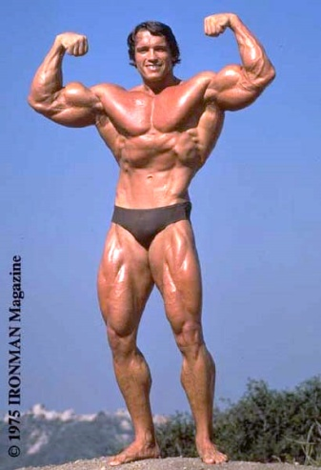
Health, spirituality, and Exercise
Health foods become popular
Reaction to environmental issues (DDT) Silent Spring
“New Age” spirituality
Crystals, meditation, holistic health, astrology, tarot
The exercise craze furthers the “look at me!” attitude of the 1970s
jogging
Aerobics (e.g. Jazzercize)
Body-building

Slide 22
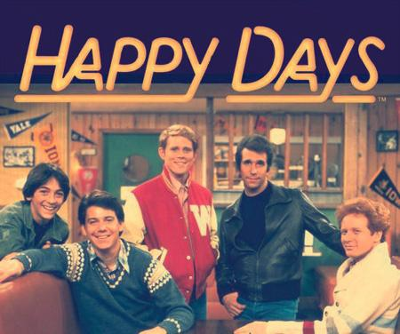
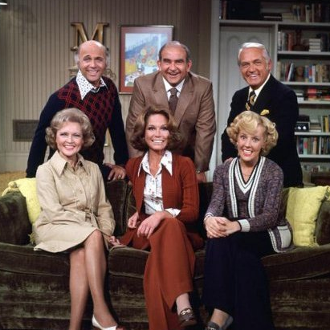
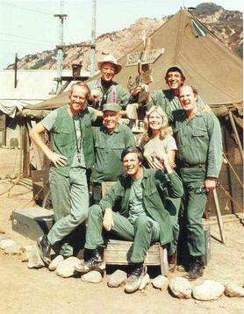
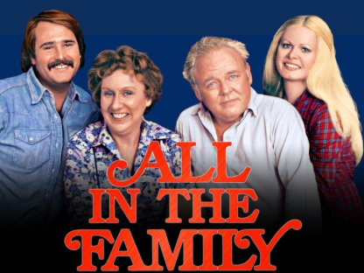
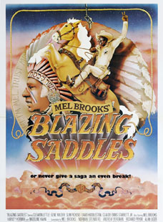
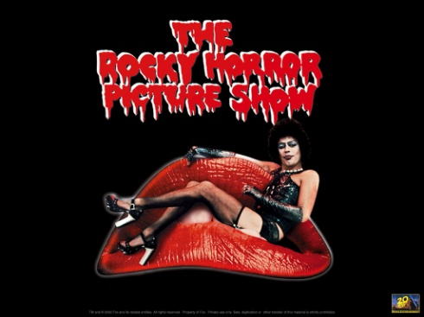
Television and Movies
Family shows, comedies, and dramas very popular
Brady Bunch, Bonanza, Little House on the Prairie, Dukes of Hazard, Dallas, Happy Days, Laverne & Shirley, Grease
Women given more prominent roles
Wonder Woman, Charlie’s Angels, Mary Tyler Moore Show
Shows tackle political and social issues
M*A*S*H, All in the Family, Saturday Night Live
More racial diversity
The Jefferson's, Good Times, Blazing Saddles
Dramatic and esoteric films
The Godfather, Star Wars, Clockwork Orange, Rocky Horror Picture Show, Apocalypse Now, Jaws, Carrie, The Exorcist, Rocky

Slide 23
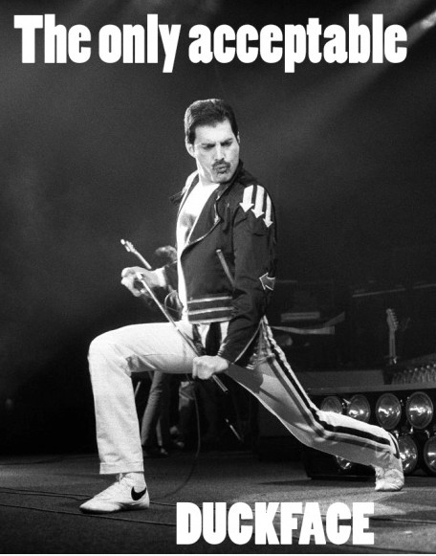
Music
Music no longer used to get across a message, simply meant to enjoy
Pop/Pop-Rock
Jackson 5, The Osmonds, The Carpenters, Barry Manilow, James Taylor, Fleetwood Mac, Billy Joel, Wings
Hard Rock
Led Zepplin, Black Sabbath, AC/DC, KISS, STYX, Journey, Pink Floyd
Punk Rock
The Ramones, Sex Pistols, The Clash
Glam Rock
Elton John, David Bowie, Queen
Disco
ABBA, Donna Summer, Bee Gees, Gloria Gaynor
Funk
James Brown, Sly and the Family Stone, Stevie Wonder, The Commodores
Southern Rock
The Eagles, Lynyrd Skynyrd, Willie Nelson

Slide 24
Gerald Ford
Dates in Office: 1974-1976
Nickname: Mr. Nice Guy, the Accidental President
Major Events:
Pardons Nixon
Helsinki Agreement: Declaration signed by the US and most European states in an attempt to improve relations between the Communist bloc and the West.

Slide 25
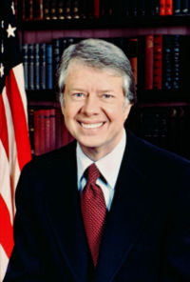
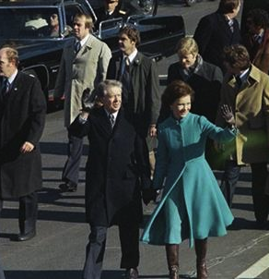
Election of 1976
Election of 1976: Ford (R) vs. Carter (D)
“Don’t vote. It only encourages them.”
“Jimmy” Carter
Ran as the Washington outsider
Came into trouble when working with Washington insiders
Devout Christian – bring morality back to politics

Slide 26
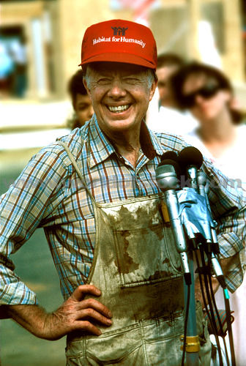
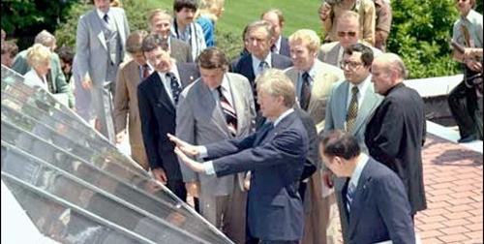
Peanuts, Not Politics
Dept. of Energy
Tax cuts to fight inflation
Pardons Vietnam draft dodgers
Human rights activist
Deregulation of transportation

Slide 27
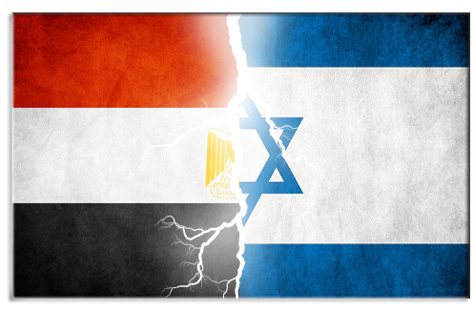
Foreign Affairs
Camp David Accords – Carter invited the leaders of Egypt and Israel to a conference at Camp David, in which he persuaded them to sign a peace accord.
Israel would withdraw from disputed territory
Egypt would respect Israel’s borders
Panama Canal Treaty – Vowed to give full control of the Panama Canal over by the year 2000.
Soviet invasion of Afghanistan ⇨ Boycott of 1980 Moscow Olympics ⇨ Boycott of 1984 LA Olympics
President Anwar Sadat of Egypt (left) and Prime Minister Menachem Begin of Israel (right)

Slide 28
Iran Hostage Crisis
American-supported Shah deposed
Carter allows him to get medical attention in the U.S.
Riots in Iran, demanding he be brought to justice
52 Americans held hostage for 444 days after a group of Islamist students and militants took over the American Embassy in Tehran.
Ayatollah Ruhollah Khomeini
Failed release negotiations and rescue missions
Enter into negotiations after Shah dies and Iraq invades
Hostages released minutes after Ronald Reagan is sworn into office.

Slide 29
Jimmy Carter
Dates in Office: 1976-1980
Nickname: The Peanut Farmer
Major Events:
Draft dodger pardons
Three Mile Island meltdown
Camp David Accords
Panama Canal Treaty
Boycott of Moscow Olympics
Iran Hostage Crisis

Slide 30
Stagflation in the Seventies
Stagflation: A combination of stagnation and inflation
High inflation, slow economic growth, high unemployment
Causes
Increase in spending but not increasing taxes (LBJ)
Rising cost of raw materials
Decline in manufacturing and GDP
International competition
Nixon takes U.S. off the gold standard

