Slide 1
Lotto Time!
Please write your birthday on a slip of paper and place it in the bucket.

Slide 2
The Vietnam War
Notes:
2

Slide 3
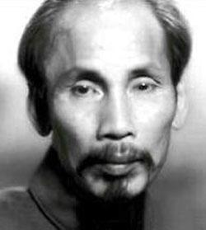
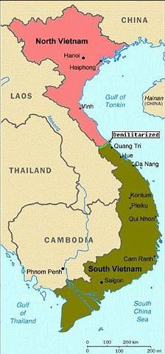
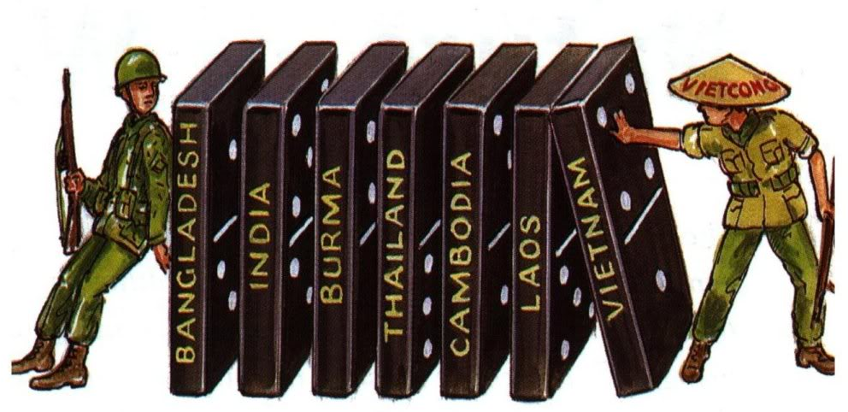
Ho Chi Minh
The Road to War
France took control of Vietnam and other SE Asian countries during the Age of Imperialism.
Ho Chi Minh led nationalist forces (Vietminh) against the French in an attempt to gain independence and create a Communist state.
SEATO
17th Parallel
Notes:
The North Vietnamese threw out the French in 1954 at Dien Bien Phu.
Domino Theory: The United States was heavily supporting the French and President Eisenhower was worried if Vietnam fell to communism, the rest of Southeast Asia would follow
SEATO is formed to prevent further communist expansion
Geneva Conference: Vietnam then becomes divided at the 17th parallel with a Communist North and a Democratic South

Slide 4
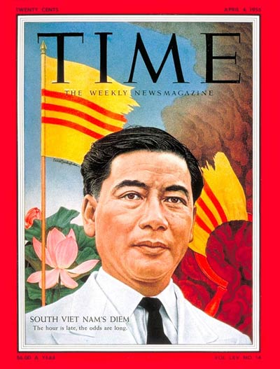
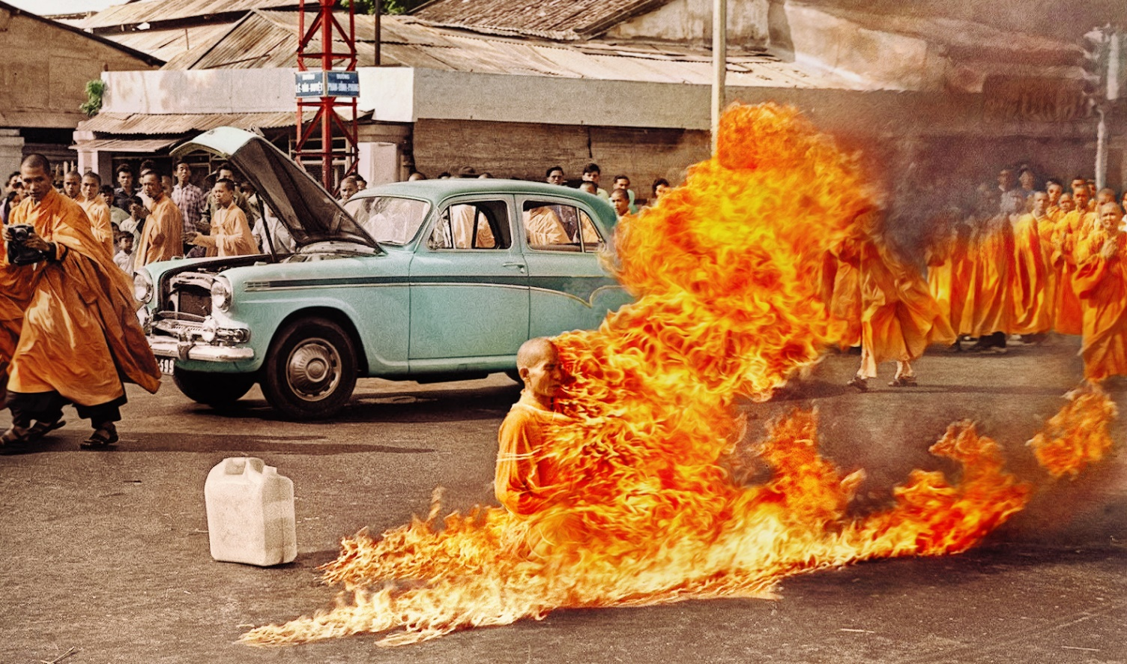
The Road to War
Ngo Dinh Diem
The Communist North led by Ho Chi Minh
Democratic South led by Ngo Dinh Diem
Educated abroad
Pro-west, Anti-communist
Discriminated against Buddhists
Killed protesters
Notes:
Following the overthrow of his government by South Vietnamese military forces the day before, President Ngo Dinh Diem and his brother are captured and killed by a group of soldiers. The death of Diem caused celebration among many people in South Vietnam, but also lead to political chaos in the nation. The United States subsequently became more heavily involved in Vietnam as it tried to stabilize the South Vietnamese government and beat back the communist rebels that were becoming an increasingly powerful threat. While the United States publicly disclaimed any knowledge of or participation in the planning of the coup that overthrew Diem, it was later revealed that American officials met with the generals who organized the plot and gave them encouragement to go through with their plans. Quite simply, Diem was perceived as an impediment to the accomplishment of U.S. goals in Southeast Asia. His increasingly dictatorial rule only succeeded in alienating most of the South Vietnamese people, and his brutal repression of protests led by Buddhist monks during the summer of 1963 convinced many American officials that the time had come for Diem to go.

Slide 5
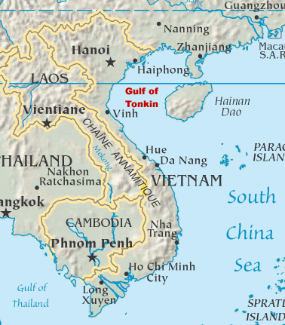
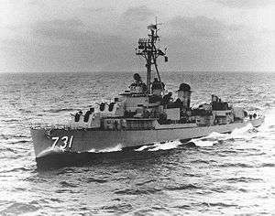
Gulf of Tonkin Incident
Gulf of Tonkin Resolution: Congress authorized President Johnson to take on their war powers; allows a “conflict”, but doesn’t declare war.
“For all I know, our navy was shooting at whales out there.”
--LBJ
Notes:
Two North Vietnamese torpedo boats supposedly attacked the USS Maddox in the Gulf of Tonkin, off the coast of Vietnam
Gulf of Tonkin Resolution: Congress authorized President Johnson to “take all necessary measures to repel any armed attack against the forces of the United States and to prevent any further aggression.”
This essentially gives the war powers of Congress to the president; allows a “conflict”, but doesn’t declare war

Slide 6
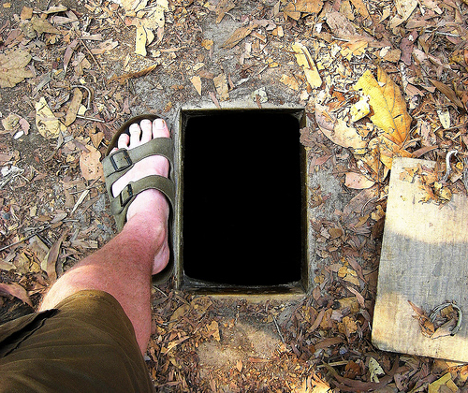
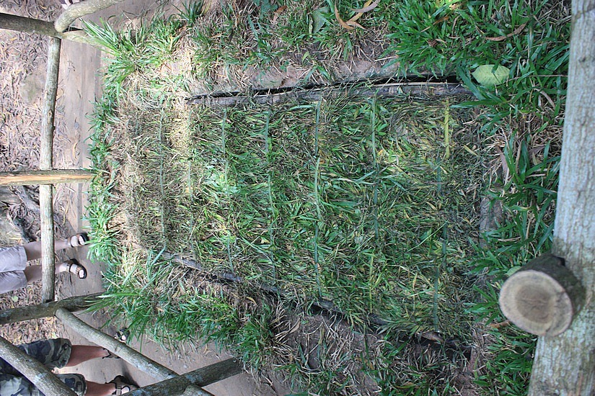
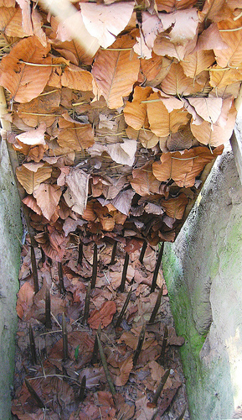
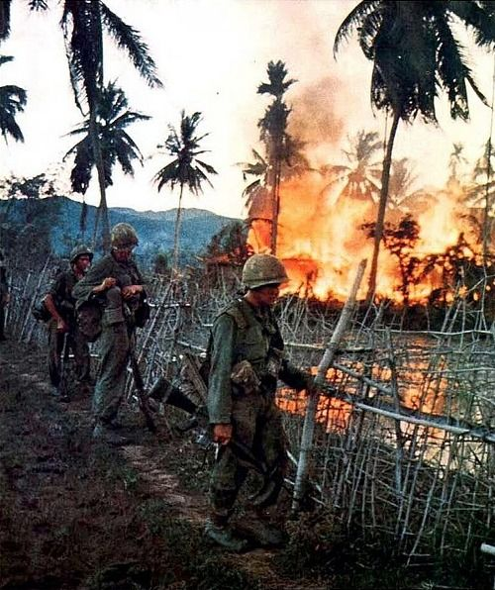
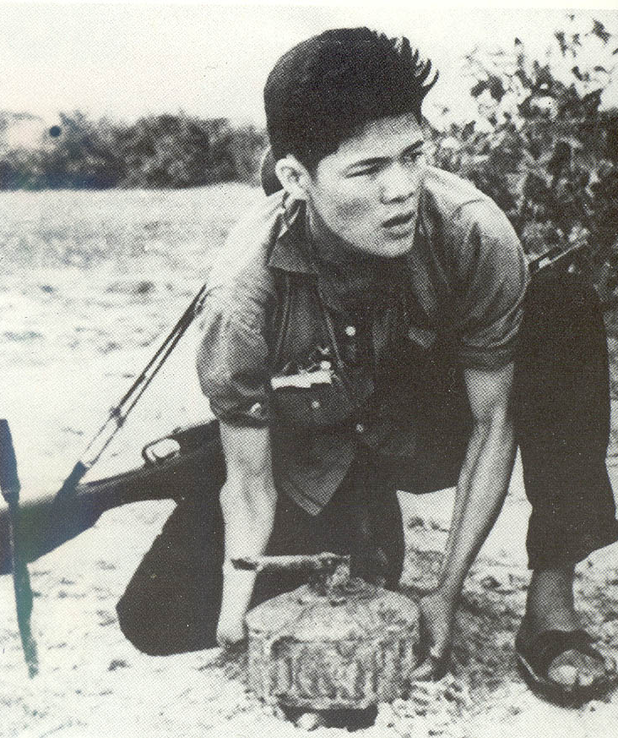
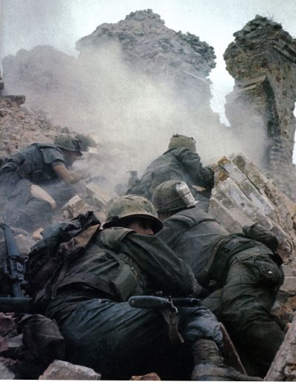
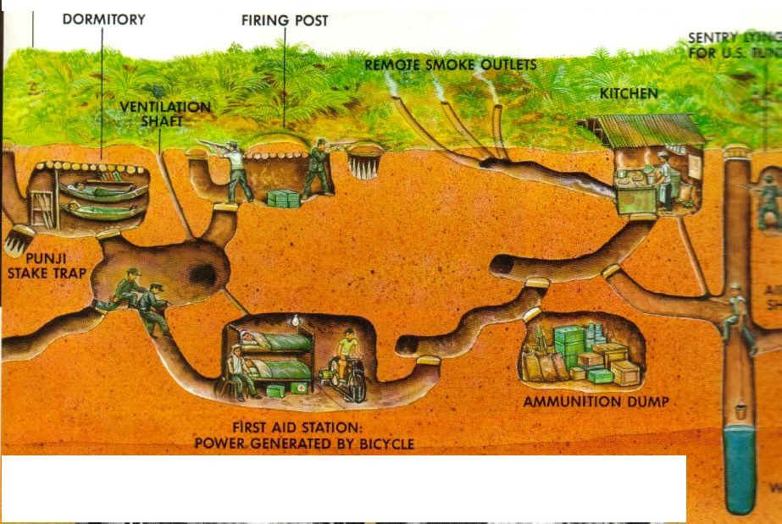
Methods of War
Viet Cong
USA and ARVN
Notes:
Vietcong/National Liberation Front – These are Communist Guerillas who were South Vietnamese.
Guerrilla warfare (ambushes, booby traps, blanding with population, etc.)
Ho Chi Minh Trail
USA
We were fighting a guerilla war in unfamiliar territory.
The South Vietnamese government we were defending was very unpopular.
We could win every battle and still lose the war.
U.S. bombing raids only strengthened people against the South Vietnamese government.
Use chemical warfare for “search and destroy” missions
6

Slide 7
Napalm: A jellied gasoline intended to destroy thick jungle areas and draw the Vietcong into the open
Napalm
Notes:
A jellied gasoline intended to destroy thick jungle areas and draw the VietCong into the open.
Made to burn at a extremely high temperatures and stick to materials, as well as rapidly deoxygenating the available air
The next slide has a picture with nudity, but that it was taken as documentation of an event, and they should take it seriously.

Slide 8
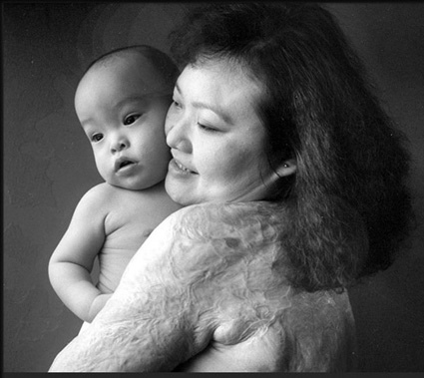
Effects of Napalm
Notes:
The iconic photo taken in Trang Bang which had been attacked and occupied by North Vietnamese forces by AP photographer Nick Ut shows Kim Phuc at about nine years of age running naked on a road after being severely burned on her back by a South Vietnamese napalm attack.
She was not expected to survive
Now is a doctor and motivational speaker

Slide 9
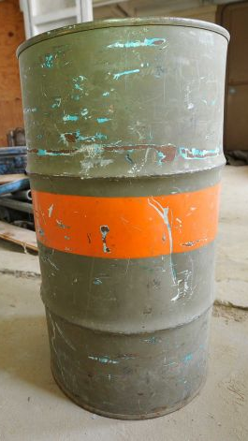
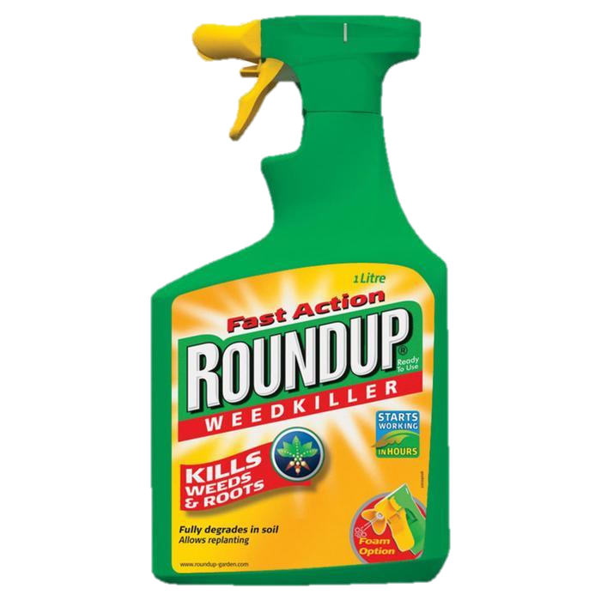
Agent Orange
An herbicide (plant killer) used by the U.S. during the Vietnam War to draw the Vietcong out in the open.
Notes:
Agent Orange is an herbicide (plant killer) used by the U.S. during the Vietnam War
An estimated 21,136,000 gal. of Agent Orange was sprayed across South Vietnam
4.8 million Vietnamese people were exposed to Agent Orange, resulting in 400,000 deaths and disabilities, and 500,000 children born with birth defects, which continues today, and gets worse with each new generation.
Created Agent Orange and RounUp
Own 90% of patents on GMO seeds
Invented aspartame (connected to cancer) and rBGH (hormone injected into cows to make them produce more milk)

Slide 10
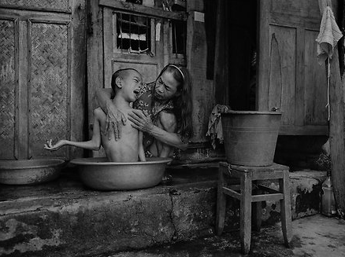
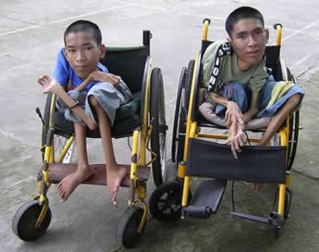
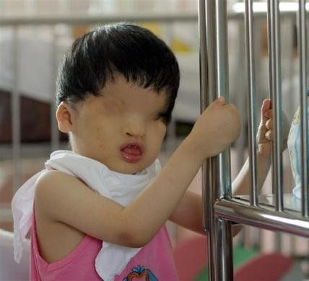
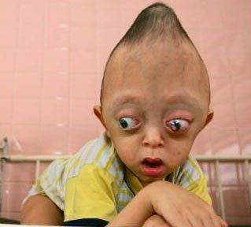
Effects of Agent Orange

Slide 11
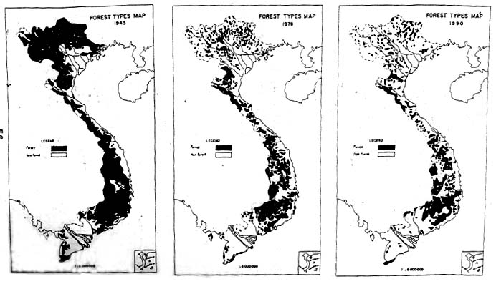
Does the United States have a responsibility for any of the horrific causes that resulted from the use of chemical warfare during the Vietnam War?

Slide 12
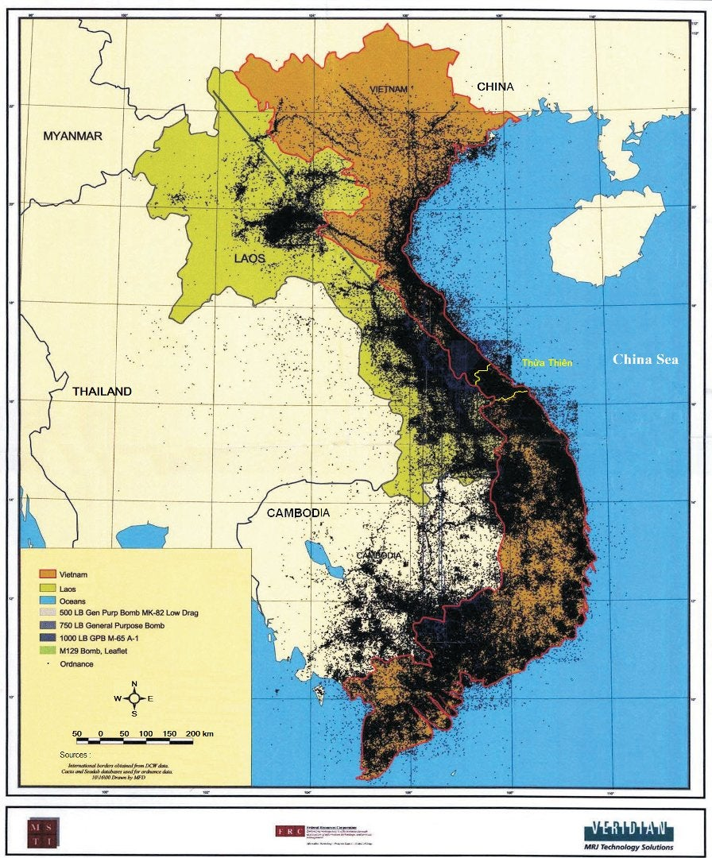
Between 1965 and 1975, the United States and its allies dropped more than 7.5 million tons of bombs on Vietnam, Laos, and Cambodia—double the amount dropped on Europe and Asia during World War II. Pound for pound, it remains the largest aerial bombardment in human history.

Slide 13
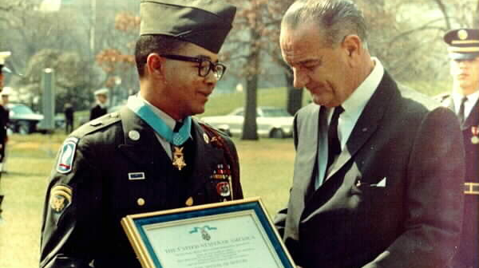
Search and Destroy
Notes:
November 8, 1965 - Operation Hump
Search and destroy operation initiated by United States and Australian forces; objective was to drive out Viet Cong fighters who had taken up positions on several key hills.
Outnumbered 6 to 1, in close hand-to-hand combat
40+ were killed that day
Picture of Lawrence Joel
Served as a medic with the 1st Battalion of the 503rd Infantry Regiment in the 173rd Airborne Brigade
Received the Silver Star and the Medal of Honor for his heroism in a battle with the Viet Cong
He was the first medic to earn the Medal of Honor during the Vietnam conflict and the first living black American to receive this medal since the Spanish–American War in 1898.
Under heavy gunfire, Joel did his duty as a medic, administering first aid to wounded soldiers. Joel defied orders to stay to the ground and risked his life to help the many wounded soldiers; nearly every soldier in the lead squad was either wounded or killed in the battle. Even after being shot twice (once in the right thigh and once in the right calf), Joel continued to do his job; he bandaged his wounds and continued to help the wounded in not only his unit, but in the nearby company as well. When his medical supplies were depleted, he hobbled around the battlefield for more, using a makeshift crutch while SP4 Randy Eickhoff ran ahead of him and provided covering fire. Eickhoff was later awarded the Silver Star and Purple Heart for his actions. Joel attended to thirteen troops and saved the life of one soldier who had a severe chest wound by improvising and placing a plastic bag over the soldier's chest in order to seal the wound until the supplies were refreshed. After the firefight which lasted over twenty-four hours, Joel was hospitalized and shipped to locations including Saigon and Tokyo to recover.

Slide 14
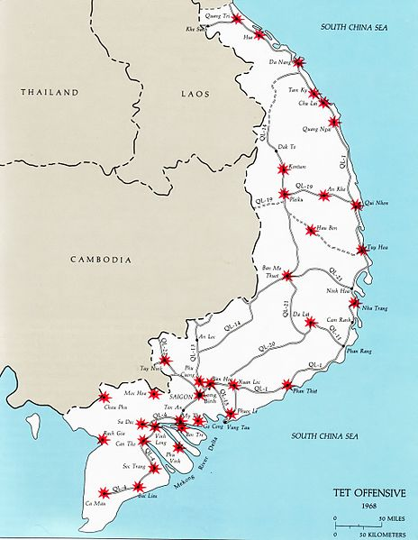
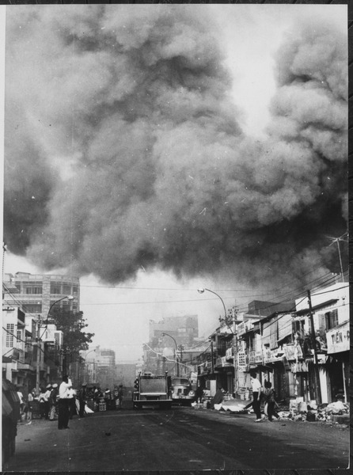
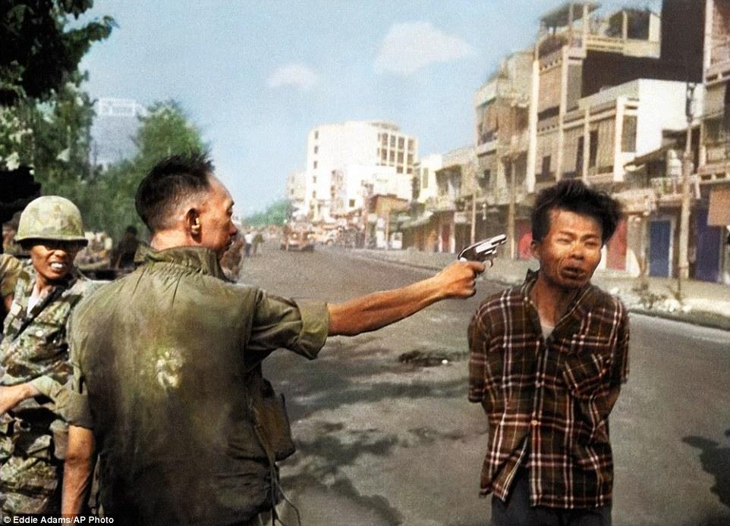
The Camera Never Lies
Tet Offensive (1968)
Surprise attack by Vietcong
“Credibility Gap”
Notes:
On January 30, 1968, the North Vietnamese launched a surprise attack on South Vietnamese military and civilian strongholds.
The operations were a surprise because there was a prior agreement to "cease fire" during the Tet Lunar New Year celebrations
The offensive was the largest military operation conducted by either side up to that point in the war
shocked the US public, which had been led to believe by its political and military leaders that the communists were, due to previous defeats, incapable of launching such a massive effort
Picture: South Vietnamese Gen. Nguyen Ngoc Loan, chief of the national police, shoots Vietcong officer Nguyen Van Lem, also known as Bay Lop, on a Saigon street on Feb. 1, 1968.
Taken by Associated Press photographer Eddie Adams
Captive Nguyen Van Lem, was the captain of a terrorist squad who had just killed the family of one of Gen. Loan’s friends
After shooting the suspect, the general justified the suddenness of his actions by saying, “If you hesitate, if you didn’t do your duty, the men won’t follow you.”
Shocked the American public at the ruthlessness of the war.

Slide 16
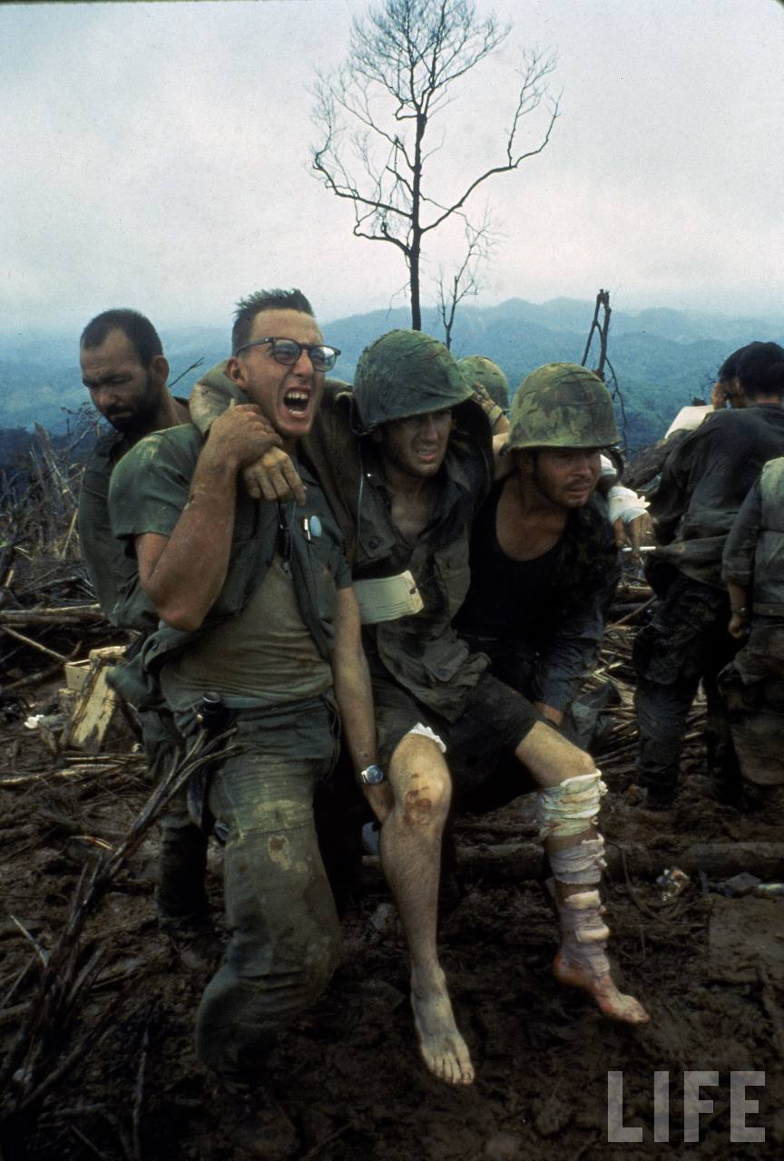
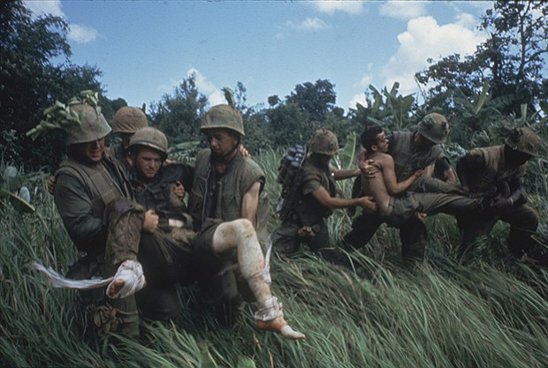
The Television War
Notes:
By the mid-1960's, television was considered to be the most important source of news for the American public, and, possibly, the most powerful influence on public opinion itself.
By the fall of 1967, 90% of the evening news was devoted to the war and roughly 50 million people watched television news each night. Up until this time, the war had strong support from the media, the public, and Congress. The military continuously reported that the U.S was making encouraging progress. However, the images did not agree.

Slide 17
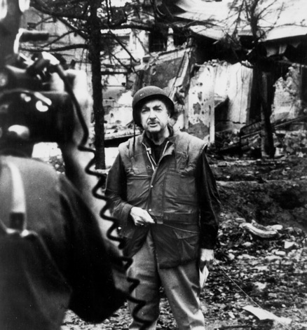
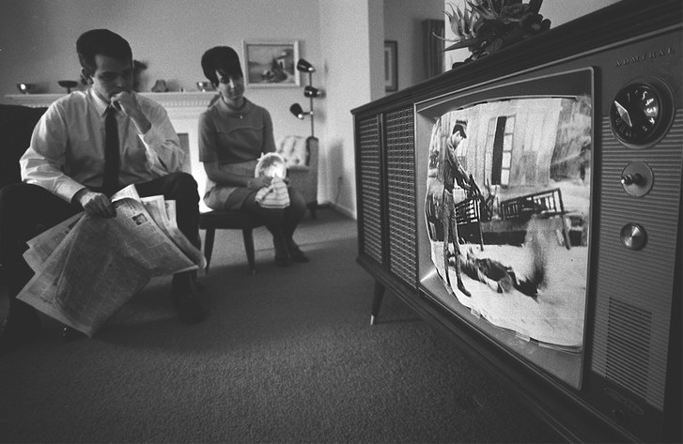
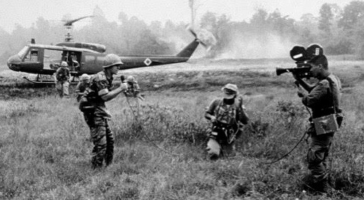
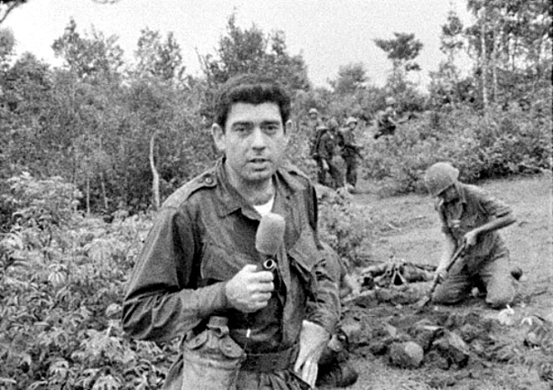
The Television War
Walter Cronkite
"If I've lost Cronkite, I've lost Middle America”
-President Lyndon B. Johnson
Notes:
Because no military censorship was established, journalists could follow the military into combat and report their observations without restriction. As journalists saw more grisly combat, they presented the public with more graphic images. Also, for the first time, interviewed soldiers expressed their frustration with the progress of the war.
“To say that we are closer to victory today is to believe, in the face of the evidence, the optimists who have been wrong in the past. To say that we are mired in a bloody stalemate seems the only realistic, yet unsatisfactory conclusion”
-Walter Cronkite

Slide 18
The Faces of War
American boys playing soldier
Notes:
18

Slide 19
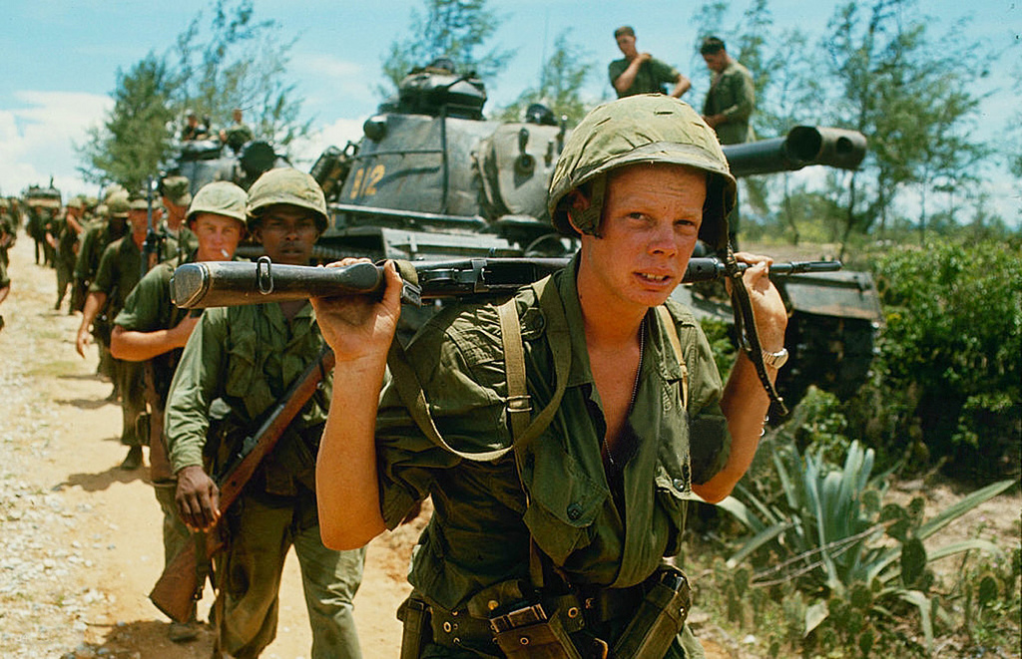
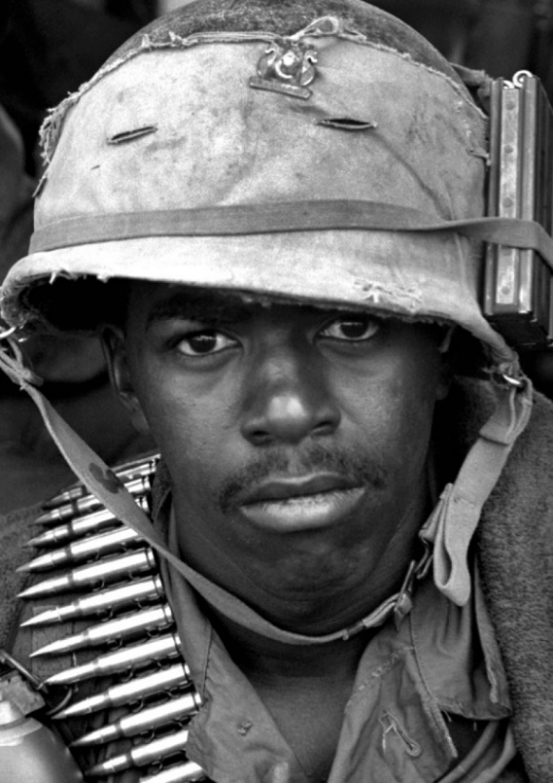
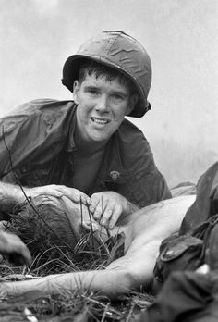
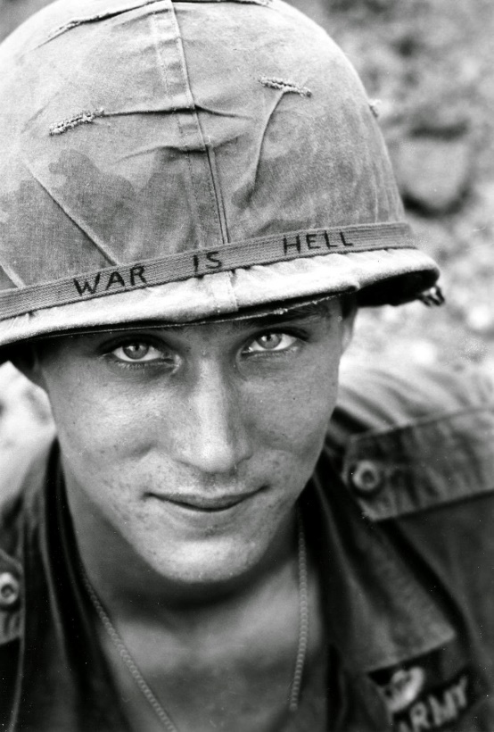
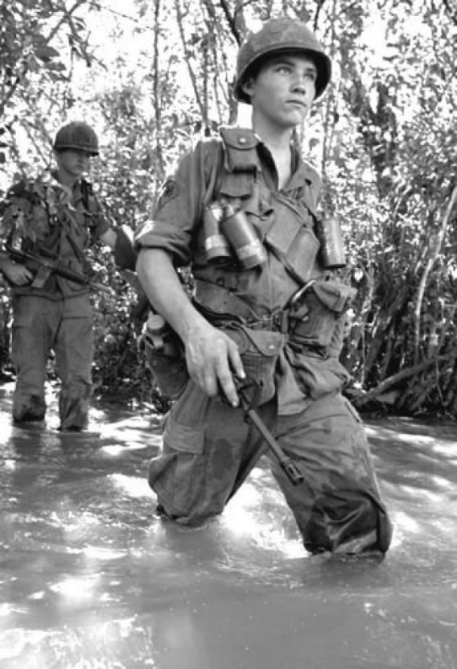
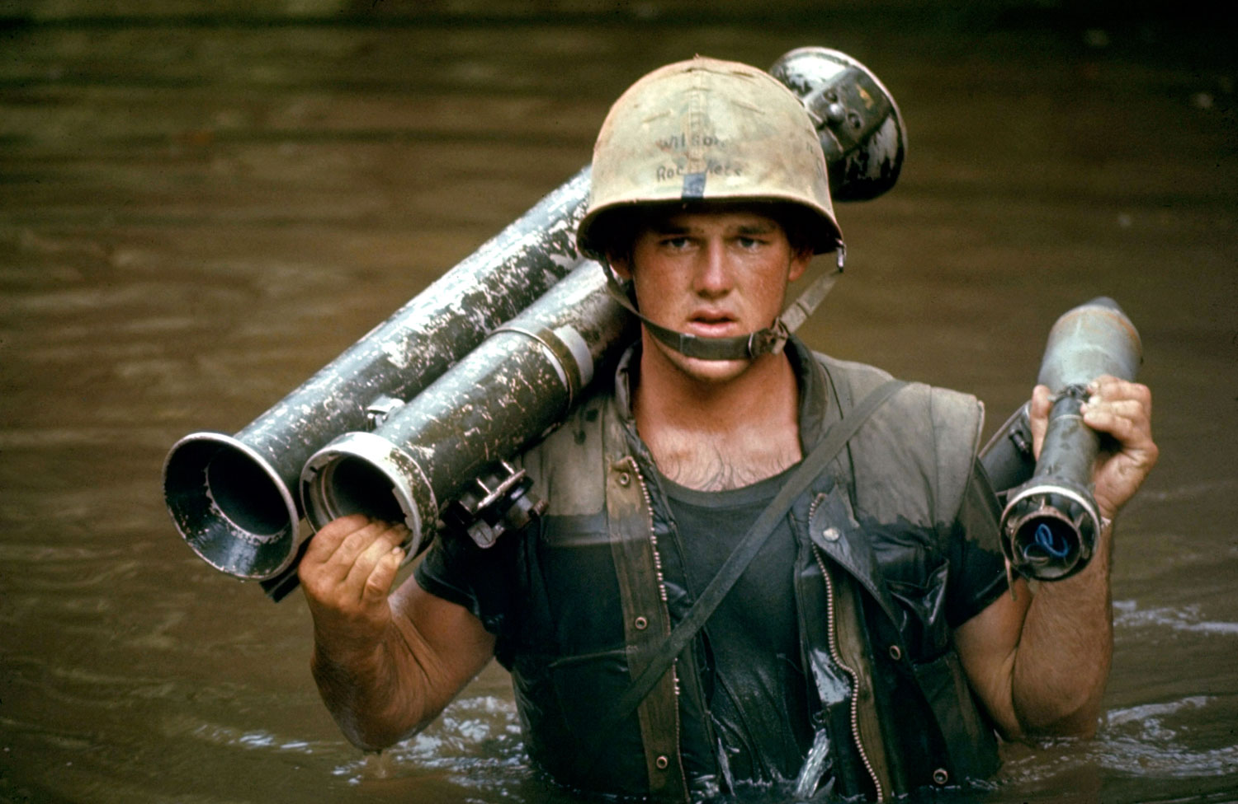
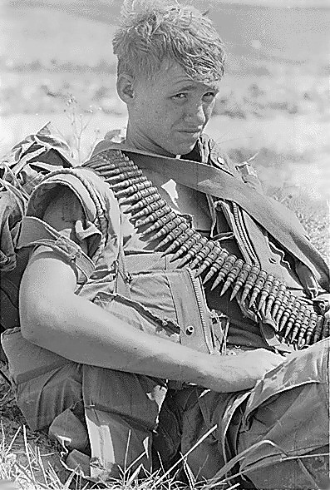
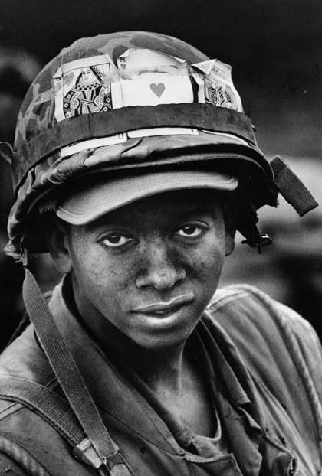
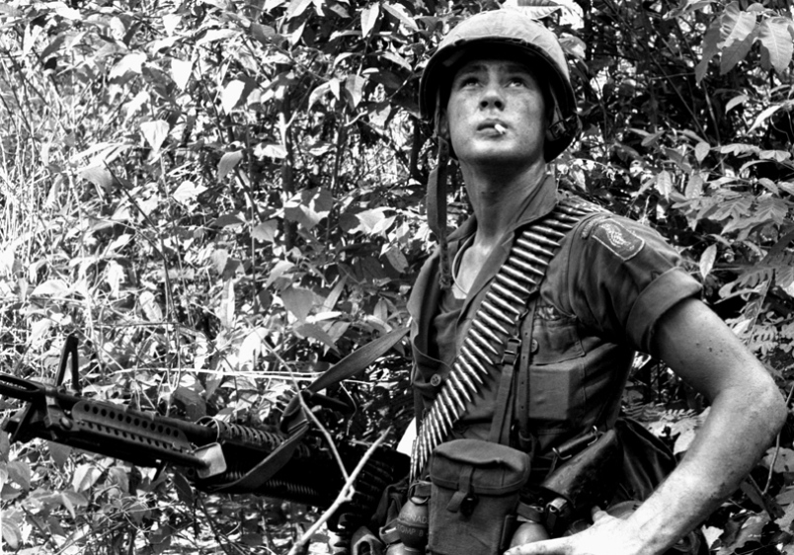
Vietnam Soldier’s Age: 22
Notes:
WWII average soldier’s age: 26
Think how many more 18-20 year olds there had to be in Vietnam to drop that average age so significantly. Pros/Cons of younger soldiers?
19

Slide 20
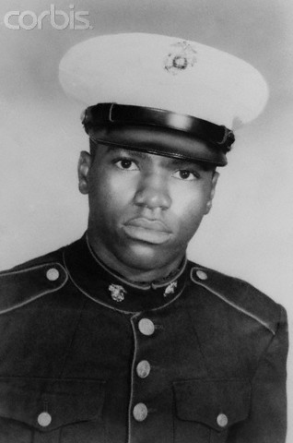
11,465 KIAs were less
than 20 years old
Dan Bulllock, 15 years old
Notes:
Came from a very poor family in Brooklyn. Lied about his age to enter the military. Died two weeks after arriving in Vietnam. He was killed instantly by small arms fire on June 7, 1969, during a North Vietnamese army night attack while making an ammunition run to resupply his beleaguered unit. Youngest casualty of the war.
20

Slide 21
Congratulations!
You’ve been drafted!
Notes:
https://www.youtube.com/watch?v=25cmARm05qs

Slide 22
JAN |  | FEB |  | MAR |  | APR |  | MAY |  | JUN |  | JUL |  | AUG |  | SEP |  | OCT |  | NOV |  | DEC
1 | 305 | 1 | 86 | 1 | 108 | 1 | 32 | 1 | 330 | 1 | 249 | 1 | 93 | 1 | 111 | 1 | 225 | 1 | 359 | 1 | 19 | 1 | 129
2 | 159 | 2 | 144 | 2 | 29 | 2 | 271 | 2 | 298 | 2 | 228 | 2 | 350 | 2 | 45 | 2 | 161 | 2 | 125 | 2 | 34 | 2 | 328
3 | 251 | 3 | 297 | 3 | 267 | 3 | 83 | 3 | 40 | 3 | 301 | 3 | 115 | 3 | 261 | 3 | 49 | 3 | 244 | 3 | 348 | 3 | 157
4 | 215 | 4 | 210 | 4 | 275 | 4 | 81 | 4 | 276 | 4 | 20 | 4 | 279 | 4 | 145 | 4 | 232 | 4 | 202 | 4 | 266 | 4 | 165
5 | 101 | 5 | 214 | 5 | 293 | 5 | 269 | 5 | 364 | 5 | 28 | 5 | 188 | 5 | 54 | 5 | 82 | 5 | 24 | 5 | 310 | 5 | 56
6 | 224 | 6 | 347 | 6 | 139 | 6 | 253 | 6 | 155 | 6 | 110 | 6 | 327 | 6 | 114 | 6 | 6 | 6 | 87 | 6 | 76 | 6 | 10
7 | 306 | 7 | 91 | 7 | 122 | 7 | 147 | 7 | 35 | 7 | 82 | 7 | 50 | 7 | 168 | 7 | 8 | 7 | 234 | 7 | 51 | 7 | 12
8 | 199 | 8 | 181 | 8 | 213 | 8 | 312 | 8 | 321 | 8 | 366 | 8 | 13 | 8 | 48 | 8 | 184 | 8 | 283 | 8 | 97 | 8 | 105
9 | 194 | 9 | 338 | 9 | 317 | 9 | 219 | 9 | 197 | 9 | 335 | 9 | 277 | 9 | 106 | 9 | 263 | 9 | 342 | 9 | 80 | 9 | 43
10 | 325 | 10 | 216 | 10 | 323 | 10 | 218 | 10 | 65 | 10 | 206 | 10 | 284 | 10 | 21 | 10 | 71 | 10 | 220 | 10 | 282 | 10 | 41
11 | 329 | 11 | 150 | 11 | 136 | 11 | 14 | 11 | 37 | 11 | 134 | 11 | 248 | 11 | 324 | 11 | 158 | 11 | 237 | 11 | 46 | 11 | 39
12 | 221 | 12 | 38 | 12 | 300 | 12 | 346 | 12 | 133 | 12 | 272 | 12 | 15 | 12 | 142 | 12 | 242 | 12 | 72 | 12 | 66 | 12 | 314
13 | 318 | 13 | 152 | 13 | 259 | 13 | 124 | 13 | 295 | 13 | 69 | 13 | 42 | 13 | 307 | 13 | 175 | 13 | 138 | 13 | 126 | 13 | 163
14 | 238 | 14 | 4 | 14 | 354 | 14 | 231 | 14 | 178 | 14 | 356 | 14 | 331 | 14 | 198 | 14 | 1 | 14 | 294 | 14 | 127 | 14 | 26
15 | 17 | 15 | 89 | 15 | 169 | 15 | 273 | 15 | 130 | 15 | 180 | 15 | 322 | 15 | 102 | 15 | 113 | 15 | 171 | 15 | 131 | 15 | 320
16 | 121 | 16 | 212 | 16 | 166 | 16 | 148 | 16 | 55 | 16 | 274 | 16 | 120 | 16 | 44 | 16 | 207 | 16 | 254 | 16 | 107 | 16 | 96
17 | 235 | 17 | 189 | 17 | 33 | 17 | 260 | 17 | 112 | 17 | 73 | 17 | 98 | 17 | 154 | 17 | 255 | 17 | 288 | 17 | 143 | 17 | 304
18 | 140 | 18 | 292 | 18 | 332 | 18 | 90 | 18 | 278 | 18 | 341 | 18 | 190 | 18 | 141 | 18 | 246 | 18 | 5 | 18 | 146 | 18 | 128
19 | 58 | 19 | 25 | 19 | 200 | 19 | 336 | 19 | 75 | 19 | 104 | 19 | 227 | 19 | 311 | 19 | 177 | 19 | 241 | 19 | 203 | 19 | 240
20 | 280 | 20 | 302 | 20 | 239 | 20 | 345 | 20 | 183 | 20 | 360 | 20 | 187 | 20 | 344 | 20 | 63 | 20 | 192 | 20 | 185 | 20 | 135
21 | 186 | 21 | 363 | 21 | 334 | 21 | 62 | 21 | 250 | 21 | 60 | 21 | 27 | 21 | 291 | 21 | 204 | 21 | 243 | 21 | 156 | 21 | 70
22 | 337 | 22 | 290 | 22 | 265 | 22 | 316 | 22 | 326 | 22 | 247 | 22 | 153 | 22 | 339 | 22 | 160 | 22 | 117 | 22 | 9 | 22 | 53
23 | 118 | 23 | 57 | 23 | 256 | 23 | 252 | 23 | 319 | 23 | 109 | 23 | 172 | 23 | 116 | 23 | 119 | 23 | 201 | 23 | 182 | 23 | 162
24 | 59 | 24 | 236 | 24 | 258 | 24 | 2 | 24 | 31 | 24 | 358 | 24 | 23 | 24 | 36 | 24 | 195 | 24 | 196 | 24 | 230 | 24 | 95
25 | 52 | 25 | 179 | 25 | 343 | 25 | 351 | 25 | 361 | 25 | 137 | 25 | 67 | 25 | 286 | 25 | 149 | 25 | 176 | 25 | 132 | 25 | 84
26 | 92 | 26 | 365 | 26 | 170 | 26 | 340 | 26 | 357 | 26 | 22 | 26 | 303 | 26 | 245 | 26 | 18 | 26 | 7 | 26 | 309 | 26 | 173
27 | 355 | 27 | 205 | 27 | 268 | 27 | 74 | 27 | 296 | 27 | 64 | 27 | 289 | 27 | 352 | 27 | 233 | 27 | 264 | 27 | 47 | 27 | 78
28 | 77 | 28 | 299 | 28 | 223 | 28 | 262 | 28 | 308 | 28 | 222 | 28 | 88 | 28 | 167 | 28 | 257 | 28 | 94 | 28 | 281 | 28 | 123
29 | 349 | 29 | 285 | 29 | 362 | 29 | 19 | 29 | 226 | 29 | 353 | 29 | 270 | 29 | 61 | 29 | 151 | 29 | 229 | 29 | 99 | 29 | 16
30 | 164 |  |  | 30 | 217 | 30 | 208 | 30 | 103 | 30 | 209 | 30 | 287 | 30 | 333 | 30 | 315 | 30 | 38 | 30 | 174 | 30 | 3
31 | 211 |  |  | 31 | 30 |  |  | 31 | 313 |  |  | 31 | 193 | 31 | 11 |  |  | 31 | 79 |  |  | 31 | 100

Slide 23
Classification | Definition
I-A | Available for military service
I-A-0 | Conscientious objector available for noncombatant military service only
I-C | Member of the armed forces of the U.S., the Coast and Geodetic Survey, or the Public Health Service
I-D | Member of reserve component or student taking military training
I-H | Registrant not currently subject to processing for induction
I-0 | Conscientious objector available for civilian work contributing to the maintenance of the national health, safety, or interest
I-S | Student deferred by statute (High School)
I-Y | Registrant available for military service, but qualified for military only in the event of war or national emergency
I-W | Conscientious objector performing civilian work contributing to the maintenance of the national health, safety, or interest
II-A | Registrant deferred because of civilian occupation (except agriculture or activity in study)
II-C | Registrant deferred because of agricultural occupation
II-D | Registrant deferred because of study preparing for the ministry
II-S | Registrant deferred because of activity in study
III-A | Registrant with a child or children; registrant deferred by reason of extreme hardship to dependents
IV-A | Registrant who has completed service; sole surviving son
IV-B | Official deferred by law
IV-C | Alien
IV-D | Minister of religion or divinity student
IV-F | Registrant not qualified for any military service
IV-G | Registrant exempt from service during peace (surviving son or brother)
IV-W | Conscientious objector who has completed alternate service contributing to the maintenance of the national health, safety, or interest in lieu of induction into the Armed Forces of the United States
V-A | Registrant over the age of liability for military service

Slide 24
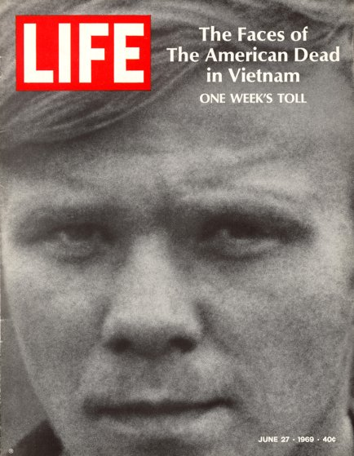
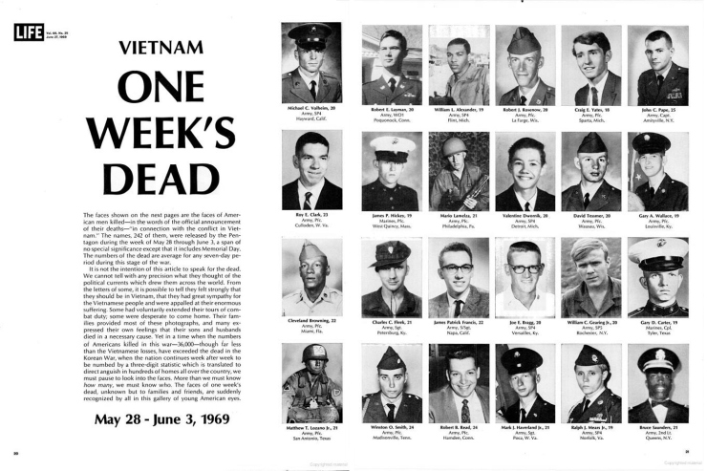
Notes:
The visual of one week’s dead in Life Magazine changed the way Americans viewed the war. Seeing all those young faces, page after page, made them realize the toll of the war. 1968 would be the deadliest year of the Vietnam War.
June 2010 – 100 people killed on war on terror in 1 month
240- in one week. Not even the deadliest week. Tet Offensive (540) KIA.

Slide 25
Protest and the War

Slide 26
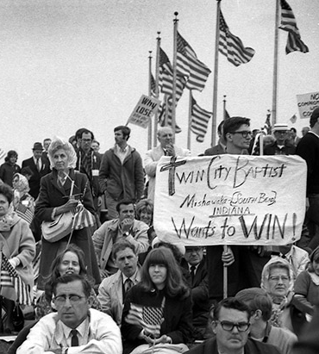
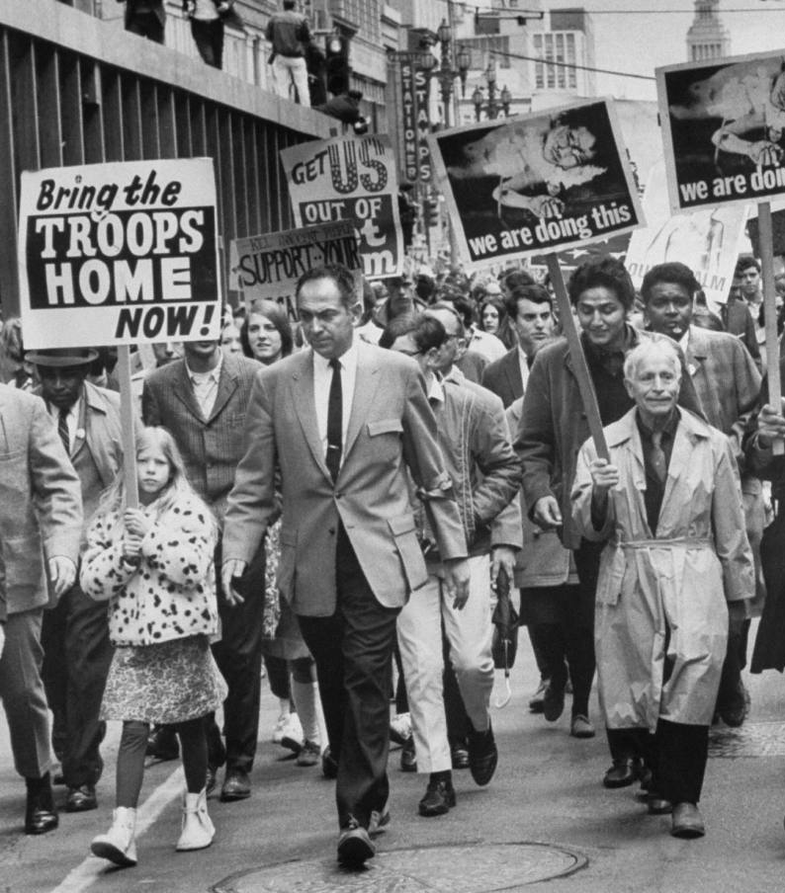
HAWKS
DOVES
Pro-war
Mostly white, older, middle-class, Republicans
War was both a political and moral obligation
Believed America could win the war, but required more public support
Anti-war
Mostly Democrats and young people
More ethnically and economically diverse
Believed in a peaceful solution to the conflict
Did not see a positive ending to the war

Slide 27
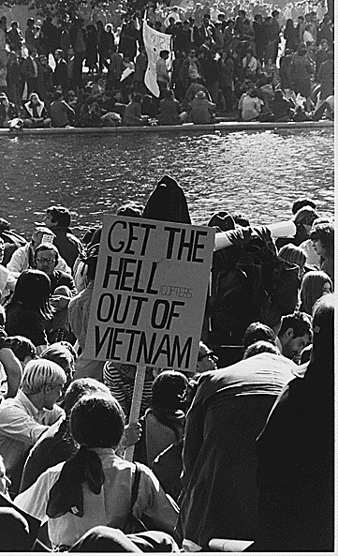
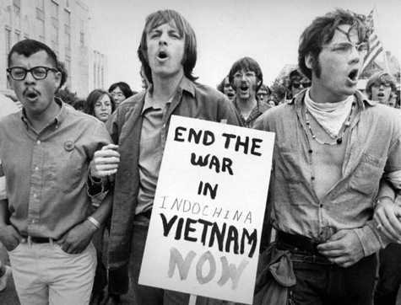
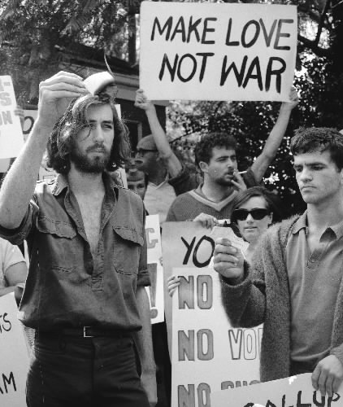
“Hey, hey LBJ, how many kids did you kill today?”
Hell no! We won’t go!
Notes:
At 18, you could be drafted, but could not vote until 21.
Young men, eager to avoid the draft, feigned homosexuality, had “hunting accidents” or blatantly burned their draft cards.

Slide 28
resist!
Cassius Clay  Muhammad Ali (1964)
Refuses to be inducted under the draft as a contentious objector (1967)
Sentenced to 5 years in prison and $10k fine
Overturned by SCOTUS
Notes:
On April 28, 1967, boxing champion Muhammad Ali refuses to be inducted into the U.S. Army and is immediately stripped of his heavyweight title. Ali, a Muslim, cited religious reasons for his decision to forgo military service.
Born Cassius Marcellus Clay, Jr., in Louisville, Kentucky, on January 14, 1942
Changed his name to Muhammad Ali in 1964 after converting to Islam.
On February 25, 1964, he defeated the heavily favored bruiser Sonny Liston in six rounds to become heavyweight champ.
On April 28, 1967, with the United States at war in Vietnam, Ali refused to be inducted into the armed forces, saying “I ain’t got no quarrel with those Vietcong.” On June 20, 1967, Ali was convicted of draft evasion, sentenced to five years in prison, fined $10,000 and banned from boxing for three years.
On June 28 1971, the U.S. Supreme Court overturned his conviction for evading the draft.
“I ain’t got no quarrel with them Vietcong,” he had told reporters.

Slide 29
Vietnam Protest Music
Protest music rose during the Civil Rights Movement
Vietnam War Protest Music
Rock and roll, Folk, Motown
Topics: Anger over the war in Vietnam, the draft, the seemingly unfair treatment for the wealthy, lack of a political voice for young people, etc.
Pro-War music: Ballad of the Green Berets, Merle Haggard
Notes:
Folk Music: Bob Dylan, Joan Byez, Arlo Guthrie, etc.
Protest music had grown in popularity during the Civil Rights Movement
Anger over the war in Vietnam, the draft, the seemingly unfair treatment for the wealthy, and the absence of a political voice for young people led to an explosion of protest songs during the 1960s and early 1970s.
Pro-war songs: Ballad of the Green Berets, By SSgt. Barry Sadler; Okie From Muskogee By Merle Haggard
ALL ALBUM COVERS LINKED TO MUSIC

Slide 30
“Just Get out alive”
America Leaves Vietnam

Slide 31
Second Lieutenant
William L. Calley
Mai Lai Massacre
Notes:
U.S. military intelligence believed that one of the Vietcong battalions responsible for the Tet Offensive was taking refuge in the village of My Lai.
On the morning of March 16, 1968, US soldiers marched into My Lai, and murdered at least 340 unarmed civilians, most of which were women, children, infants, and elderly people.
The first public reports claimed that "128 Viet Cong and 22 civilians" were killed in the village during a "fierce fire fight“, and General William Westmoreland, commander of military operations in Vietnam, congratulated the unit on the "outstanding job".
Two years later the truth about the incident emerged, which prompted global outrage. The massacre also increased domestic opposition to the U.S. involvement in the Vietnam War.
Three U.S. servicemen who had tried to halt the massacre and protect the wounded were initially denounced by several U.S. Congressmen as traitors. They received hate mail and death threats and found mutilated animals on their doorsteps. The three were later widely praised and decorated by the Army for their heroic actions.
“You’re a criminal either way.”

Slide 33
Vietnam Veterans Against the War (VVAW)
"How do you ask a man to be the last man to die in Vietnam? How do you ask a man to be the last man to die for a mistake?"
John Kerry
Notes:
In April 1971, the Senate Foreign Relations Committee began to hear testimony on continuing the war in Vietnam.
John Kerry (Representative of VVAW) spoke on the necessity of immediate and total withdrawal, based on Vietnam veterans' personal experiences.

Slide 34
Nixon promises withdrawal from Vietnam in 1968 campaign
Nixon Doctrine: U.S. would aid nations in need, but would no longer fight their wars for them
Vietnamization: Replace U.S. troops with South Vietnamese forces
Time to leave!
Notes:
When Richard Nixon was elected in 1968, he promised to gradually withdraw U.S. troops from Vietnam.
Nixon Doctrine: In a press conference in 1969, President Richard Nixon stated that "the United States would assist in the defense and developments of allies and friends," but would not "undertake all the defense of the free nations of the world.”
This doctrine meant that each ally nation was in charge of its own security in general, but the United States would act as a nuclear umbrella when requested.
Vietnamization: American troops would withdraw from Vietnam and ee would train and prepare the South Vietnamese to fight their own war against North Vietnam and the Vietcong.
The last U.S. forces left in 1973.

Slide 35
Invasion of Cambodia
Notes:
On April 30, 1970, President Richard M. Nixon appeared on national television to announce the invasion of Cambodia by the United States In hopes of defeating the approximately 40,000 Vietcong troops who were concealed along the eastern border regions of Cambodia, and the need to draft 150,000 more soldiers for an expansion of the Vietnam War effort.
Cambodia's official neutrality and military weakness made its territory effectively a safe zone where Vietnamese Communist forces could establish bases for operations over the border (e.g. Ho Chi Minh Trail).
With the U.S. shifting toward a policy of Vietnamization and withdrawal, the Nixon administration wanted to build up South Vietnam's security by eliminating the cross-border threat.

Slide 36
America Attacks Its Own
Student protests erupt across the country (Cambodia, Laos)
Kent State Massacre (1970)
Peaceful demonstration got out of hand
4 killed, 9 wounded by OH National Guard
Notes:
Protests against the invasion were quick in coming on the campuses of America's universities, erupting against what was perceived as an expansion of the conflict into yet another country.
On May 4, 1970, over 2,000 students attended a demonstration against the Invasion of Cambodia; got out of hand. Set fire to the ROTC building.
Ohio National Guardsmen shot and killed four unarmed student protesters (two of whom were not involved in the protest), and wounded nine others on the campus of Kent State. Shooting lasted 13 seconds.
The shootings led to protests on college campuses throughout the United States, and a strike of over 4 million students, causing more than 450 campuses across the country to close with both violent and non-violent demonstrations
John Filo, a student and part-time news photographer, distilled that feeling into a single image when he captured Mary Ann Vecchio (14 year-old runaway) crying out and kneeling over a fatally wounded Jeffrey Miller. Filo’s photograph was put out on the AP wire and printed on the front page of the New York Times. It went on to win the Pulitzer Prize and has since become the visual symbol of a hopeful nation’s lost youth.
As Neil Young wrote in the song “Ohio,” inspired by a LIFE story featuring Filo’s ­images, “Tin soldiers and Nixon coming/ We’re finally on our own/ This summer I hear the drumming/ Four dead in Ohio.”

Slide 37
The Pentagon Papers
Classified history of the Vietnam conflict was leaked to the New York Times by Daniel Ellsberg
LBJ’s administration had systematically lied to both Congress and the public about the success of the war
Notes:
A history of the conflict in Vietnam by the Department of Defense was leaked to the New York Times that revealed that Johnson’s Administration had systematically lied, not only to the public but also to Congress, about the events and success of the war in Vietnam.
America lost what little faith they still had in their government and the Vietnam War.

Slide 38
Paris Peace Accord
Cease-fire, US withdrawal from Vietnam, release of POWs, and reunification of N and S Vietnam through peaceful means.
War Powers Resolution
Takes back Congress’ war powers
Congressional approval or national emergency
Must notify Congress w/in 48 hours
Must remove troops after 60 days if not given approval by Congress
Ending the War (1973)
Notes:
US signs Paris Peace Accord – March 29, 1973
Its key provisions included a cease-fire throughout Vietnam, the withdrawal of U.S. forces, the release of prisoners of war, and the reunification of North and South Vietnam through peaceful means. The South Vietnamese government was to remain in place until new elections were held, and North Vietnamese forces in the South were not to advance further nor be reinforced.
Even before the last American troops departed on March 29, the communists violated the cease-fire, and by early 1974 full-scale war had resumed.
War Powers Resolution (1973): Allows the President to send U.S. armed forces into action abroad only by authorization of Congress or in case of a national emergency.
Requires the President to notify Congress within 48 hours of committing armed forces to military action and forbids armed forces from remaining for more than 60 days, with a further 30 day withdrawal period, without an authorization by Congress or a declaration of war.
Within two years of American withdrawal, Communists overran South Vietnam.
58,000 Americans died during the war in Vietnam.

Slide 39
The Fall of Saigon (1975)
N. Vietnamese invade S. Vietnam, breaking the Peace Accords
Many Southerners feared retaliation by N. Vietnamese
Ambassador Graham Martin sought a gradual evacuation to avoid chaos
Four-Option plan developed for evacuation
South Vietnamese President resigns as Options 1 & 2 are implemented, resulting in fear and chaos
Notes:
North Vietnamese invade South Vietnam (breaking Peace Accords)
Many feared that once the communists took control of the city, a bloodbath of reprisals would take place (had previously targeted counterrevolutionaries, Westerners, intellectuals, etc.). Most Americans and citizens of other countries allied to the United States wanted to evacuate the city before it fell, and many South Vietnamese, especially those associated with the United States or South Vietnamese government, wanted to leave as well.
Defense Attaché Office (DAO) illegally airlifted refugees to Clark Airforce Base in the Philippines (illegal under the Peace Accords)
“Operation Babylift”: Ford calls for the evacuation of 2,000 orphans
Graham Martin: US Ambassador to S. Vietnam, only son KIA in Vietnam

Slide 40
Operation Frequent Wind
Notes:
Operation Frequent Wind (April 29-30, 1975)
Evacuation Plans:
Option 1: Evacuation via commercial flights
Option 2: Evacuation via military planes
Option 3: Evacuation by sea via Saigon port
Option 4: Evacuation via helicopter
13 Landing Zones (LZ) for helicopters around the city
Main locations: DAO compound and US Embassy
Tan Son Nhat Airport is bombed, destroying the ability of using airplanes for evacuations
The last two American servicemen to die in Vietnam, Charles McMahon and Darwin Judge

Slide 41
Notes:
the last two American servicemen to die in Vietnam, Charles McMahon and Darwin Judge
Vietnamese Boat People (1975-1995)
41

Slide 42
Vietnamese Boat People
Notes:
Boat of No Smiles

Slide 43
Notes:
43

Slide 44
Whistle-Blower or Traitor?

