Slide 1
Bell Ringer
What are some things you do that your parents don’t approve of/drives them nuts?

Slide 2
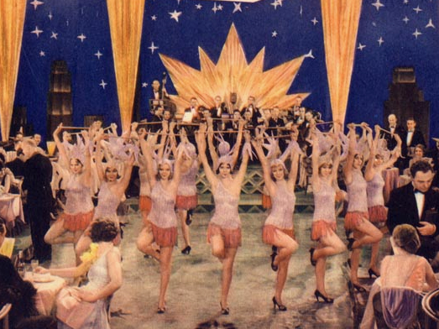
The Jazz Age
Glamour, culture, and excitement!

Slide 3

The New Morality
The struggle between tradition and modernity

Slide 4

The New Morality
A shift in the beliefs of many Americans during the 1920s on their ideas of family, relationships, gender roles, religion, and especially, war.
"Old" Culture | "New" Culture
Emphasized Production | Emphasized Consumption
Character | Personality
Scarcity | Abundance
Religion | Science
Idealized the Past | Looked to the Future
Local Culture | Mass Culture
Substance | Image

Slide 5
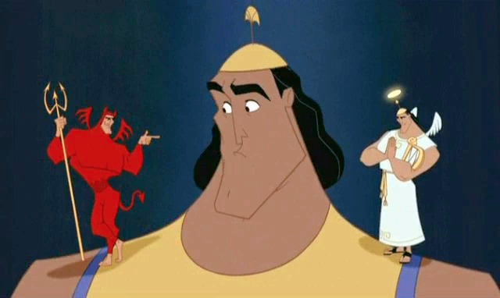
Causes for the “New Morality”
World War I
Increasing role of women in politics
Mass Media

Slide 6
The Lost Generation
Finding a new meaning of life in postwar America

Slide 7
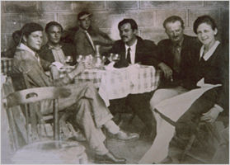
The Lost Generation
Coined by poet Gertrude Stein
Artists disillusioned after WWI
  Questioned accepted ideas about reason, progress, religion, the mind, and explored anxieties about the future
Settled in Paris

Slide 8
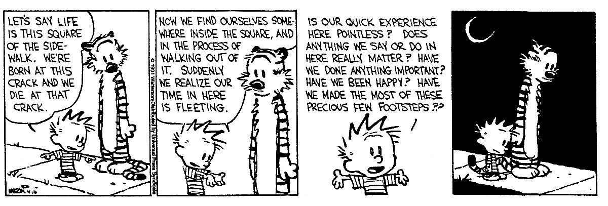
Existentialism
There is no universal understanding or meaning to life. Each person creates his or her own meaning in life through actions and choices taken.

Slide 9
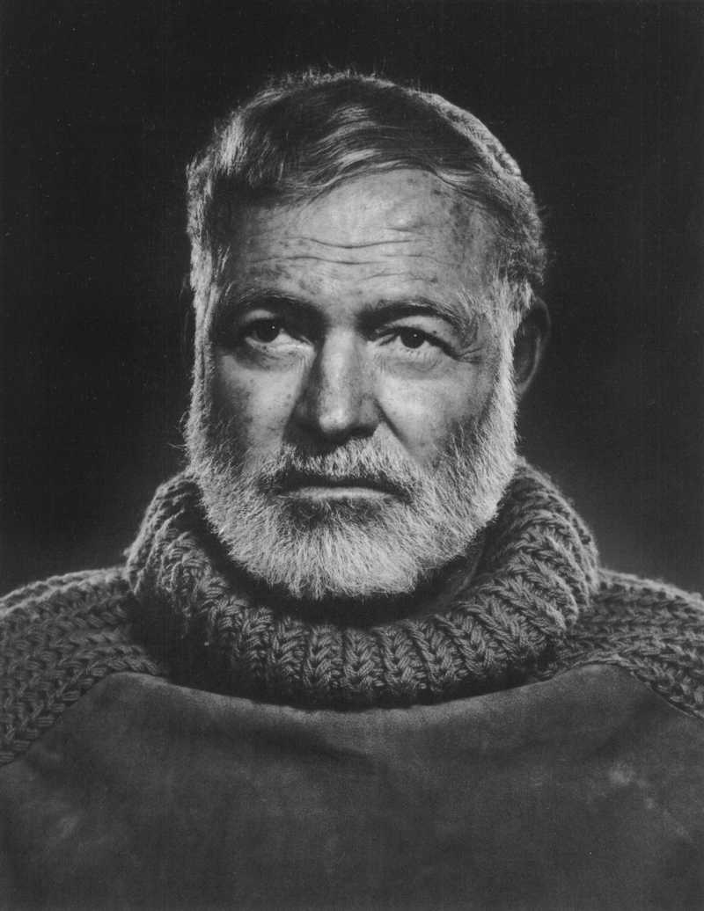
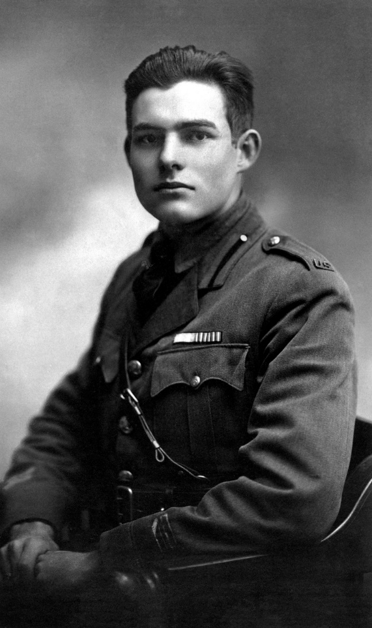
Lost Generation Writers
Ernest Hemmingway – known for stoic male characters and disillusionment with youth and heroism; The Sun Also Rises and A Farewell to Arms

Slide 10
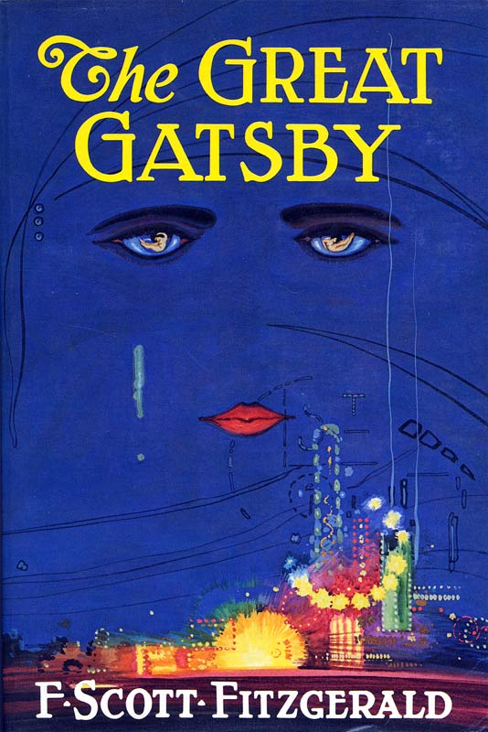
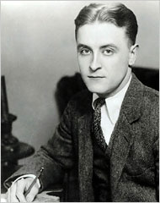
F. Scott Fitzgerald
The epitome of the youthful, glamorous lifestyle of the era
Coined the term the “Jazz Age”
The Great Gatsby

Slide 11
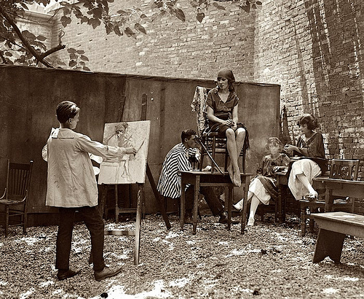
La Vie Boehme!
"Bohemians“: unconventional, usually artistic
  Greenwich Village (NYC)
Sought to break social barriers, refuting traditional gender norms and sexual stereotypes

Slide 12
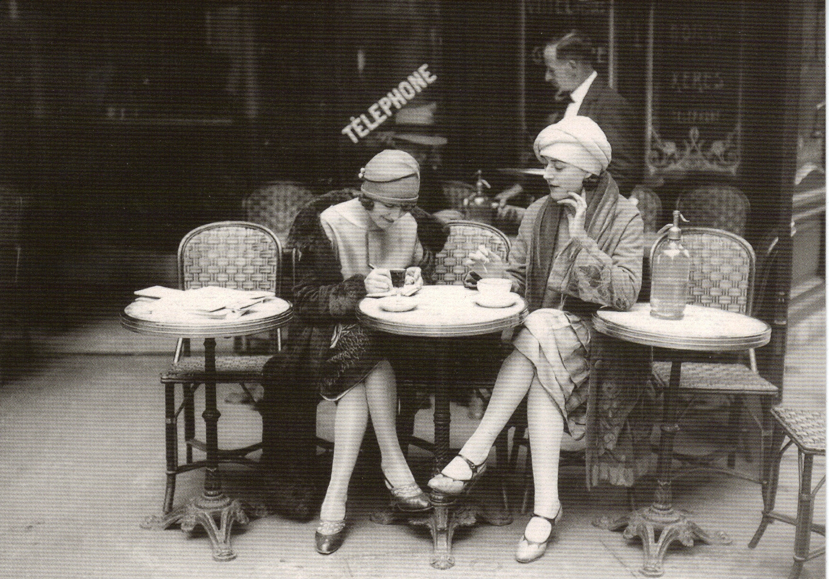
Redefining Femininity
The New Morality for Women

Slide 13
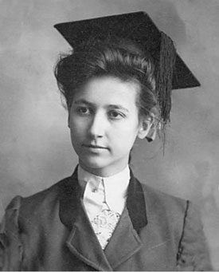
Changes in Society
Women in the workforce
  Women in the workforce during WWI
  Some stayed after the war ended
  Menial jobs
Women’s colleges
  Pre-WWI: Genuine fear that college made women unfit for marriage
  1920s: The new “modern woman” was more educated and independent; more likely to attend college and put off marriage

Slide 14
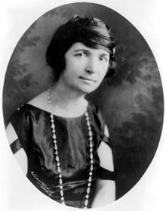
Margaret Sanger
Founded the American Birth Control League (would later become Planned Parenthood)
  Eugenicist
  Believed that families standard of living would improve if they limited the number of children they had.
  Would later become one of the driving forces for the FDA approval of “The Pill”

Slide 15
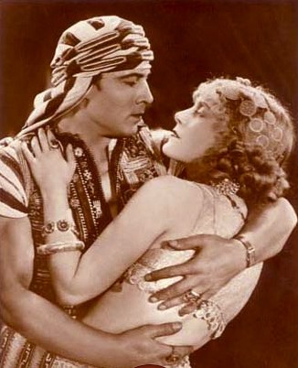
New Roles in the Home and Family
Women and consumer culture
  Became the “purchasing agent” of the family
Household tasks become much easier with electric appliances
  No less time spent on housework
  Decrease in “domestics”
Romance and relationships
  Highly inspired by the romances on the silver screen

Slide 16
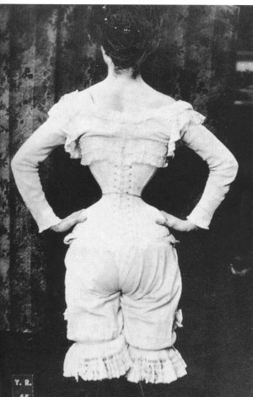
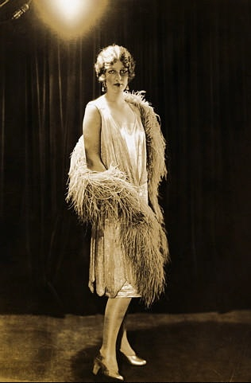
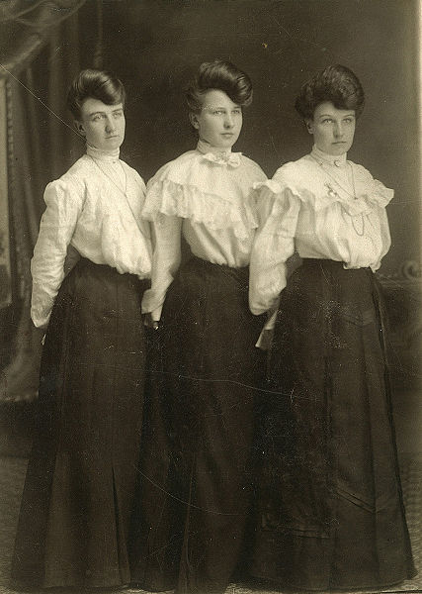
The New Girl
1900
1920

Slide 17
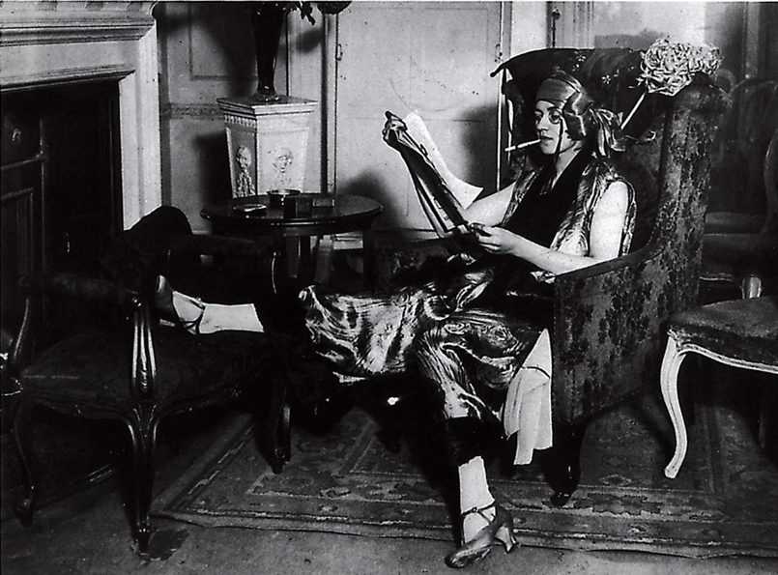
What’s wrong with
this picture?

Slide 18
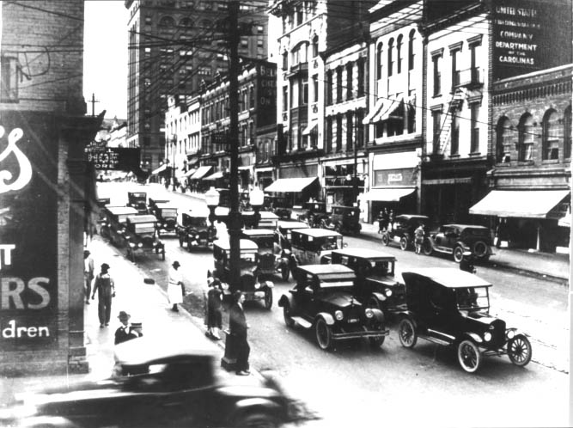
Inventions and their effect on culture
“Enjoy Now, Pay Later!”

Slide 19
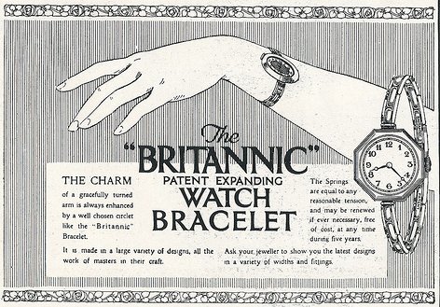
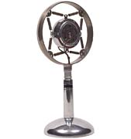
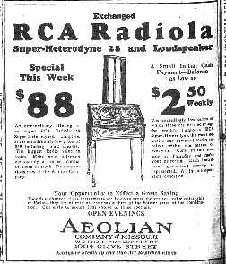
A New Consumer Culture
Buying lots of “things” was the sign of affluence and luxury
Exciting new goods become available
  More disposable income
  Advertised on the radio
Consumer credit – Buy now, pay later!
  Enticing to members of all social classes
  Credit applied to purchases big and small
  Inflated ideas of wealth and economic strength
Notes:
Ads for products as well as for political candidates (Hoover)

Slide 20
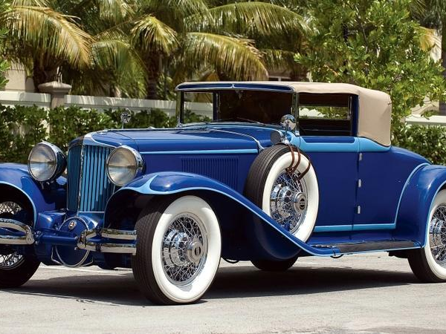
America and the Automobile
The automobile quickly became a staple of American consumerism
  Played a major role in economic boom
  Stimulated job market
  Spurred urban sprawl
  Created opportunities for youth to pursue interests away from their parents
  Most bought on credit

Slide 21
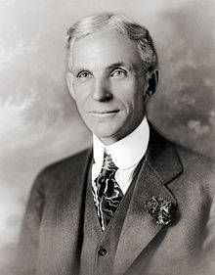
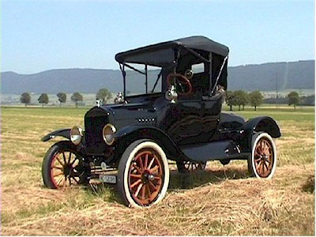
Putting America on the Move
Henry Ford produced the first affordable automobile by using the assembly line.
  1913: Workers could build a car every 93 minutes. Sold for $490.
  1925: Workers finished a new Ford every 10 seconds. Sold $295.
Model T was nicknamed the “Tin Lizzie” or “Flivver”
“You can get the Model T in any color you wish, as long as that color is black.”
Notes:
1 in 6 Americans owned a car by 1929
Played a major role in America’s economic boom - $2.58 billion in 1929
Created 3.7 million jobs directly or indirectly

Slide 22
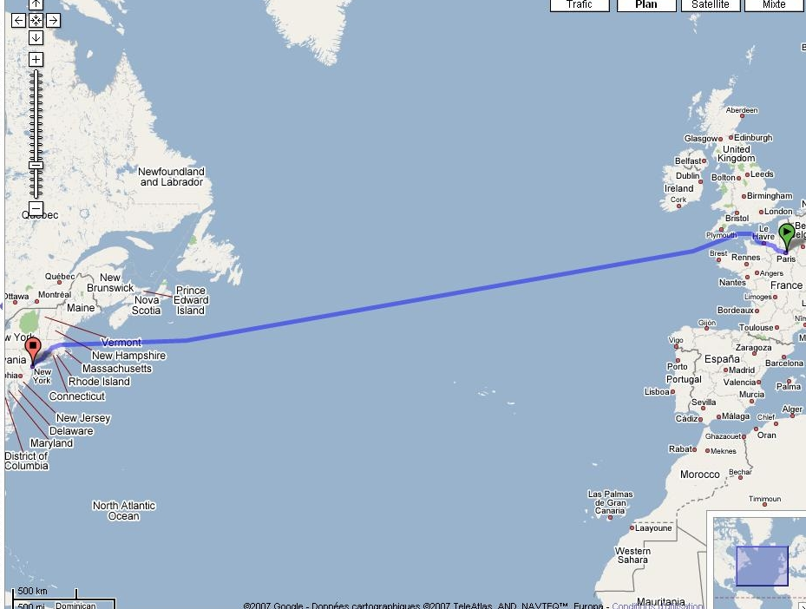
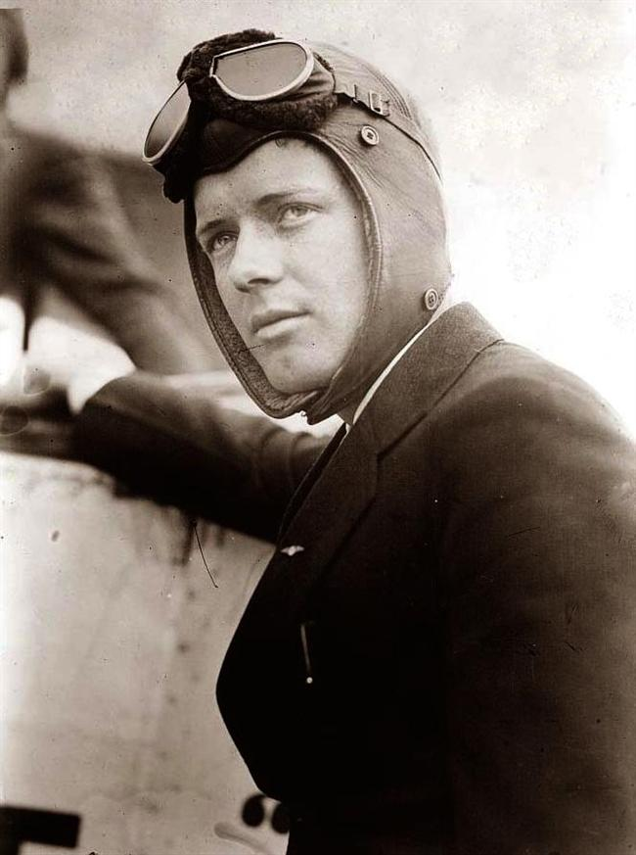
1st Solo transatlantic flight
Charles Lindbergh
Notes:
In 1919, a New York City hotel owner offered $25,000 to the first aviator to fly nonstop from New York to Paris.
Several pilots were killed or injured while competing for the Orteig prize.
An American aviator who made the first solo nonstop flight across the Atlantic Ocean on May 20-21, 1927.
Total flight time: 33 hours, 30 minutes, 29.8 seconds. Charles Lindbergh had not slept in 55 hours.

Slide 23
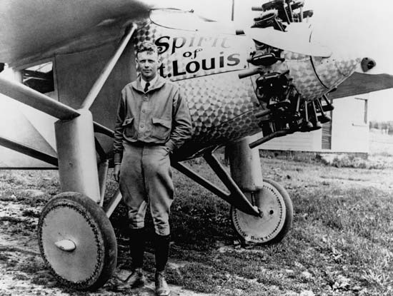
Notes:
Total flight time: 33 hours, 30 minutes, 29.8 seconds. Charles Lindbergh had not slept in 55 hours.
Lindbergh's feat gained him immediate, international fame. The press named him "Lucky Lindy" and the "Lone Eagle."
Americans and Europeans idolized the shy, slim young man and showered him with honor.

Slide 24
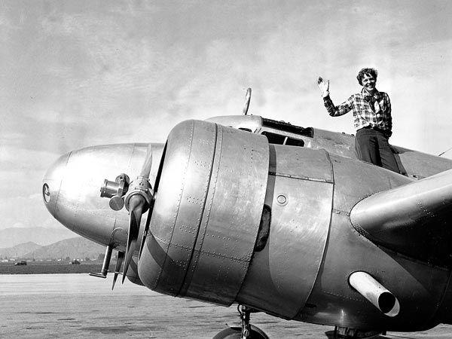
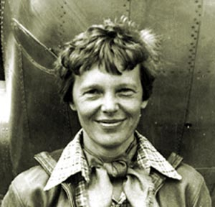
Amelia Earhart

Slide 25
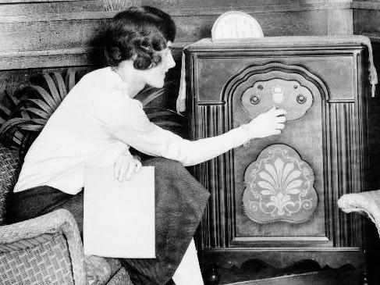
The Radio
More than any other invention of the age, the radio changed the very nature of how Americans communicated
  In 40% of American homes by 1929
It created a homogeneous American culture:
  Sports
  Entertainment
  News
  Advertising
  Standardized speech patterns
Notes:
National Broadcasting Company and the Columbia Broadcasting System became the first national broadcasts

Slide 26
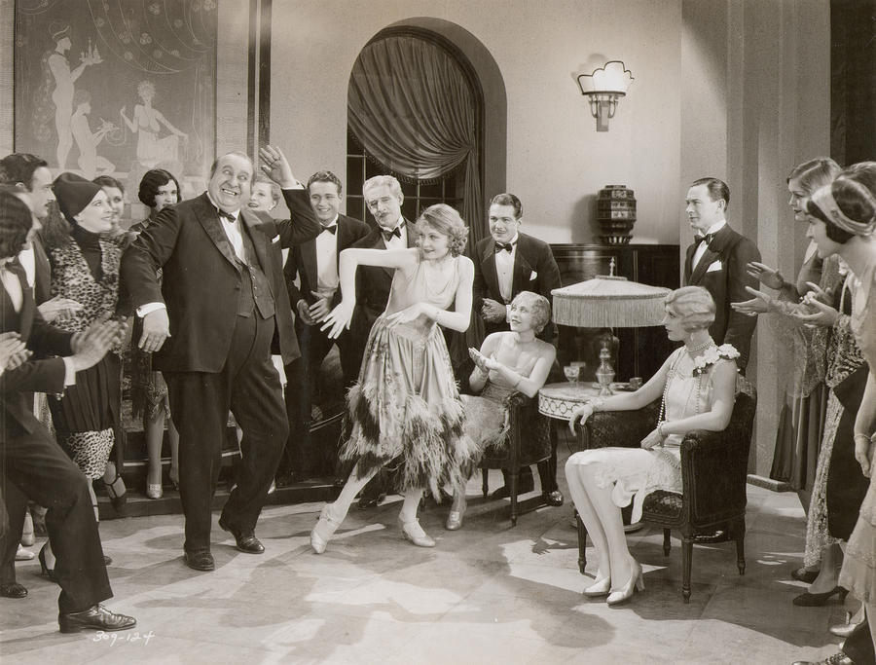
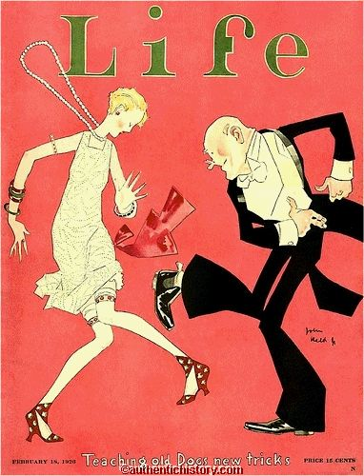
The Jazz Age Starts Swingin’
America’s Social Revolution

Slide 27
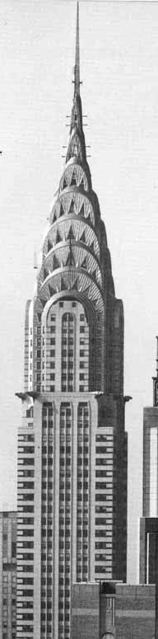
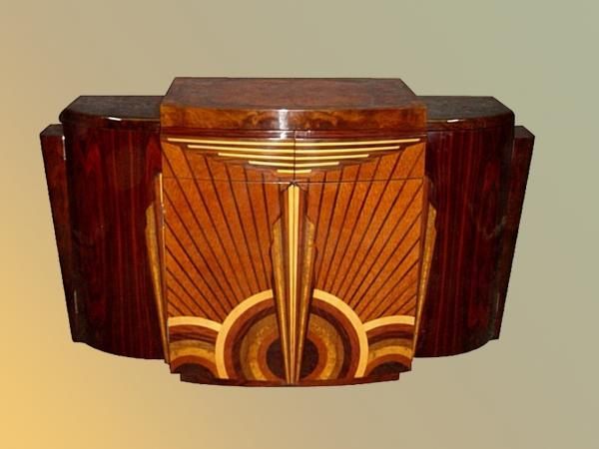
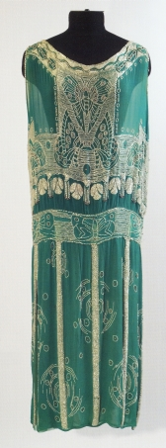
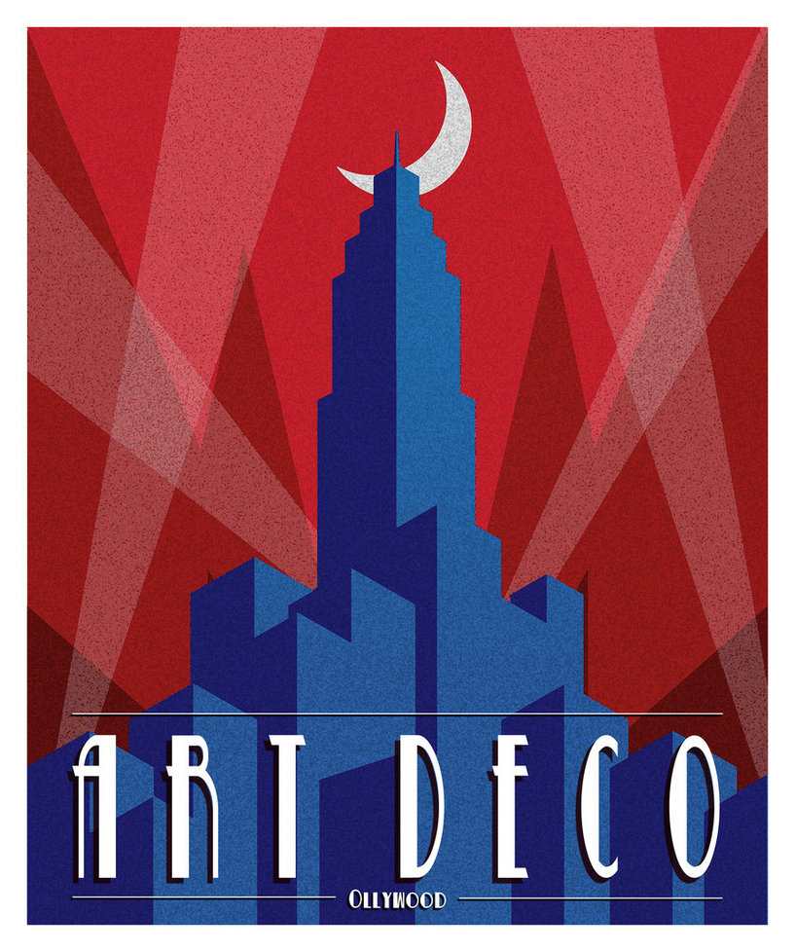
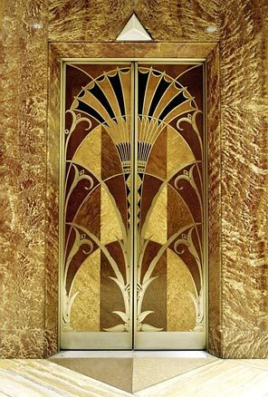

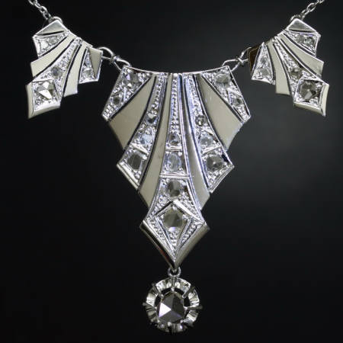
What do these have in common?

Slide 28
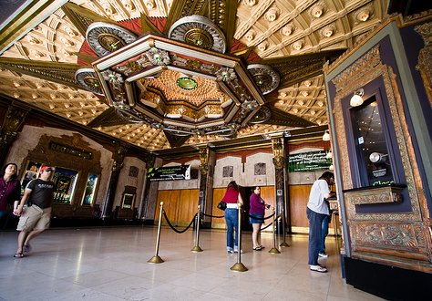
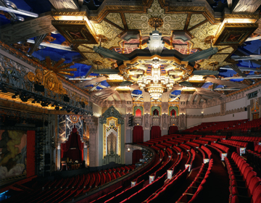
Pantages Theatre

Slide 29
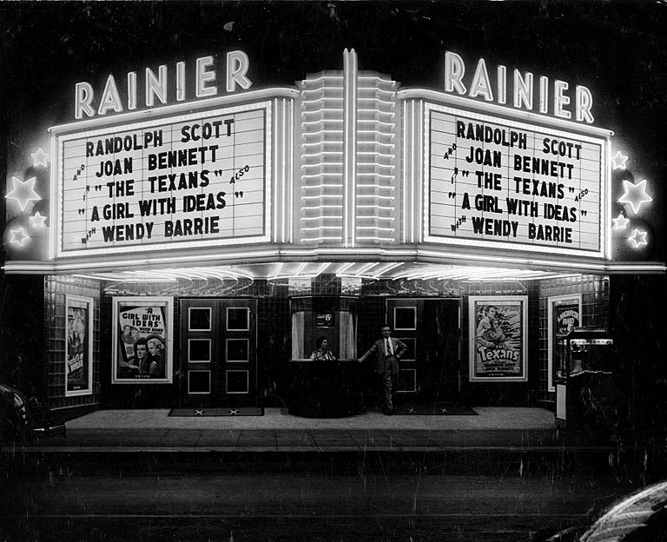
The Movies

Slide 30
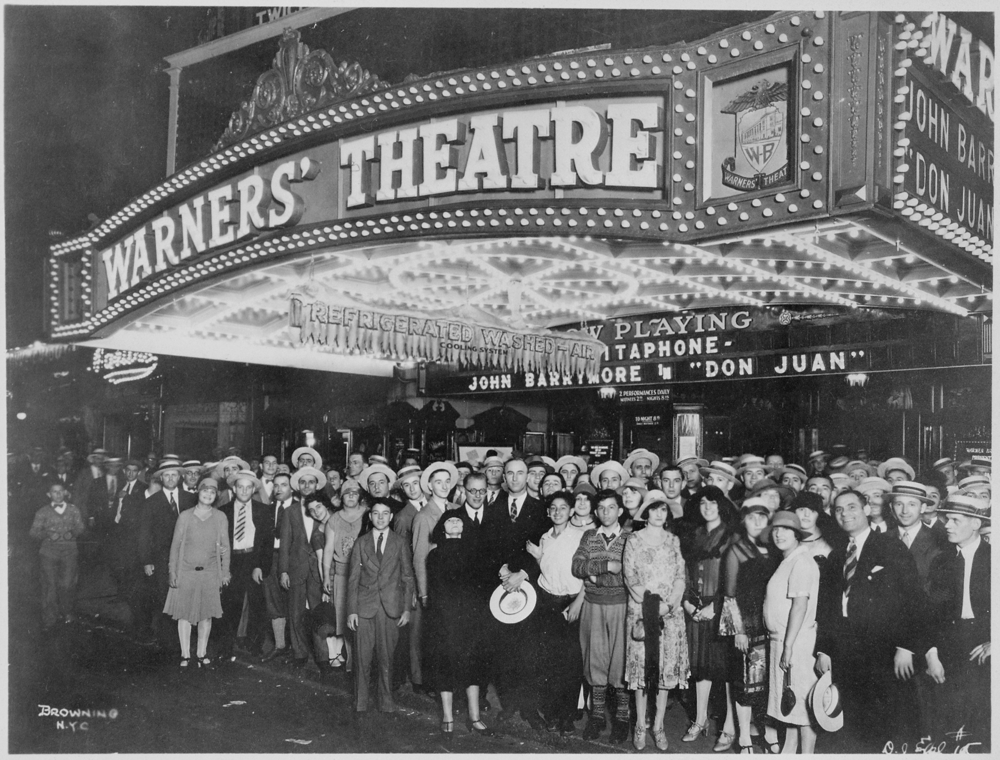
Conflict Over Film
Silent films
Luxurious movie houses
Inspired the fashion and behavior of America’s youth
Movies were seen as morally dangerous
  Foreign stars stole the hearts of young Americans
  Promoted “immorality”

Slide 31
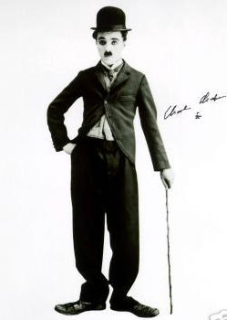
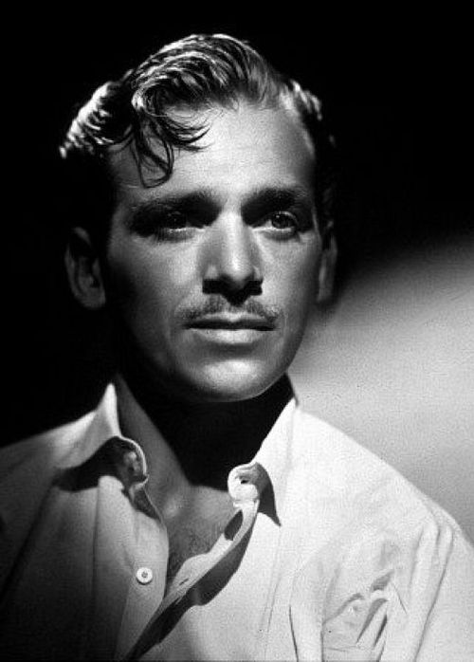
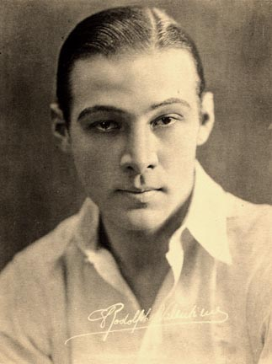
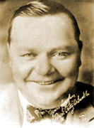
Hunks and Hams
Charlie
Chaplin
Rudolph
Valentino
Douglas
Fairbanks
“Fatty”
Arbuckle
Notes:
Valentino in The Shiek

Slide 32
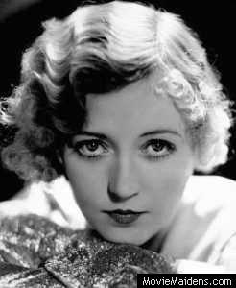
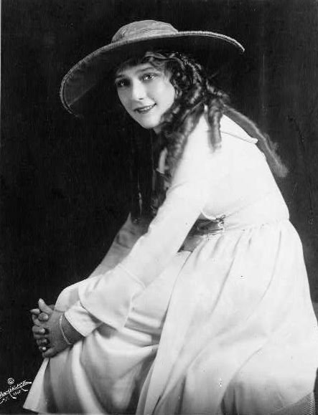
Glittering Starlets
Mary Pickford
Marion Davies

Slide 33
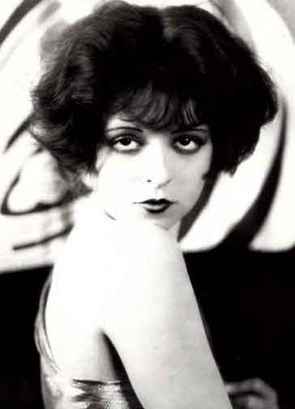
The Ultimate Flapper!
The first “It” girl
Clara Bow

Slide 34
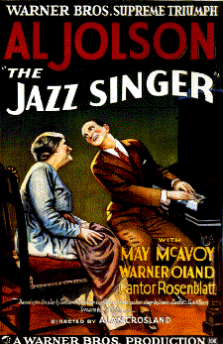


The Jazz Singer – The first “Talkie”

Slide 35



NFL
Babe Ruth
Jack Dempsey

Slide 36


The “Great Experiment”

Slide 37

The Great Experiment
Causes:
  19th century temperance movement
  Wartime anti-German prejudice (beer brewers)
  16th amendment removed government need for alcohol taxes
Wet vs. Dry
  Wet – generally from urban areas; working class
  Dry – generally rural; Protestant
Hailed as a victory for health, morals, and Christian values

Slide 38

Moonshining and Bootlegging
With alcohol still being a desirable product, many turned to illegal methods of obtaining it
  Moonshining
  Bootlegging
  Speakeasies

Slide 39






Slide 40

Gangsters
Emergence of a cutthroat black market
Bootleggers began using intimidation and violence to guard their “territory”
Organized crime families took over in major cities
  Chicago, NYC

Slide 41





Many gangsters with colorful names began making headlines: “Baby Face” Nelson, Lucky Luciano, “Pretty Boy” Floyd, Jack “Legs” Diamond, “Bugs” Moran, and John Dillinger

Slide 42


Al Capone
The most influential and dangerous gangster
  Leader of Chicago’s Southside gang
Suspected of orchestrating numerous murders, but unable to be pinned for the crime.
  St. Valentine’s Day Massacre
Eventually convicted of tax evasion, sent to Alcatraz

Slide 43

St. Valentine’s Day Massacre

Slide 44

The Harlem Renaissance
Bringing African American culture into the forefront

Slide 45
The Harlem Renaissance
Rebirth of African American culture
Illustrated the struggles and contributions of African Americans
Seen in literature, art, music, dance, etc.
Harlem becomes a hub for artists (result from WWI Great Migration)

Slide 46

Marcus Garvey
A dynamic leader from Jamaica, he promoted “Negro Nationalism,” which glorified black culture and the traditions of the past
  Universal Negro Improvement Association (UNIA) to promote black separatism
    “Back to Africa” Movement
    Black Star Line
  Imprisoned and deported for mail fraud

Slide 47

Literature
Literature of the Harlem Renaissance reflected the struggles and contributions of African Americans.
Zora Neale Hurston – Their Eyes Were Watching God
  Relates the story of fiercely independent Janie Crawford, and her evolving selfhood through three marriages and a life marked by poverty, trials, and purpose.

Slide 48

Literature
What happens to a dream deferred?
Does it dry up
like a raisin in the sun?
Or fester like a sore--
And then run?
Does it stink like rotten meat?
Or crust and sugar over--
like a syrupy sweet?
Maybe it just sags
like a heavy load.
Or does it explode?
-Langston Hughes
Notes:
Traditionally, poets are lyric historians. From the days of the bards and troubadours, the songs of the poets have been not only songs, but oftenrecords of the most moving events, the deepest thoughts and most profound emotional currents of their times. To understand Africa today, it is wise to listen to what its poets say—those who put their songs down on paper as well as those who only speak or sing them.

Slide 49

Music

Slide 50

Blues
Bessie Smith – Empty Bed Blues
I woke up this morning with a awful aching head
I woke up this morning with a awful aching head
My new man had left me, just a room and a empty bed
Bought me a coffee grinder that's the best one I could find
Bought me a coffee grinder that's the best one I could find
Oh, he could grind my coffee, 'cause he had a brand new grind

Slide 51
Jazz
Originated in New Orleans
  Blues, ragtime, popular music
Performers improvise around a basic melody
Became instantly popular in dance halls across the country
  Prompted lively, energetic dances

Slide 52

Louis Armstrong – “Satchmo”

Slide 53


Rhapsody in Blue by George Gershwin

