Slide 1
Bell Ringer: Choose the statement that most closely aligns with your beliefs and explain why you chose that one.
In a democracy, people should have the freedom to make their own choices and be responsible for their actions. If they want to indulge in destructive personal behavior, that's their business, not the government’s.
A democratic government is made up of its citizens and a major responsibility of government is to guarantee equal opportunity for all. The government has a duty to alleviate social ills and guarantee that no one is in need.

Slide 2
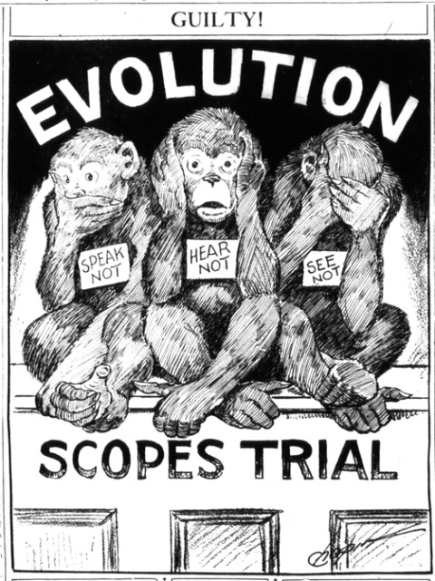
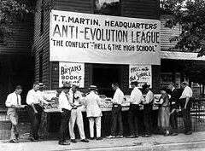
A Clash of Values

Slide 3
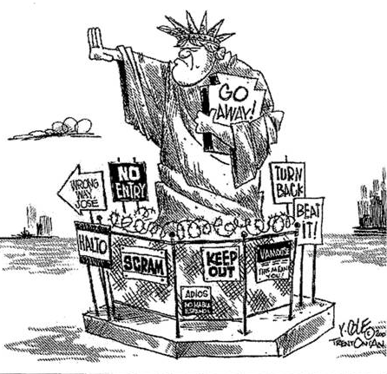
THE RISE OF NATIVISM

Slide 4
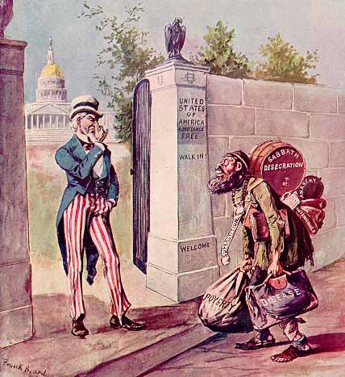
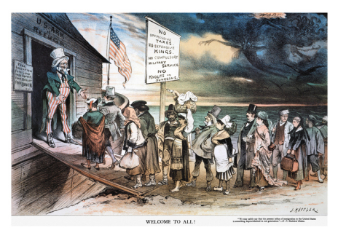
“Keep America American”
After WWI, American immigration policies changed in response to economic recession and the pleas of nativists

Slide 5
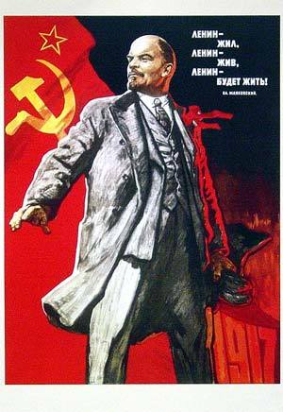
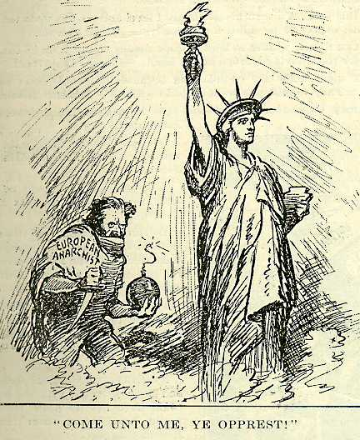
The Red Scare
Red Scare: Post-war period marked by fear of worker (socialist) revolution and political radicalism.
Causes:
      The Bolshevik Revolution and Russia’s retreat from WWI.
      Anarchist and left-wing political violence and social agitation
Targets: Recent European immigrants (hyphenated-Americans), IWW
Xenophobia: Fear or suspicion of outsiders or foreigners

Slide 6
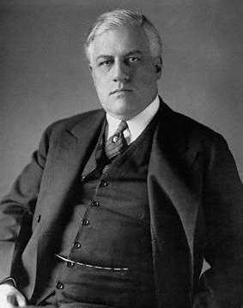
Red Scare Fears Come True
Italian anarchists sent a series of letter bombs to prominent government officials, businessmen, and law enforcement officials
      Attacked the home of Attorney General A. Mitchell Palmer

Slide 7
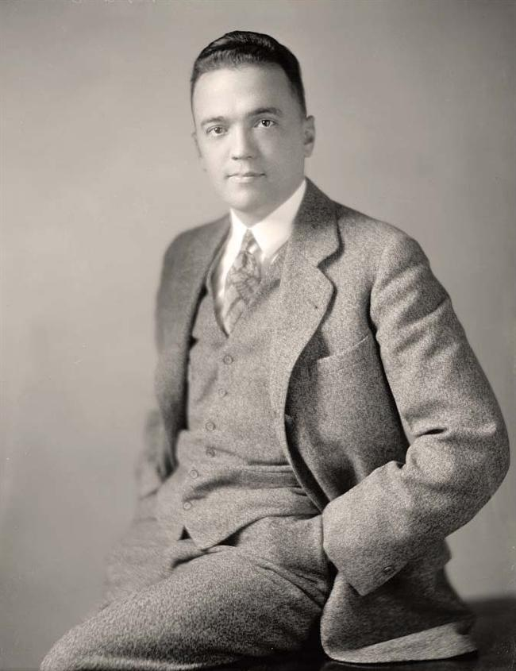
Red Scare Fears Come True
Federal Bureau of Investigation (1919) is created in response to the bombings
        Led by J. Edgar Hoover
        Would investigate the programs of radical groups and identify their members.

Slide 8
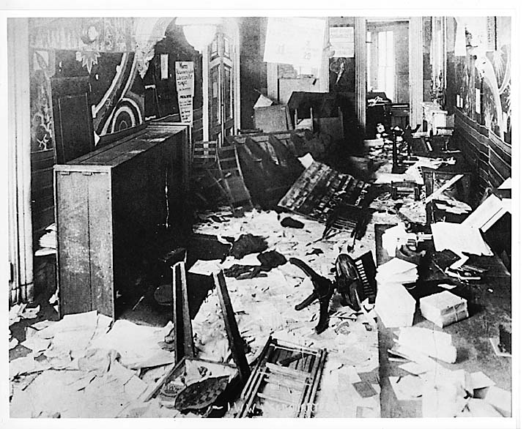
Palmer Raids: A series of well-publicized and violent raids on suspected anarchists and socialist sympathizers by the Bureau of Investigation
      November 7, 1919 (second anniversary of the Bolshevik revolution)
      Targeted the Union of Russian Workers.
      Many arrested, few actually deported (little to no evidence)

Slide 9
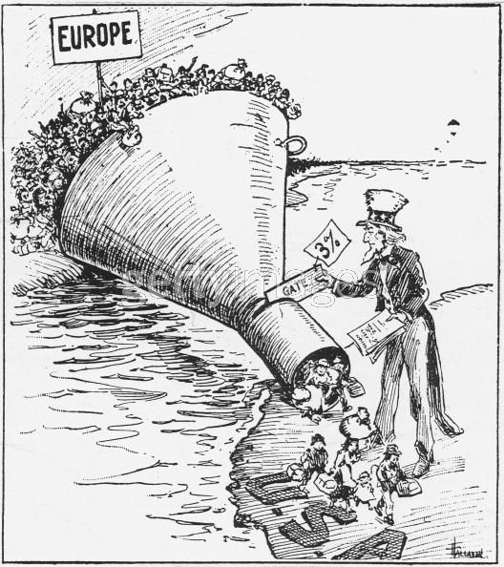
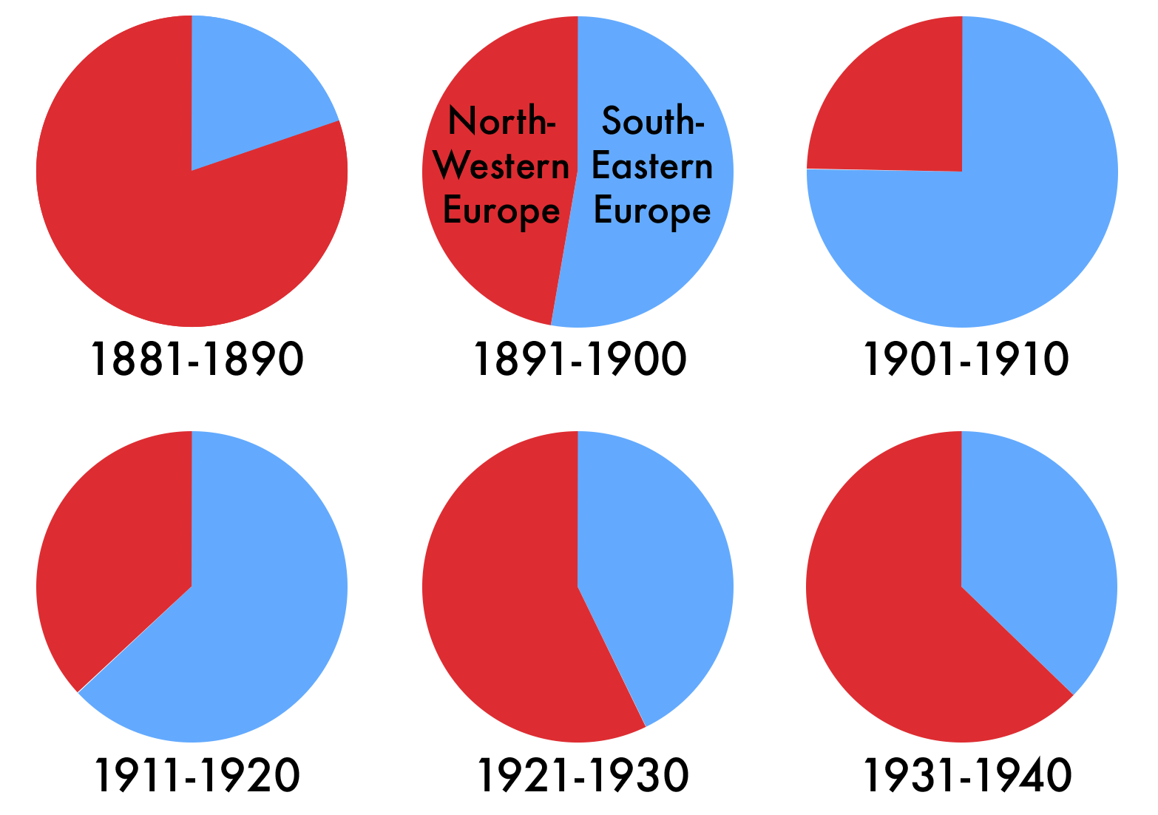
Immigration Issues
Emergency Quota Act (1921): Cut the number of immigrants who could enter America to 3% of their nationality’s U.S. population in 1910
National Origins Act of 1924: Restricted the number down to 2% of the population from 1890 (before many New Immigrants arrived)
Natives of the Western Hemisphere not included in quotas

Slide 10
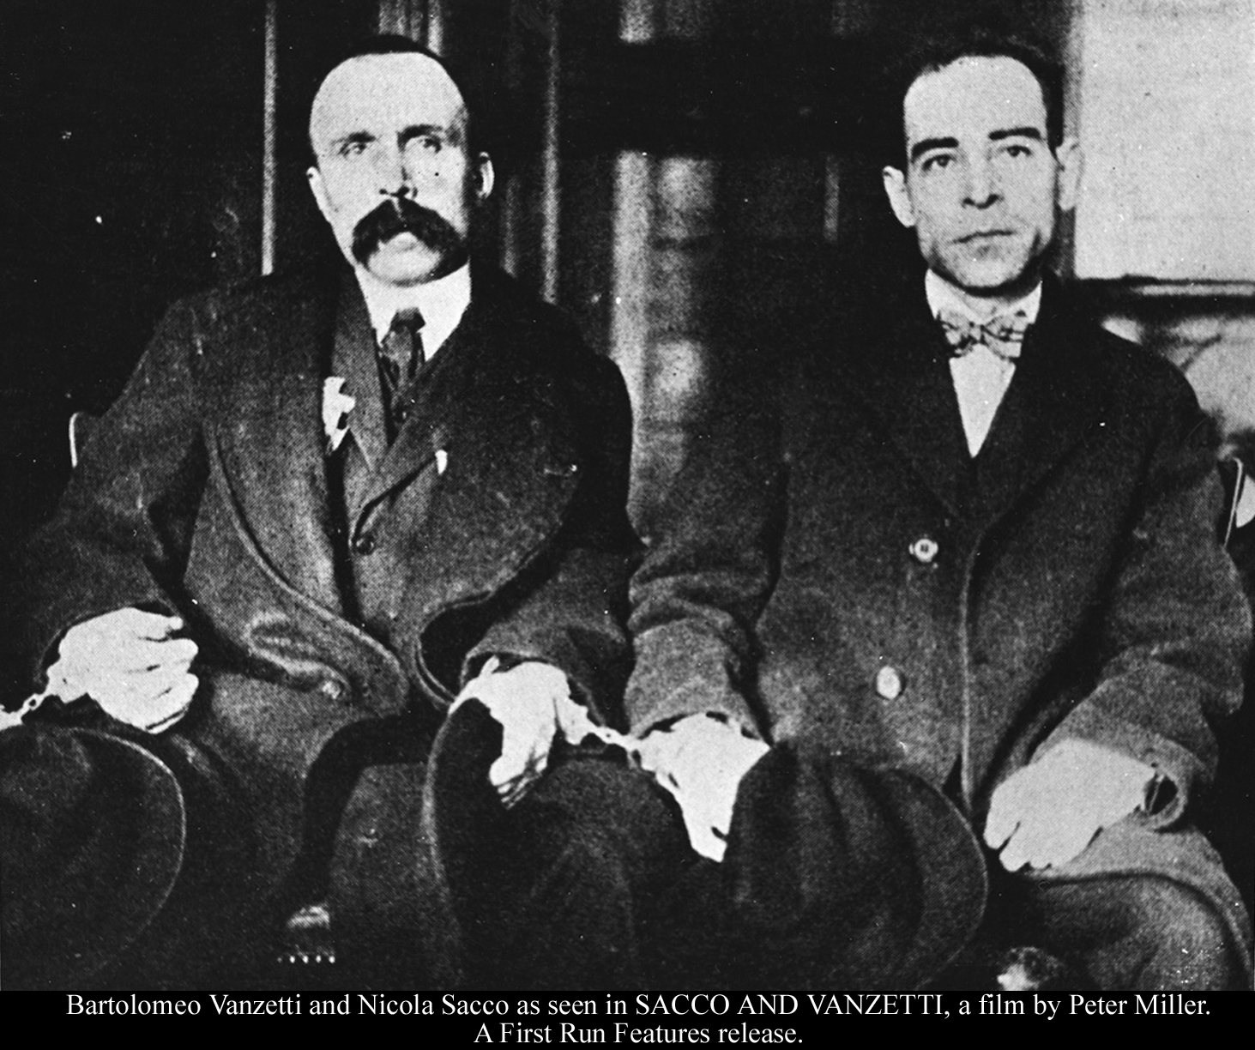
Trial of Sacco and Vanzetti
Ferdinando Nicola Sacco and Bartolomeo Vanzetti were accused of killing two employees of the Slater & Morrill Shoe Co. and robbed them of their $15,000 payroll
      Italian immigrants
      Militant anarchists
Found guilty and executed
Spurred violent demonstrations worldwide
Trials generally seen as unfair, targeting radical immigrants, and holding opinion over evidence at trial

Slide 11
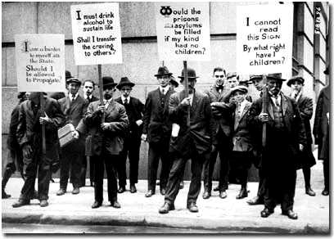
What are these men
protesting against?

Slide 12
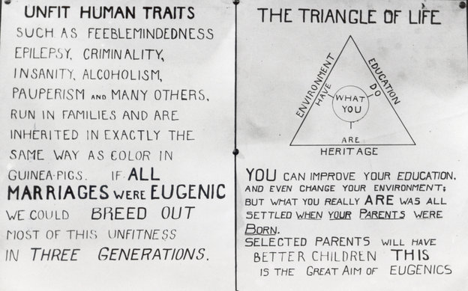
Eugenics
Eugenics: A pseudo-science claiming it was possible to improve the genetic features of human populations through selective breeding and sterilization
      Based on IQ Testing, physical traits, social mobility, and predisposition towards violence and crime.
      Reaffirmed the existing class and racial hierarchies
Compulsory sterilization laws
      Men: Treat aggression and eliminate criminal behavior
      Women: To control their sexuality
Notes:
31 U.S. states passed compulsory sterilization laws
60,000 nationwide from 1909 up until the 1960s

Slide 13
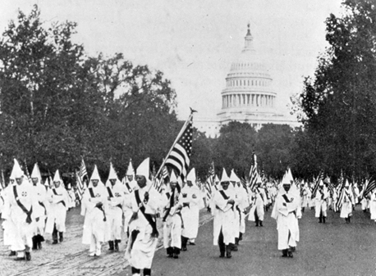
Revival of The Ku Klux Klan
Revival of the Klan caused by fear and hatred from WWI
  Increased list of “we don’t likes”: Catholics, Jews, pacifists, communists, socialists, anarchists, bootleggers, gamblers, birth control activists, and, of course, African Americans.
  Used the same methods of fear, intimidation, and lynching
Over 5 million members, including prominent members of local, state, and the national government. Superman vs. KKK

Slide 14
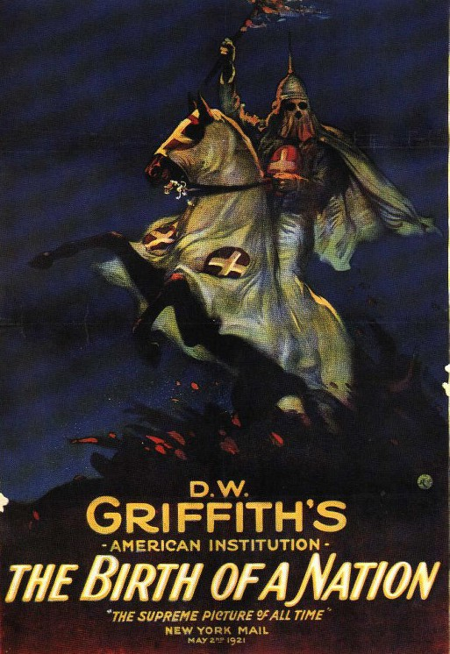
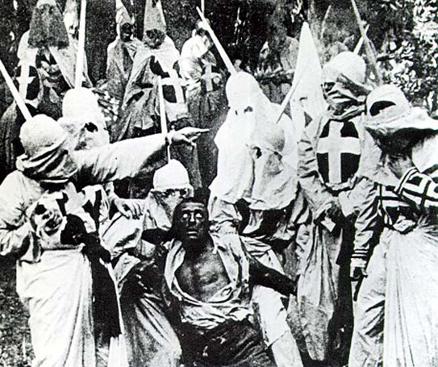
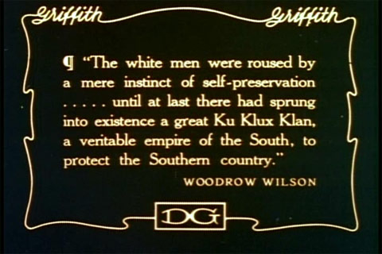
The Birth of a Nation
The Birth of a Nation (1915) – A silent film by D.W. Griffith that chronicled the “true story” of the American Civil War, and the rise of the Ku Klux Klan.
The first movie blockbuster and was the first motion picture to be shown at the White House.
”…like writing history with lightning. And my only regret is that it is all so terribly true.”
- Woodrow Wilson

Slide 15
A Clash of Values

Slide 16
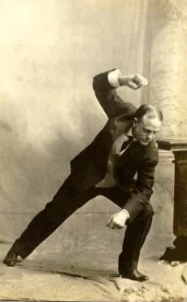
The Fundamentalist Movement
Fundamentalism – the belief that the Bible is literally true and without error
Rose out of fear that America was losing its traditional values.
Rejected Charles Darwin’s theory of evolution, and believed in creationism
Popularized by Billy Sunday

Slide 17
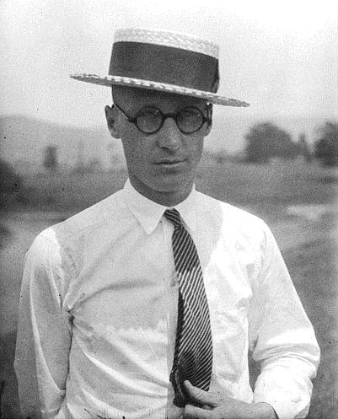
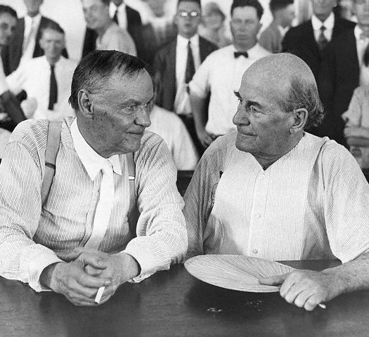
Scopes Trial – AKA: The “Monkey Trial”
John Scopes accused of violating TN’s Butler Act (outlawed teaching evolution)
      Had volunteered to be the test case for the ACLU
Defended by Clarence Darrow; WJB argued for the prosecution
Found guilty, but drew more attention to the growing divide between Fundamentalists vs. Modernists

Slide 18
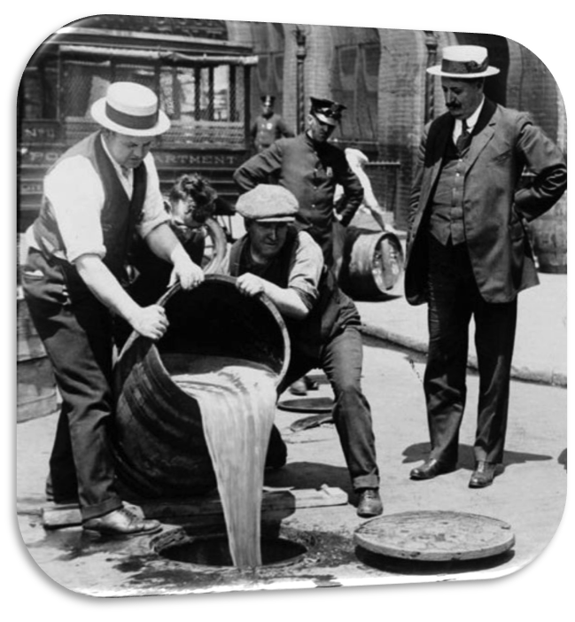
America Loves Their Liquor
The prohibition movement gained steam during WWI.
18th Amendment: Prohibits the manufacture, distribution, and sale of alcohol in the United States.
      Volstead Act: Gave the government the ability to enforce Prohibition, making over 540,000 arrests.
      Called the “Great Experiment”

