Slide 1
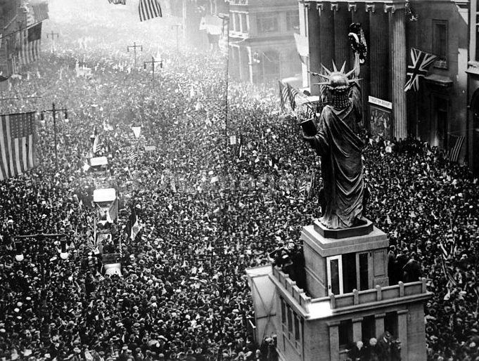
Ending the “War to end all Wars”
…and setting the stage for WWII

Slide 2
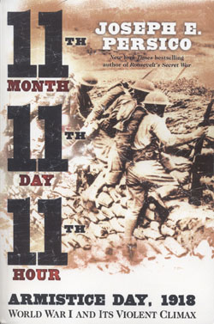
11, 11, 11
Central Powers offer an armistice
  War weary, low morale, immense war debt, etc.
  Nov. 11, 1918 @ 11am
Armistice Day (AKA: Veterans Day)
Notes:
No clear direction after initial agreement at 5am – do they keep fighting until 11 am, or put down their weapons now?
Left to each officer to decide. One American battalion was told to go “over the top” in the last minutes of the war in order to take back a small strip of land that had been lost on the first day of the war. German army urged them to go back and did not want to fire. The Americans ran forward, and the last man to die in the war died at 10:59am.

Slide 3
A Plan for Peace: Wilson’s Fourteen Points
Outlined a plan for creating a “just and lasting peace” (Solve the problems that started the war in the first place)
Points 1-4: Ending secret treaties, freedom of the seas, free trade, and reducing national armies and navies
Point 5: Adjustment of colonial claims with fairness toward colonial peoples
Point 6-13: Specific suggestions for changing borders and creating new nations
Point 14: Proposed a “general association of nations” that would protect “great and small states alike”

Slide 4
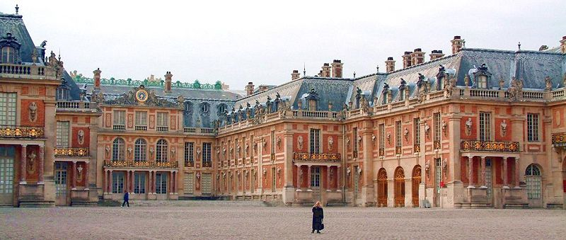
The Paris Peace conference
The belligerent nations met at the Palace of Versailles to hash out the terms of the Central Powers’ surrender.

Slide 5
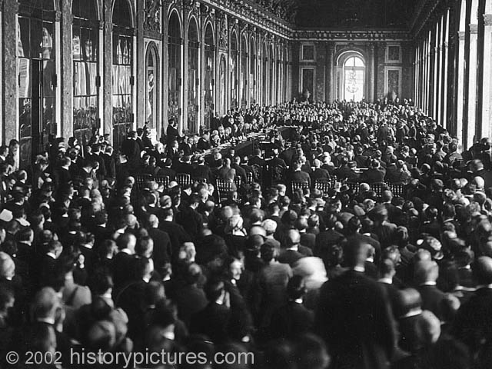
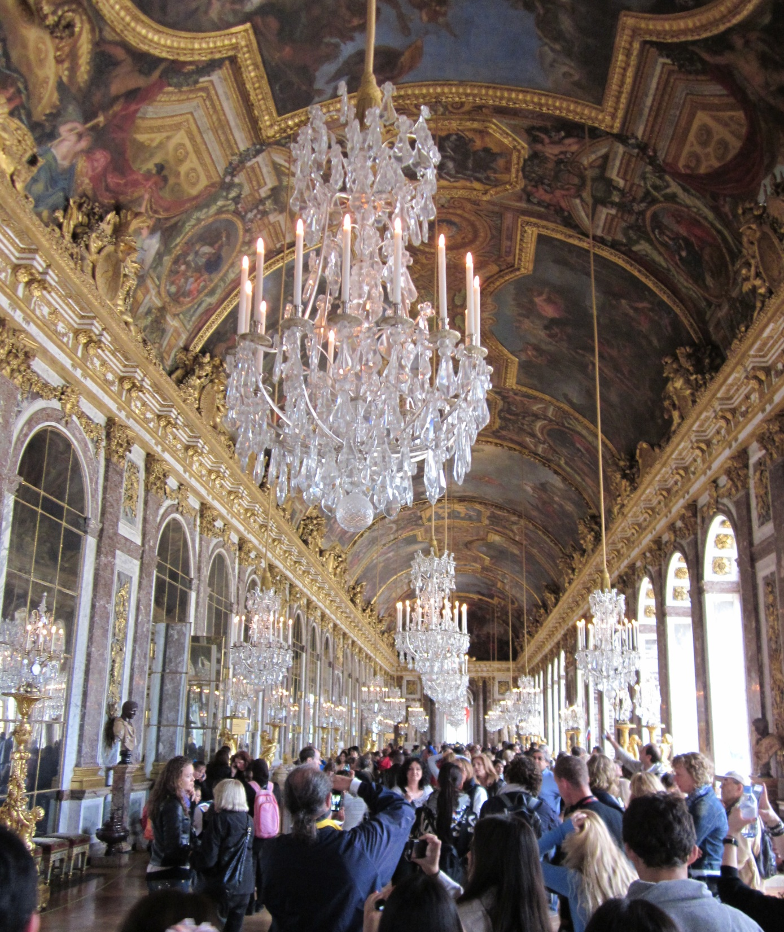
Hall of Mirrors
Notes:
Germany and other Central Powers present, but not allowed to speak during the proceedings.
Wilson and the Big Four seated at the center of the table at the left.

Slide 6
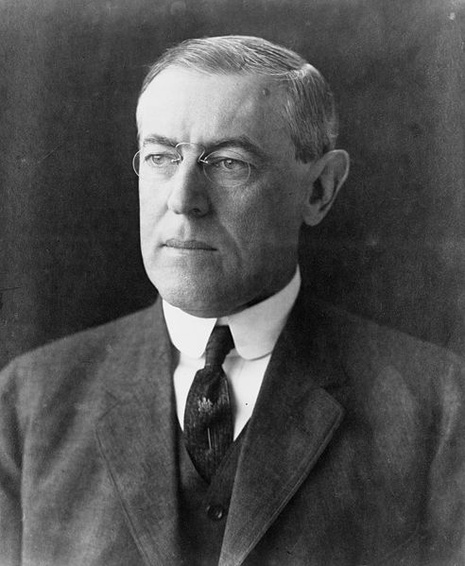


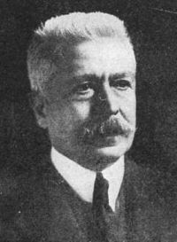
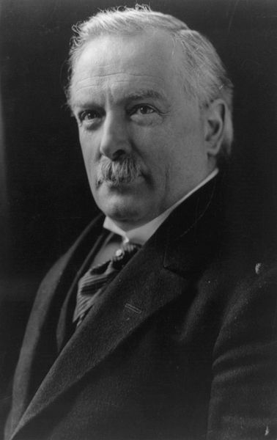
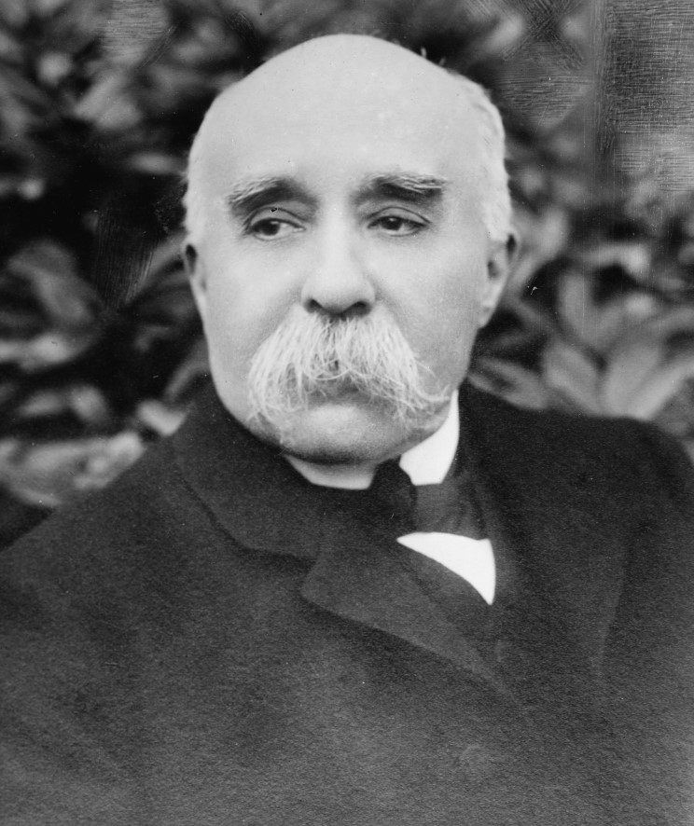


The Big Four
Woodrow Wilson Vittorio Orlando
David Lloyd George Georges Clemenceau
Who’s Missing?
Notes:
6
Russia was not represented (in the grips of civil war), nor was Germany (they lost)

Slide 7
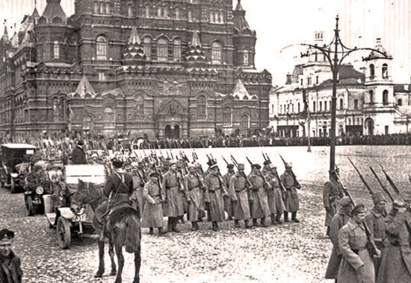
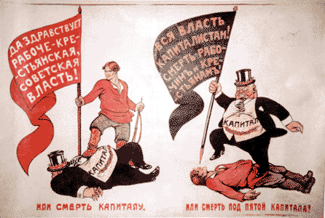
Russian Civil War
1917-1921
Notes:
Left WWI early, causing mistrust between the US and new Soviet Union

Slide 8

The Treaty of Versailles
The other Allied governments saw Wilson’s plan as too lenient towards the “aggressor” nations.
Losses for Germany under the Treaty of Versailles:
  Officially blamed for the war
  Stripped of its military
  Territories were split up
  Required to pay “reparations” to the Allied countries to a total of…
33 Billion Dollars!

Slide 9
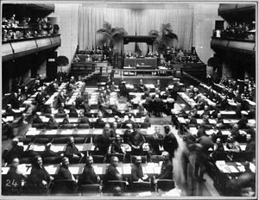
League of Nations
Member nations would help preserve peace and prevent future wars by pledging to respect and protect each other’s territory and political independence.
Talk it out instead
of fighting it out
Notes:
Wilson’s Point #14

Slide 10
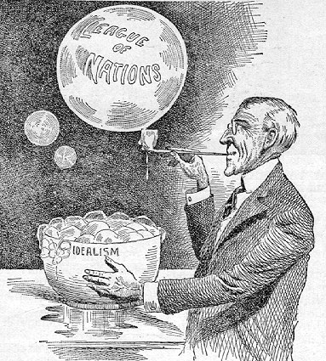
American Reaction to the Treaty of Versailles
Treaty requires Senate approval
“Irreconcilable” senators: Bitter opponents of the Treaty of Versailles
  Led by Sen. Henry Cabot Lodge
Concerns:
  Article X: Required the US to help a League nation if it were attacked; this would entangle the US in European affairs.
  Feared that it might supersede Congress’ war powers.

Slide 11
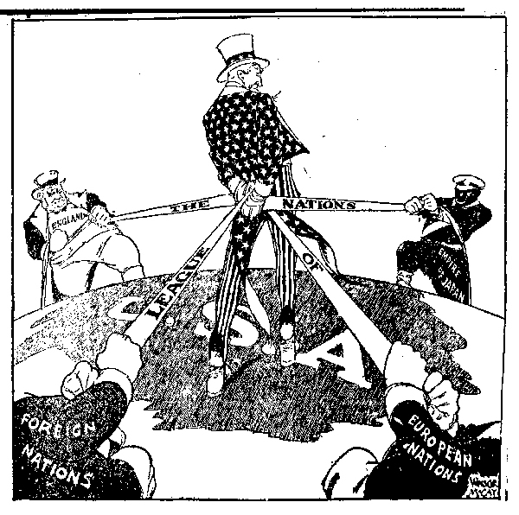
American Reaction to the Treaty of Versailles
The Senate tacks on amendments to retain its power, causing Wilson to now ask Democrats to vote against the Treaty.
The Treaty was not ratified and thus the US did not join the League of Nations
America retreated into isolationism.

Slide 12

How vill all zis affect ze Germans?

Slide 13
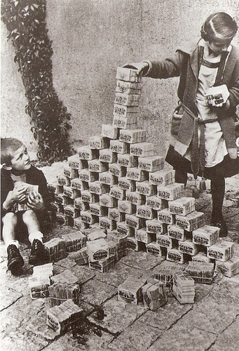
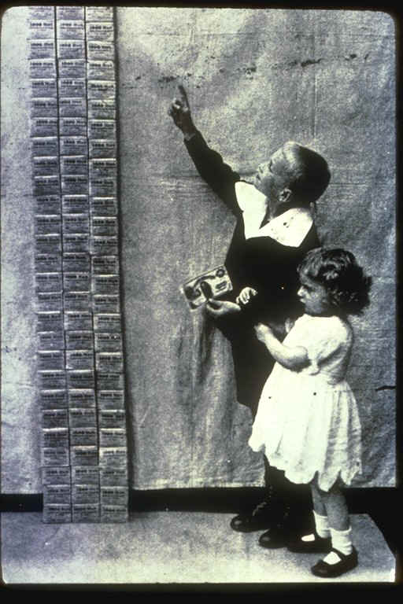
Effects for Germany
Germany experiences “hyper-inflation”: Inflation is the general rising of prices over time; hyper-inflation is an extreme increase in prices over a short period of time.
Children play with virtually worthless German money (reichsmarks)

Slide 14
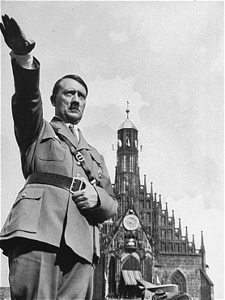

When trouble rears its ugly head, people need…
A Hero?
A Hero!
Notes:
The effects of the Treaty of Versailles directly lead to the rise of Adolf Hitler, which will inevitably lead to World War II
Germany poor and in shambles, looks for a strong leader who will restore them to their previous greatness. Adolf Hitler is able to revive Germany in just a few years, is a hero to the people. They will follow him blindly because he “saved” their country.

Slide 15
Effects of the War
Isolationism and Conflict

Slide 16
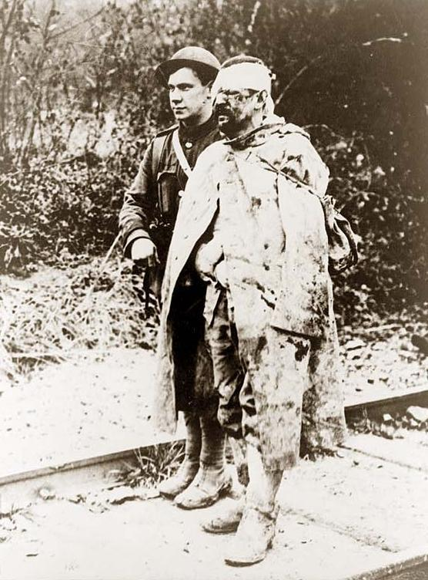
The Human Impact of War
The Great War impacted Americans both on and off the battlefield.
Shell Shock, AKA: Battle fatigue; Post-traumatic stress disorder (PTSD)
  Led to increased acceptance of psychiatry and study of mental illness

Slide 17
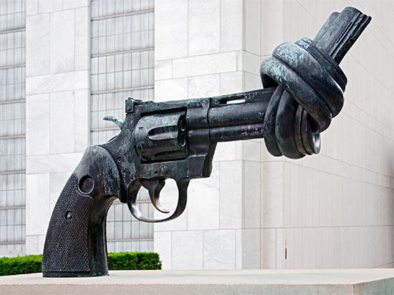
Forging Peace
The Washington Disarmament Conference (1921): Discussed limiting the weapons to be held by each country in hopes of preventing future wars; no method of enforcement.
Kellogg-Briand Pact (1928): Outlawed war; nice idea, not gonna happen.

Slide 18

The Dawes Plan (1924)
US banks would loan Germany $200 million to stabilize the economy
  Created by Charles Dawes – banker and VP under Coolidge
  Set a realistic repayment plan
  Germany could pay back Britain and France, who could then repay the US

Slide 19
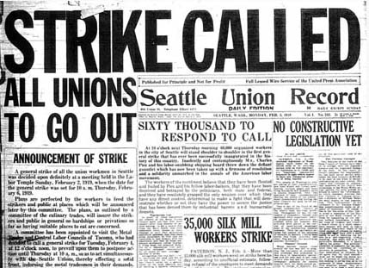
Postwar Labor Disputes
Many laborers went on strike following the end of WWI
  Sought better wages, better conditions, and the ability to collectively bargain
Strikes were only mildly successful; fear of Communist revolution limited their success

Slide 20
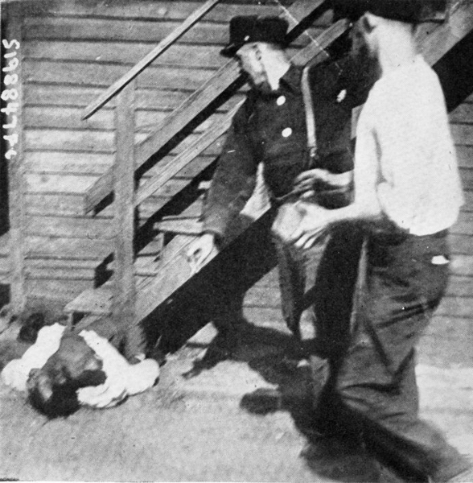
Chicago Race Riots
The Great Migration caused huge demographic shifts in major cities
  Racial tension in formerly white neighborhoods
  White war veterans upset over loss of jobs
The Chicago Race Riots:
  Cause: Death of an African American teen at an informally segregated beach
  The riot lasted about a week. During the riot, dozens died and hundreds were injured.
Red Summer: Numerous race riots across the country during the summer of 1919

