Slide 1
Bell Ringer
Describe the various reasons why Americans supported the Allies before officially joining the war.

Slide 3
War on the Home Front
Fostering Support and Eliminating Opposition

Slide 4
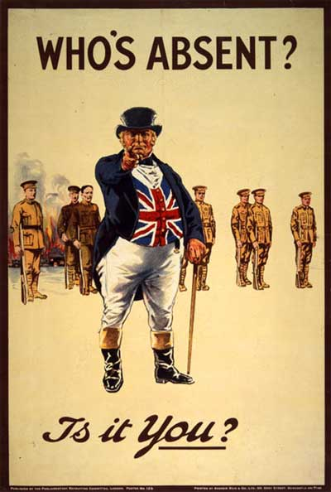
Selling the War
War rages in Europe for three years while America remains neutral
Allies push for American involvement
Propaganda
Limited information
Selling the War becomes a major focus once America joins the Allies

Slide 5
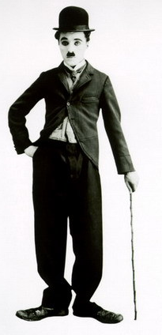
Committee on Public Information
Created to sell the war through various types of propaganda; headed by George Creel
“Four minute men”
Propaganda posters
Movie shorts and propaganda films
Patriotic songs
American Protective League: A private organization in support of the war
Identified slackers, spies, draft dodgers and anti-war organizations for the federal government.

Slide 6
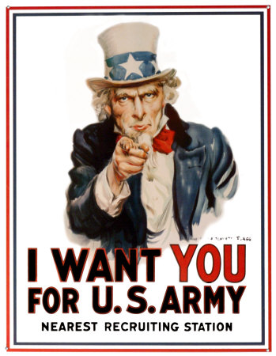
American
Propaganda

Slide 7
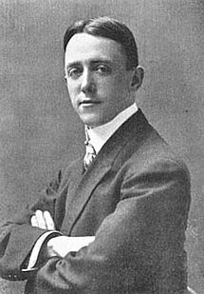
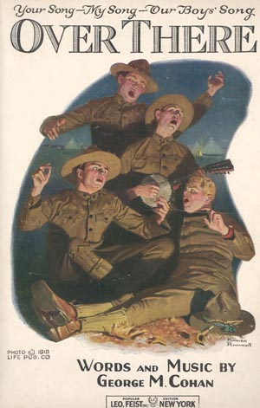
“Over There”
Johnnie get your gun, get you gun, get your gun, Take it on the run, on the run, on the run, Hear them calling you and me; Every son of Liberty Hurry right away, no delay, go today, Make your daddy glad to have had such a lad Tell your sweetheart not to pine, To be proud her boy's in line. Chorus: Over There, Over There Send the word, send the word, Over There That the Yanks are coming, The Yanks are coming, The drums rum tumming everywhere So prepare, Say a Prayer Send the word, Send the word to beware We'll be over, we're coming over. And we won't be back till it's over over there! Johnnie get your gun, get you gun, get your gun, Johnnie show the Hun, you're a Son-of-a-Gun, Hoist the flag and let her fly Like true heros do or die Pack your little kit, show your grit, do your bit, Soldiers to the ranks from the towns and the tanks, Make your Mother proud of you and to Liberty be true.

Slide 8
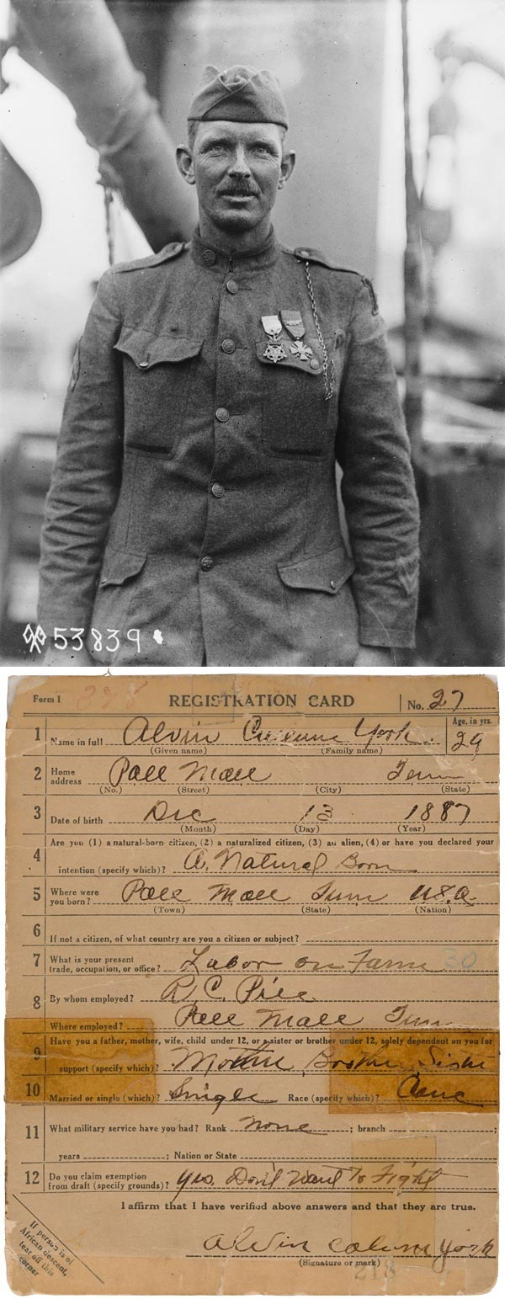
The Draft
U.S. needed massive military force quickly
1917 - Draft implemented for men 18-45
No exemptions
24 million men registered; 6 million called into service
Very little training

Slide 9
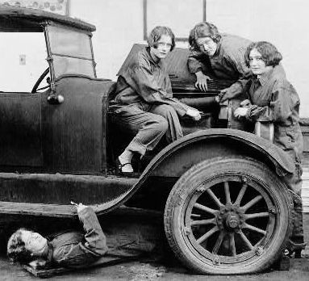
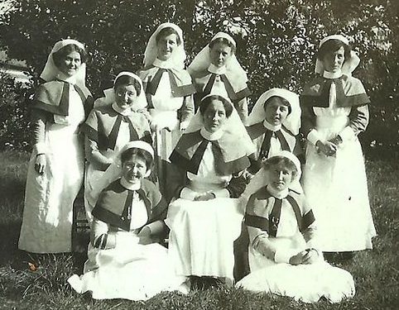
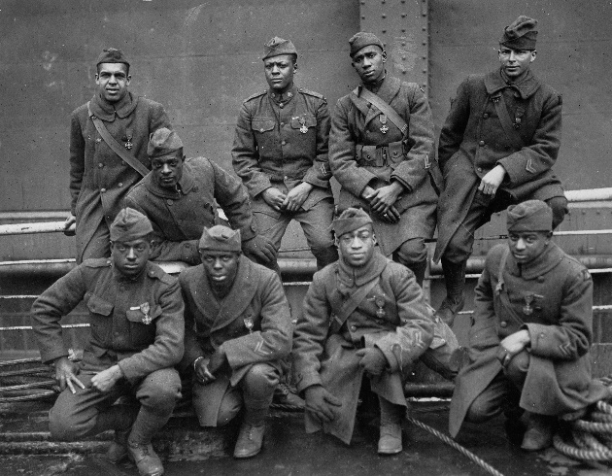
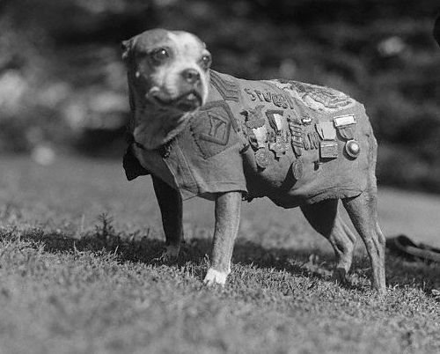
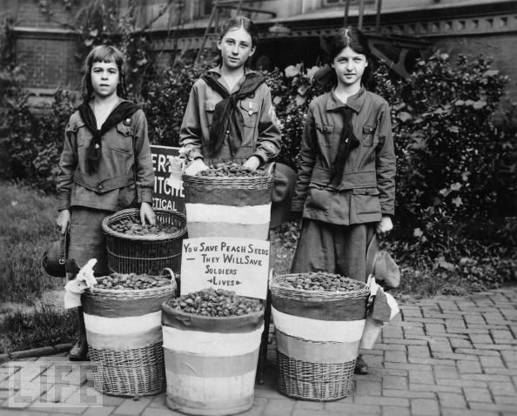
Supporting Our Boys “Over There”
Women served as nurses, volunteered with Red Cross relief efforts, or helped with war production
Blacks served in segregated units, mostly as support staff
Military dogs were highly important to the war effort
Children collected items for the war effort

Slide 10
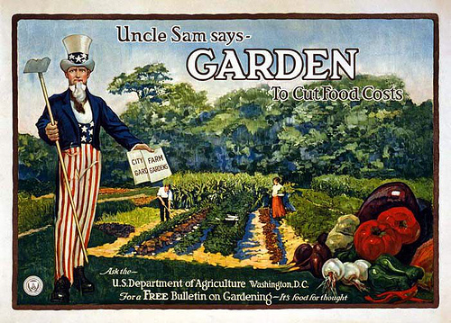
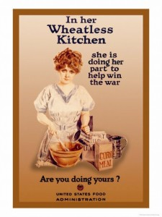
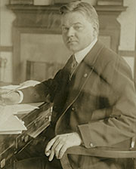
Food Administration
Headed by Herbert Hoover
Relied on volunteer efforts to conserve food for the soldiers; was wildly popular
Meatless Mondays, Wheat-less Wednesdays,
Encouraged citizens to plant victory gardens

Slide 11
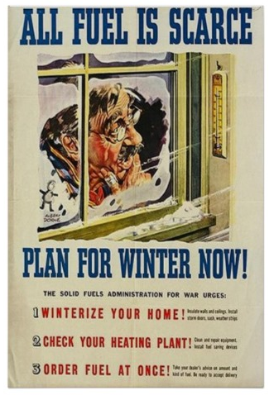
Fuel Administration
Encouraged citizens to conserve oil, coal, and electricity for the war effort
Lightless Nights, Heatless Tuesdays
Instituted Daylight Saving Time to help conserve energy and fuel.
Not nearly as popular as the Food Administration

Slide 12
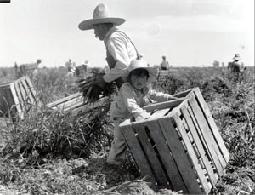
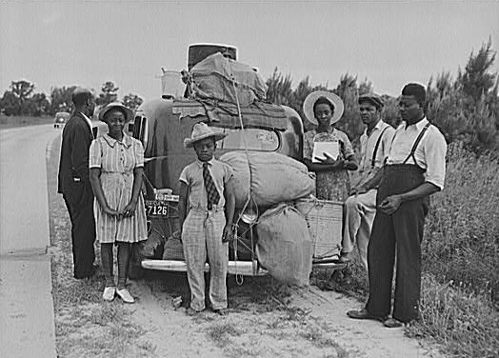
America on the Move
Mexican farm labor: Over 200,000 Mexican immigrants moved to the US seeking better job opportunities, settling mainly in the Southwest.
The Great Migration: The movement of one million African Americans to Northern industrial cities during WWI.
NYC, Chicago, Detroit, and Cleveland
Took over manufacturing jobs left by men who went off to war.
Changed demographics dramatically.

Slide 13
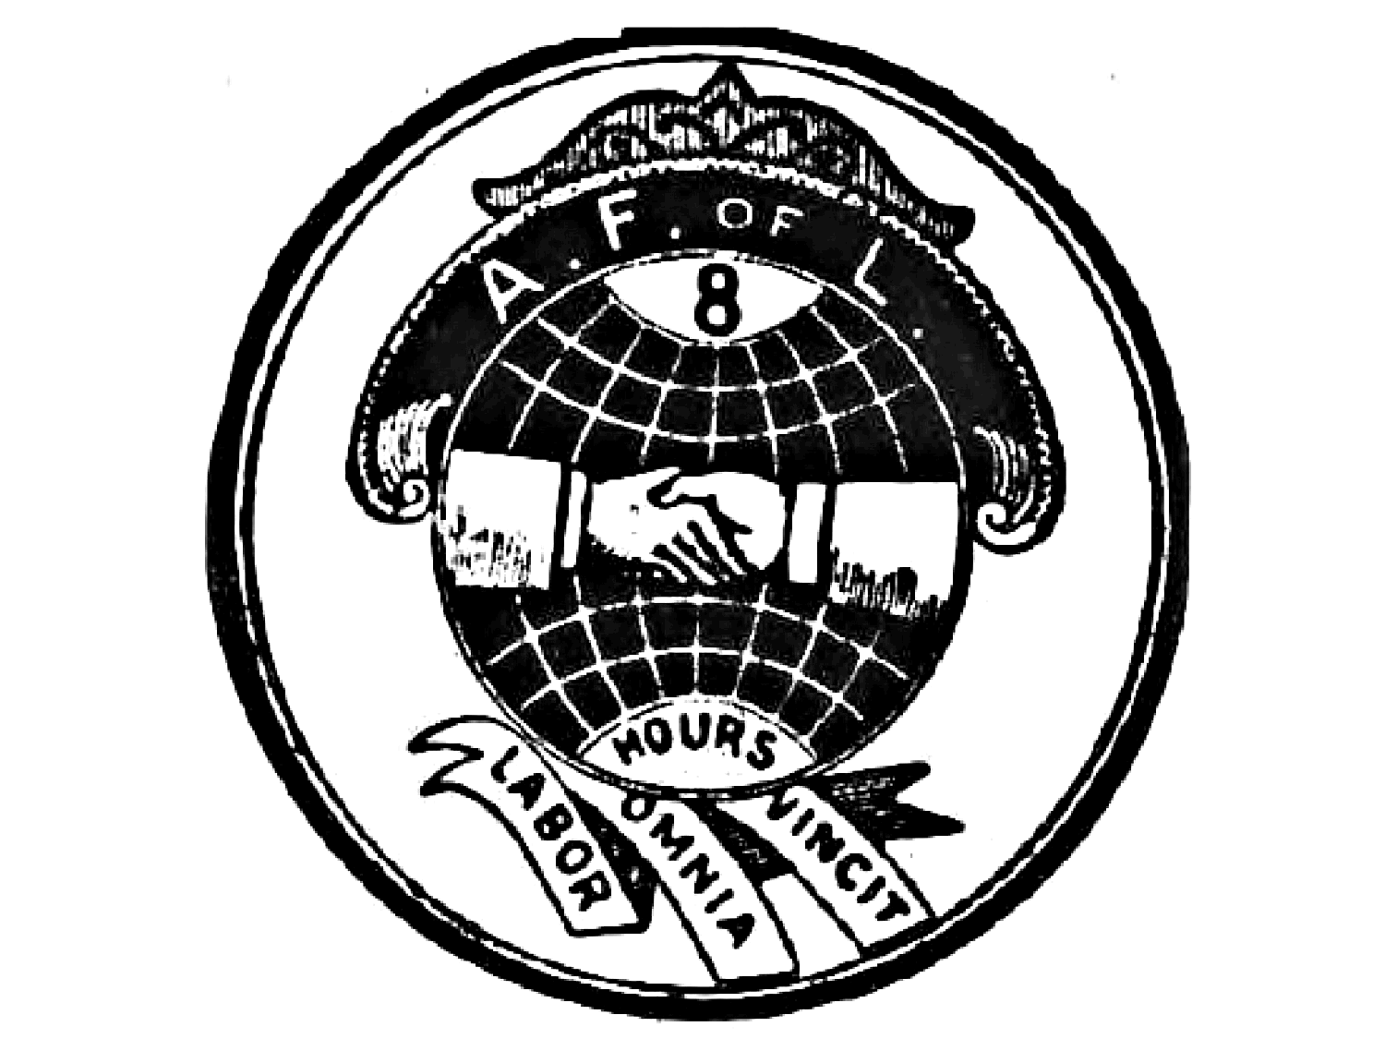
War Industries Board and National War Labor Board
National War Labor Board: created to settle any worker disputes and keep people on the job
Businesses were encouraged to keep wages high and hours long
Supported by the AFL
Not Supported by the IWW
War Industries Board: created to coordinate production of materials for the war effort
Difficult to do in an era still attached to laissez faire economics

Slide 14
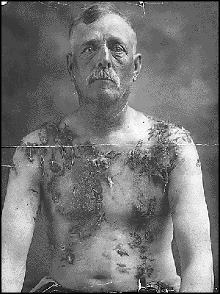
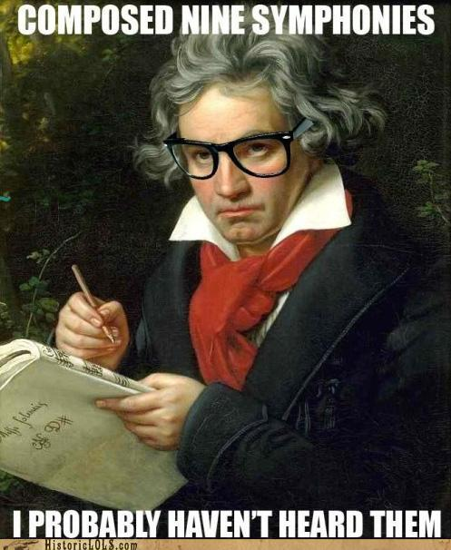
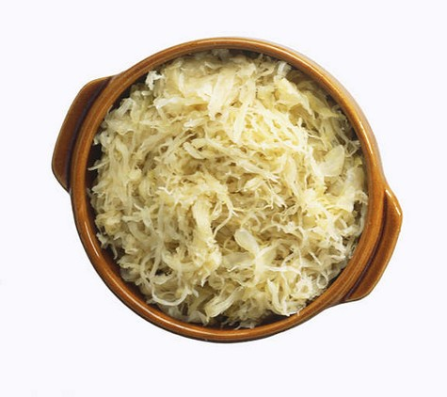
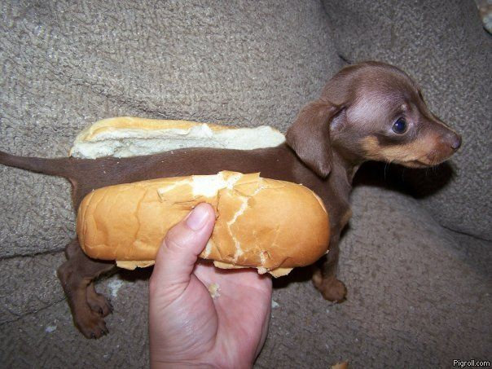
Anti-German Sentiment
German-Americans were largely loyal to the United States, but were branded as spies and saboteurs.
German names were re-branded to more “patriotic” names.

Slide 15
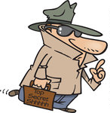
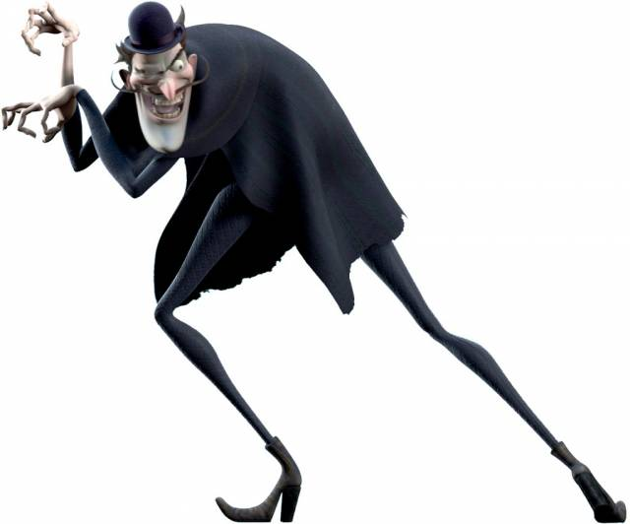
Espionage and Sedition Acts
Espionage Act: sought to prosecute “spies”
1,900 prosecutions followed, including Eugene V. Debs, the Socialist leader
Sedition Act: sought to prosecute anyone engaging in “seditious” activity
Essentially negated the first amendment
Trading With the Enemy Act: sought to prosecute those who traded with the Central Powers during wartime
Also imprisoned those who communicated with the enemy.

Slide 16
Protecting Liberties?
ACLU: American Civil Liberties Union
Created to protect the basic rights of Americans; used legal system to protect citizens and release the unrightfully imprisoned
Trumps Muslim ban 2017
Schenck v. United States: the Supreme Court invented the famous "clear and present danger" test to determine when a state could constitutionally limit an individual's free speech rights under the First Amendment

Slide 17
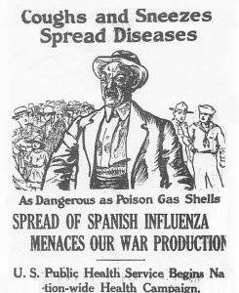
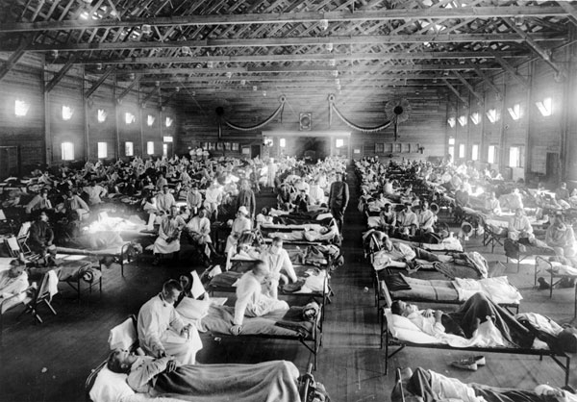
Epidemic!
Influenza Pandemic of 1918: Deadliest virus in history, killing 50-100 million people (3-5% of the world’s population)
Unclear origins, but spread rapidly due to close quarters during the war
Unworthy nickname of the Spanish Flu
The influenza epidemic killed soldiers and civilians alike; deadliest for young, normally healthy adults.

