Slide 1
Presidential Imperialism

Slide 2
The Pledge of Allegiance
I pledge allegiance to my Flag and the Republic for which it stands; one Nation indivisible, with Liberty and Justice for all.
One Country! One Flag! One Language!
Notes:
1892

Slide 3
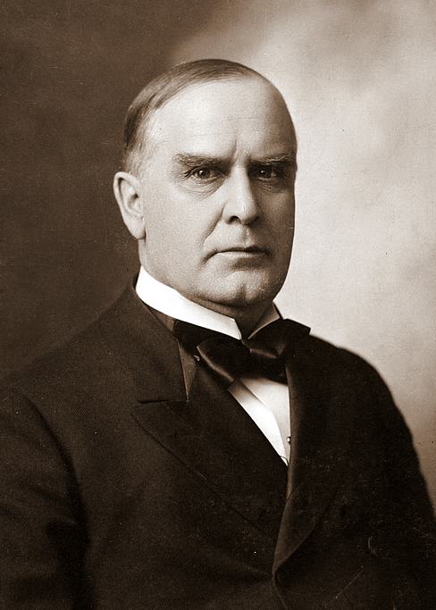
William McKinley
William McKinley as an expansionist president:
Spanish-American War
Annexation of Hawaii
Open Door Policy

Slide 4
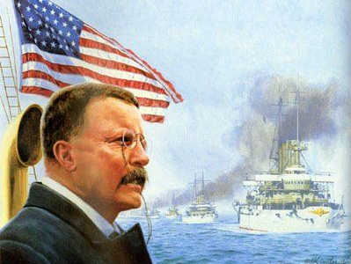
Roosevelt and the World

Slide 5
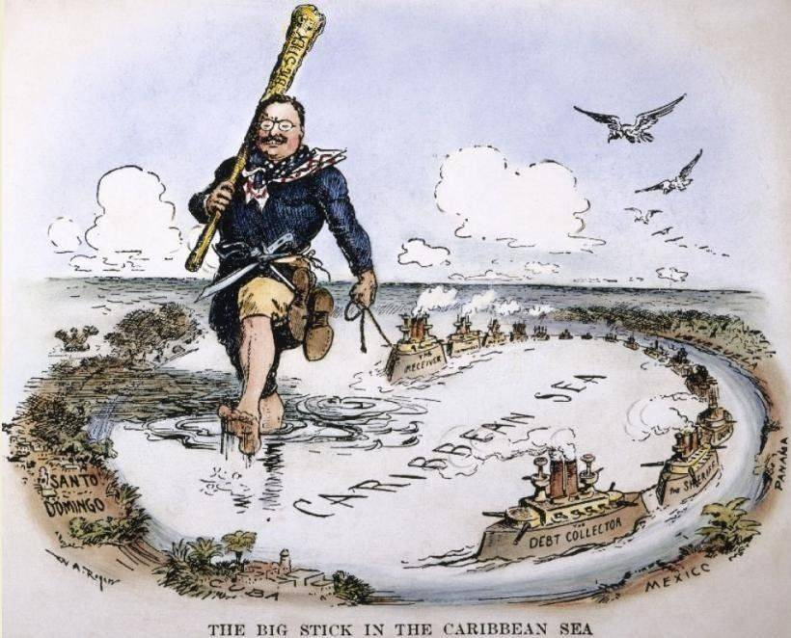
“Speak softly, and
carry a big stick”

Slide 6
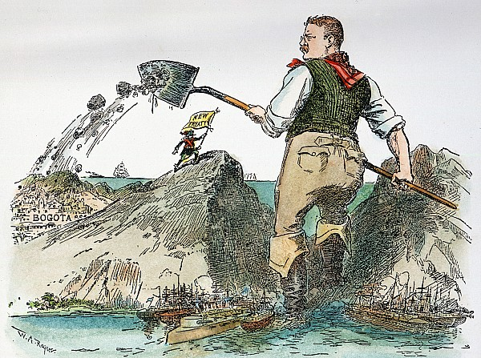
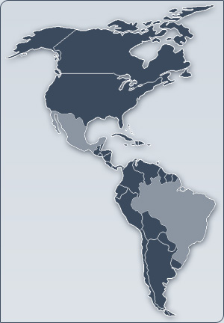
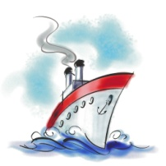
A Canal in Panama
Weaknesses of a split navy
Canal in Panama
Location issues
Panama was part of Colombia; didn’t like the U.S.
TR incited a rebellion in Panama
Looks like we’ll have to take the long way, boys!
Notes:
The Spanish-American War showed the weakness of a navy split between two oceans – a canal was desperately needed!
Hay-Pauncefote Treaty – A treaty signed by the US and Great Britain that nullified the Clayton-Bulwer Treaty of 1850 and gave the United States the right to create and control a canal across the Central American isthmus to connect the Pacific Ocean and the Atlantic Ocean.
The location of the canal was the problem
Nicaragua was the first choice, but scrapped due to an erupting volcano.
Panama was a second choice, but it was part of Colombia.
TR and the French (who had failed to complete a canal in Panama already) incited a rebellion in Panama.

Slide 7
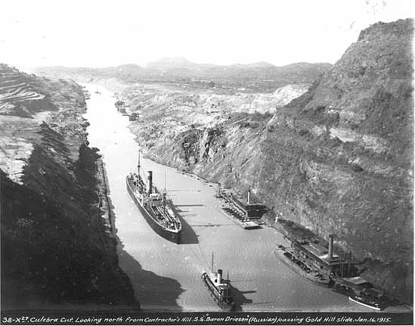
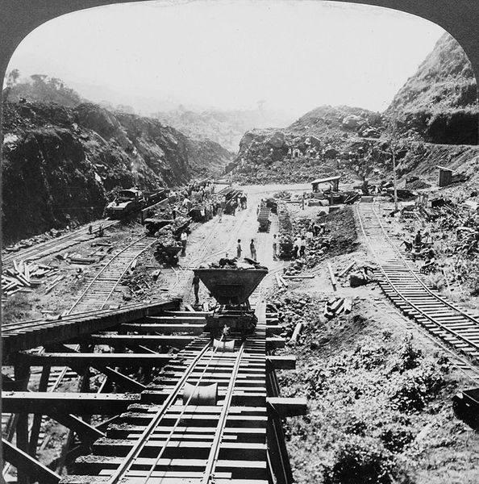
A Canal in Panama
More dangerous and costly than planned
Sanitation and disease
Largest modern engineering undertaking to date; One of the greatest technological innovations in modern history
Cut shipping time in half

Slide 8
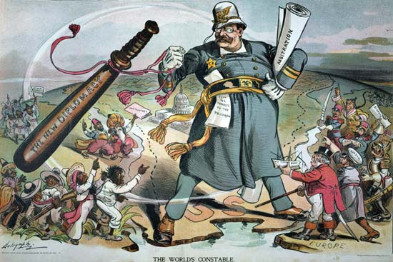
The “Big Sister” Policy in Action
Latin American debts to Europe
Roosevelt Corollary: the US would intervene in Latin America and collect the debts for Europe
Monroe Doctrine
Notes:
Nations like Venezuela and the Dominican Republic were always behind in their loan payments to European nations.
TR was afraid Europe might use force to collect their money
Roosevelt Corollary: said the US would intervene in Latin America and collect the debts for Europe

Slide 9
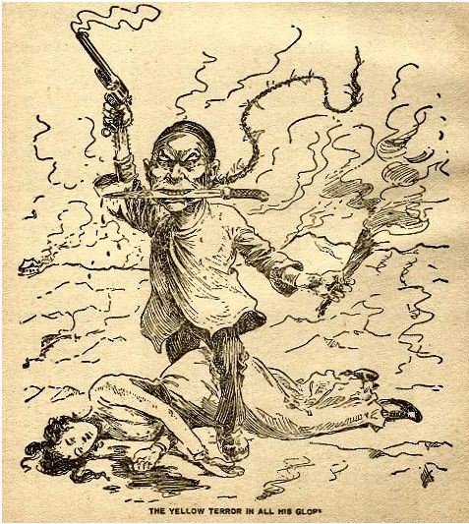
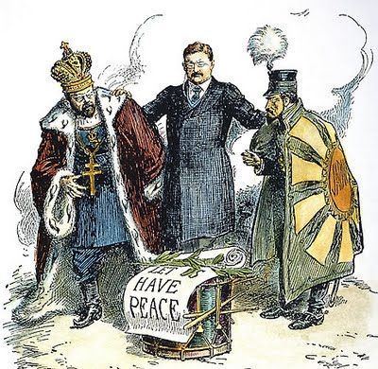
Problems with Asia
Russo-Japanese War
Treaty of Portsmouth
Nobel Peace Prize
Fears of the “yellow peril” in the West
“Gentlemen’s Agreement”

Slide 10
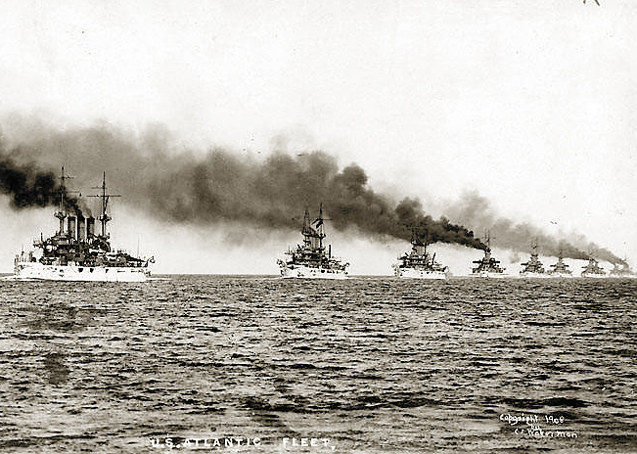
Sending Out the
“Great White Fleet”
Notes:
The Great White Fleet: America’s highly advanced naval fleet
They went on a diplomatic “good-will” mission around the world; had the bonus effect of showing America’s military muscle.

Slide 11
Big Stick, Dollar, Moral Diplomacy

Slide 12
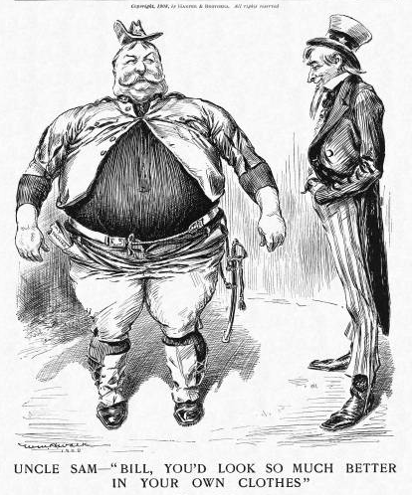
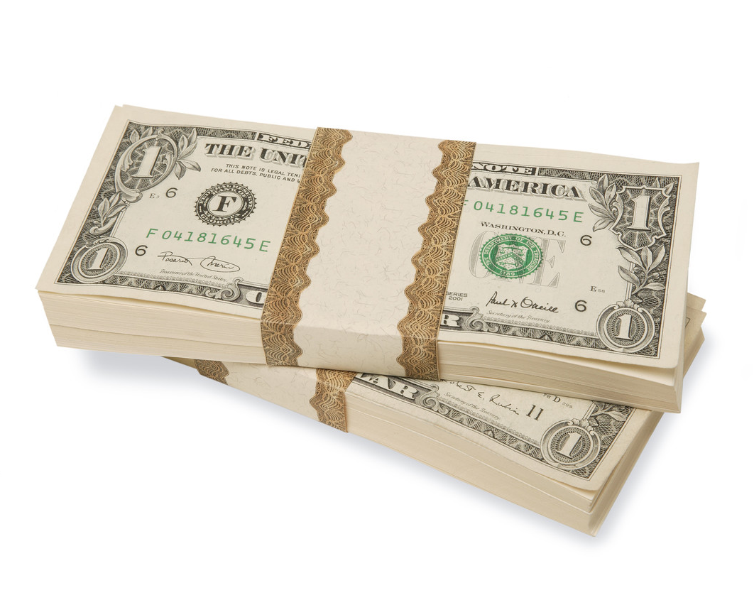
Imperialism Under Taft
Attempted to maintain TR’s imperialist policies
Impacted by time in Philippines
Dollar Diplomacy

Slide 13
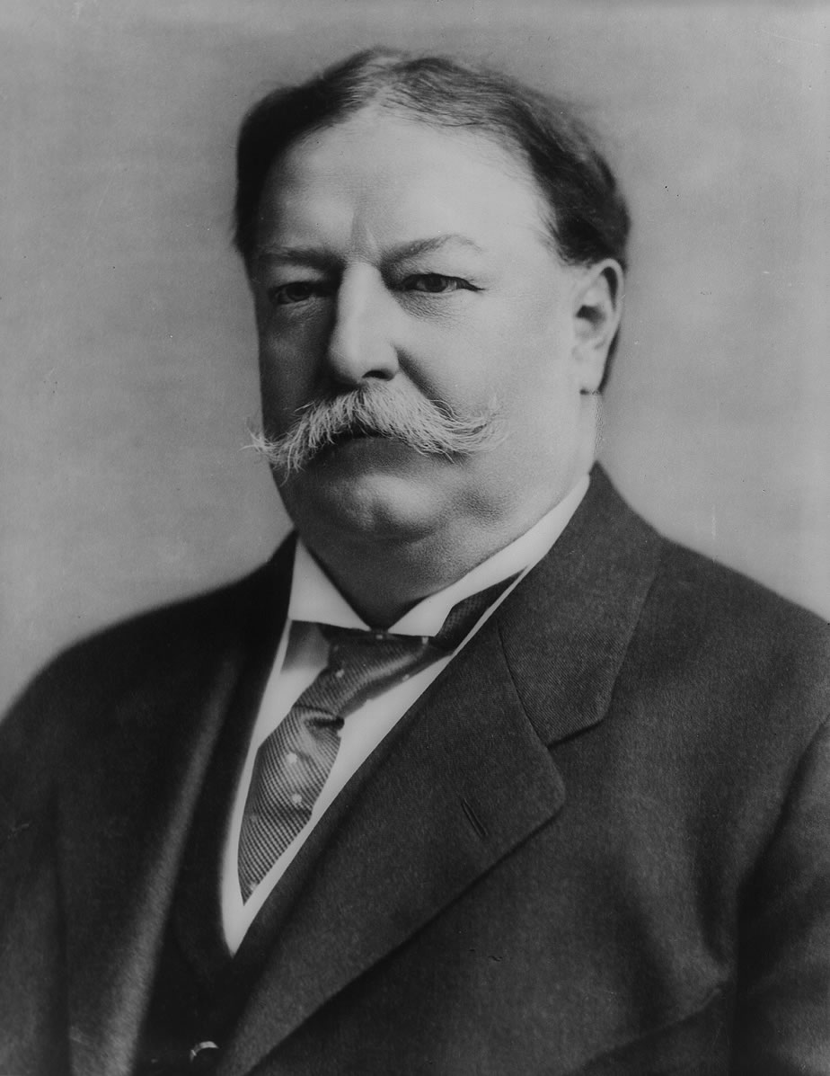
William Howard Taft
Dates in Office: 1909-1913
Nickname: Big Lub, Big Chief
Political Party: Republican
Major Events:
16th Amendment ratified
Dollar Diplomacy
Payne-Aldrich Tariff Bill
Balinger-Pinchot Quarrel

Slide 14
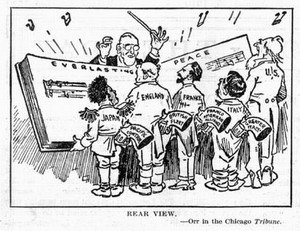
Wilsonian Morality

Slide 15
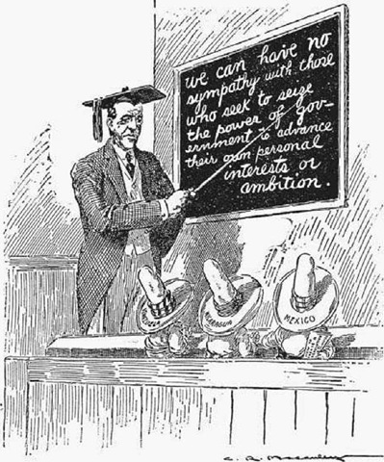
Believed in isolationism
Moral Diplomacy
“Accidental Imperialism”
Failed Nicaraguan coup
Failed Haitian coup
Failed Dominican coup
Purchase of Virgin Islands

Slide 16
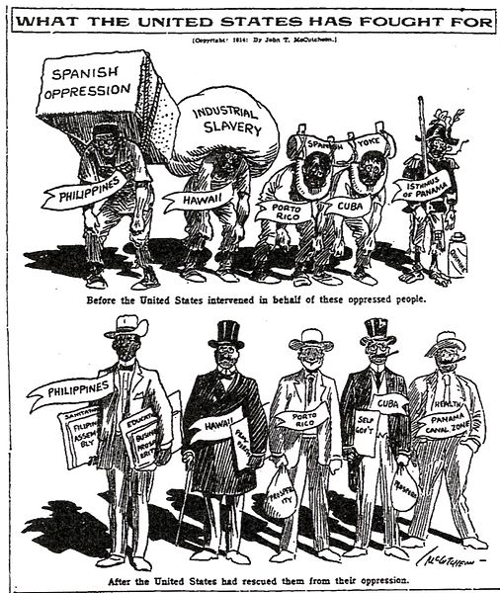
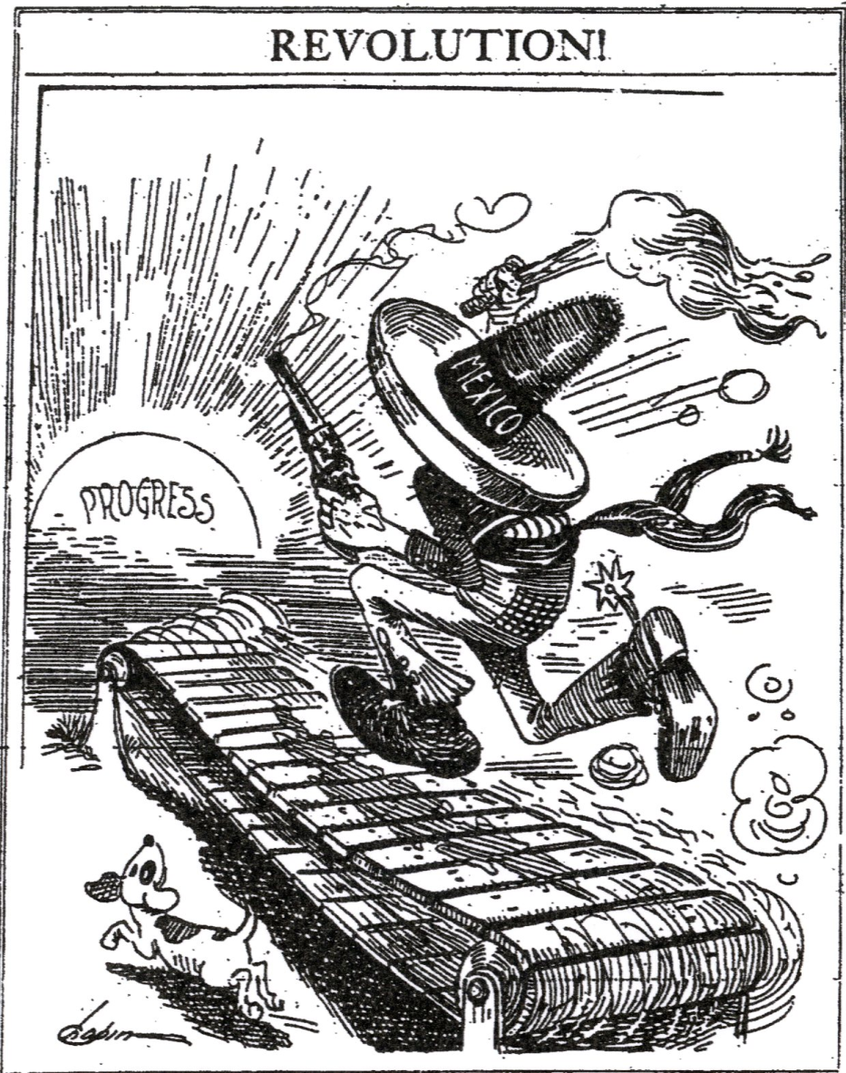
The Mexican Revolution
Gen. Victoriano Huerta has corrupt president assassinated; assumes power
Positive changes for poor
Military dictatorship
Wilson allows arms to go to Huerta’s rivals, Venustiano Carranza and Francisco “Pancho” Villa
Incident with American sailors visiting Mexico gives excuse to place Carranza in power

Slide 17
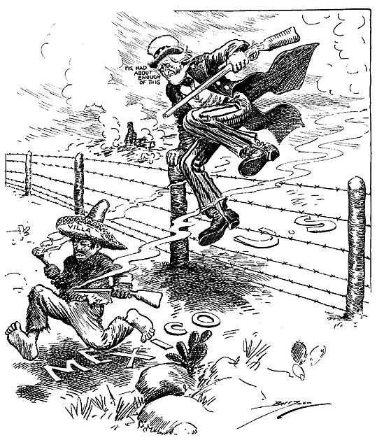
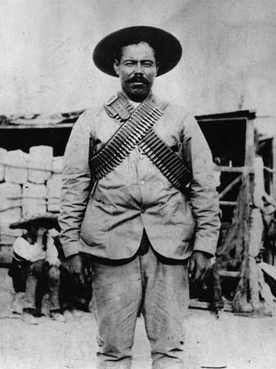
The Last Invasion of America
Villa slighted by U.S.
Invasion of U.S.
Troops sent to capture Villa
World War I
Notes:
Huerta was replaced with Carranza, making Villa believe he’d been slighted by the US
He staged a series of violent escapades in New Mexico, trying to incite a war
Wilson sent 6,000 troops to find and capture Villa, but were unsuccessful in capturing the guerillas.
Was ultimately killed by a Mexican rival
Pulled troops back suddenly in 1914 due to the outbreak of WWI in Europe

Slide 18
The cartoon is titled “The World’s Constable.” The policeman’s night stick is labeled The New Diplomacy. The paper under his left arm is labeled Arbitration. The paper tucked in his belt reads “Tell yer troubles to the policeman.” Figures representing various countries are holding signs labeled Disputes or Controversies.
a) Briefly explain the American foreign policy represented in the cartoon.
b) Identify one American foreign policy action from this time period and briefly explain how it fits the option of the night stick.
c) Identify another American foreign policy action from this time period and briefly explain how it fits the option of arbitration.

