Slide 1
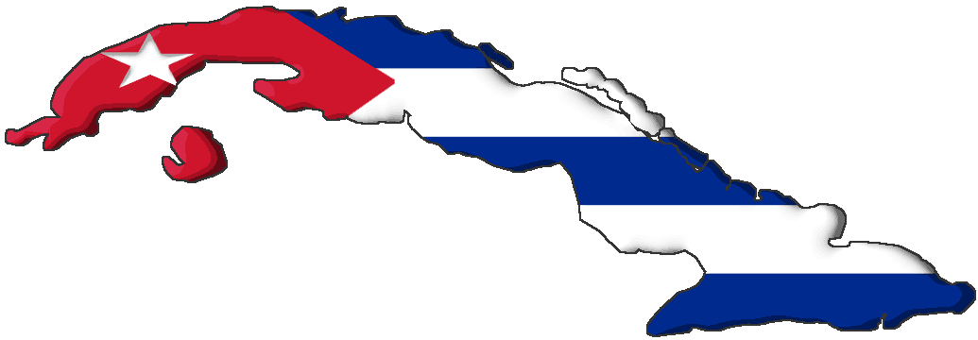
Trouble in Cuba
The Spanish-American War

Slide 2
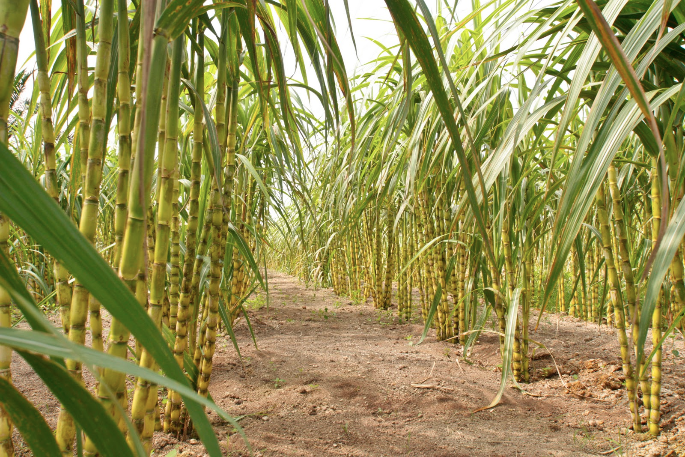
Cubans Rise in Revolt
Cuban “insurrectos” burn sugar cane fields in revolt against Spanish overlords
Americans watched with interest
Reminded us of our own fight for independence
Felt it supported the Monroe Doctrine
Might open up a gateway for a Latin American canal

Slide 3
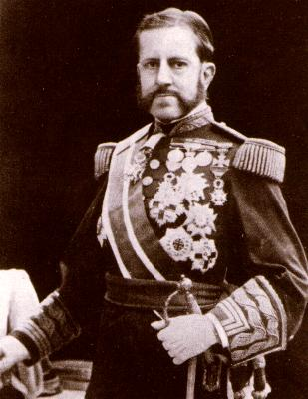
Halting the Revolt
Gen. Valeriano “Butcher” Weyler
Violent methods of control
Reconcentration camps
Yellow journalism
“You furnish the pictures, I’ll furnish the War”
Wm. Randolph Hearst to Frederick Remington
Notes:
Gen. Valeriano “Butcher” Weyler was sent by Spain to stop the revolt.
Marked by periodic executions, mass exile, destruction of farms and crops. Weyler's methods reached their height in October 1896, when he ordered all countryside residents and their livestock to gather in various fortified areas and towns occupied by his troops within eight days. Hundreds of thousands of people had to leave their homes, creating appalling and inhumane conditions in the crowded towns and cities, called “reconcentration” camps.” It is estimated that this measure caused the death of at least one third of Cuba’s rural population.
“Yellow press” newspapers tried to outscoop each other
Hearst and Frederick Remington

Slide 4
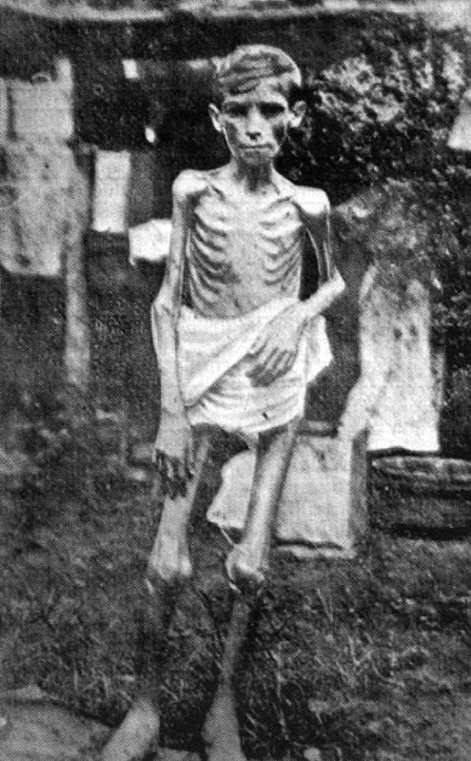
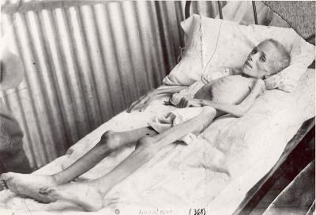
Spanish Reconcentration Camps

Slide 5
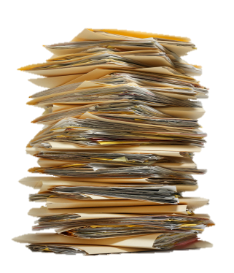
The Road to War
Document Analysis

Slide 6
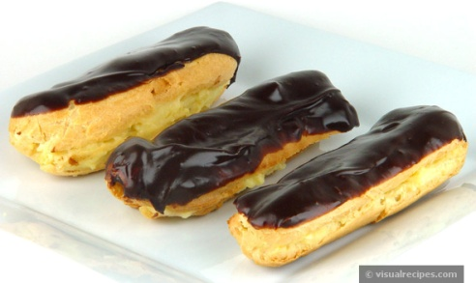
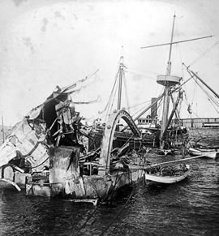
The Road to War
The de Lôme Letter: Spanish ambassador in US who wrote a letter which criticized President McKinley and called him a wimp
Mysterious explosion of the U.S.S. Maine in Havana harbor
Killed 260 American sailors
“Remember the Maine!”
Found later to be an accident
McKinley slow to enter a war
Secretary of the Navy, Teddy Roosevelt said he had “the backbone of a chocolate éclair.”

Slide 7
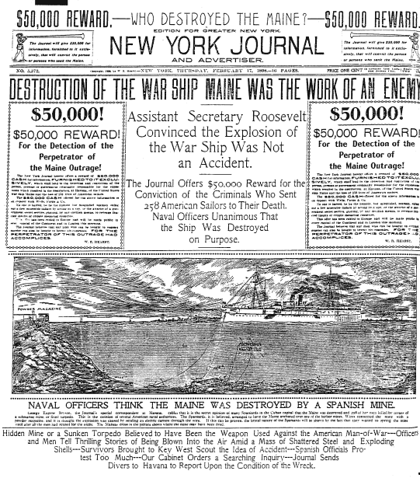
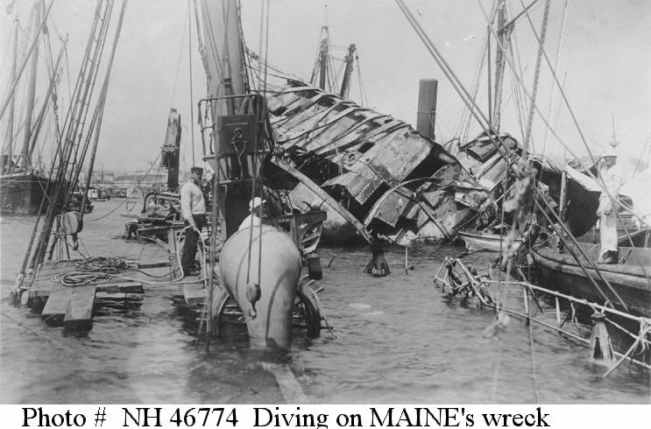
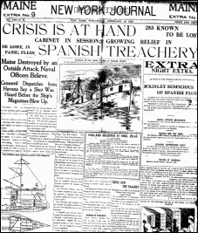
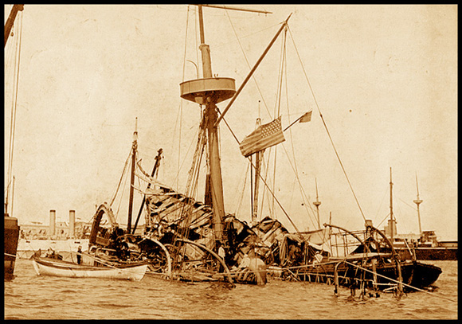
February 15, 1898
“Remember the Maine!”
Notes:
Remember the maine, to hell with spain!

Slide 8
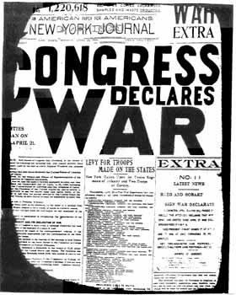
Declaring War on Spain
Spanish American War begins
April 11, 1898
Teller Amendment: Said the U.S. would give Cuba its freedom after kicking out Spain.
Notes:
April 11, 1898, Congress declares war on Spain
Congress also passes the Teller Amendment that said the U.S. would give Cuba its freedom after kicking out Spain.

Slide 9
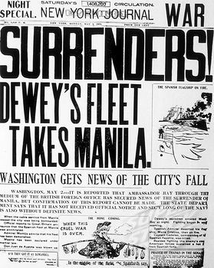
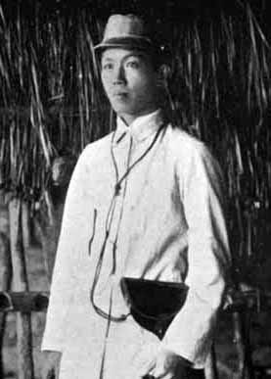
Victory at Manila
Commodore George Dewey sent to Philippines
Victory at Manila Bay
Emilio Aguinaldo
Notes:
Under-secretary of the Navy, Teddy Roosevelt, ordered Commodore George Dewey to move to the Philippines (another Spanish colony) if war broke out
Dewey’s six ships out maneuvered and out-shot Spain’s 10 naval ships, but was unable to take the shores of Manila.
Foot soldiers eventually arrived, and with the help of Emilio Aguinaldo (leader of a group of Filipino insurgents), they took Manila.

Slide 10
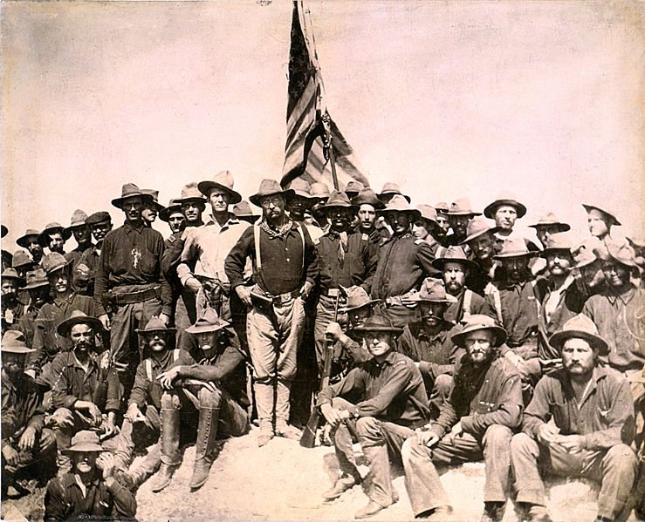
The Confused Invasion of Cuba
Underprepared for war
The Rough Riders
Theodore Roosevelt
San Juan Hill
Barricade of Havana harbor
Armistice
August 12, 1898
Notes:
The U.S. Army was vastly underprepared for war (had not been in conflict since the Civil War)
More men would die from disease than bullets
Teddy Roosevelt organized a cavalry group known as the Rough Riders
They gathered a diverse bunch of men consisting of cowboys, gold or mining prospectors, police officers, military veterans, hunters, gamblers, Native Americans and college boys; all of whom were able-bodied and capable on horseback and in shooting.
Famous for the attack on San Juan Hill (not on horseback), which forced Spain to rely on it’s naval fleet, which the Americans had already bottled in Havana Harbor.
The Spanish decided to run the gauntlet, and the U.S. mowed down the Spanish ships
The two countries signed an armistice on August 12, 1898

Slide 11
Issues Stemming From War

Slide 12
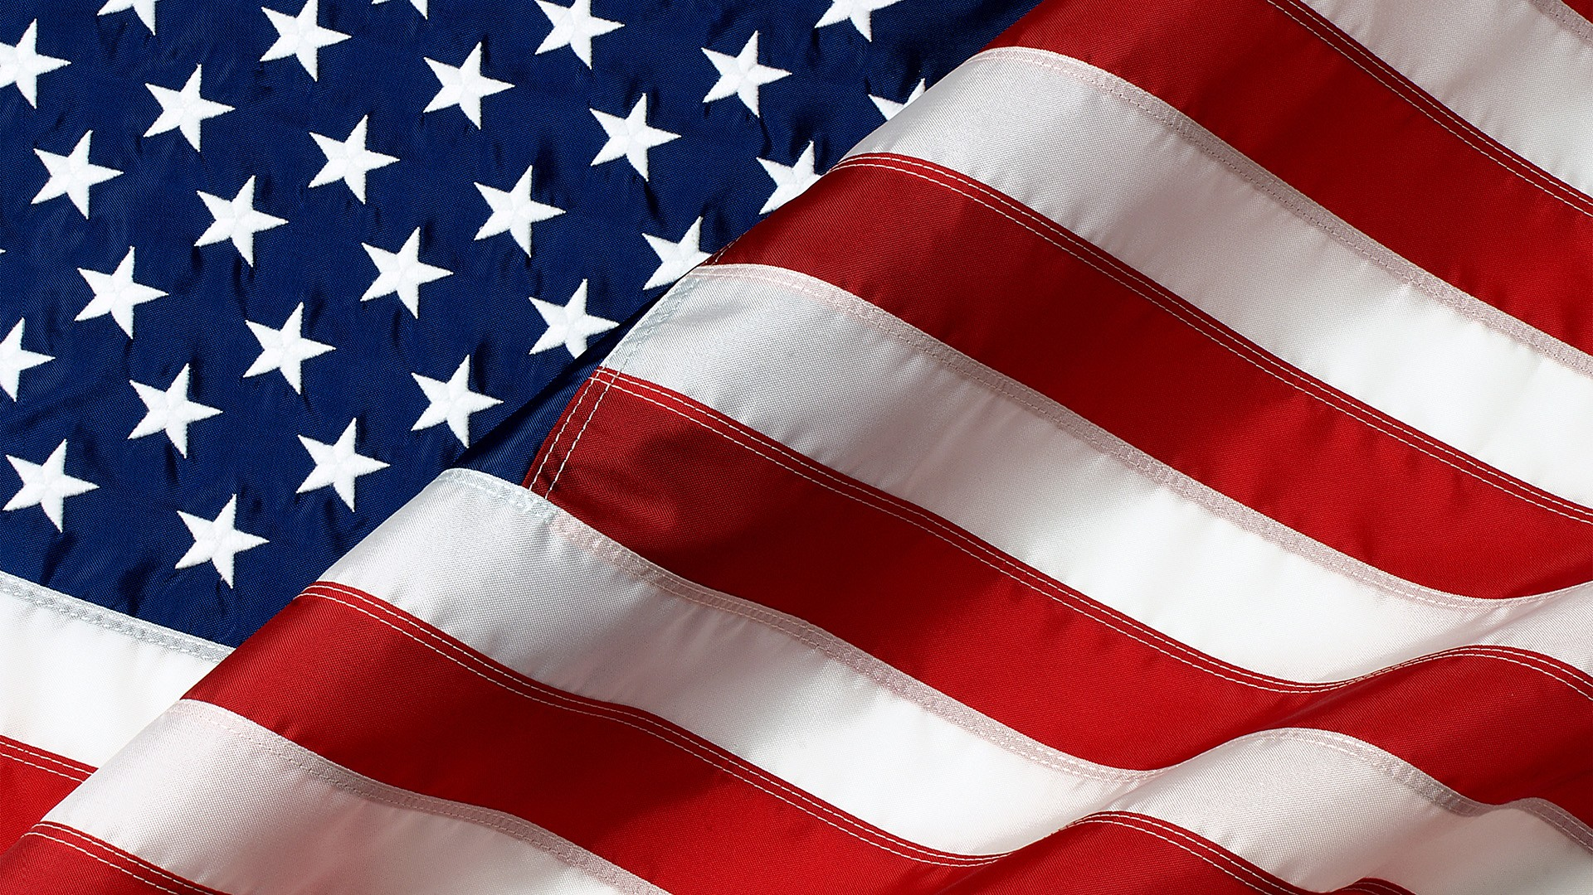
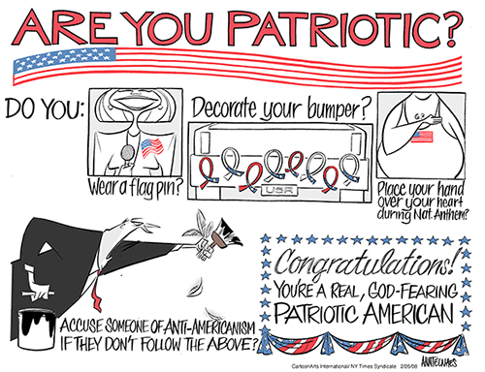
‘Murica!
Jingoism
John Philip Sousa
Stars and Stripes Forever
Notes:
Jingoism was in full swing during the Spanish-American War, and the quick victory only fueled the fire.
America was now seen as one of (if not the) strongest nation in the world
North/South divisions were overshadowed by a foreign enemy
John Philip Sousa’s marching music (Stars and Stripes Forever) fueled the patriotic fervor

Slide 13
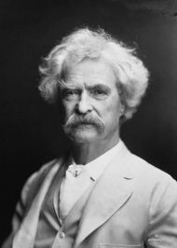
Ending the War
Cuba was now free from Spanish control; U.S. gains Puerto Rico, Guam, and the Philippines.
Anti-Imperialist League emerged to halt annexation
Mark Twain, Carnegie, Samuel Gompers
Other lands had generally been closely located or sparsely populated; not so with Spanish territories
Strain on American resources, harming business/labor
The War Prayer
“I don't think the prayer will be published in my time. None but the dead are permitted to tell the truth."

Slide 14
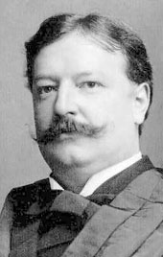
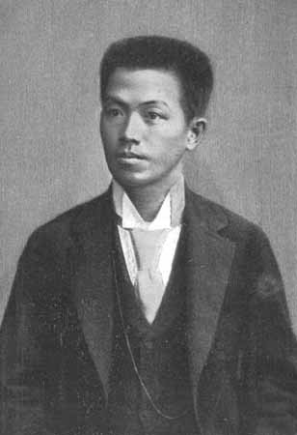
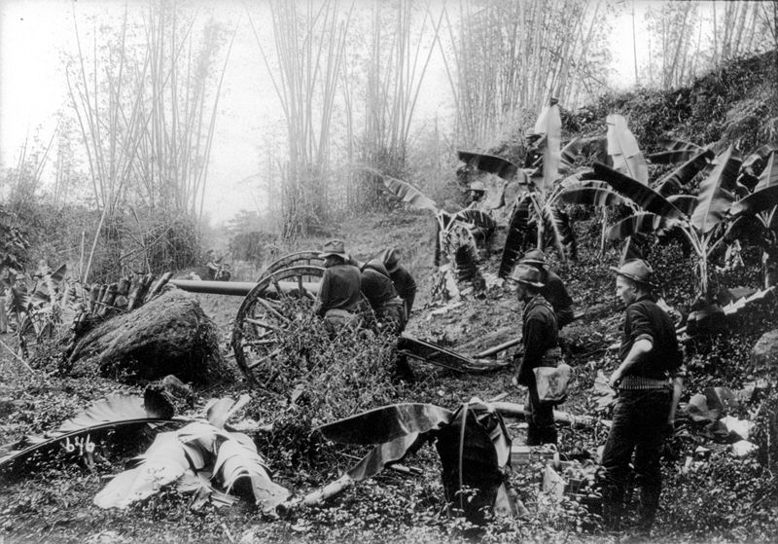
What to Do With the Philippines?
Assumed they’d be granted independence like Cuba had been promised; denied
Bloody guerrilla warfare against the U.S.
Led by Emilio Aguinaldo
U.S. creates reconcentration camps and the “water cure”
Effects for Philippines
Set up a democratic government - Governor William Howard Taft
Improved transportation, sanitation, public health, and education

Slide 15
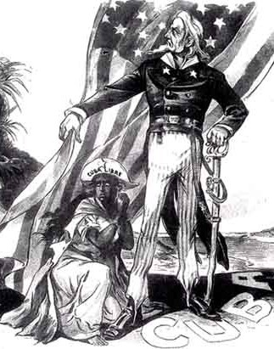
What to Do With Cuba?
A military government set up after the war to rebuild
Offered U.S. statehood; rejected
The Platt Amendment: Ensured U.S. involvement in Cuban affairs
Guantanamo Bay Naval Base

Slide 16
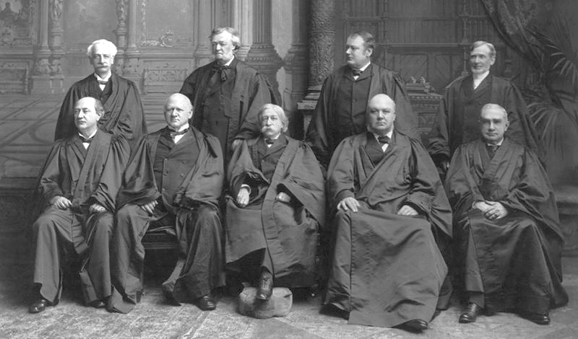
What to do with our “Little Brown Brothers?”
Insular Cases: SCOTUS cases concerning the status of territories acquired after the Spanish American War
QUESTION: Do American laws and rights apply to foreign lands and peoples?
DECISION: Supreme Court said NO.
NO!
…oh, except you Hawaii. You have white people.
We are Americans now, no?
Notes:
The Insular Cases: Several Supreme Court cases concerning the status of territories acquired after the Spanish American War.
QUESTION: Do American laws and rights apply to foreign lands and peoples?
DECISION: Supreme Court said NO.
This would mean that the people of imperialized nations could legally be treated less than American citizens, and Americans living in those countries did not have the same protections they would at home.

