Slide 1
Pre-Write
Is it ever okay to attack civilian populations during war? Why or why not? What other options might be available to end a war quickly?

Slide 2
“I am death, destroyer of worlds”
The End of WWII

Slide 3
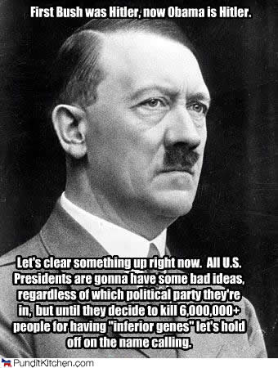
Defiance, Destruction, and Deliverance
Ending the War in Europe

Slide 4
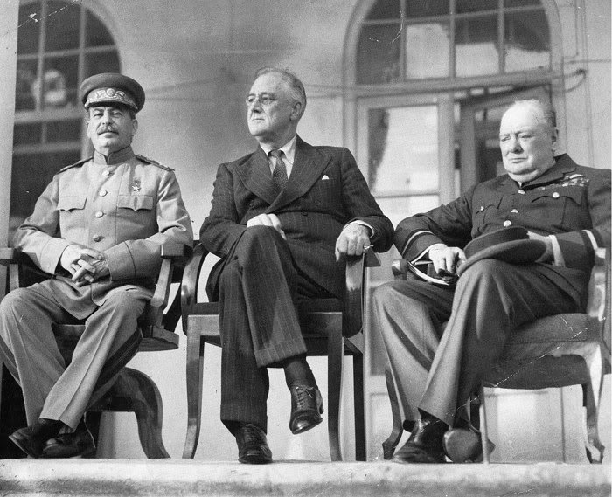
A Series of Conferences – 1944
Casablanca Conference
  FDR and Churchill meet in Morocco
  Decision: to accept nothing less than unconditional surrender of the Axis powers
Tehran Conference
  The “Big Three” – FDR, Churchill, and Stalin meet in Iran
  Decisions: Soviet agreement to enter war with Japan after Germany is defeated
  Begin discussion of demilitarization and occupation of Germany

Slide 5
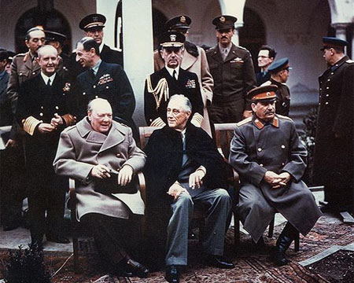
A Series of Conferences - 1945
Yalta Conference
  The Big Three meet in Yalta, USSR
  Decisions: Germany is to be divided into four zones and occupied by Allied powers
  Discussion of organization of United Nations
  USSR to hold free elections on Eastern Europe
  War crimes to be tried after the war

Slide 6
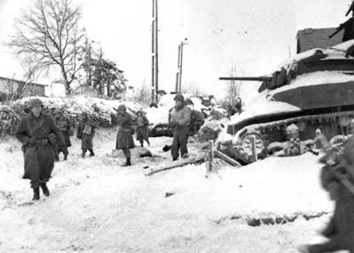
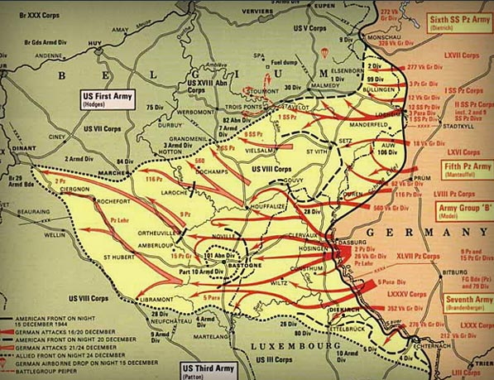
The Battle of the Bulge
Hitler’s last offensive
  Attempt to cut off Allied supply lines in Belgium
Winter of 1944-45
Caught American troops off-guard, forcing their lines to “bulge” outward
Severely depleted Germany's armored forces
Largest and bloodiest battle fought by the United States in World War II
Notes:
Intended to split the British and American Allied line in half, so the Germans could then proceed to encircle and destroy four Allied armies, forcing the Western Allies to negotiate a peace treaty in the Axis Powers' favor. Once that was accomplished, Hitler could fully concentrate on the eastern theatre of war.
The fierce fighting ended with over 19,000 American and 100,000 German deaths

Slide 7
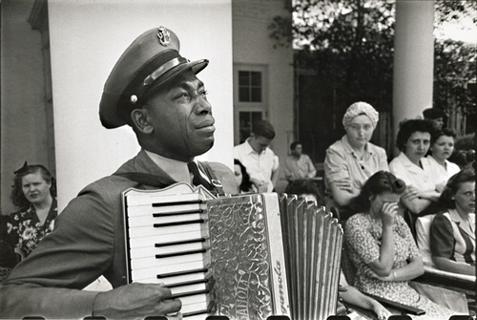
Death of FDR
Notes:
FDR died suddenly of a stroke on April 12, 1945
Roosevelt's death was met with shock and grief across the U.S. and around the world.
Flags remained at half-staff for 30 days, despite the surrender of Nazi Germany
He would only serve 16 months of his fourth term.

Slide 8
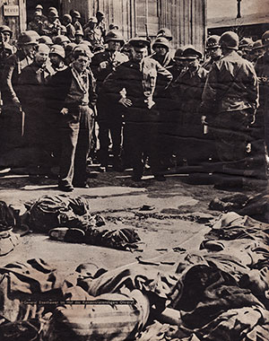
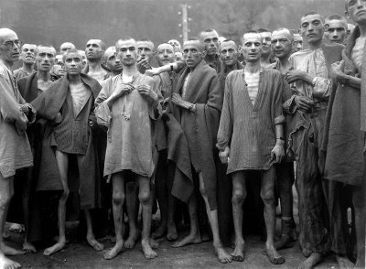
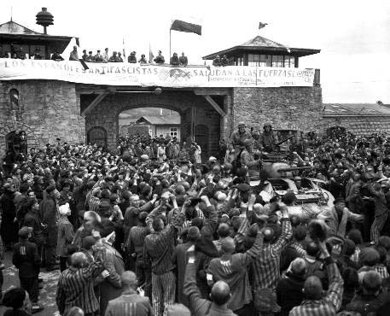
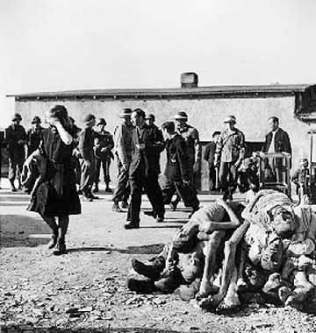
Liberation
American forces liberate the concentration camps at Buchenwald, Mauthausen, and Dachau
Liberators confronted unspeakable conditions in the Nazi camps
Gen. Eisenhower forced local German citizens to tour, and later clean up the camps as punishment for their indifference

Slide 9
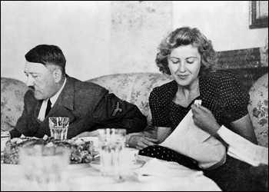
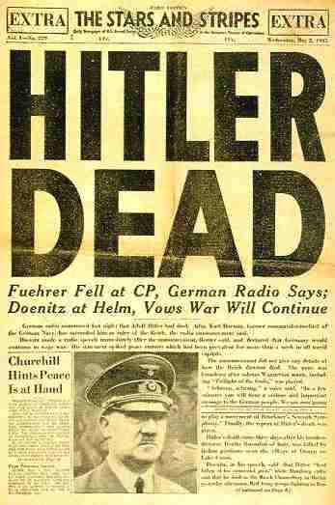
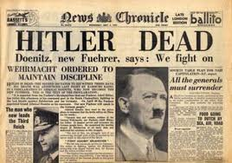
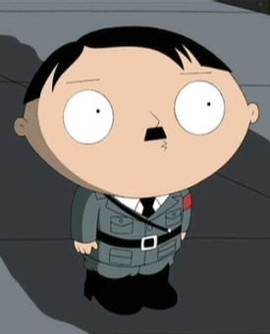
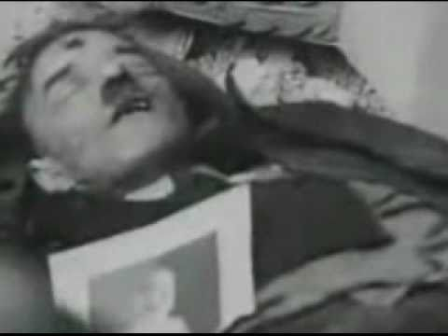
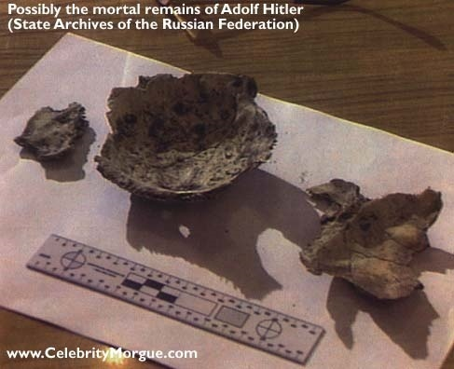
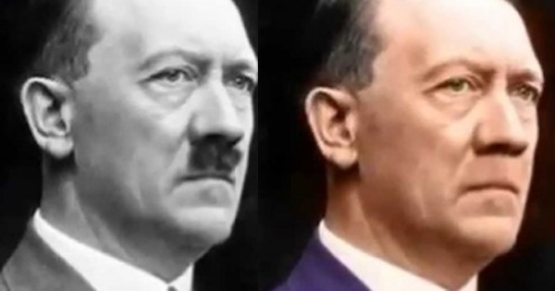
The Death of Hitler

Slide 10
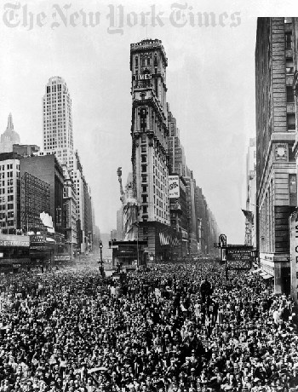
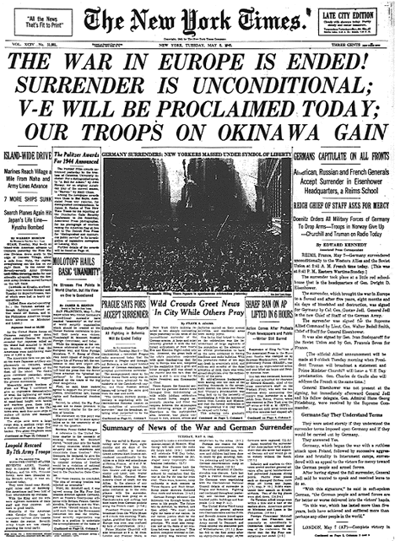
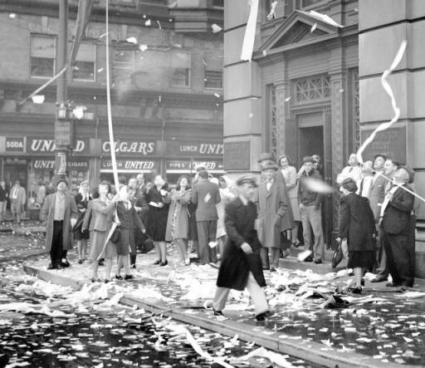
V-E Day

Slide 11
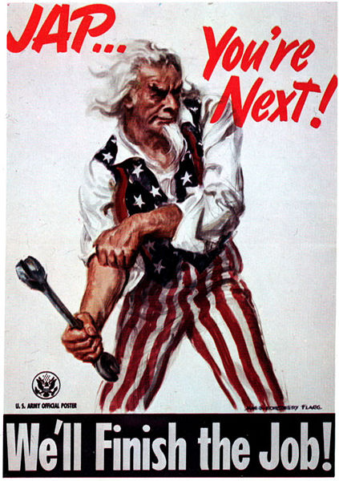
A Difficult Decision
Ending the War in the Pacific

Slide 12
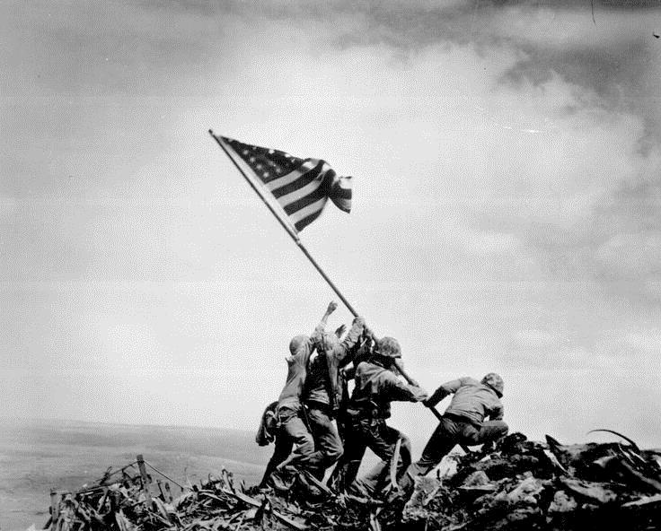
Iwo Jima
Feb. - March, 1945
First American attack on Japanese home islands
Japanese attacked using a vast system of bunkers and underground tunnels
Only 216 of the more than 18,000 Japanese soldiers were taken prisoner; 6,800 American casualties
This was the first time an invaders flag flew over Japanese territory
Photographer Joe Rosenthal won the Pulitzer Prize for this photo – improved dedication towards ending the war in the Pacific
Notes:
20,000 Japanese to 110,000 Americans

Slide 13
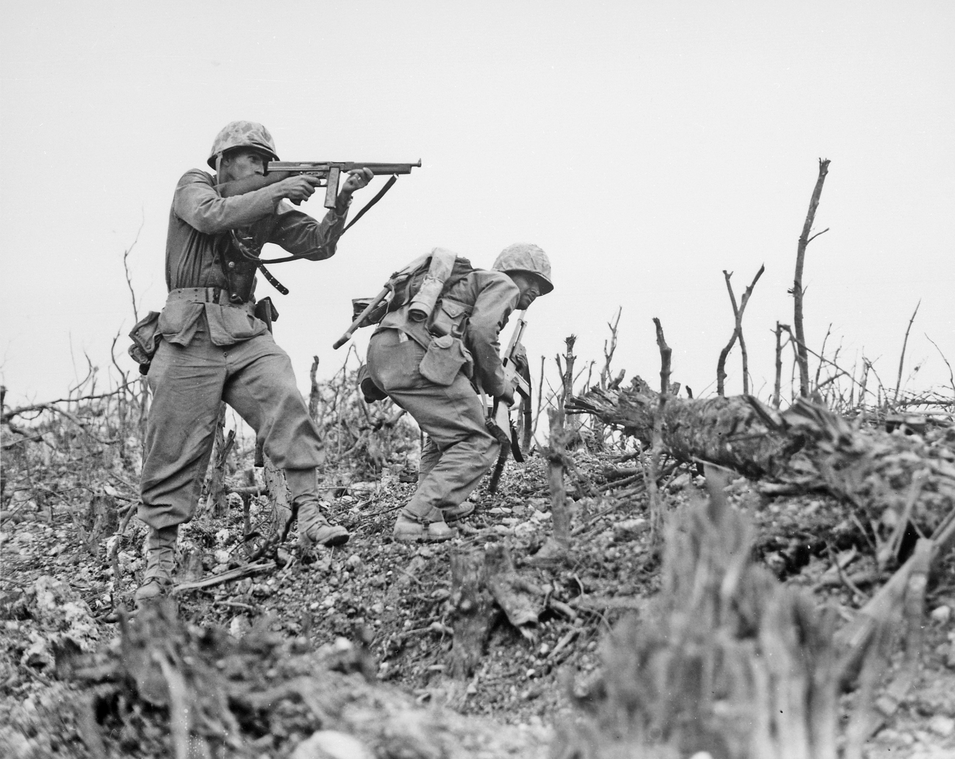
Okinawa
April- June, 1945
Bloodiest battle of the Pacific Theatre – AKA: “Typhoon of Steel”
Goal was to take out important Japanese airfields
Heavy use of kamikaze in initial attack; majority of Japanese force was barricaded in the well-fortified interior of the island (“Let them come to us” attitude)
Japanese lost over 77,000 soldiers; over 14,000 Allied casualties

Slide 14
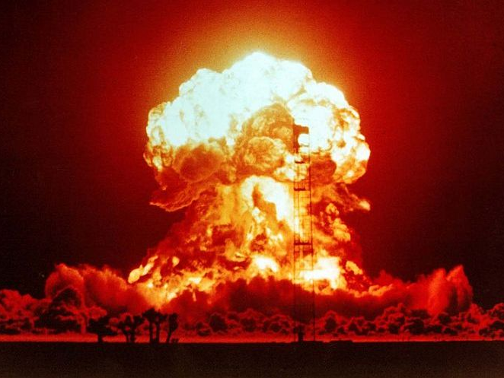

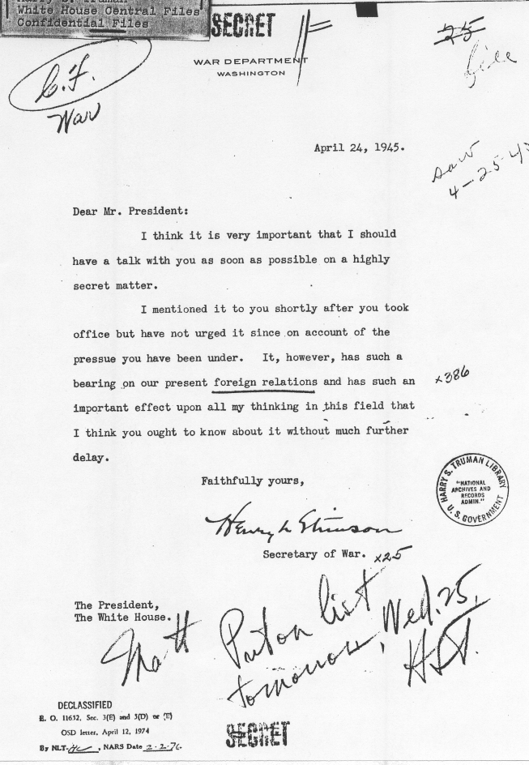
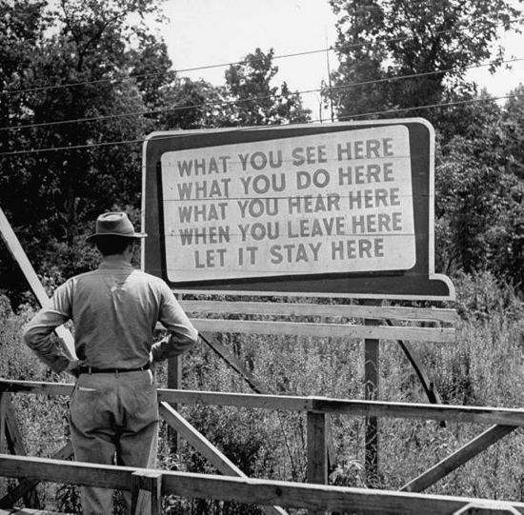
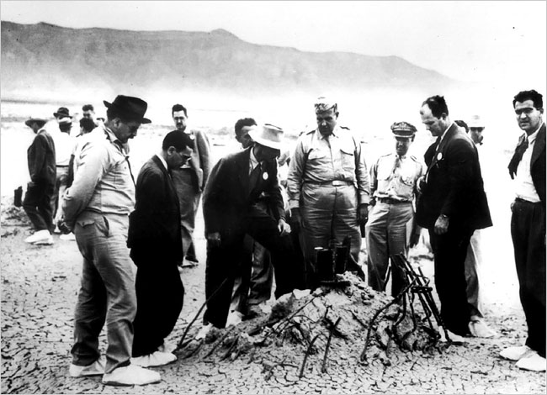
The Manhattan Project
The code name for the atomic bomb project in Los Alamos, NM
Under the direction of Major General Leslie Groves and Dr. Robert Oppenheimer
The Manhattan Project operated under a blanket of tight security, and information was given on a “need-to-know” basis.
“Now I am become Death, destroyer of worlds”

Slide 15
Four Options
Invade Japan with Allied troops; this would result in high deaths on both sides and an unknown timeline.
Drop an atomic bomb out in the Pacific away from people to show Japan our military strength.
Drop the bomb without warning to “shock” Japan into surrendering.
We give the people of cities 24 hours notice, then we drop the bomb.

Slide 16
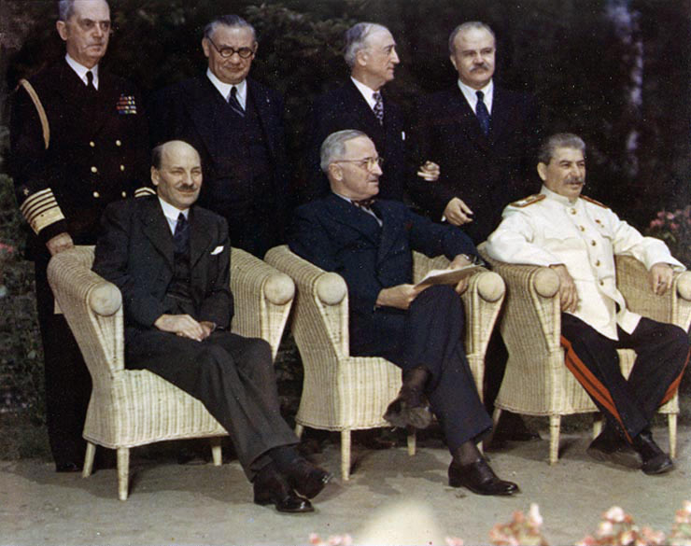
The Potsdam Ultimatum
July-Aug. 1945
President Truman, Prime Minister Clement Attlee, and Joseph Stalin met at Potsdam, Germany to discuss the end of the war and the post-war world.
  Demand Japan’s unconditional surrender
  If Japan refused, Truman threatened to deliver "prompt and utter destruction“ – he received no response.

Slide 17
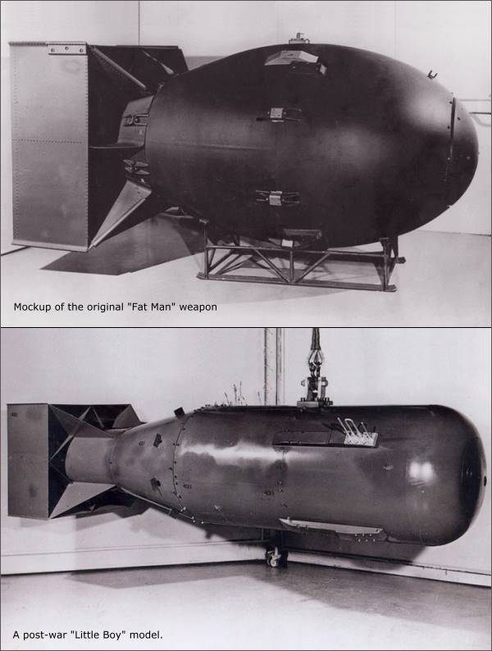
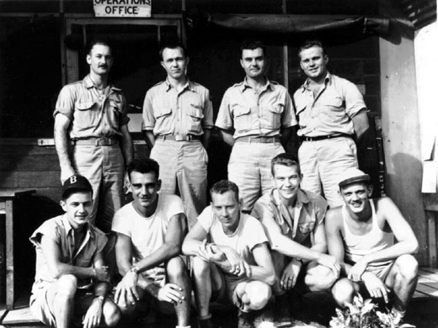
The Atomic Bomb
Bombs nicknamed Little Boy and Fat Man
Delivered from Tinian Island by Col. Paul Tibbets and the Enola Gay crew

Slide 18
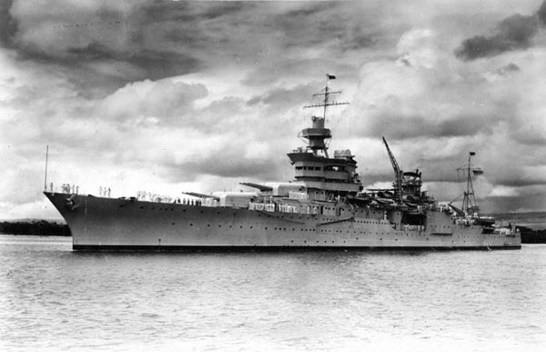
U.S.S. Indianapolis
USS Indianapolis sent to deliver vital parts for the atomic bomb to a U.S base in Tinian
Attacked and sunk by a Japanese submarine
The ship sent no distress signals
300 men died in the attack while another 880 floated in the ocean for another four days before being rescued
They suffered from lack of food and water, exposure to the elements, severe desquamation, and did I mention shark attacks?

Slide 19
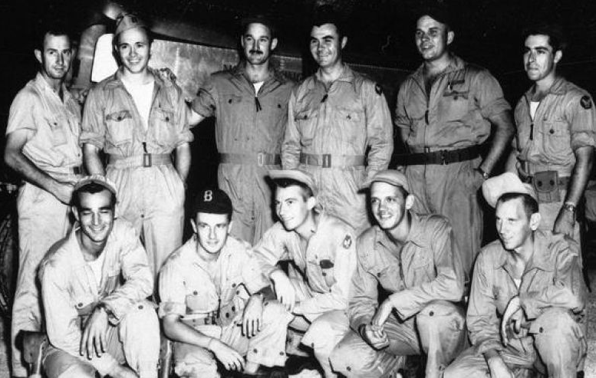
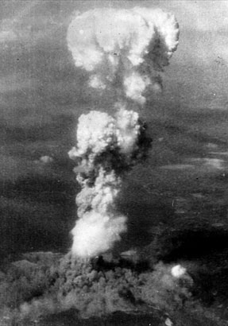
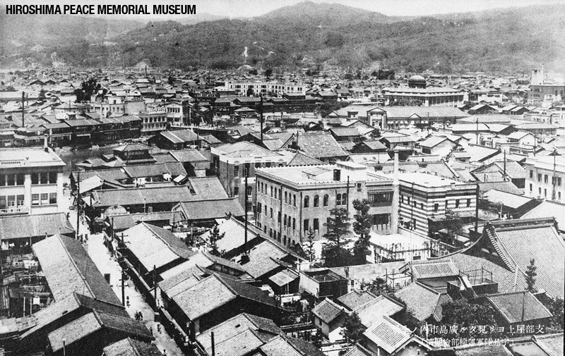
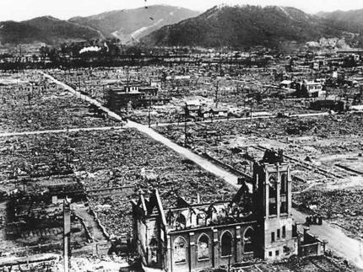
Major industrial and military center
70,000–80,000 people killed instantaneously, with 90,000 to 166,000 dying from radiation and other effects
Hiroshima
August 6, 1945
Notes:
Little Boy
Bomb expected to kill 40,000-60,000; radiation was not greatly considered.

Slide 20
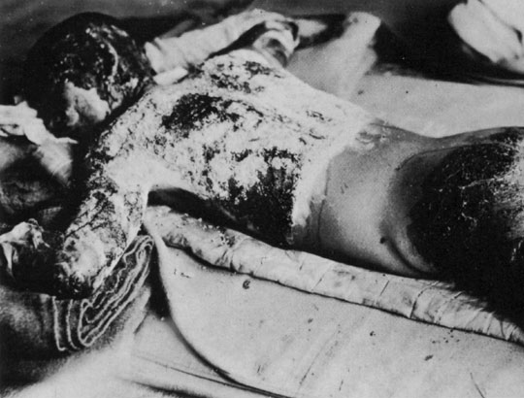
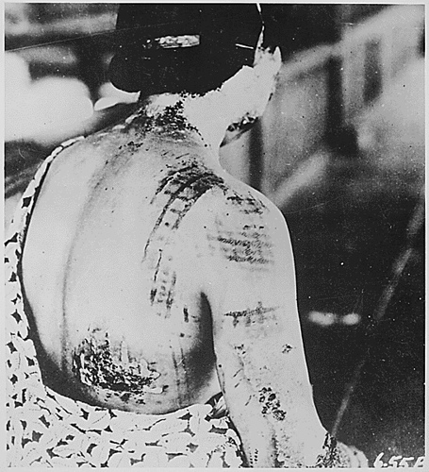

Slide 21
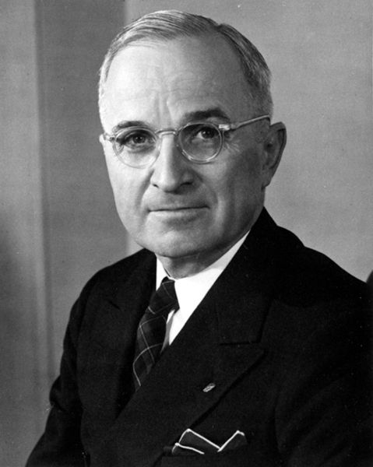
Truman’s Second Ultimatum
“If they do not now accept our terms, they may expect a rain of ruin from the air, the like of which has never been seen on this earth. Behind this air attack will follow sea and land forces in such numbers and power as they have not yet seen and with the fighting skill of which they are already well aware.”

Slide 22
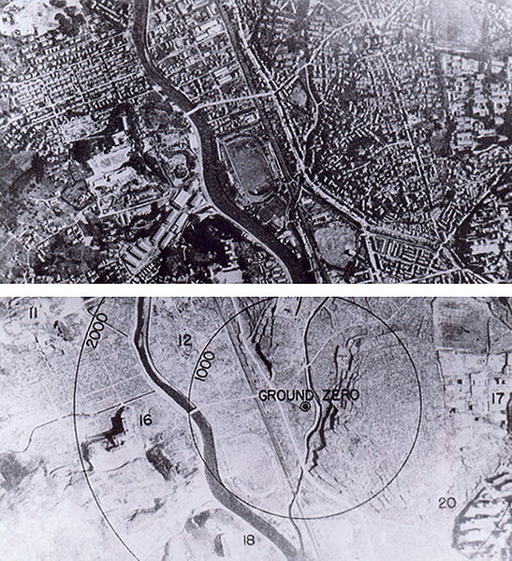
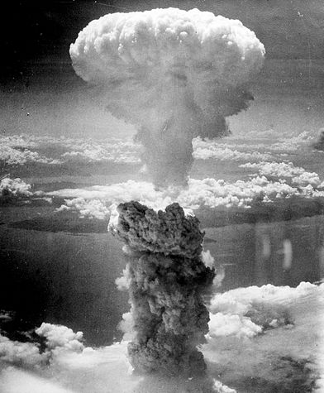
Nagasaki also an industrial and military target (major sea port)
The US dropped Fat Man on Nagasaki.
Estimated at 40,000- 75,000 casualties, with 80,000 actual deaths
Nagasaki
August 9, 1945
Notes:
Fat Man

Slide 23
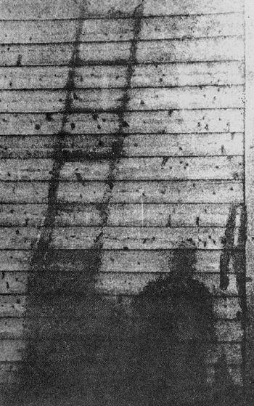
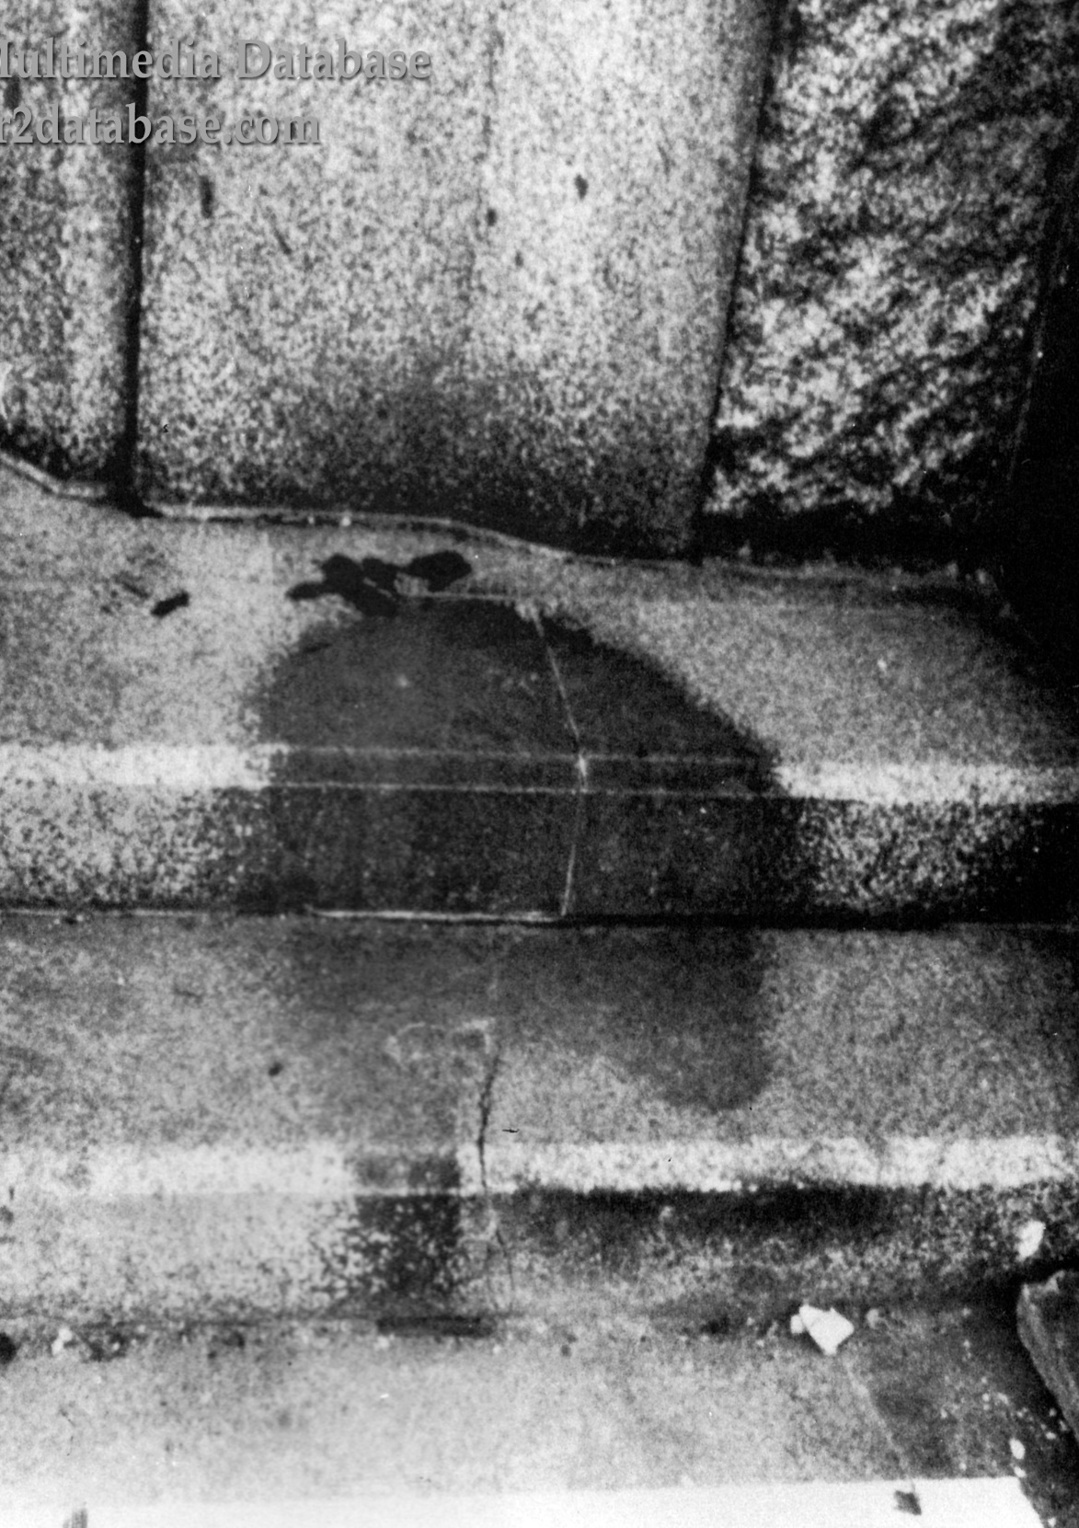
Atomic Shadows

Slide 24
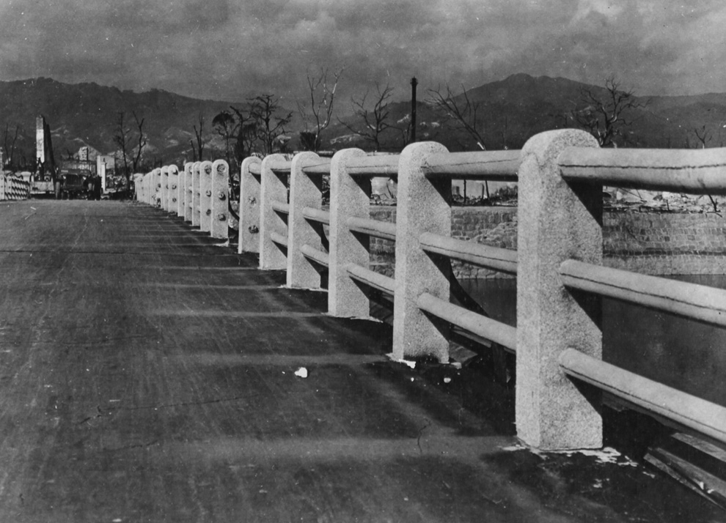
Atomic Shadows

Slide 25
Lucky...?
Kokura was the primary target, but cloud
cover had obscured the city, prohibiting the
visual attack required by orders
An unknown number of survivors from the
Hiroshima bombing had made their way to
Nagasaki, where they were bombed again.

Slide 26
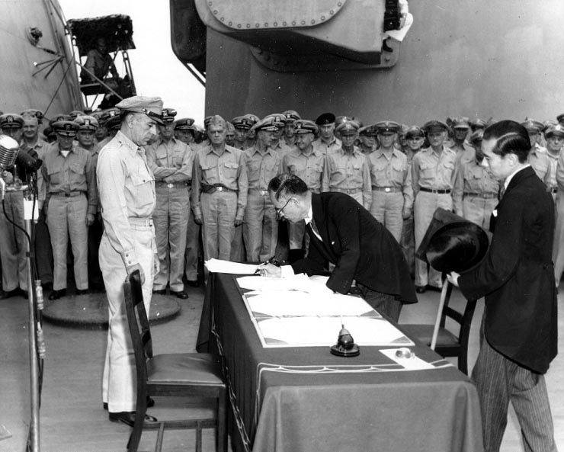
Victory Over Japan (V-J Day)
U.S.S. Missouri
August 15, 1945

Slide 27
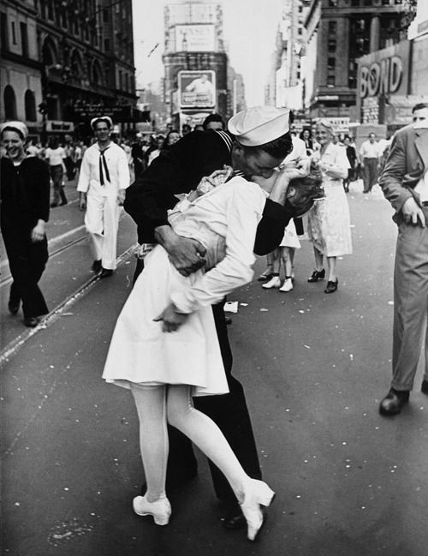
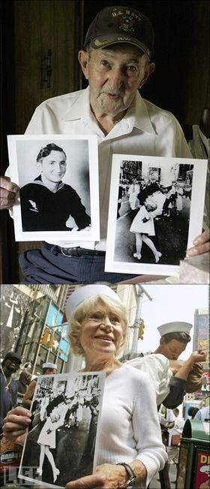

Slide 28

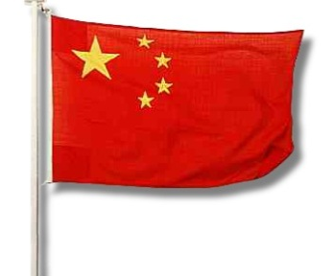
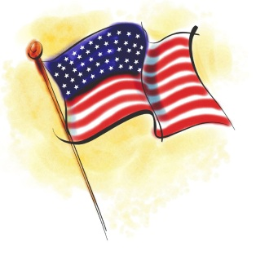
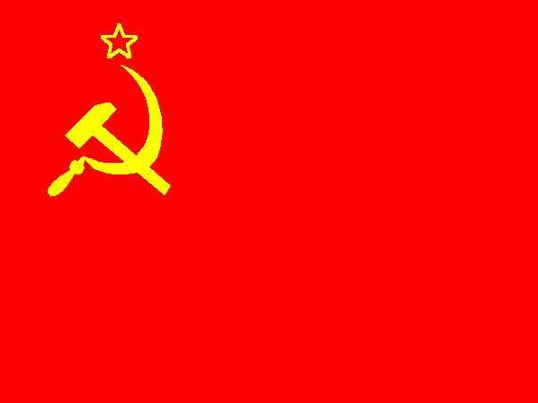
Building a New World
United Nations (UN): a new international organization of peace (to replace the ineffectual League of Nations)
  General Assembly: every member nation would have one vote.
  Security Council: 11 member group, with 5 permanent positions (Britain, France, China, USSR, and USA) and 6 rotating positions; given veto power.
  What do you notice about the permanent positions of the Security Council?

Slide 29
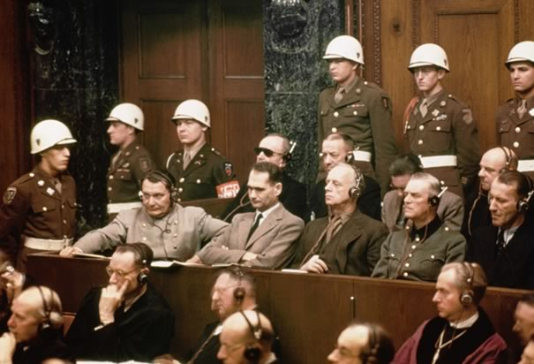
Nuremberg Trials
International Military Tribunal (IMT) in Nuremberg, Germany
Tried German leaders suspected of committing war crimes. Similar trials were also held in Tokyo, Japan against Japanese leaders.
Several sentenced to death and many more were given prison sentences. Many others evaded capture and some committed suicide.
Notes:
Hermann Göring, Commander of the Luftwaffe 1935-1945, Chief of the 4-Year Plan 1936-1945, and several departments of the SS. Second only to Hitler in the Nazi hierarchy during the last years of the war. Committed suicide the night before his execution.

Slide 30

What About Japan?
Hideiki Tojo sentenced to death; attempted suicide, but failed.
Emperor Hirohito was exonerated for his role in the war
  How much power did he really have during the war?
  MacArthur argued to save the emperor, who he saw as a symbol of the continuity and cohesion of the Japanese people

Slide 31


Was the Atomic Bomb Necessary to End World War II?

