Slide 1
World War II
1941-1945

Slide 2
The European Theatre
Defeating Hitler: Job #1

Slide 3
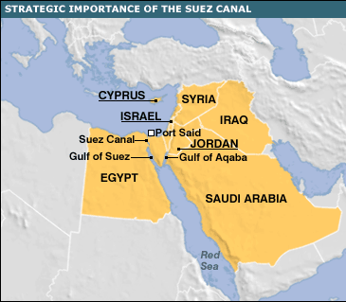
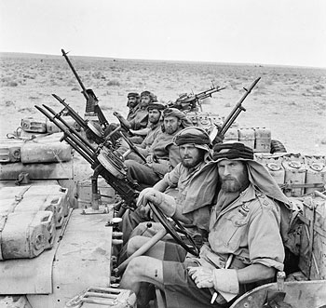
Struggle for North Africa
Axis invades N. Africa
  Sought control of the Suez Canal
  Led by General Erwin Rommel (AKA: Desert Fox)
First US foray into European Theatre
  US forces led by General George Patton and Dwight D. Eisenhower
  Suffer great casualties before pushing the Axis back

Slide 4
The Italian Campaign
Allies conquer Sicily
  Damages Axis supply lines
Mussolini arrested
Hitler comes to the rescue
Allied attack behind Axis lines
  Five months of bloody battle; cost 300,000 Allied lives
Notes:
September 1943 - The Allied forces decided to attack the Axis on the island of Sicily, and caused irreparable damage to Axis supplies and weaponry.
By August 18, Germans had evacuated the island. Mussolini was placed under arrest by the king of Italy, and the Italian government announced Italy’s surrender.
Is Hitler going to let that go?
Hitler sent German troops to seize control of Italy and put Mussolini back in power
The Allies chose to attack from behind Axis lines, which led to five months of bloody battle.
In May 1944, the Germans retreated at the cost of 300,000 Allied lives.

Slide 5
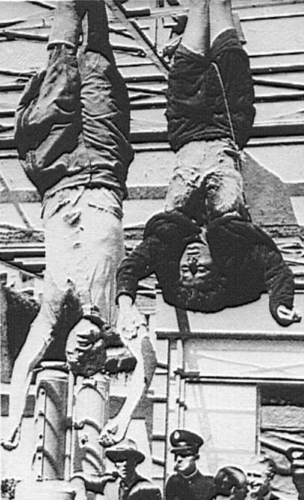
Mussolini &
His Mistress,
Claretta Petacci
Are Hanged in Milan, 1945

Slide 6
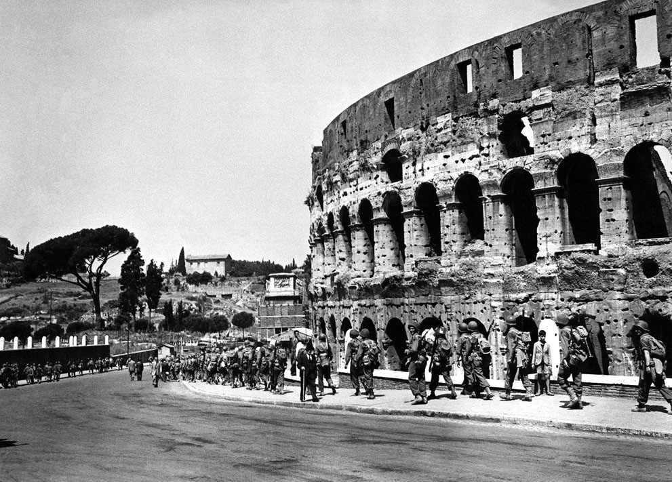
Liberation of Rome
June 4, 1944
Notes:
Massive casualties, but liberate Rome June 4, 1944
Mussolini and his mistress are hanged in Milan

Slide 7
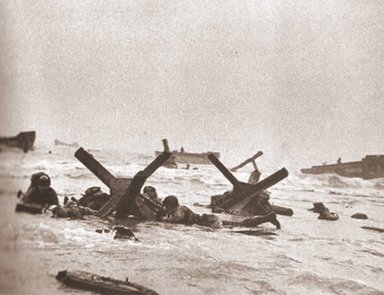
D-Day

Slide 8
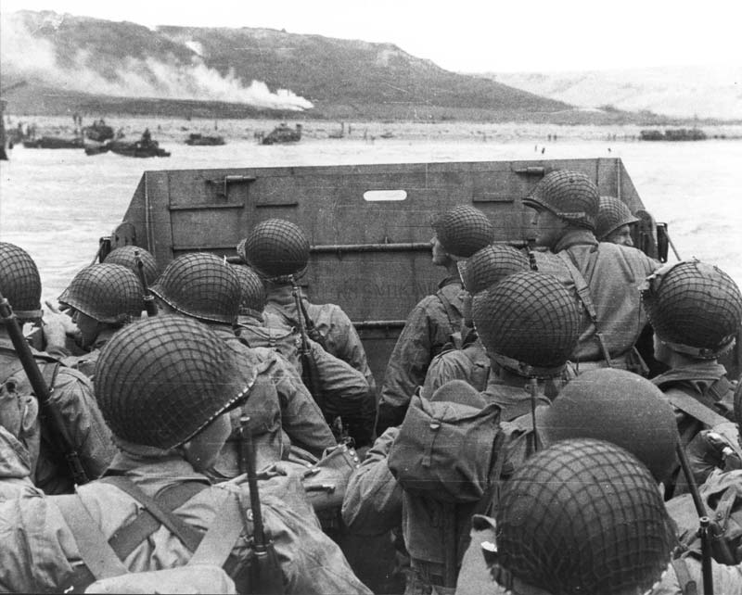
Invasion of France
Operation Overlord: Code name for the invasion of Normandy, France by the Allies
Gen. Dwight D. Eisenhower, commander
Element of surprise
Notes:
Operation Overlord: the code name for the planned invasion of Normandy, France by the Allies, commonly known as D-Day.
General Eisenhower was selected to command the invasion.
The Allies had the advantage of surprise—the Germans did not know when or where they would strike.
The Germans believed the Allies would land at Pas-de-Calais
To convince them they were right, the Allies placed inflated rubber tanks, empty tents, a d dummy landing craft along the coast from Calais.

Slide 9
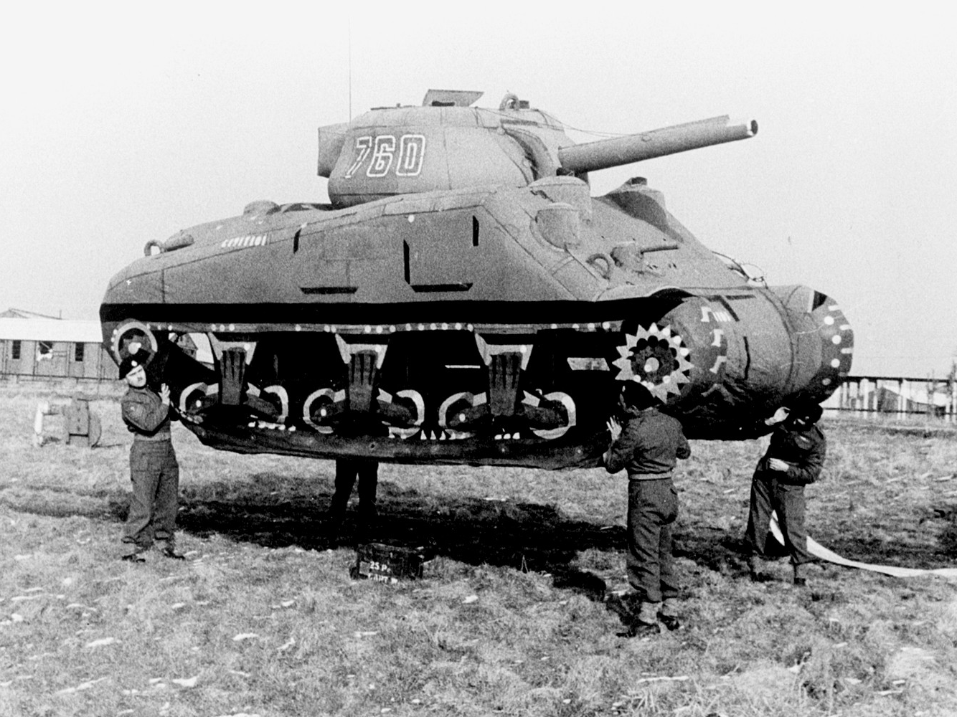
The Most Amazing Hoax in History
Juan Pujol Garcia and the Ghost Army

Slide 10
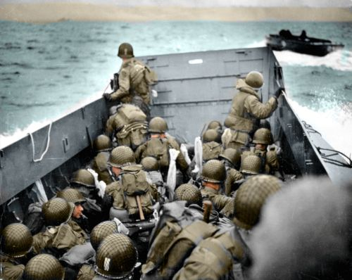
D-Day: The “Date” of the Attack
Notes:
May 1?
June 4?
June 5?
June 6, 1944

Slide 11
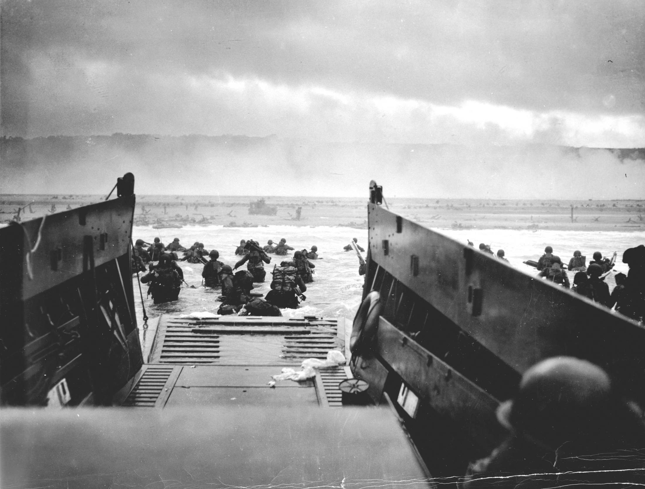
Operation Overlord
Massive mobilization of troops and weaponry
Very specific requirements for day of attack
June 6, 1944 – D-Day invasion
  Utah, Omaha, Gold, Sword, Juno
  Omaha beach the deadliest
Liberation of Paris two months later
Notes:
Over 1.5 million American soldiers, 12,000 airplanes, more than 5 million tons of equipment was prepared for the invasion.
The invasion had to begin at night to hide the ships crossing the English Channel, and had to arrive at low tide (dawn) so gunners bombarding the coast could see their targets.
Over 7,000 ships carrying more than 100,000 soldiers set sail for Normandy on June 6, 1944. 23,000 paratroopers were dropped in behind enemy lines. Allied fighter-bombers raced up and down the coast, hitting bridges, bunkers, and radar sites. As dawn broke, the Allied forces were ready to attack the beaches, code-named Utah, Omaha, Gold, Sword, and Juno.
The Allied forces had little trouble capturing the Utah Beach and moving inland.
The American forces at Omaha Beach met intense German fire, causing General Omar Bradley to plan an evacuation of Omaha Beach
American troops moved forward against the Germans. The invasion succeeded.
2,500 Americans were wounded or killed on Omaha Beach.

Slide 12
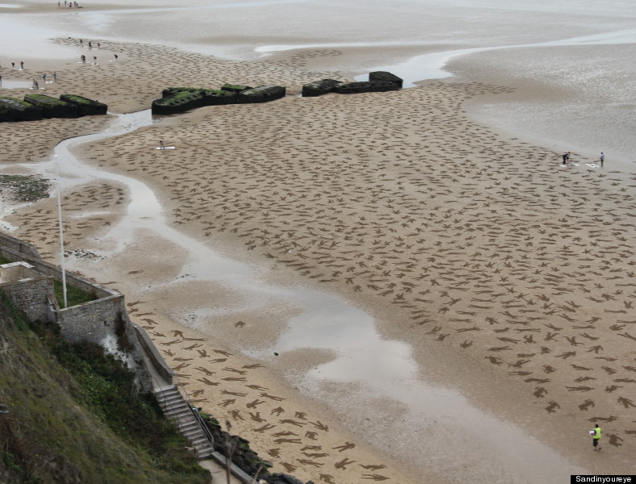
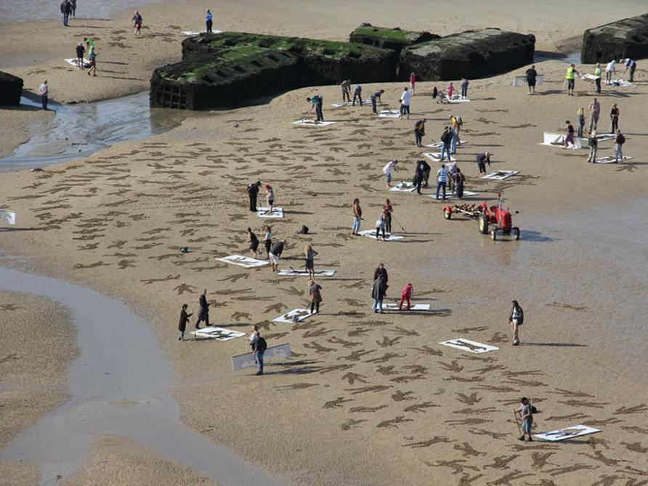
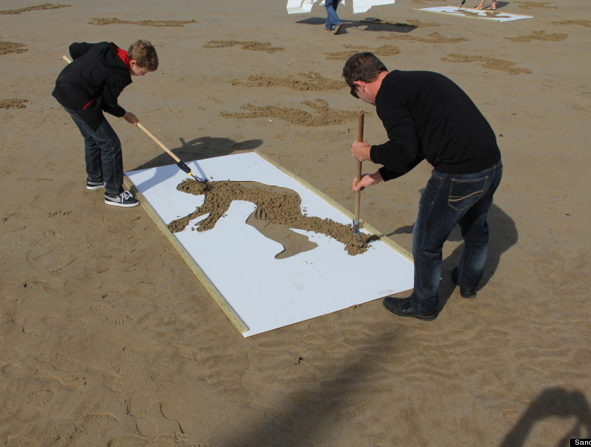

Slide 13
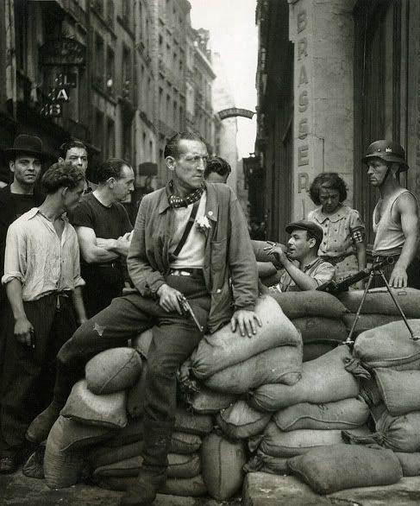
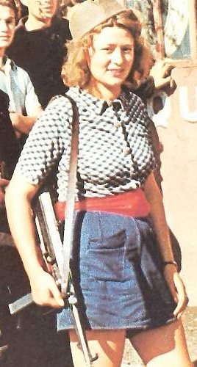
The French Resistance

Slide 14
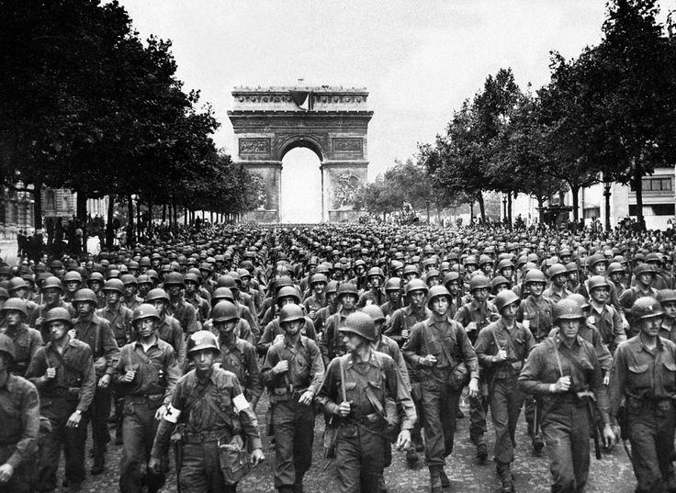
Liberation of Paris: August 25, 1944

Slide 15
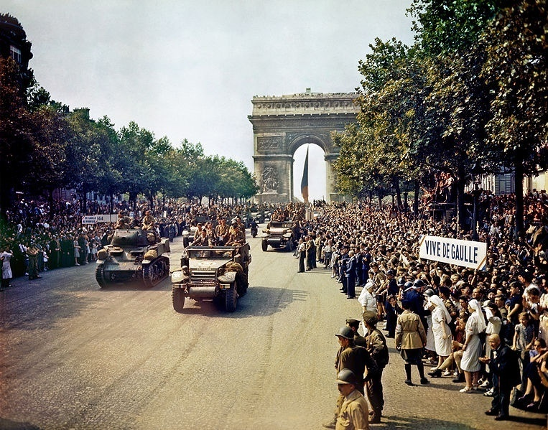

Slide 16
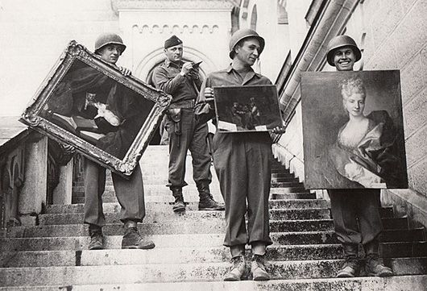
The Monuments Men
Notes:
Louvre only has 70,000 pieces of art; Nazis stole an estimated 5,000,000 pieces.

Slide 17
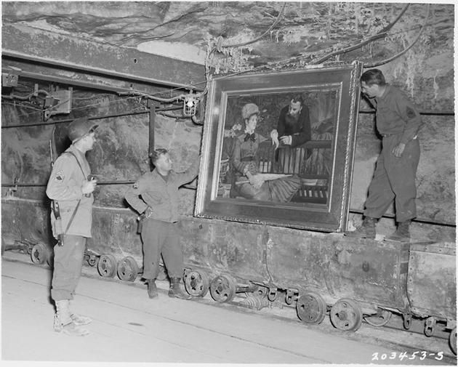

Slide 18
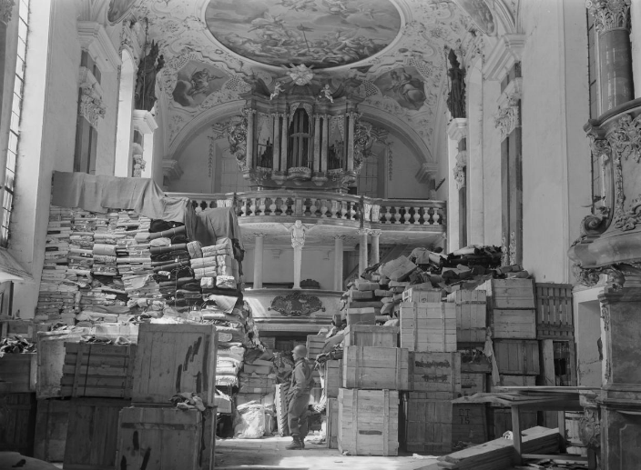

Slide 19
You’re In The Army Now!
Life Of A Soldier

Slide 20
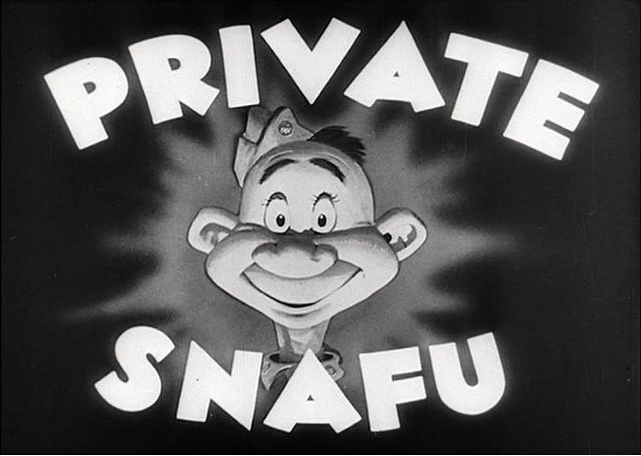
Private SNAFU
Private SNAFU was a character created to help enlisted men with poor reading skills learn military protocol through fun, instructional cartoons.
  Private SNAFU did everything wrong (hence the name), so men learned through his negative
  Somewhat racy – kept men entertained while they learned.
Created by Frank Capra (It’s a Wonderful Life), written by Theodore Geisel (Dr. Seuss), and voiced by Mel Blanc (Bugs Bunny)

Slide 21
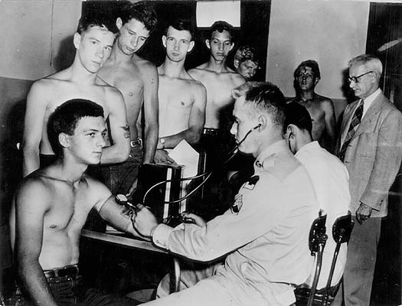
Selective Service Act (1940)
  First peacetime draft
  All men, 18-45; 1 year term
    OHIO
    Pearl Harbor draws thousands of volunteers
Notes:
Selective Service Act (October, 1940) - It was the first peacetime conscription in United States history. When the U.S. entered World War II, all men aged 18 to 45 were made subject to military service.
Service was limited to 12 months. By the early summer of 1941, FDR asked Congress to extend the term of duty. Many soldiers drafted in October 1940 threatened to desert once the original twelve months of their service was up, painting “OHIO” ("Over the hill in October“) on the walls of their barracks in protest.
Following the Japanese Attack on Pearl Harbor, thousands of American men and women volunteered for service, and thousands more by conscription.

Slide 22
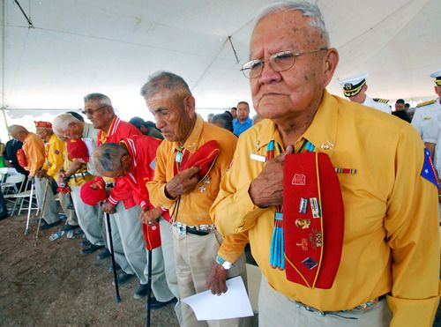
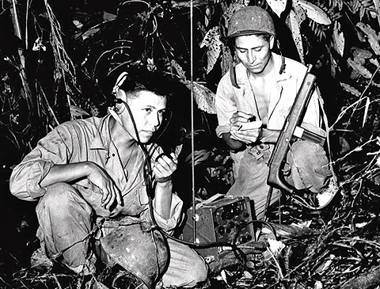
Navajo Code Talkers (AKA: Windtalkers)
Decoding of Enigma Machine proved that all codes could be broken
Navajo Code Talkers: Used Navajo “hidden language” to transmit messages for the U.S. in the Pacific
  Used Navajo words to spell or describe military movements or weapons
Classified until 1970s
Notes:
The decoding of the German Enigma Machine made the transmission of messages harder than ever.
Navajo were enlisted to transmit codes (mainly in the Pacific)
The Navajo language is a “hidden language” – there is no written form of the language and is unique to the United States
When a Navajo code talker received a message, what he heard was a string of seemingly unrelated Navajo words. The code talker first had to translate each Navajo word into its English equivalent. Then he used only the first letter of the English equivalent in spelling an English word.
The Navajo words "wol-la-chee" (ant), "be-la-sana" (apple) and "tse-nill" (axe) all stood for the letter "a."
One way to say the word "Navy" in Navajo code would be "tsah (needle) wol-la-chee (ant) ah-keh-di- glini (victor) tsah-ah-dzoh (yucca)."
Not all words had to be spelled out letter by letter. The developers of the original code assigned Navajo words to represent about 450 frequently used military terms that did not exist in the Navajo language.
Several examples: "besh- lo" (iron fish) meant "submarine," "dah-he- tih-hi" (hummingbird) meant "fighter plane" and "debeh-li-zine" (black street) meant "squad.“
Classified until the 1970s, the Navajo were only recently awarded medals for their contribution to the war effort

Slide 23
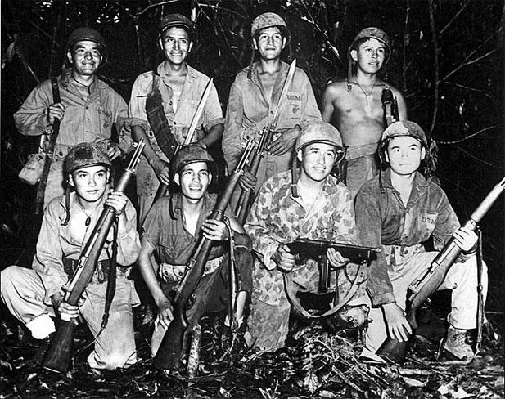
Navajo Code Talkers
Spelling a message:
  The Navajo words "wol-la-chee" (ant), "be-la-sana" (apple) and "tse-nill" (axe) all stood for the letter "a."
  One way to say the word "Navy" in Navajo code would be "tsah (needle) wol-la-chee (ant) ah-keh-di- glini (victor) tsah-ah-dzoh (yucca)."
Short-hand codes:
  Several examples: "besh- lo" (iron fish) meant "submarine," "dah-he- tih-hi" (hummingbird) meant "fighter plane" and "debeh-li-zine" (black street) meant "squad."

Slide 24
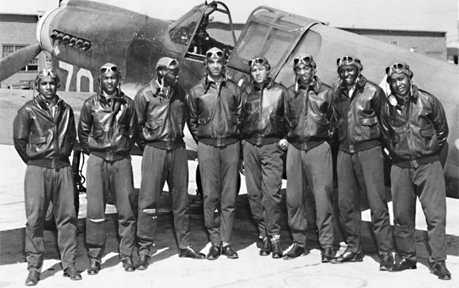
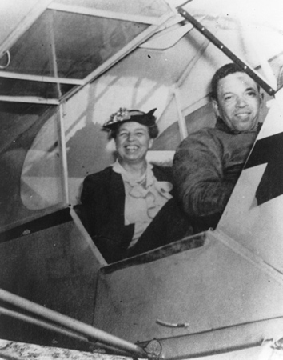
Tuskegee Airmen
First African-American military aviators
  Trained at the Tuskegee Institute
Military was racially segregated; seen as inferior and incapable of military greatness
  Held one of the greatest military records in the war
  Flew First Lady Eleanor Roosevelt
Notes:
The Tuskegee Airmen were the first African-American military aviators in the United States armed forces
The American military was racially segregated, as was much of the federal government. The Tuskegee Airmen were subjected to racial discrimination, both within and outside the army.
Despite these adversities, they trained and flew with distinction, with numerous air combat victories and only 25 lives lost in hundreds of escort missions.
In 1941, First Lady Eleanor Roosevelt visited Tuskegee Army Air Field and asked to take a flight with one of the Tuskegee pilots. Although the Secret Service was anxious about the ride, flight instructor Charles A. Anderson piloted Mrs. Roosevelt over the skies of Alabama for over an hour. That flight proved for Mrs. Roosevelt that blacks could fly airplanes and she did everything in her power to help them in that endeavor. Mrs. Roosevelt marked the occasion with a photograph of herself and Mr. Anderson which she promptly brought back to her husband, the President of the United States, and successfully urged FDR to utilize the 99th Squadron in combat missions.

Slide 25
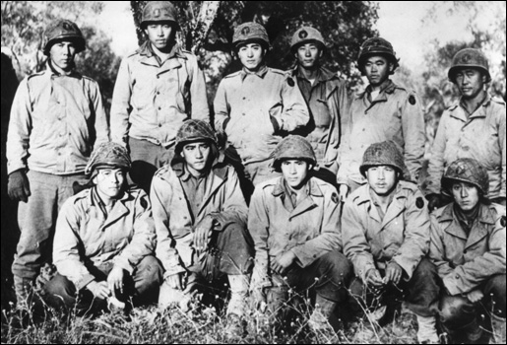
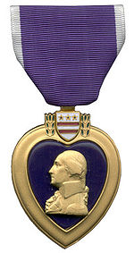
442nd Regimental Combat Team
Japanese-American army regiment
Many family members were interned
Most highly decorated regiment in history
  “Purple Heart Battalion”
  Saved the “Lost Battalion”
  “Go for broke!”
Notes:
The 442nd was composed of Japanese-American enlisted men and mostly white officers, fighting primarily in Europe.
The families of many of its soldiers were subject to internment.
The unit became the most highly–decorated regiment in the history of the United States Armed Forces, including 21 Medal of Honor recipients, and became known as the “Purple Heart Battalion”

Slide 26
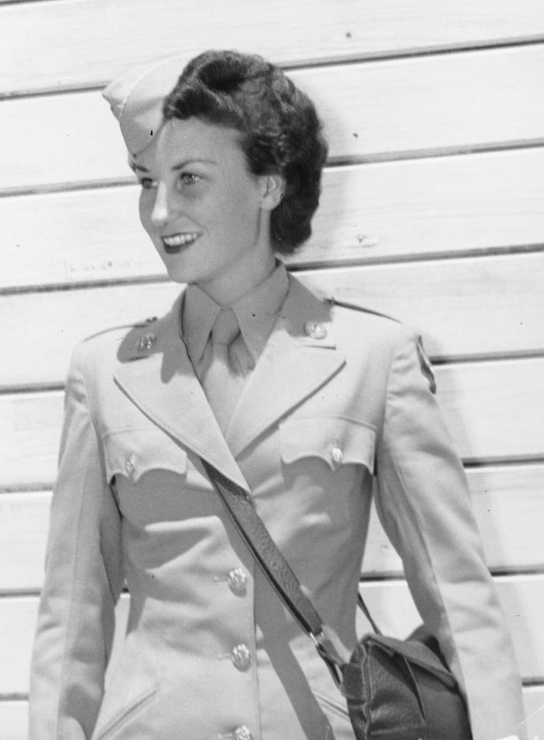
Women in the Military
Between 1940-1945 the percentage of women in the workforce rose from 27% to 37%, and 1 in 4 married women worked outside the home.
Some 350,000 women joined the armed forces in official military units

Slide 27
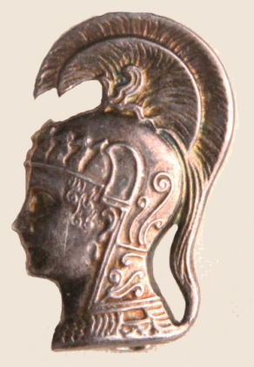
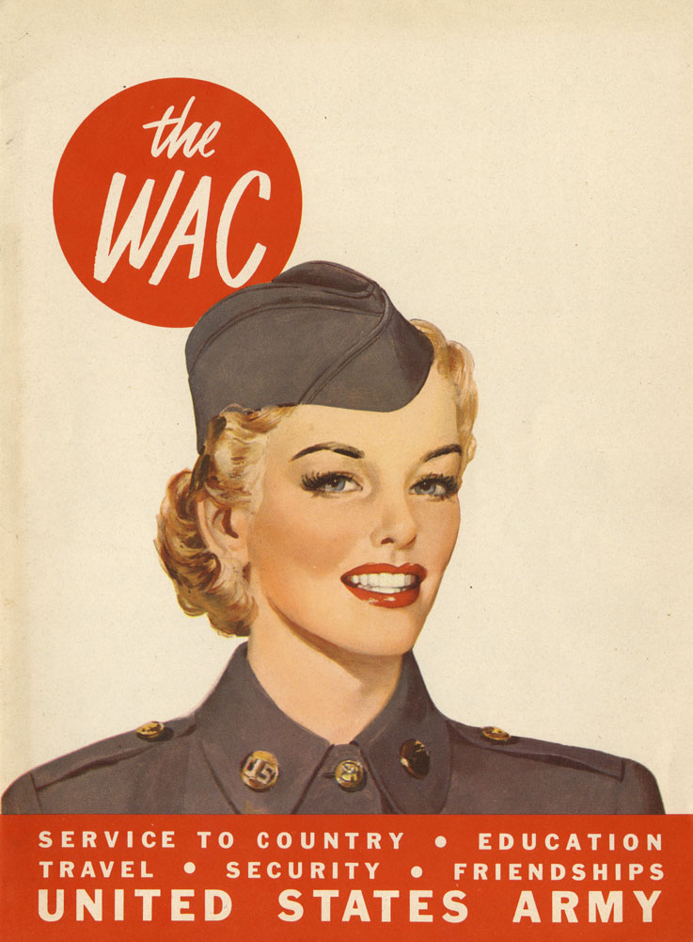
Women in the Military
First official women’s military units
Purpose: “To Release a Man for Combat”
  Non-combat support jobs
Women’s Auxiliary Army Corps (WAACs) becomes…
Notes:
Between 1940-1945 the percentage of women in the workforce rose from 27% to 37%, and 1 in 4 married women worked outside the home.
Some 350,000 women joined the armed forces in official military units
Women’s Auxiliary Army Corps (WAACs, later on, WACs): the women's branch of the United States Army, where women worked in more than 200 non-combat support jobs.
They were the first women other than nurses to serve with the Army
Purpose: “To release a man for combat”
The 150,000 women who served released the equivalent of 7 divisions of men for combat.
General Douglas MacArthur called the WACs "my best soldiers", adding that they worked harder, complained less, and were better disciplined than men.

Slide 28
Women in the Military
Women’s Army Corps (WACs):
200 non-combat support jobs.
The 150,000 women who served released the equivalent of 7 divisions of men for combat.
General Douglas MacArthur called the WACs "my best soldiers", adding that they worked harder, complained less, and were better disciplined than men.

Slide 29
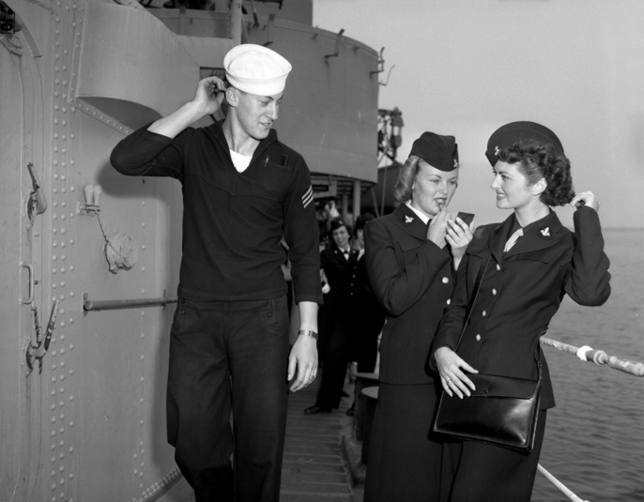
Women in the Military
Women Accepted for Volunteer Emergency Service (WAVES)
  Same rank, responsibilities, and pay as males
  Served stateside
Notes:
Women Accepted for Volunteer Emergency Service (WAVES): A female division of the Navy, this group supported the servicemen stateside and served as reservists.
As full-fledged members of the US Navy, WAVES members held the same rank and ratings as male personnel, received the same pay, and were subject to military discipline.

Slide 30

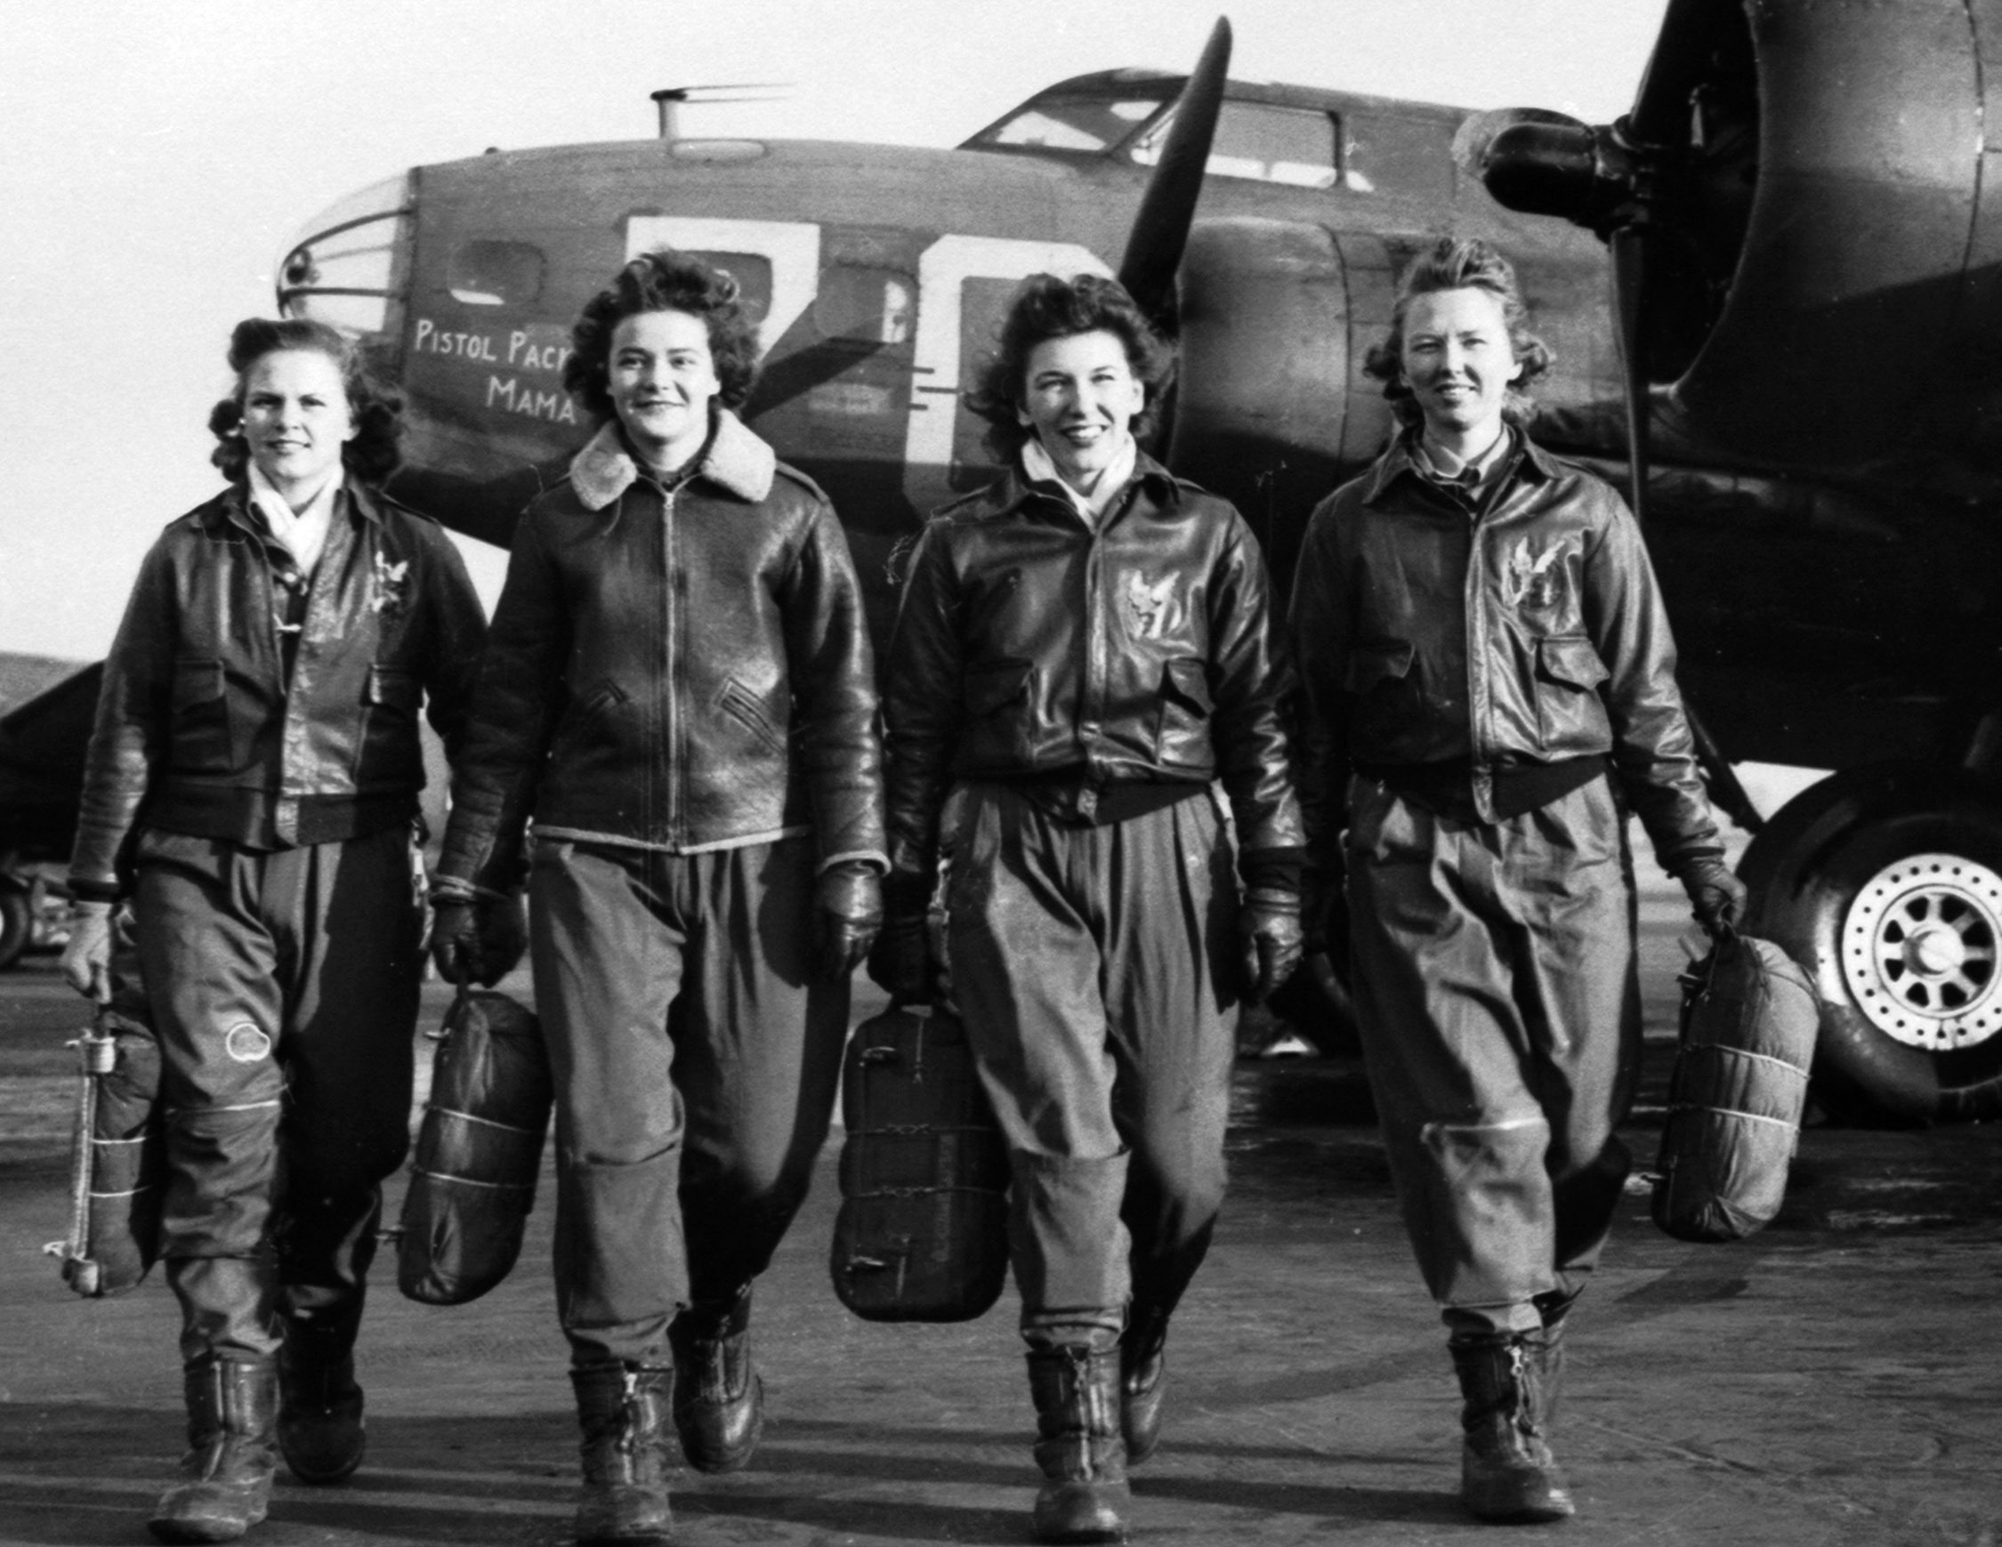
Women in the Military
Women’s Air Force Service Pilots (WASPs)
  Over 1,000 women
  Ferried planes, transported cargo, participated in combat training
  Lobbied for by Eleanor Roosevelt
  No African-Americans
Fifinella: Roald Dahl and Disney-created mascot
Notes:
Women’s Airforce Service Pilots (WASPs): The first women to fly military aircraft, served by ferrying planes from factories to bases, transporting cargo, and participating in training sessions for air force combat missions
1,074, each freeing a male pilot for combat service and duties
Lobbied for by Eleanor Roosevelt
They were required to complete the same primary, basic, and advanced training courses as male Army Air Corps pilots and many of them went on to specialized flight training
no African-Americans were allowed to join the WASP
Fifinella: The official WASP mascot, conceived by Roald Dahl and drawn by Walt Disney, appeared on their shoulder patches

Slide 31
Bell Ringer
In what ways was America not really “neutral” at the beginning of World War II?

Slide 32
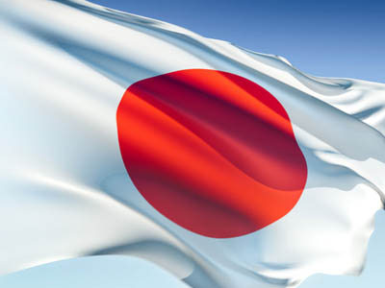
The Pacific Theatre
Early Battles Against Japan

Slide 33
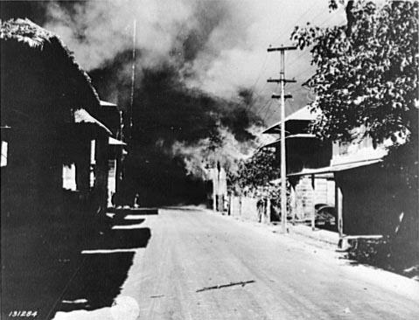
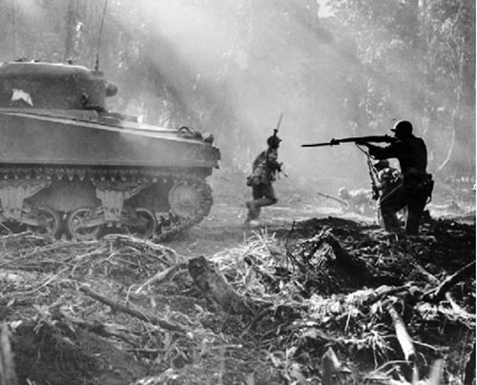
Japan looks to the Philippines
Japan attacks American-owned Philippines
US and Filipino forces take up a defensive position on the Bataan Peninsula
Japan takes over the Philippines after three months of fighting
Japan treated POW’s with extreme cruelty

Slide 34
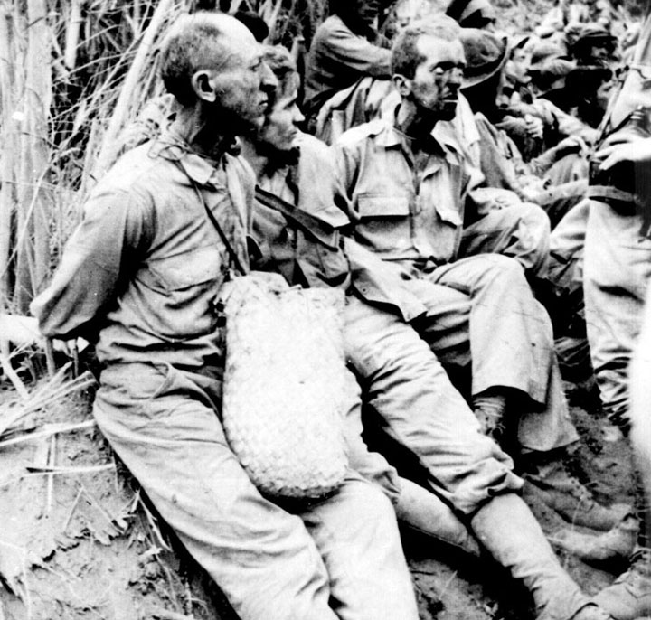
The Bataan Death March
Bataan Death March: Forced march of 76,000 Filipino and American POWs by the Japanese
Approximately 2,500–10,000 Filipino and 100–650 American prisoners of war died on the 80 mile march
Endured physical abuse and murder at the hands of the Japanese Army

Slide 35
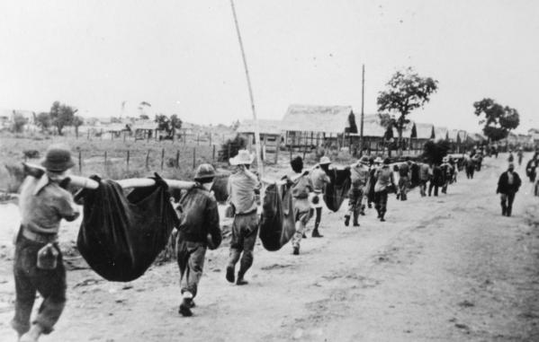

Slide 36
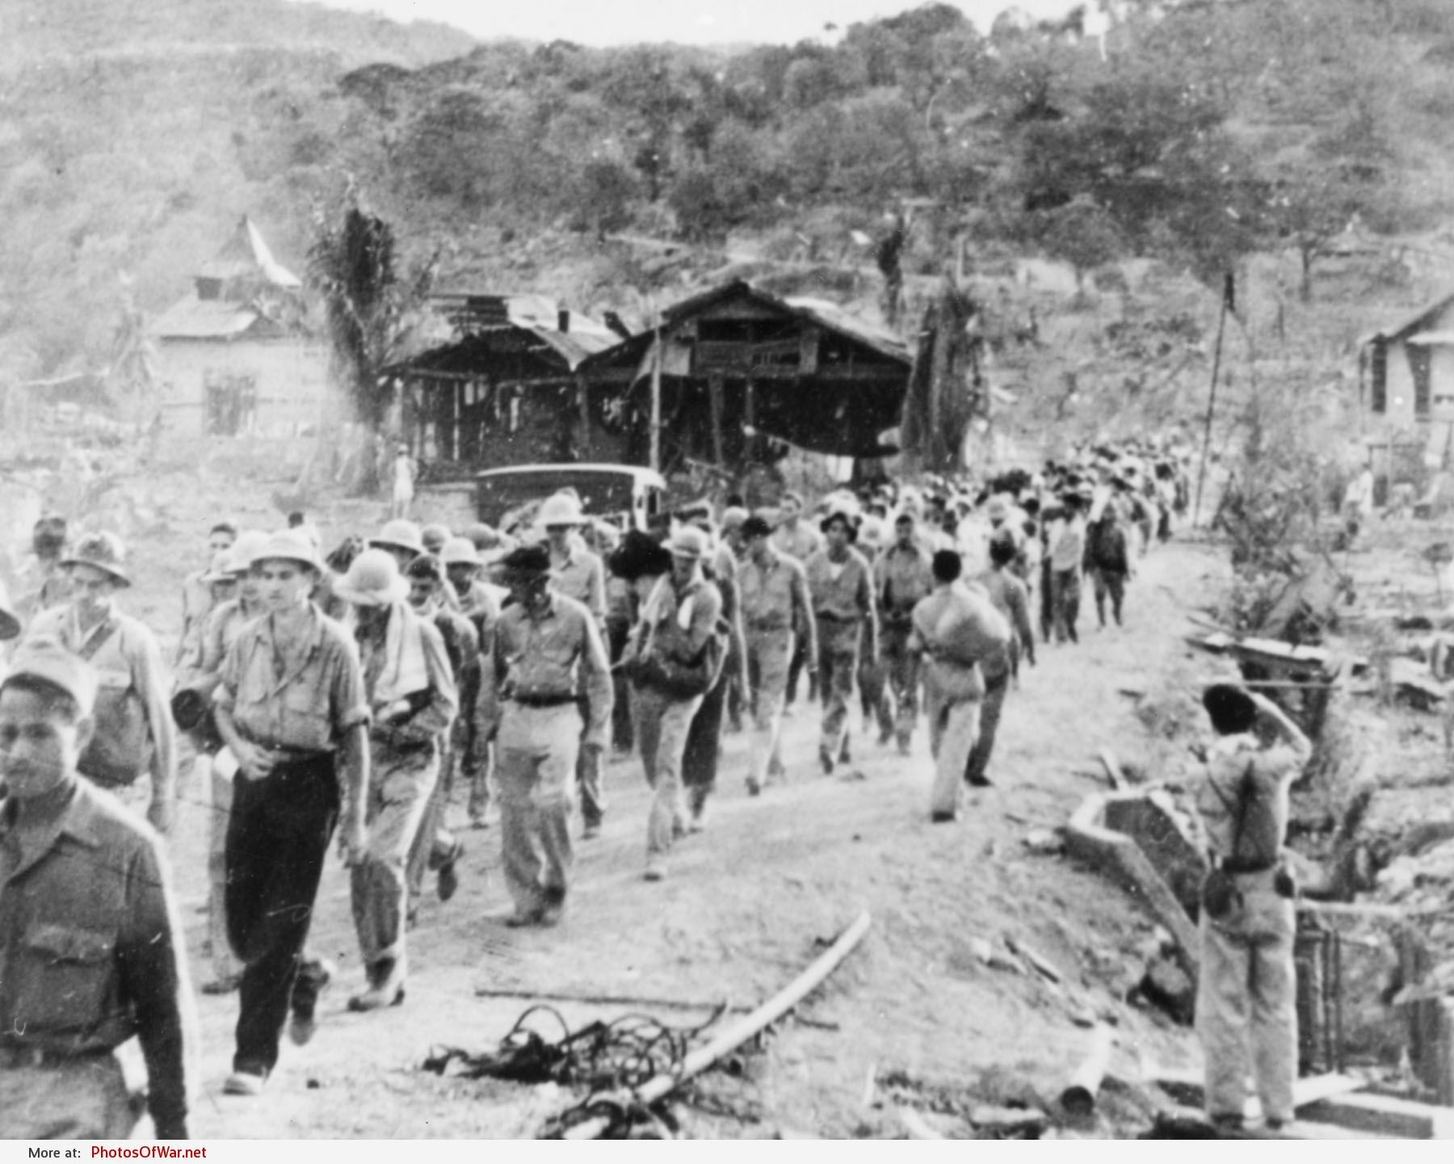

Slide 37
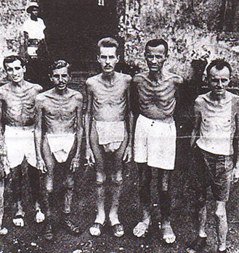
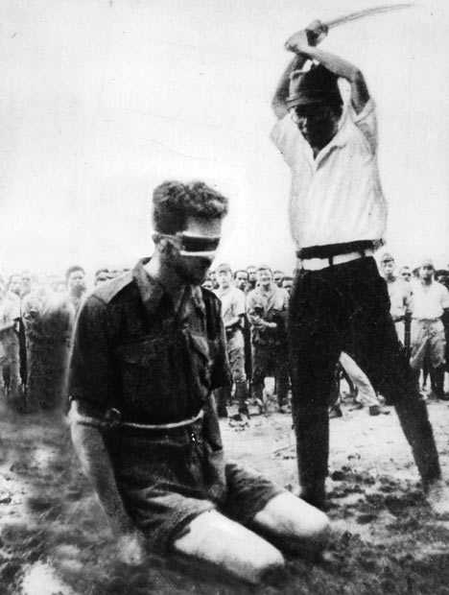
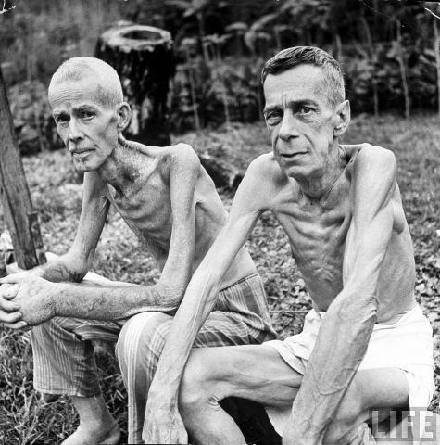
Cultural Differences Cause Conflict
Japanese justified cruelty due to extreme view of honor. Surrender = dishonor = worthless

Slide 38
Primary Source
“I was questioned by a Japanese officer, who found out that I had been in a Philippine Scout Battalion. The [Japanese] hated the Scouts… Anyway, they took me outside and I was forced to watch as they buried six of my Scouts alive. They made the men dig their own graves, and then had them kneel down in a pit. The guards hit them over the head with shovels to stun them and piled earth on top.”
Lt. John Spainhower

Slide 39
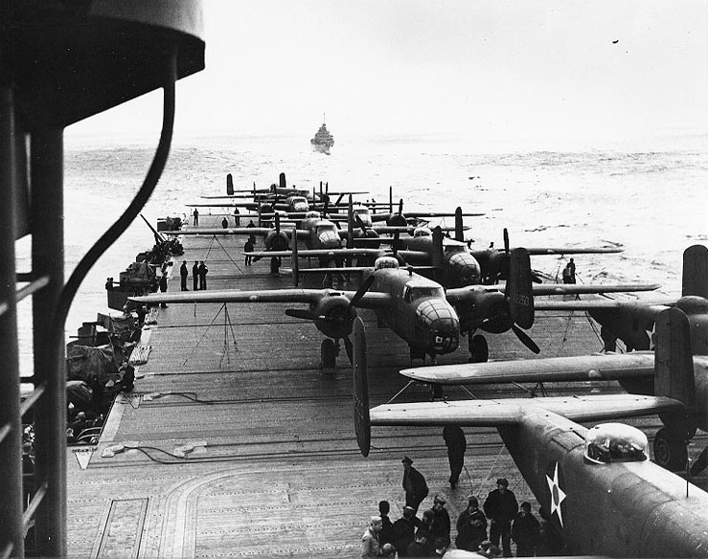
The Doolittle Raid
U.S. bombs Tokyo, lands in nearby China
America's first strike back at the Japanese during the war.
A surprise due to the damage done at Pearl Harbor
Lifted America’s morale

Slide 40
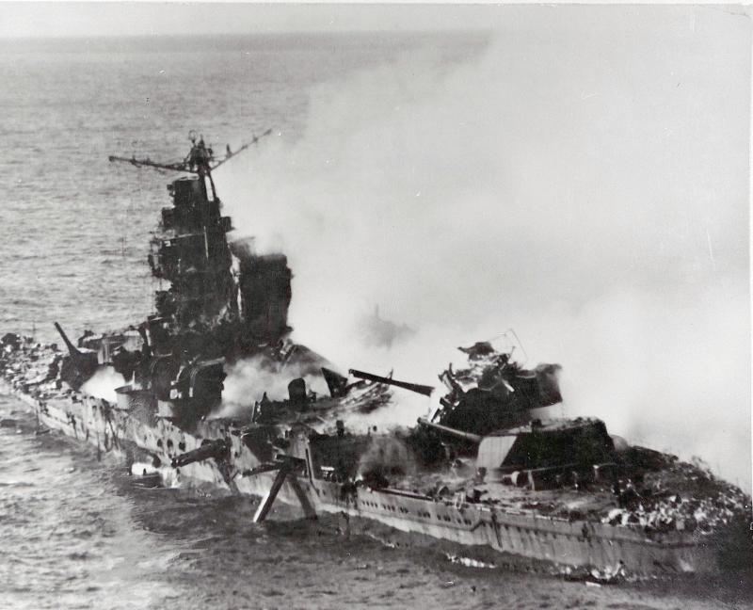
Battle of Midway
Japanese planned to launch an attack at Midway Island
  Was essential to American supply lines to Australia
Code breakers discovered the plan, which Admiral Nimitz used to launch a surprise attack on Japan
Destroyed 38 Japanese aircraft, and four of their aircraft carriers
Turning point in the war in the Pacific

Slide 41
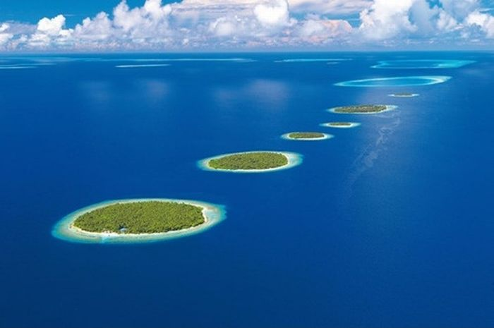
Island Hopping
Driving the Japanese back

Slide 42
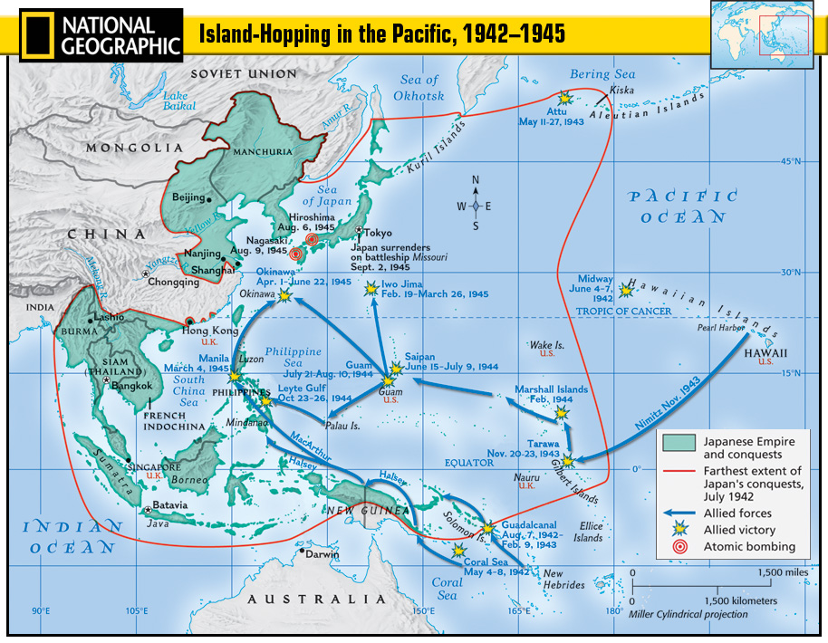

Slide 43

Island Hopping
Purpose: Prevent destructive all-out war with Japanese (who don’t give up)
Plan: Get closer and closer to Japan by taking over less fortified islands on the way
  Fight ⇨ defeat ⇨ move supplies ⇨ rebuild ⇨ plan next attack
  Helped avoid Pacific islands surrounded by dangerous coral reef that made supply movement difficult

Slide 44
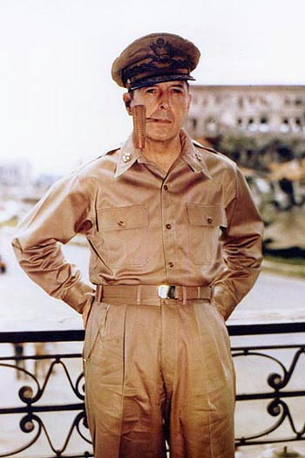
General Douglas MacArthur
Leader of the Allied forces in the Pacific
Brilliant military leader, dedicated to his troops, but stubborn
“Americans never quit.”

Slide 45
Bell Ringer
What are some of the reasons the war in the Pacific would be a longer, bloodier war than that in Europe?

