Slide 1
Second Semester Overview
1935-2017

Slide 2
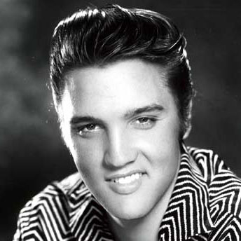
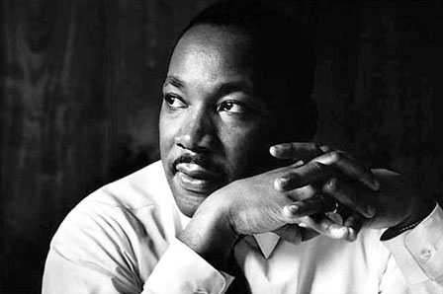
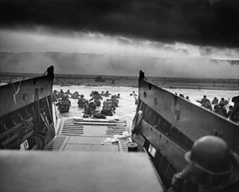
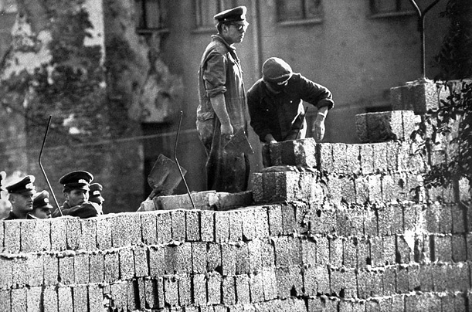
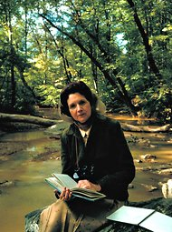
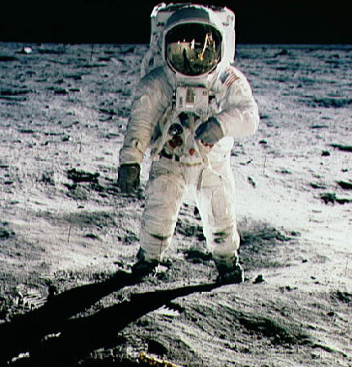
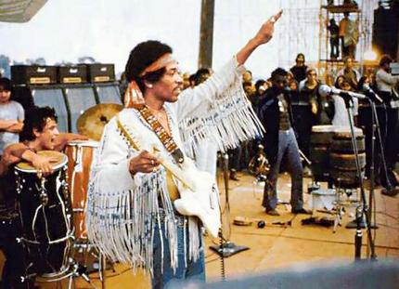
Topics We Will Cover the rest of the Semester
World War II
The atomic bomb
The Cold War
1950s Youth Culture
Conformity in the 1950s
Civil Rights Movement
Space Race
Non-conformity in the 1960s
Equality movements
Stagnation in the 1970s
Environmentalism
Ending the Cold War
Modern History
Internet
Globalization

Slide 3
World War II Begins

Slide 4
How The Great War Caused WWII
1918-1939

Slide 5
Treaty of Versailles Review: True or False?
Largely designed by Great Britain, France, Italy, and the U.S.
The Treaty was designed to create a “just and lasting peace”
Austria-Hungary officially blamed for the war
Germany stripped of its military
Central Powers stripped of their territories
Germany required to pay reparations
Created a “general association of nations” that would protect “great and small states alike”
Was a cause of German hyperinflation after the war

Slide 6
1. Largely designed by Great Britain, France, Italy, and the U.S.

Slide 7
2. The Treaty was designed to create a “just and lasting peace”

Slide 8
3. Austria-Hungary officially blamed for the war

Slide 9
4. Germany stripped of its military

Slide 10
5. Central Powers stripped of their territories

Slide 11
6. Germany required to pay reparations

Slide 12
7. Created a “general association of nations” that would protect “great and small states alike”

Slide 13
8. Was a cause of German hyperinflation after the war

Slide 14
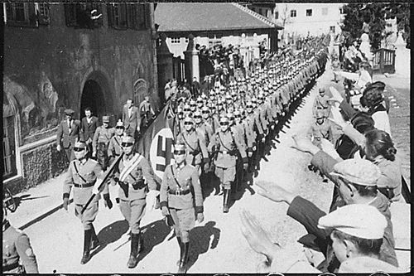
Hitler Defies the Versailles Treaty
Adolf Hitler announced that he would not obey the Treaty’s limitation of the German army.
The League of Nations issued a mild condemnation.
Adolf Hitler threatened to invade Austria unless Austrian Nazis were given important government posts.
The League of Nations issued a mild condemnation.
In March 1938, Hitler announced the unification of Austria and Germany
The League of Nations issued a mild condemnation.
Hitler claimed the Sudetenland (an area of Czechoslovakia with a large German-speaking population).

Slide 15
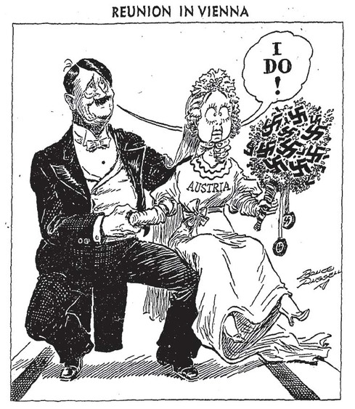

Slide 16
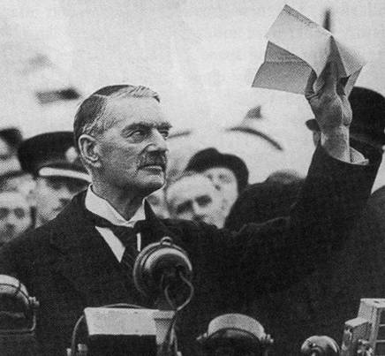
Europe’s Response to Hitler
Britain, France, Germany, and Italy met in Munich, Germany to solve the Czechoslovakia crisis
The Munich Pact: Permitted Hitler’s annexation of the Sudetenland, and essentially control over the rest of Czechoslovakia as long as Hitler promised to go no further
Appeasement
British Prime Minister Neville Chamberlain
Now we have “peace in our time!” Herr Hitler is a man we can do business with.

Slide 17
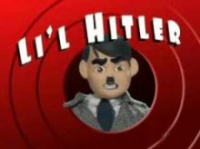
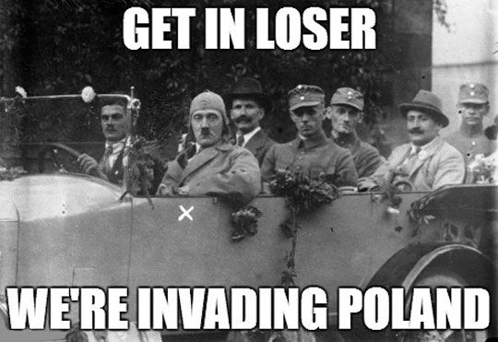
March 12, 1938 - Hitler annexes Austria
September 30, 1938 - Hitler claims the Sudetenland
March 15, 1939 - Hitler claims control over Czechoslovakia
September 1, 1939 – Hitler invades Poland
Hitler gets Greedy

Slide 18
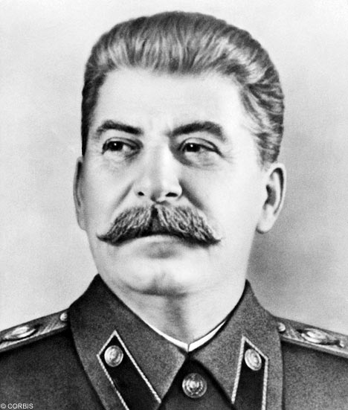
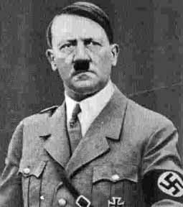
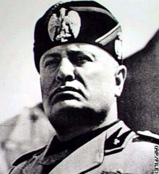
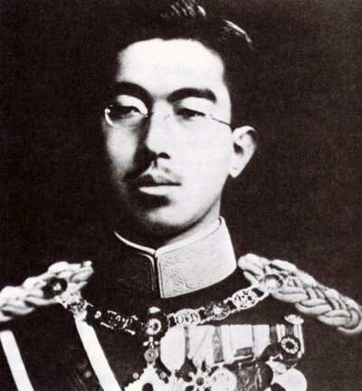
Hitler Makes Friends (Yes, even genocidal megalomaniacs have friends… sorta)
Nazi-Soviet Non-Aggression Pact: Hitler and Stalin; neither will attack the other in the event of war
Hitler wants to avoid a two-front war
Stalin knows his country is not ready to defend itself against the German military
Tripartite Pact (1940): A military alliance between Germany (Hitler), Italy (Benito Mussolini), and Japan (Emperor Hirohito); known as the Axis powers

Slide 20
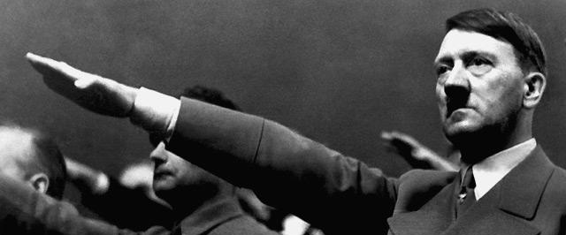
The War Begins!
Britain and France threaten war if Germany doesn’t withdraw from Poland immediately
Germany ignores them
Britain declares war on September 3rd, 1939
Phony War: Not much happens between the invasion of Poland and April, 1940. Both sides are prepping for war.

Slide 21
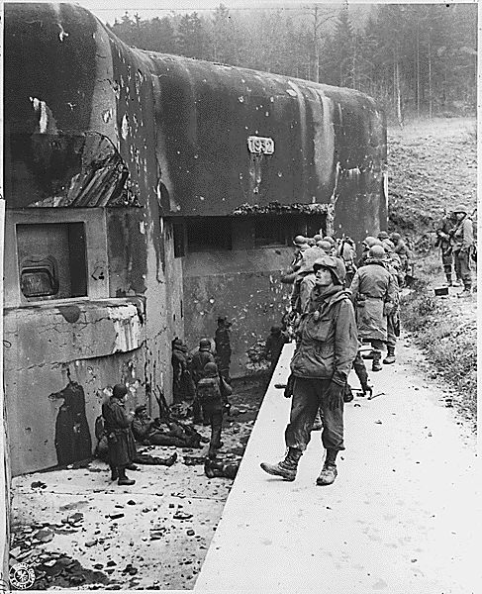
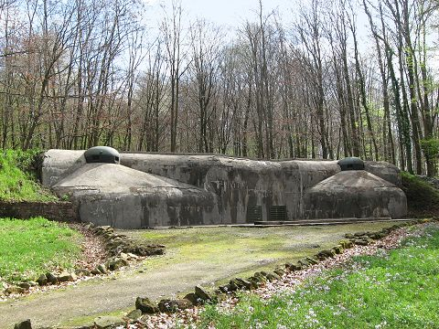
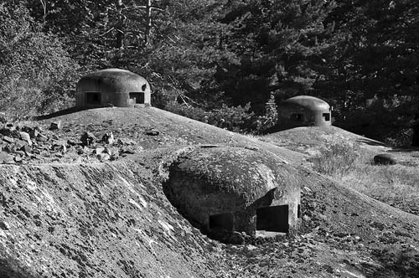
Maginot Line

Slide 22
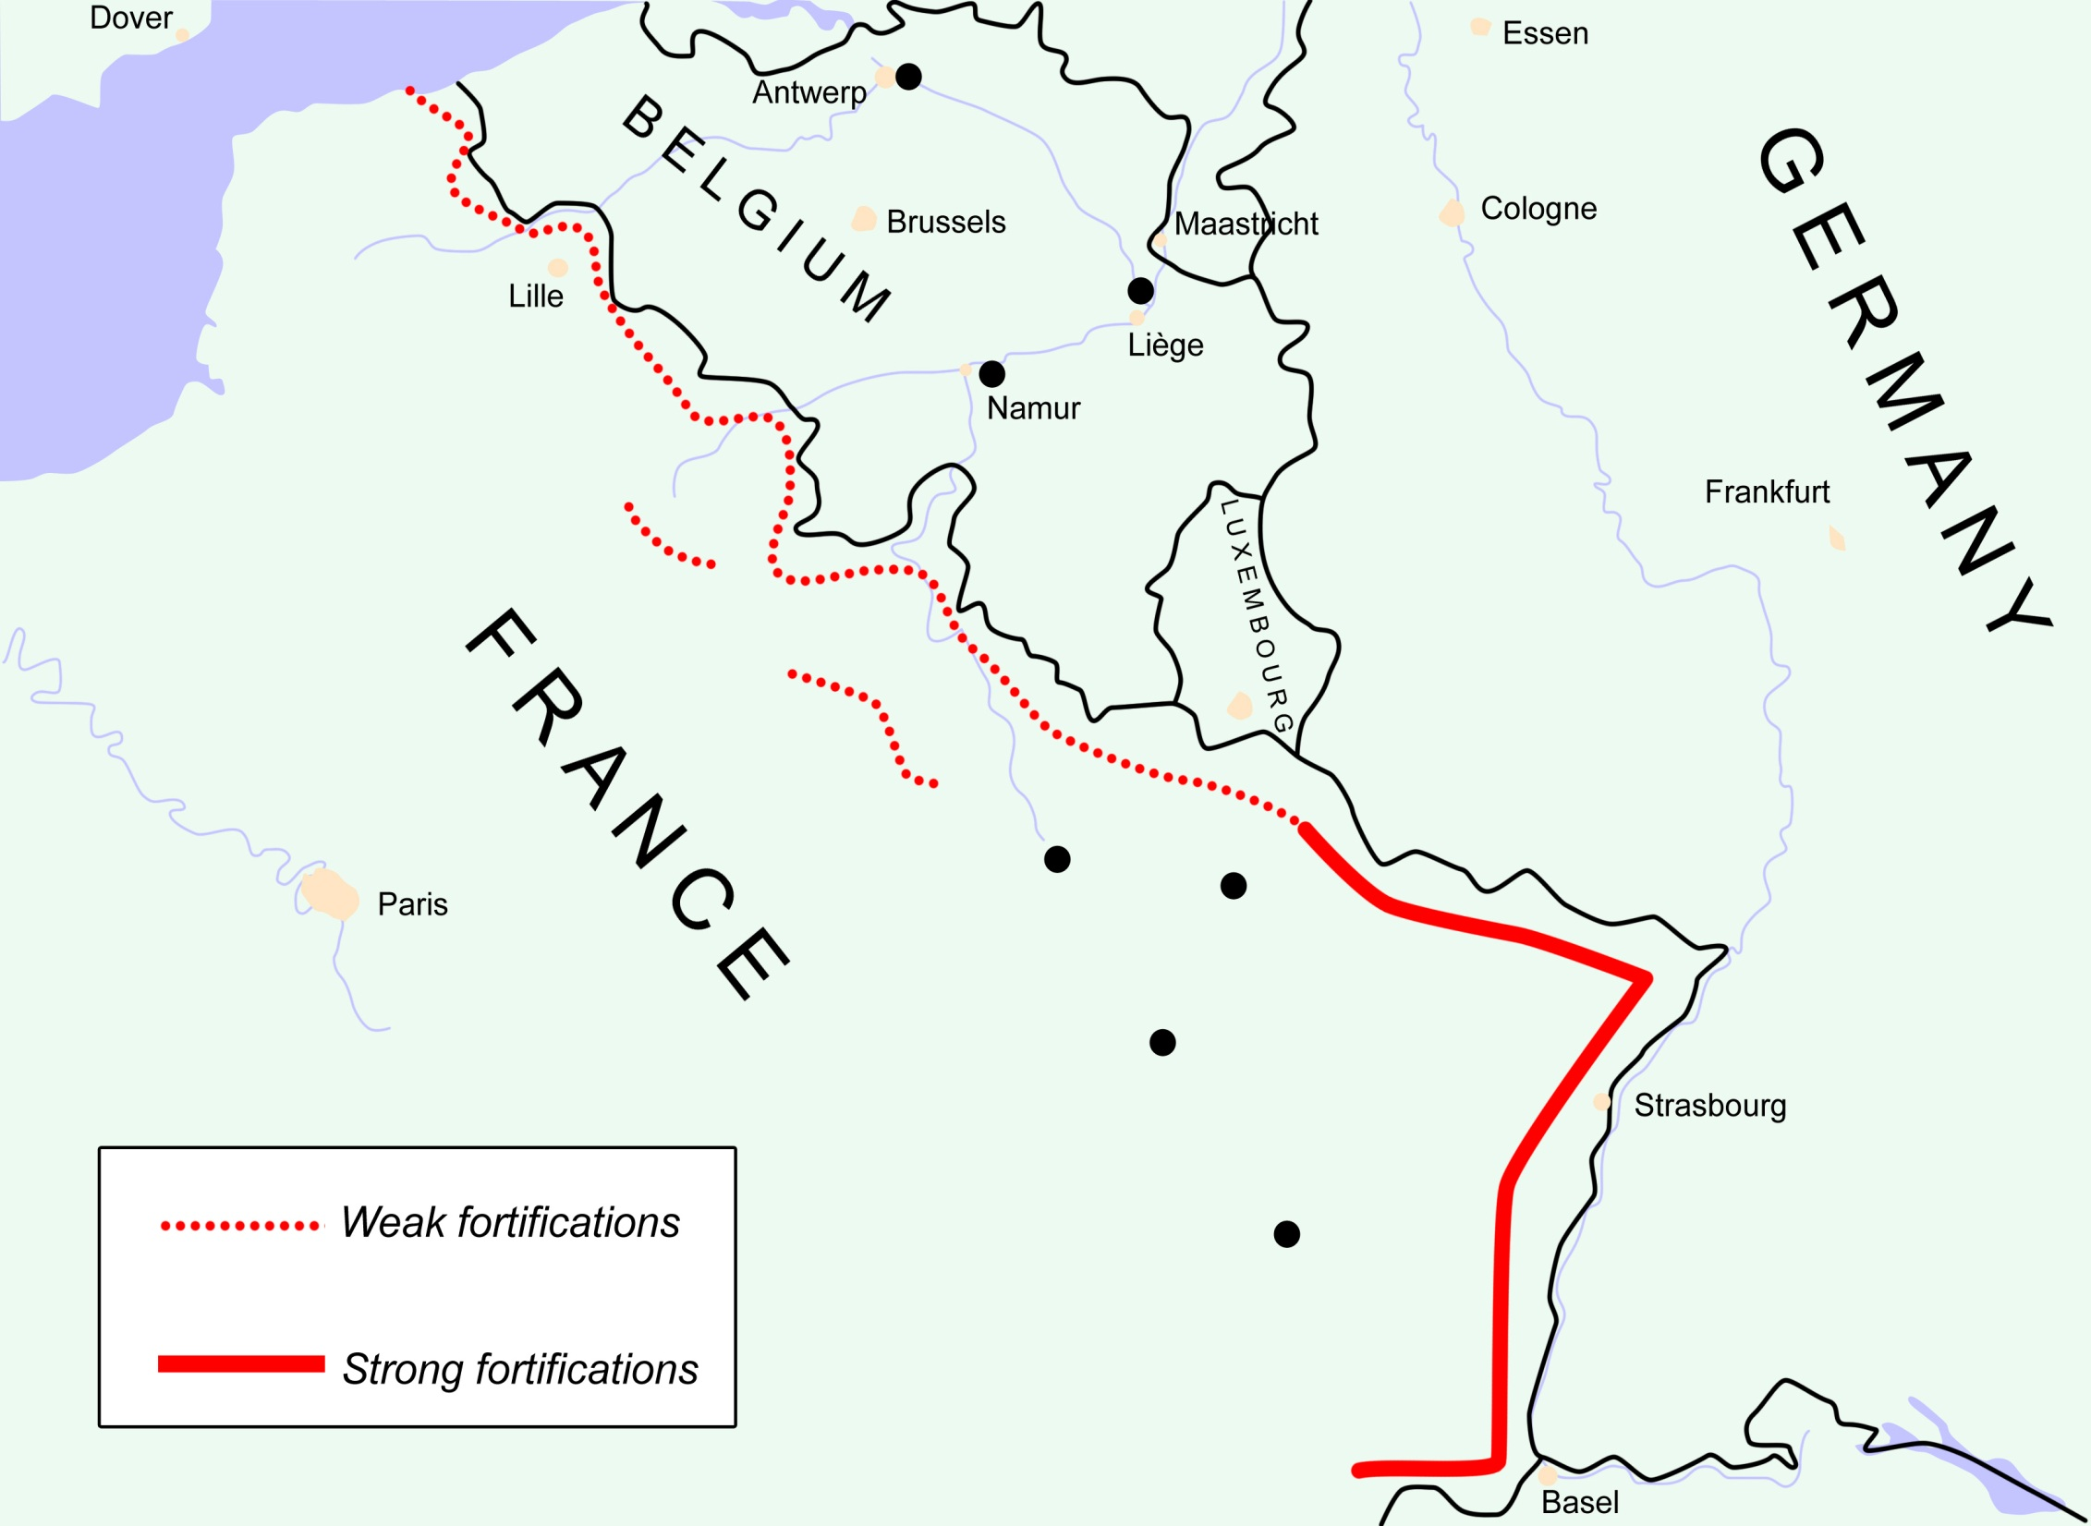
(Maginot Line)
If you were Hitler, what would be your strategy for invading France?

Slide 23
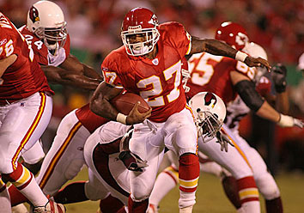
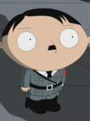
The Blitz!

Slide 24
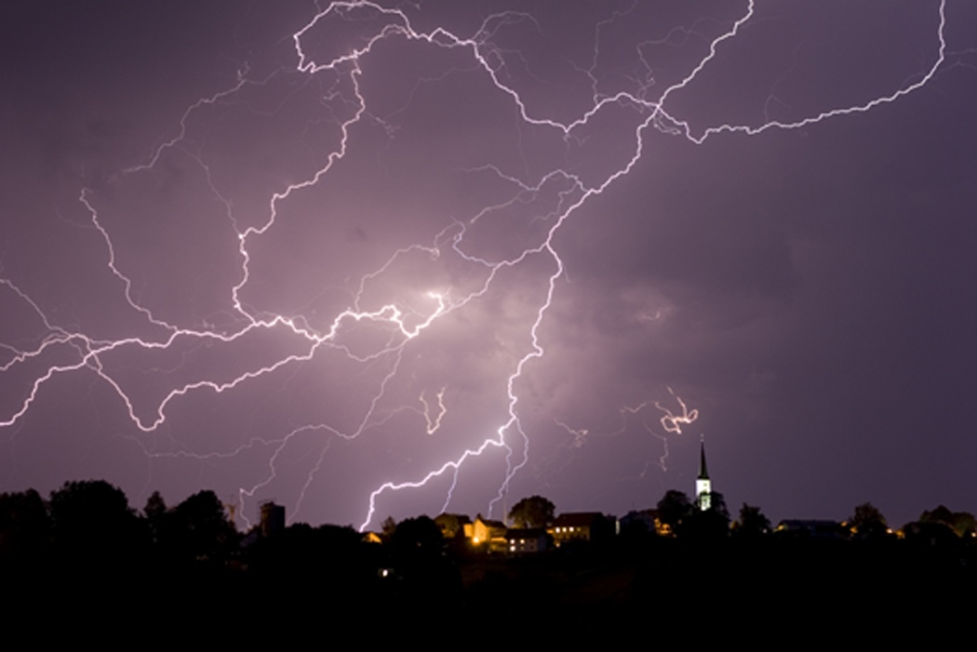
“Blitzkrieg”
Means “lightning war”
Used surprise attacks, rapid advances into enemy territory, and massive air attacks
Germany achieved most of its victories in World War II with the Blitzkrieg tactic.

Slide 25
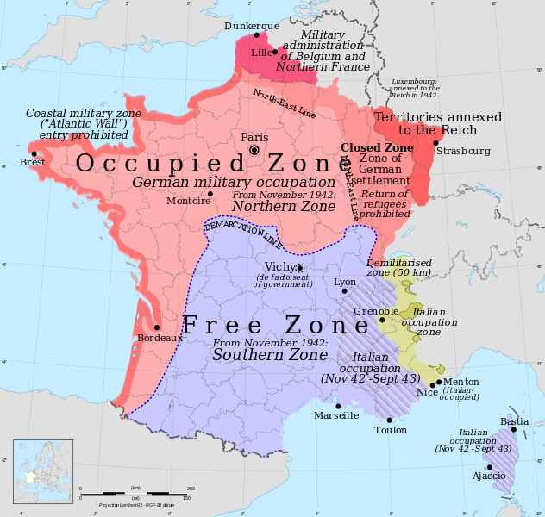
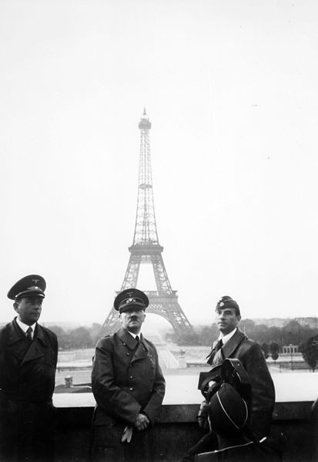
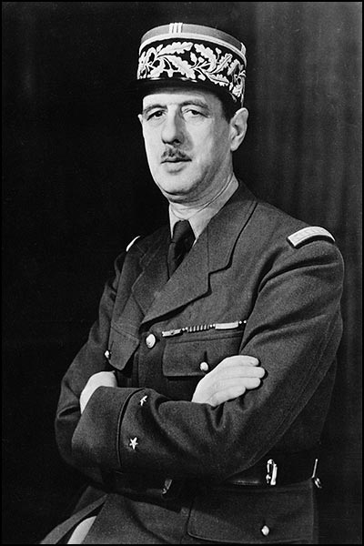
The Invasion of France
Germany invades France, who surrenders in only 39 days
Germany takes over the North and Western parts of France (Vichy France)
Free France’s leaders fled to GB
The French Resistance was led by Charles DeGaulle

Slide 26
American “Neutrality”
Picking sides without actually picking sides

Slide 27
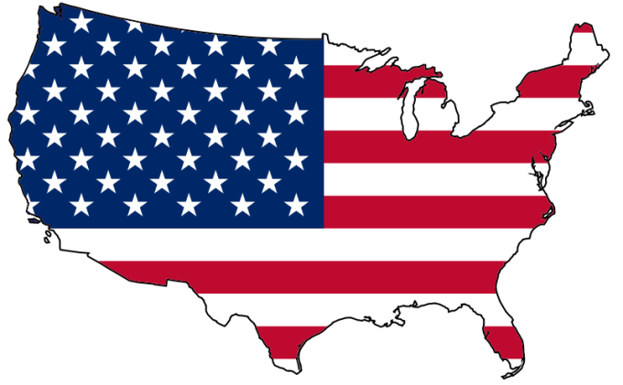
Post-war America
Only nation with a stable economy post-WWI
1920s solidified America’s place as the most powerful nation in the world
The Great Depression tanked the U.S. economy, and the effects were felt worldwide
America retreated into isolationism

Slide 28
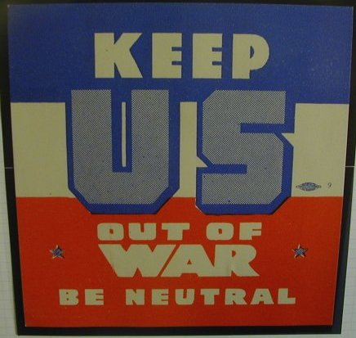
American Neutrality
Neutrality Acts (1930s): America officially declares its neutrality in the European conflict
Do not want another WWI
Made no distinction between aggressor and victim, treating both equally as "belligerents” = U.S. cannot aid former allies against Nazi aggression

Slide 29
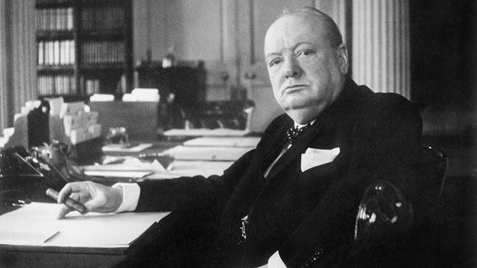
Britain Remains Defiant
Great Britain stands alone against Germany
Led by Winston Churchill
Hitler expects GB to surrender quickly; wrong.

Slide 30
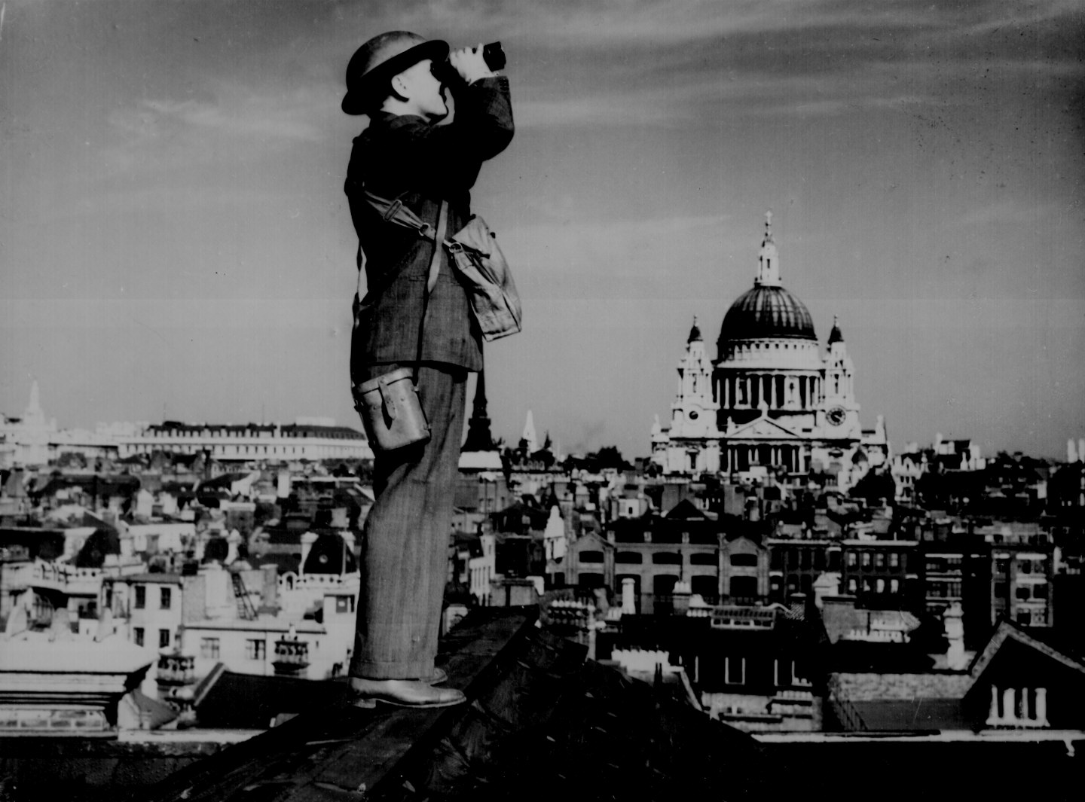
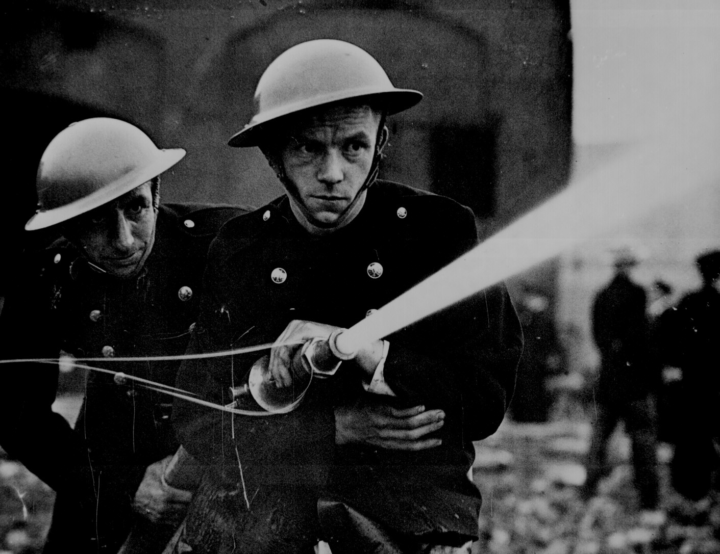
Battle of
Britain

Slide 31
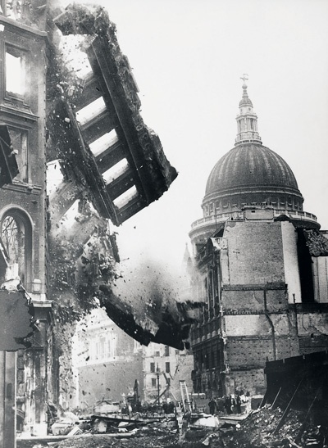
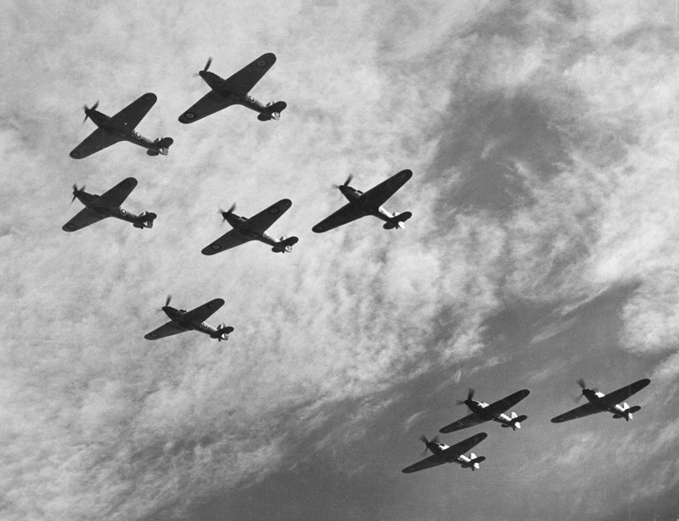
Battle of
Britain

Slide 32
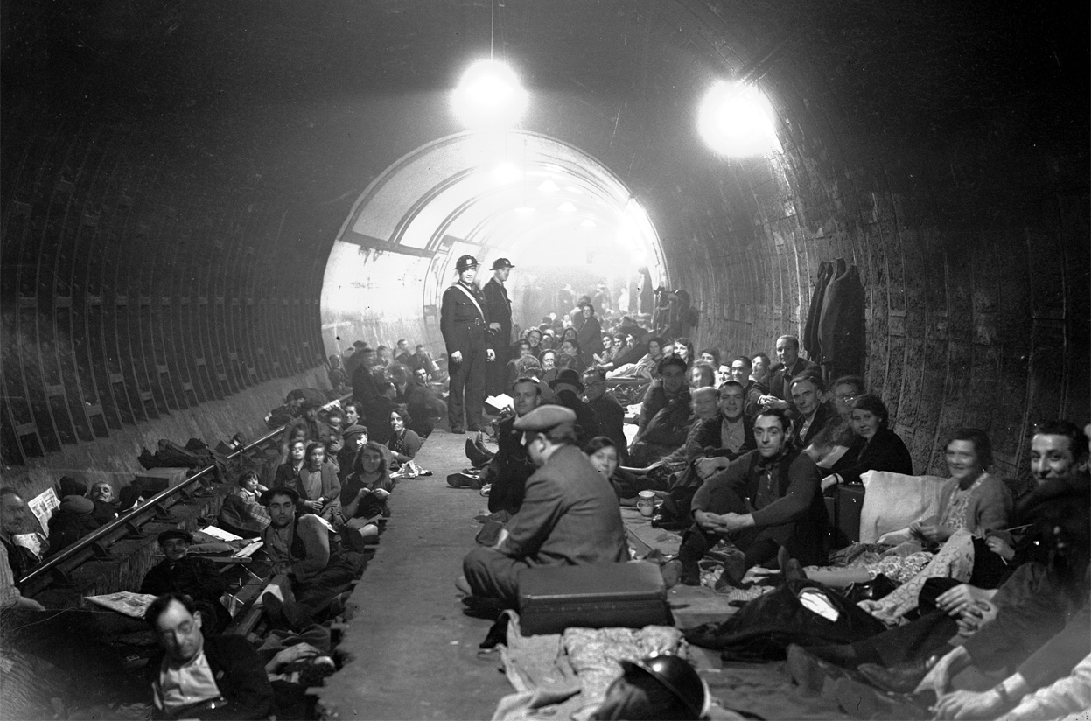
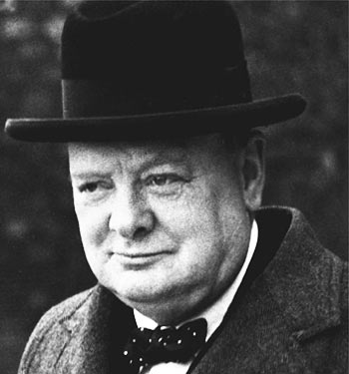
The London “Tube”:
Air Raid Shelters During the Blitz

Slide 33
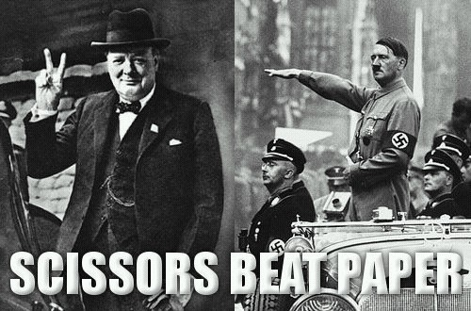
Just remember...

Slide 34
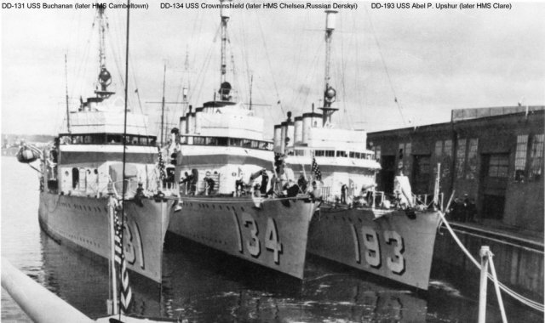
American Neutrality is Tested
After seeing its long-time ally attacked by Nazi forces, America’s neutrality quickly dissolved.
Cash-and-Carry: Allowed the sale of war materials to “belligerents,” as long as the recipients arranged for the transport using their own ships and paid immediately in cash, (why) assuming all risk in transportation
Destroyers-for-Bases: Transferred fifty mothballed destroyers from the United States Navy in exchange for land rights on British possessions

Slide 35
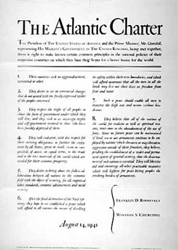
American Neutrality is Tested
Lend-Lease Act: The U.S. supplied war materials to the Allies, provided that the materials were to be used until time for their return or destruction.
Atlantic Charter: A treaty of friendship signed by Roosevelt and Churchill in August 1941, it stated the ideal goals of the war.
Fashioned after Wilson’s 14 Points.
The agreement proved to be one of the first steps towards the formation of the United Nations

Slide 36
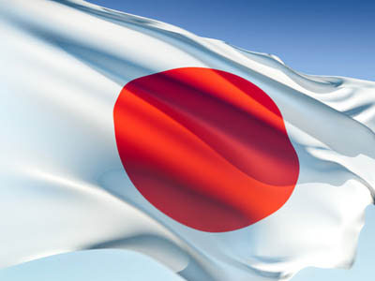
Japan Seeks an Empire
The events that bring America into the war

Slide 37
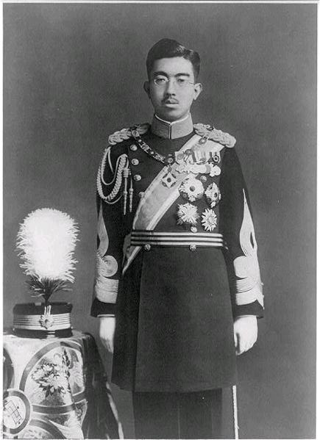
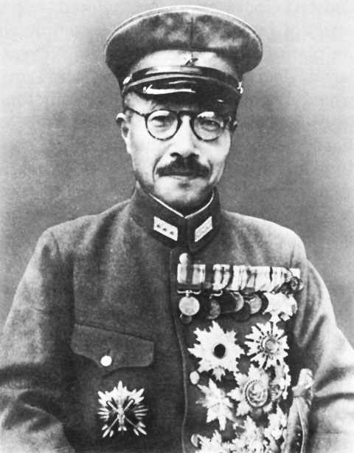
Imperial Japan
Japanese Emperor seen as god-like, with ultimate authority
Citizens lost faith in the Japanese government during the Depression
Military took control of the country, but kept Hirohito as a symbol of power for citizens; now led by PM
Sought to increase Japan’s economy through foreign expansion
Emperor Hirohito
PM Hideki Tojo

Slide 38
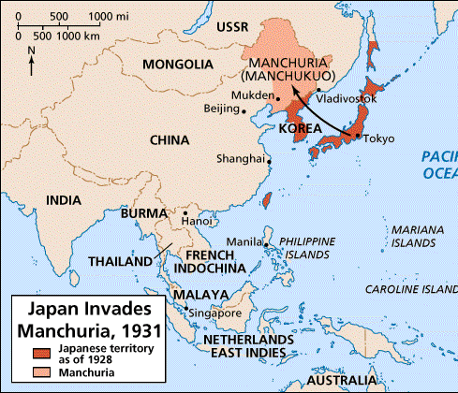
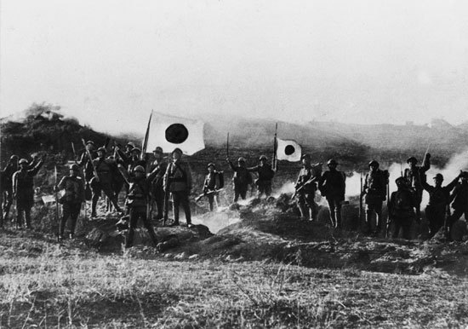
Japan Seeks An Empire
Japan attacks Manchuria (1931) for commodities like iron and coal
Japan invades mainland China (1935)
Despite being severely outnumbered (China had over 1 million troops), Japan wins due to better equipment and training

Slide 39
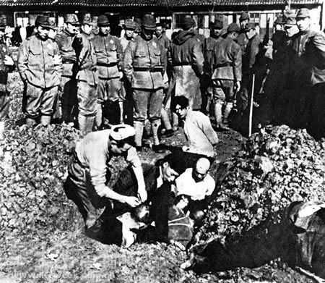
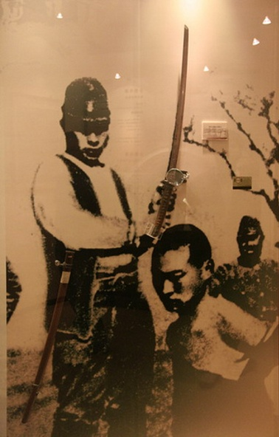
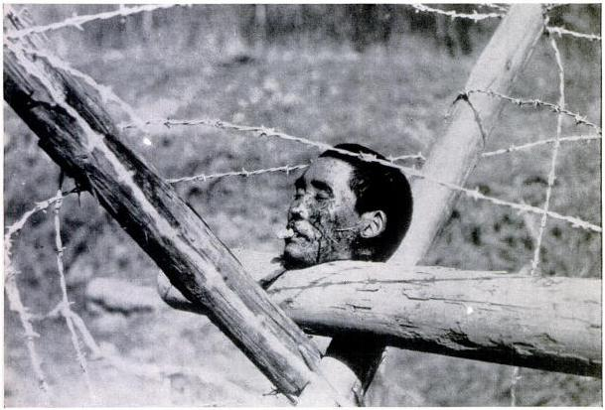
Japan Seeks An Empire
Rape of Nanking: After the fall of the city, hundreds of thousands of civilians in Nanking were murdered, and 20,000–80,000 women were raped by soldiers of the Imperial Japanese Army
Swung public opinion in the West sharply against Japan
US provides $ to China for its defense
Japan invades Vietnam
US stops shipments of war materials to Japan
Perceived by Japan as an unfriendly act

Slide 40
“A date which will live in infamy”
America enters the war

Slide 41
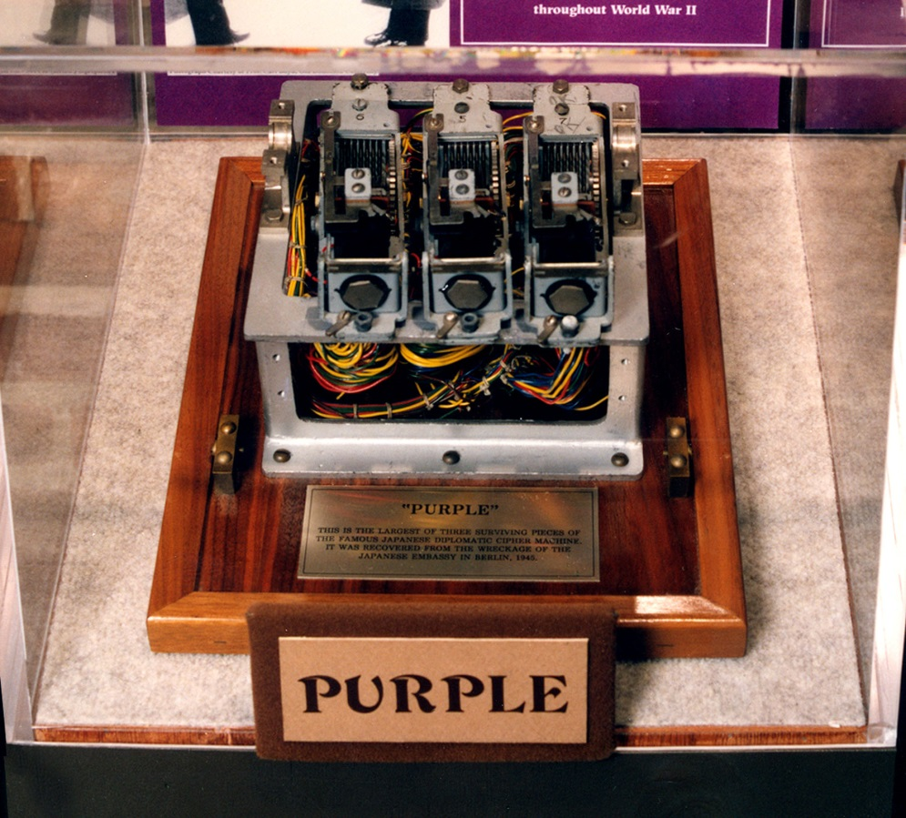
The “Surprise” attack on Pearl Harbor
U.S. well aware of Japan’s plans for Southeast Asia
Could threaten American –controlled Guam and the Philippines.
The US cuts off oil supplies to Japan
Admiral Isoroku Yamamoto calls for an attack on the US

Slide 42
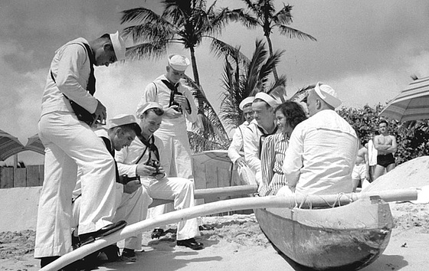
Oahu, 1940

Slide 43
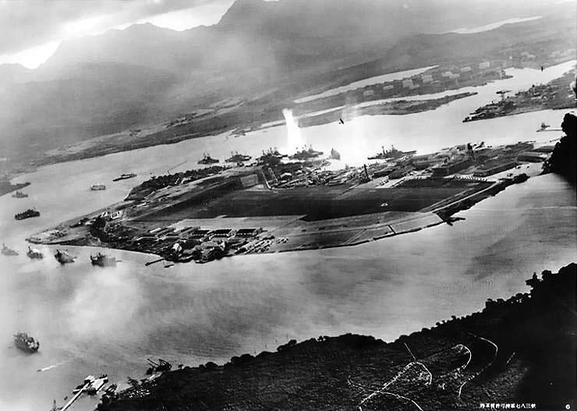
December 7, 1941
Intended by Japan as a preventive action to remove the US Pacific Fleet as a factor in the war
No declaration of war was given
Just before 8 am, December 7, 1941, The naval base at Pearl Harbor on the island of Oahu was attacked.

Slide 50
December 8, 1941 – The U.S. Goes to War

Slide 52
USS Arizona: Exploded; total loss.
1,177 dead

Slide 53
Pearl Harbor Memorial
2,402 killed 1,247 wounded

Slide 54
The Axis Powers
Germany – Adolf Hitler
Italy – Benito Mussolini
Japan – Emperor Hirohito & Hideki Tojo

Slide 55
The Allied Powers
United States
Great Britain
Soviet Union
French Resistance
China

Slide 56
“Four Freedoms” Speech
In the future days, which we seek to make secure, we look forward to a world founded upon four essential human freedoms. The first is freedom of speech and expression—everywhere in the world. The second is freedom of every person to worship God in his own way—everywhere in the world. The third is freedom from want—which, translated into world terms, means economic understandings which will secure to every nation a healthy peacetime life for its inhabitants—everywhere in the world. The fourth is freedom from fear—which, translated into world terms, means a world-wide reduction of armaments to such a point and in such a thorough fashion that no nation will be in a position to commit an act of physical aggression against any neighbor—anywhere in the world. That is no vision of a distant millennium. It is a definite basis for a kind of world attainable in our own time and generation. That kind of world is the very antithesis of the so-called new order of tyranny which the dictators seek to create with the crash of a bomb.
—Franklin D. Roosevelt, excerpted from the State of the Union Address to the Congress, January 6, 1941

Slide 57
“Four Freedoms”
At the 1941 State of the Union Address, FDR gave a speech in which he described four essential freedoms that the world should all enjoy:
Freedom of Speech
Freedom of Religion
Freedom from Want
Freedom from Fear
They would later be included in the UN’s Universal Declaration of Human Rights and inspire Norman Rockwell to paint four illustrations of the ideals for the cover of the Saturday Evening Post
Notes:
Move to “American Neutrality” section!

Slide 58
Freedom of
Speech
Freedom
from Fear
Freedom
from Want
Freedom of
Worship

