Slide 1
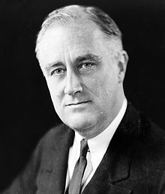
The dawn of a new era
FDR’s Administration

Slide 2
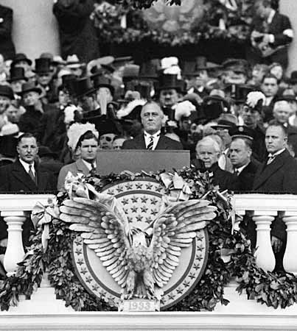
Election of 1932
Franklin Delano Roosevelt ran on the Democratic ticket in the election of 1932.
“Happy Days Are Here Again!”
Herbert Hoover was nominated by the Republican party; unpopular due to the Depression and Bonus Army.
“We are turning the corner”; “It could have been worse”
FDR wins by a landslide
“The only thing we have to fear is fear itself!”

Slide 3
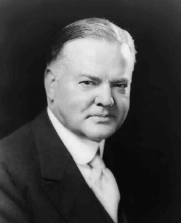
Election of 1932
vs.

Slide 4
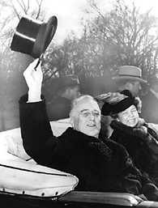
Getting Down to Business
First Hundred Days – FDR pushed tons of legislation through the Democratic-held Congress, kick-starting America’s road to recovery.
On his first day in office, Roosevelt issued a Bank Holiday, closing the banks until they were financially sound enough to reopen.
Fireside chats - a series of thirty evening radio addresses given by FDR urging listeners to have faith in the banks and to support his New Deal measures.
The "fireside chats" were considered enormously successful and attracted more listeners than the most popular radio shows
FDR would continue these broadcasts throughout WWII.

Slide 5
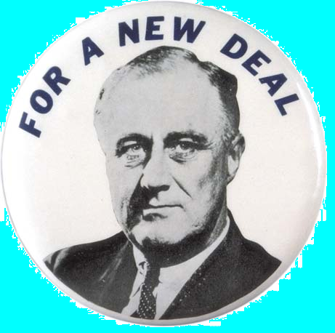
The New Deal
Keynesian economics (John Maynard Keynes): Belief that deficit spending during recessions and depressions could revive national economies
The New Deal: A series of programs designed to help America’s economy recover and give relief to its citizens during the Great Depression
Goals: relief, recovery, and reform
The New Deal programs were nicknamed “alphabet soup” because of all the acronyms for the programs themselves.
There were two New Deals, taking place in his first and second terms.

Slide 6
FDR’s New Deal Programs
Tennessee Valley Authority (TVA)
Agricultural Adjustment Act (AAA)
Public Works Administration (PWA)
Civil Works Administration (CWA)
Securities Exchange Commission (SEC)
Federal Emergency Relief Act (FERA)
Works Progress Administration (WPA)
Social Security Administration (SSA)
Federal Housing Administration (FHA)
Federal Deposit Insurance Corporation (FDIC)
National Recovery Act (NRA)

Slide 7
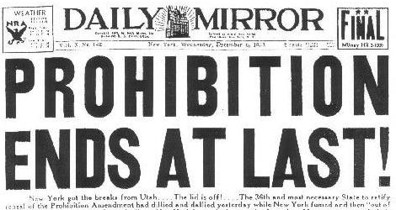
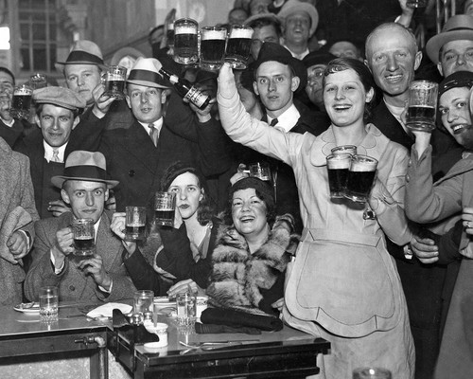
FDR’s First Term
The First New Deal
Good Neighbor Policy: A plan to improve relations with Latin-America, by nullifying the Monroe Doctrine, Roosevelt Corollary, and Platt Amendment.
The Twenty-First Amendment repealed Prohibition (1933)

Slide 8
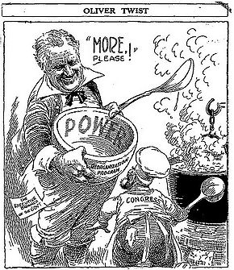
Roosevelt’s Critics
FDR’s use of deficit spending (borrowing money to pay for programs) made him a lot of enemies.
American Liberty League – formed in 1934 by conservative Democrats and wealthy businessmen to oppose the New Deal of Franklin D. Roosevelt.

Slide 9
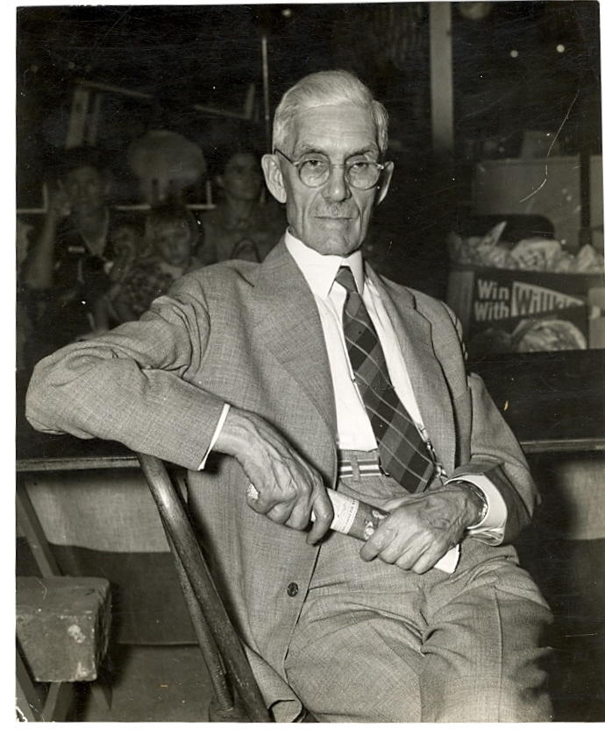
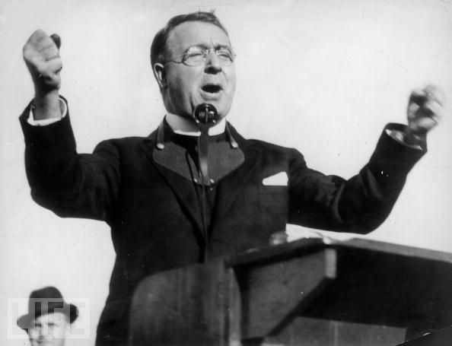
Roosevelt’s Critics
Dr. Francis Townsend
Father Coughlin
Proposed the federal government pay citizens over the age of 60 a pension of $200 a month, which they would be required to spend every month. He believed it would increase spending and open up jobs for the unemployed.
Would inspire the creation of the SSA.
A Catholic priest from Detroit who had a popular radio show
Originally supported the New Deal, but became impatient with moderate reforms, and began lambasting FDR.
Was pulled by the diocese because of fascist and anti-Semitic comments.

Slide 10
Roosevelt’s Critics
Huey Long
A senator from Louisiana, he was the champion of the downtrodden, and claimed the New Deal didn’t do enough for the poor.
“Share Our Wealth” campaign – would put a cap on personal wealth, make a minimum family income, as well as provide veterans benefits and universal access to education.
Ended when Long was assassinated

Slide 11
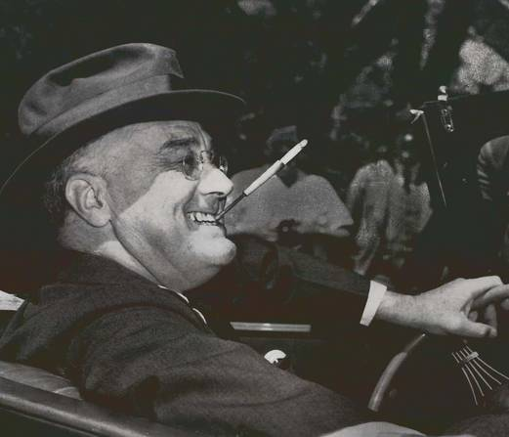
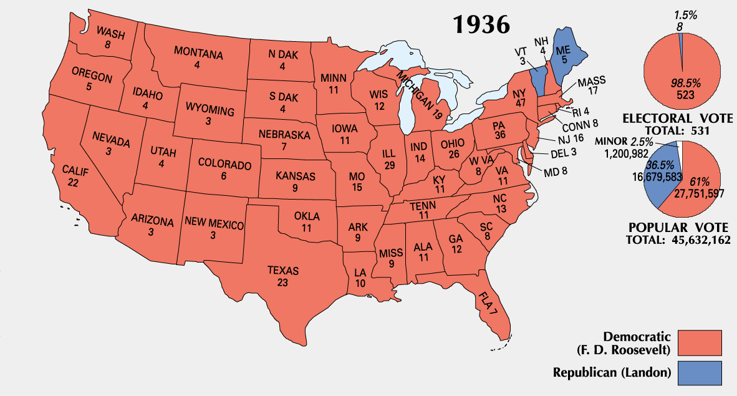
Election of 1936
FDR elected for a second term
The Democratic party became the party of the dispossessed, the new party of the African Americans, and the party of the immigrants and urban masses.
“You look happier than you did four years ago!”
“Happy Days Are Here Again!”

Slide 12
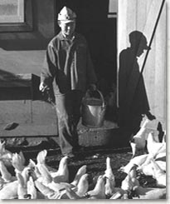
Judging the New Deal
NIRA: Companies voluntarily created minimum wages, maximum work hours, and other methods of “unfair competition”
The Live Poultry Code
Schechter v. United States: SCOTUS held that the Live Poultry Code created under the NIRA violated the Constitution's separation of powers because it was written by the Executive branch, not Congress, essentially negating the New Deal program.
The Supreme Court found six of Roosevelt's eight major New Deal statutes unconstitutional.

Slide 13
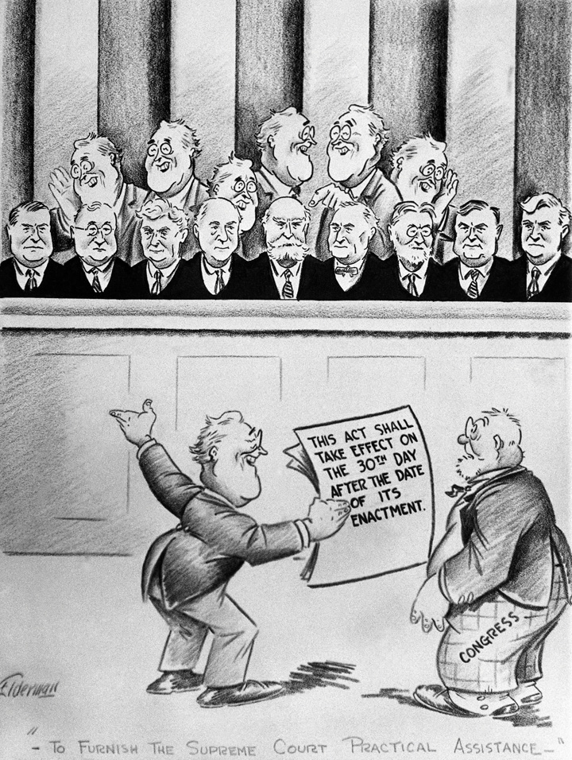
Disorder in the court!
To counter the impact of the Court's decisions on the New Deal reforms, President Roosevelt proposed legislation that would allow him to appoint an additional six justices to the Supreme Court.
The legislation immediately came under sharp criticism from legislators, bar associations, and the public.
The law didn’t pass, and the “court packing scheme” tarnished FDR’s image.

Slide 14
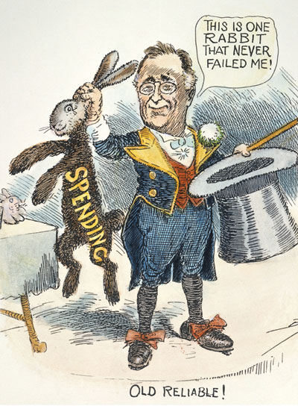
The Roosevelt Recession
In 1937, America faced yet another economic downturn, largely as the result of overspending by the federal government.
Nicknamed the “Roosevelt Recession,” citizens were concerned that the slip was a sign that the New Deal programs hadn’t worked.

Slide 15
Year | Unemployment Rate 1929 | 3.2% 1930 | 8.7% 1931 | 15.9% 1932 | 23.6% 1933 | 24.9% 1934 | 21.7% 1935 | 20.1% 1936 | 16.9% 1937 | 14.3% 1938 | 19.0% 1939 | 17.2% 1940 | 14.6% 1941 | 9.9% 1942 | 4.7% 1943 | 1.9% (Darby 1976: 8).
Roosevelt Recession

Slide 16
Positive Changes under Roosevelt
Wagner Act/National Labor Relations Board: Recognized for the first time the right of workers to organize and bargain collectively with their employers
Keynesian Economics: Argues that the government should spend heavily during a recession, even if it had to run into deficit, in order to jump start the economy.
The Repeal of Prohibition in the United States was accomplished with the passage of the Twenty-first Amendment to the United States Constitution on December 5, 1933.

Slide 17
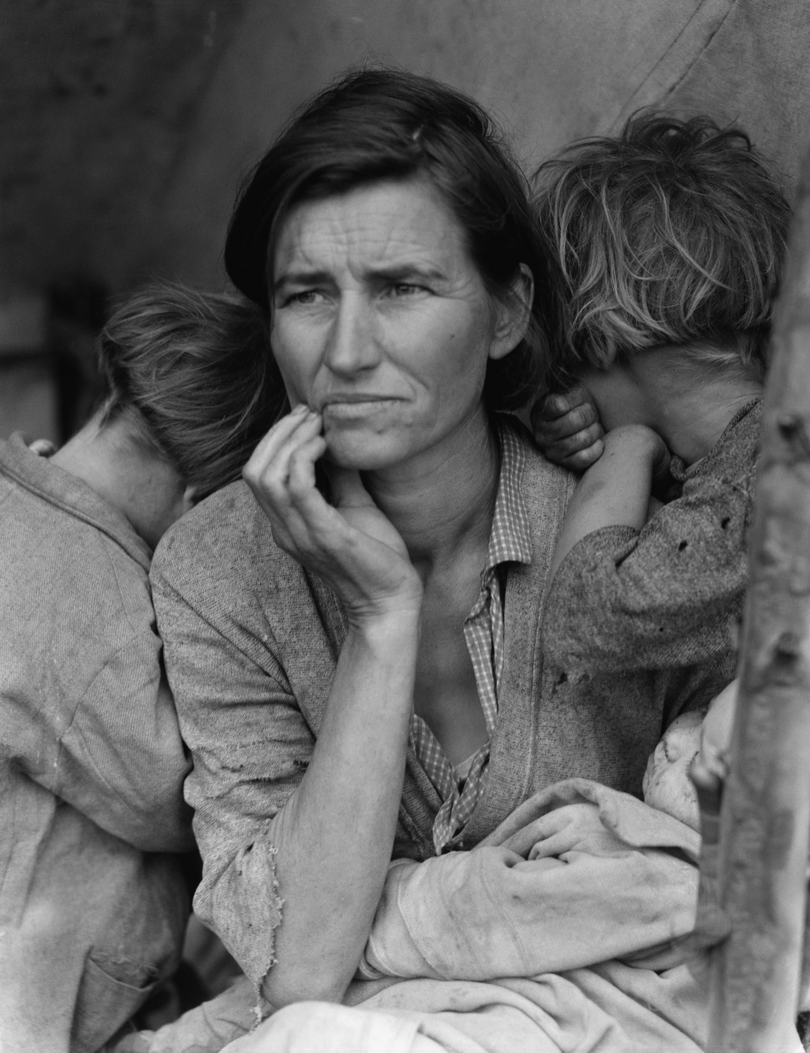
The End of the Depression
Although the New Deal provided the relief necessary to allow America to begin the road to recovery, it would be the outbreak of war in Europe that would truly pull America out of the Great Depression.
Massive Federal Spending on war-time products, and the transformation of American factories into war-time producing factories, helped pull the economy out of the Great Depression.

Slide 18
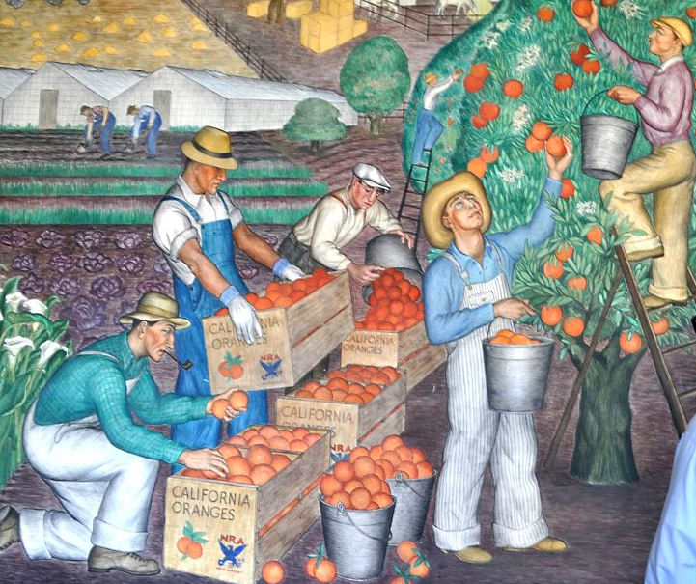

Slide 19
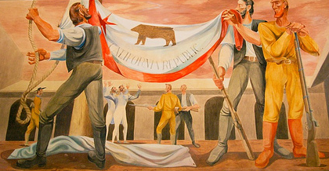

Slide 20
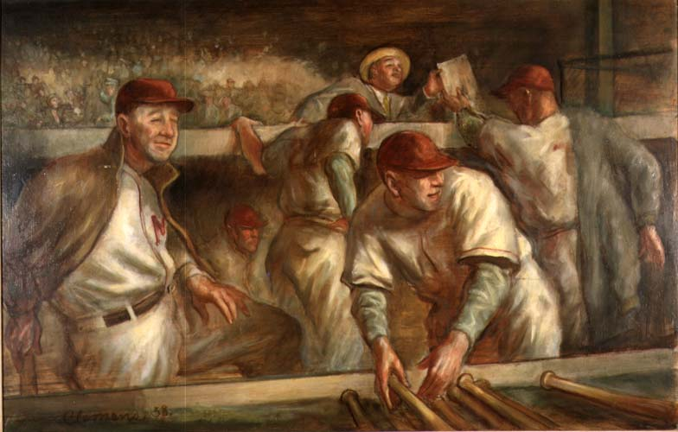

Slide 21
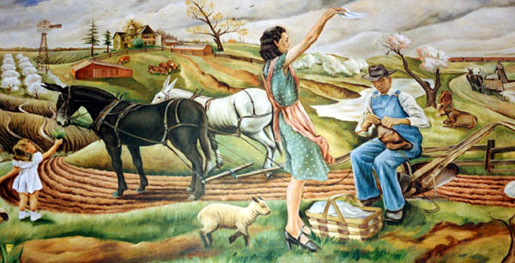

Slide 22
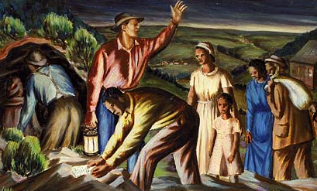

Slide 23
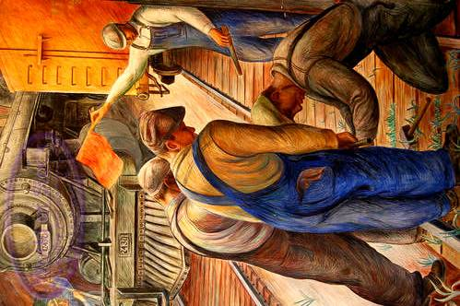

Slide 24
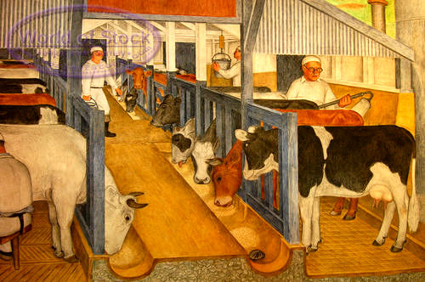

Slide 25
