Slide 1
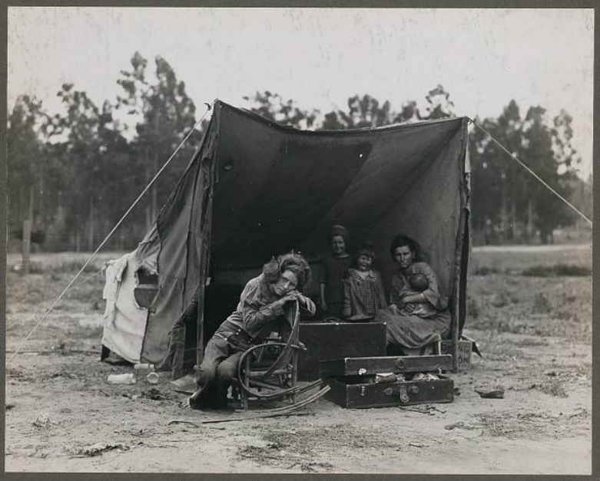
Analyze this Photo: 1) Where do you think the picture is located? 2) What year do you think it is? 3) How do you think this family came to be in these circumstances? 4) Who is missing from this photo, where might this person be? 5) Do you recognize any of them?

Slide 2
The Great Depression
The Aftermath of the Roaring Twenties

Slide 3
Causes of The Great Depression
Unrestrained speculation on the stock market that led to the crash
Overproduction and low demand leads to employee layoffs
Uneven distribution of income.
High tariffs restrict foreign demand for American goods
The natural disaster of the Dust Bowl

Slide 4
Causes of the Stock Market Crash
Long bull market, due to unregulated speculation.
Speculation: investing on the hopes that a stock will go up in value.
Buying stock “on margin” – purchasing stock in installments, rather than all at once
Margin call: a broker could call in the full price of the stock if the value of the stock fell.

Slide 5
Causes of the Stock Market Crash
Bull Market Saturates
Bull market begins running out of investors
Professional investors begin dropping stock while prices remain high
Prices Slip
Brokers make a margin call
Investors begin selling shares to pay brokerage loans
Prices Fall Further
Black Thursday – the market plummets
The Stock Exchange is closed on Friday to stop the hemorrhage

Slide 7
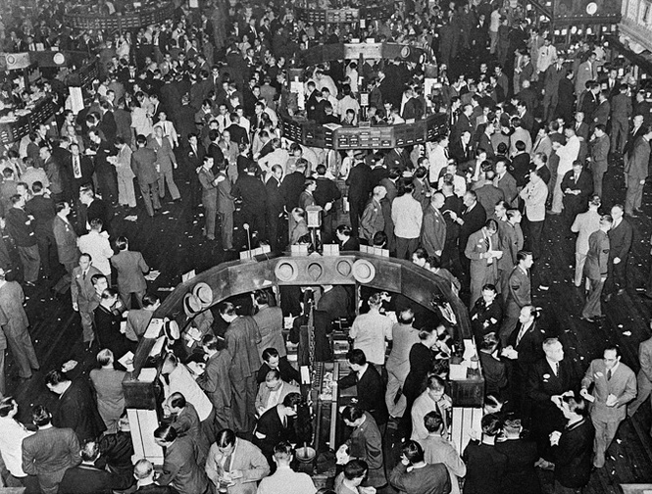
Black Tuesday, October 29, 1929
Stocks took the deepest dive in history on Tuesday, losing $15 billion in one day.
Prices continued to fall throughout November
Banks lost millions in the crash
Had lent money to stock speculators
Had invested the peoples money on the stock market
When the stock market crashed, the banks lost their investments and investors defaulted on their loans, causing banks to limit loans offered, or sometimes close.

Slide 8
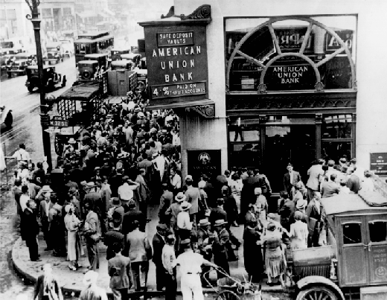
Bank runs – when customers pull their money from a bank in large numbers due to financial panic, often causing the bank to collapse
Within the first two years of the depression, 10% of the nation’s banks were forced to close.

Slide 9
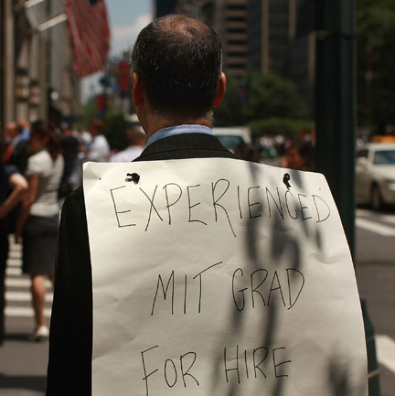
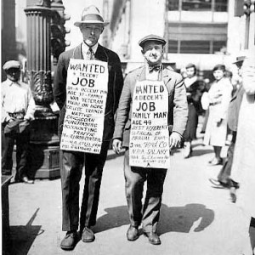
Problems with Overproduction
New machinery + more efficient methods of production = more goods ➔ price drops ➔ market saturates ➔ excess goods ➔ prices drop further ➔ businesses lose money ➔ lay off workers or close

Slide 10
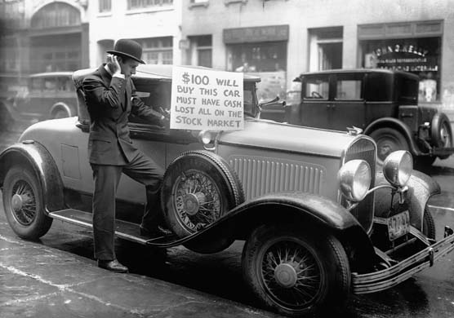
Uneven distribution of income
In 1929, the top 5% made 30% of the income.
Two-thirds of families made less than $2500 a year, with little disposable income. When credit was suspended and loans called in, these families faced a dire situation.

Slide 11
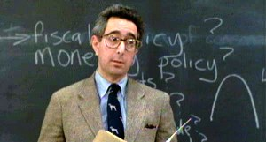
Hawley-Smoot Tariff
High tariffs in the 1920s to boost sales for American goods
Made it nearly impossible for foreign nations to repay war debts to the US
Hawley-Smoot Tariff: Raised the tariff rate to 59.1%, the highest in American history.
Foreign countries raise their tariffs in retaliation/protection
Sales of American goods overseas drop

Slide 12
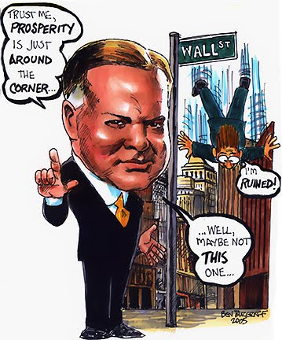
Hoover Responds to the Crisis
“Rugged Individualism” Falters

Slide 13
Hoover Faces Unemployment
President Herbert Hoover opposed most government relief programs; believed private charity should help the poor
Hoover urged businesses to keep wages high to allow workers to help reenergize the economy.
By keeping wages high, businesses could afford fewer workers, and unemployment rose dramatically.
Height of unemployment (1933) hit 25%

Slide 14
Hoover Tries to Help
Reconstruction Finance Corporation: Gave $2 billion in aid to state and local governments and made loans to banks, railroads, mortgage associations and other businesses to keep them going.
Hoover hoped it would keep workers on their jobs; too little too late

Slide 15
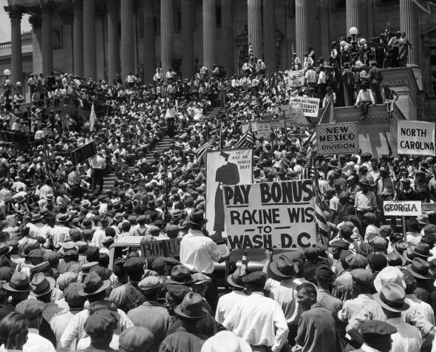
The Bonus Army
WWI veterans promised a bonus – to be paid in 1945
Marched on Washington in 1932 to demand early payment for 20,000 unemployed vets, camping out on the lawn of the U.S. Capitol building
Hoover orders Gen. Douglas MacArthur to disperse the “Bonus Army”
Burns camps and disbands the Bonus Army by military force
Hoover’s reputation was destroyed as a result

Slide 16
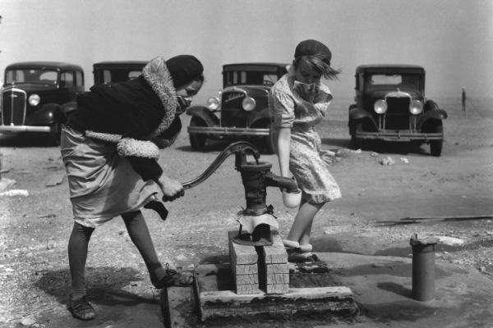
The Disaster of Dust
The Dust Bowl

Slide 17
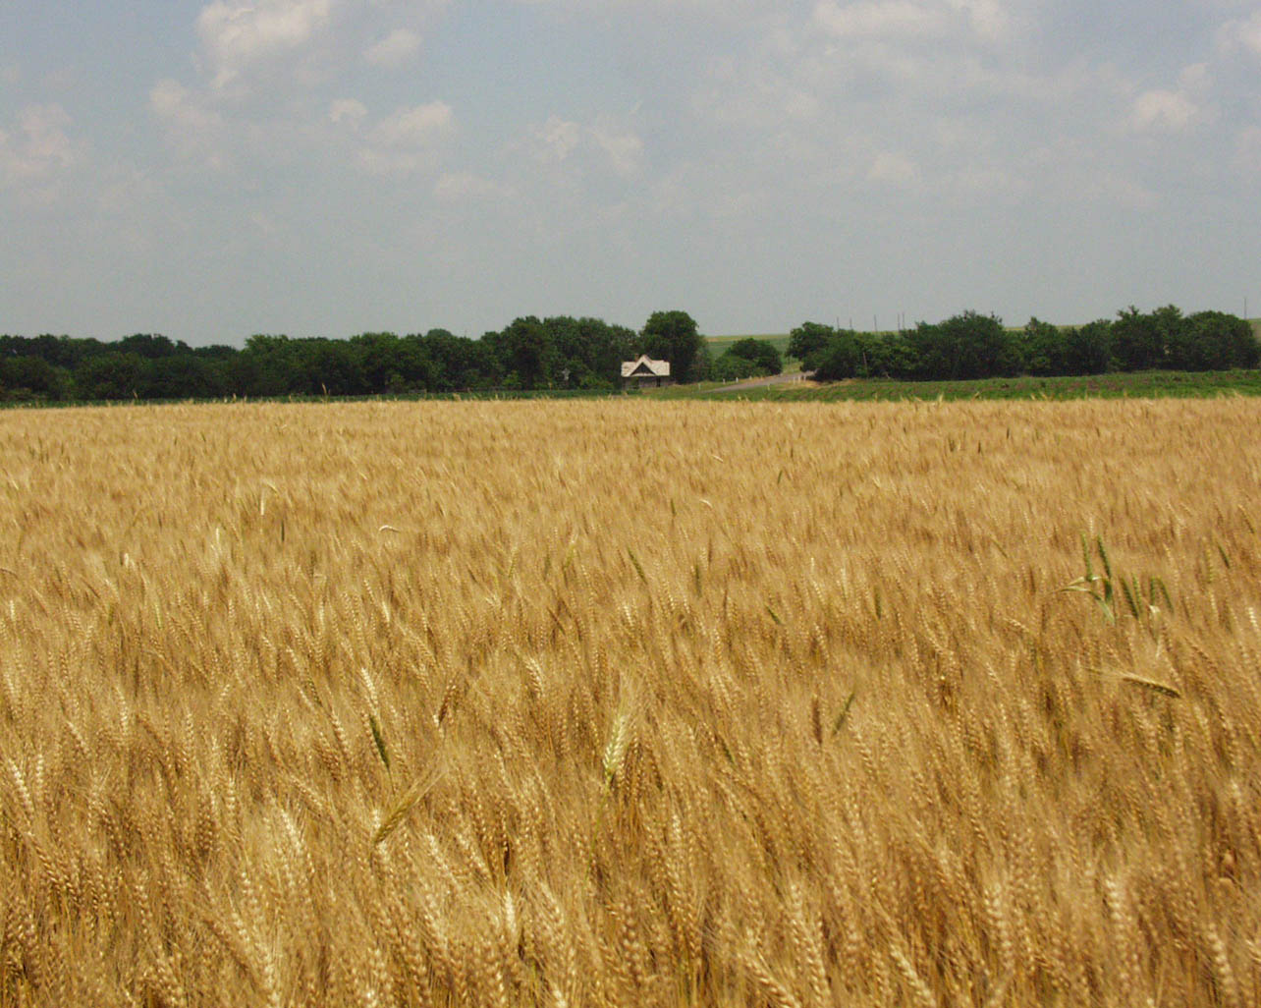
Dealing with mistakes of the past
Plains settled due to the Homestead Act of 1862
Fought against nature – poor soil, drought, infestations, wildfires
Dry farming: Planting crops in the top few inches of soil to ensure absorption of moisture
Allowed farmers to plant oceans of wheat
Actually sucked the top layer of soil dry, leaving a fine layer of dust
A severe drought begins in 1932 that makes conditions worse, allowing the dust to blow across the plains.

Slide 19
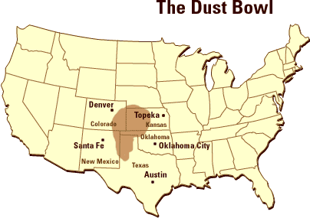
The Dust Bowl
The Dust Bowl covered the states of Oklahoma, Texas, New Mexico, Colorado, and Kansas, with winds blowing the dust as far as Washington D.C.
Massive dust storms choked the remaining vegetation and blocked out the sun.
Storms could dump as much as four feet of dust in a matter of hours

Slide 20
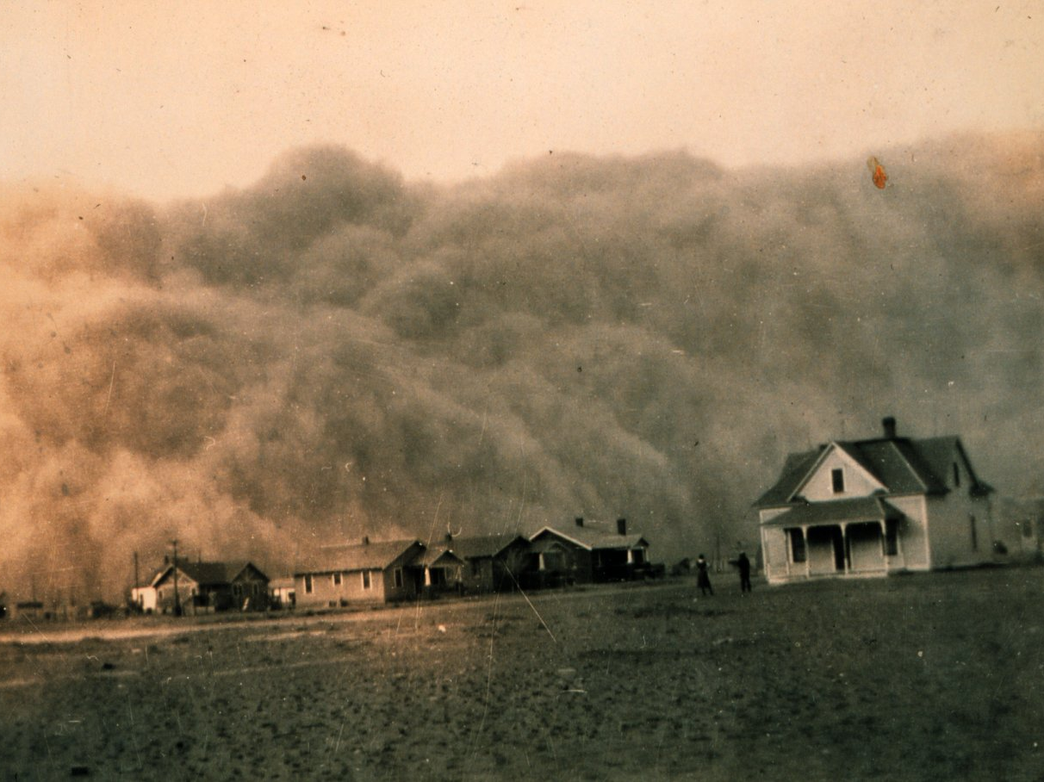

Slide 21
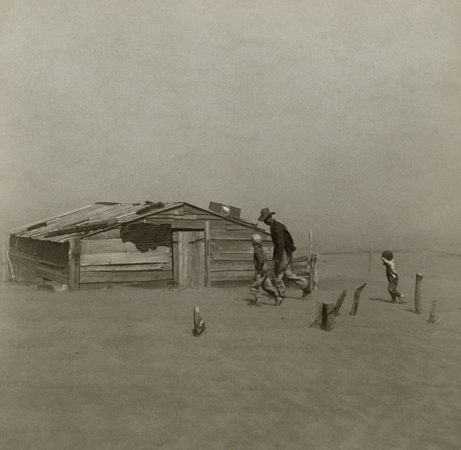

Slide 22
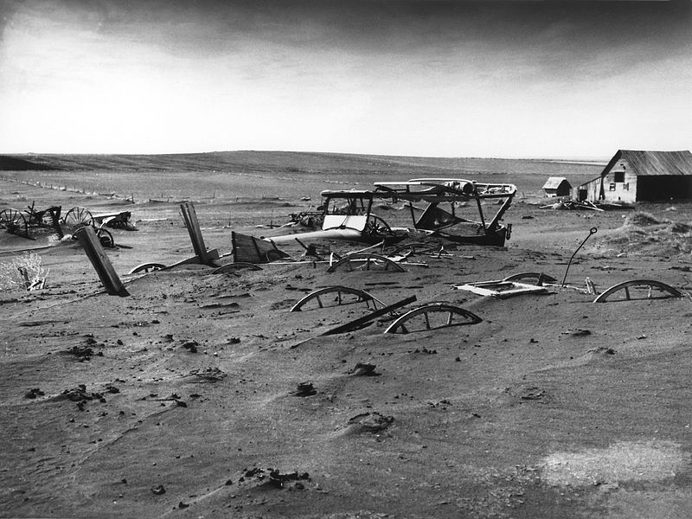

Slide 23
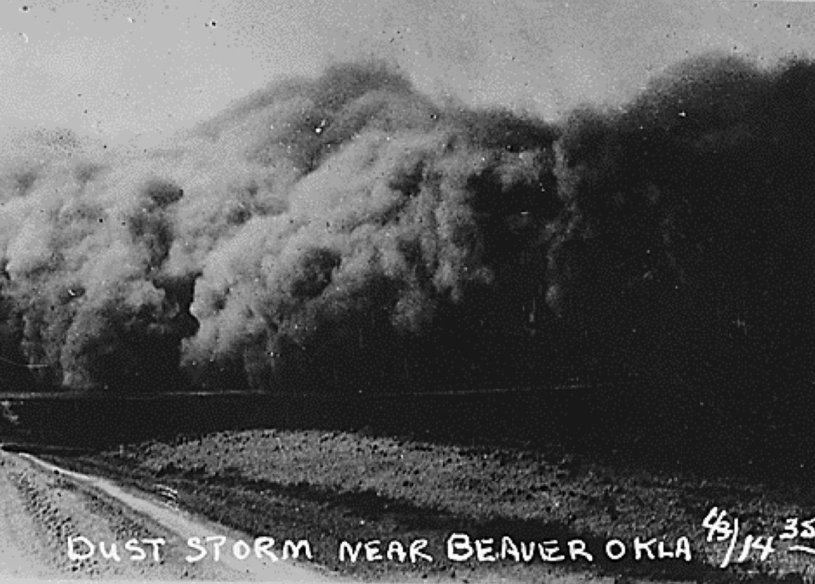
Black Sunday
April 14, 1935 – A “black blizzard” hit Oklahoma and Texas displacing 300 million tons of topsoil from the surrounding prairie.
The storm blotted out the sun and left visibility to about a meter.

Slide 24
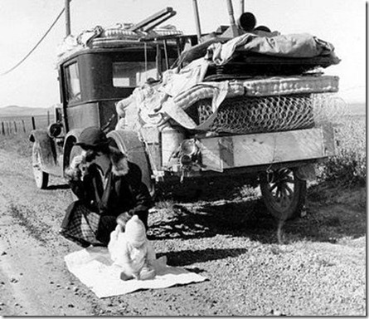
Leaving the Dust Bowl
With their land barren and homes seized in foreclosure, many farm families were forced to leave
Thousands of people migrated to the rich farmlands of California
Although they came from various states, these migrants were disparagingly called “Okies”

Slide 25
APUSH Review Quiz #1
Puritan theology included a belief that
Every individual contained an “inner light” that could lead to salvation
The Bishop would chose ministers for each church.
Man was innately good, and free from sin.
God chose who was saved before they were born.
Good works and faith would lead to salvation.
Which of the following had the greatest impact on the American victory in the War for Independence?
Large population of Tories
Popular support for the Sons of Liberty
The victory at Bunker Hill
Understanding of the region buy colonial militiamen
The financial and military support of France
Which of the following is not associated with Andrew Jackson's presidency?
a challenge to the states' rights forces in South Carolina during the tariff crisis of 1832
veto of the Maysville Road bill which would have expanded internal improvements
a reverence towards John Marshall and the decisions of the Supreme Court.
a challenge to the power of the Bank of the U.S.
a firm belief in the president receiving a direct mandate to rule from the voters
In the 1803 Marbury v. Madison case
the Judiciary Act of 1789 was ruled unconstitutional
the midnight appointments of John Adams were allowed to assume their positions as federal judges
Jefferson and his limited-government supporters scored an unqualified victory
the provision in Article III of the Constitution giving the Supreme Court the right to rule an act of Congress unconstitutional was referred to by John Marshall in his decision
the checks and balance system of the federal government was weakened
A national Fugitive Slave Act was a provision of which of the following?
the Missouri Compromise
the Wilmot Proviso
the Compromise of 1850
the Kansas-Nebraska Act
the Ostend Manifesto

Slide 26
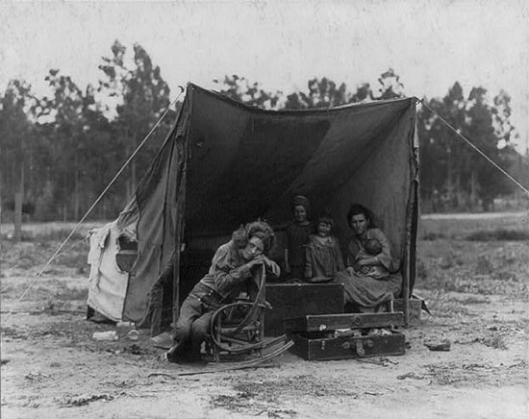
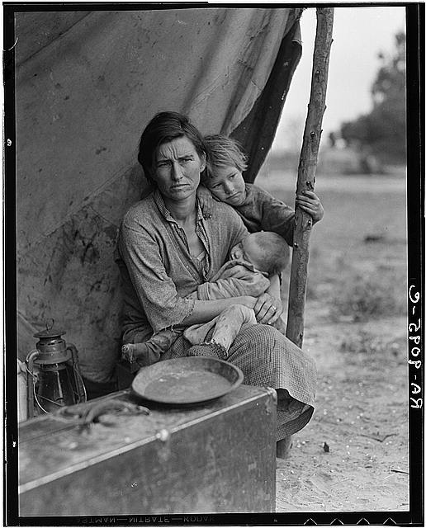
Faces of the
Okie Migration

Slide 27
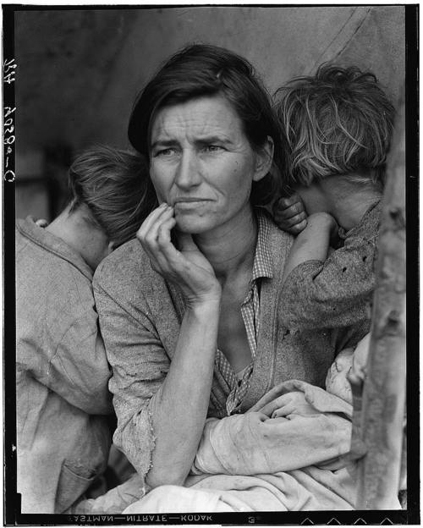
Faces of the Okie Migration
Dorothea Lange – an influential photographer who captured the desperation of the Great Depression and the plight of Dust Bowl migrants.
Migrant Mother (1936) - "Destitute pea pickers in California. Mother of seven children. Age thirty-two. Nipomo, California.“
These photographs put a face to the Dust Bowl encouraging the government to focus more relief efforts on those affected by the natural disaster

Slide 28
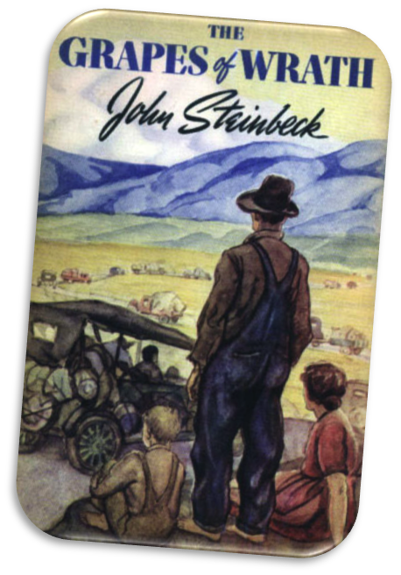
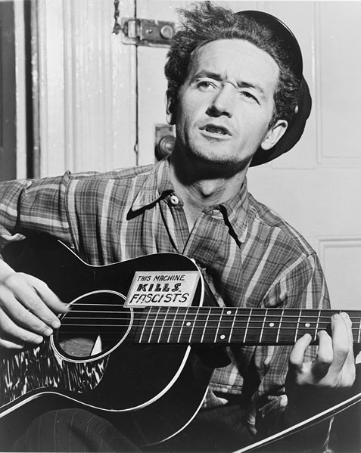
Effects of the Great Depression and the Okie migration
California’s Anti-Okie Law
John Steinbeck – His books were greatly influenced by the Depression, as well as the migration of the Plains farmers
Cannery Row, Of Mice and Men, The Grapes of Wrath
Folk singer Woody Guthrie gained fame with songs about the plight of Dust Bowl refugees – Ain’t Got No Home, Hobo’s Lullaby, This Land Is Your Land

