Slide 1
American Imperialism
FROM SEA TO SHINING SEA… AND BEYOND!
Notes:
Imperialism: The economic and political control of a weaker nation by a stronger nation.

Slide 2
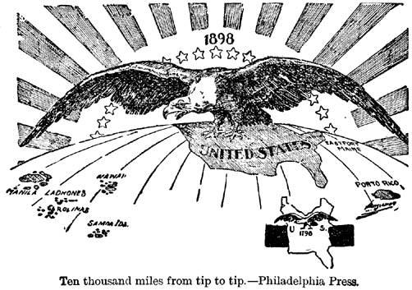

Slide 3

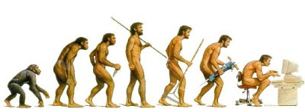
Influences Towards Imperialism
Alaska Purchase (Seward’s Folly)
Missionaries and the Social Gospel
Social Darwinism
Need for new markets
Notes:
Purchase of Alaska in 1867 paved the way for territory expansion beyond the contiguous states.
Missionaries and social activists of the Progressive era wanted to improve the lives of “heathens” in un-Christian lands.
Social Darwinism was growing in popularity.
The growing need for new markets for industrial products.

Slide 4

Influences towards Imperialism
WASPs
Other Europeans
Latinos
Asians
Native Americans
Africans
Social Darwinism
Anglo-Saxonism
Notes:
Social Darwinism: The belief that Darwin’s theory of evolution and “survival of the fittest” applied to humans, and society could be could be artificially improved through this ideal.
Anglo-Saxonism: The idea that English-speaking nations had superior character, ideas, and systems of government, and were destined to rule.

Slide 5
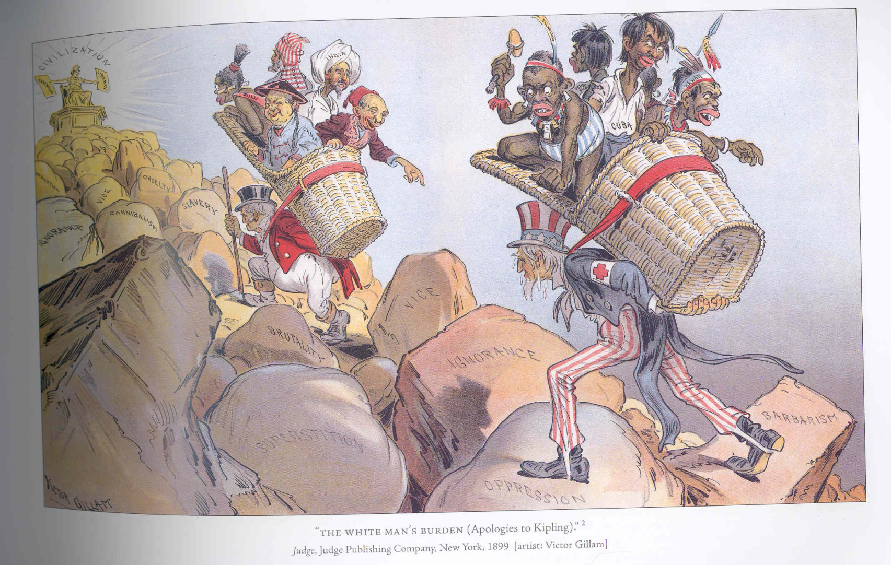

White Man’s Burden – Rudyard Kipling
Take up the White Man's burden-
Send forth the best ye breed-
Go bind your sons to exile
To serve your captives' need;
To wait in heavy harness,
On fluttered folk and wild-
Your new-caught, sullen peoples,
Half-devil and half-child.
Notes:
Rudyard Kipling: English author; born in Bombay, India while it was under British colonial rule, and was taken by his family to England when he was five years old.
Wrote the poem for Queen Victoria’s Diamond Jubilee, celebrating the power and influence of the British Empire.
Known for the poems White Man’s Burden and If---, and short stories, including The Jungle Book.

Slide 6
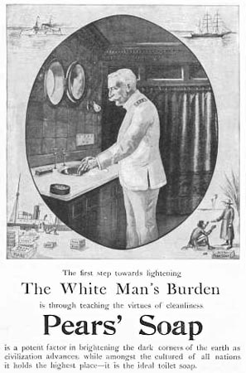
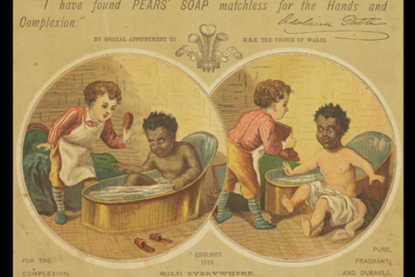
White Man’s Burden
Justification for imperialism
Obligation to lesser nations
Effective advertisement
Notes:
Imperialists understood the phrase "white man's burden" as a characterization for imperialism that justified the policy as a noble enterprise.
A belief that white people have an obligation to rule over, and encourage the cultural development of people from other ethnic and cultural backgrounds until they can take their place in the world economically and socially.
The slogan was placed on products that aimed to promote cleanliness, purity, health, and wealth.

Slide 7


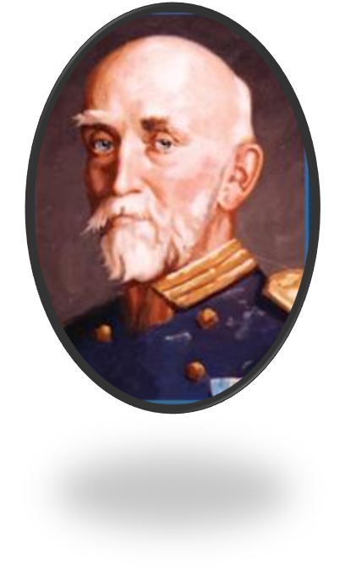
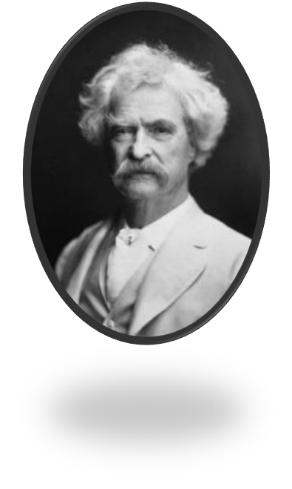
I this! I this!
  Captain Alfred Thayer Mahan – The Influence of Sea Power on History
  Mark Twain – The War Prayer
Notes:
Captain Alfred Thayer Mahan, The Influence of Sea Power on History – said that they key to a nation’s power is through its naval power.
Mark Twain – The War Prayer; A scathing indictment of war, and particularly of blind patriotic (jingoism) and religious fervor as motivations for war.

Slide 8
Pros and Cons of Imperialism
Pros
Cons
Increased economic opportunities
Improved global status
New materials/goods
Expansion of democracy
Expensive – militarily and economically
Negative impact on American labor/business
Negative international opinion of the US
Destruction of traditional cultures

Slide 9
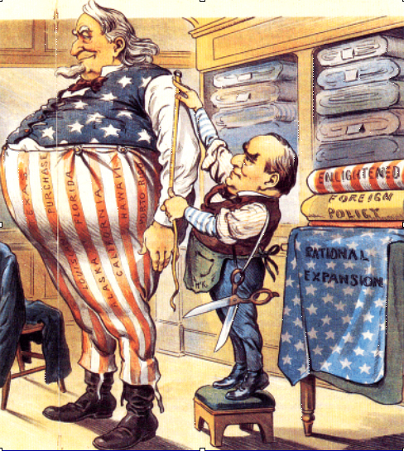
Early Foreign Forays
Latin America and The Pacific

Slide 10
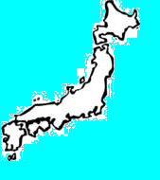
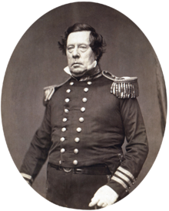
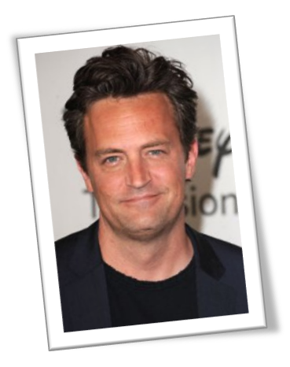
Expansion in the Pacific
Treaty of Kanagawa (1858)
  Commodore Matthew C. Perry
Annexation
  Samoa
  Midway Island
  Pacific islands
Notes:
Americans had always expanded the nation by moving west, so it seemed only natural to look to the Pacific when looking for new markets.
Treaty of Kanagawa: Pres. Fillmore ordered Commodore Matthew C. Perry led four American warships to Japan to convince them to trade with the US
Japan was impressed by the technology and firepower, causing them to not only begin trade with the US, but to update their own technology to compete with western nations.
America would go on to annex a number of small islands in the Pacific
Samoa (1898)
Midway Island (important in WWII)
Uninhabited coral islands (for military and commercial use)

Slide 11
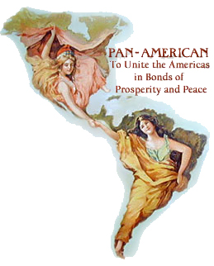
Early Foreign Forays
“Big Sister” policy
Pan-American Conference (1889)
Monroe Doctrine as justification
Notes:
James G. Blaine advocated the “Big Sister” policy towards Latin America.
Led the Pan-American Conference tin 1889
On October 2, 1889, the first Pan-American Conference began in Washington, D.C. The conference was a meeting between the United States and various countries in Latin America. Its goal was to improve economic and political relations between participants.
Harrison and Blaine hoped to reach agreements at the conference to create a customs union for free trade and establish a system for arbitration of international disputes. Failed to make any major agreements or improvements.
The U.S. intervened on behalf of Venezuela against Britain who desired gold that had been found in Guiana.
Justified this action using the Monroe Doctrine.

Slide 12
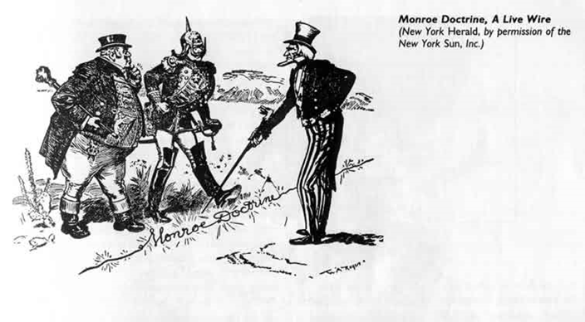
Monroe Doctrine 1823
-Western Hemisphere

Slide 13

Aloha!
Welcome to Hawai’i

Slide 14

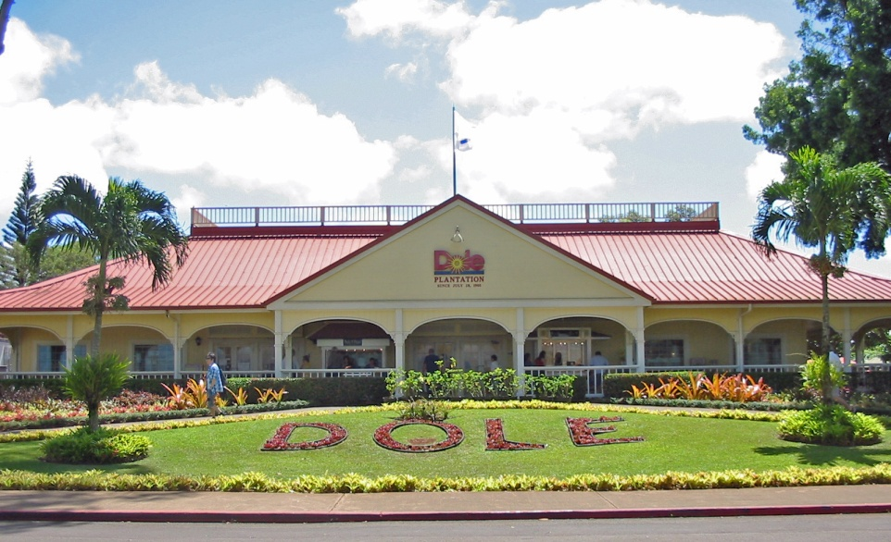
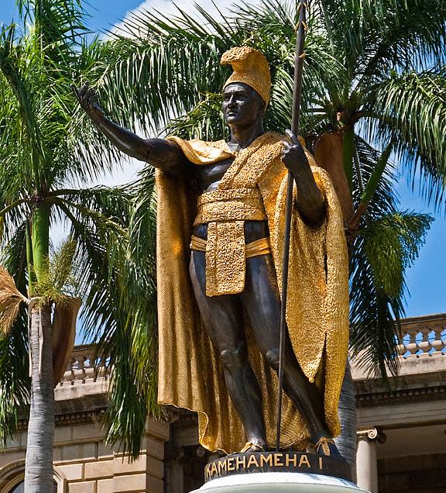
Old Hawai’i
Notes:
King Kamehameha unified the Hawaiian Islands in 1810
Modern Hawaiian history begins on January 20, 1778, when Captain James Cook's expedition made its first contact with the Hawaiian people on the islands of Kauai and Niihau.
European businessmen quickly took advantage of the fertile soil and set up large plantations of sugarcane, pineapples, etc.

Slide 15
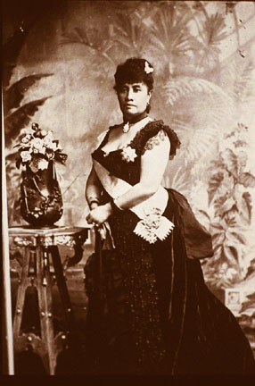
The Last Monarch: Queen Lili'uokalani
Queen Lili’oukalani
Committee of Safety
Surrender and abdication
  Sanford Dole
Annexed in 1898
Notes:
Rivalry was intense between white businessmen who dominated the economy and native politicians who still retained political power.
Lili'uokalani looked to create a new constitution which would restore the full power of the monarchy.
A Committee of Safety was formed by prominent annexationists. They took it upon themselves to create a provisional government and a militia. The Queen could have declared martial law and arrested the conspirators, but she felt that this would begin armed conflict which would result in loss of innocent lives.
The Committee of Safety then made its move and armed companies of militia took over government buildings and offices. The evening before, marines and sailors from the U.S.S. Boston were landed to keep order in Honolulu. The Queen was powerless.
Finally on January 17, 1893, the Queen faced the inevitable and surrendered under protest. Sanford Dole was named President of the Republic of Hawai’i.
Grover Cleveland refused to annexation because of the way it had been taken
McKinley would annex Hawaii in 1898
Lili’uokalani spent the rest of her life protesting the overthrow of Hawai’i

Slide 16
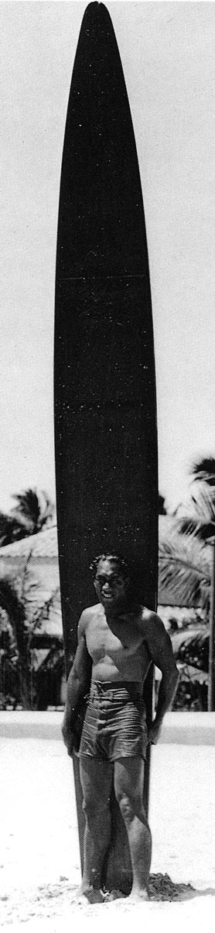
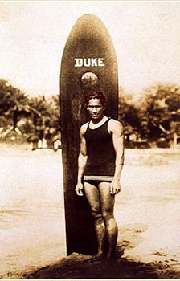

Pitfalls of Anglo-Saxonism
Duke Kahanamoku
Hula
Notes:
Early missionaries disliked the hula they saw. The sight of scantily clad women moving in rhythm to poetry offended their puritan ethics and they made strenuous efforts to abolish this aspect of ancient Hawaiian culture.
Royalty used surfing as a means of maintaining their strength, liveliness and authority over their people. Only the elite class was allowed to use certain materials and wood for their boards resulting in a superior quality board, which separated the royalty from the commoners.
Duke Kahanamoku is singularly credited with popularizing surfing world-wide during the 1920s

Slide 17
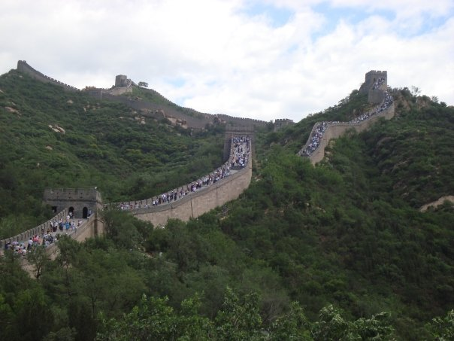
China

Slide 18
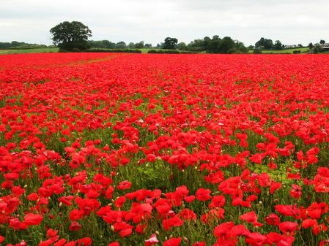
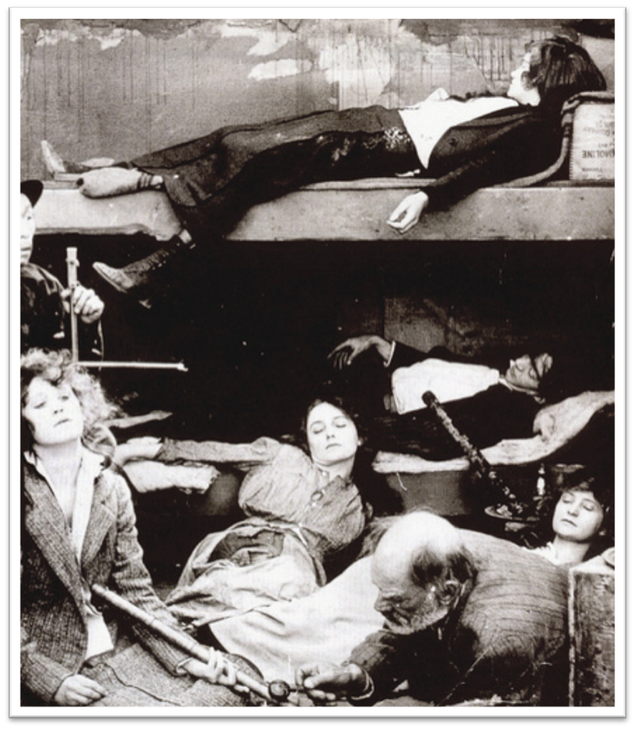
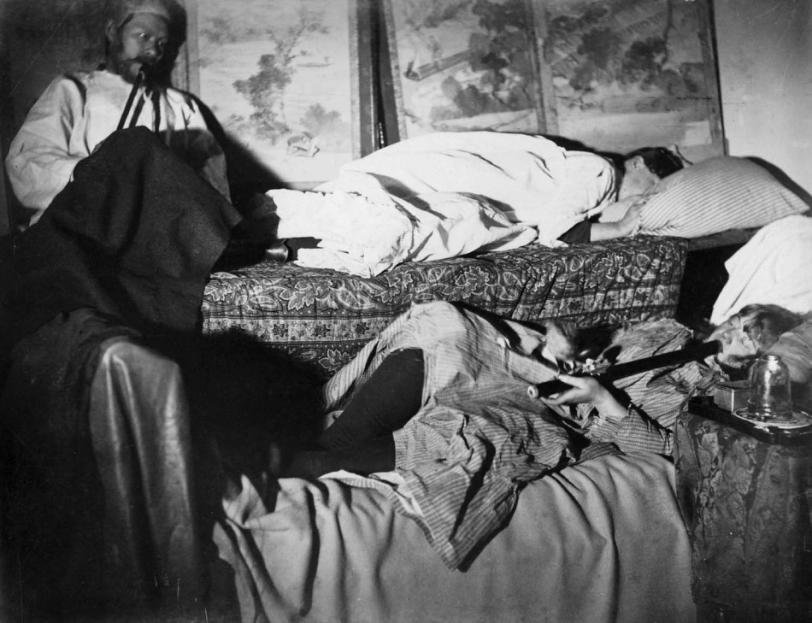
Opium
Notes:
China’s emperor tried to stop the cultivation of opium because so many of his subjects had become addicted.
Many Americans became addicted to the substance as well, despite villianize Chinese immigrants for the practice.
The Opium Wars: Britain attacked closed Chinese ports to re-open the opium trade.

Slide 19
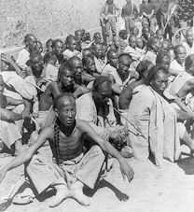
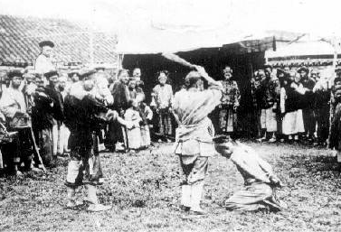
Boxer Rebellion
“Society of Righteous and Harmonious Fists” (AKA: Boxers)
  Anti-foreign
  Anti-Christian
Violent aftermath
Notes:
A violent anti-foreign, anti-Christian movement led by the “Society of Righteous and Harmonious Fists” in China
Began in the countryside
Occurred in response to imperialist expansion, growth of cosmopolitan influences, and missionary evangelism, and against the backdrop of state fiscal crisis and natural disasters.
By late 1899, bands of Boxers were massacring Christian missionaries and Chinese Christians.
Performed rituals they believed would make them impervious to bullets
In 1900, an international force of 2,100 American, British, Russian, French, Italian, and Japanese soldiers were sent to subdue the "rebellion.“
Violent aftermath, where many Boxers or sympathizers were executed

Slide 20
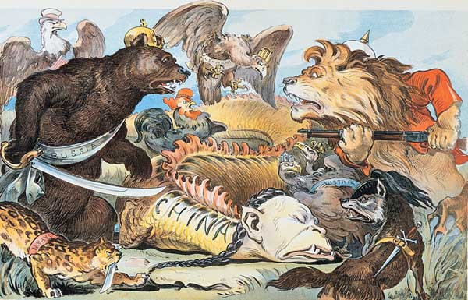

Slide 21
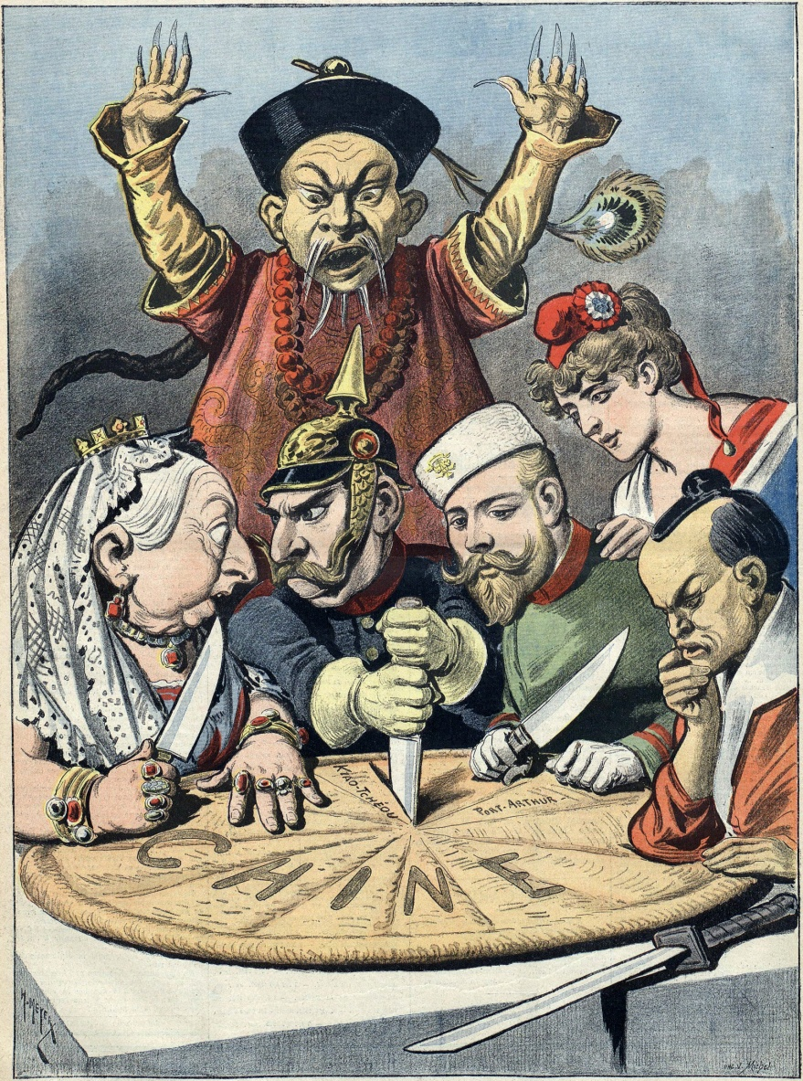
Open Door Policy
Increase influence in China
  Foreign spheres of influence
Open Door Policy (1900)
  SoS John Hay
Granted consent “in principle”
Notes:
In the late 1800s, the United States increased its Asian presence and was expecting to further its commercial and political interest in China. It felt threatened by other powers' much larger spheres of influence in China and worried that it may lose access to the Chinese market should the country be partitioned.
SoS John Hay sent notes to the major powers (France, Germany, Britain, Italy, Japan, and Russia), asking them to declare formally that they would uphold Chinese territorial and administrative integrity and that all nations, including the United States, could enjoy equal access to the Chinese market.
In reply, each country tried to evade Hay's request, taking the position that it could not commit itself until the other nations had complied. However, by July 1900, Hay announced that each of the powers had granted consent in principle.

Slide 22
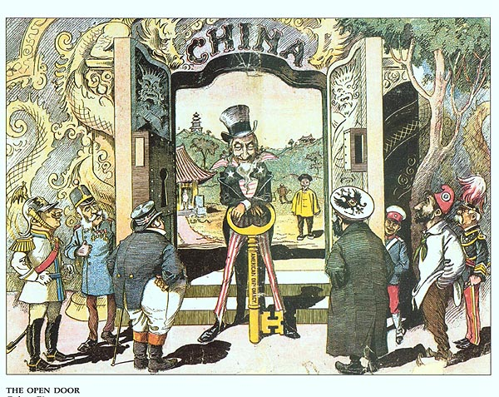
Notes:
So, the doors of China were opened with American diplomacy, and the United States was now primed to prove itself as an imperial giant.

