Slide 1
Helping Those Who Cannot Help Themselves
Social Progressivism

Slide 2
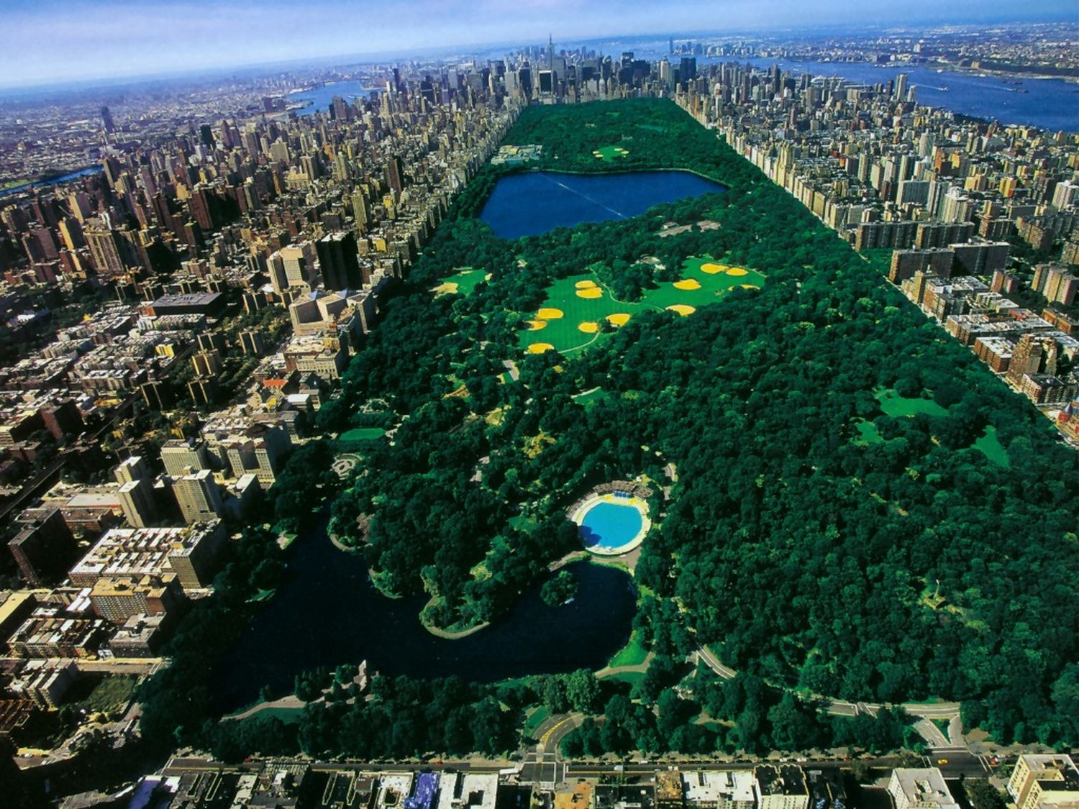
Central Park
Lack of public spaces
Designed by Frederick Law Olmstead
Designed for relaxation, recreation, and education
Notes:
1857 with 778 acres; 840 acres today
Frederick Law Olmsted and Calvert Vaux won a design competition to improve and expand the park, completed in 1873
As the city expanded, people were drawn to the few existing open spaces, mainly cemeteries, to get away from the noise and chaotic life in the city

Slide 3
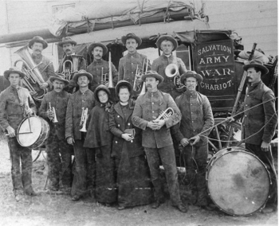
Social Gospel
Christian charity
Young Men’s Christian Association (YMCA)
Dwight L. Moody
Organized Bible studies, prayer meetings, citizenship training, and fitness activities
Salvation Army
Notes:
A movement that strove to improve conditions in cities according to the biblical ideals of charity and justice.
YMCA - Young Men’s Christian Association; Dwight L. Moody (American organizer)
Tried to help industrial workers and the urban poor by organizing Bible studies, prayer meetings, citizenship training, and fitness activities.
Salvation Army
Founded in 1865 in the UK by William and Catherine Booth as the East London Christian Mission and with a quasi-military structure.
The Salvation Army's main converts were at first alcoholics, morphine addicts, prostitutes and other "undesirables" unwelcome in polite Christian society, which helped prompt the Booths to start their own church
Founded in 1865 in the United Kingdom
Its goals are the advancement of the Christian religion, of education, the relief of poverty, and other charitable objects beneficial to society or the community of mankind as a whole.
Was brought to the United States in 1880
Its first converts were alcoholics, morphine addicts, prostitutes and other "undesirables" unwelcome in polite Christian society
Gained respect for their disaster relief efforts following the Galveston Hurricane of 1900 and the 1906 San Francisco earthquake.

Slide 4
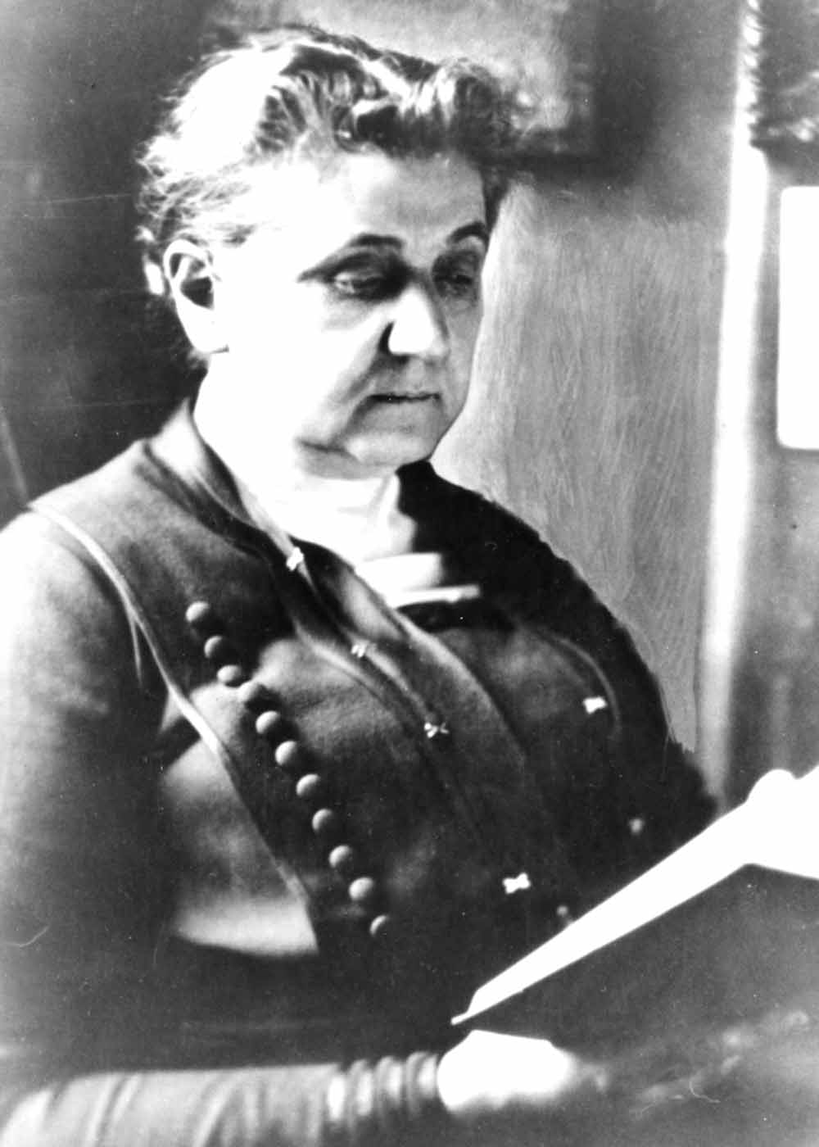
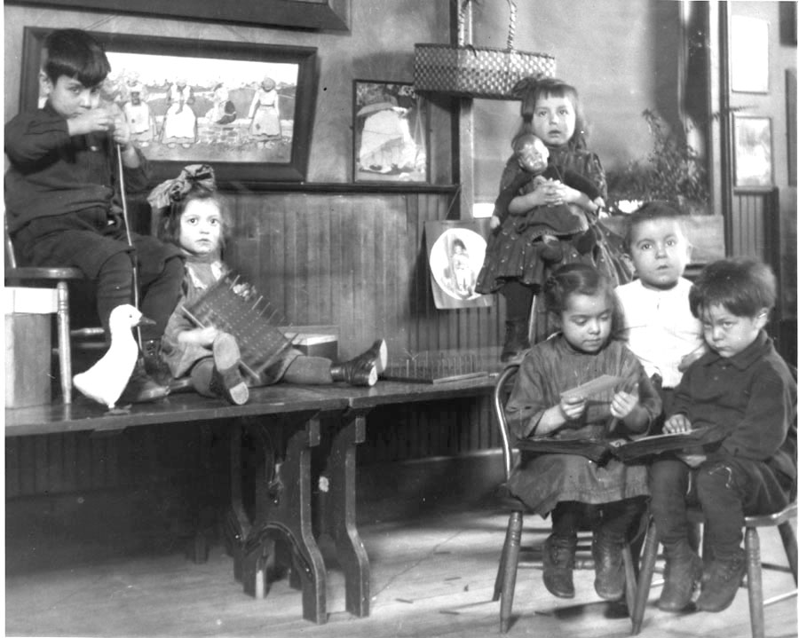
Social Gospel
Settlement Houses: Homes where middle class residents lived with and helped poor residents, by providing them with medical care, English classes, hot lunches, etc.
Jane Addams and Hull House (1889)
Notes:
Settlement houses were homes where middle class residents lived with and helped poor residents, by providing them with medical care, English classes, hot lunches, etc.
Jane Addams – opened the famous Hull House in Chicago in 1889
Hull House – one of the largest settlement houses in America.

Slide 5
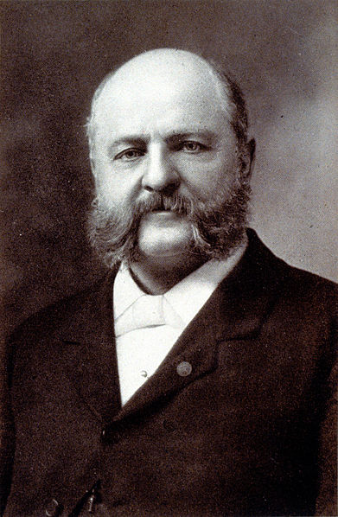
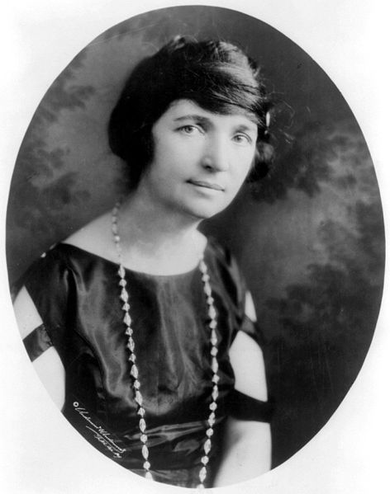
Regulating Morality
Comstock Laws
Illegal to send “obsene, lewd, and/or lascivious” materials through the mail.
Margaret Sanger
American Birth Control League (Planned Parenthood)
Notes:
Comstock Laws
Made it illegal to send any "obscene, lewd, and/or lascivious" materials through the mail, including contraceptive devices and information, and also banned the distribution of information on abortion for educational purposes.
The law was named after its chief proponent, the anti-obscenity crusader Anthony Comstock. The enforcement of the Act was, in its early days, often conducted by Comstock himself as postal inspector or through the New York Society for the Suppression of Vice which he led.
Margaret Sanger
Sex educator, nurse, and birth control activist; established the American Birth Control League (Planned Parenthood).
Sanger’s mother had 18 pregnancies in 22 years, and died at age 50 of tuberculosis and cervical cancer, inspiring her future activism.
Led to the success of a Supreme Court case that legalized contraception.

Slide 6
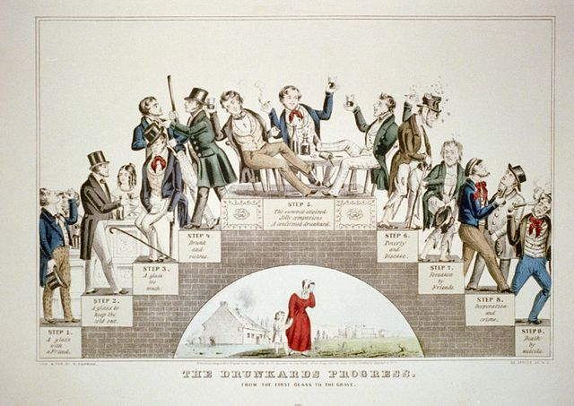
The Temperance Movement

Slide 7
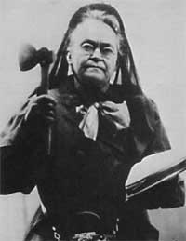
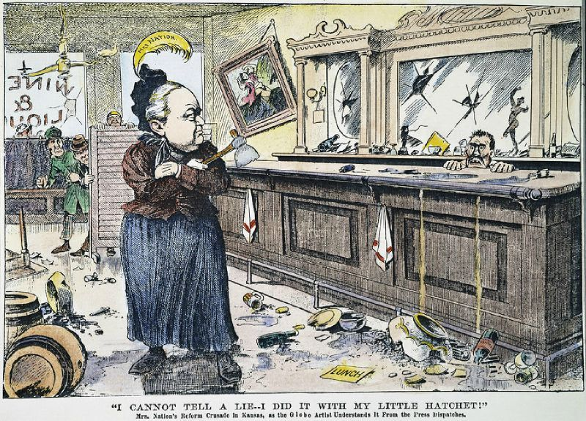
The Temperance Movement
“Smash, ladies, smash!”
Carrie A. Nation
Radical member of the temperance movement
“Hatchetations”
Notes:
Carrie Nation
A brief marriage to an alcoholic in the late 1800's fueled Nation's disdain for alcohol.
a radical member of the temperance movement, noteworthy for promoting her viewpoint through vandalism.
Alone or accompanied by hymn-singing women she would march into a bar, and sing and pray while smashing bar fixtures and stock with a hatchet.
Between 1900 and 1910 she was arrested some 30 times after leading her followers in the destruction of one water hole after another with cries of "Smash, ladies, smash!”
In April 1901 Nation came to Kansas City, Missouri, a city known for its wide opposition to the temperance movement, and smashed liquor in various bars on 12th Street in Downtown Kansas City.[11] She was arrested, hauled into court and fined $500 ($13,400 in 2011 dollars),[12] although the judge suspended the fine so long as Nation never returned to Kansas City

Slide 8
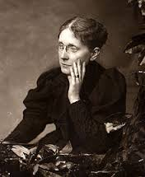
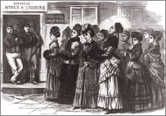
Temperance Movement
Women’s Christian Temperance Union (WCTU)
Create a “sober and pure world”
Frances Willard
Expanded the scope of the Union’s goals
Notes:
Women’s Christian Temperance Union
The first mass organization among women devoted to social reform; to create a "sober and pure world“ by abstinence, purity and evangelical Christianity.
The WCTU perceived alcoholism as a cause and consequence of larger social problems rather than as a personal weakness or failing.
Led by Frances Willard
interested in a number of social reform issues, including labor, prostitution, public health, sanitation, and international peace.
Argued that women needed the vote to help bring morals back to the nation

Slide 9
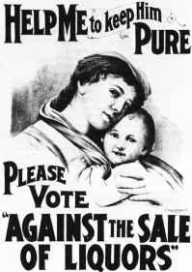
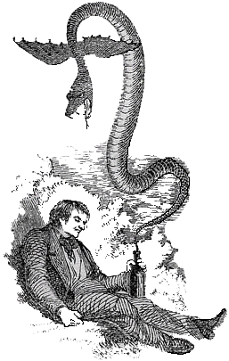
The Temperance Movement
Anti-Saloon League
Focused on legislation, not behavior
South and rural North; Protestant churches
18th Amendment (1919)
Notes:
Anti-Saloon League
The leading organization lobbying for prohibition in the United States in the early 20th century. It concentrated on legislation, and cared about how legislators voted, not whether they drank or not.
Strongest in the South and rural North, Methodists, Baptists, and Congregationalists
Replaced the WCTU as the main prohibition lobby in America
Used emotion, patriotism, and anti-German sentiment in WWI
Achieved success in the 18th Amendment (1919)

Slide 10
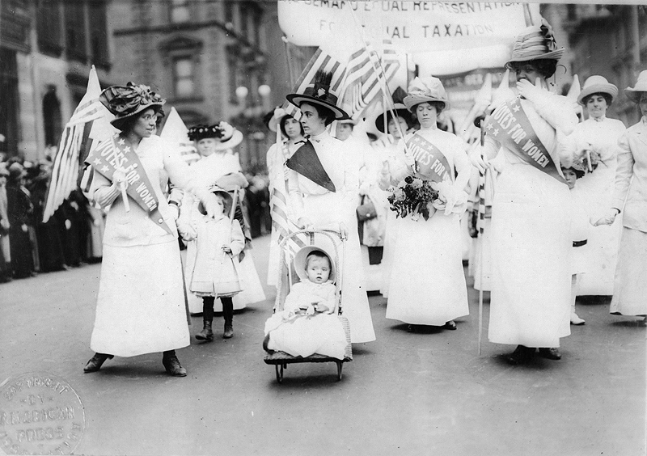
Women’s Suffrage

Slide 11
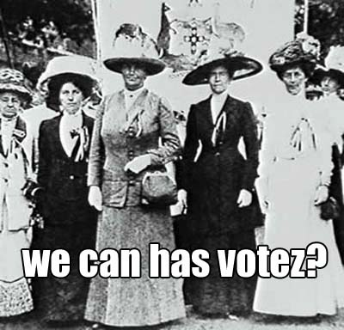
Women’s Suffrage
Seneca Falls Convention (1848)
Declaration of Sentiments
Elizabeth Cady Stanton and Lucretia Mott
Grew out of the abolitionist movement
Largely middle class, urban women
Notes:
Seneca Falls Convention
Declaration of Sentiments
Elizabeth Cady Stanton and Lucretia Mott
Grew out of the abolitionist movement.
Were bitterly disappointed when freedmen were given the right to vote, but not women.

Slide 12
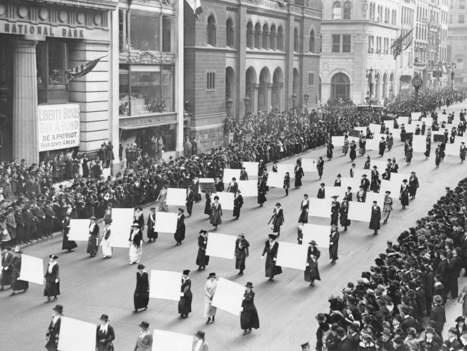
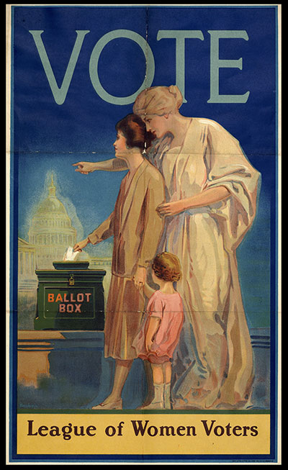
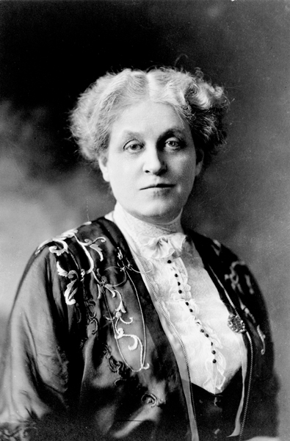
Women’s Suffrage
National American Woman’s Suffrage Association (NAWSA)
Susan B. Anthony
State-by-state replaced with national amendment
Carrie Chapman Catt
League of Women Voters
Notes:
National American Woman’s Suffrage Association (NAWSA)
primary promoter of women's right to vote
Moved from state-by-state legislation to national legislation
It recruited celebrities, both men and women, who could draw attention to the cause. It raised money from members and wealthy donors, using the funds to train and send paid and volunteer organizers into the field to canvass for votes and enlist new members. It specialized in parades and street rallies, with its white uniforms and banners designed to draw crowds as well as newspaper reporters. It built alliances with local women's clubs, as well as state and national groups, and even some labor unions.
After success in 1920, the NAWSA was reformed as the League of Women Voters, which continues the legacy.
The downside? Convincing men it was a good idea.

Slide 13
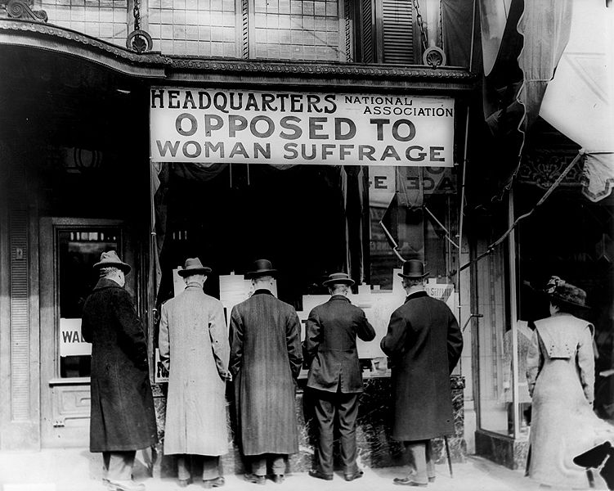

Slide 14
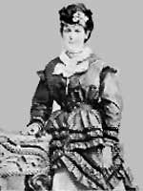
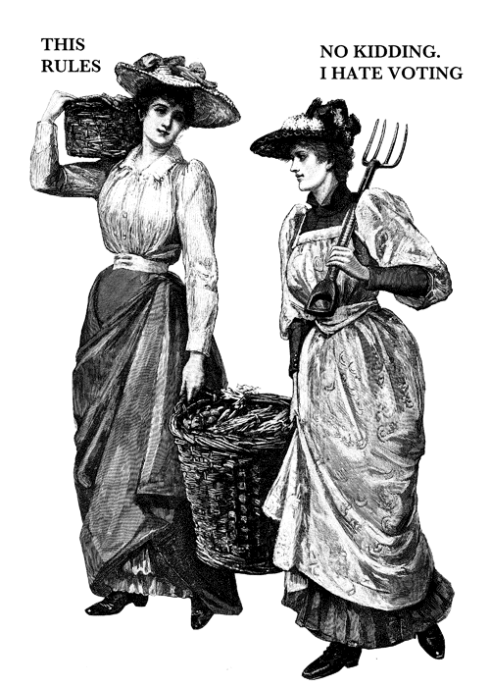
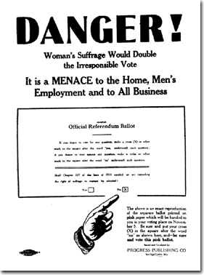
Women’s Suffrage
Anti-Suffragettes: Suffrage seen as immoral and unfeminine
Argued that women didn't need the vote in order to establish equality and that women's role in the domestic sphere was essential for maintenance of the American republic
Helen Kendrick Johnson
National Association Opposed to Woman Suffrage
Notes:
The women who supported suffrage were seen as unfeminine and immoral. Several were physically attacked.
Helen Kendrick Johnson
she argued that women didn't need the vote in order to establish more legal, economic and other equality and that women's role in the domestic sphere was essential for maintenance of the American republic.
National Association Opposed to Woman Suffrage

Slide 15
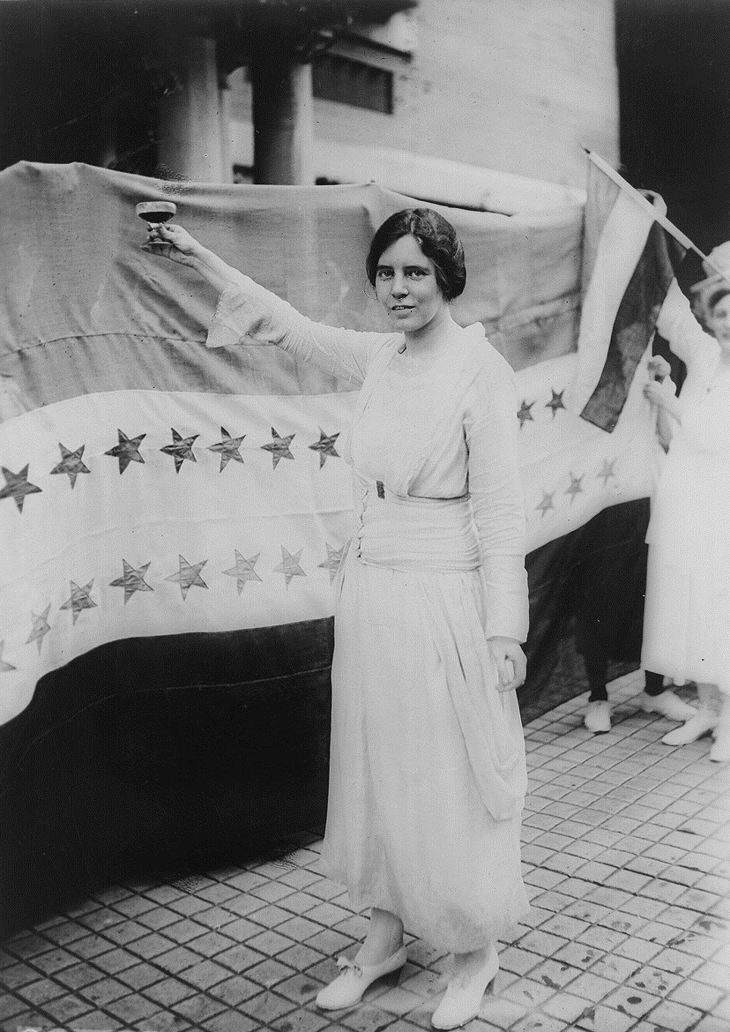
Women’s Suffrage
Alice Paul
National Women’s Party
Picketed the White House
Occoquan Workhouse – Night of Terror
Notes:
Alice Paul created the National Women’s Party, using a more public method to gain suffrage
After the US joined WWI, the NWP began picketing the White House
Was jailed three times for demonstrating for women’s suffrage.
She went on a hunger strike in protest of her arrest and was force-fed by the warden.
On the night of November 15, 1917, the superintendent of the Occoquan Workhouse, , ordered the nearly forty guards to brutalize the suffragists. They beat Lucy Burns, chained her hands to the cell bars above her head, then left her there for the night. They threw into a dark cell and smashed her head against an iron bed, which knocked her out. Her cellmate, , who believed Lewis to be dead, suffered a heart attack. According to affidavits, guards grabbed, dragged, beat, choked, pinched, and kicked other women.

Slide 16
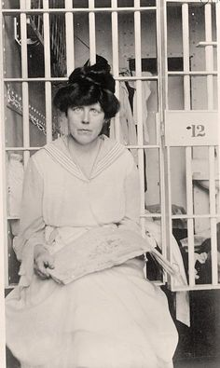
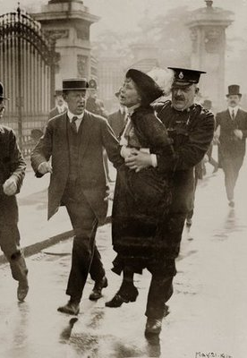
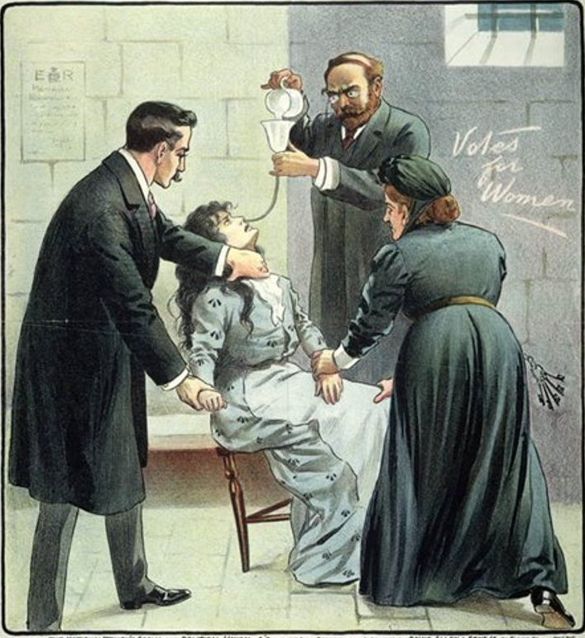
Notes:
She went on a hunger strike in protest of her arrest and was force-fed by the warden.
On the night of November 15, 1917, the superintendent of the Occoquan Workhouse, , ordered the nearly forty guards to brutalize the suffragists. They beat Lucy Burns, chained her hands to the cell bars above her head, then left her there for the night. They threw into a dark cell and smashed her head against an iron bed, which knocked her out. Her cellmate, , who believed Lewis to be dead, suffered a heart attack. According to affidavits, guards grabbed, dragged, beat, choked, pinched, and kicked other women.

Slide 18
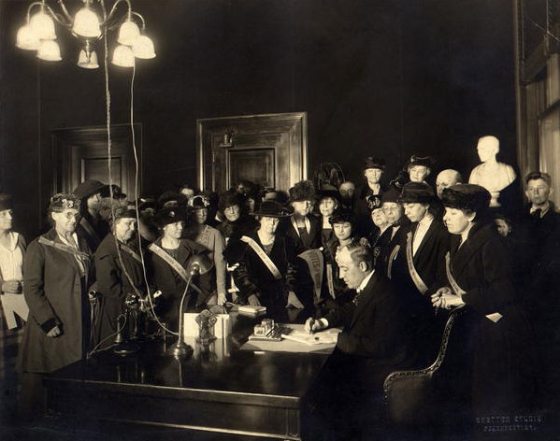
19th Amendment: Women are given the right to vote (1920)

