Slide 1
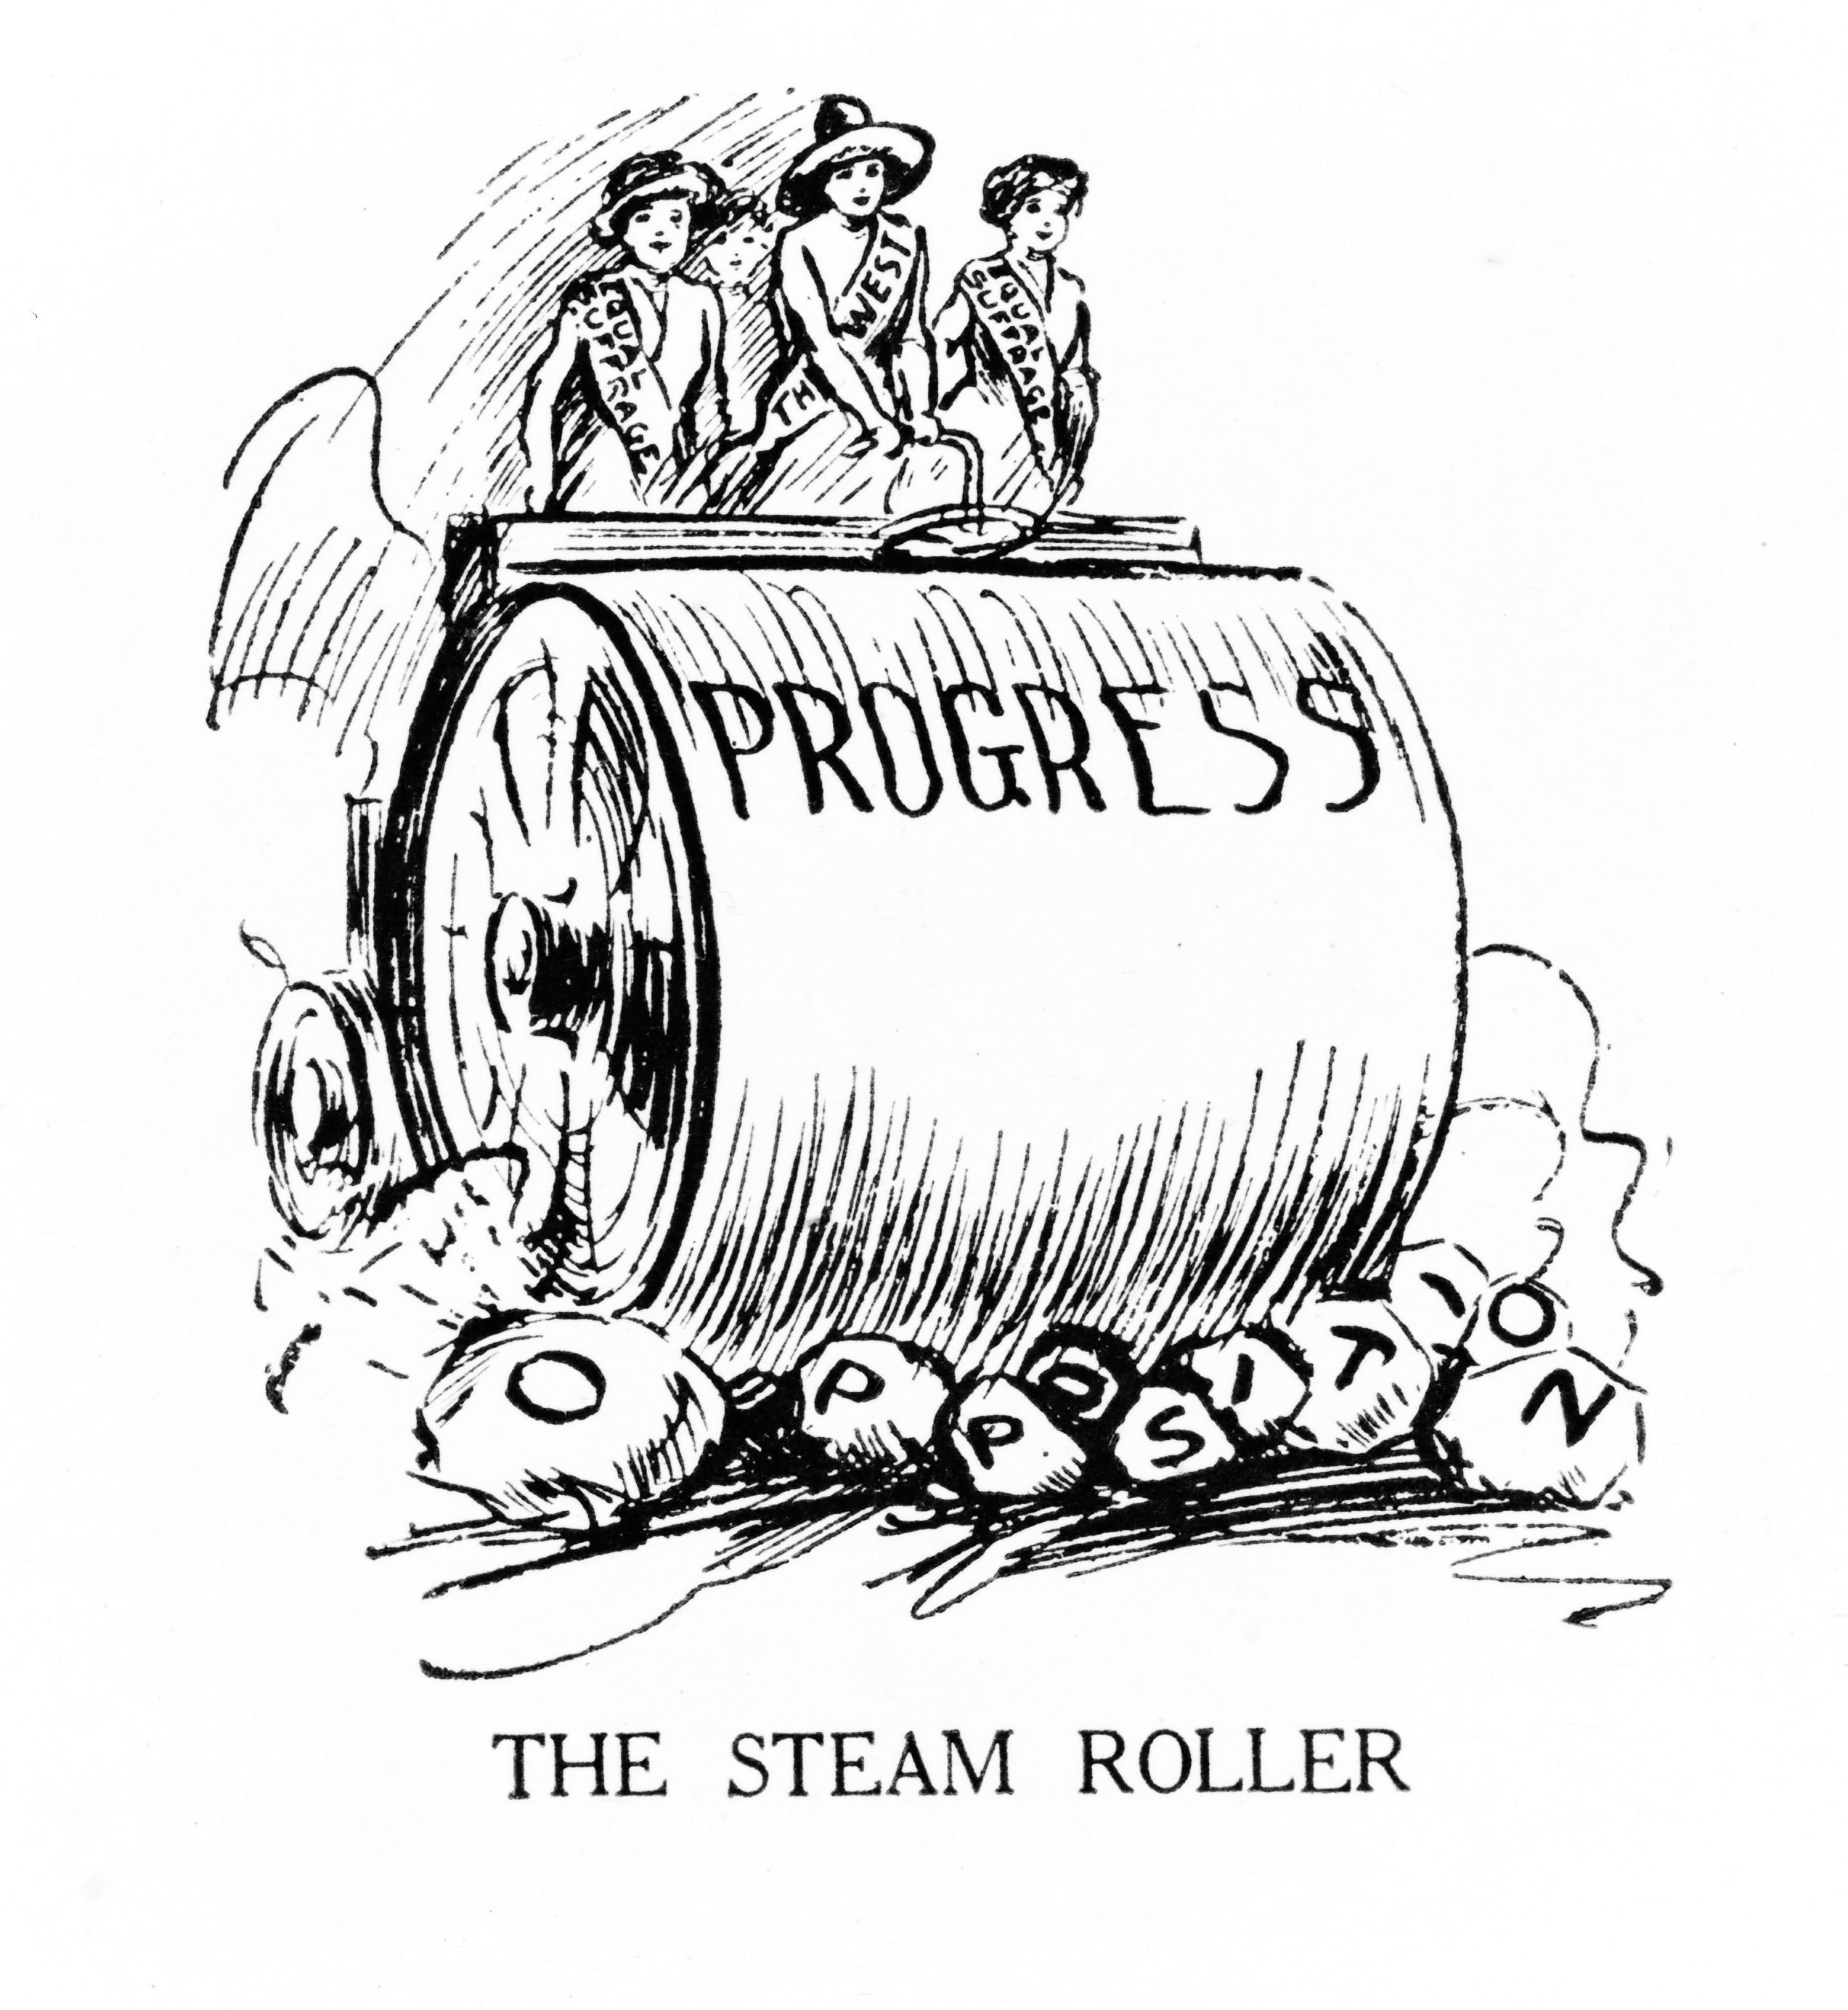
Pushing for Progress
The Progressive Movement Begins

Slide 2

Progressivism
Progressive Era (~1890-1920): A collection of views on how to fix the problems that existed in American society.
  Reaction to the Gilded Age
  Sought increased government involvement
  Participants: Urban, middle-class, women
Notes:
Progressive Era (~1890-1920)
Progressivism: A collection of views on how to fix the problems that existed in American society.
Most believed that government should take a larger role in solving the problems created by immigration and industrialization.
Progressives were usually urban, middle-class Americans.

Slide 3

Drawing Attention to the Problem
Muckrakers: Investigative journalists who drew attention to the problems that had been created by the Gilded Age
  Monopolies, unethical practices of the stock market, child labor, racial bigotry, government corruption, etc.
Varying levels of respect
Muckraker
Journalists
Bad parts of
society
Notes:
Investigative journalists who drew attention to the problems that had been created by the Gilded Age
Writers covered everything from the ruthlessness of monopolies, the unethical practices of the stock market, child labor, racial bigotry, and the corruption of the U.S. Senate.
McClure’s, Collier’s, Cosmopolitan
Term coined by Teddy Roosevelt, who did not necessarily respect these investigative journalists – they were seen to be inflammatory and inciting anger over issues without necessarily providing solutions to those problems.

Slide 4
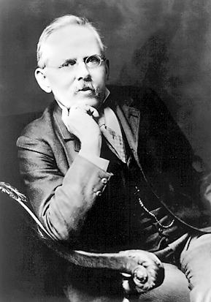
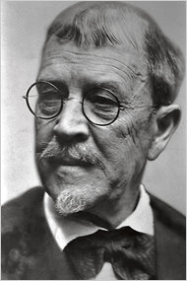
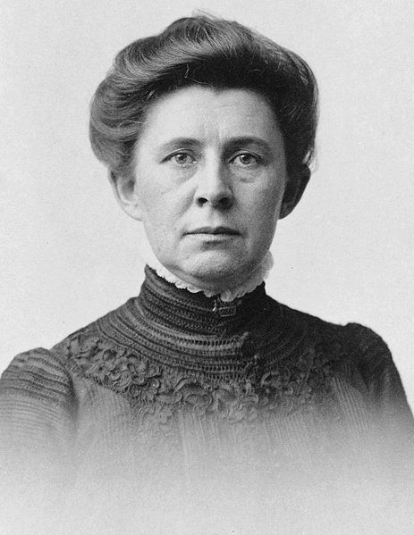
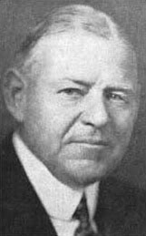
Muckrakers in Action
Jacob Riis - “How the Other Half Lives”
Lincoln Steffens – “The Shame of the Cities”
Ida M. Tarbell – The History of the Standard Oil Company
Samuel Hopkins Adams - The Great American Fraud
Notes:
Jacob Riis - “How the Other Half Lives”
Illustrated the destitution of the tenements, which led to a rise in social reform.
Lincoln Steffens – “The Shame of the Cities”
Sought to expose public corruption in many major cities
Ida M. Tarbell – The History of the Standard Oil Company
An exposé of the Standard Oil Company, run by oil tycoon John D. Rockefeller, and is credited with hastening the breakup of Standard Oil.
Samuel Hopkins Adams - The Great American Fraud (1905)
Revealed fraudulent claims and endorsements of patent medicines in America. This article shed light on the many false claims that pharmaceutical companies and other manufactures would make as to the potency of their medicines, drugs and tonics.

Slide 5
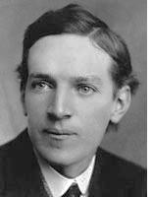
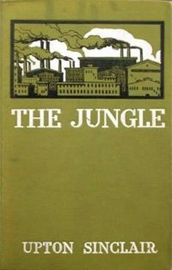
Muckrakers in Action
Upton Sinclair
The Jungle (1906)
Chicago meat packing industry
Intention: Draw attention to the plight of immigrant workers
  Result much different
Notes:
In 1906, Upton Sinclair wrote The Jungle, a novel that details the plight of the immigrant working class in the meat-packing district of Chicago.
Sinclair spent six months researching the industry, spending seven weeks gathering information while working incognito in the meatpacking plants of the Chicago stockyards.
Sinclair intended to "set forth the breaking of human hearts by a system which exploits the labor of men and women for profit”. The book depicts poverty, the absence of social programs, unpleasant living and working conditions, and the hopelessness prevalent among the working class, which contrasted with the deeply rooted corruption of people in power. A review by the writer Jack London called it, "the Uncle Tom's Cabin of wage slavery.”
The novel featured Jurgis Rudkus, a Lithuanian immigrant who works in a meat factory in Chicago, his teenage wife Ona, and their extended family. Sinclair portrays their mistreatment by Rudkus' employers and the wealthier members of society.

Slide 6
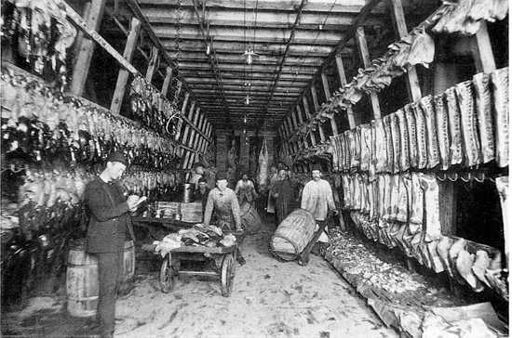
Notes:
Reaction to the book was not as Sinclair intended – readers focused on the graphic descriptions of the unsanitary conditions of the meat packing plants and the disgusting results of these conditions
Domestic and foreign purchases of American meat fell by half
Sinclair wrote in Cosmopolitan Magazine in October 1906 about The Jungle: "I aimed at the public's heart, and by accident I hit it in the stomach.”
The novel brought public support for Congressional legislation and government regulation of the industry, including passage of the Meat Inspection Act and the Pure Food and Drug Act.
In 1919, he published The Brass Check, a muckraking exposé of American journalism that publicized the issue of yellow journalism and the limitations of the “free press” in the United States. In 1943, he won the Pulitzer Prize for Fiction.

Slide 7
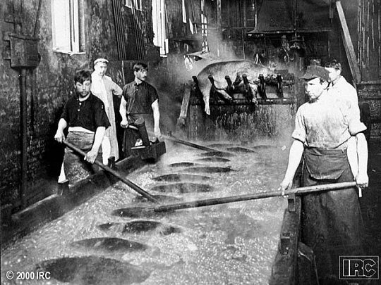

Slide 8
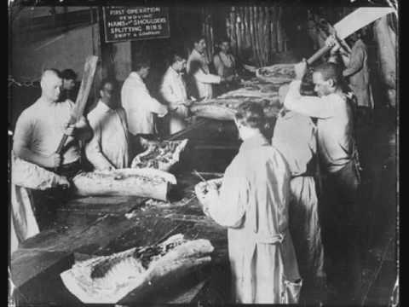

Slide 9
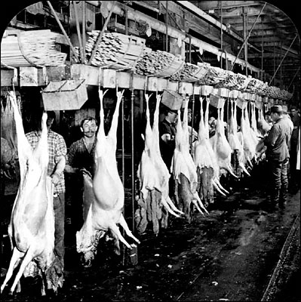
"I aimed at the public's heart, and by accident I hit it in the stomach.”

Slide 10


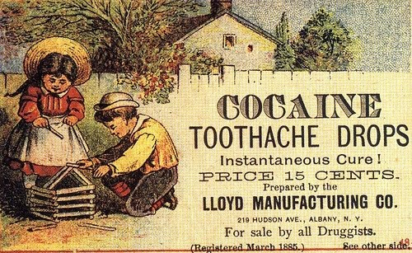
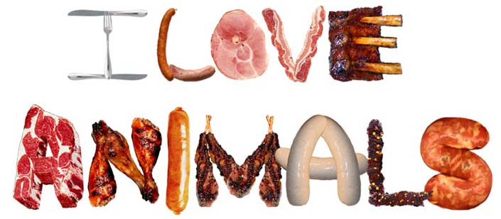
Effects of
The Jungle
Meat Inspection Act (1906)
Pure Food and Drug Act (1906)
Notes:
TR read The Jungle and was incensed by the deplorable conditions described in the book. He demanded an investigation of the meat packing industry. Factories got word of the inspection and cleaned up, but inspectors were still horrified by what they found.
Meat Inspection Act (1906): Meat would be inspected and graded by the U.S.D.A.
Pure Food and Drug Act: Goal was to ensure proper labeling of food and drugs, and to prevent tampering.

Slide 11
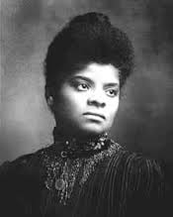
Muckraking for Minorities
Ida B. Wells - "Southern Horrors: Lynch Laws in All Its Phases”
Showed how lynching was often a way to control or punish blacks who competed with whites.
Stated that black economic progress threatened not only white Southerners' pocketbooks, but also their ideas about black inferiority.
She was active in women's rights and the women's suffrage movement
Notes:
Ida B. Wells – “Southern Horrors: Lynch Laws in All Its Phases”
She documented lynching in the United States, showing how it was often a way to control or punish blacks who competed with whites.
Having examined many accounts of lynching based on alleged "rape of white women," she concluded that Southerners concocted rape as an excuse to hide their real reason for lynchings: black economic progress, which threatened not only white Southerners' pocketbooks, but also their ideas about black inferiority.
She was active in women's rights and the women's suffrage movement
Ray Stannard Baker – Following the Color Line (1908)
In 1908 Baker produced a series of five articles on the plight of the African Americans. In this pioneering work in the study of race relations in the United States, Baker dealt with issues such as political leadership, Jim Crow laws, lynching and poverty. These articles were eventually turned into the book, Following the Color Line (1908).

Slide 12
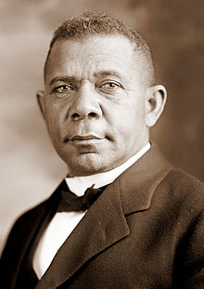
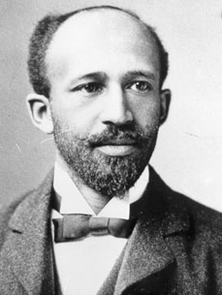
Muckraking for Minorities
W.E.B. Du Bois
Booker T. Washington
Tuskegee Institute
Atlanta compromise
National Association for the Advancement of Colored People (NAACP)
Niagara Movement
Notes:
Booker T. Washington
Advocated the equality of African Americans through economic advancement
Created the Tuskegee Institute as a vocational school for African Americans
Born in Virginia in the mid-to-late 1850s, Booker T. Washington put himself through school and became a teacher. In 1881, he founded the Tuskegee Normal and Industrial Institute in Alabama (now known as Tuskegee University), which grew immensely and focused on training African Americans in agricultural pursuits.
In 1895 his Atlanta compromise stated hat Southern blacks would work meekly and submit to white political rule, while Southern whites guaranteed that blacks would receive basic education and due process in law. Blacks would not agitate for equality, integration, or justice, and Northern whites would fund black educational charities
W.E.B. Du Bois
Advocated equality for African Americans through political and governmental changes
Created the National Association for the Advancement of Colored People (NAACP)
Du Bois rose to national prominence as the leader of the Niagara Movement, a group of African-American activists who wanted equal rights for blacks. Du Bois and his supporters opposed the Atlanta Compromise. Instead, Du Bois insisted on full civil rights and increased political representation, which he believed would be brought about by the African-American intellectual elite. He referred to this group as the talented tenth and believed that African Americans needed the chances for advanced education to develop its leadership.

Slide 13
Rage Against the Machine!
Economic and Political Progressivism

Slide 14
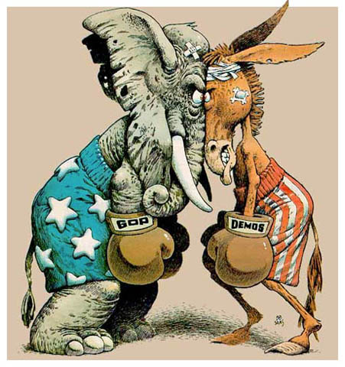
Fixing Politics and Voting

Slide 15
City Reforms
Increasing government efficiency
  Experts, not politicians
  Pendleton Act
City Governments
  Mayor-Council Form
  Council-Manager Form
  Commission Form
City Council
Mayor
City Manager
Heads of City Departments
Voters
Voters
City Council
Voters
Mayor
City Council
Heads of City Departments
City Manager
City Commissioners
Notes:
Meant to increase government efficiancy by having experts fun various government programs.
Would help eliminate the power of corrupt political machines
Preceded/inspired by the Pendleton Civil Service Act
Mayor-Council Form: Mayor and city council are elected by voters; the mayor appoints heads of the city departments
Council-Manager Form: Voters elect a city council, which selects one of their own as mayor. The city council also appoints a city manager, who, in turn, selects the heads of city departments
Commission Form: Voters elect the city council, who appoints a city manager, who selects commissioners of major departments (finance, police, fire, public works)
This form of government originated in Galveston, Texas as a response to the Galveston Hurricane of 1900, mainly for the reason that extra support was needed in certain areas.
Despite differences in structure, all were designed to give citizens more direct control over how their cities were run

Slide 16
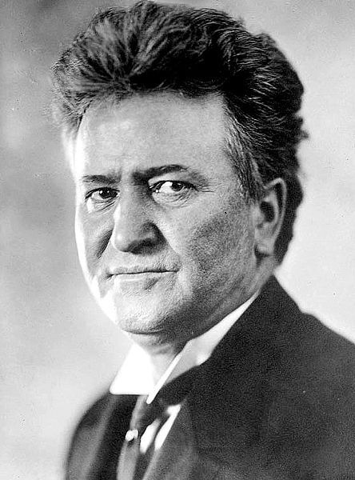
State Reforms
Governor Robert “Fighting Bob” La Follette (WI)
Progressive legislation
  RR rate reform, direct primaries, minimum wage, women’s suffrage, etc.
“Laboratory for democracy”
Notes:
Governor Robert La Follette – one of the most prominent Progressives in politics at the time
Listed as one of the greatest congressmen and senators in US History
Gained national attention when muckraking journalist Lincoln Steffens began to cover his campaign.
As governor, La Follette championed numerous progressive reforms
Railroad rate reform
Direct primary
First Worker’s compensation system
Direct legislation (Initiative and referendum)
Minimum wage
Open primary
Women’s suffrage
Progressive taxation
By working with the University of Wisconsin, This made Wisconsin a "laboratory for democracy”

Slide 17

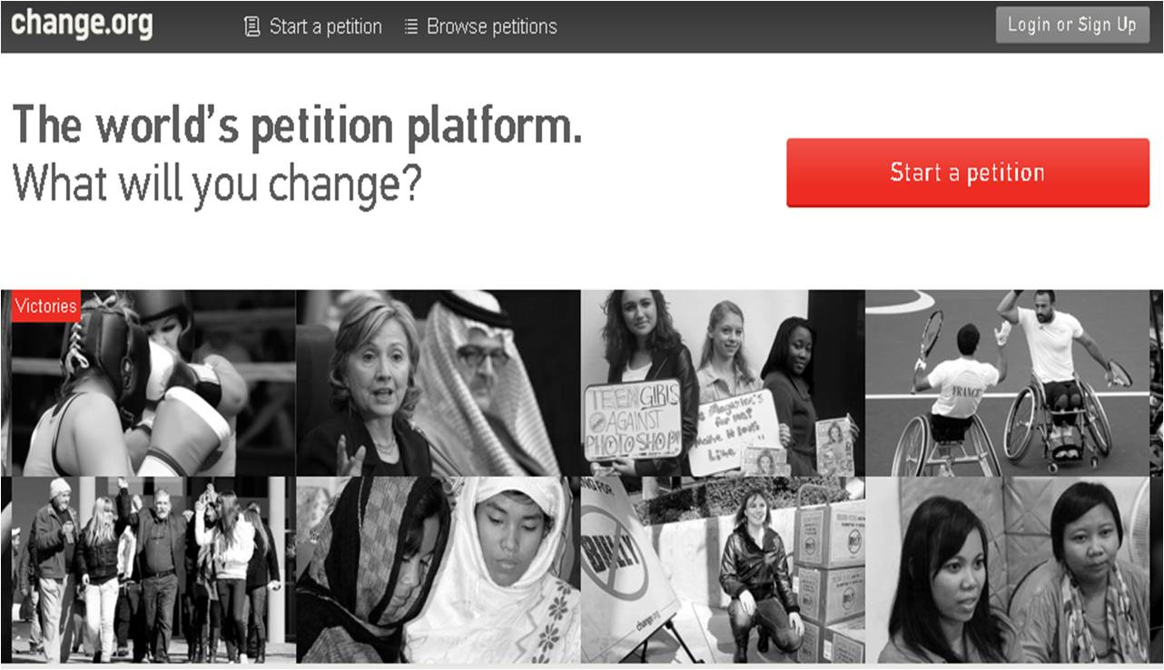
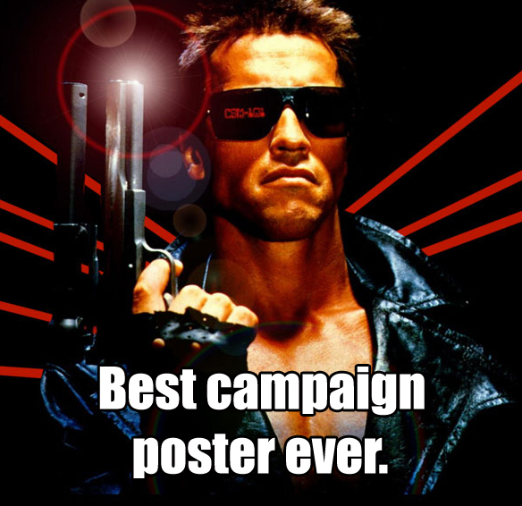

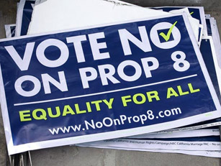
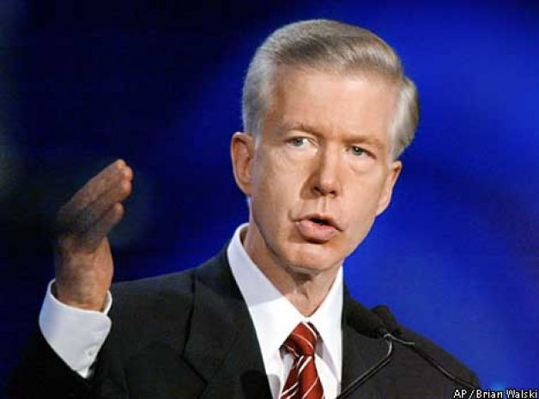
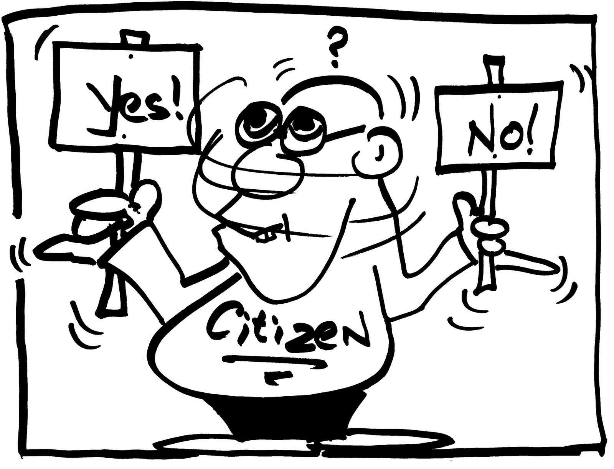
State Reforms
Initiative
Referendum
Recall
Notes:
Initiative: Citizens could initiate or introduce new legislation
Referendum: Allowed legislation to be submitted to the voters approval (e.g. Prop 30)
Recall: Allowed voters to demand a special election to remove an elected official from office before their term had ended (e.g. Governor Gray Davis, 2003)

Slide 18
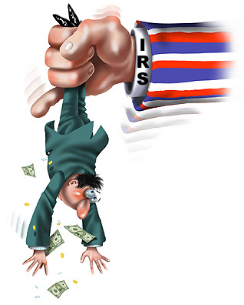
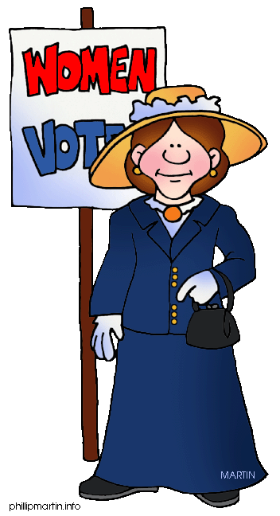
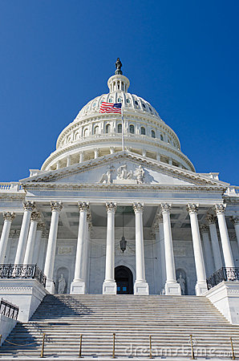
National Reform
16th
16th Amendment: Graduated income tax
17th Amendment: Direct election of senators
19th Amendment: Women’s Suffrage
19th
17th

Slide 19
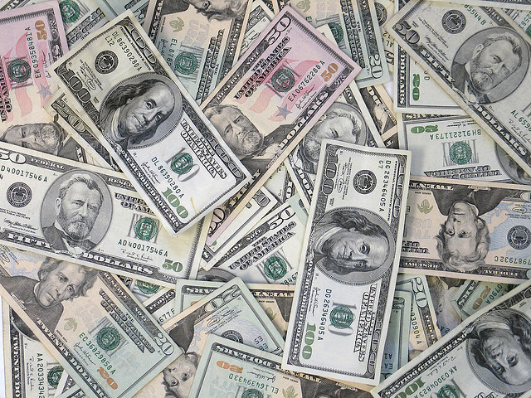
Economic
Reform

Slide 20
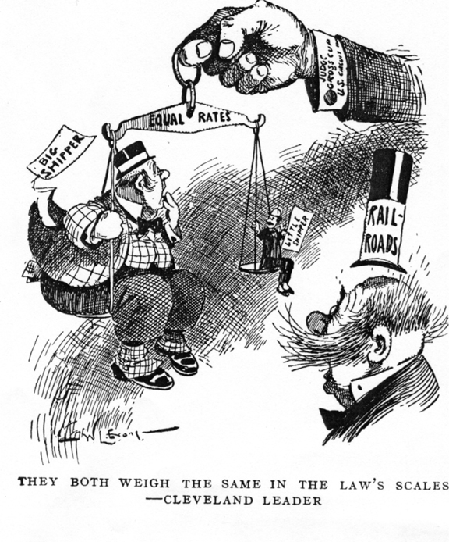
Solution:
Problem: Railroad abuses
Interstate Commerce Commission
    Elkins Act: Authorized the ICC to impose heavy fines on railroads that offered rebates
    Hepburn Act: Gave the ICC the power to set maximum railroad rates and extend its jurisdiction. This led to the discontinuation of free passes to loyal shippers.
Notes:
Problem: Rebates, pools, and unfair business practices by railroads
Solution: Legislation created to prevent unfair treatment and equal opportunity on railroads.
Interstate Commerce Commission
Elkins Act
amended the Interstate Commerce Act of 1887.[1] The Elkins Act authorized the Interstate Commerce Commission to impose heavy fines on railroads that offered rebates, and upon the shippers that accepted these rebates. The railroad companies were not permitted to offer rebates. Railroad corporations, their officers, and their employees, were all made liable for discriminatory practices
Hepburn Act
gave the Interstate Commerce Commission (ICC) the power to set maximum railroad rates and extend its jurisdiction. This led to the discontinuation of free passes to loyal shippers.[1] In addition, the ICC could view the railroads' financial records, a task simplified by standardized bookkeeping systems. For any railroad that resisted, the ICC's conditions would remain in effect until the outcome of legislation said otherwise. By the Hepburn Act, the ICC's authority was extended to cover bridges, terminals, ferries, railroad sleeping cars, express companies and oil pipelines.

Slide 21
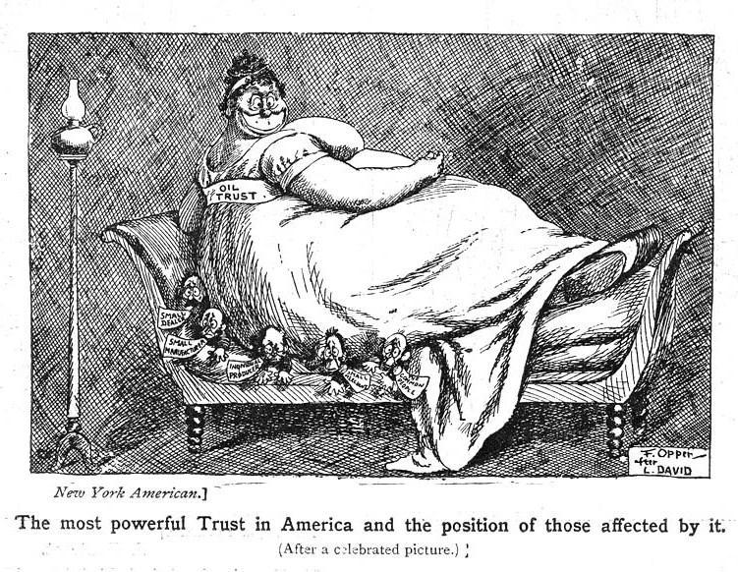
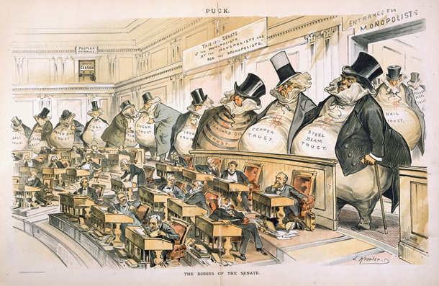
Solution:
Problem: Trusts and Monopolies
Sherman Anti-Trust Act
  United States vs. E.C. Knight (AKA: Sugar Trust case): Outlawed all trade combinations that restricted trade between states (e.g. monopolies)
Clayton Anti-Trust Act
Notes:
Problem: Trusts and Monopolies manipulating the market
Solution: Legislation created to prohibits certain business activities that reduce competition, including trusts and monopolies.
Sherman Anti-Trust Act
United States vs. E.C. Knight
also known as the "Sugar Trust Case," was a United States Supreme Court case that limited the government's power to control monopolies.
One of its two main provisions outlawed all trade combinations or agreements that severely restricted trade between states or with foreign powers. The second outlawed any attempts to monopolize trade within the United States. When the American Sugar Refining Company acquired almost all of the sugar-producing capacity in the U.S., the government sought to divest it of its monopoly.
Clayton Anti-Trust Act
specified particular prohibited conduct, the three-level enforcement scheme, the exemptions, and the remedial measures.

Slide 22
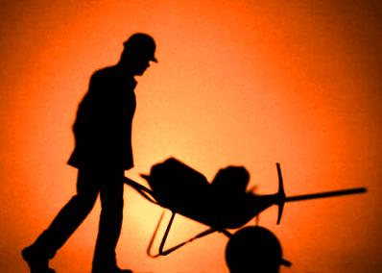
Business
Reform

Slide 23
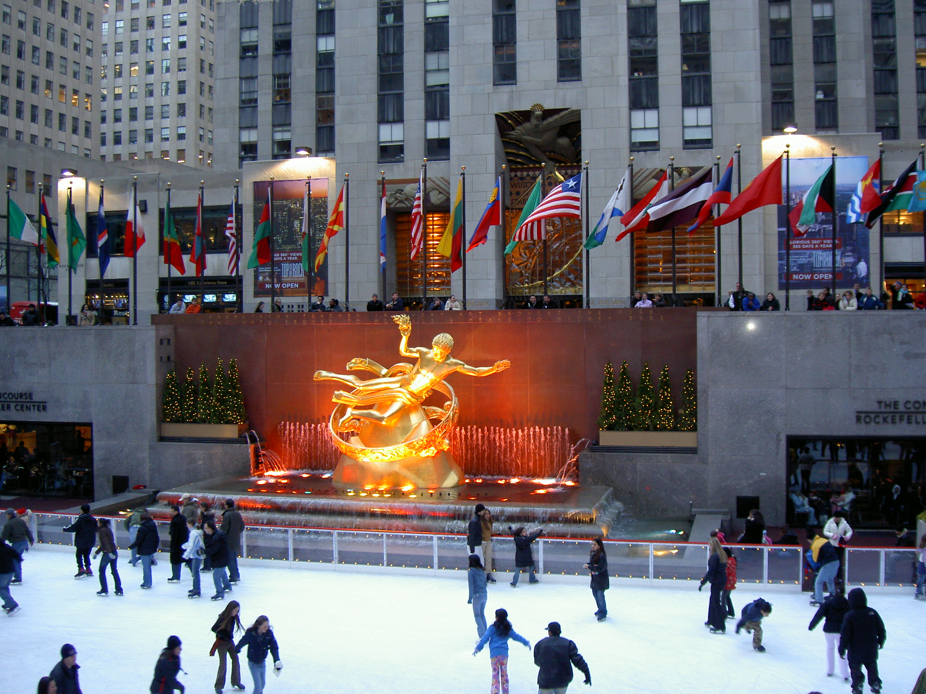

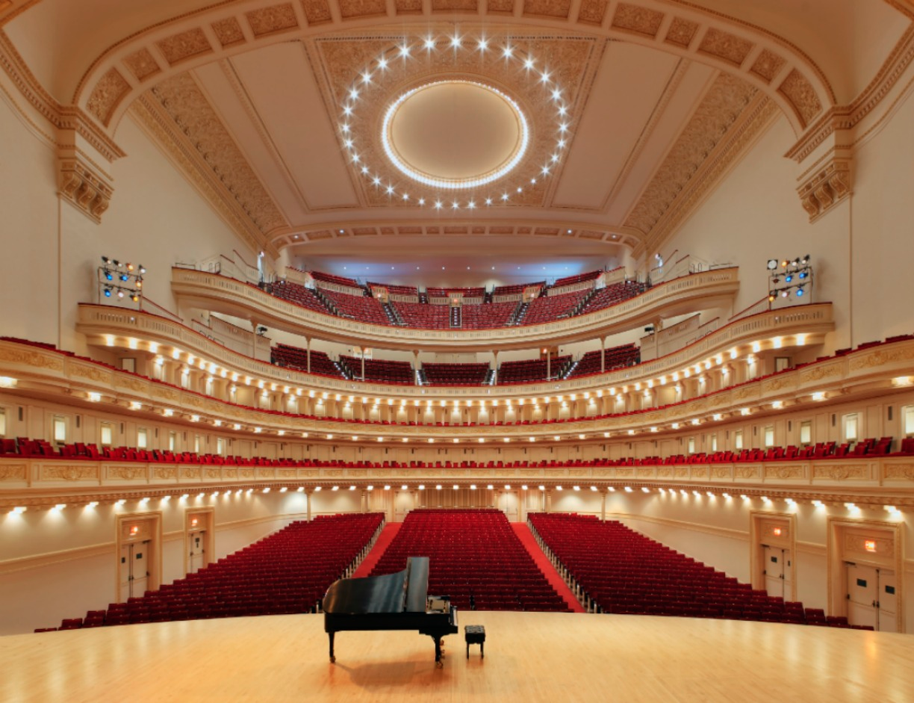
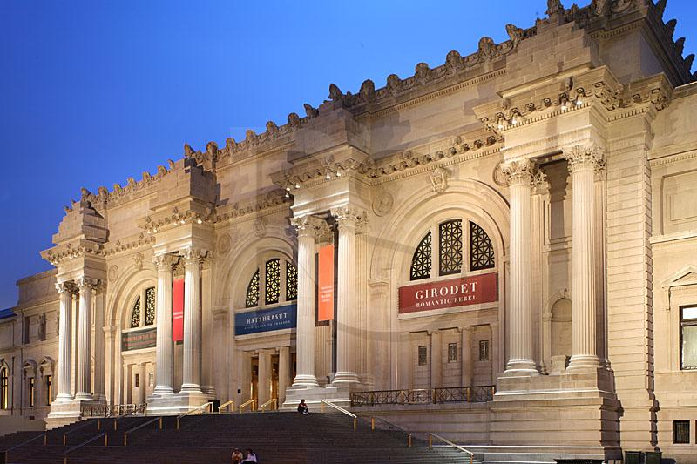
Gospel of Wealth
Andrew Carnegie
Moral Philanthropy
  Rockefeller Center
  Vanderbilt University
  Carnegie Hall
  Metropolitan Museum of Art
Mixed reactions
Notes:
Gospel of Wealth – Andrew Carnegie
Stated that the rich have a moral obligation to give away their fortunes.
All personal wealth beyond that required to supply the needs of one's family should be regarded as a trust fund to be administered for the benefit of the community.
Established public libraries; spent over $56 million to build 2,509 libraries throughout the English-speaking world.
During his lifetime, Carnegie gave away over $350 million.
Other business titans of the time donated part of their fortunes to various charities and programs, creating some of the most iconic locations in America.
Not everyone agreed – some saw this as going against their class

Slide 24
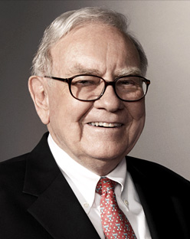



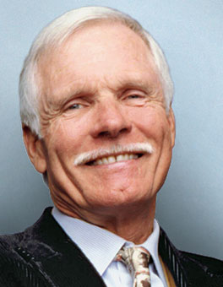

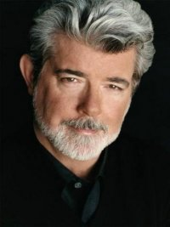
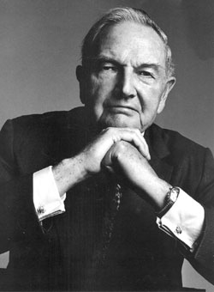
Modern-day Gospel of Wealth
The Giving Pledge: Currently, 128 billionaires from around the world have joined this campaign and pledged to give 50% or more of their wealth to charity
  Diane von Furstenberg
  Elon Musk
  Warren Buffett
  Bill Gates
  Mark Zuckerberg
  Ted Turner
  George Lucas
  David Rockefeller
  J.K. Rowling

Slide 25
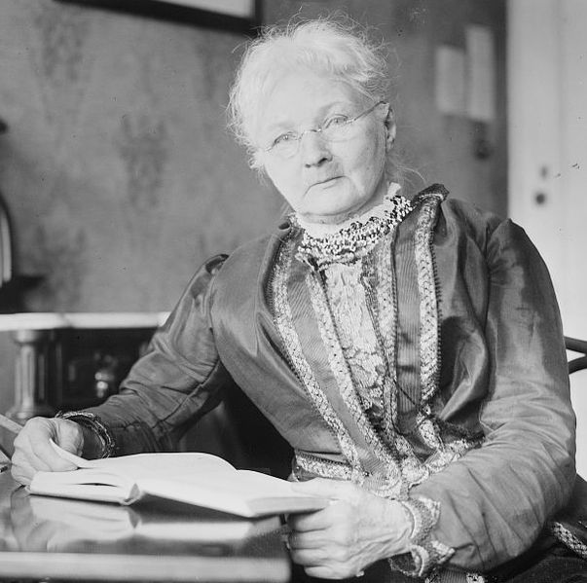
Mother Jones
Mary Harris Jones
  “The most dangerous woman in America”
Organized strikes and boycotts
Children’s March
Co-founder of Industrial Workers of the World (IWW, AKA: “Wobblies”)
“Philadelphia’s mansions were built on the broken bones, the quivering ears, and drooping heads of these children… Some day the workers will take possession of your city hall, and, when we do, no child will be sacrificed on the altar of profit!”
Notes:
Mary Harris Jones - An Irish schoolteacher and dressmaker who became a prominent labor and community organizer
Shocked by the number of children working in Pennsylvania factories, and the horrible accidents that had befallen them.
Organized the Children's March (200+ children) from Philadelphia to the home of then president Theodore Roosevelt in New York.
“Philadelphia’s mansions were built on the broken bones, the quivering ears, and drooping heads of these children… Some day the workers will take possession of your city hall, and, when we do, no child will be sacrificed on the altar of profit!”
who helped coordinate major strikes and co-founded the Industrial Workers of the World (aka: the wobblies).

Slide 26
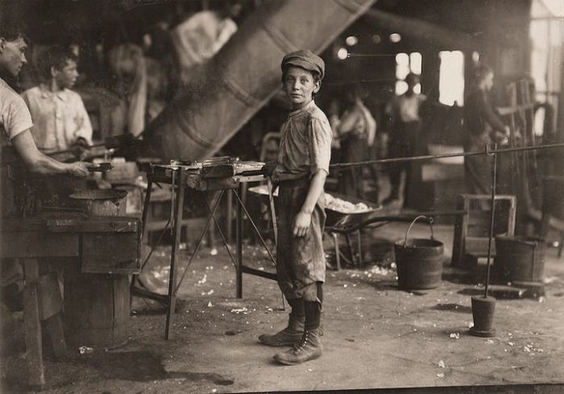
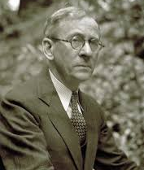
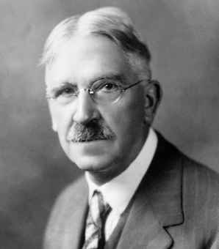
Campaign Against Child Labor
National Child Labor Committee (1904)
  Lewis Hine
Children’s Bureau (1912)
  Keating-Owen Act: prohibited the sale in interstate commerce of goods produced by factories that employed young children
Horace Mann
Notes:
In 1900 over 1.7 million children under the age of 16 were working in factories, earning $1/hr. in 2012 dollars.
National Child Labor Committee was created to abolish child labor.
Employed photographer Lewis Hine to capture the plight of the nation’s child workers
Many states passed laws limiting or banning child labor based off of the reports of the Committee
Children’s Bureau – Tackled a variety of issues that affected children (labor, health, safety, etc.)
Keating-Owen Act: prohibiting the sale in interstate commerce of goods produced by factories that employed young children
Horace Mann
Compulsory education was created as an alternative location for children, instead of work.

Slide 27
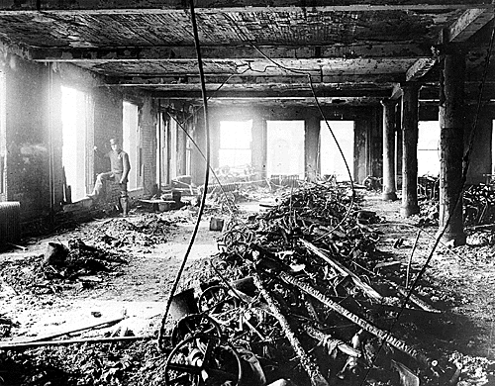
Triangle Shirtwaist Factory Fire - 1911

Slide 28
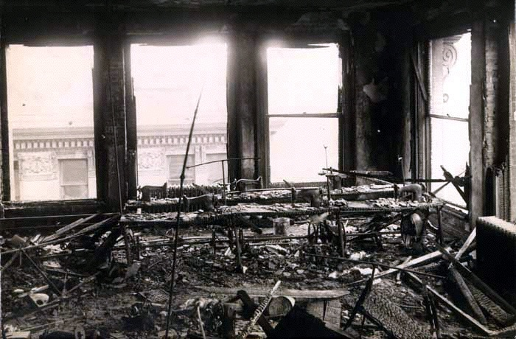
Remnants of the Factory
Notes:
28

Slide 29
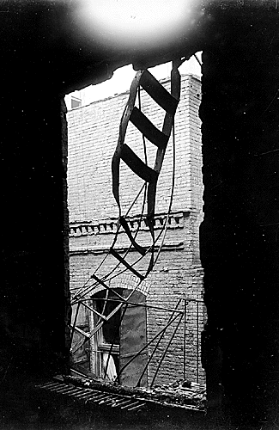
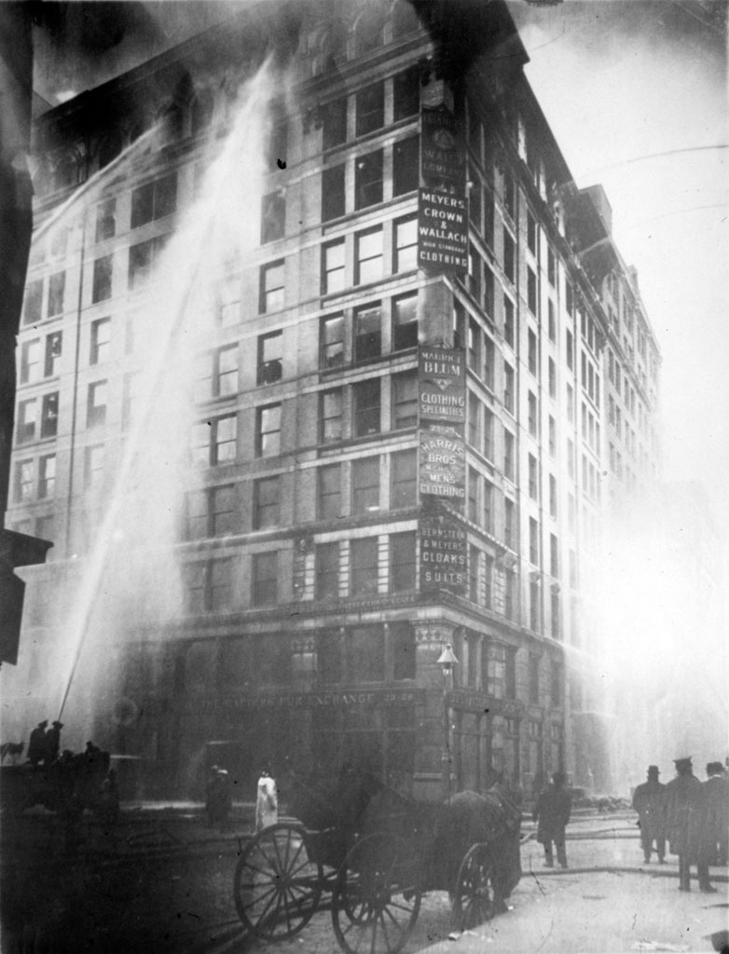
Notes:
29

Slide 30
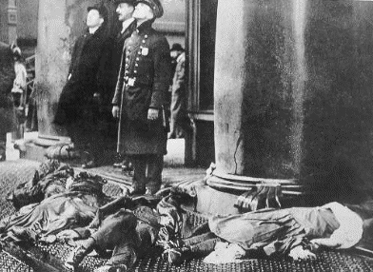
Notes:
30

Slide 31
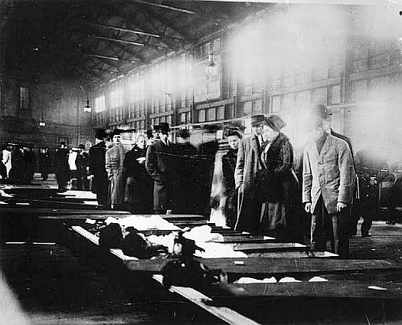
Some of the bodies
were so grotesque that
they were covered up.
A brief description was
written on the outside
of the coffin.
Notes:
31

Slide 32
Recent Tragedies
Oakland Warehouse Fire – (Dec. 2016) Ghost Ship (36)
Schoharie Limo Crash- (Oct. 2018) (20) A month before the crash, the state Department of Transportation placed an "out of service" sticker on limo's windshield, but the vehicle was put back on the road by its owner, Prestige Limousine of Saratoga County, state officials have said.
Duck Boat- (July 2018) (13)

Slide 33
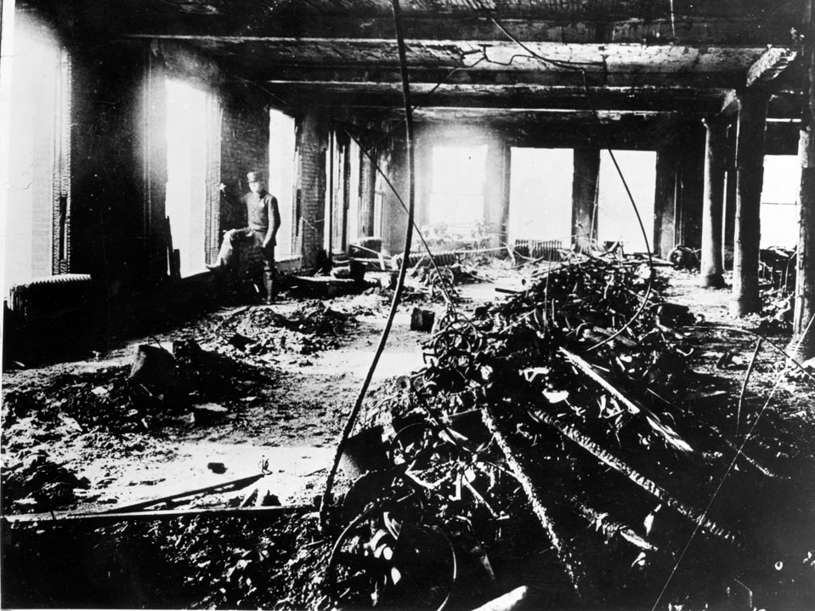


Results
The public outcry prompted many states to pass laws regulating hours and conditions in such “sweatshops” and to pass worker’s compensation laws.
Because of this tragedy laws were passed in NY requiring all buildings to have exterior fire escapes, automatic sprinklers, fire alarms, and well-lit exit doors. Other states followed suit.

