Slide 1

The Power of the People
The Populist Party

Slide 2
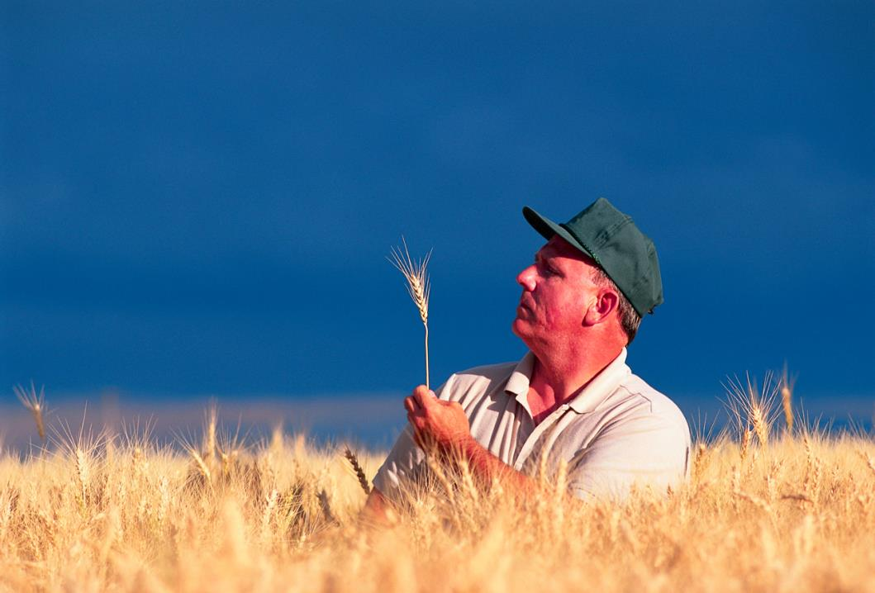
Causes of Populism
Increased competition, foreign and domestic
Overproduction due to industrialization
Abuses by railroad companies and storage facilities
High tariffs lead to difficulty selling goods overseas
Drop in agricultural prices worldwide
Large numbers of farmers in severe debt

Slide 3
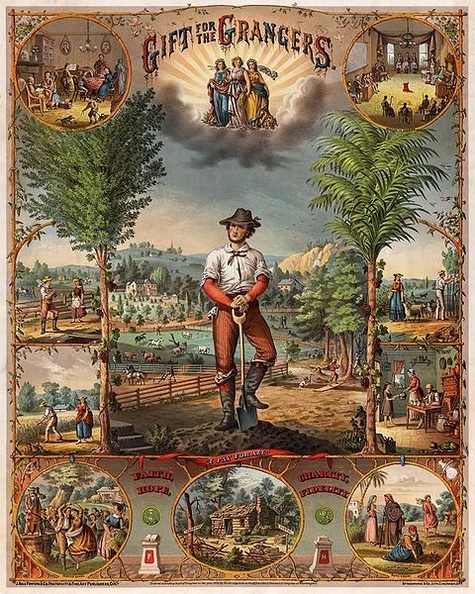
The Movement Begins
National Grange of the Order of Patrons of Husbandry (1867)
Developed out of a need for updated farming practices and a support system for struggling farmers post Civil War.
  Education, socialization, religion, co-ops
“Granger Laws”to regulate RR
Munn v. Illinois (1877)
  Regulated grain warehouses as a “public good”
  Overturned by Wabash v. Illinois (1886)
Notes:
National Grange of the Order of the Patrons of Husbandry
Oldest agricultural advocacy group with a national scope; est. 1867
Developed out of a need for updated farming practices and a support system for struggling farmers post Civil War.
Included women as an integral part of the organization
Encouraged education, both formal and informal
Socializing for isolated formers
Highly religious
Set up co-ops (cooperatively owned stores) so farmers wouldn’t have to sell to one grain elevator
Sought to regulate the railroads – “Granger Laws”
Munn v. Illinois (1877) – held that grain warehouses were a “private utility in the public interest,” and therefore could be regulated by public law. Overturned by SC in Wabash v. Illinois (1886).

Slide 4
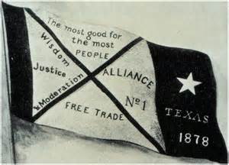
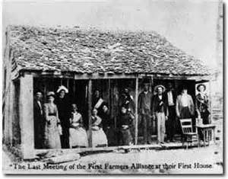
The Movement Grows
The Farmer’s Alliance (1877)
  Supported regulation of RR, income tax, inflation
  Most popular in South and Great Plains
  No tenant farmers, sharecroppers, blacks
  Politically ineffective
Notes:
Farmers’ Alliance: promoted collective economic action by farmers; very popular in the South and Great Plains.
Over 1 million members by 1890
Excluded tenant farmers, sharecroppers, and blacks
Supported regulation of the transportation industry, establishment of an income tax, and inflation of the nation’s money supply
Was ineffective at achieving their goals because they had no means against to change national policy.
Would evolve into the People’s/Populist party

Slide 5
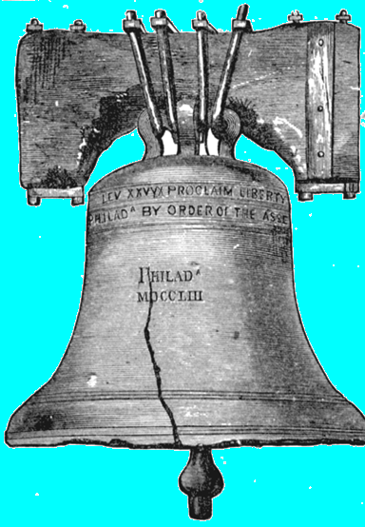
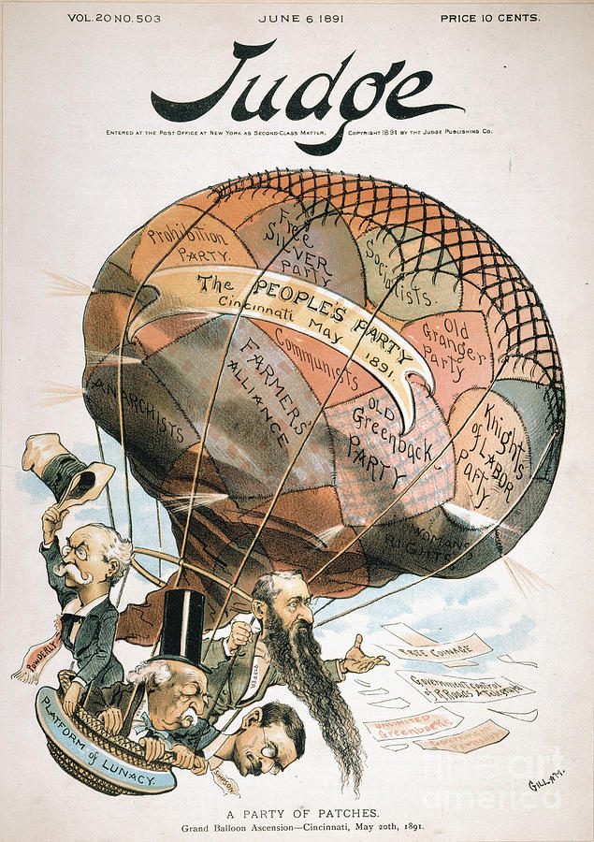
A Party is Born
People’s Party (AKA: Populists), 1891
  Grew out of Farmers’ Alliance and KOL
  Farmers, factory workers, women
  Goal was to fight against the moneyed classes that controlled business and the government and create legislation to benefit the working classes
“Raise less corn and more hell”
  “If one man has not enough to eat three times a day and another man has $25 million, that last man has something that belongs to the first.”
- Mary Elizabeth Lease
Notes:
Neither the Democrats or Republicans were willing to take on the issues of the Farmers’ Alliance.
The Farmers’ Alliance and the Knights of Labor created the Populist Party, AKA: the People’s Party. 1891
Made up of mostly farmers and factory laborers; women were highly involved.
Goal was to fight against the moneyed classes that controlled business and the government and create legislation to benefit the working classes
Mary Elizabeth Lease, AKA: Mary Yellin’ or the Kansas Pythoness
“If one man has not enough to eat three times a day and another man has $25 million, that last man has something that belongs to the first.”

Slide 6
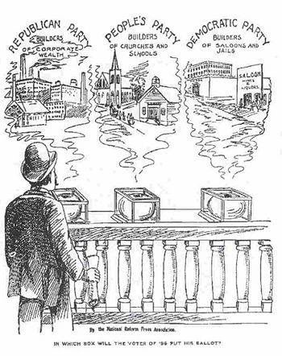
The People’s Party Platform (AKA: The Omaha Platform)
Platform meant to address the needs of both farmers and factory workers (e.g. abuses of big business against the “little guy” and unfair practices under the US government)
Won some elections, but never held positions at the top of the national government
Would achieve most of their goals, though some not for many years, and not through their own party
Notes:
Populists met in Omaha in 1892 to draw up the official party platform, addressing the needs of both farmers and factory workers
Largest issue was the free coinage of silver, but also addressed abuses of big business against the “little guy” and unfair practices under the US government
Gained a few Congressional seats and governorships, but never held positions at the top of the national government.
Would achieve most of their goals, though some not for many years, and not through their own party

Slide 7
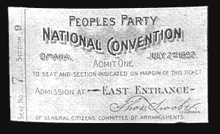

The Omaha
Platform
Free coinage of silver
Federal loans to farmers
Graduated income tax
Abolition of national banks
Civil service reform
Public ownership of railroads, telephone, and telegraph systems
Prohibition of foreign land ownership
Immigration restriction
Ban on use of “private armies” by corporations to break strikes
8 hour workday
Single, six-year term for president
Direct election of senators
The right of initiative and referendum
Use of the “Australian” (secret) ballot
Women’s suffrage

Slide 8
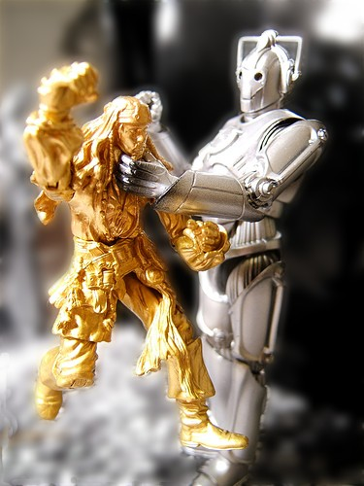
The Currency Question
The Gold Standard had been the basis of the nation’s monetary supply for most of its history
Civil War: greenbacks
  Caused inflation, but benefitted poorer Americans
Gilded Age: Resumption Act, Panics 1873/93
  Greenbacks replaced with gold-backed dollars – reduced inflation
  Less money in the system = bad for workers and borrowers

Slide 9
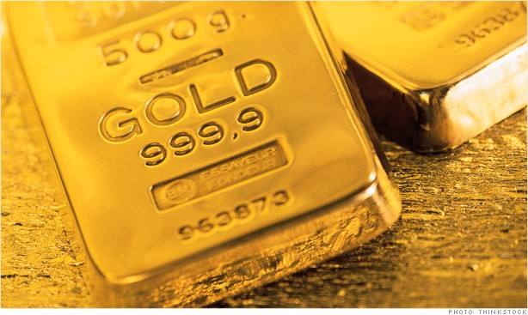
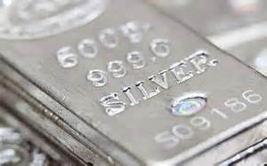
Gold Standard
Silver Standard
“Gold Bugs”
Fair repayment of debts
Republicans
Big business
Banks
“Silverites”/“Free Silver”/“16 to 1”
Easier repayment of debts
Westerners
Populists
Some Democrats
Bimetallism
Notes:
The Silverite coalition's famous slogan was "16 to 1" – that is, the ratio of sixteen ounces of silver equal in value to one ounce of gold
Wanted to inflate the money supply to help debtors paying off their loans. The debt amount would stay the same but they would have more silver money with which to pay it.
Largely supported by Westerners (where silver was mined), Populists, and some Democrats

Slide 10
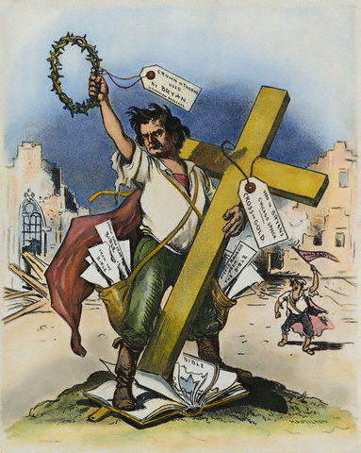
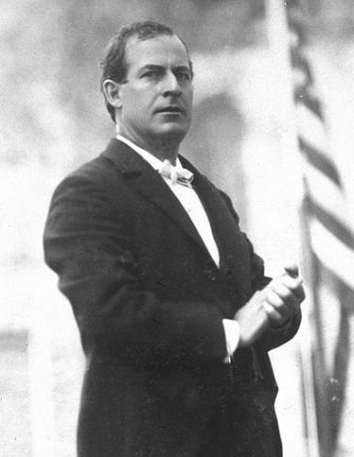
“…you shall not press down upon the brow of labor this crown of thorns. You shall not crucify mankind upon a cross of gold.”
William Jennings Bryan
Notes:
William Jennings Bryan, a former Congressman from Nebraska, took on the Silverite’s cause at the 1896 Democratic Nominating Convention.
The Cross of Gold speech denounced gold as the standard of the rich, at the expense of the nation's working classes: “…you shall not press down upon the brow of labor this crown of thorns. You shall not crucify mankind upon a cross of gold.”
At only 36 years old, he was named the party’s candidate for the upcoming presidential election as a result of his impassioned speech in favor of the silver standard.
Many other elements of the Populists’ platform were included in the Democratic Party’s platform that year, including tariffs, immigration, regulation of the railroads, and labor laws

Slide 11
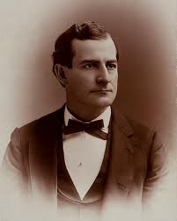
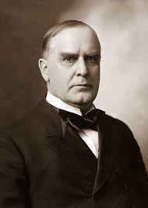
Election of 1896
William Jennings Bryan (D)
William McKinley (R)
Anti-tariff
Fairly unknown Congressman
Pro-labor
Silver standard would save the poor
Pro-tariff
Civil War veteran
Pro-business
Gold standard was the answer for saving jobs and the economy
Notes:
Although other issues were addressed, the currency question was at the forefront of the 1896 election.
Both sides threw around wild economic accusations and played on people's economic fears, reminding voters of the terrors of the Panic of 1893.
William Jennings Bryan was a brilliant and energetic orator. His campaign speeches rose the silver standard to near religion status. Silver was going to save the poor.
McKinley hinted that if Bryan were elected, people would lose their jobs, that employers would cut wages for remaining workers, and gold was the answer to saving the economy.
McKinley won the election 1896 easily, 271 to 176 electoral votes. Bryan carried the South and West, McKinley carried the Northeast, Midwest, and far West.
The election was a victory for business, conservatives, and middle class values (as opposed to the working class), and it started 16 years of Republican presidents (and 8 of the next 36 years).

Slide 12
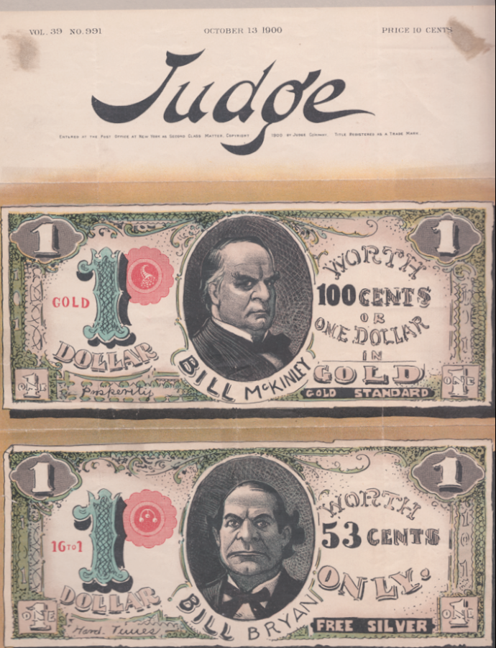
The Movement Moves On
Increase in tariff rates
Gold Standard Act (1900)
Klondike gold rush
Economy rebounds
End of Populists (most become Democrats)
Notes:
With the gold/silver issue decided, the tariff became the lead issue. Congress raised the tariff rates to 46.5% - higher, but not as high as some had wanted.
Congress passed the Gold Standard Act (1900) officially set America’s currency on the gold standard, bringing economic calm and stability.
Also, there was a gold rush in Alaska, the "Klondike gold rush." Lots of new gold brought the inflation that the silverites had long wanted.
The economy rebounded as well due to
the natural business cycle rebounding form the Panic of 1893
McKinley’s pro-business policies
The settling of the gold/silver question.
The Populist movement faded away over the next few years, with their two presidential candidates (1904 and 1908) failing to secure any electoral votes
Most Populists began voting with the Democratic party, but were largely split over the issue of segregation
They disbanded in 1908, just 16 years after their creation.

Slide 13
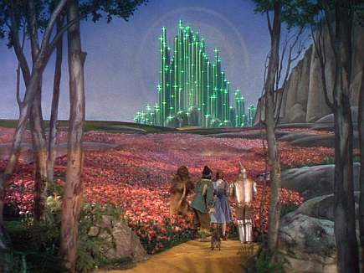
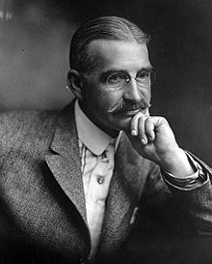
The Wonderful Wizard of Oz

Slide 14
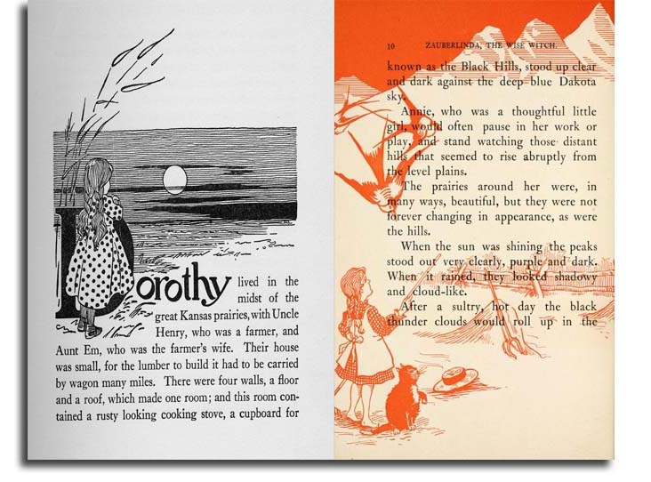
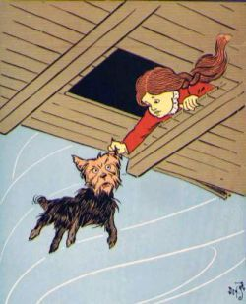

Slide 15
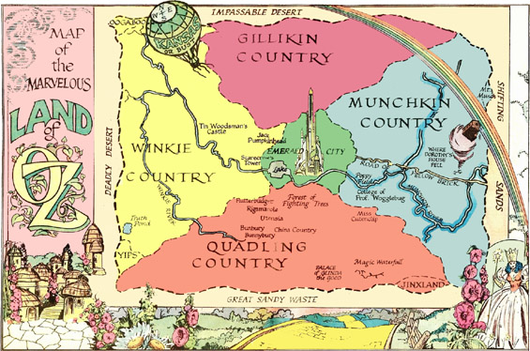

Slide 16
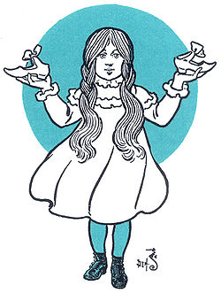
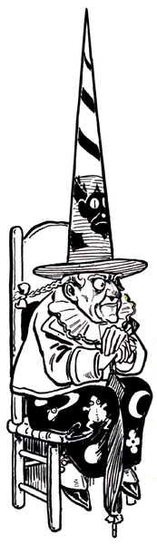
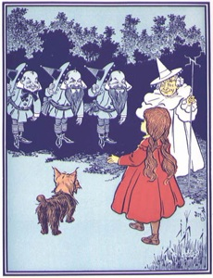

Slide 17
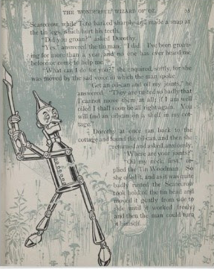
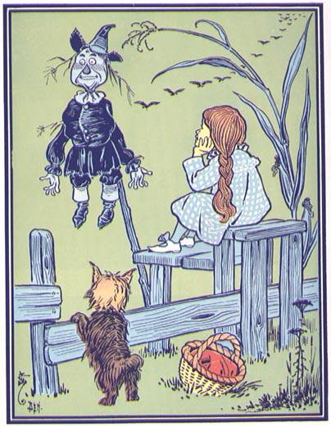

Slide 18
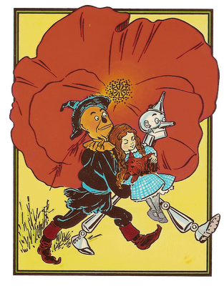
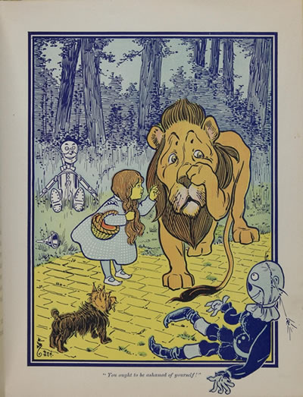

Slide 19
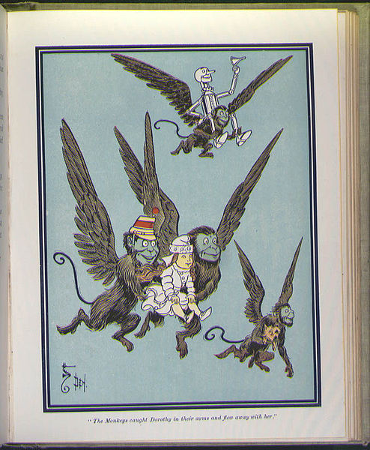
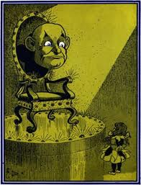

Slide 20
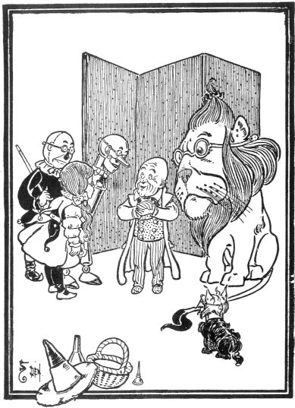
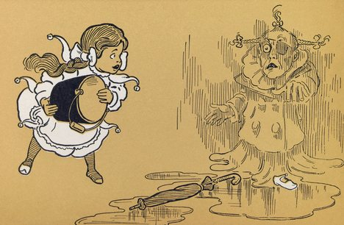

Slide 21
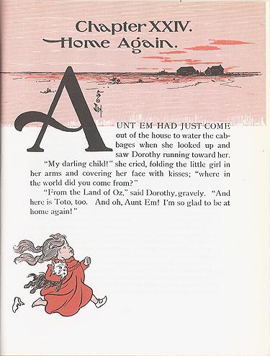
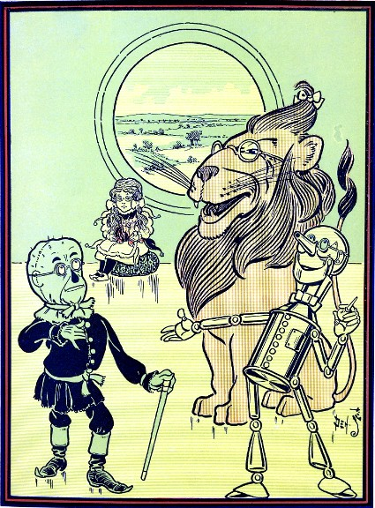

Slide 22
The Wonderful Wizard of Oz
EXPOSED

Slide 23
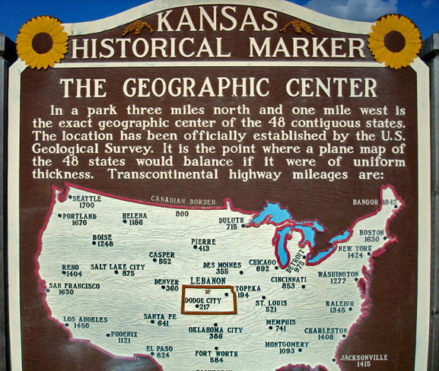


Slide 24
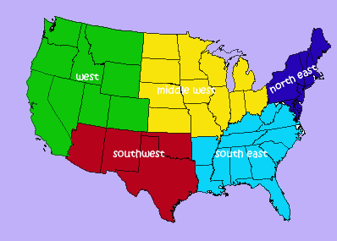


Slide 25
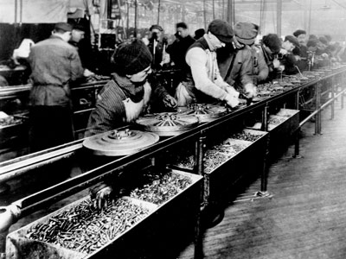

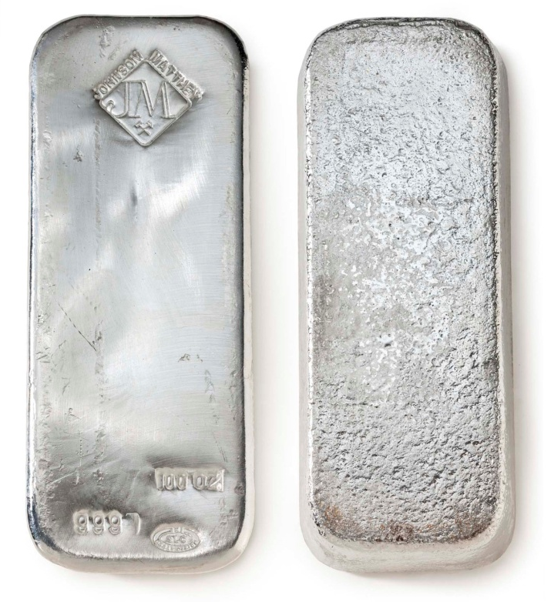

Slide 26

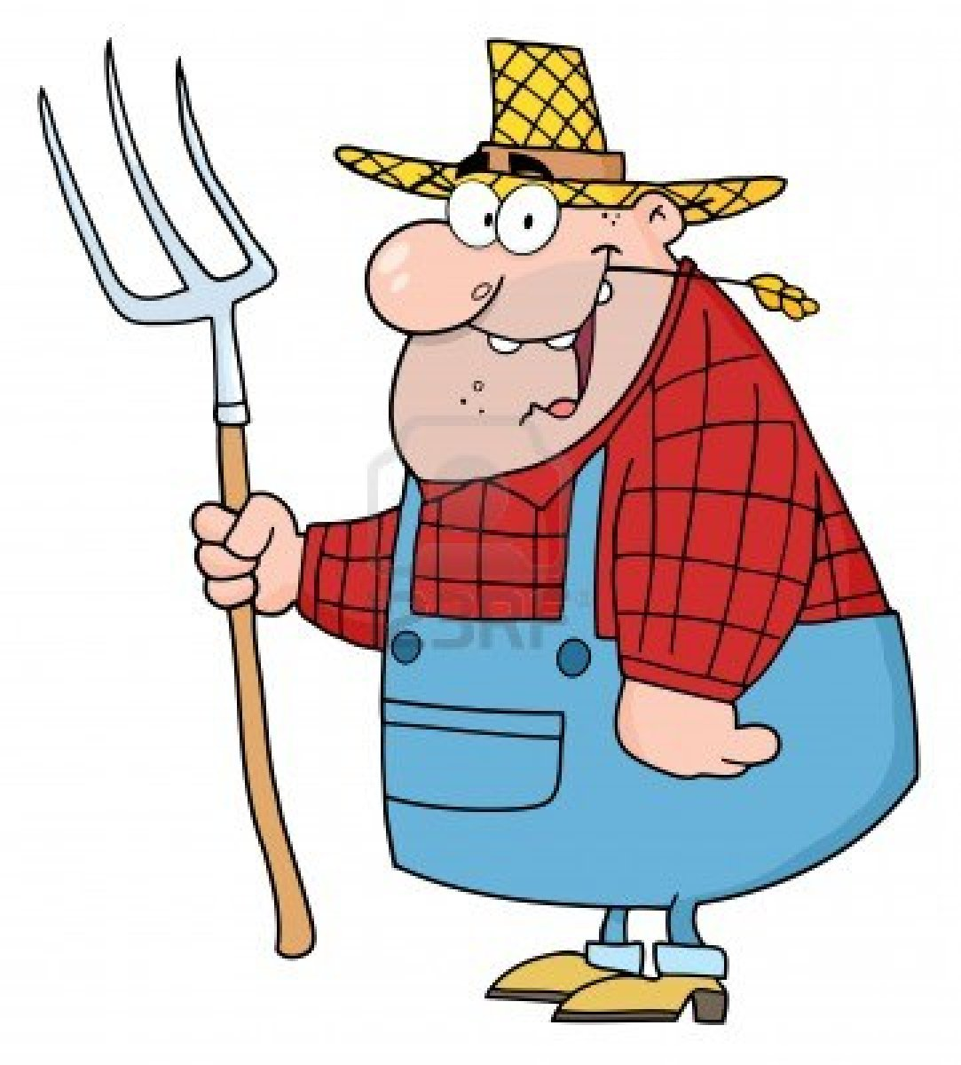

Duhhhh…

Slide 27
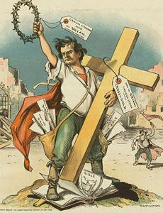
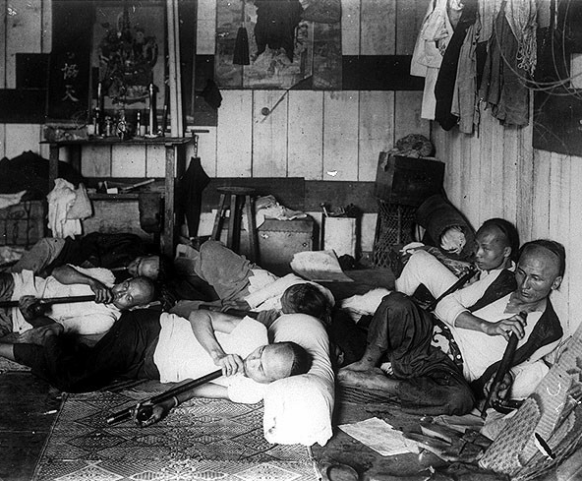

Slide 28
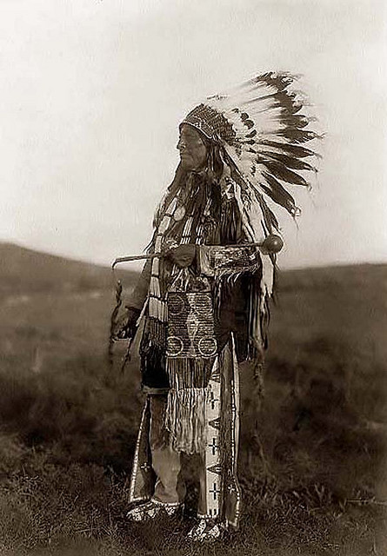


Slide 29



Slide 30
