Slide 1
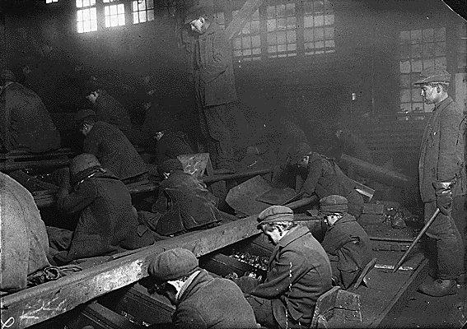
Working in the United States
The men, women, and children who really built America

Slide 2
Working in the United States
Industrialization brought about a dramatic rise in the standard of living for all Americans.
The uneven division of income between the working class and the wealthy caused resentment among workers.
The practice of laissez faire did not protect workers from harsh labor conditions, and the average life expectancy for those working in the cities dropped dramatically.
Big business was largely unregulated since they could easily bribe legislators to vote pro-business. Corporate lawyers were also able to get corporations legally classified as people under the 14th amendment

Slide 3
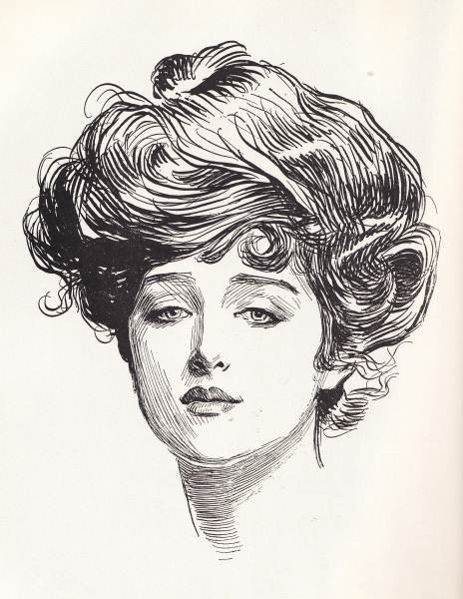
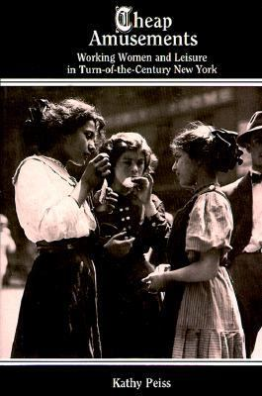
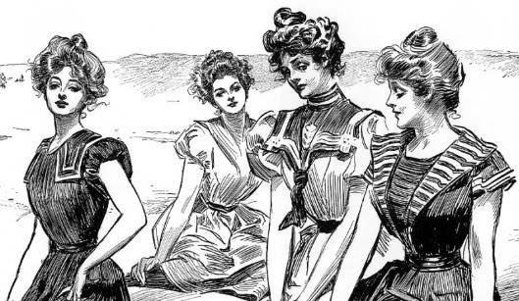
The Gibson Girl
Illustrations by Charles Dana Gibson showed a new American woman – the Gibson Girl.
She was athletic, poised, witty, stylish, and attractive, and invariably wealthy
Her styles were poorly impersonated by the working class who altered homemade dresses and hairstyles to meet the haute couture.

Slide 4
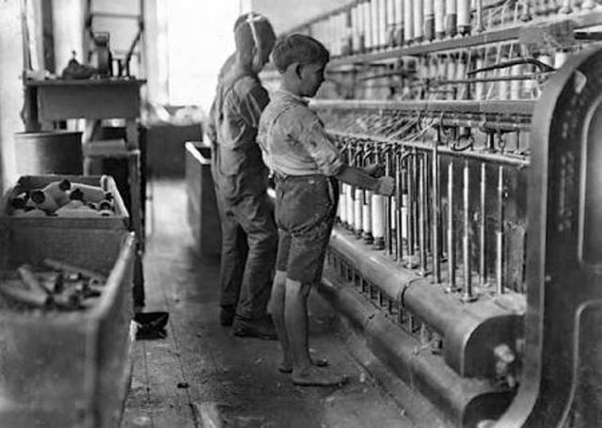
Child Labor
Families grew smaller, and children began working at younger ages to help provide for the family.
Children as young as six years old worked long, hard hours (up to 19 hours a day) for little or no pay in horrible conditions.
Children were using large, heavy, and dangerous equipment, and many accidents occurred injuring or killing children on the job.
Children were paid only a fraction of what an adult would get, and sometimes factory owners would get away with paying them nothing.
The treatment of children in factories was often cruel, and the children's safety was generally neglected.

Slide 5
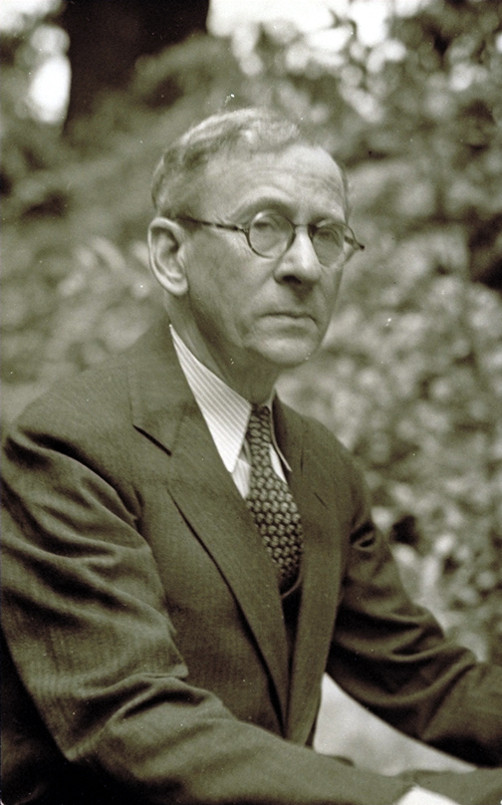
Lewis Hine
An American sociologist and photographer.
Hine used his camera as a tool for social reform.
His photographs were instrumental in changing the child labor laws in the United States.

Slide 6
Factory Children
Notes:
6

Slide 7
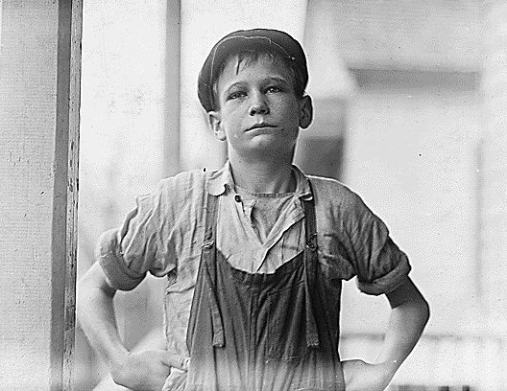
Furman Owens, 12 years old. Can't read. Doesn't know his A,B,C's. Said, "Yes I want to learn but can't when I work all the time." Been in the mills 4 years, 3 years in the Olympia Mill. Columbia, S.C.

Slide 8
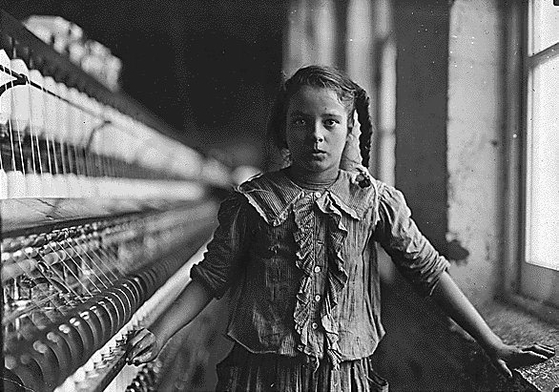
One of the spinners in Whitnel Cotton Mill. She was 51 inches high. Has been in the mill one year. Sometimes works at night. Runs 4 sides - 48 cents a day. When asked how old she was, she hesitated, then said, "I don't remember," then added confidentially, "I'm not old enough to work, but do just the same." Out of 50 employees, there were ten children about her size. Whitnel, N.C.

Slide 9
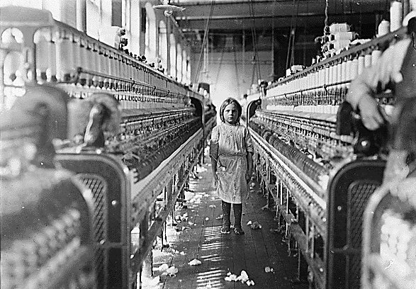
The overseer said apologetically, "She just happened in." She was working steadily. The mills seem full of youngsters who "just happened in" or "are helping sister."
Notes:
9

Slide 10
Smaller children had to climb on the machines to complete their jobs. The youngest children were used to crawl under the machines to retrieve lost bobbins.
Notes:
10

Slide 11
Casualties were quite
common. Once you
were hurt, you were
fired, since you were of
no more use.
Notes:
11

Slide 12
Children who worked in the mines had the worst conditions of all. Often they were required to provide their own candles and lanterns for light, so many worked without light. The caverns were cramped and the air was filled with fine black coal dust that caused a myriad of respiratory diseases, including Black Lung Disease. It was not uncommon for a mine shaft to collapse or for children to be maimed or killed from exploding dynamite. Most would not survive more than seven years working in the mines.
Notes:
12

Slide 13
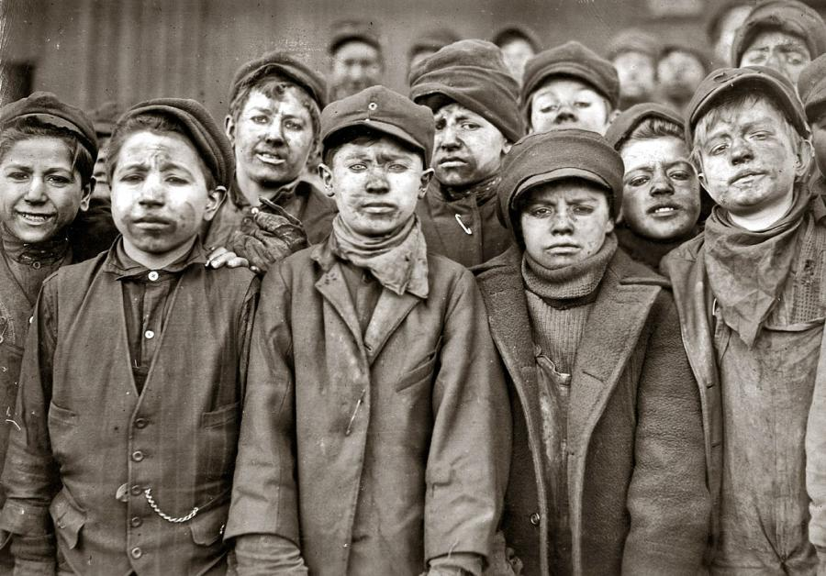
Work began at 3:30am and
went until after dark.

Slide 14
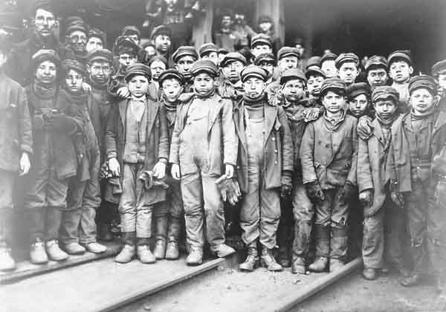
Younger children were sought for climbing into
small crevices to place and light dynamite.

Slide 15
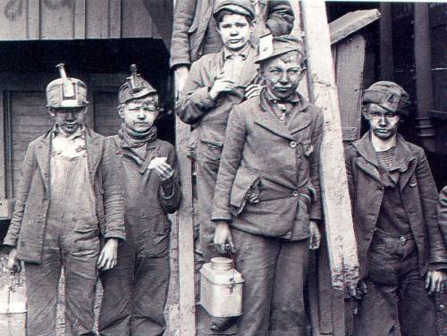
Miner children suffered from "Black Lung"
disease, which caused coughing, breathlessness,
and death of lung tissue.

Slide 16
The Newsies
Notes:
16

Slide 17
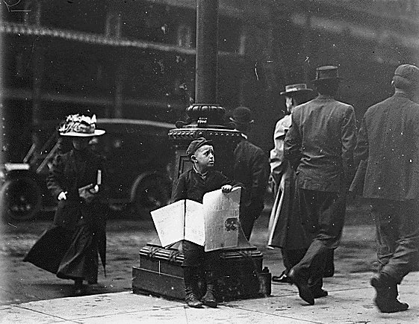
Many newsies were as young
as five years old

Slide 18
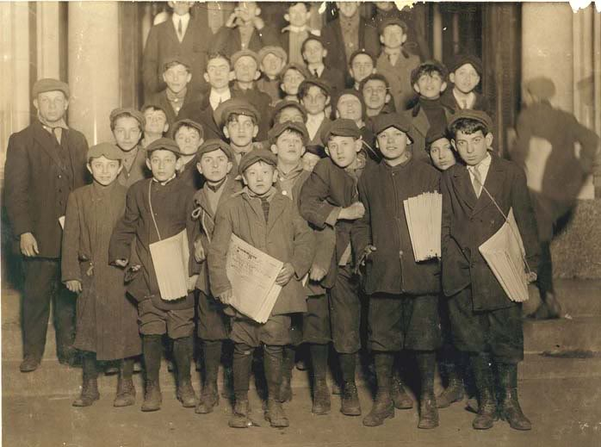
Some newsies were orphans,
but many voluntarily left home
to help their families

Slide 19
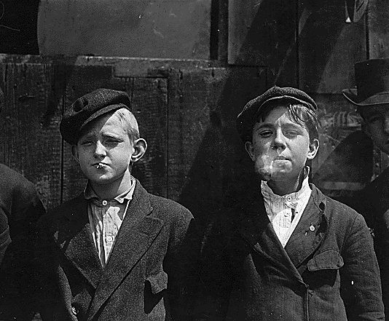
Working on the streets allowed for fresh
air and exercise not afforded to most,
but also the vices of the street

Slide 20
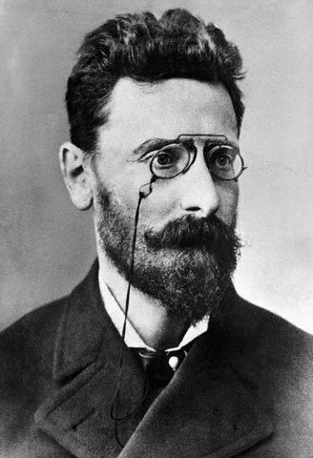
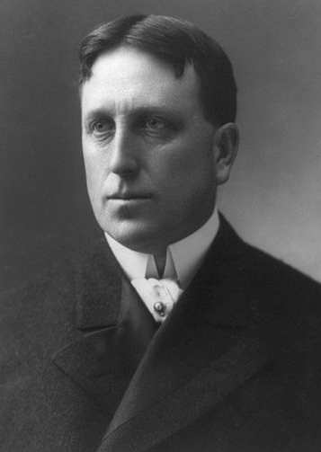
Newspaper Wars
In the late 19th century, two titans of journalism emerged, gaining enormous wealth and prestige.
Joseph Pulitzer – a Hungarian immigrant, owned the New York World; established the Pulitzer Prize (for writing)
William Randolph Hearst – created a vast newspaper empire by buying a chain of newspapers across the country, including his flagship paper, the New York Journal
The competition for readers led to a bitter rivalry between the two journalistic giants
The result – yellow journalism (sensationalist reporting not necessarily based on fact)

Slide 21
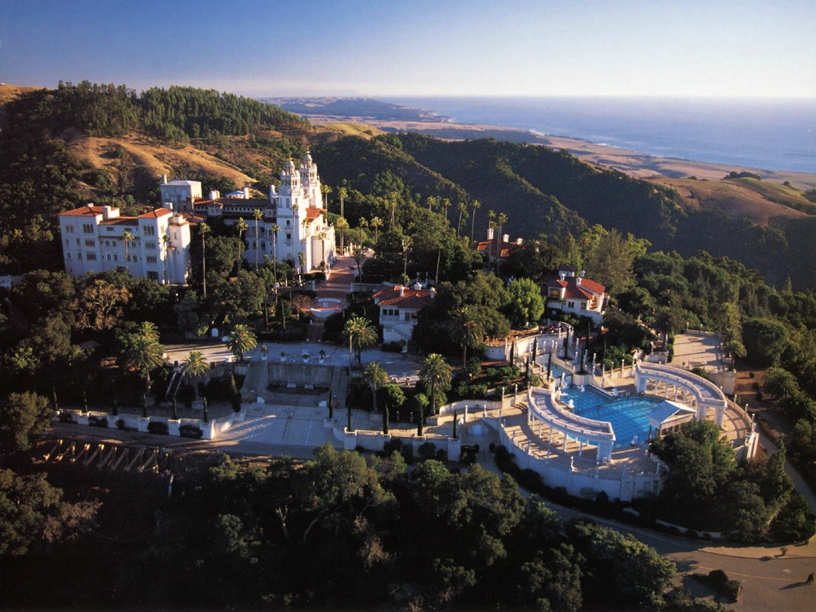
Hearst Castle

Slide 22
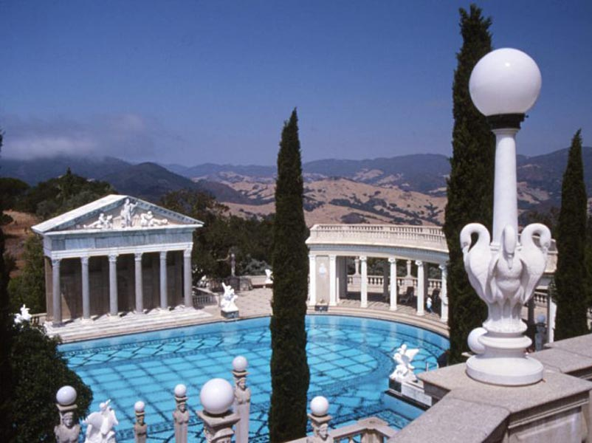

Slide 23
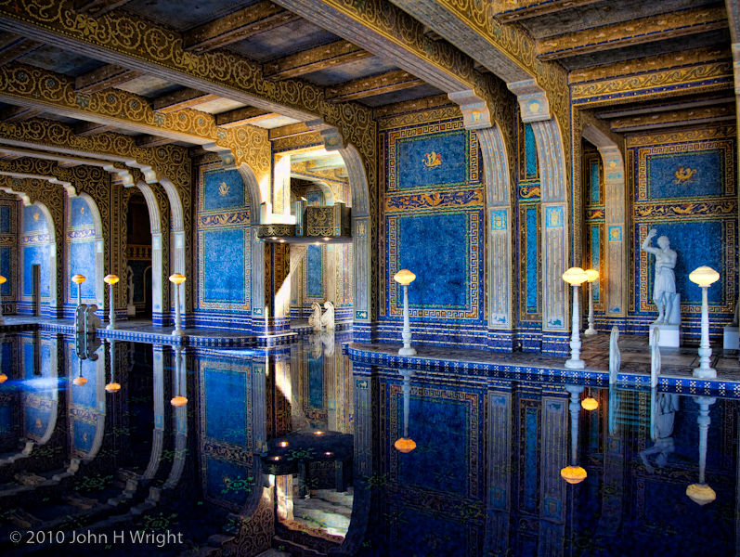

Slide 24
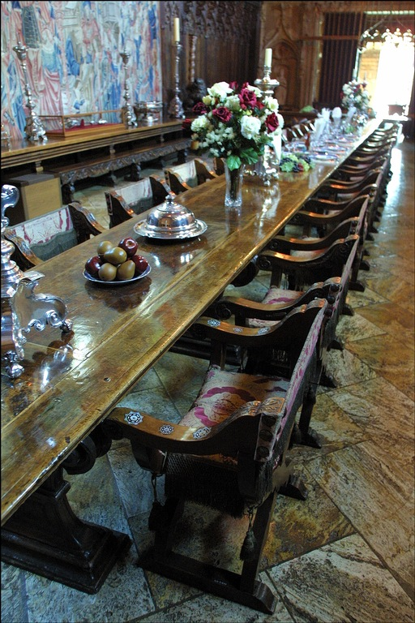
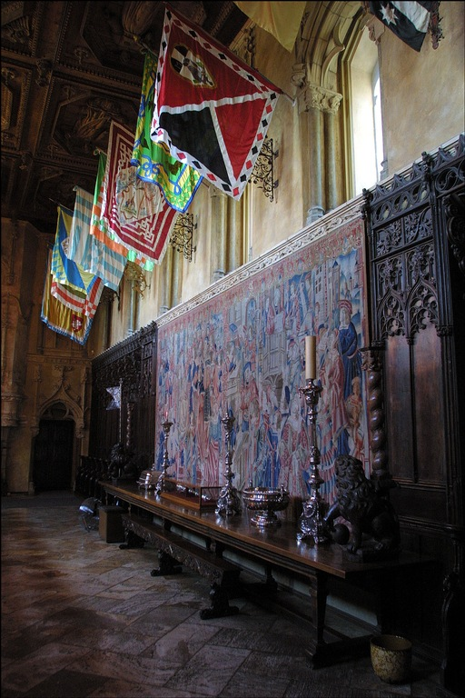

Slide 25
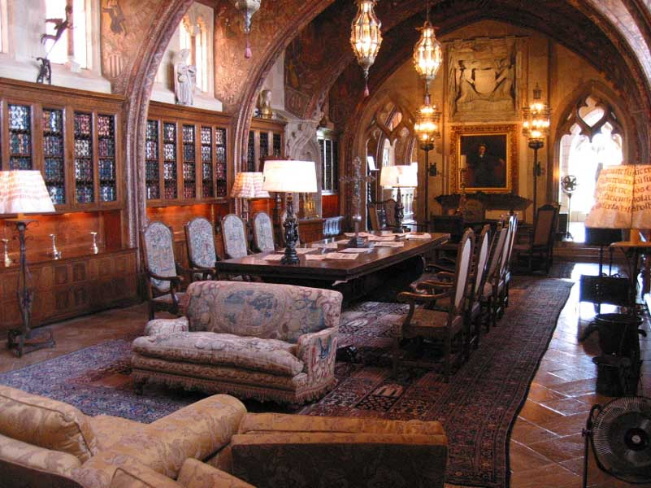

Slide 26
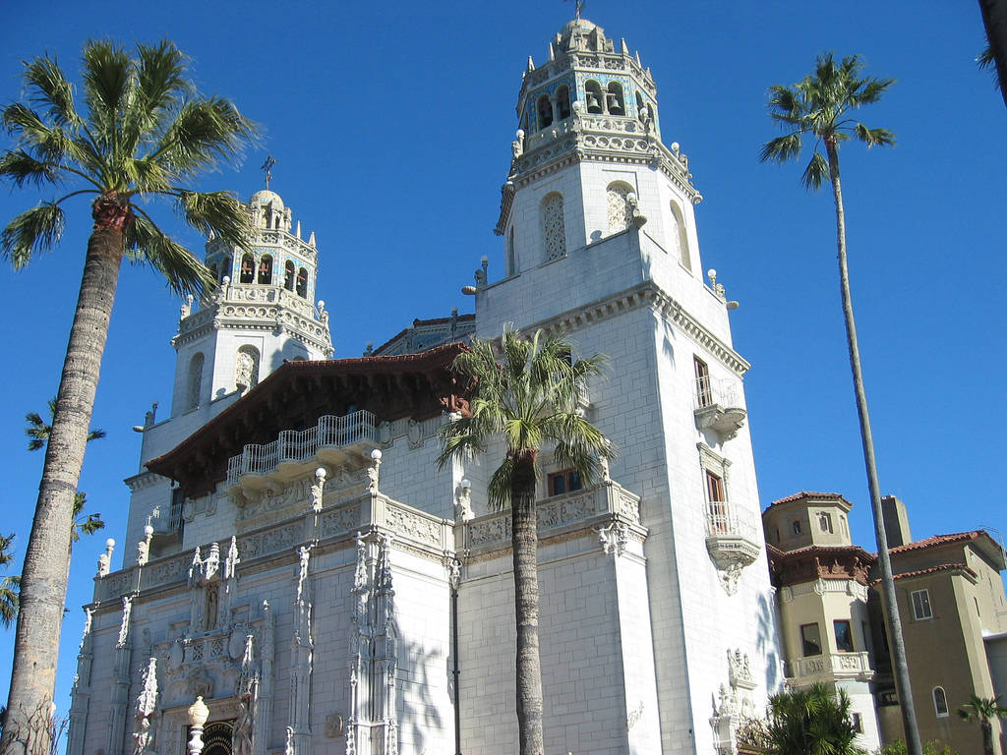

Slide 27
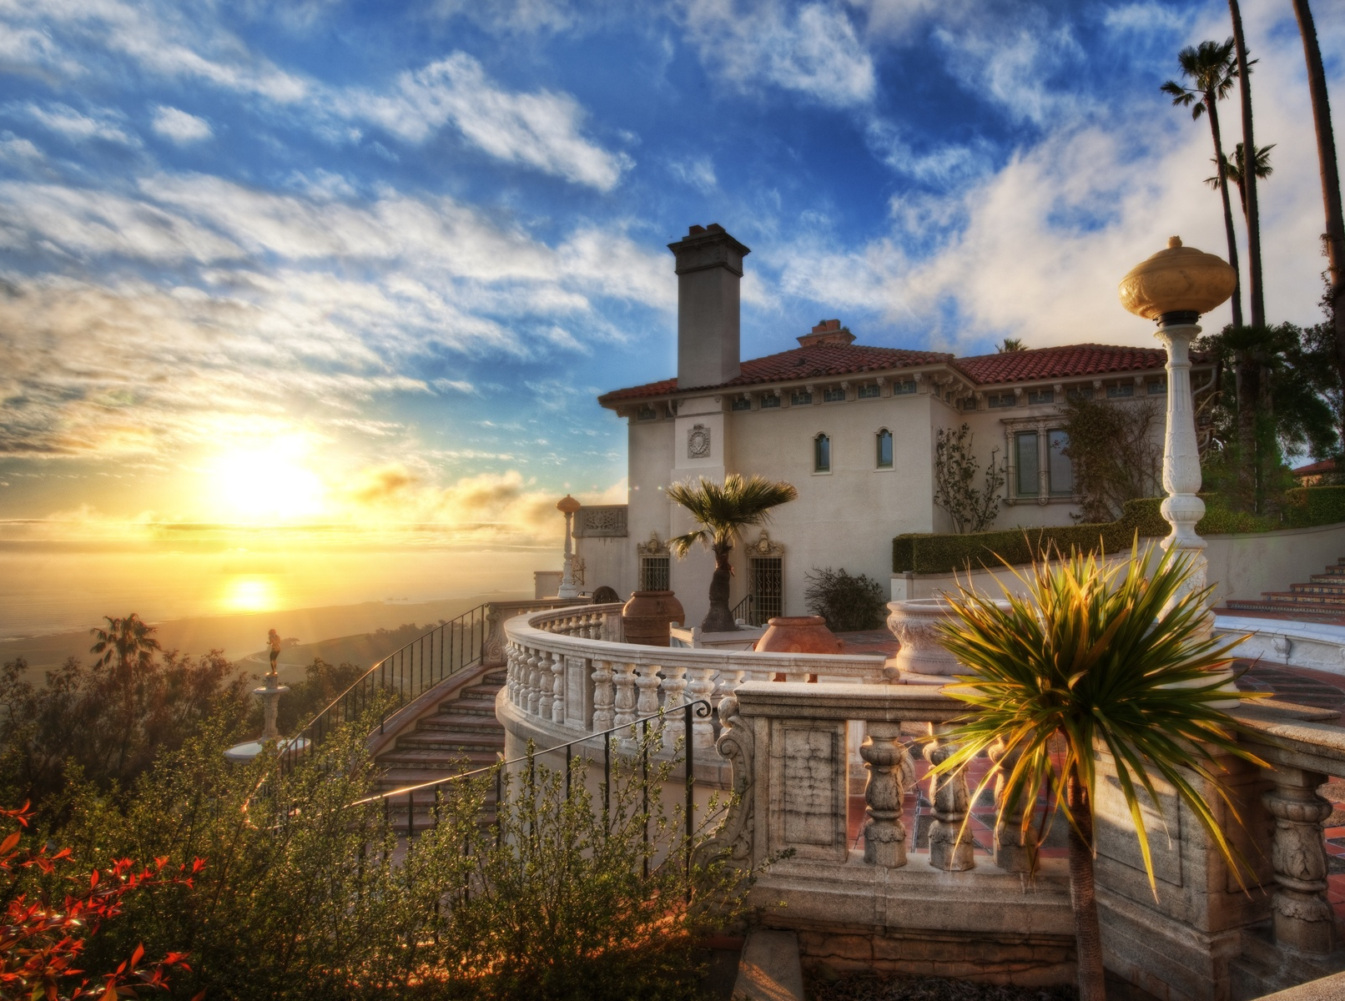

Slide 28
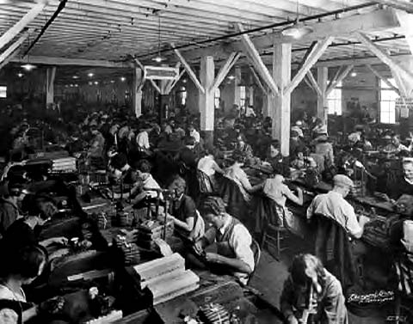
Unions: The Struggle to Organize

Slide 29
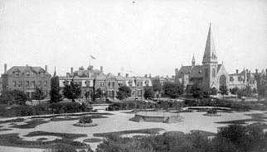
Company Towns
Company towns - a town or city in which everything is owned by a single company, which serves as the major employer of the town. (e.g. Pullman, Chicago)

Slide 30
Unions: The Struggle to Organize
Unions unite workers to achieve three basic goals:
Better working conditions
Better hours
Better pay
Many factory owners were against unionization because it hurt their profits.

Slide 31
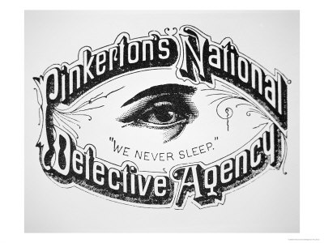
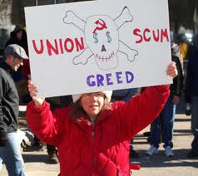
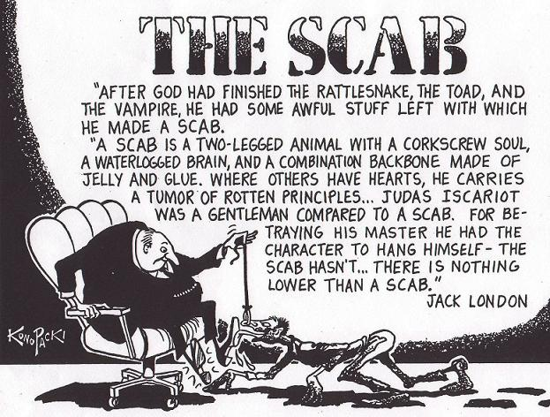
Techniques to Stop Unionization
“Yellow dog” contracts
Pinkerton detectives
Blacklisting
Lockouts
Injunctions
scabs

Slide 32
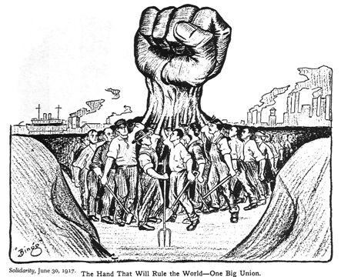
The National Labor Union
The National Labor Union (1866) lasted only 6 years, but grew to 600,000 members.
Members: skilled, unskilled, farmers, some minorities and women
Goals:
Arbitration
8-hour workday
Ruined by the Panic of 1873

Slide 33
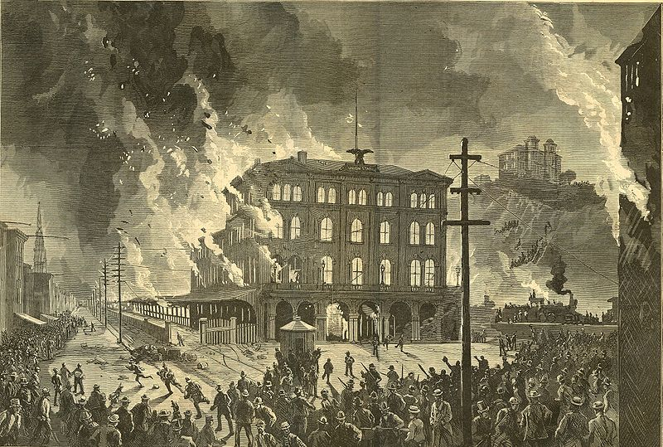
Great Railroad Strike of 1877
Cause: Cutting of wages for the second time in a year by the Baltimore & Ohio Railroad (B&O).
Response: Governor uses state militia to break up strike; President Hayes sends in federal troops when state militia proves ineffectual
Result: Failure.

Slide 34
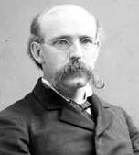
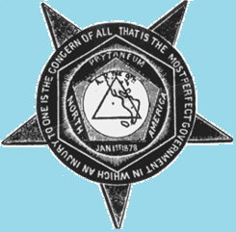
Knights of Labor
Led by Terrence V. Powderly
Members: skilled, unskilled, women, blacks, no “non-producers”
Goals:
Workers cooperatives
Better working conditions
8-hour workday
Arbitration

Slide 35
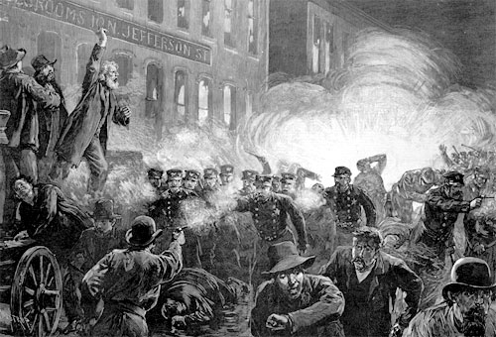
Haymarket Riot
Knights of Labor became involved in a series of May Day strikes which ultimately hurt the Knights’ image.
Haymarket Square Riot – Began as a rally in support of striking workers. An unknown person threw a dynamite bomb at police as they dispersed the public meeting. The bomb blast and ensuing gunfire resulted in the deaths of eight police officers and an unknown number of civilians.
Eight anarchists were later tried for the crime; four were executed.

Slide 36
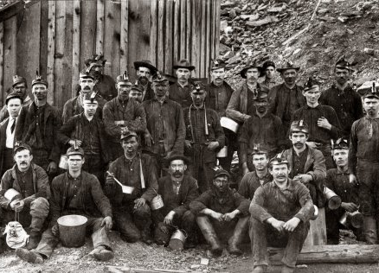
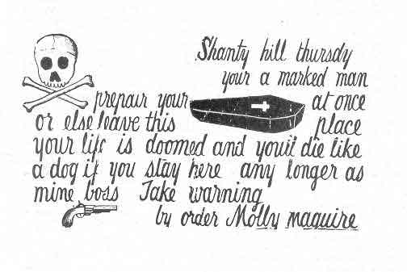
Molly Maguire's
Secret society of mainly Irish coal miners; associated with the Workingmen's Benevolent Association union
Strikes and negotiations with management/owners failed ; mine operators controlled the workplace, housing, stores and often the police and courts
Molly Maguire's destroyed equipment, intimidated officials, sometimes injured or killed management and owners.
Notes:
A forgotten chapter in the history of American labor, revealing the true nature of the so-called Molly Maguires as pioneers and martyrs in a determined struggle of the Pennsylvania anthracite region miners to improve their miserable working conditions during the 1870s. Comprised of irish and irish-american miners, the mollies were a secret society that committed sabotage, kidnapping of mine bosses, assassinations and sent threatening ‘coffin notices’ to warn bosses what would happen to them if there demands weren’t met. No work published since sets forth so clearly the role of the railroad company which owned the mines, whose president hired the Pinkerton spies and provocateurs and acted as State prosecutor in the trials which sent the mollies to the gallows.

Slide 37
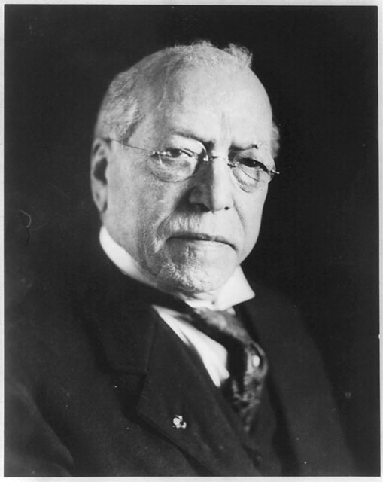
American Federation of Labor (AFL)
Led by Samuel Gompers (1886)
Members: Made up of small, independent unions of skilled workers only
Goals: the “Pure and Simple” approach
Better wages
Better working conditions
Shorter hours
Weapons used:
Boycotts and strikes

Slide 38
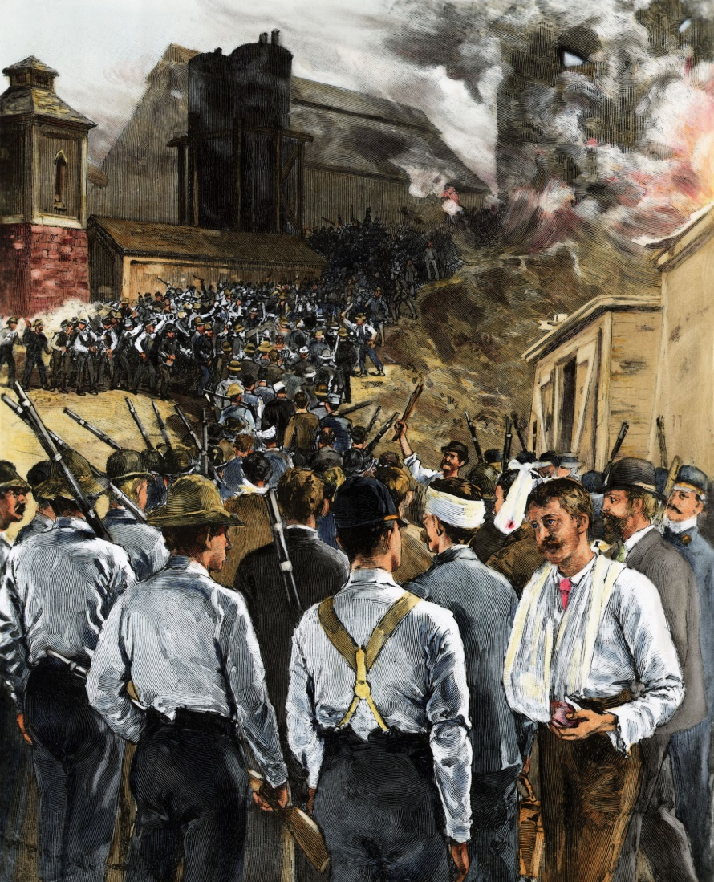
Homestead Strike
The Homestead Strike: A strike of workers at Carnegie’s Homestead Steel plant.
Cause: Reduced wages and lockout to break up the local craft union
Response: A battle between workers and Pinkerton Detectives
Result: Failure, and tarnished Carnegie’s reputation

Slide 39
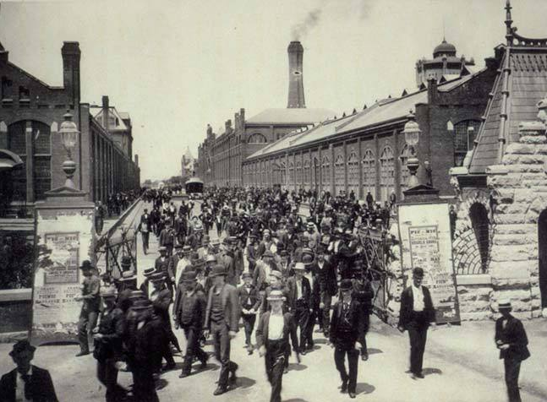
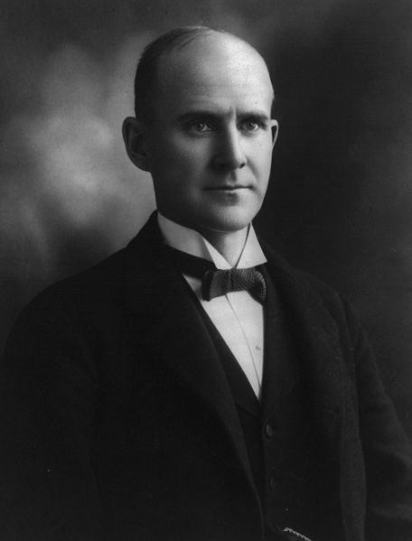
Pullman Strike
Cause: Reduction in wages at Pullman Palace Car Co.; nationwide strike and boycott of RR
Response: Federal injunction to stop the strike was ignored; Army brought in to stop the strike
Result: Failure.

Slide 40
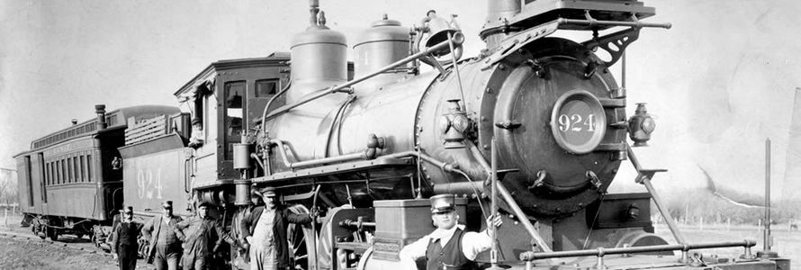
Successes of Labor
Interstate Commerce Commission
Sherman Anti-Trust Act: enacted in an attempt to outlaw trusts or monopolies.
Bark was worse than its bite, largely ineffectual
“closed shops”: businesses closed to non-union members
8-hour work day; minimum wage; weekends; benefits; holiday pay; etc.
Labor Day: passed in 1894 to honor the nation’s labor force, where workers take the day off from work.

Slide 41
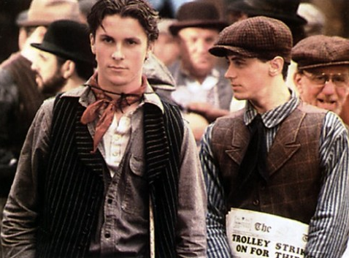
Newsies

