Slide 1
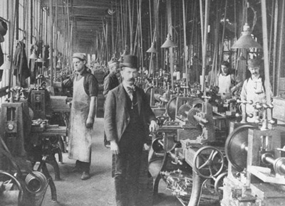
Industrialization

Slide 2
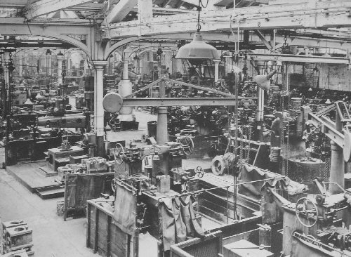
Industrial Review
Change from human labor to machines
Development of new energy sources
Increased use of natural resources
Standardization of products
Effects on environment
Effects on politics and economics

Slide 3
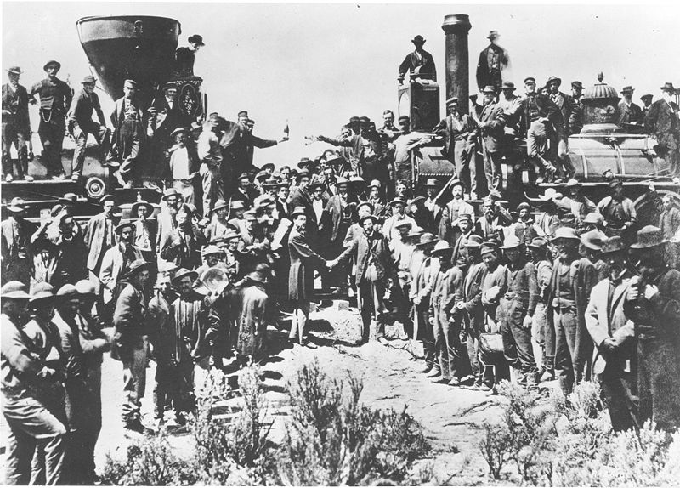
Industry Comes of Age
The railroads were the first “big business” in America.
Efficiency (standard gauge), safety (Westinghouse air brakes), and comfort (Pullman Palace Cars)
Effects of the railroads
East and Western markets were now linked
Travel and shipping was now eased
Western cities boomed
Millionaires (and some Billionaires) were made

Slide 4
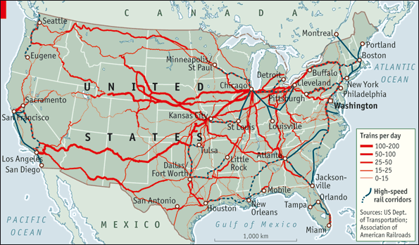
What do you notice about America’s railway lines?

Slide 5
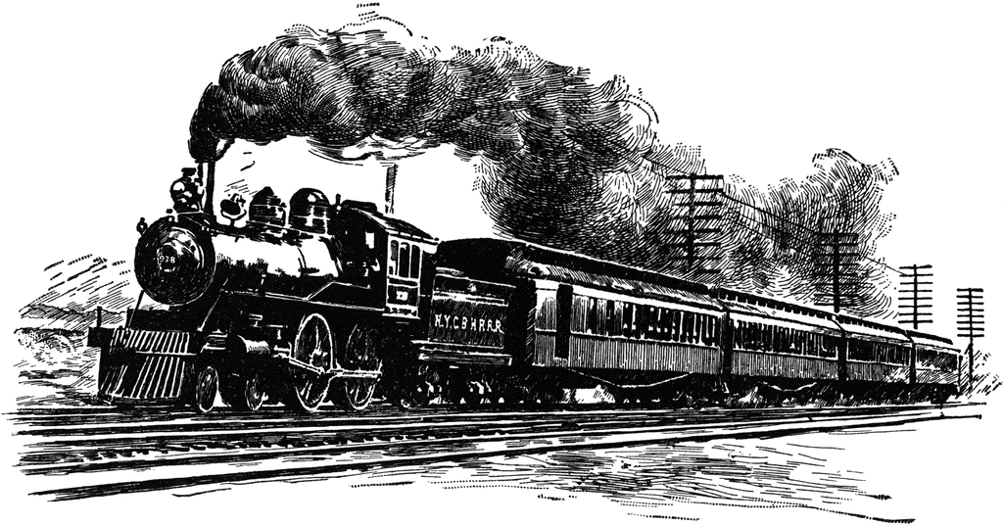
Problems of the Railroads
“stock watering” – Owners would artificially inflate the company so the stock would skyrocket
Bribes given to governmental officials and major customers for deals on land and products
The formation of “pools” – where competitors agreed to cooperate as if they were one mega company
Rebates were given to large companies that shipped large quantities of goods; kept rates high for the little guy.
Free passes were given to members of the press to ensure good publicity.

Slide 6
Attempts to Fix Railroad Abuses
The National Grange of the Order of Patrons of Husbandry (The Grange) protested the inequalities in railroad prices
Wabash v. Illinois (AKA: Wabash case)– the Supreme Court said that states cannot regulate interstate trade, only Congress can
Interstate Commerce Act/Commission ICC (1887)–outlawed rebates and pools, required rates to be openly published, and banned charging different rates for high and low quantity shippers

Slide 7
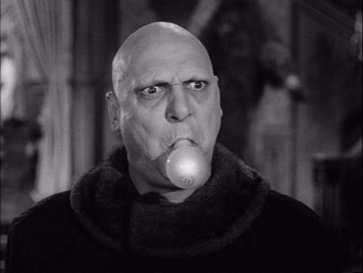
Bright Ideas!
Gilded Age Inventions

Slide 8
Inventor of Alternating Current (AC), X-Rays, radio, RADAR, remote control, neon lighting, wireless communications, the electric motor, etc. etc. etc.

Slide 9
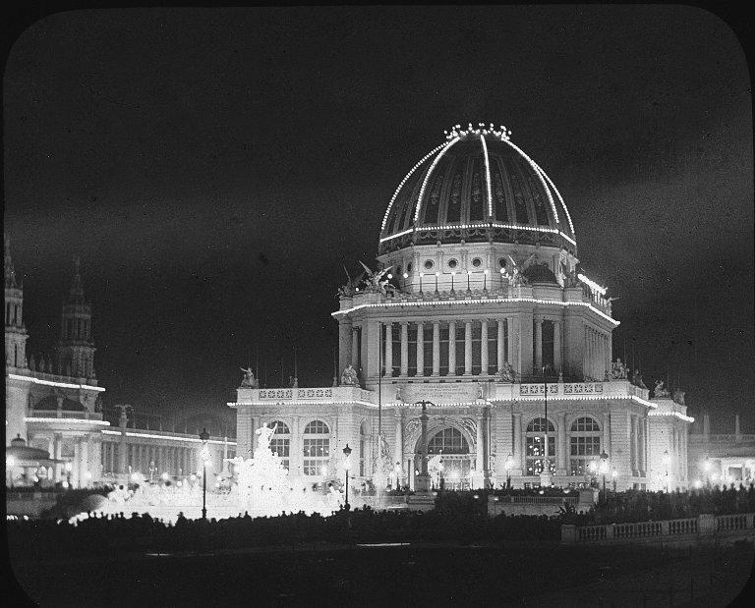
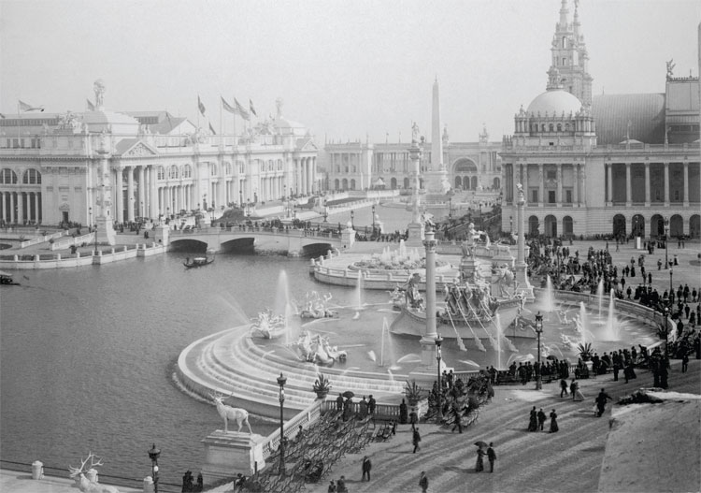
The White
City

Slide 10
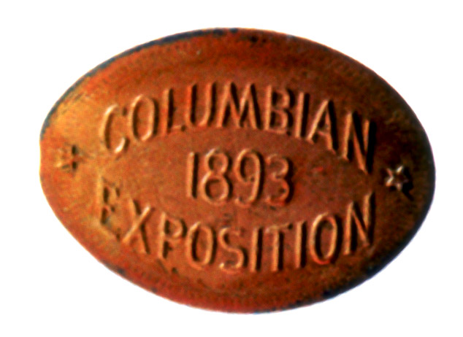
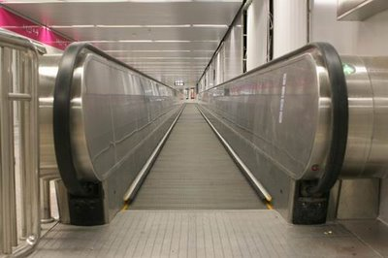
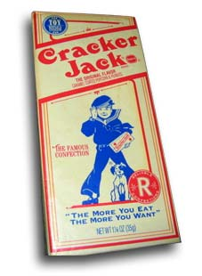
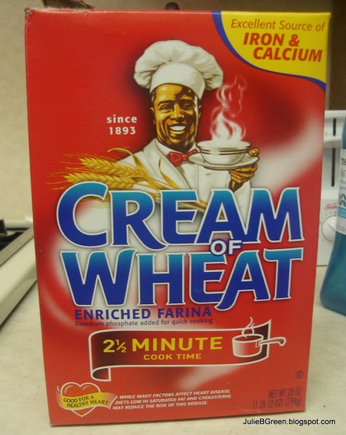
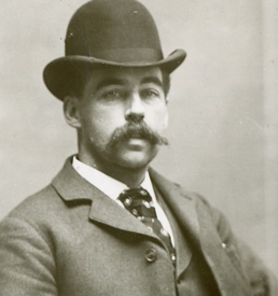
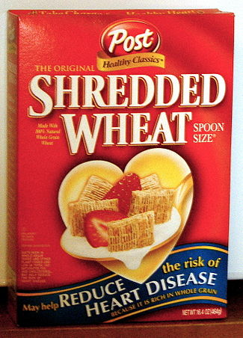
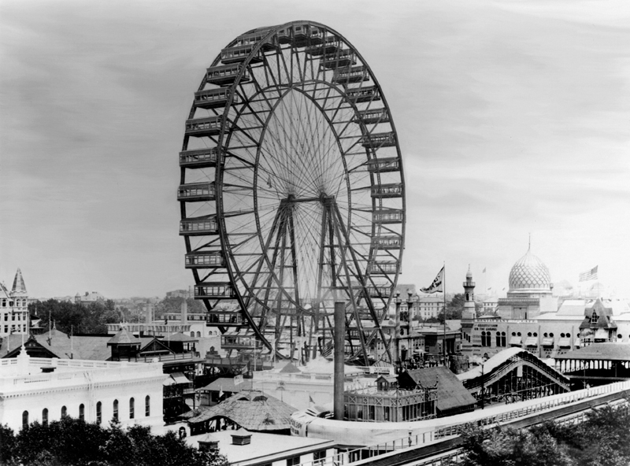
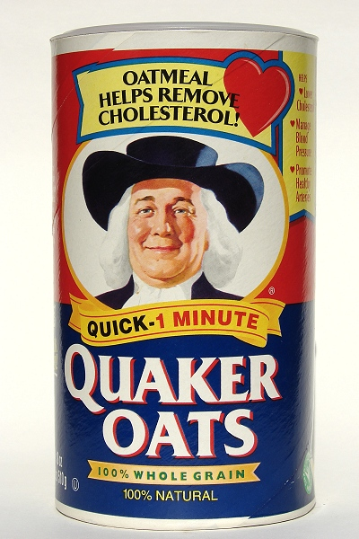
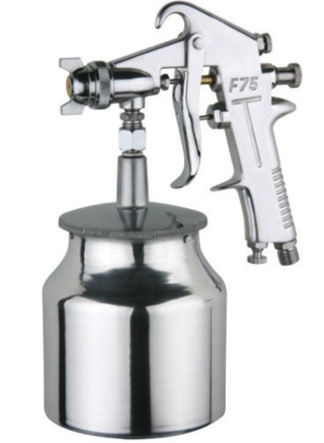
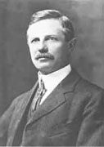
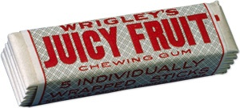
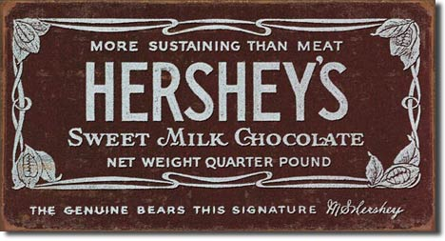

Slide 11
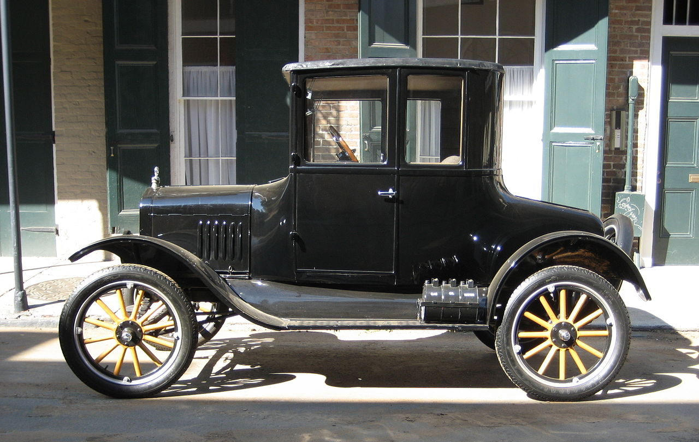
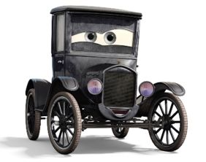
Henry Ford and the Model T
Model T (1908-1927)
Built by Henry Ford
First affordable automobile
Ford’s Innovations:
Assembly line production
The “Five dollar workday”

Slide 12
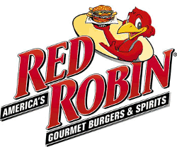
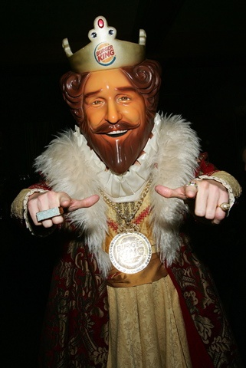
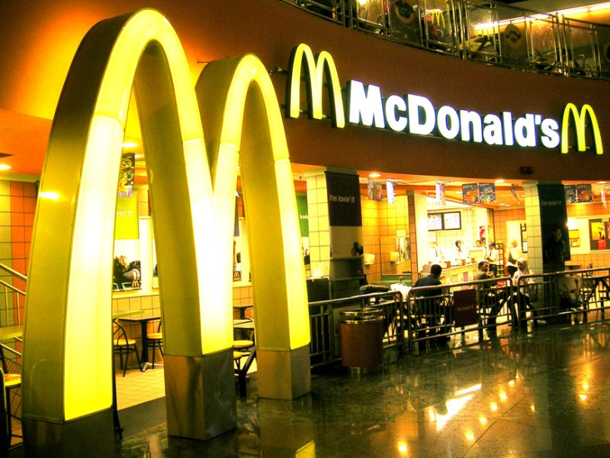
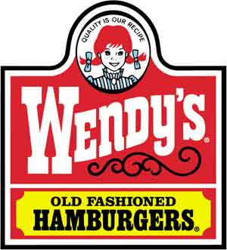
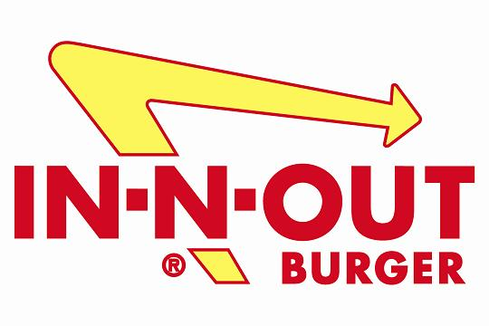
Free Enterprise
Companies compete for customers by making a better product at better prices.

Slide 13
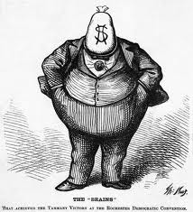
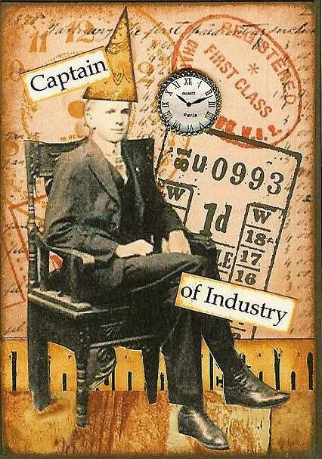
The Gilded Age
Captains of Industry and Robber Barons

Slide 14
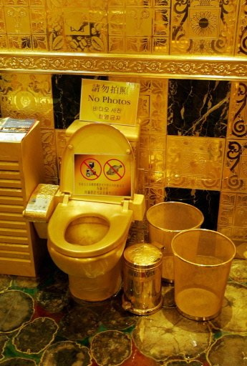
The Gilded Age
Term coined by Samuel Clemens (AKA_____)
The times looked glittery and good, but hid a dark/dishonest underbelly.
The era was controlled by a handful of incredibly wealthy businessmen

Slide 15
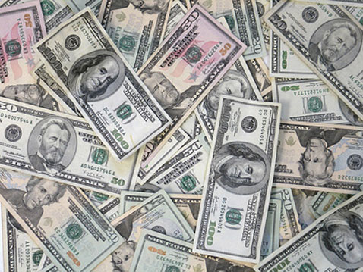
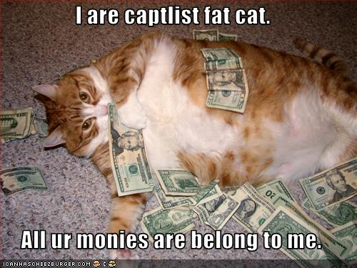
Laissez Faire
(French phrase meaning, “let be,” or “hands off”)
Government keeps it’s hands off business, except to protect private property, allowing open competition.
Allowed businesses to grow larger and faster than ever before.

Slide 16
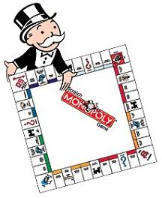
Monopoly
When a single company achieves control over an entire market.
Benefits:
Makes the owner very rich
Consistency in products
Economies of scale: Large companies are able to produce goods at a cheaper price
Costs:
Prices can go up dramatically
No competition = no choice
Interlocking Directorates: A company places their own employees on the board-of-directors of their competitors; their decisions are to cooperate not compete.

Slide 17
How does a monopoly happen?
Vertical Integration
Ace Meat Industries
Delivery Wagons
Meat Packing Plant
Cooled Warehouse
Refrigerated Railroad Cars
Slaughterhouse
Cattle
The company owns all the different businesses on which
it depends for its operation.

Slide 18
How does a monopoly happen?
Horizontal Integration
Combining many firms engaged in the same type of business into one large corporation.
U.S. Oil Company
Independent Oil Refinery
Independent Oil Refinery
Independent Oil Refinery
Independent Oil Refinery

Slide 19
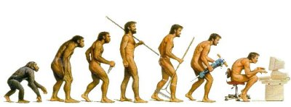
Social Darwinism
An ideology that applies Darwin’s evolutionary theory to society and politics.
Feel that conflict between groups in society leads to social progress as superior groups outcompete inferior ones.

Slide 20
You can see it two ways…
1.Captains of Industry:
Served USA positively, created jobs, increased productivity, expansion of markets, providing more jobs.
Philanthropists- giving to charities, founding libraries and museums
2. Robber Barons:
Built fortunes from exploiting workers, form anti-competitive trusts, and place the accumulation of wealth above all else
Engaged in some unethical and illegal business practices

Slide 21
The Wealthiest Americans EVER

Slide 22
The Wealthiest Americans EVER

Slide 23
The Wealthiest Americans EVER

Slide 24
The Wealthiest Americans EVER…
and he’s not even #1!

Slide 25
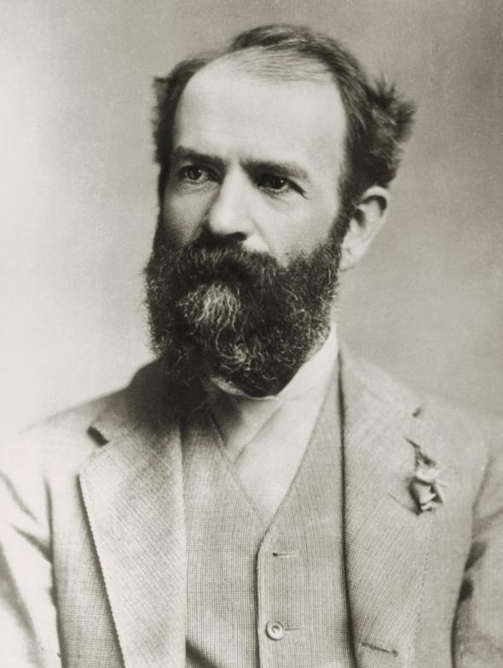
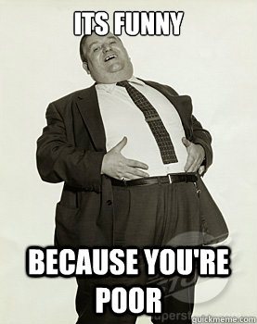
Jay Gould: THE Robber Baron
Gould and James Fisk joined with Tammany Hall and made Boss Tweed a director of the Erie Railroad; Tweed arranged favorable legislation for them
Gould used “stock watering” for the Erie RR, nearly bankrupting Vanderbilt’s line
Gould and Fisk began buying gold in an attempt to corner the market; led to the stock market panic of Black Friday, dropping the price of gold 27%.

Slide 26
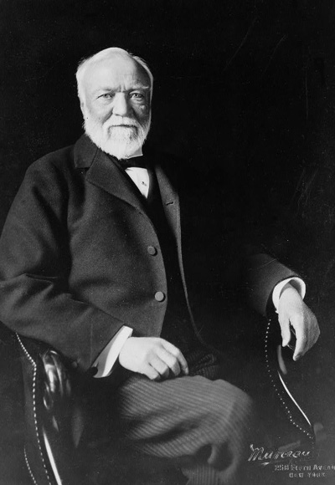
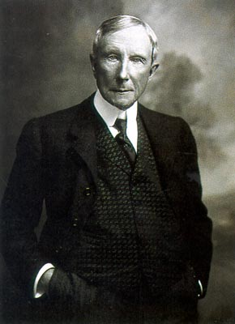
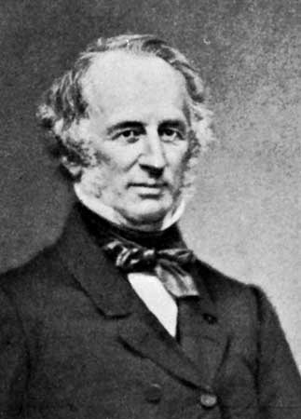
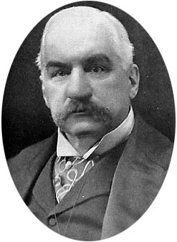
Masters of Business: The men who built America
Carnegie
Rockefeller
Vanderbilt
Morgan

Slide 27
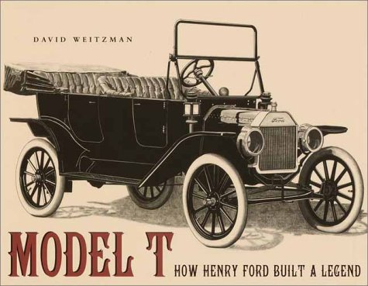
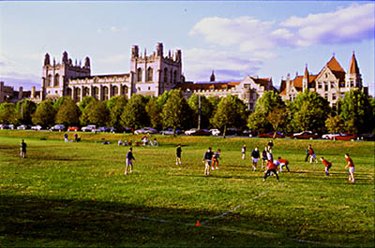
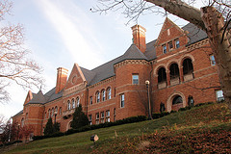
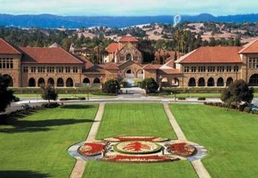
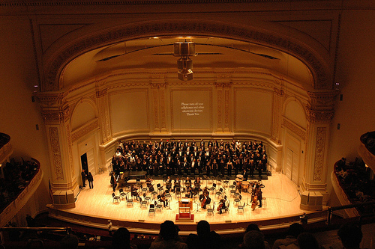
They gave back and innovated

Slide 28
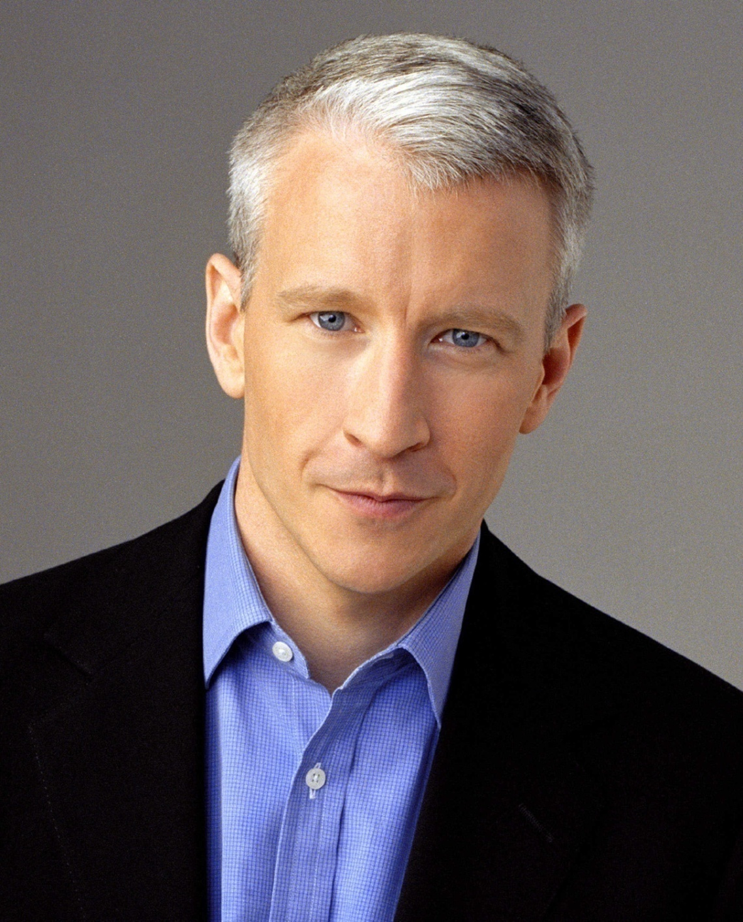
Vanderbilt University
Anderson Cooper

Slide 29
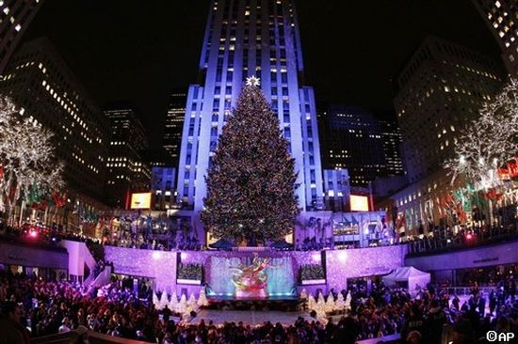
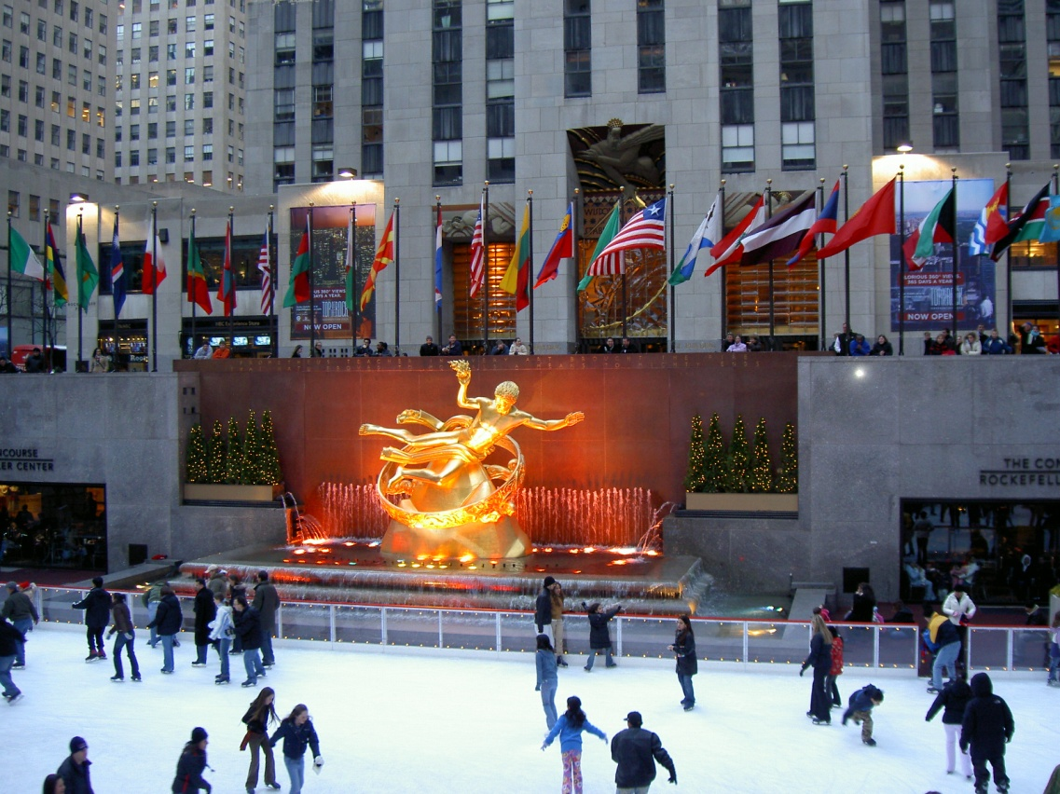
Rockefeller Center

Slide 30
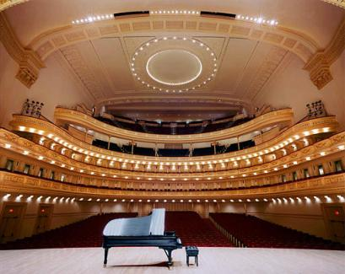
Carnegie Hall

Slide 31
Gospel of Wealth – Andrew Carnegie
The rich have a moral obligation to give away their fortunes
Felt that all personal wealth beyond that required to supply the needs of one's family should be used for the benefit of the community
Established thousands of free public libraries to make available to everyone a means of self-education
Gave away over $350 million during his lifetime

