Slide 1
America Moves to the City
Immigration and Urbanization

Slide 2
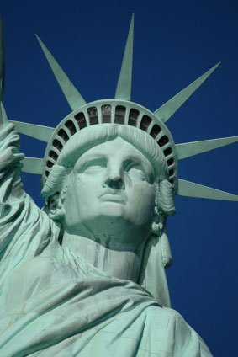
Coming to America

Slide 3
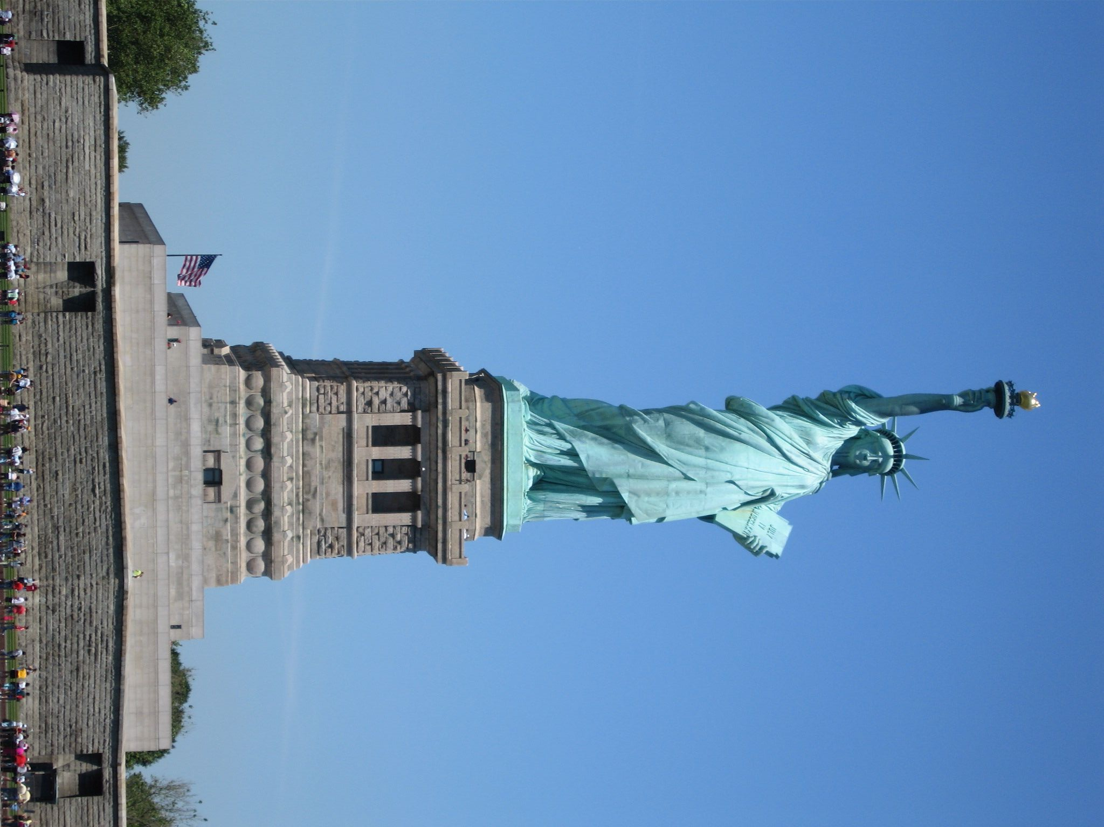
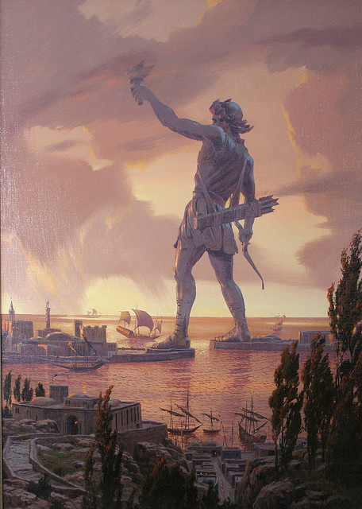
The New Colossus
Not like the brazen giant of Greek fame,
With conquering limbs astride from land to land;
Here at our sea-washed, sunset gates shall stand
A mighty woman with a torch, whose flame
Is the imprisoned lightning, and her name
Mother of Exiles. From her beacon-hand
Glows world-wide welcome; her mild eyes command
The air-bridged harbor that twin cities frame.
"Keep, ancient lands, your storied pomp!" cries she
With silent lips. "Give me your tired, your poor,
Your huddled masses yearning to breathe free,
The wretched refuse of your teeming shore.
Send these, the homeless, tempest-tossed to me,
I lift my lamp beside the golden door!"
Emma Lazarus, 1883

Slide 4
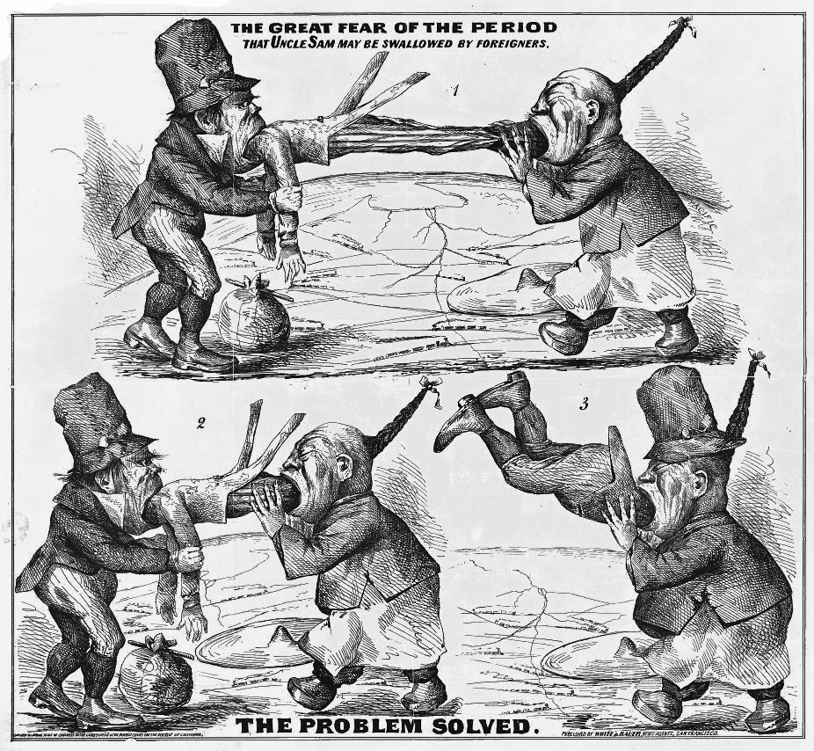
Old Immigrants

Slide 5
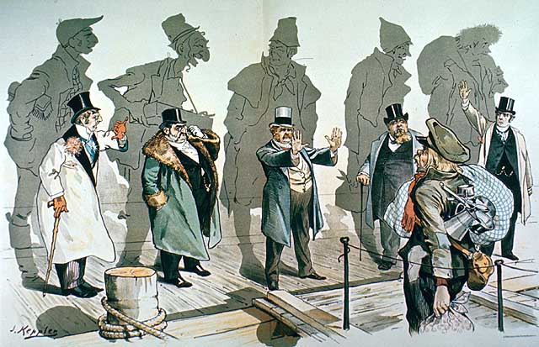
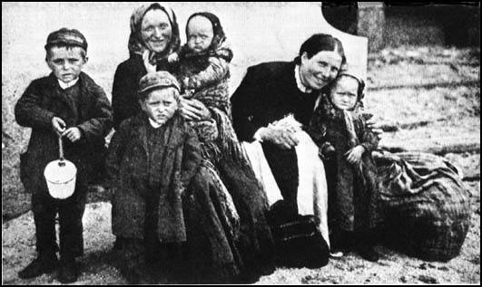
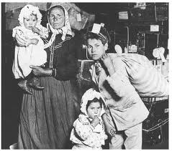
Old Immigrants
New Immigrants
Most from Northern and Western Europe
Fair-skinned, Anglo-Saxon type
Came from countries with democratic backgrounds
Were mainly Protestant (except Irish)
Generally had some education and money
Mostly from Southern or Eastern Europe
Not considered “white” Europeans
Came from countries with dictatorships, socialism, and some were even anarchists
Mainly Catholic
Generally uneducated with little money or job training

Slide 6
PUSH/PULL
Overpopulation
War
Discrimination
Economic opportunity
Social mobility
Religious toleration
25% of immigrants came to America not to live, but to work and then return home with their fortunes.

Slide 7
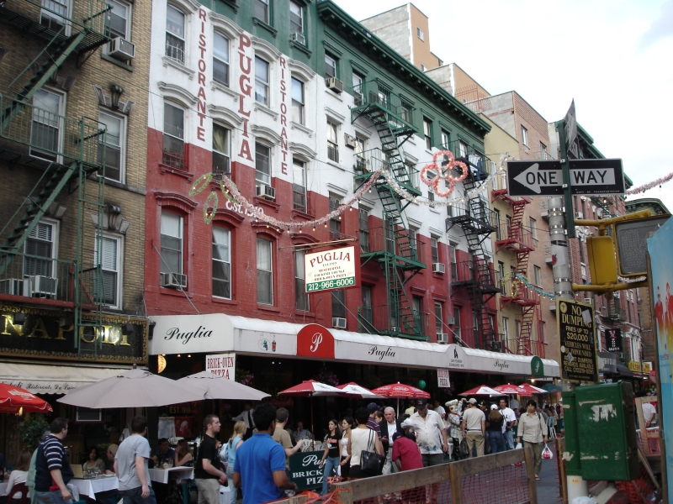
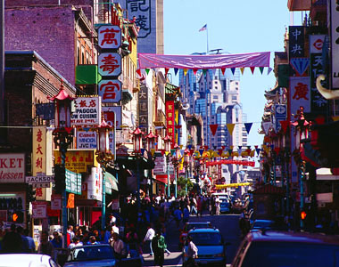
New Immigration
New Immigrants generally settled in areas of the same ethnicity – “Little Italy”, “Little Poland”, “China Town”
Set up systems to keep Old World traditions: Catholic schools, foreign language newspapers, ethnic restaurants, theatres, and social clubs

Slide 8
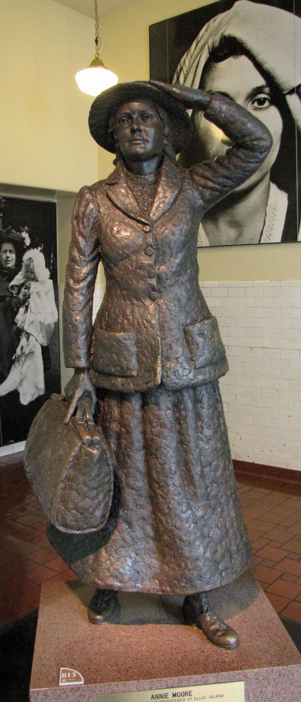
Ellis Island
12m. Immigrants enter the U.S. through Ellis Island, 1892-1924
Nearly half of all Americans can trace their heritage back to an Ellis Island immigrant
January 1, 1892 - Annie Moore, a 15 year-old Irish girl, was the very first immigrant to be processed at Ellis Island.

Slide 9
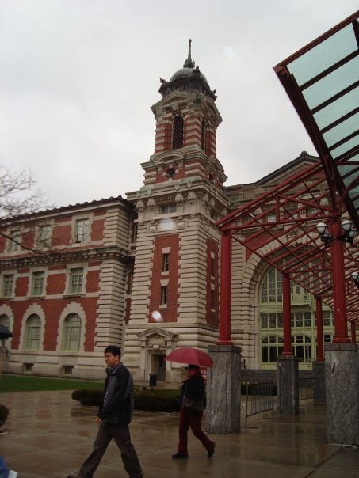
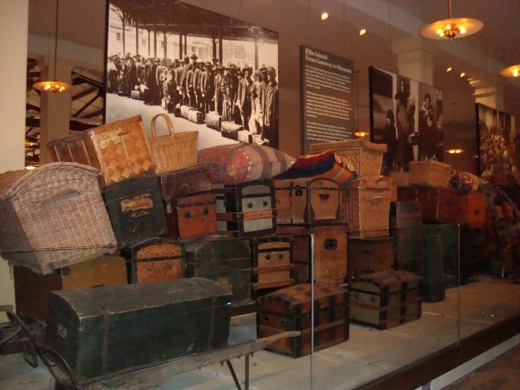
Coming to
America

Slide 10
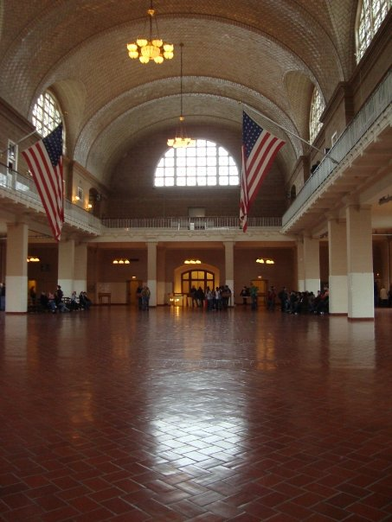
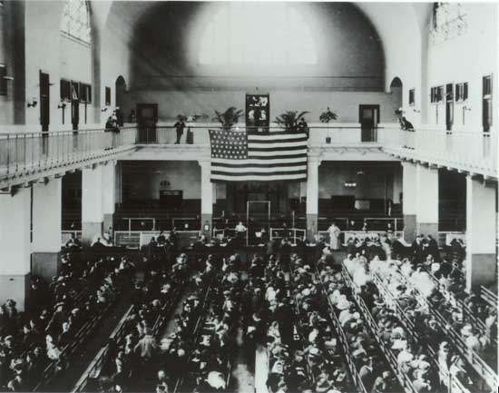
Coming to America
The Great Hall

Slide 11
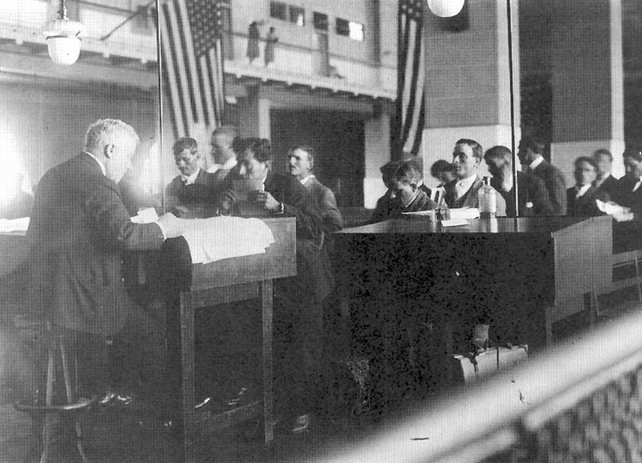
What’s In A Name?
Try to pronounce the following names:
Wilczynski
Hudzietz
Nüchter
Ikospentarhos
Wojciech
Many families’ names were changed upon arrival, either by confused clerks, illiterate immigrants, or to make assimilation easier
Aivaliotis
Marcic
Taaffe
Szilágyi
Björnus

Slide 12
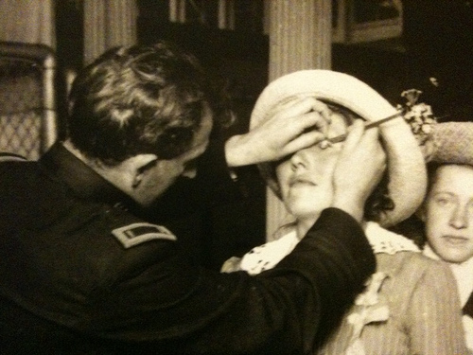

Slide 13
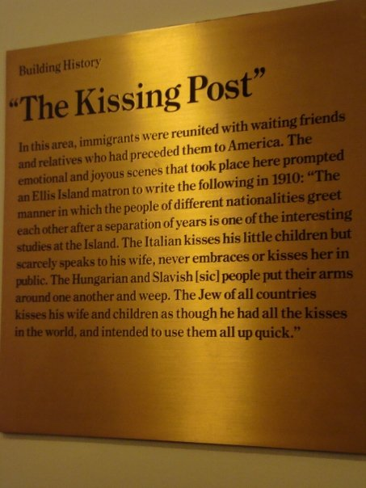
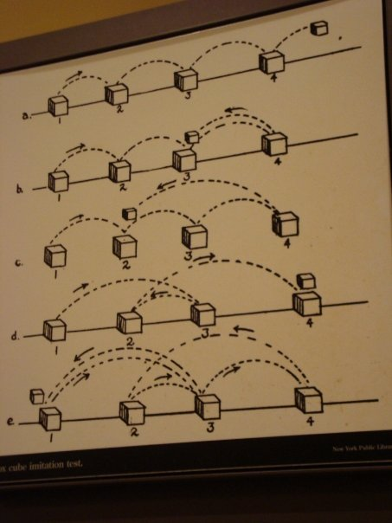

Slide 14
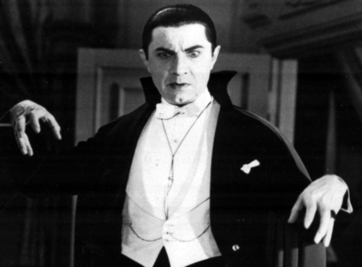
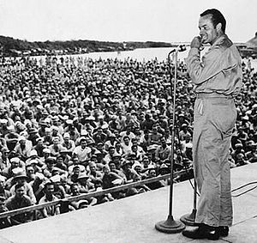
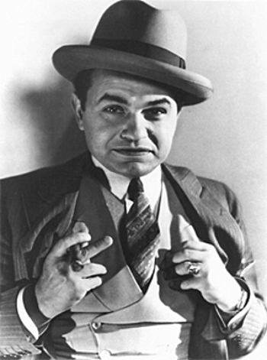
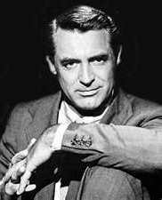
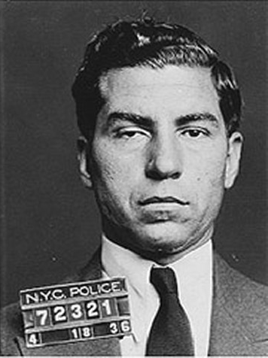
Famous immigrants:
Science fiction novelist Isaac Asimov (Russia)
Composer Irving Berlin (Belarus) – Wrote “Blue Skies”, “God Bless America”, “Puttin’ On The Ritz”, “White Christmas”
Chef Ettore Boiardi (Chef Boyardee) (Italy)
Film director Frank Capra (Italy) - Mr. Deeds Goes to Town, Mr. Smith Goes to Washington, Arsenic and Old Lace, It's a Wonderful Life
Cosmetologist Max Factor (Poland)
Comedian Bob Hope (England)
Actor Cary Grant (England)
Pop singer and actor Al Jolson (Lithuania)
Gangster Lucky Luciano (Italy)
Actor Béla Lugosi (Hungary)
Actor Edward G. Robinson (Romania)
The Trapp Family Singers (Austria)
Actor Rudolph Valentino (Italy)
Olympic swimming medalist and actor (Tarzan) Johnny Weissmuller (Austria-Hungary)

Slide 15
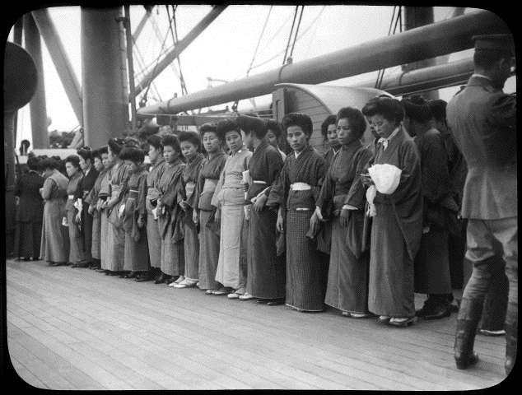
Immigration on the
West Coast

Slide 16
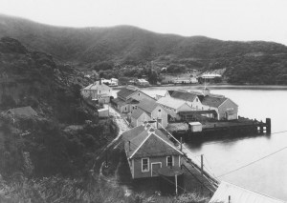
Angel Island
Processed immigrants on the West Coast, 1910-1940
Mostly from China
Terrible treatment – Held in detention barracks for months, subjected to rounds of interrogation
Many deemed unfit for entry for trivial reasons and deported

Slide 17
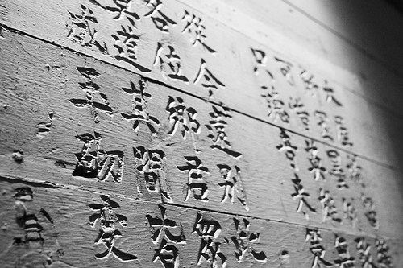
Angel Island
Poetry
The experiences of the detainees is documented in hundreds of poems that have been carved into the walls of the Angel Island detention center.

Slide 18
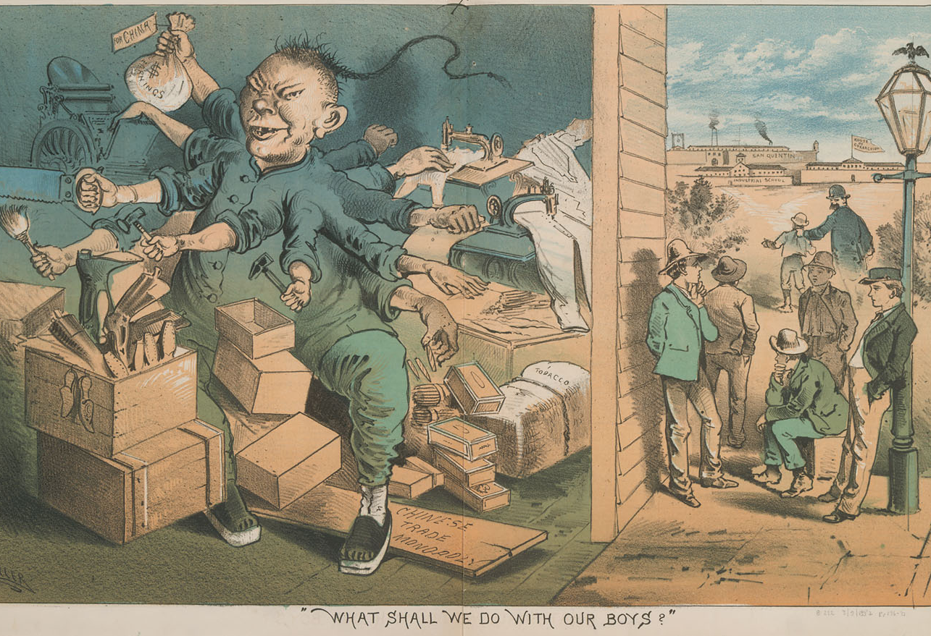
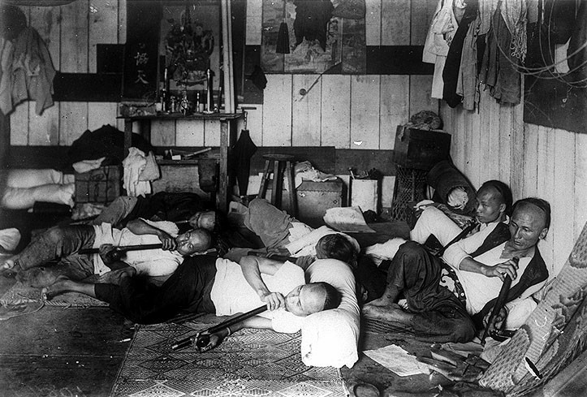
Chinese Prejudice
Many were fearful of the cultural differences between European Americans and Chinese immigrants.
Chinese were relegated to menial labor – owning groceries, Laundromats, tailor shops, or working on railroads. Americans were still afraid of Chinese “stealing” their jobs
Were demonized for their religious beliefs, strange customs, and vilified for their use of opium
Chinese Exclusion Act (1886) – banned the immigration of Chinese; came in large numbers and worked for little pay, undermining labor unions.

Slide 19
America Moves to the Cities
American Urbanization

Slide 20
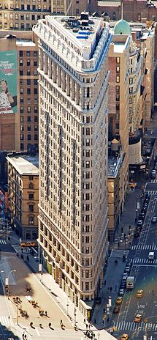
The Cities Grow Up
U.S. population doubled (1870-1900), urban population tripled
People were attracted to the cities mainly for job opportunities
The Cities grow OUT: Electric trolley and cable cars
The Cities grow UP: Skyscrapers (Louis Sullivan)
  “Form follows function”
  Daniel Burnham’s Flatiron Building in NYC
  The Brooklyn Bridge – technological marvel of its time
  The dumbbell apartment – had an airshaft vertically down through the building to let in air

Slide 21
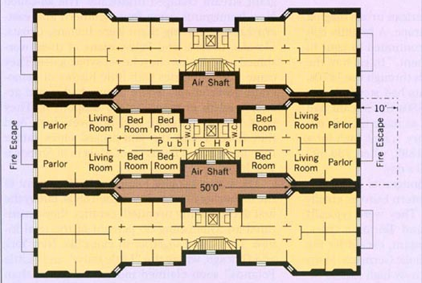

Slide 22

Lifestyles of the rich and famous
Champagne wishes and caviar dreams!

Slide 23
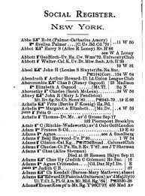
The Astors
Fabulously wealthy got wealthier
Hated the nouveau riche
Lady Caroline Astor created the first American social register – The New York Social Register, or “The 400”
  One must have had at least $1 million in ready cash
  At least three generations of wealth
  Never labored a day in their life

Slide 24
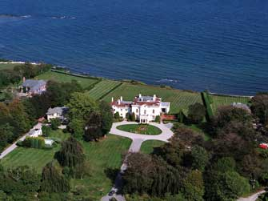
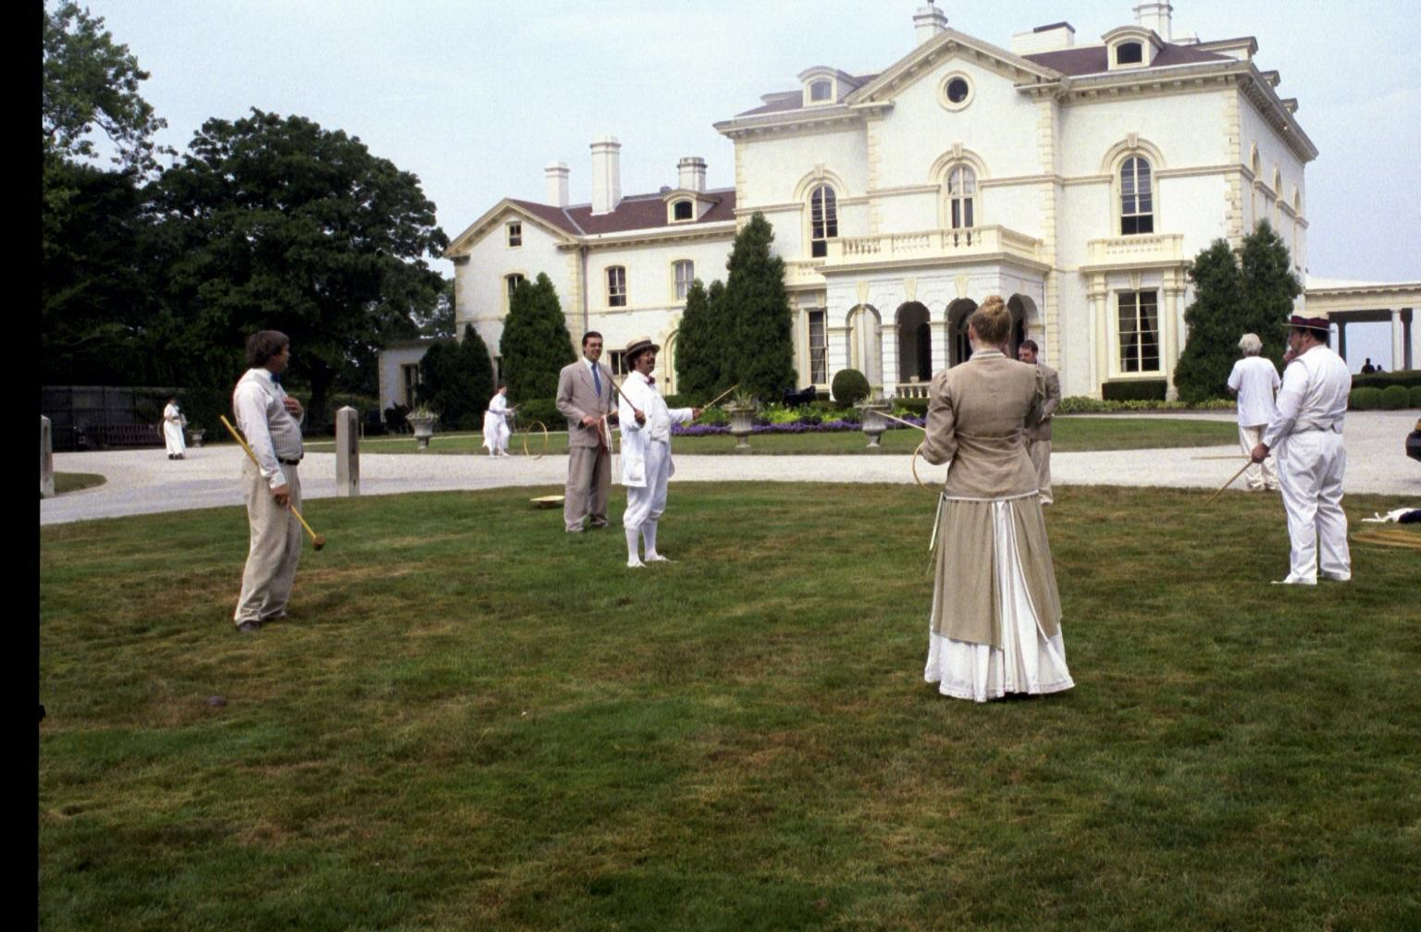
The Beechwood Summer Cottage

Slide 25
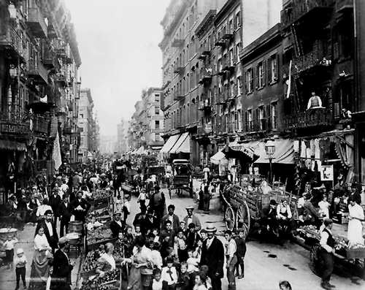
Documenting the
Tenements

Slide 26
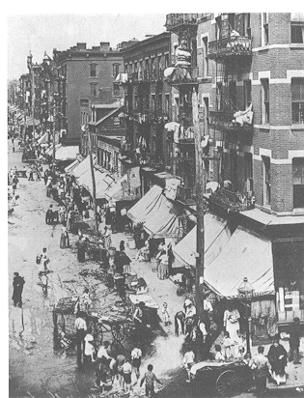
“Helping” Those Less Fortunate
City governments were unable to keep up with the vast expansion of the cities.
Political machine: A political organization that systematically maintains control through the support of campaign workers, who receive rewards for their efforts.

Slide 27
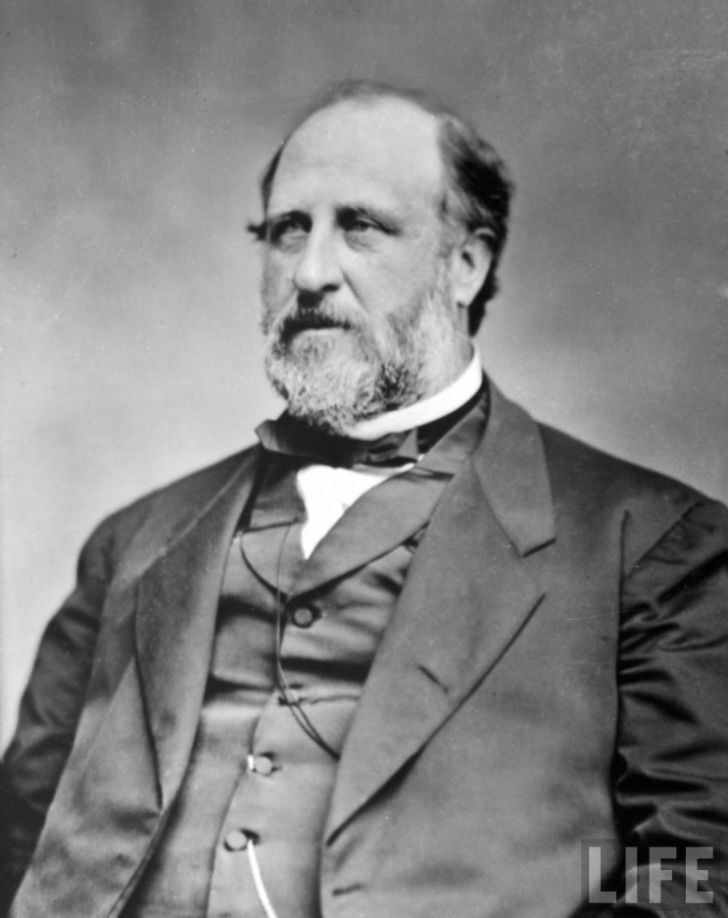
“Helping” Those Less Fortunate
Tammany Hall: A Democratic political machine in New York City; held political control from 1854-1932.
  Notorious for graft (use of authority for personal gain) and political corruption.
  Used Irish immigrants as their voter base; helped Irish assimilate and gain power.
William “Boss” Tweed: Leader of Tammany Hall between the 1850s-70s
  Able to dole out city jobs and projects to his supporters
  Found guilty of stealing $45 million from taxpayers through graft.

Slide 28
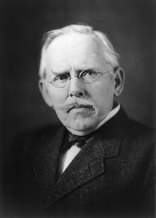
How the Other Half Lives – Jacob Riis
An early publication of photojournalism documenting squalid living conditions in New York City slums in the 1880s.
Middle and Upper classes were shocked by the destitution of the slums.

Slide 29
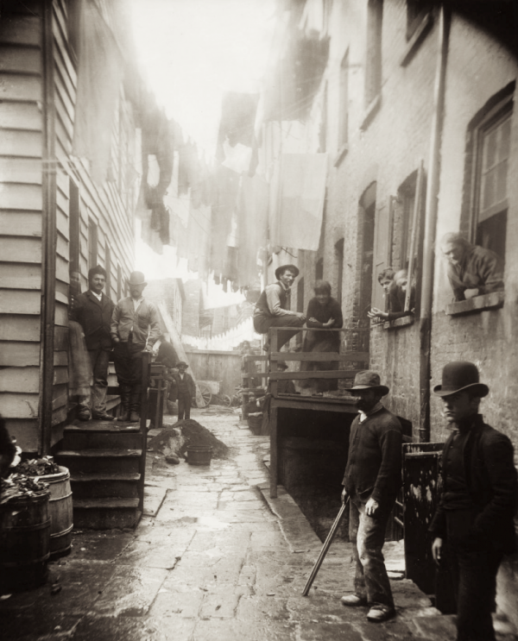
Bandit’s Roost,
1888
Mulberry Bend was the most dangerous neighborhood in NYC. Also known as Five Points (for the meeting of five roads), it was initially occupied by Irish immigrants. As the Irish began to assimilate and move out of Five Points, other ethnic groups began to take their place – Italians, Jews, Poles, etc.

Slide 30
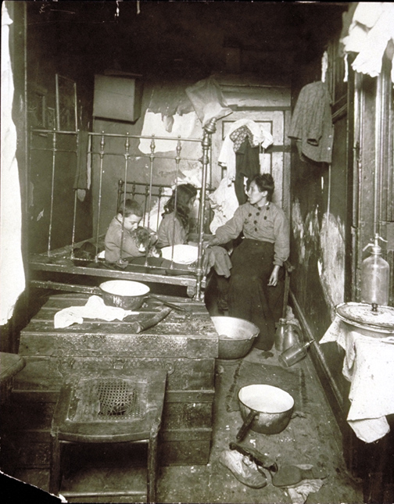
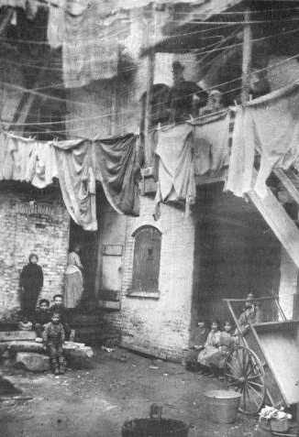

Slide 31
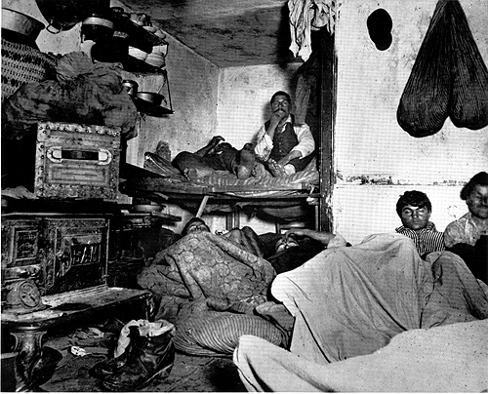

Slide 32
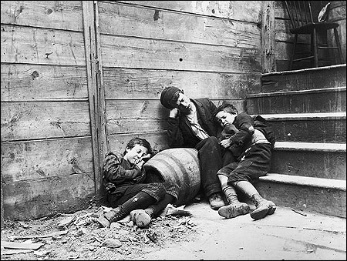

Slide 33
