Slide 1
Political Paralysis in the Gilded Age

Slide 2
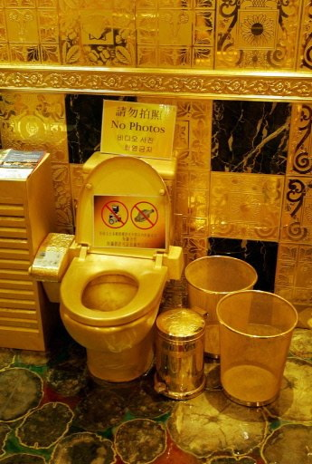
The Gilded Age
“The Gilded Age” – A term coined by Samuel Clemens (AKA: Mark Twain) to describe the late 1800s – the times looked glittery and good, but hid a dark/worthless underbelly
The period held the creation of the first billionaires, the connection of the country by rail, an explosion of technology, as well as political corruption, shady business dealings, and a growing wave of destitute immigrants living in squalid conditions.

Slide 3
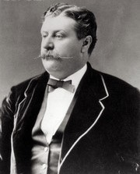
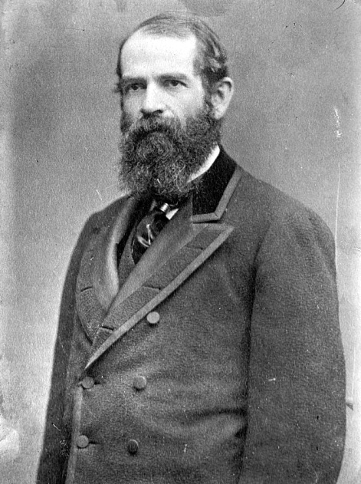
The “Era of Good Stealings”
Black Friday, 1869: Caused by two speculators’ efforts, Jay Gould and James Fisk, to corner the gold market on the New York Gold Exchange.
Causes: It was generally believed that the U.S. Government would buy back the “greenbacks” from the Civil War with gold.
Gould and Fisk recruited President Grant’s brother-in-law, Albert Corbin, who gave them opportunities to get close to the President, and argue against government sale of gold. They convinced Grant to appoint one of their partners as assistant Treasurer of the United States, who would tip the men off when the government intended to sell gold.
Gould began buying large amounts of gold, which caused prices to rise and stocks to plummet. The federal government sold $4 million in gold to balance Gould’s actions. Gould bought more, driving prices even higher.
Grant’s administration was marred by the scandal (the first of many), called the “era of Good Stealings”.

Slide 4
The “Era of Good Stealings”
Crédit Mobilier Scandal: In 1868, Congressman Oakes Ames had distributed Crédit Mobilier shares of stock (from the Union Pacific RR) to other congressmen, in addition to making cash bribes, during Andrew Johnson’s presidency. Was not discovered until 1872, during Grant’s re-election campaign.
Whiskey Ring Scandal: Exposed in 1875, it involved the diversion of millions of dollars in tax revenues in a conspiracy among government agents, mostly Republican politicians, whiskey distillers, and distributors.
Belknap Scandal: Involved Secretary of War William W. Belknap, his wife, and two federal appointees who received quarterly kickback payments derived from an illicit Fort tradership contract.

Slide 5
Post-War Money Troubles
Panic of 1873: Caused by post-war inflation , over-speculation in railroads and factories, and too-easy credit given by banks.
Debtors wanted paper money (“greenbacks”) printed to create inflation and thus make it easier to pay off debts; called “soft money” policy (advocated coinage of silver).
Greenback Labor Party – started with the mission of bringing soft money policies to life.
Bankers and the wealthy felt this was unfair because debts would be paid back at lower values than initially given; favored “hard money” policies.
President Grant passed the Resumption Act (1875) that lowered the number of greenbacks in circulation and redeem paper money at face value.

Slide 6
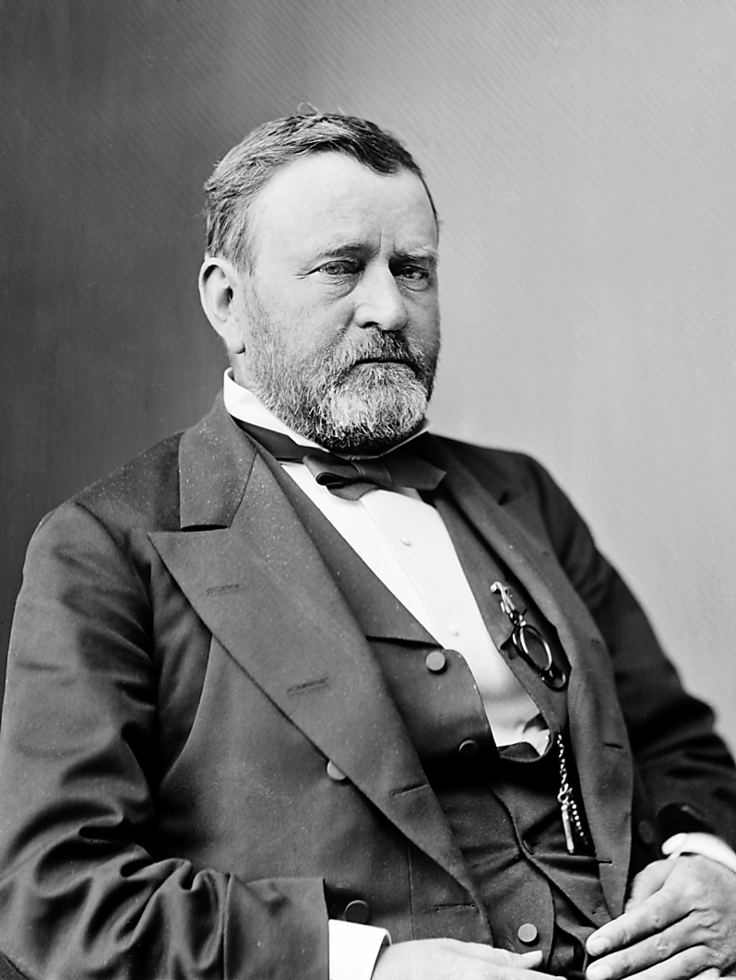
Ulysses S. Grant
Dates in Office: 1869-1877
Nickname: “Unconditional Surrender”
Political Party: Republican
Major Events:
“waving the bloody shirt”
Transcontinental Railroad Completed
Black Friday Scandal
Fifteenth Amendment Ratified
Crédit Mobilier Scandal
Panic of 1873
Whiskey Ring Scandal
Belknap Bribery Scandal
Battle of Little Bighorn

Slide 7
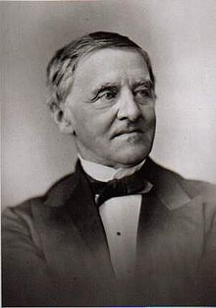
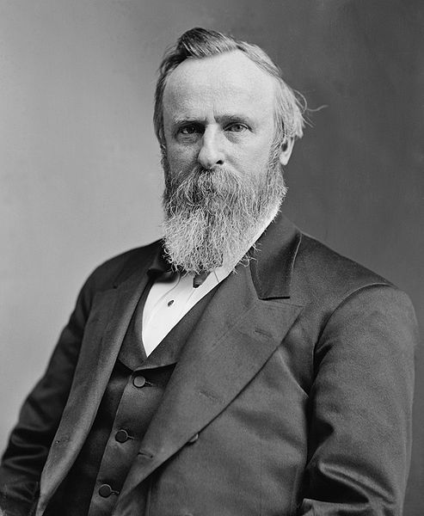
Compromise of 1877
Democrats nominated NY Governor Samuel J. Tilden
Republicans nominated OH Governor Rutherford B. Hayes
Neither candidate won the electoral majority – was solved by the Compromise of 1877: Hayes was elected as a Republican president, with the assurance that he would remove military occupation in the South.

Slide 8
Rutherford B. Hayes
Dates in Office: 1877-1881
Nickname: Rutherfraud
Political Party: Republican
Major Events:
Compromise of 1877
Great Railroad Strike of 1877
Knights of Labor is established

Slide 9
Bell Ringer
Why did Samuel Clemens name the post-Reconstruction era the “Gilded Age”? Cite an example of this definition.

Slide 10
The Republican Party Splits
STALWARTS
HALF-BREEDS
Led by Senator Roscoe Conkling (sometimes called “Conklingites”)
Conservative “traditional” Republicans opposed to civil service reform.
Led by Senator James G. Blaine; a disparaging term meant to suggest that they were only half Republican.
Moderately-liberal Republicans who supported civil service reform.
Nominated James Garfield and Chester A. Arthur as a compromise.

Slide 11
James Garfield
Dates in Office: 1881
Nickname: Boatman Jim
Political Party: Republican
Major Events:
Elected with Stalwart Chester A. Arthur as running mate
Assassinated by Charles J. Guiteau (Stalwart)

Slide 12
Chester A. Arthur
Dates in Office: 1881-1885
Nickname: Prince Arthur
Political Party: Republican (Stalwart)
Major Events:
Chinese Exclusion Act
Pendleton Act

Slide 13
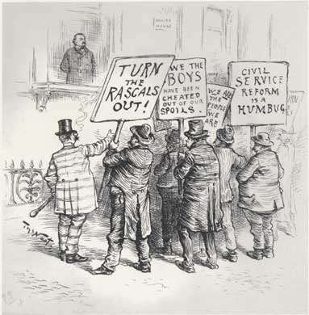
Civil Service Reform
Pendleton Civil Service Act – required merit to receive government positions; would essentially eliminate the Jacksonian “spoils system” tradition.
Initially affected only 10% of government jobs, but stopped the worst offenses

Slide 14
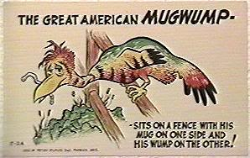
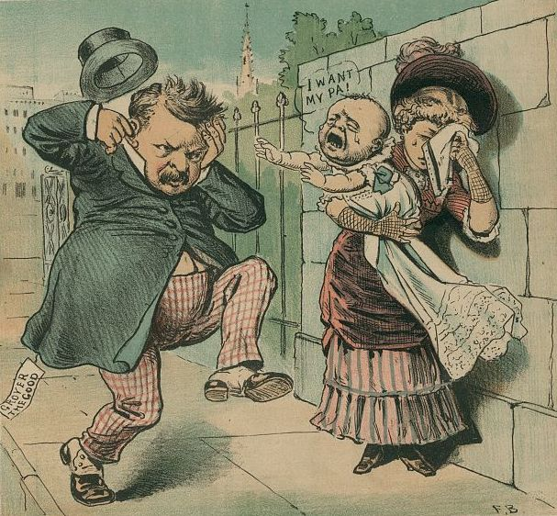
Mudslinging in ‘84
Mugwumps: Republicans who did not agree with the nomination of James G. Blaine, and voted for Democrat Grover Cleveland.
Mudslinging reached its worst level yet, focusing on Cleveland’s illegitimate child.
The popular Republican slogan: “Ma, Ma, where’s my Pa?”
After Cleveland’s win, Democrats responded with “Gone to the White House, ha-ha-ha!”

Slide 15
Grover Cleveland
Dates in Office: 1885-89, 1893-1897
Nickname: His Obstinancy, Grover the Good
Political Party: Democrat
Major Events:
Presidential Succession Act
Dedication of Statue of Liberty
American Federation of Labor is established
Interstate Commerce Act
Dawes Severalty Act
LEAVE ROOM!!!

Slide 16
The Lone Democrat
Cleveland was the first democratic president since Buchanan (pre-Civil War)
Had a laissez-faire capitalism mindset, which made big business very happy
Bridged the North-South gap by naming two former Confederates to his cabinet (jobs awarded by merit, as per the Pendleton Act)
The Grand Army of the Republic (Union war veterans who generally sided with Republicans) pushed several bills through Congress that gave pensions to many veterans, though not always well-deserved.
Many of these bills were vetoed by Cleveland.

Slide 17
A Budgetary Anomaly
Cleveland had an unusual problem – a budget surplus.
Most extra money came in as a result of high tariffs
To get rid of the surplus, Cleveland cut taxes and asked for a reduction in the tariff. This made him even more unpopular with Republicans.
Cleveland would lose the upcoming election to Republican candidate Benjamin Harrison (William Henry Harrison’s grandson).

Slide 18
Benjamin Harrison
Dates in Office: 1889-1893
Nickname: The Front Porch Campaigner
Political Party: Republican
Major Events:
Sherman Anti-Trust Act
Sherman Silver Purchase Act
McKinley Tariff
Homestead Strike

Slide 19
The Billion Dollar Congress
Republicans reasserted their power in Congress
Became known as the “Billion Dollar Congress” – the first time Congress had doled out that much money.
Pensions were given liberally to veterans
More silver was purchased
The McKinley Tariff hiked rates to 48%

Slide 20
Grover Cleveland
Dates in Office: 1885-89, 1893-1897
Nickname: His Obstinancy, Grover the Good
Political Party: Democrat
Major Events:
Presidential Succession Act
Dedication of Statue of Liberty
American Federation of Labor is established
Interstate Commerce Act
Dawes Severalty Act
Panic of 1893
Cross of Gold Speech
Coxey’s Army
Pullman Strike

