Slide 1
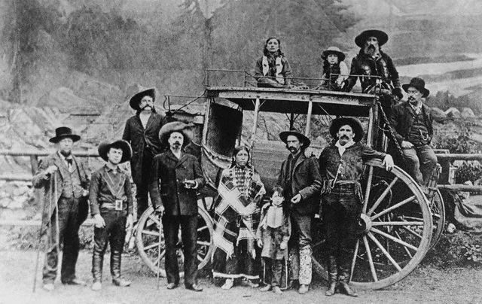
Closing the West
Conquering America's
Frontier

Slide 2
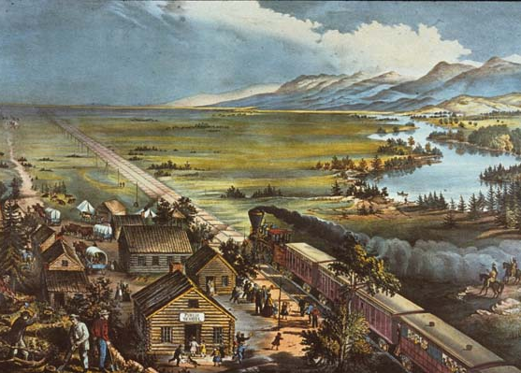
Closing the Frontier
Frederick Jackson Turner’s Frontier Thesis
“American social development has been continually beginning over again on the frontier. This perennial rebirth, this fluidity of American life, this expansion westward with its new opportunities, its continuous touch with the simplicity of primitive society, furnish the forces dominating American character....In the crucible of the frontier the immigrants were Americanized, liberated, and fused into a mixed race, English in neither nationality nor characteristics...."
Believed that the frontier was the basis of the American identity – self-reliance, innovation, adaptation, independence, and opportunity
The frontier is unique to America

Slide 3
American West, American Football

Slide 4
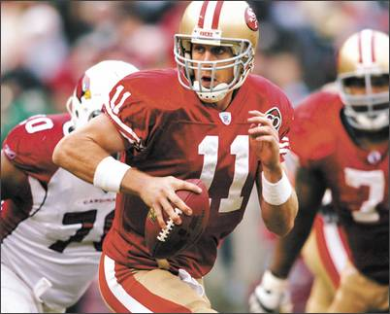
‘49ers Strike Gold!

Slide 5
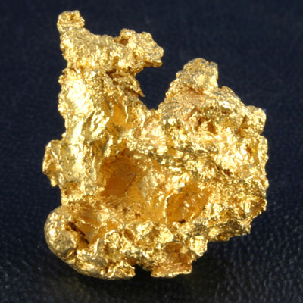
January 24, 1848 – Sutter’s Mill,
Coloma, California

Slide 6
Don’t work harder,
Work SMARTER!
Notes:
Placer mining: simple equipment such as picks, shovels, and pans.
Sluice mining: diverts the current of a river into earthen or wooden trenches. The water was directed to a box with metal “riffle” bars that disturbed the current, causing heavier minerals to settle on the bottom of the box. A screen at the end of the riffle box kept the minerals from flowing out.

Slide 7
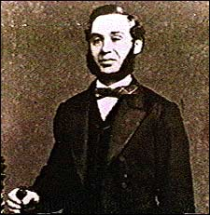
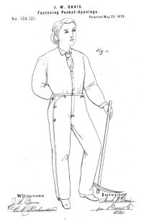
When life hands you lemons,
make lemonade!
...And then SELL IT!
Notes:
Strauss expected the miners would welcome his buttons, scissors, thread and bolts of fabric. He also brought along canvas sailcloth, intended to make tents and covers for the Conestoga wagons many miners lived out of.
Strauss opened his dry goods wholesale business as Levi Strauss & Co. He often led his pack-horse, heavily laden with merchandise, to the mining camps in the Gold Rush country.^{[citation needed]} He learned that prospectors and miners complained about their cotton trousers and pockets tearing too easily. A tailor named Jacob Davis decided to make rugged overalls to sell to the miners.^{[citation needed]} Fashioned from brown sailcloth made from hemp, his trousers has ore storage pockets that were nearly impossible to split.^{[citation needed]} Davis wanted to register a patent, but lacked money. Strauss agreed to help him and they went into partnership.
On May 20, 1873, Strauss and Davis received United States patent #139121 for using copper rivets to strengthen the pockets of denim work pants.

Slide 8
Boom Town to Ghost Town

Slide 9
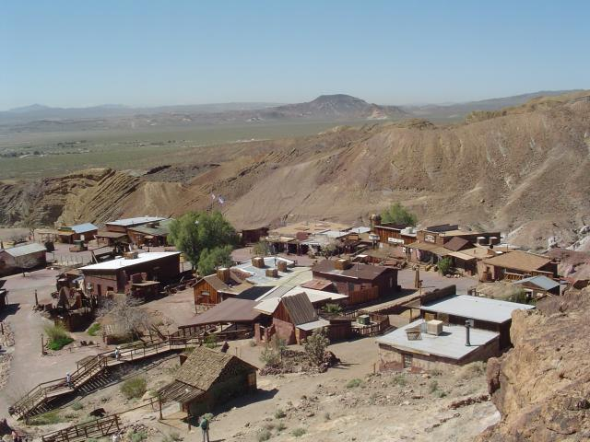
Calico – A local California Ghost Town

Slide 10
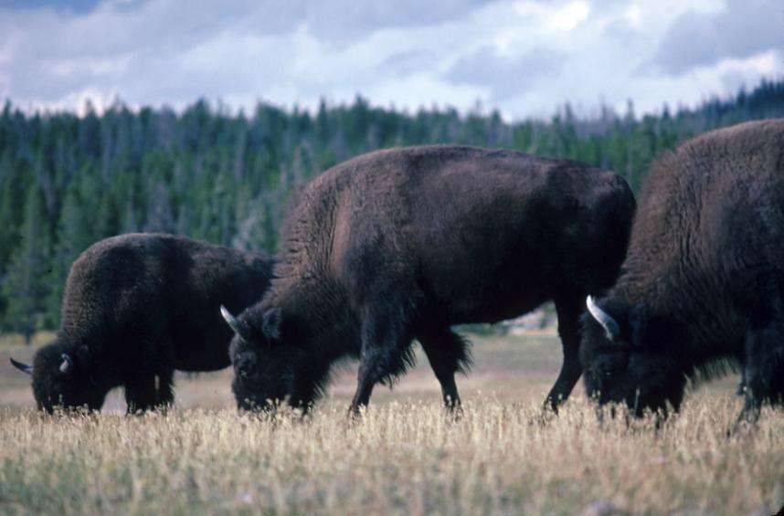
Home on the Range

Slide 11
The Homestead Act - 1862
In May 1862, Congress passed the Homestead Act, which declared that any citizen of the United States could claim 160 acres of surveyed government land, most of it west of the Mississippi. After payment of a nominal filing fee, homesteaders were to "improve" their land by living on it, building a dwelling, and planting crops. If the settlers fulfilled these requirements, and stayed on the land for a period of five years, the land became their property. However, the Act's seemingly lenient requirements proved impossible for many would-be homesteaders.
Notes:
Could claim 160 acres by filing for a homestead and living on the land for five years.

Slide 12
The Homestead Act - 1862
The Homestead Act: Citizens could claim 160 acres of government land west of the Mississippi
Pay a small filing fee
Must improve the land
Must build a dwelling
After five years, the land became theirs, free of charge.
Notes:
Could claim 160 acres by filing for a homestead and living on the land for five years.

Slide 13
A famous Homestead Certificate

Slide 14
How they got there

Slide 15
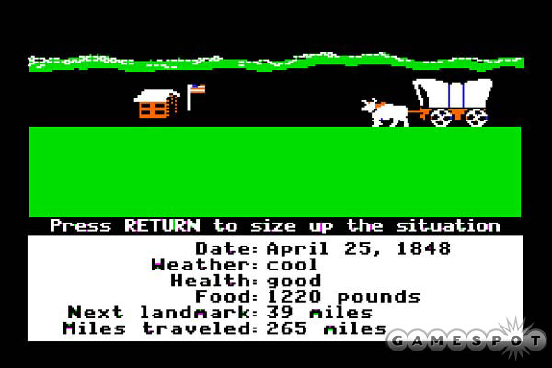
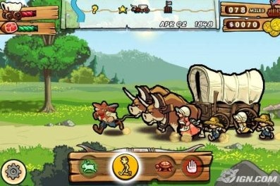
Oregon Trail

Slide 16
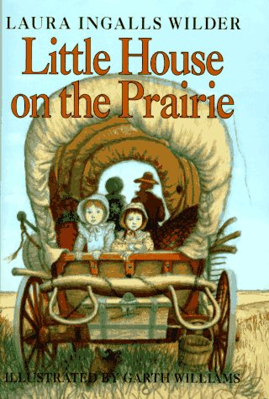

Slide 17
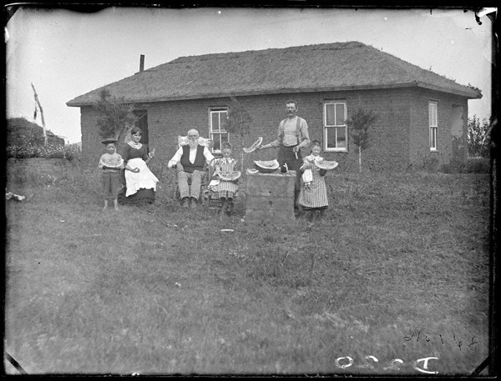
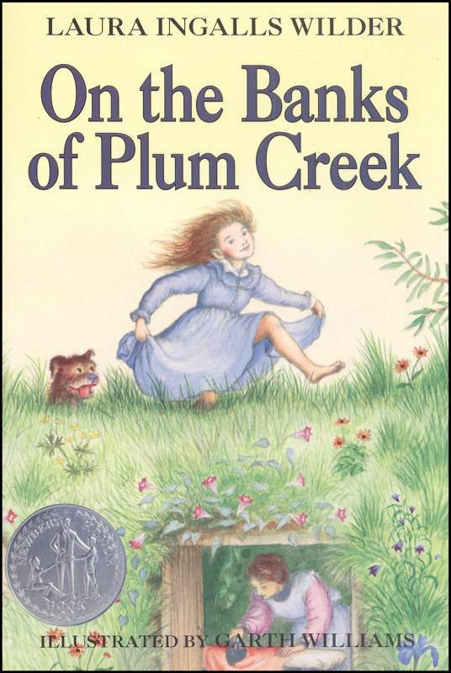
Sodbusters

Slide 18
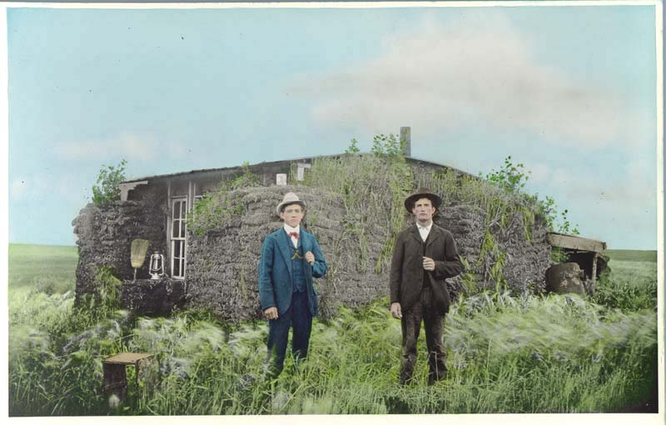
Sodbusters!
What features make a sod house look like a regular house?
What features make a sod house look distinctive or unusual?
Why was this type of structure popular for pioneers to build as their homes?
What possible problems may arise for sodbusters out on the plains?

Slide 19
The American
Buffalo

Slide 20
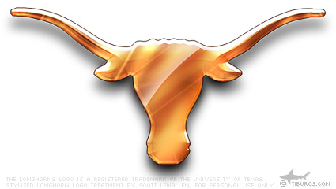
The Buffalo’s Replacement

Slide 21
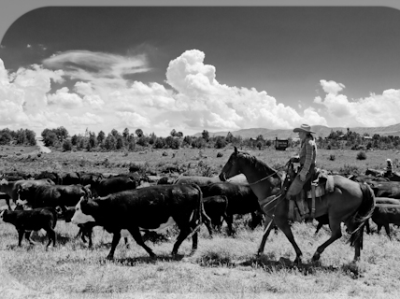
Chisholm Trail – The “Long Drive”
Notes:
Texas to Kansas

Slide 22
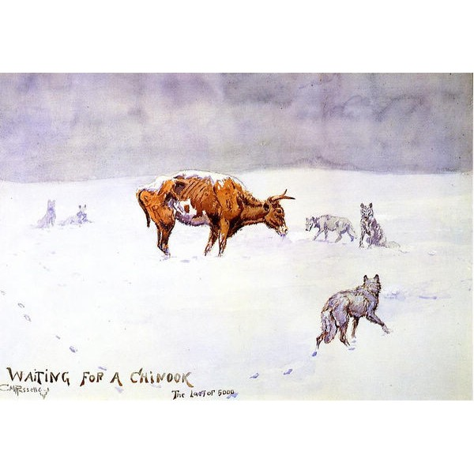
Winter of 1887
The Winter of 1887 was incredibly harsh in the West
Marked the end of the Open Range era and led to the entire reorganization of ranching.
Extreme cold temperatures killed humans and animals alike.
The few remaining cattle were in poor health, being emaciated and suffering from frostbite. This resulted in the cattle being sold for much lower prices, in some cases leading ranch owners to bankruptcy.
Charles Russell: Known as the “cowboy artist,” he painted vividly realistic images of the West, with some of the few accurate portrayals of Native American tribes.
His painting “Waiting for a Chinook” revealed the devastation of the Winter of 1887 to the East.

Slide 23
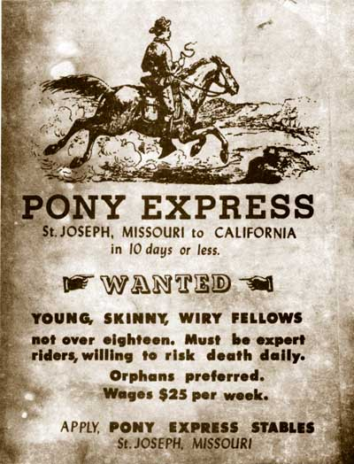
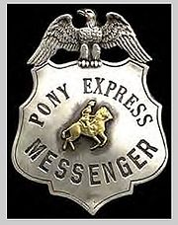
"Neither snow, nor rain, nor heat, nor gloom of night stays these couriers from the swift completion of their appointed rounds"
The Pony Express

Slide 24
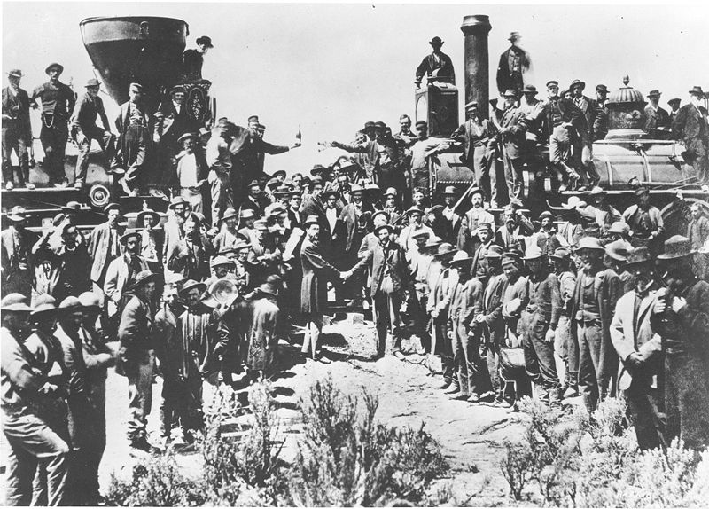
Central Pacific
Union Pacific
Transcontinental
Railroad

Slide 25
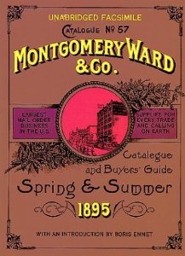
Long-distance Shopping
The connection of East and West by rail allowed consumers to purchase goods from across the country. Stores began printing catalogues of their goods, which could be purchased and shipped via rail.
Montgomery Ward

Slide 26
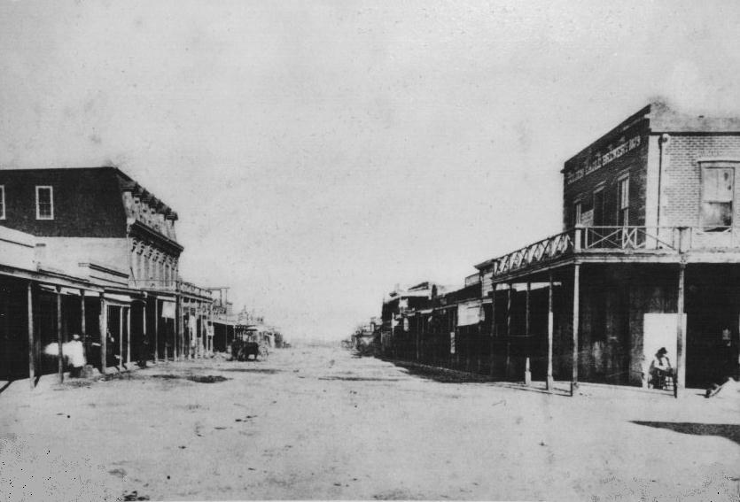
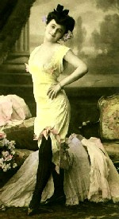
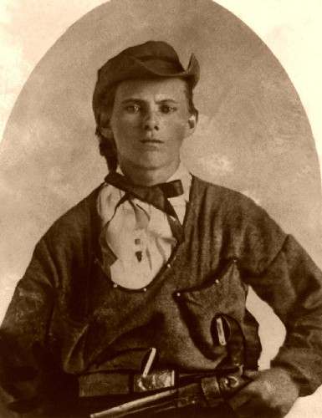
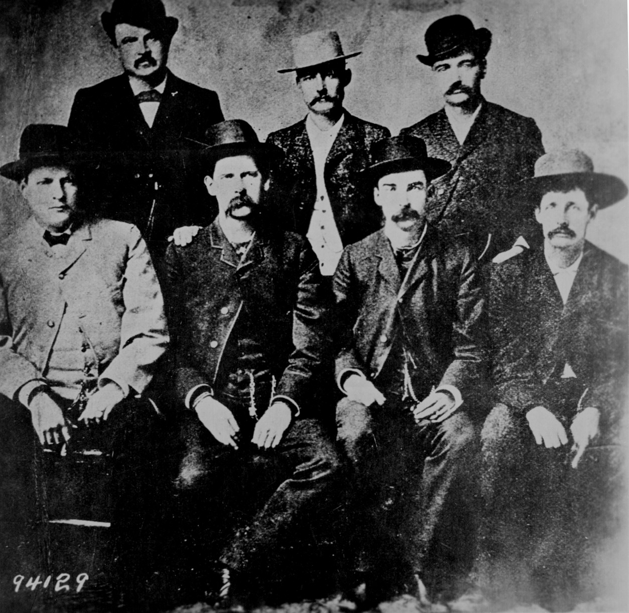
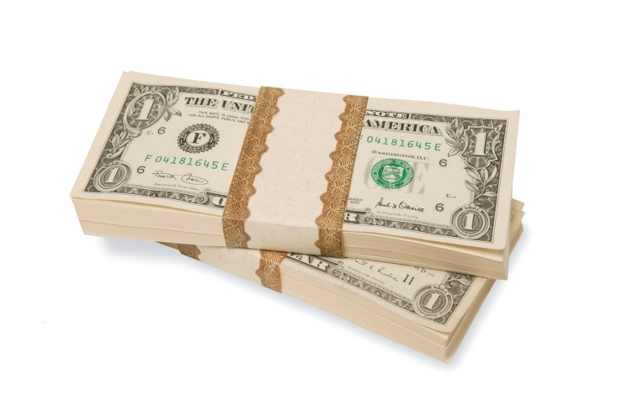
Towns of 5,000 people sprang up almost overnight
Notes:
Vigilance committees: AKA: Vigilantes
Groups that set themselves up as the law and sometimes didn’t bother with a trial before hanging.

Slide 27
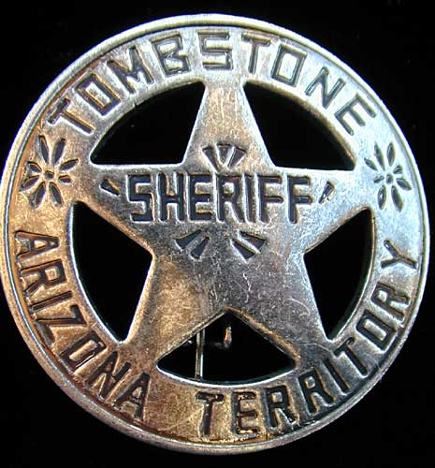
OUTLAWS, LAWMEN, AND ENTERTAINERS

Slide 28
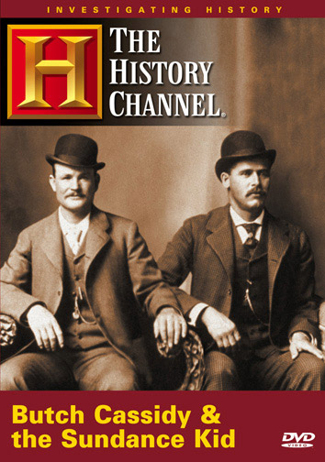
Outlaws, Lawmen, and Entertainers
Notes:
Henry McCarty, AKA: Henry Antrim, William H. Bonney, or BILLY THE KID
notorious outlaw and beloved folk hero
According to legend, he killed 21 men, one for each year of his life, but he most likely participated in the killing of less than half that number.
Robert LeRoy Parker, AKA: Butch Cassidy and Harry Alonzo Longabaugh, AKA: The Sundance Kid
notorious train robbers, bank robbers and leaders of the Hole in the Wall Gang

Slide 29
Outlaws, Lawmen, and Entertainers
Notes:
an American outlaw in the state of Missouri and the most famous member of the James-Younger Gang. After his death, he became a legendary figure of the Wild West, although his robberies benefited only him and his band.

Slide 30
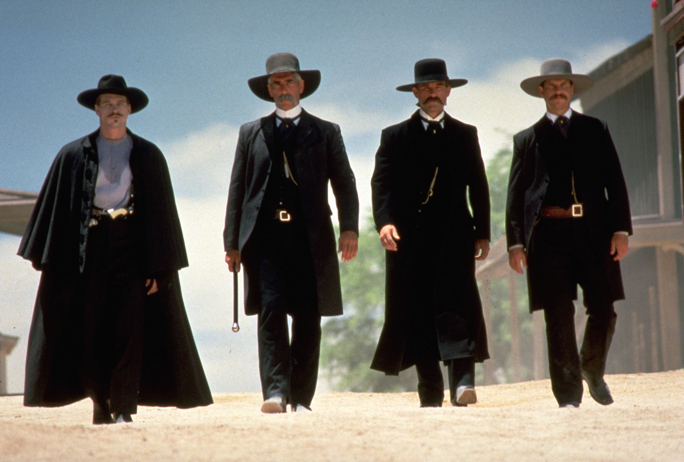
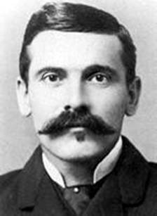
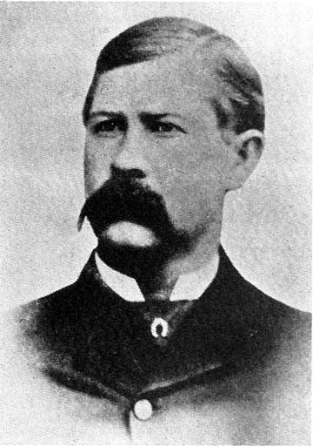
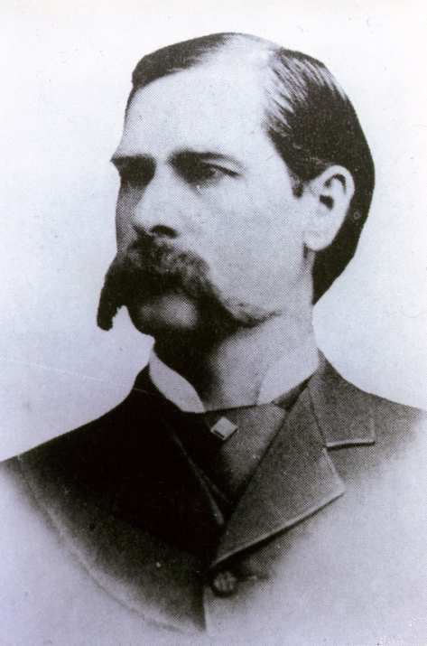
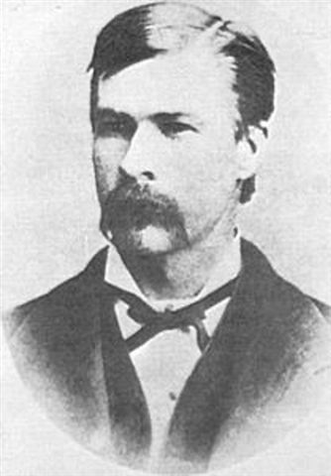
Outlaws, Lawmen, and Entertainers
“I’m your huckleberry”
Notes:
Gunfight lasted only about 30 seconds

Slide 31
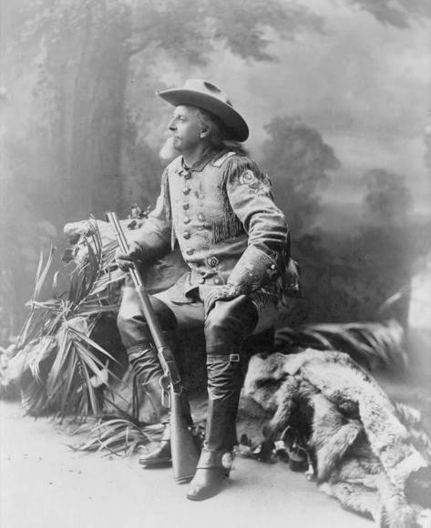
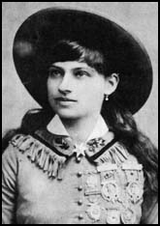
Notes:
William Frederick Cody, AKA: Buffalo Bill
master buffalo hunter
Reeenactments of history combined with displays of showmanship, sharp-shooting, hunts, racing, or rodeo style events. Each show was 3-4 hours long and attracted crowds of thousands of people daily.
Phoebe Ann Mosey, AKA: Annie Oakley
Sharpshooter

Slide 32
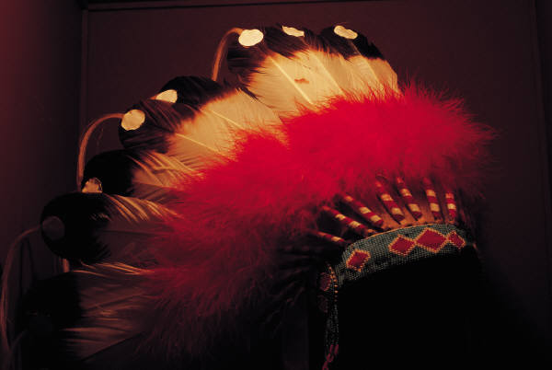
Solving the “Indian Problem”
The Indian Wars

Slide 33
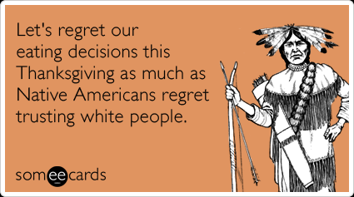
A Clash of Cultures
White settlers clashed with local tribes over land and customs
Treaties were signed that began the reservation system
Not signed by real “chief”
Cheated out of compensation promised to them
Many “chiefs” who signed the treaties did not have authority over the entire group or area.
Were not given the compensation promised to them by the government

Slide 34
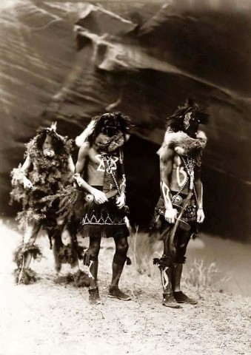
The end of the Trail for the Indians
The “Ghost Dance”
Sioux tribe religious dance
Celebrated a hoped-for where whites would be cast out of Indian lands
Prompted the Battle of Wounded Knee
Not a battle but a massacre: 200+ Indians were killed, essentially killed for dancing.
This marked the end of the Indian Wars.

Slide 35
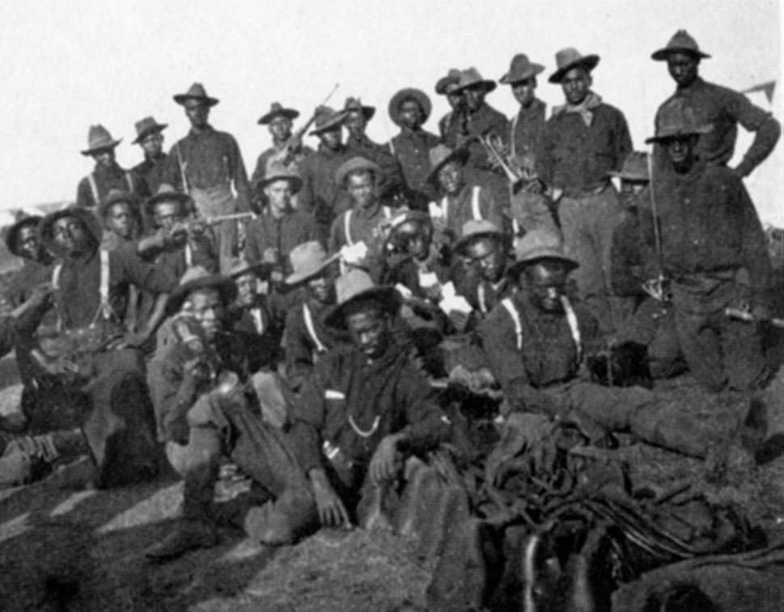
Buffalo Soldiers
Buffalo Soldiers were members of the U.S. 10th Cavalry Regiment of the United States Army; the first peacetime all-black regiments in the regular U.S. Army
This nickname was given to the "Negro Cavalry" by the Native American tribes they fought
"We called them 'buffalo soldiers,' because they had curly, kinky hair...like bisons.” (-)
Comparison from their fierce fighting ability as well (+)
Most known for their actions in the Indian Wars, but also served a variety of roles along the frontier from building roads to escorting the U.S. mail.

Slide 36
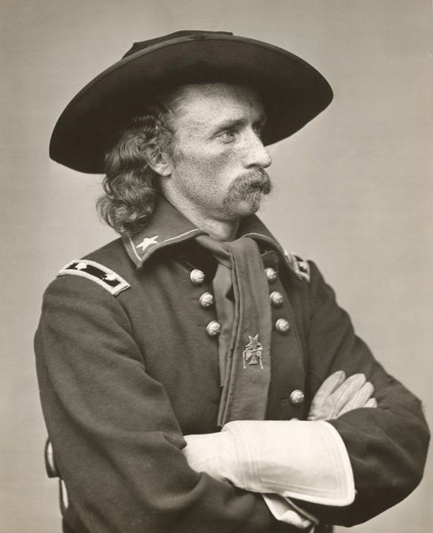
The Indian Wars
Battle of Little Bighorn (AKA: Custer’s Last Stand)
Battle against a united Sioux nation
Led by “Crazy Horse” and “Sitting Bull”
Refused to go to the reservation.
U.S. Army crushed by Indian forces
One of the few Indian victories

Slide 37
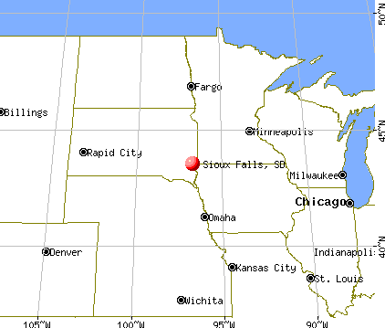
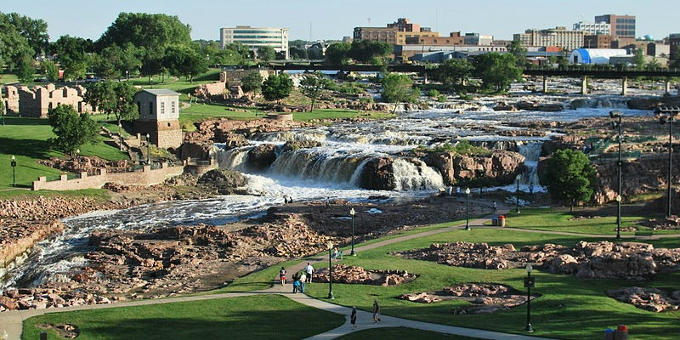
The Indian Wars Cont..
Treaty of Fort Laramie: A treaty made between the federal government and the Sioux. Established the Sioux reservation in the Dakota Territory
Later on gold was discovered in the Black Hills of South Dakota(on the Sioux reservation)
Col. William Armstrong Custer led a geological expedition into the Black Hills.

Slide 38
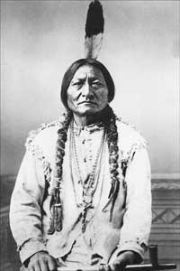
The Indian Wars
Battle of Little Bighorn
Started in 1876 (AKA “Cluster’s Last Stand)
Was led by “Crazy Horse” and “Sitting Bull,” who stubbornly refused to go to the reservation.
Custer led about 700 cavalry, while he faced against 10,000 Indians
Custer and 200+ of his men were killed.

Slide 39
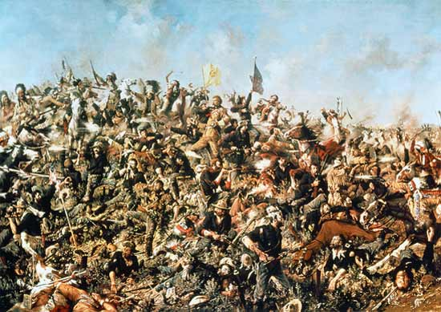

Slide 40
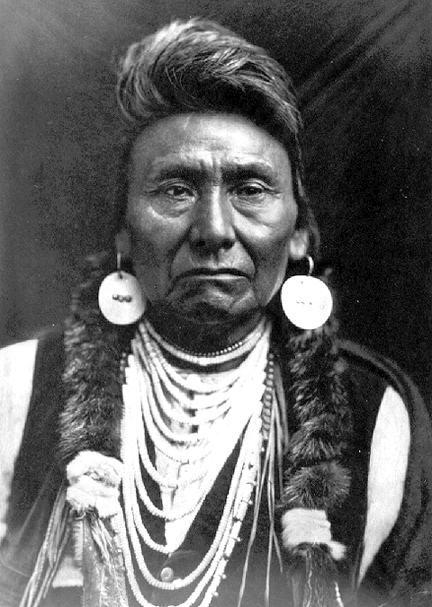
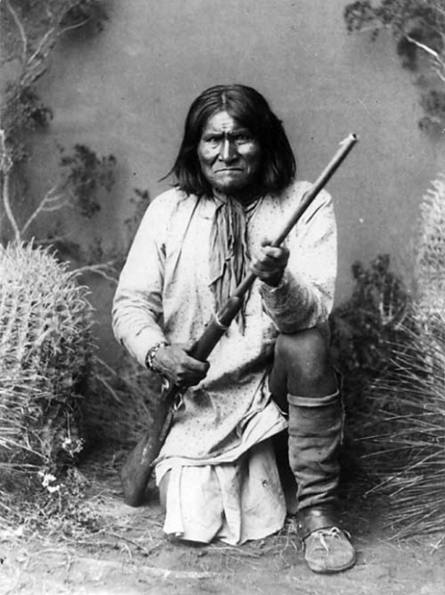
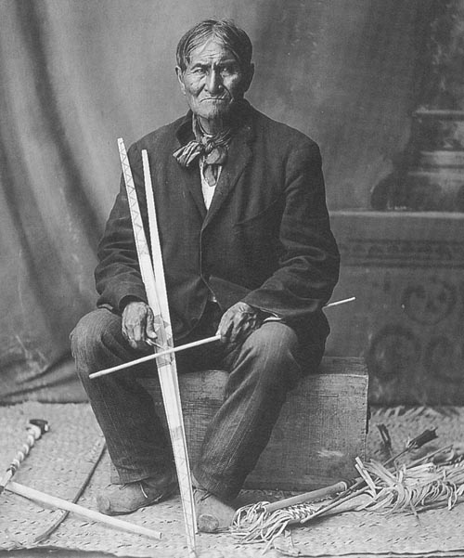
The Indian Wars
The Nez Perce tribe was led by Chief Joseph, revolted when the government tried to force them onto a reservation and fled for Canada.
They were caught and defeated at the Battle of Bear Paw Mountain and were sent to a Kansas reservation where 40% died from disease.
“From where the sun now stands I will fight no more Forever.” - Chief Joseph
Geronimo, the Apache warrior, was notorious for consistently leading raids upon Mexican provinces and towns, and later against American locations across the Southwest. He was captured in 1886.

Slide 41
The Indian Wars
Nez Perce
Led by Chief Joseph
Fled placement on the reservation
Caught and defeated at the Battle of Bear Paw
40% died once on the reservation
“From where the sun now stands I will fight no more Forever.” - Chief Joseph
Apache
Geronimo – fierce fighter
Caught and made a “prisoner of war” by the U.S. Government

Slide 42
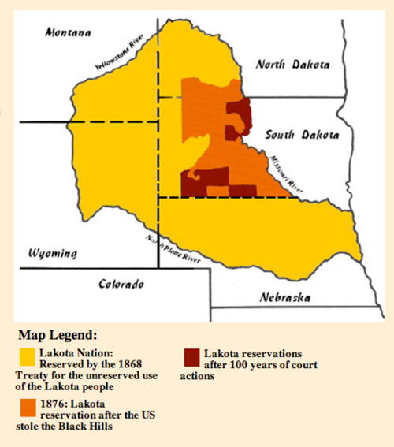
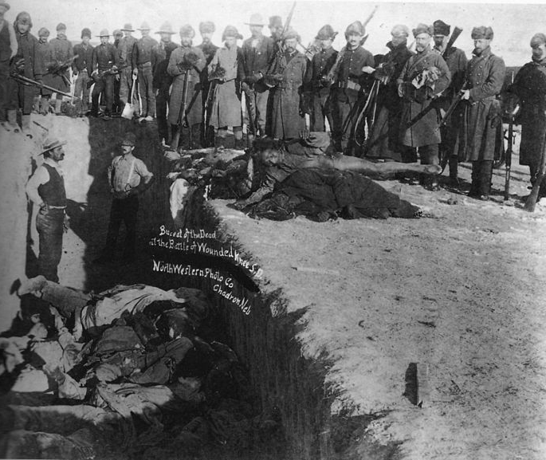
Battle of Wounded Knee (1890)
The US Army was sent to disarm the Lakota and move them onto new reservation land (as a result of the Ghost Dance).
Unclear exactly how it started, but it is assumed it was accidental.
Wounded Knee was not a battle but a massacre. 200+ Indians were killed.
This marked the end of the Indian Wars.

Slide 43
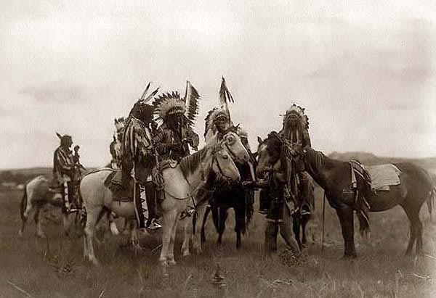
The Indians were subdued due to
1. railroads
2.diseases
3.lack of buffalo
4.war
5.the loss of their land to white settlement

Slide 44
Americanization
In 1887 the Dawes Act was passed.
Goal was to erase the tribes and set the Indians on the road to “becoming white.”
Allotted each head of household 160s acres of reservation land for farming – meant to kill off the traditional communal living style.
Indians would become U.S. citizens after 25 years if they behaved as the U.S. government preferred (like “good white settlers”)
Carlisle Indian School:
-the goal was to train the Indian children in whites’ ways
-”kill the Indians, save the child.” were their policies
-In 1900 Indians held only 50% of the land they’d held just 20 years prior.

