Slide 1
 | Radical Republicans | Defeated Southern Leaders | Freedmen | Moderate Republicans | Copperheads
How to treat former Confederate leaders
Former Confederate citizenship
Plan for the occupied areas of the South
Rights of free blacks
Rebuilding the Southern economy
Racial peace

Slide 2
Reconstruction
Reuniting a Broken Nation

Slide 3
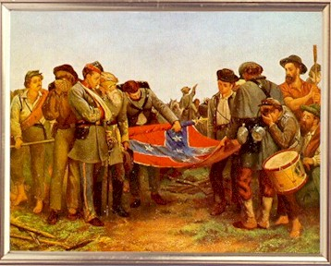
The Problems of Peace
Reconstruction: The process of rebuilding the South and reunifying the Union.

Slide 4
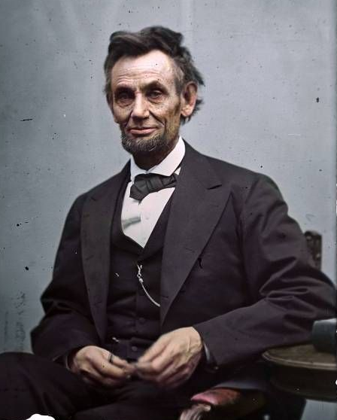
Presidential Reconstruction
13th Amendment (1865): Outlawed “involuntary servitude” in the U.S.
Lincoln’s 10% Plan: Ten percent of Southern voters required to take an oath of loyalty before the state would be readmitted to the Union.
Goal: Bring the South back into the Union as quickly and painlessly as possible

Slide 5
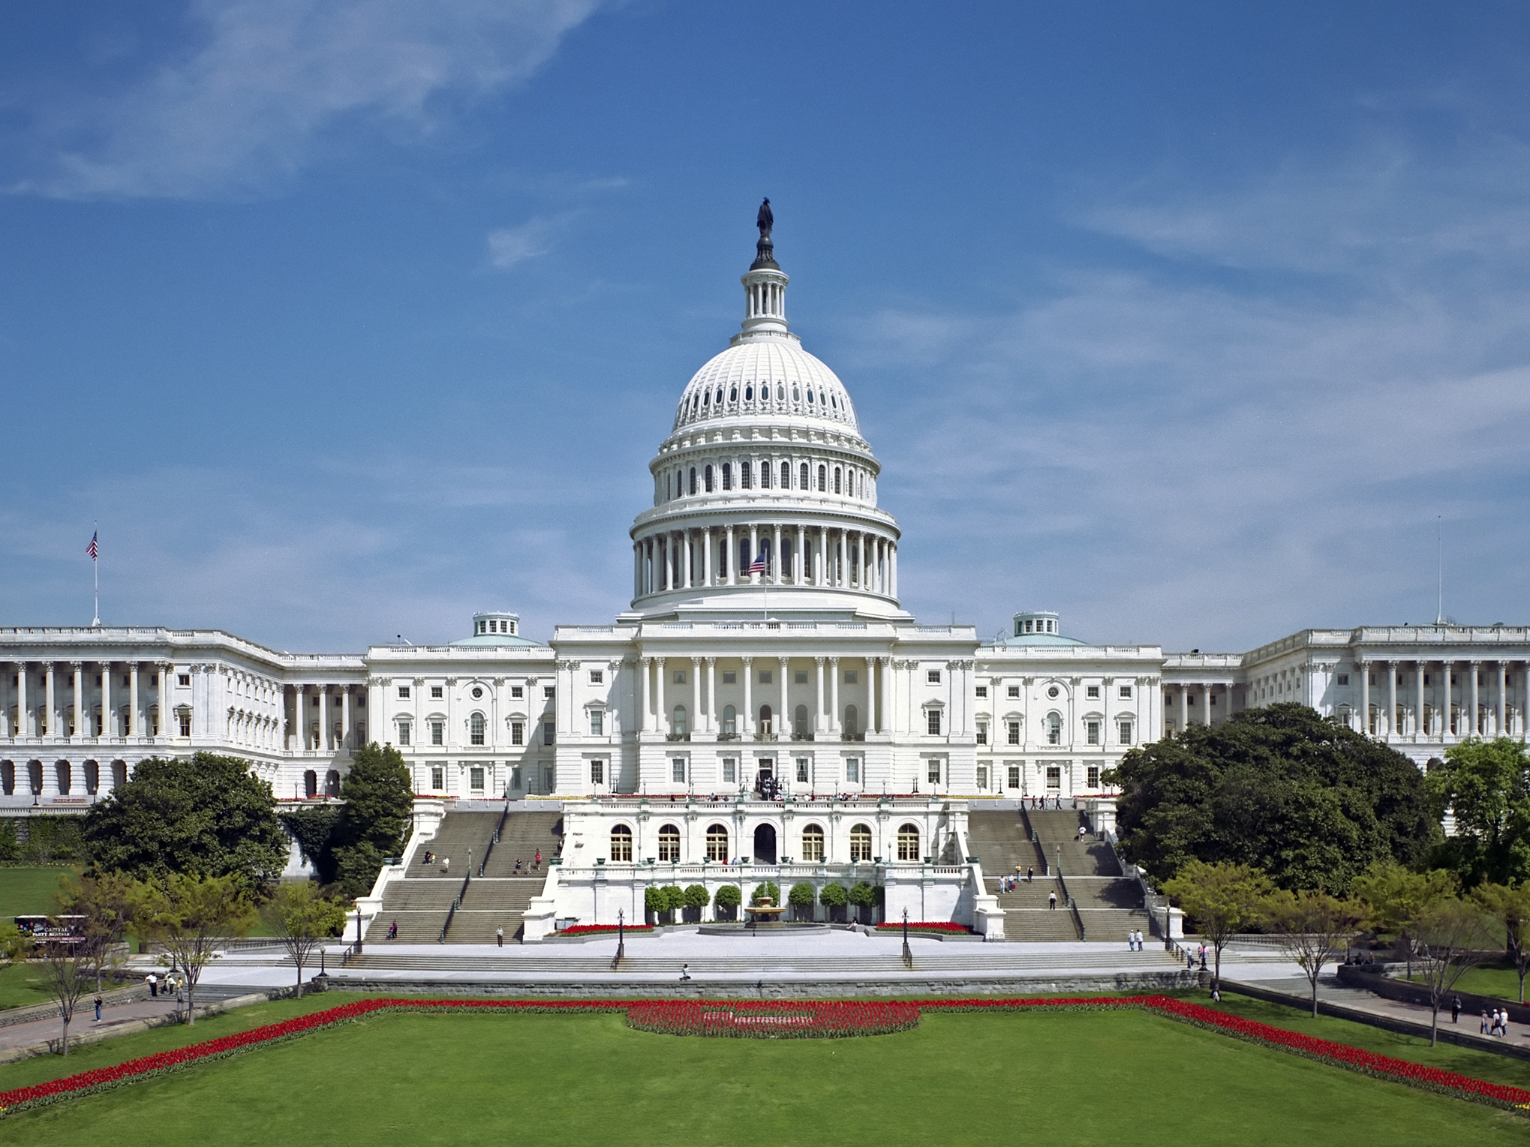
Congressional Reconstruction
"Radical Republicans“
  Wanted to punish the South for the war
  Felt the Southern states had voluntarily seceded; therefore, Congress could set the rules of re-admittance.
Wade-Davis Bill: Required that more than 50 percent of white males take an “ironclad” oath of allegiance before the state could call a constitutional convention. The bill also required that the states abolish slavery.
  Lincoln pocket-vetoed the bill and killed it.

Slide 6
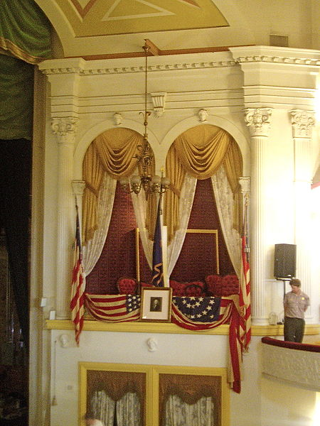
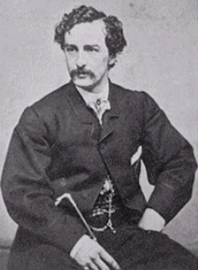
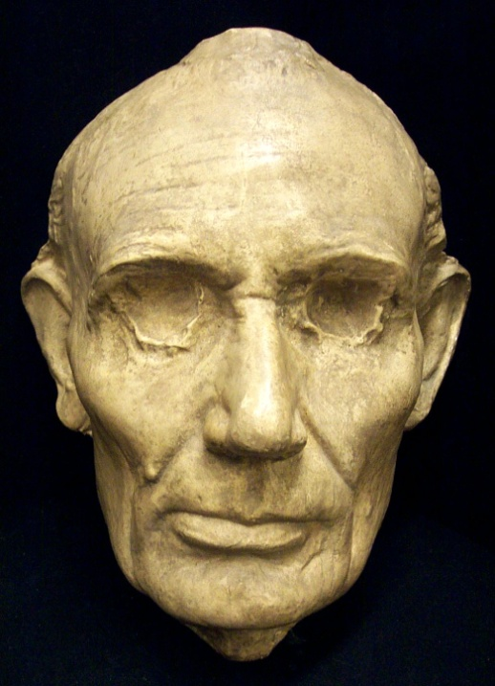
The Martyrdom of Lincoln
On April 14, 1865, President Lincoln was shot and killed at Ford's Theater by John Wilkes Booth. Andrew Johnson took over as President.

Slide 7
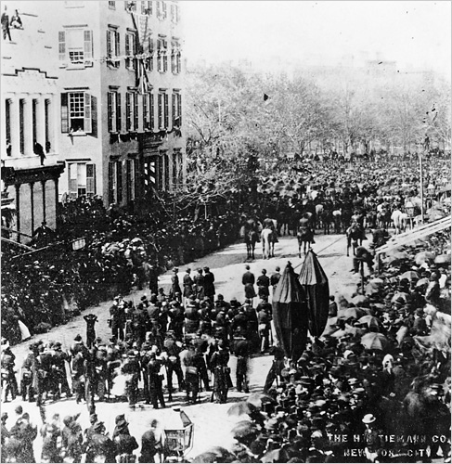
A President Watching A President
Future President Teddy Roosevelt, 6 years old

Slide 8
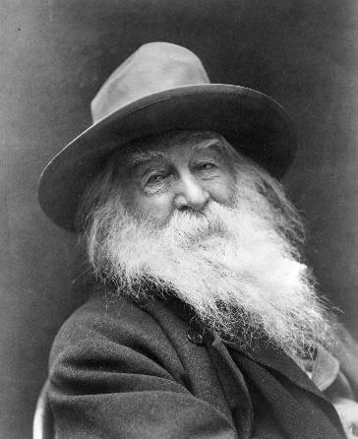
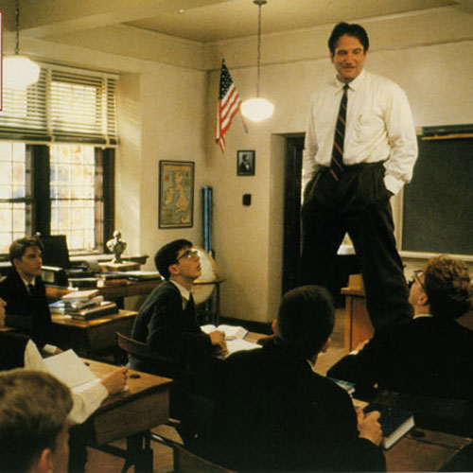
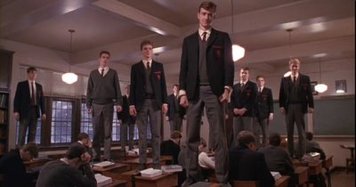
O Captain! My Captain! – Walt Whitman
O Captain my Captain! our fearful trip is done;
The ship has weathered every rack, the prize we sought is won;
The port is near, the bells I hear, the people all exulting,
While follow eyes the steady keel, the vessel grim and daring:
But O heart! heart! heart! O the bleeding drops of red, Where on the deck my Captain lies, Fallen cold and dead.
O Captain! my Captain! rise up and hear the bells;
Rise up—for you the flag is flung—for you the bugle trills;
For you bouquets and ribboned wreaths—for you the shores a-crowding;
For you they call, the swaying mass, their eager faces turning; Here Captain! dear father! This arm beneath your head; It is some dream that on the deck, You’ve fallen cold and dead.
My Captain does not answer, his lips are pale and still;
My father does not feel my arm, he has no pulse nor will;
The ship is anchored safe and sound, its voyage closed and done;
From fearful trip, the victor ship, comes in with object won; Exult, O shores, and ring, O bells! But I, with mournful tread, Walk the deck my Captain lies, Fallen cold and dead.

Slide 9
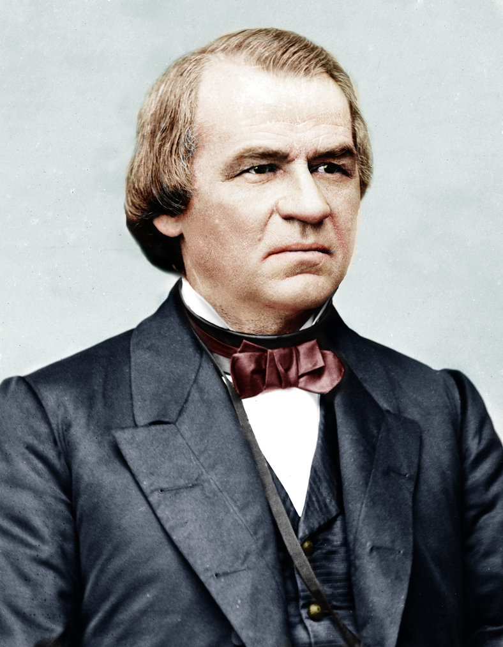
Johnson’s Reconstruction Plan
Johnson’s Plan = Lincoln’s 10% Plan +
  Leading Confederates were to be disenfranchised
  The states must protect the rights of freedmen

Slide 10
Johnson Clashes with Congress
Johnson and Congress clash; distrusted for being a Southern Democrat
  Civil Rights Bill of 1866: Would grant citizenship to blacks. Vetoed twice by Johnson, passed by Congress anyway
Midterm Election of 1866: Johnson faced off against Radical Republicans over Reconstruction
  Radical Republicans led by Sen. Charles Sumner and Rep. Thaddeus Stevens; wanted Reconstruction to bring about real social and economic change
  Johnson irate and heckled by crowds during campaign
  Republicans gained a “super-majority,” which made their causes veto-proof

Slide 11
Rights for Freedmen
The Fourteenth Amendment (1868)
  Broad definition of citizenship
  State/local governments cannot deprive citizens of life, liberty, or property without due process
  All citizens must be given equal treatment under the law
  Cut state Congressional representation if blacks were denied voting
  Disqualified Confederate leaders from federal offices

Slide 12
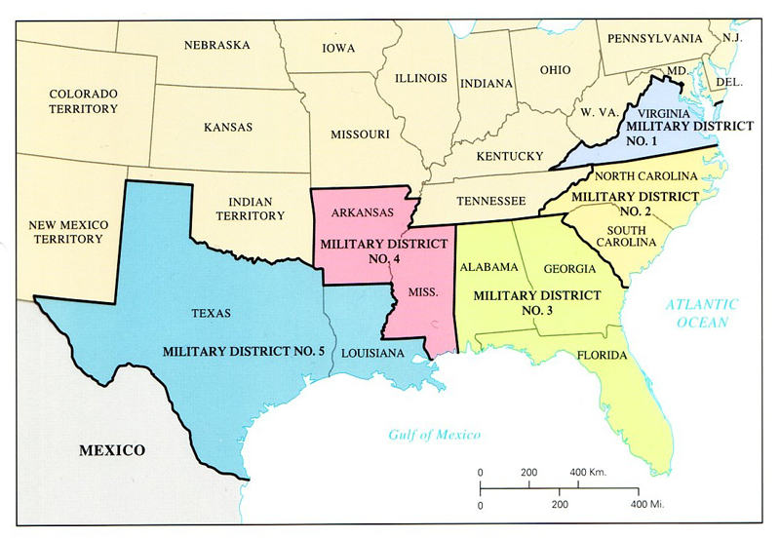
Military Reconstruction
The Reconstruction Act of 1867: Divided the South into 5 military districts. U.S. soldiers would be stationed in each to make sure things stayed under control.
To be readmitted, States must
  Pass the 13th and 14th Amendments
  Guarantee black suffrage
Radical Republicans still worried that even if black suffrage was granted, it could later be removed.
  15th Amendment (1870): Gave all men the right to vote, regardless of race

Slide 13
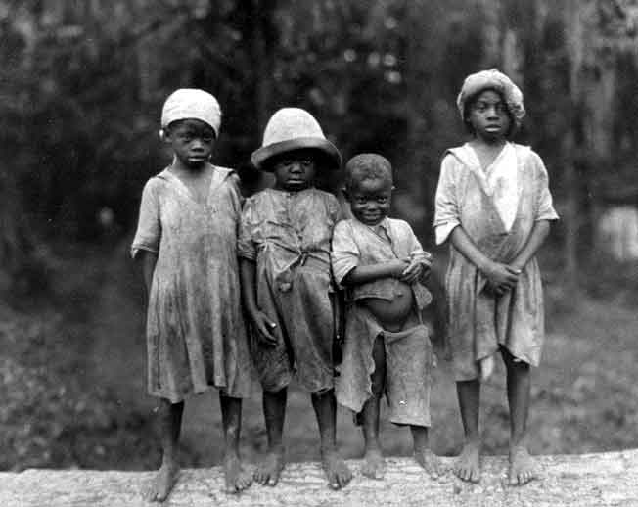
All Men Are Created Equal?

Slide 14
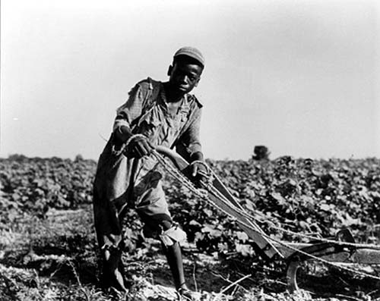
Freedmen Define Freedom
Freed blacks, or "freedmen" were in a confusing situation – Stay, go, or get revenge.

Slide 15
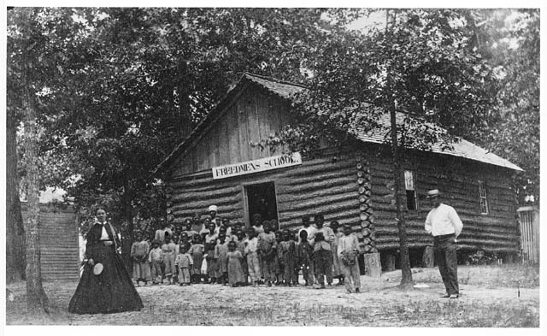
Freedmen Define Freedom
With the blacks' social structure torn down, churches became a strong pillar of the black community
Education difficult to achieve – discrimination and lack of economic resources
Union League: A web of clubs that informed blacks of their civic duties, built churches, pushed for Republican candidates in elections, sought to solve problems, and even recruited a black militia for defense
No real change for black women

Slide 16
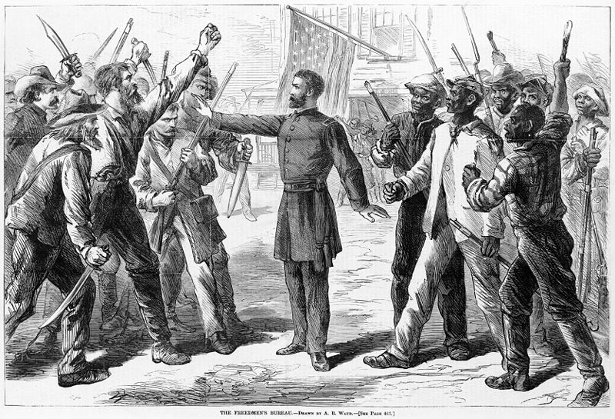
The Freedman’s Bureau
Freed slaves were largely unskilled, uneducated, and untrained
Freedman’s Bureau: Provided food, clothing, health care, and education for newly freed slaves.
  Gen. O. O. Howard headed the bureau (and later founded Howard University in D.C.)
  Minimal success
  Disliked by Southerners

Slide 17
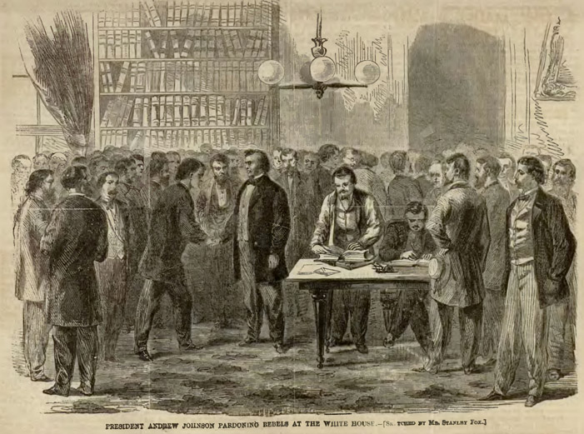
Congressional Reconstruction
Southern Congressmen return (1865)
  3/5 Compromise negated by Reconstruction Amendments
  Southern representation went up, Northern representation went down for the first time

Slide 18
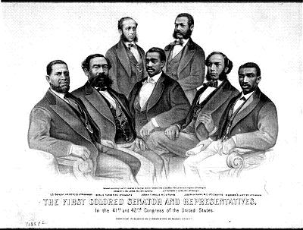
With many white Southerners unable to vote (until taking the oath of allegiance to the U.S.) black Congressmen were elected.
  Hiram Revels (R, MI) – First black Senator

Slide 19
Maintaining Southern Tradition
Methods used to keep Southern blacks “in their place”

Slide 20
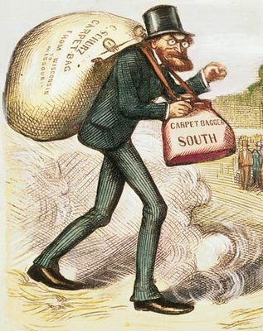
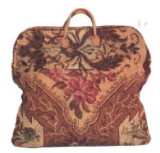
Carpetbaggers and Scalawags
Scalawag
  Southerners who joined the Republican party after the war and supported Reconstruction.
Carpetbagger
  Northerners who moved to the South during Reconstruction, seen with a "carpet bag" (suitcase) in their hand.

Slide 21
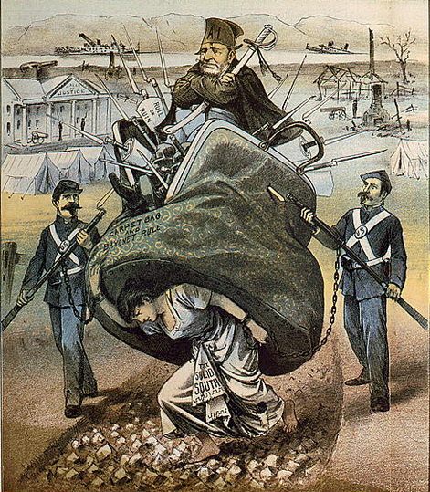
Two views on Southern Reconstruction
The “New South”: The desire to rebuild the South with an agricultural society based around the growth of several crops, as well as the introduction of industrialization.
“Redeemers”: White Southern Democrats who sought to oust the Republican governments in the South that were run by freedmen, “carpetbaggers,” and “scalawags”

Slide 22
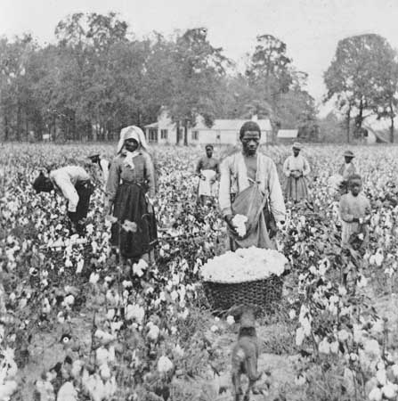
Economic Subservience
Sharecropping: Landowners allow tenants to use their land in return for a share of the crop produced on the land (e.g., 50% of the crop). Most sharecroppers were in continuous debt.

Slide 23
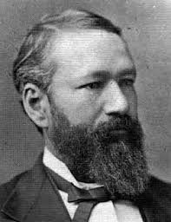
Political Subservience
Black Codes: Local laws passed to keep freedmen in a subservient position
  Banned from juries, holding local office, arrested them for “idleness”
Jim Crow Laws: Laws that created segregation of the races in public places (schools, RR, restaurants, doctors offices, etc.).
Plessy v. Ferguson: Upheld the constitutionality of segregation in public facilities
  "separate but equal.”
Homer Plessy

Slide 24
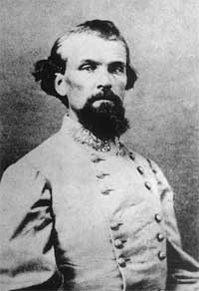
The Ku Klux Klan
Social Subservience -
Ku Klux Klan (AKA: "Invisible Empire of the South”) : Created by former Confederate soldiers to keep the social status quo in the South
  Thrived on fear: Masked men and horses, burned crosses, threatened blacks who didn't "know their place", and lynched blacks.
Nathan Bedford Forrest - First Grand Wizard of the KKK

Slide 25
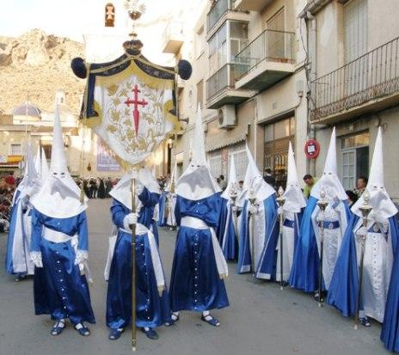
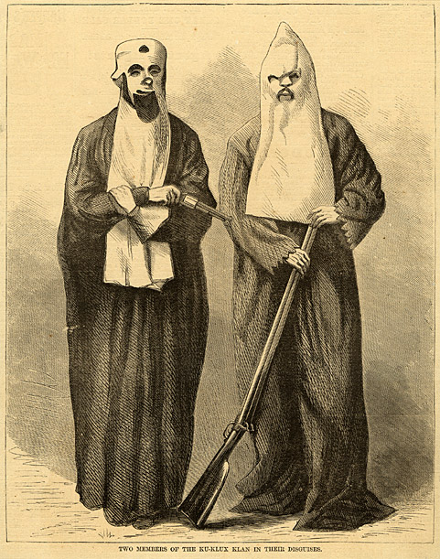
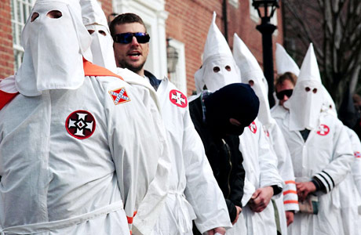
Ku Klux Klan

Slide 26
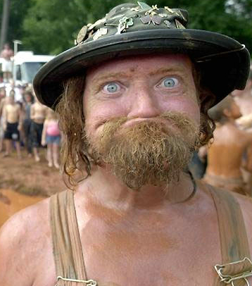
Saving the Dumb White Folk
Southern whites used a variety of methods to disenfranchise blacks:
Poll taxes: Taxes required at the polls that would limit blacks’ ability to vote.
Literacy Tests: Meant to test someone’s ability to read, and therefore vote. Purposefully made more difficult for black voters.
**“Grandfather clause“: Anyone whose grandfather had been able to vote could also vote. This meant whites were grandfathered in (regardless of their ability to read), blacks not.
‘Cause a mah dear ol’ granpappy I gits tuh vote!

Slide 27
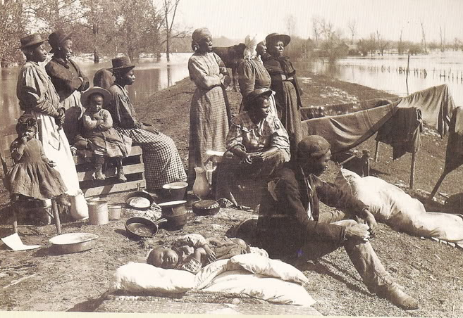
Escaping the South
Homestead Act of 1862: Any citizen who had never borne arms against the U.S. government could claim 160 acres of government land virtually for free
Exodusters: A name given to African Americans who migrated from the South to Kansas post-Civil War (1879).

Slide 28
Where Do We Go From Here?
The Heritage of Reconstruction

Slide 29
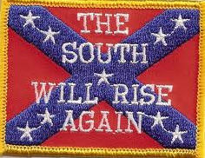
The Heritage of Reconstruction
To many in the South, the shame of Reconstruction was worse than the war.
The war and Reconstruction also bred generations of animosity.
The lot of many Southern blacks, despite good intentions, was likely as bad, or even worse, than before the war.

Slide 30
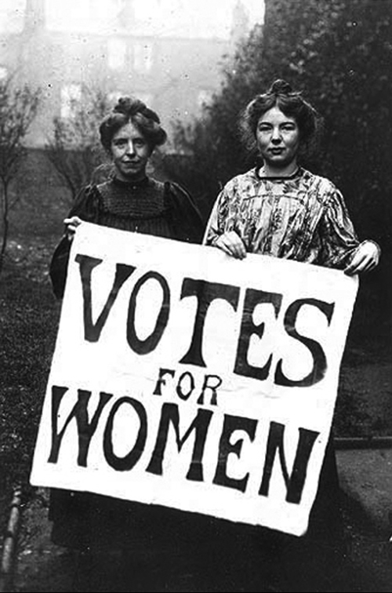
When Mama Ain’t Happy…
Pre-CW: Women saw their lot the same as slaves (disenfranchised; slaves to their homes, children, and husbands)
Highly involved in the abolitionist movement
Angry they were overlooked in the Reconstruction Amendments
  14th Amendment made reference to "males" as citizens—a step back in many women's rights' eyes
  15th Amendment read that voting shouldn't be denied based on "race, color, or previous condition of servitude." Women were not included

Slide 31
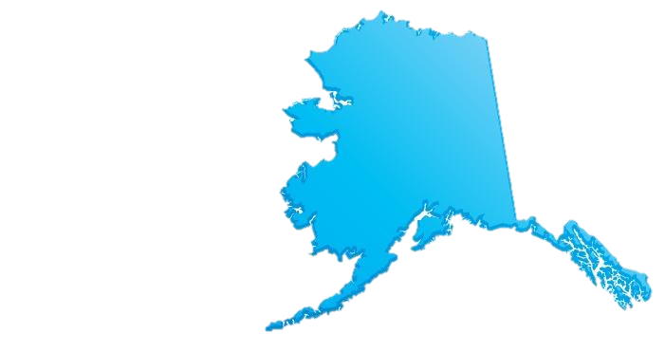
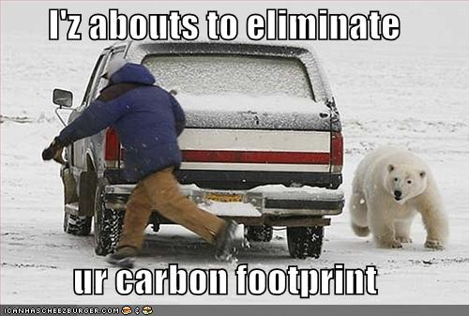
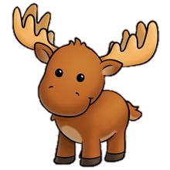

Seward’s Folly
SoS William H. Seward purchases Alaska from Russia for $7.2 million (1867)
  Not popular
  Called "Seward's Folly," "Seward's Icebox," "Frigidia," and "Walrussia."
Seward would later be redeemed when large deposits of gold and oil were discovered in Alaska.

Slide 32
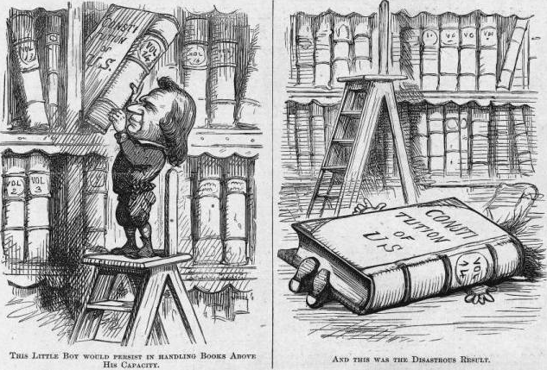
Johnson Walks the Impeachment Plank
Radical Republicans plot to remove Johnson
Tenure of Office Act: Said the president needed the Senate's okay to fire anyone who'd been previously appointed by him and approved by the Senate.
  Johnson looking to fire RR - Edward M. Stanton as Sec. of War
  Johnson impeached (a formal accusation of wrong doing) by Senate for not following the new law

Slide 33
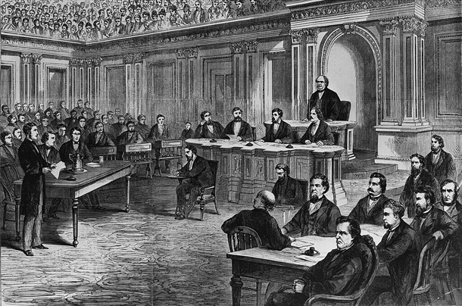
Putting the President on Trial
Johnson’s lawyers argued that he was operating under the Constitution, not the Tenure of Office Act
Needed 2/3 vote to remove Johnson from office; came 1 vote short
The fear of creating instability and setting a dangerous example were factors in the not-guilty verdict.

Slide 34
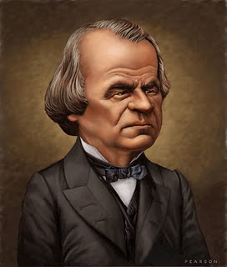
Andrew Johnson
Dates in Office: 1865-1868
Nickname: The Tennessee Tailor
Political Party: Democrat
Major Events:
Reconstruction Act of 1867
Freedmen’s Bureau
13th and 14th Amendments
Seward’s Folly
Impeachment

Slide 35
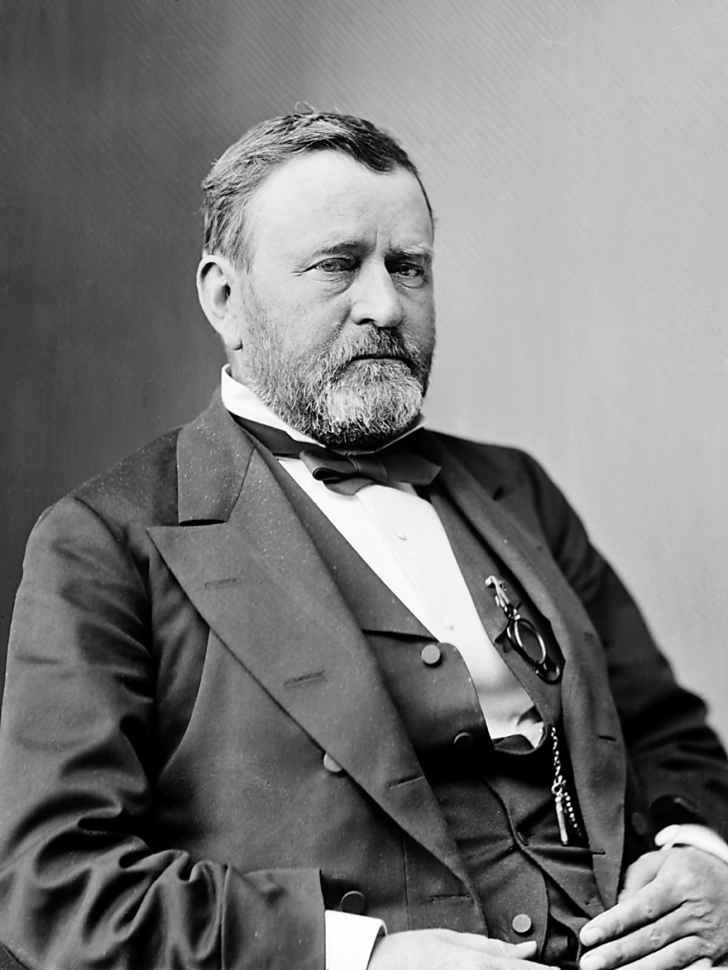
Election of 1868
Ulysses S. Grant (R) vs. Horatio Seymour (D)
“waving the bloody shirt”: Grant constantly reminded voters of his military record and that he led the North to victory
Had no political experience and would earn a position as one of the worst presidents in US history

Slide 36
“Era of Good Stealings”
Grant’s administration is plagued by scandal
  Crédit Mobilier scandal – A sham corporation set up by Union Pacific RR shareholders to secure government grants at an enormous profit; shares given to Congressmen to keep them quiet.
  Whiskey Ring – A network of liquor distillers and treasury agents who defrauded the government of millions of dollars of excise taxes on whiskey; led by Grant’s personal secretary
Panic of 1873: Triggered by the bankruptcy of the Northern Pacific RR, led by a Republican financier
  Problems increased due to a gold-hoarding scheme and Grant’s failure to replace CW greenbacks
  Severely injured both farmers and industrialists alike

Slide 37
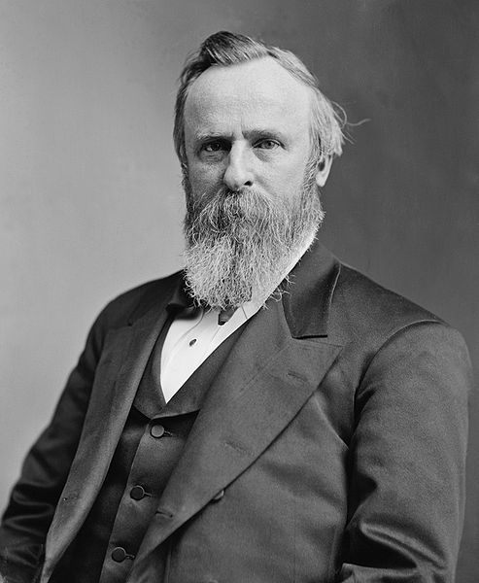
Reconstruction is Rolled Back
Rutherford B. Hayes (r)
Samuel J. Tilden (D)
Untainted by corruption (unlike Grant)
Came from Ohio (swing state)
Wall Street lawyer
Reputation for reform and home rule for the South
Two sets of electoral votes gave no clear winner
Congress appoints an electoral commission to settle the question
Compromise of 1877: Hayes would be given the presidency if he promised to end military occupation of the South
  “Rutherfraud” B. Hayes

Slide 38
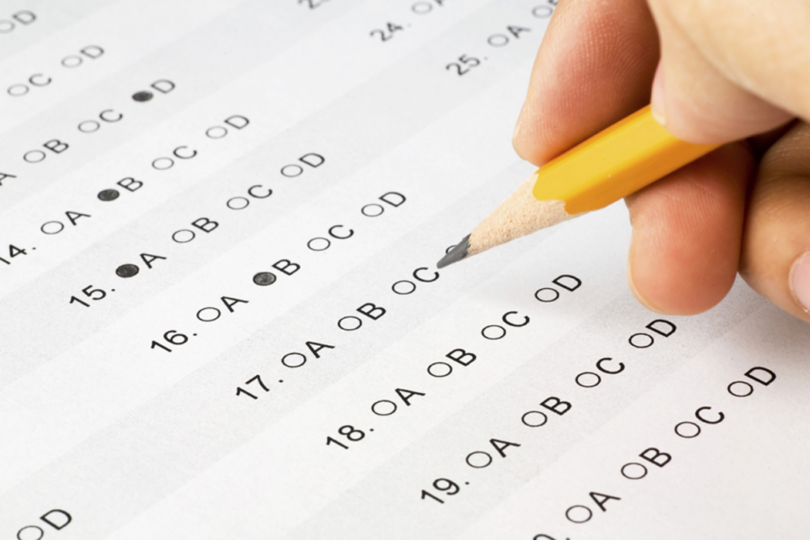
Literacy
Test!

