Slide 1
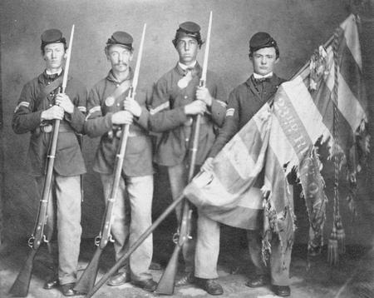
Blue and Grey
The Civil War

Slide 2
America Divides
Secession and the Confederacy

Slide 3
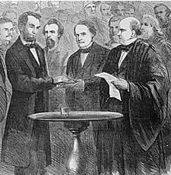
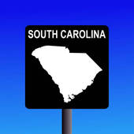
Lincoln’s Inheritance
Election of 1860
Lincoln’s election = Southern secession
Lincoln inherited a “union” where 7 states had already left and 8 more stood on the brink
Felt secession was impractical since the south could not geographically separate
Peace out, suckas!

Slide 4
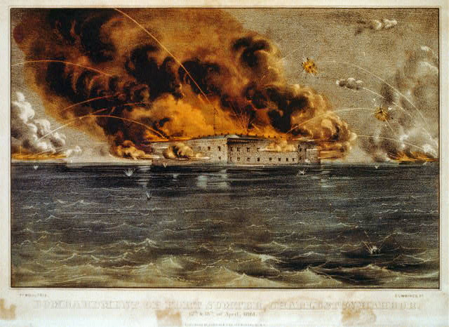
South Carolina… Starting stuff again!
Lincoln needs to resupply Fort Sumter in Charleston
CSA took the move as an act of aggression
CSA fires on Fort Sumter April 12, 1861
Three more states secede
Lincoln calls for the raising of an army

Slide 5
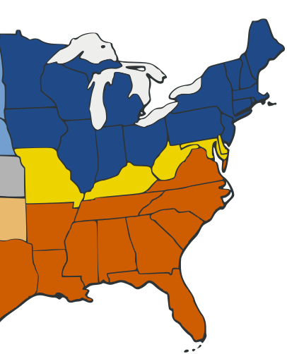
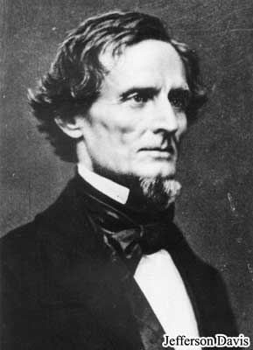
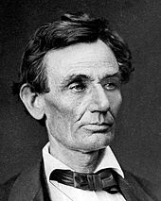
Taking Sides
Border
Confederacy
Union

Slide 6
Brothers Blood and Border Blood
Johnny Reb
Billy Yank

Slide 7
Two Brothers
Two brothers on their way Two brothers on their way Two brothers on their way One wore blue And one wore grey One wore blue and one wore grey As they marched along the way A fife and drum began to play All on a beautiful morning One was gentle, one was kind One was gentle, one was kind One came home, one stayed behind A cannonball don't pay no mind A cannonball don't pay no mind If you're gentle or if you're kind It don't think of the folks behind All on a beautiful morning
All on a beautiful morning

Slide 8
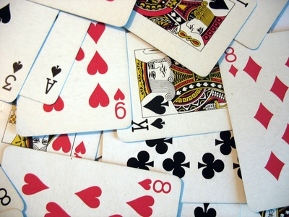
WAR!

Slide 9
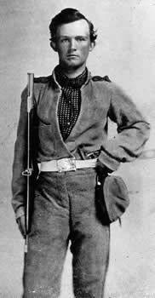
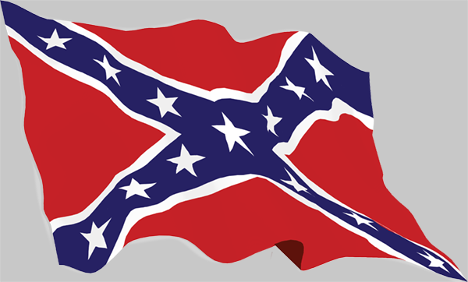
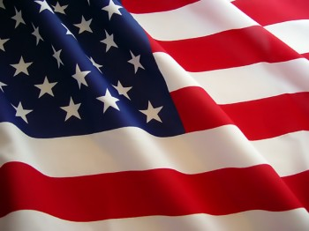
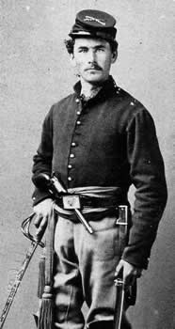
The Balance of Forces
Southern Scorecard
Physically prepared for war
Had a defined reason for fighting
Better military leaders: Robert E. Lee
Lacked supplies for war
Southern troops could not be forced to fight
Northern Scorecard
Well supplied for war – ¾ of RR and factories
Had a standing army and navy
Had an existing government and money system
Poor military leaders and strategies
Lacked motivation to fight

Slide 10
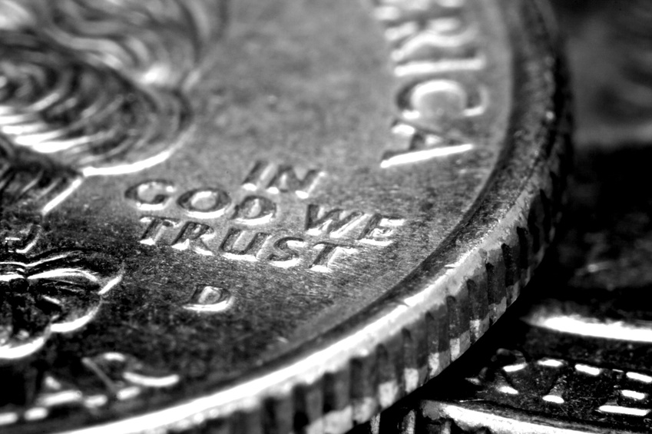
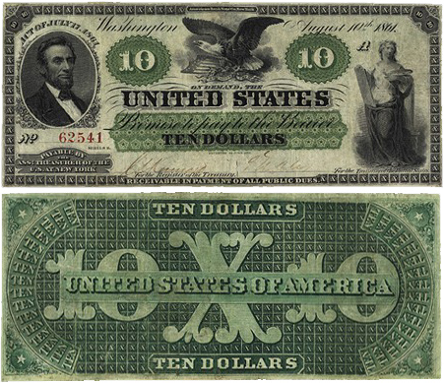
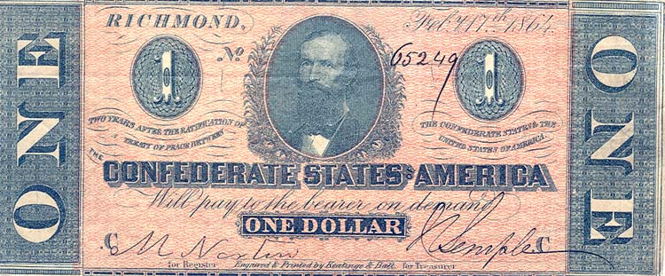
The Economic Stresses of War
North increased tariffs, excise taxes, and the first income tax to financially support the war.
Morrill Tariff Act (1861): A high protective tariff to protect Northern manufacturing
Greenbacks: Paper money issued by the U.S. Treasury, backed by the fluctuating gold supply
National Banking System: Member banks could buy government bonds and issue sound paper money backed by the bonds.
CSA: Blue-backed paper money that was subject to "runaway inflation.”

Slide 11
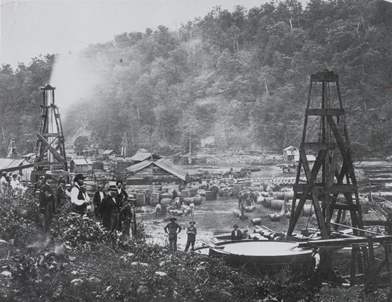
The North's Economic Boom
Newly invented labor-saving machinery enabled men to leave the farms for the war and provided grain that contributed to Northern profits
The discovery of petroleum in Pennsylvania in 1859 led to a rush of people known as the "Fifty-Niners."
War opened up many jobs for women that were originally occupied by men

Slide 12
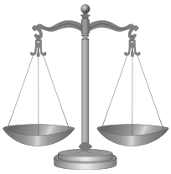
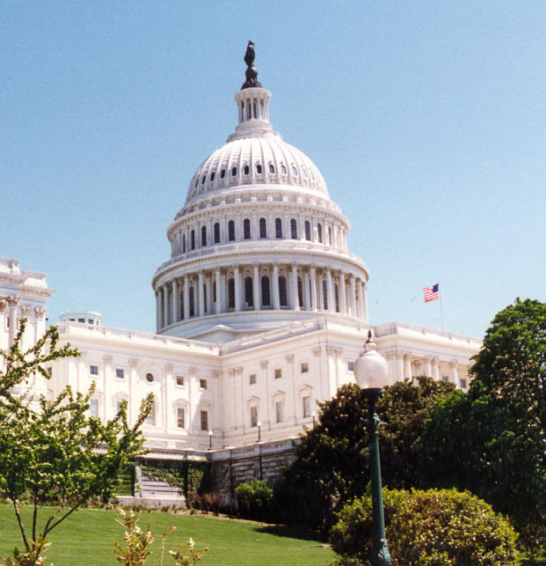
Limitations on Wartime Liberties
Congress was not in session when the war broke out, which gave the President vast wartime powers.
proclaimed a blockade
increased the size of the Federal army
took out a $2 million advance for military purposes
suspended habeas corpus

Slide 13
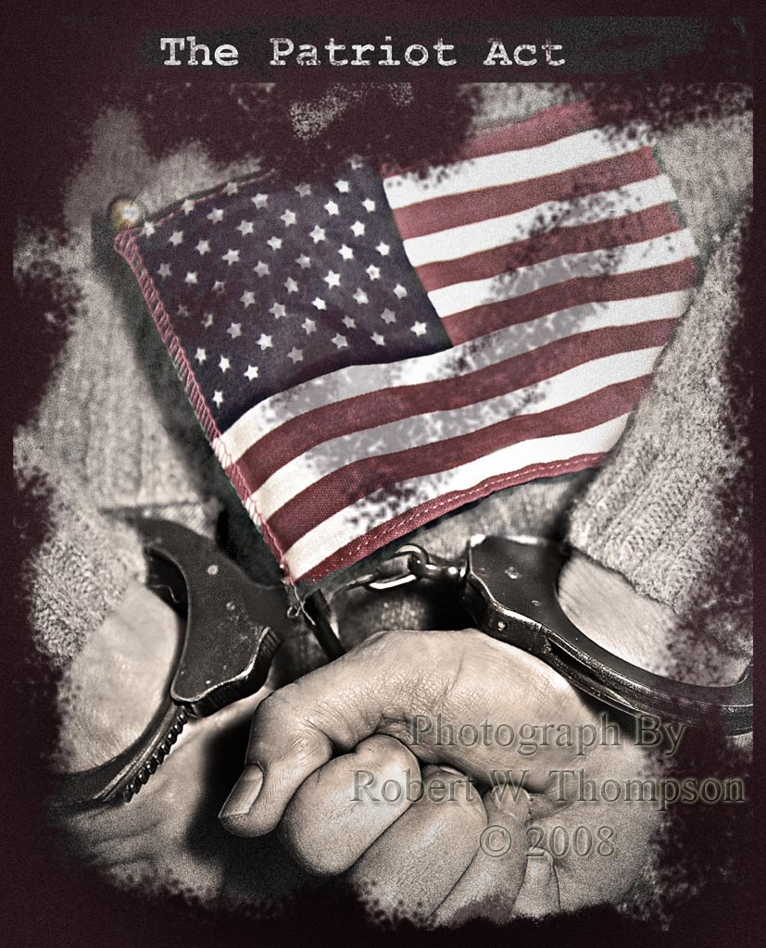
Habeas Corpus
Latin, “you have the body”
Requires a person to be brought before a court or judge, especially to determine if that person is being legally detained
"Inter arma silent leges”: Common Northern phrase; "during war, the laws are silent.”
April 1861 – Lincoln orders for the arrest of anyone between Washington and Philadelphia suspected of subversive acts or speech
Specifically authorized suspension of habeas corpus
Especially dangerous for those in the border states

Slide 14
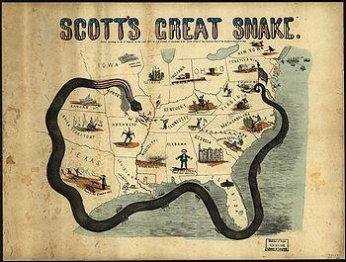
Anaconda Plan: The Northern plan to squeeze the south into submission by closing its supply routes and blockading its ports

Slide 15
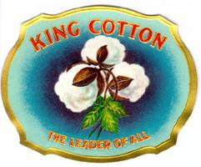
Dethroning King Cotton
South counting on foreign intervention to win the war, esp. Britain
Citizens support North because of abolition
Manufacturers support South
Britain would not break the Northern blockade
Goes against their anti-slavery policy
Would have lost grain and corn from Midwest

Slide 16
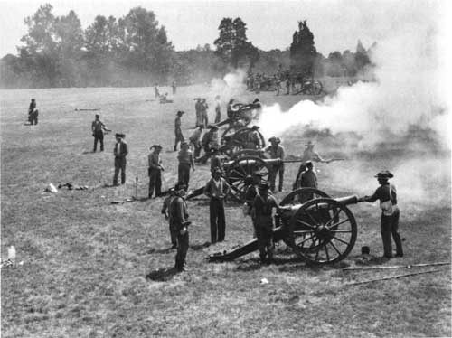
Bull Run Ends the "Ninety-Day War"
Bull Run = Manassas; North/South
A Union victory was thought to be for sure, as evident when spectators showed up.
The Confederates won as "Stonewall" Jackson held his line of Confederate soldiers until reinforcements arrived.
Proved that the war would be much longer than either side anticipated.

Slide 17
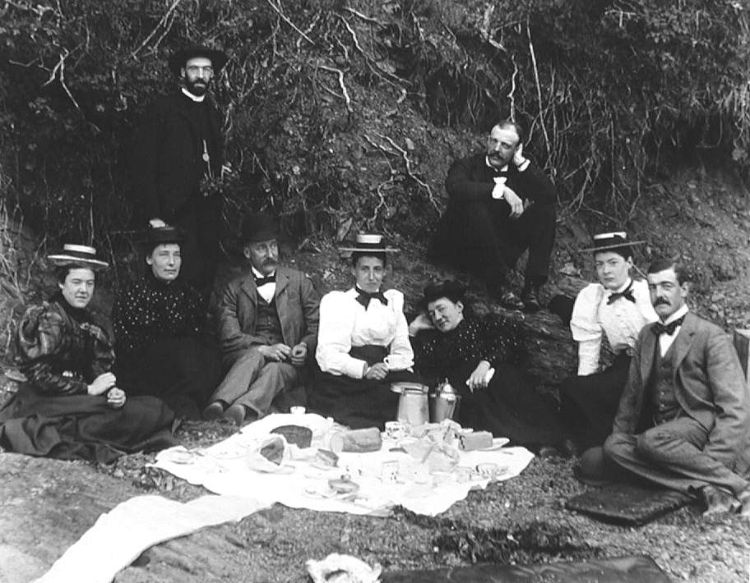
Picnic at the
Battle of Manassas

Slide 18
Bell Ringer
Which side do you think was better prepared for the war at the beginning and why?

Slide 19
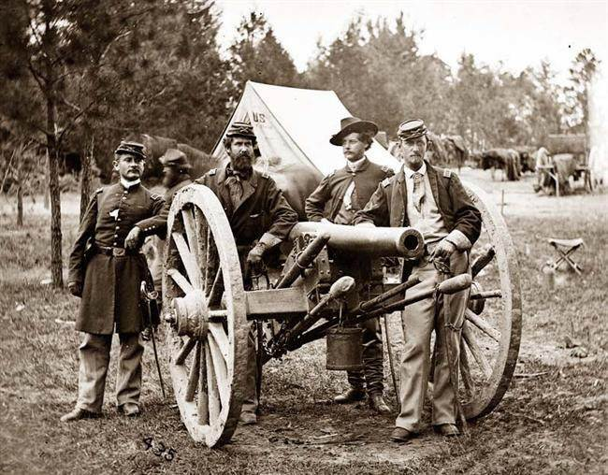
Life as a Soldier

Slide 20
The Average Union Soldier
Notes:
Discussion:
Why do you think the Civil War is sometimes called the “Boys’ War?”
How many Union Soldiers were under 16?
How many soldiers were between 16 and 23?
How many were over 23?
Do you think most soldiers in the Confederate army would have been older or younger? Why?

Slide 21
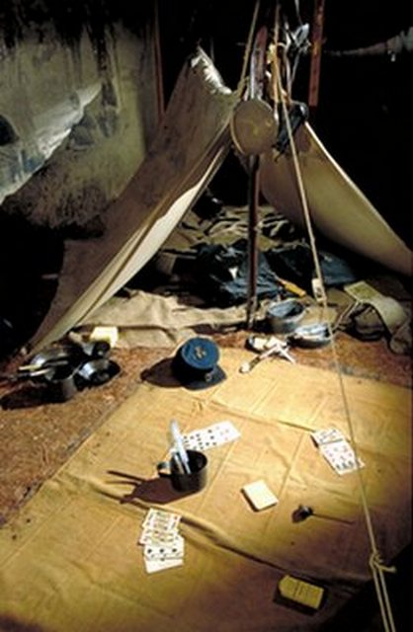
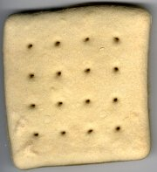
Life as a soldier
Thick wool uniforms
Bland, dry, or spoiled food
Sparse living quarters

Slide 22
Women in War
Lax medical examinations allowed for some women to sneak through and serve in the army disguised as men.
Nursing became an increasingly feminized profession
Organized by Clara Barton and Dorothea Dix
Notes:
Notes for the Teacher:

Slide 23
Civil War Weaponry
The rifled musket killed more soldiers than anything else, except disease.
Larger caliber, slow moving; pulverized flesh and bone
Amputation the only practical treatment
The Civil War also introduced the Gatling Gun (precursor to the machine gun), submarine, ironclad ships, use of hot air balloons for espionage, as well as modern technologies for communication (telegraph) and transportation (railroads)

Slide 24
Civil War “Hospitals”

Slide 25
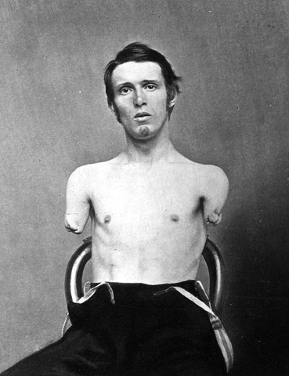
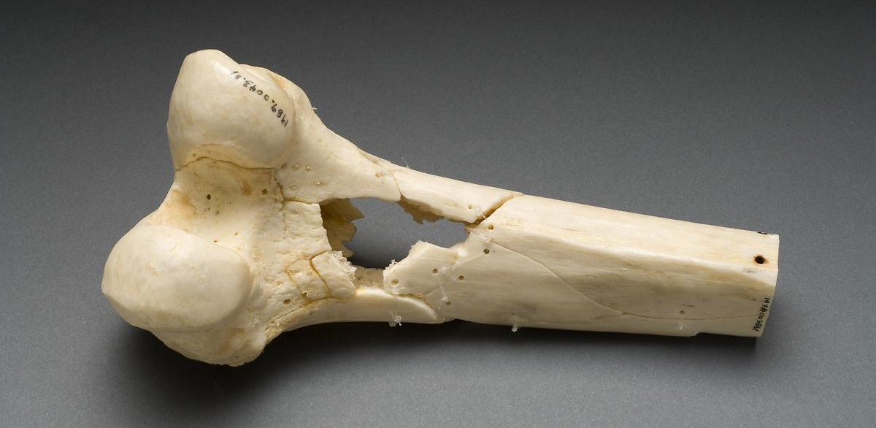

Slide 26
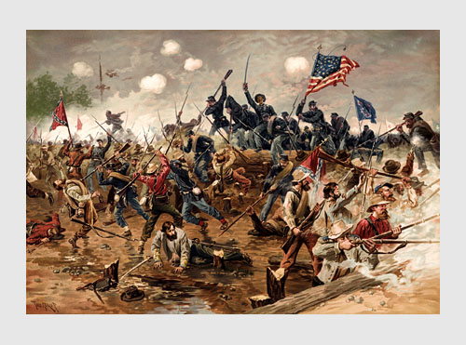
The War Heats Up
Battles, Bayonets, and Blood

Slide 27
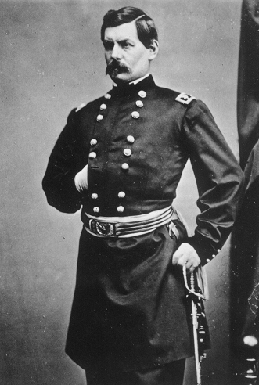
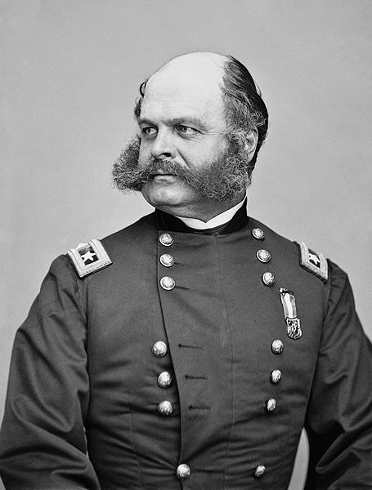
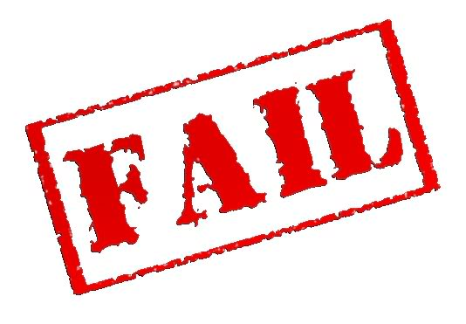
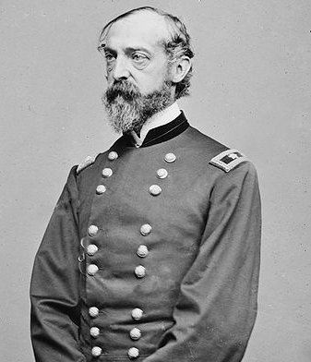
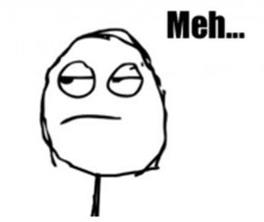
The Many Faces of Union Generals
General George B. McClellan (1861)
General Ambrose E. Burnside (1862)
General Joseph Hooker (1862-1863)
General George G. Meade (1864)

Slide 28
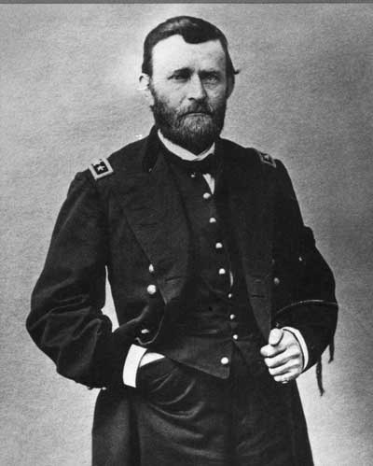
Going for Grant!
Ulysses S. Grant gained recognition for his successes in the Western Campaign and the siege of Vicksburg.
He was promoted to the position of Commanding General of the U.S. Army in 1864.
Would be the general to accept Lee’s surrender in 1865.

Slide 29
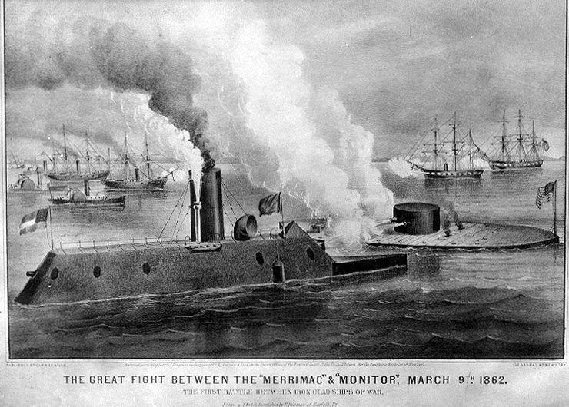
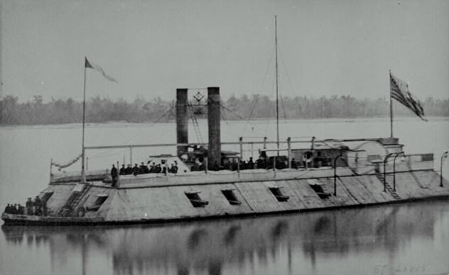
The War at Sea
Ships needed to combat the Northern blockade
Improved speed
Ironclads
Merrimack (CSA) and the Monitor (USA)
Had the ability to crush through the wooden ships.
Fought to a standstill

Slide 30
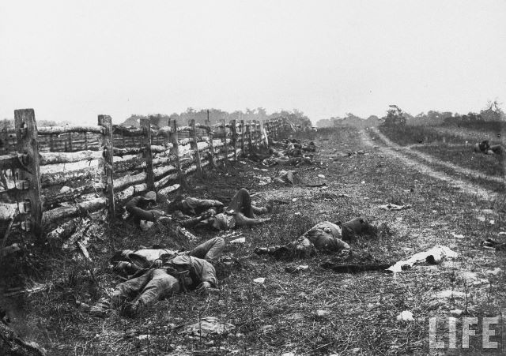
The Pivotal Point: Antietam
Although not a victory, the Union stopped the Confederate march northward.
Statistically the bloodiest day of the Civil War
Confederate Losses | Union Losses
Killed-1,512 | Killed--2,108
Wounded--7,816 | Wounded--9,549
Captured/Missing--1,844 | Captured/Missing--753

Slide 31
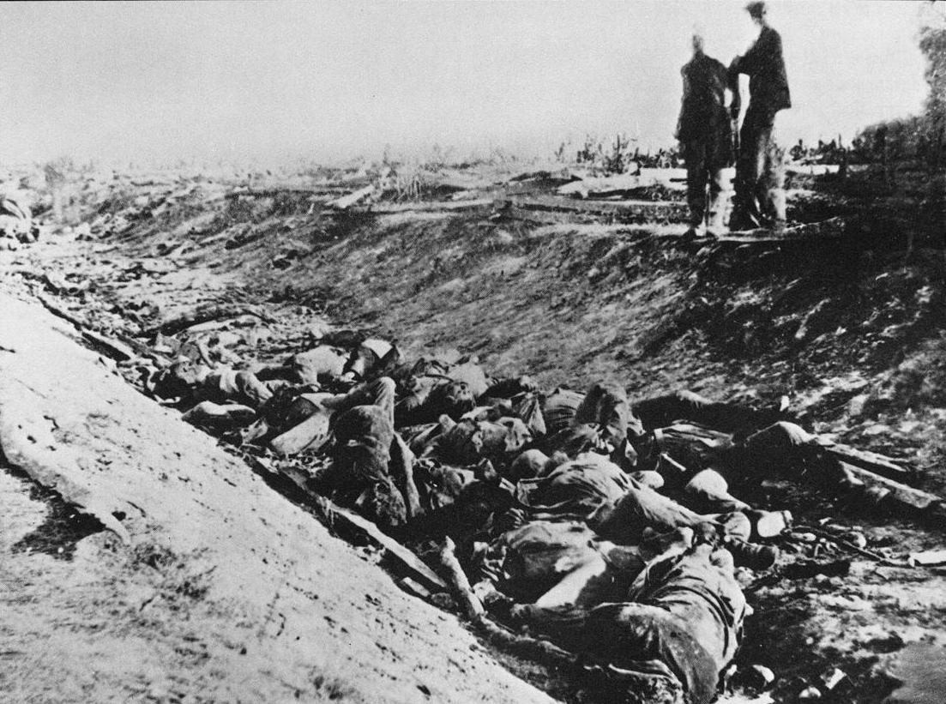
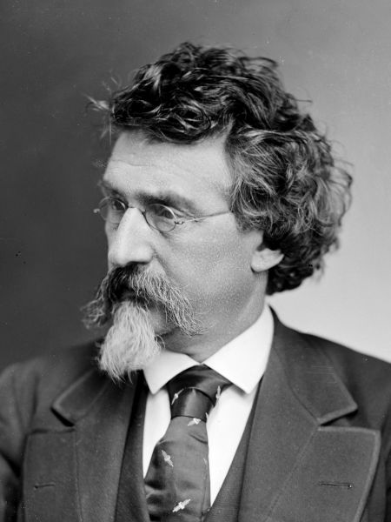
Documenting the War: Mathew Brady
Casualties at Antietam
Matthew Brady

Slide 32
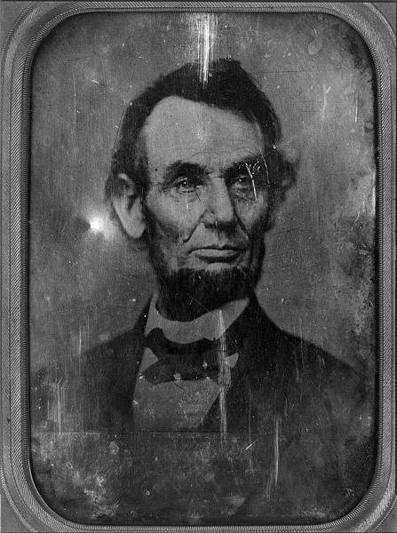
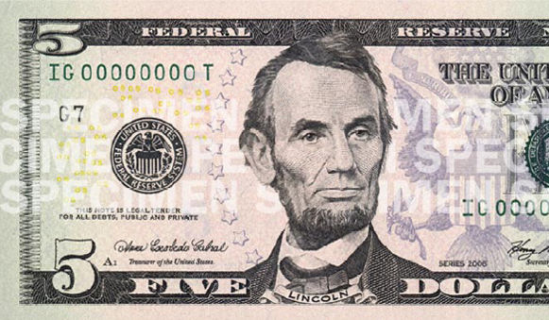
Look Familiar?

Slide 33
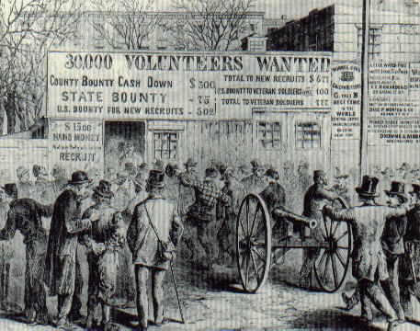
Conscription Issues
Not enough volunteers
Enrollment Act (1863)
First federal draft law
All white men between 20 and 45 years old
Could pay $300 in order to buy a “replacement.”

Slide 34
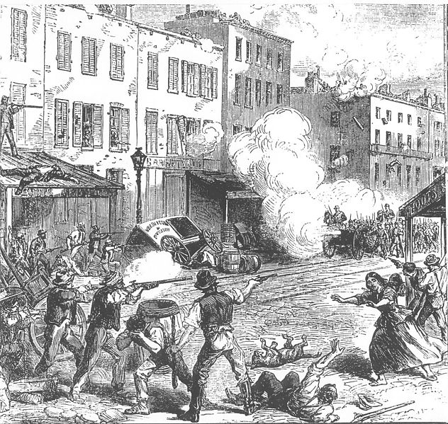
New York Draft Riots
Discontent with draft law led to rioting
Mostly working class men, resentful because the draft unfairly affected them while sparing wealthier men.
Protest turned into a racial riot, as blacks were exempt from draft laws
Suppressed by military who had just returned home from Antietam
Largest civil insurrection in American history apart from the Civil War itself

Slide 35
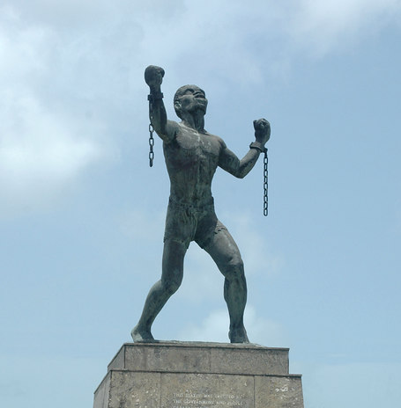
Defining “The Cause”
Giving the North a Reason to Fight

Slide 36
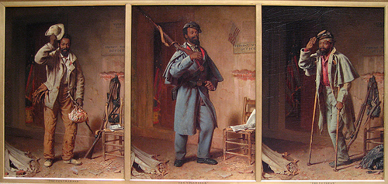
Blacks Battle Bondage
Over 180,000 blacks served in the Union army, most escapees from the Southern states
“Intelligent Contraband”: Escaped slaves or those who came into the possession of Union forces
The Confiscation Act of 1862 punished "traitors" by declaring their slaves property of war who shall be free.
The Confederacy allowed blacks to enlist towards the end of the war

Slide 37
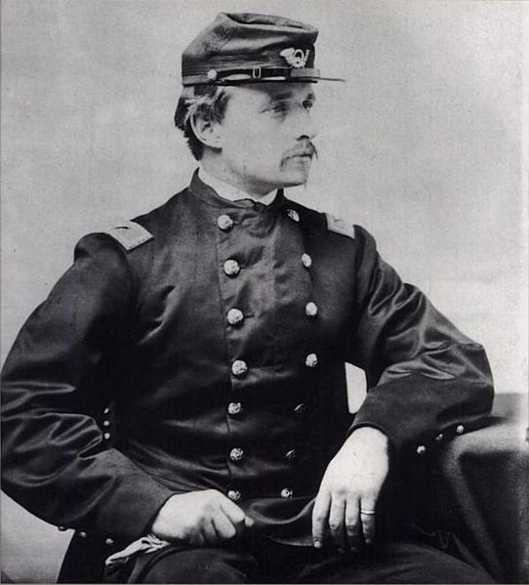
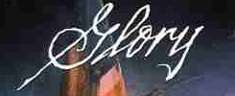
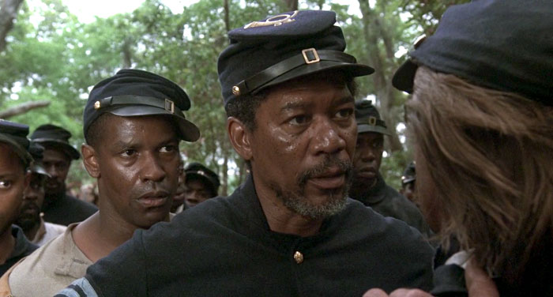
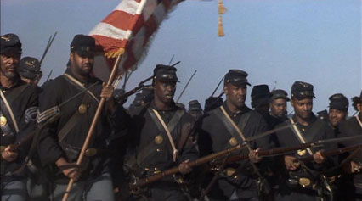
Massachusetts 54th
One of the first official black units in the United States during the Civil War
Became famous after the heroic, but ill-fated, assault on Fort Wagner, South Carolina
The courage and sacrifice of the 54th helped to dispel doubt within the Union Army about the fighting ability of black soldiers and earned this regiment undying battlefield glory.

Slide 38
The Emancipation Proclamation
Emancipation Proclamation: Immediately called for the emancipation of all slaves in the states of rebellion.
Gave the Union a moral cause

Slide 39
Bell Ringer
I will stand by that great principle of state’s rights, no matter who may desert it. I intend to stand by it for the purpose of preserving peace between the North and the South, the free and the slave States. If each State will only agree to mind its own business, and let its neighbors alone, there will be peace forever between us… I hold that the people of the slaveholding States are civilized men as well as ourselves; that they bear consciences as well as we, and that they are accountable to God and their posterity, and not to us. It is for them to decide, therefore, the moral and religious right of the slavery question for themselves within their own limits. I assert that they had as much right under the Constitution to adopt the system of policy which they have as we had to adopt ours. So it is with every other State in this Union. Let each State stand firmly by that great Constitutional right, let each State mind its own business and let its neighbors alone, and there will be no trouble on this question. If we will stand by that principle, then Mr. Lincoln will find that this Republic can exist forever divided into free and slave States, as our fathers made it and the people of each State have decided.
--Stephen Douglas
Give three examples of how the perspective illustrated above influenced American politics in the years preceding the Civil War

Slide 40
Ending the War

Slide 41
Siege of Vicksburg
Civilians in Vicksburg lived through a 47 day long siege by the Union under Ulysses S. Grant. Families lived in caves and trenches to escape the bombardment and many starved in the process. Some civilians suffered from shell shock as a result of the constant bombardment.

Slide 42
Lee's Last Lunge at Gettysburg
Considered the turning point in the war
Would be the furthest North the Confederate forces would reach
Notes:
Pickett’s Charge: After Confederate attacks on both Union flanks had failed the day and night before, Lee was determined to strike the Union center on the third day. Approximately 12,500 men in nine infantry brigades advanced over open fields for three-quarters of a mile under heavy Union artillery and rifle fire. Although some Confederates were able to breach the low stone wall that shielded many of the Union defenders, they could not maintain their hold and were repulsed with over 50% casualties.

Slide 43
Gettysburg resulted in 51,000 casualties: killed, wounded, or missing
Notes:
Over 8,000 dead
Almost 30,000 wounded
Over 10,000 captured or missing

Slide 44
Gettysburg Address
“In the modesty of [Lincoln’s] nature he said ‘the world will little note, nor long remember what we say here.’ He was mistaken. The world noted at once what he said, and will never cease to remember it. The battle itself was less important than the speech."
--Senator Charles Sumner, Abraham Lincoln’s funeral

Slide 45
Four score and seven years ago our fathers brought forth on this continent, a new nation, conceived in Liberty, and dedicated to the proposition that all men are created equal. Now we are engaged in a great civil war, testing whether that nation, or any nation so conceived and so dedicated, can long endure. We are met on a great battle-field of that war. We have come to dedicate a portion of that field, as a final resting place for those who here gave their lives that that nation might live. It is altogether fitting and proper that we should do this.
But, in a larger sense, we can not dedicate -- we can not consecrate -- we can not hallow -- this ground. The brave men, living and dead, who struggled here, have consecrated it, far above our poor power to add or detract. The world will little note, nor long remember what we say here, but it can never forget what they did here. It is for us the living, rather, to be dedicated here to the unfinished work which they who fought here have thus far so nobly advanced. It is rather for us to be here dedicated to the great task remaining before us -- that from these honored dead we take increased devotion to that cause for which they gave the last full measure of devotion -- that we here highly resolve that these dead shall not have died in vain -- that this nation, under God, shall have a new birth of freedom -- and that government of the people, by the people, for the people, shall not perish from the earth.

Slide 46
Discuss as a Group
In your reading, what words did you see repeated? Why do you think this was done? What impact does it have on the speech?
What event does Lincoln mark as America’s birth? How accurate is this statement? What other events could be considered?
How does Lincoln’s speech reflect traditional American ideals and values?
What task does Lincoln set before the nation within the speech?
What was “that cause for which they gave the last full measure of devotion?” What cause could both sides have been fighting for?
What specifically do you think Lincoln means by a government “of the people, by the people, and for the people?”
What effect might this speech have on the war?

Slide 47
An Unexpected Leader
Never wanted to be a soldier
Graduated from West Point, 21st in a class of 39
Victory at Vicksburg, July 4, 1863
Wilderness Campaign
Usually described as a draw, it was a strategic victory for the Union army
The North suffered large casualties, but they were smaller than the percentage of casualties suffered by Lee's smaller army.

Slide 48
Grant Outlasts Lee
War of attrition: A battle strategy in which one side attempts to win a war by wearing down its enemy to the point of collapse through continuous losses in soldiers and materials.
The war will usually be won by the side with greater resources.
Example: Union victory at Cold Harbor (1864) - Thousands of Union soldiers were killed within a matter of minutes, but Grant's strategy of losing two men and killing one Confederate worked. Grant captured Richmond and cornered Lee.

Slide 49
Sherman’s March to the Sea
Led by William Tecumseh Sherman
Known for his outstanding command of military strategy
Sherman’s March to the Sea: A campaign to conquer Georgia, from Atlanta to Savannah.
Destroyed military targets as well as industry, infrastructure, and civilian property (scorched earth system) and disrupted the South's economy and its transportation networks
Had his soldiers eat food from places they had conquered
Sherman captured Savannah on December 21, 1864
The entire South – man, woman, and child – is against us. We are not fighting just an army, but a whole people. We must make old and young, rich and poor feel the hard hand of war. The more awful we make war the sooner it will end.

Slide 50
The Politics of War
The Congressional Committee on the Conduct of the War was dominated by radical Republicans
Resented the expansion of presidential power; pressed Lincoln on emancipation; wanted to punish the south
Democrats
Stephen Douglas dies
War Democrats: Supported Lincoln
Moderate Democrats: Didn’t fully support Lincoln or the war
Copperheads: Radical Peace Democrats
War
Democrats
Moderate
Democrats
Copperheads
Northern Democrats
Radical Republicans
Moderate
Republicans
What effect might
this have on the
upcoming election?

Slide 51
Copperheads
Seen as dangerous, like a copperhead snake
Strongly opposed the war
Blamed abolitionists for starting it
Resisted draft laws
Persuaded Union soldiers to desert
Helped Confederate soldiers escape Union prisons
Saw Lincoln as a tyrannical dictator

Slide 52
The Election of 1864
Union Party: Republicans and War Democrats united in the Election of 1864
Lincoln (R) and Andrew Johnson (Southern War Democrat)
Democrats and Copperheads nominated General McClellan
The Northern Democrats lost the election of 1864. The removal of Lincoln was the last hope for a Confederate victory.

Slide 53
The War Ends!
On April 9, 1865, Lee surrenders to Grant at Appomattox Courthouse in Virginia, effectively ending the Civil War.

Slide 54
Casualties of the Civil War
The Civil War claimed over 600,000 lives and cost over $15 billion.

