Slide 1
Renewing the Sectional Struggle
The National Divide

Slide 2
Main Causes of the Civil War
Sectional Issues
  Social differences
  Economic differences
  Cultural differences

Slide 3
Life in the North
Socially: Despite the existence of a wealthy class, there was more social mobility than the South. Class distinctions were less severe than the South.
Economically: Known for lumber, manufacturing, shipping, and banking/trade
Culturally: North more community-based, more metropolitan, more egalitarian

Slide 4
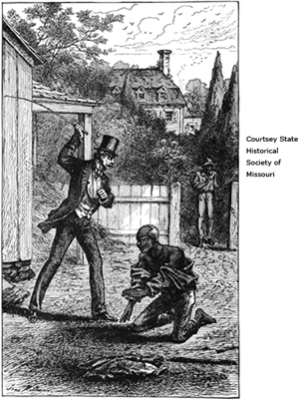
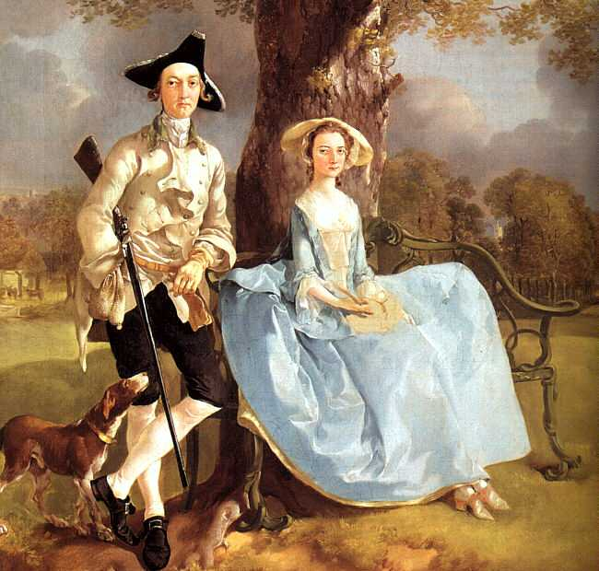
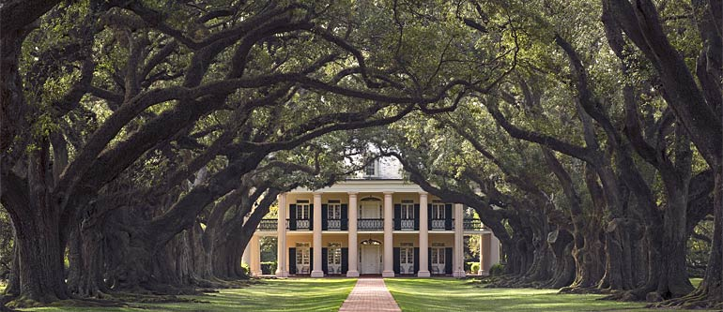
Slavery in the South

Slide 5
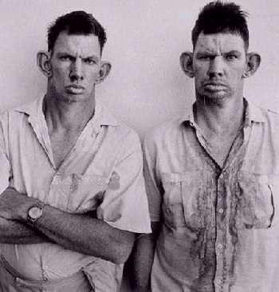
The White Majority
¾ of Southern white population did not own slaves
  Supported the institution as part of the “American Dream” of economic success
Poor, nonslave-holding whites (PWT, hillbillies) were at least better off than slaves
Agricultural lifestyle of the South created an environment of individualism and a distrust towards authority

Slide 6
Division of Slave Population (The Reality)
In 1860, only about 25% of Southerners owned slaves.

Slide 7
Southern
Myth
Planter Aristocracy
White Majority
PWT, Tenant Farmers, White Immigrants
Blacks (free, mulatto, or slave)

Slide 8
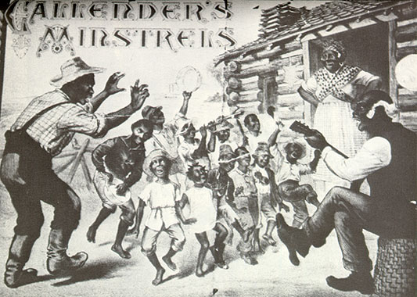
Justification of Slavery
Paternalism/”Apologists”
  Better off than in Africa
  Taken care of by the Master and his Family
  Better off than Northern immigrants
  Slavery exists in the Bible
  Christianizing heathen slaves
The “peculiar institution”

Slide 9
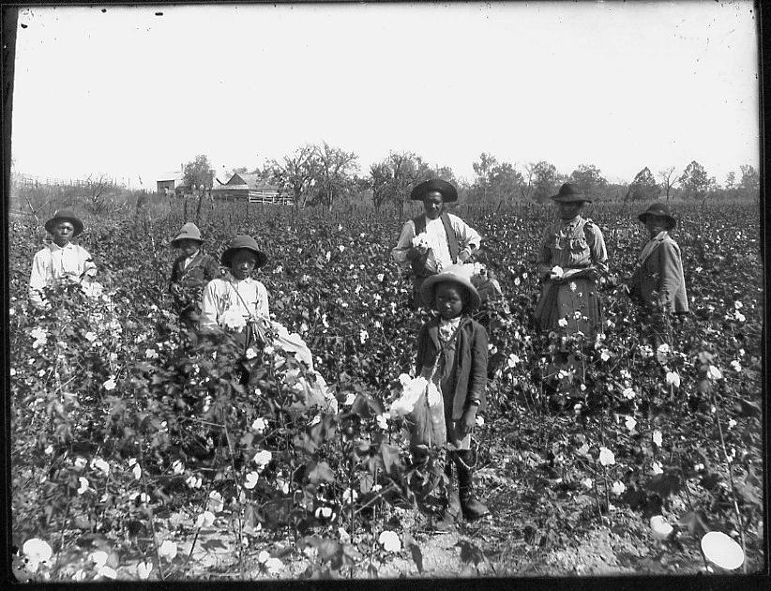
Life Under the Lash
"Black Belt"- region where most slaves were concentrated; the Deep South.
Conditions varied from region to region, farm to farm
  Often worked from dawn to dusk
  Whipped for slow work or insubordination
  Highly valuable; saved from the most dangerous work
  No civil or political rights
Blacks managed to sustain family life in slavery.
  “Until death or distance do you part”
Blacks molded their own distinctive religious forms from a mixture of Christian and African elements.

Slide 10
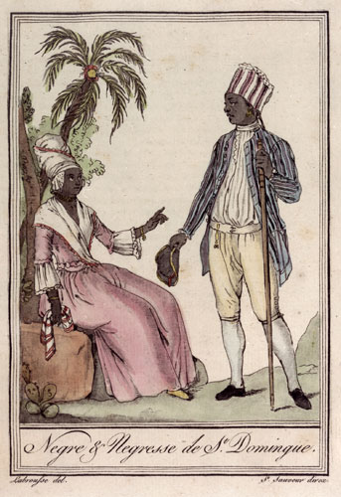
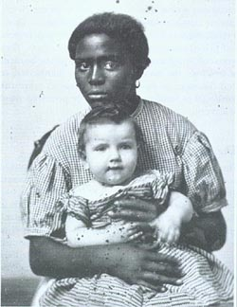
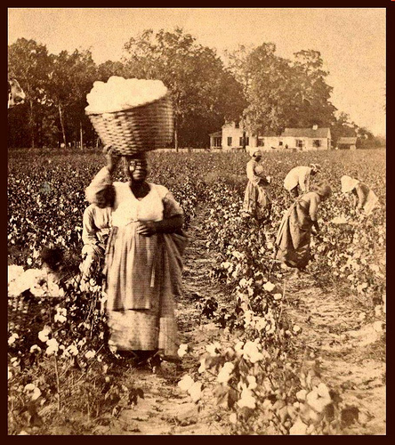
Being Black in the South
Free Blacks
House Slaves
Field Slaves

Slide 11
Main Causes of the Civil War
2. Political Issues
  Congressional Power
  New Territories
  States Rights and Slavery

Slide 12
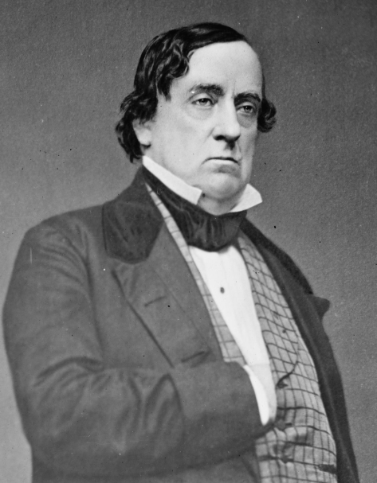
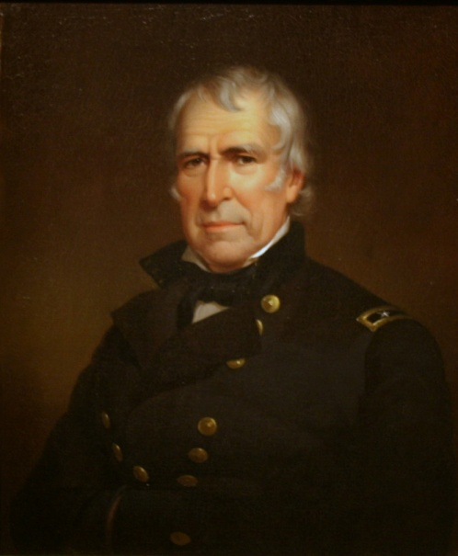
Election of 1848
General Lewis Cass
Zachary Taylor
Democrat
Hero of the War of 1812
Supported popular sovereignty (safe and diplomatic)
Whig
Hero of the Mexican War
No official stance on slavery, but owned many slaves

Slide 13
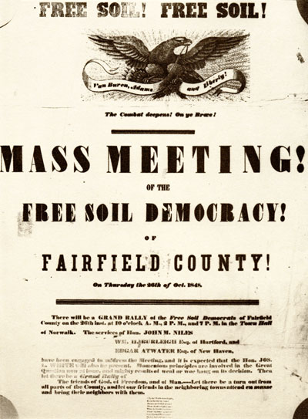
Issues in the Election of 1848
Popular sovereignty: citizens of each territory would determine the statutes of slavery.
Free Soil Party:
  Nominated Van Buren
  Antislavery Northerners
  Supported federal aid for internal improvements

Slide 14
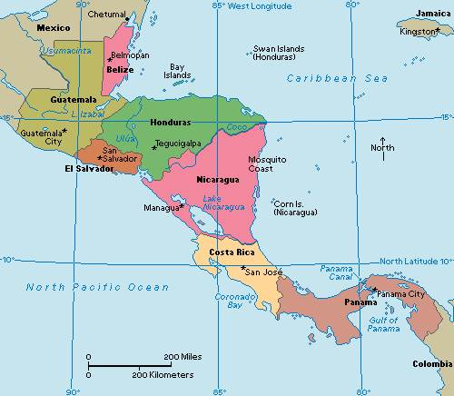

Clayton-Bulwer Treaty
British influence in Central America was strong and even growing, despite the Monroe Doctrine
Clayton-Bulwer Treaty stated that neither the U.S. or Britain would take over the area without the other’s agreement.

Slide 15
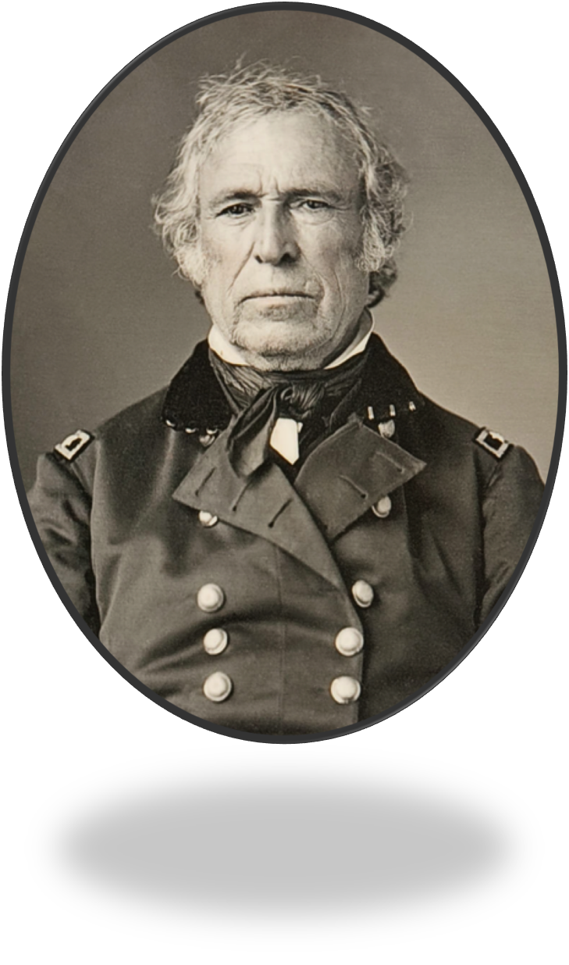
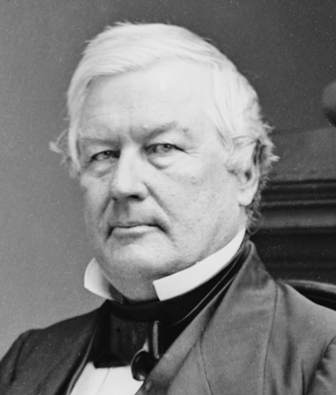
Zachary Taylor
Dates in Office: 1849-1850
Nicknames: Old Rough and Ready
Political Party: Whig
Major Events:
Clayton-Bulwer Treaty
Died in office from cholera
http://www.cdc.gov/cholera/general/

Slide 16
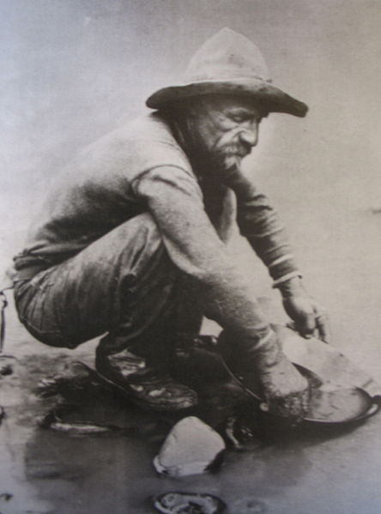

California Joins the Union
CA Gold Rush ➔ population boom ➔ CA able to bypass territorial stage and request entrance into the union as a free state
Would have disrupted the 15-15 balance in the Senate

Slide 17
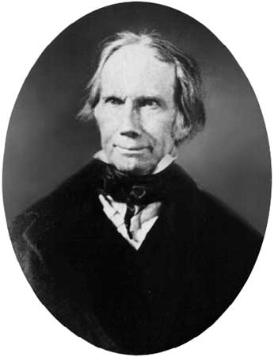
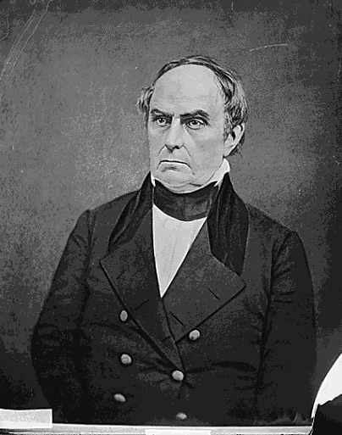
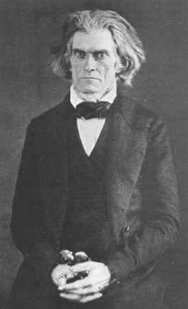
End of an Era
Congressional Debate of 1850 - the “Immortal Trio” gives suggestions
  Clay – The Great Compromiser, suggested compromise
  Webster – supported compromise and a stricter fugitive slave law
  Calhoun – the Great Nullifier, suggested to leave slavery alone, but elect two presidents – one from the North and one from the South

Slide 18
Compromise of 1850
Stricter Fugitive Slave Law enacted (“Bloodhound Bill”)
Popular sovereignty in Mexican Cession lands (negates MO Comp.)
Admission of CA as a free state; NM and UT allowed to decide by popular sovereignty
The slave trade was abolished in D.C., symbolically shows that the nation is taking a stance on the subject

Slide 19
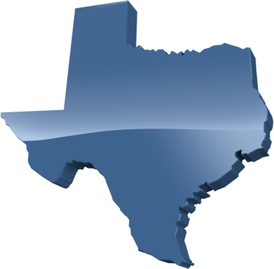
An Escalating Problem
Missouri Compromise
1820
Texas Annexation
1845
Compromise of 1850
36°30’
What do these decisions have in common?

Slide 20
Millard Fillmore
Dates in Office: July 10, 1850 - 1853
Nicknames: The Accidental President
Political Party: Whig
Major Events:
Compromise of 1850
Treaty of Kanagawa

Slide 21
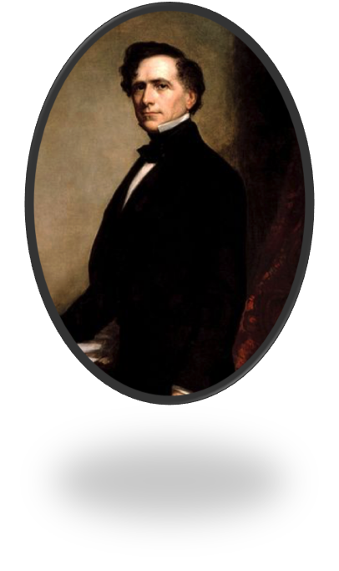
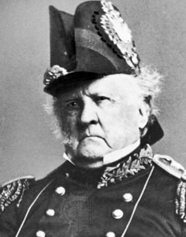
End of the Whigs – Election of 1852
Franklin Pierce
Winfield Scott
Democrat
Supported both the Compromise of 1850 and the Fugitive Slave Law
Whig
Mexican-American War hero
Supported both the Compromise of 1850 and the Fugitive Slave Law
Party split over supporting the cause or the candidate
End of the Whigs

Slide 22
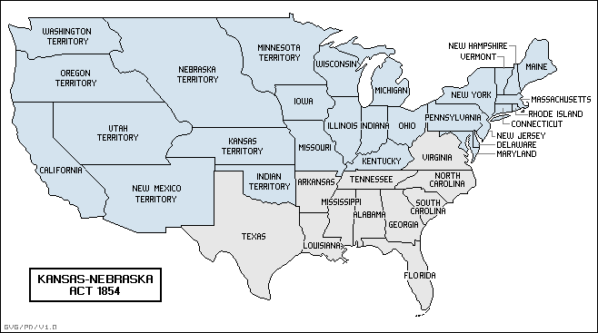
Competition for Kansas
Kansas-Nebraska territory open for popular sovereignty
The unspoken understanding during the Kansas-Nebraska Act was that Kansas would go slave and Nebraska free

Slide 23
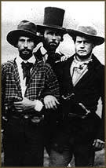
Competition for Kansas
Northern “Free Soilers” move to Kansas
“Border ruffians” jump the border to sway the election in favor of slavery
Free soilers argue the election was rigged and drew up the Topeka Constitution ➔ LeCompton Constitution
Results:
  Division of the Democratic party
  Kansas in limbo
  Slavery problem still not solved

Slide 24
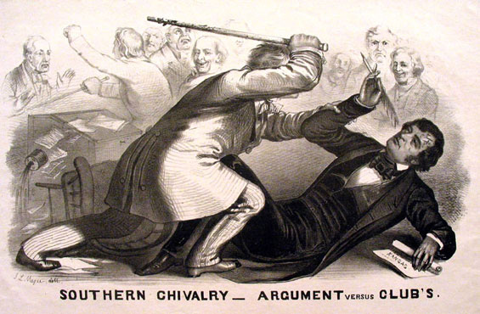
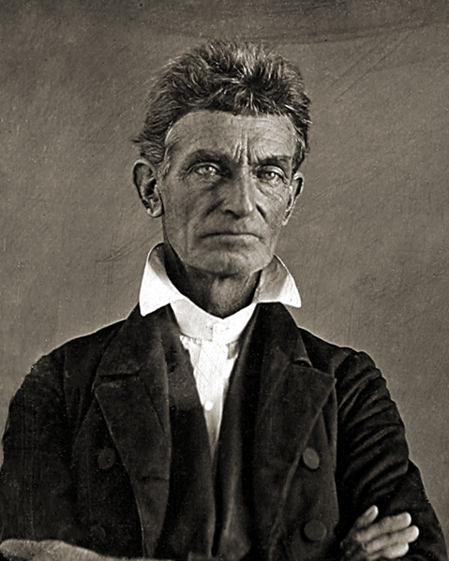
Bleeding Kansas
John Brown: A violent abolitionist who used militant actions to abolish slavery
  Bleeding Kansas/Pottawatomie Creek
  Raid on Harper’s Ferry
Sen. Charles Sumner (northern abolitionist) insulted the family of a South Carolina congressman in his “crime Against Kansas” speech. "Bully" Brooks beat Sumner with a walking cane.
  Sumner's "Crime Against Kansas" speech became a rallying point for the North
  Brooks became something of a Southern cult hero
  Clear that compromise was now over

Slide 25
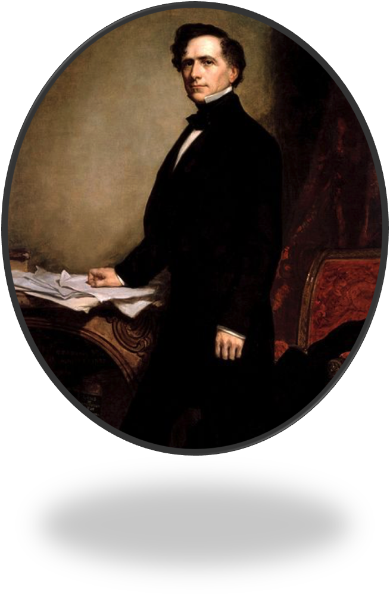
Franklin Pierce
Dates in Office: 1853-1857
Nicknames: Young Hickory of the Granite Hills, Handsome Frank
Political Party: Democrat
Major Events:
Gadsden Purchase
Kansas-Nebraska Act
Bleeding Kansas
Ostend Manifesto

Slide 26
Main Causes of the Civil War
3. Abolitionism
  Slave Rebellion
  Uncle Tom’s Cabin
  Abolitionists

Slide 27
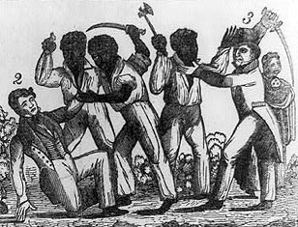
Methods of Rebellion
Slaves rebelled by breaking tools, working at a slower pace, stealing from their masters, or feigning sick.
Nat Turner’s Rebellion (1831)
  Believed he’d been sent by God to release fellow slaves
  Rallied 75 other slaves; murdered master and his family and 50 other whites in the area
  VA militia put down the rebellion; Turner was hanged

Slide 28
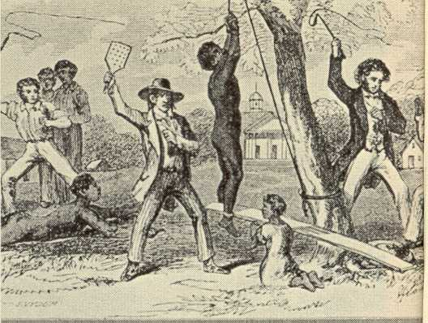
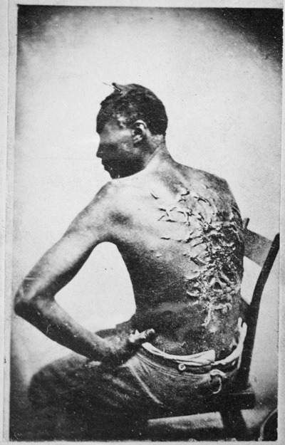
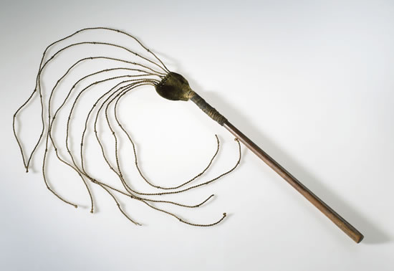
Consequences for Slaves

Slide 29
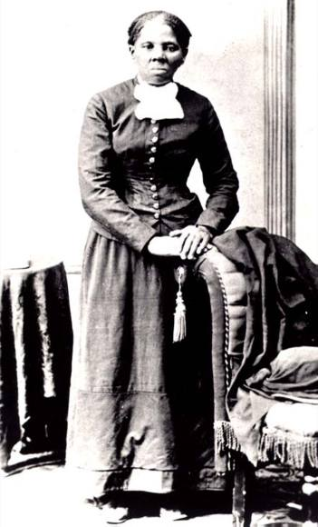
Stresses to the Slave System
Underground Railroad: Escape system set up by white abolitionists and former slaves
  Harriet Tubman
  Negro spirituals
Gag Resolution (1836): required all anti-slavery appeals to be tabled without debate in the House of Representatives

Slide 30
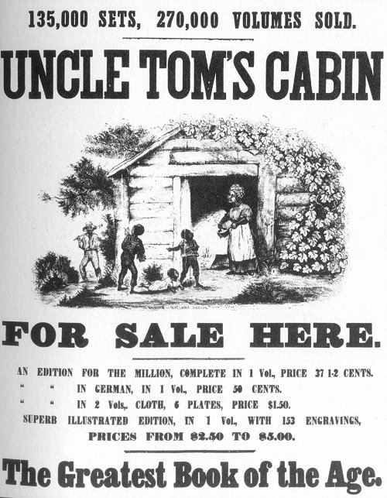
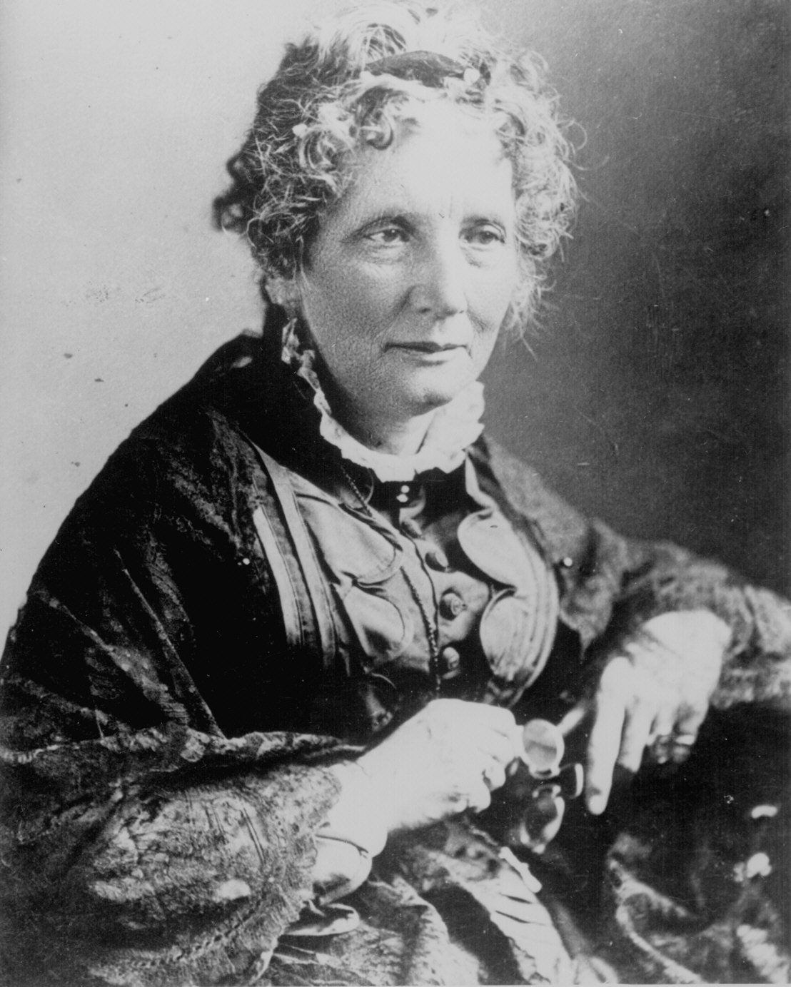
Uncle Tom’s Cabin
Written by Harriet Beecher Stowe
A novel dramatizing the cruelties of slavery
It touched readers emotionally and created widespread antislavery support among northerners.

Slide 31
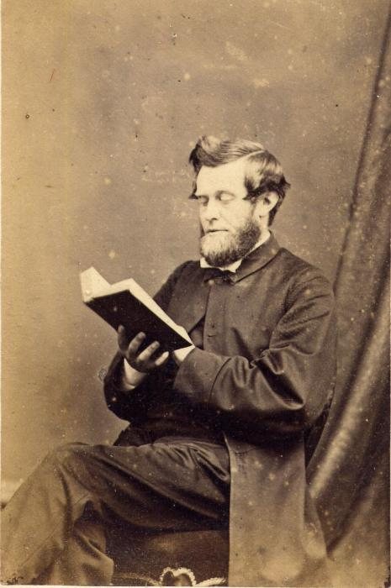
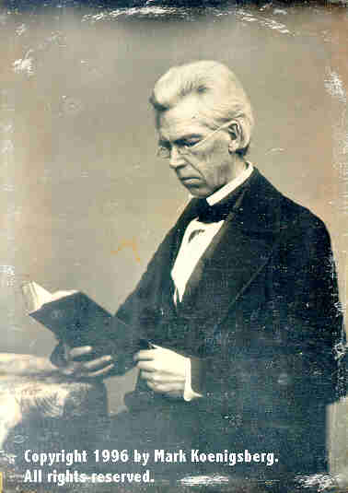
Different perspectives of the book:
Northerners
Southerners
“What a horribly cruel system!”
“What kinda Yankee abolitionist propaganda is this?!”

Slide 32
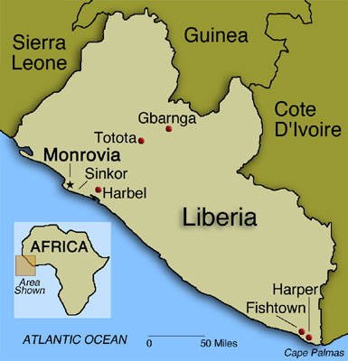
Early Abolitionism
American Colonization Society- founded in 1817; focused on transporting the blacks back to Africa.
  Republic of Liberia- founded in 1822 as a place for former slaves.

Slide 33
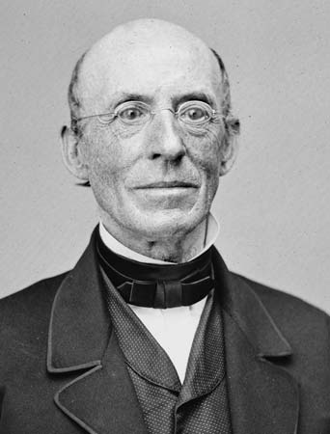
Radical Abolitionism
William Lloyd Garrison
  The Liberator;
  American Anti-Slavery Society
  Promoted "immediate and uncompensated emancipation" of slaves in the United States

Slide 34
Radical Abolitionism
John Brown: A violent abolitionist who used militant actions to abolish slavery
  Bleeding Kansas at Pottawatomie Creek
Raid on Harper’s Ferry: Brown raided a federal arsenal in hopes of inciting slave rebellion. It failed, and he was tried, convicted, and hanged.
He became an instant martyr for the abolitionist cause.

Slide 35
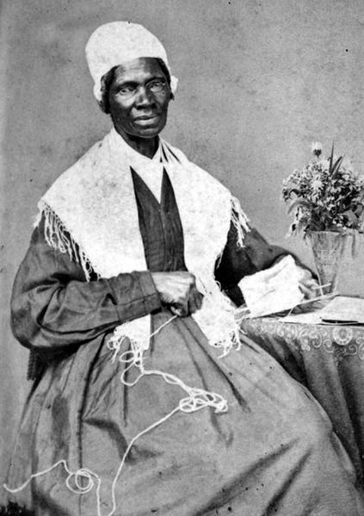
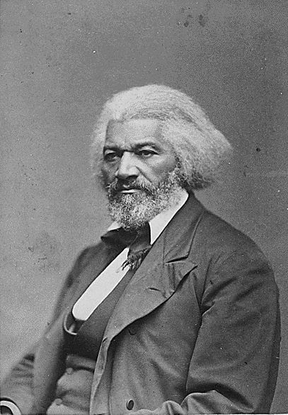
Radical Abolitionism
Sojourner Truth- freed black woman who fought for black emancipation and women's rights.
Frederick Douglass- lectured widely for abolitionism; looked to politics to end slavery. Was a consultant for Abraham Lincoln.

Slide 36
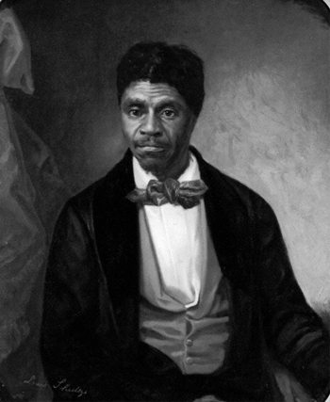
Dred Scott v. Sanford, 1857
Dred Scott was a slave whose owner moved (with Scott) to a free state and then back to the South.
  Scott sued for his freedom
The Chief Justice Taney’s decision said
  Slaves not citizens and therefore not entitled to sue
  Said Scott was to remain a slave until he was freed by his master
  Concluded the Missouri Compromise had been unconstitutional all along
Slavery could now invade the North without obstacles

Slide 37
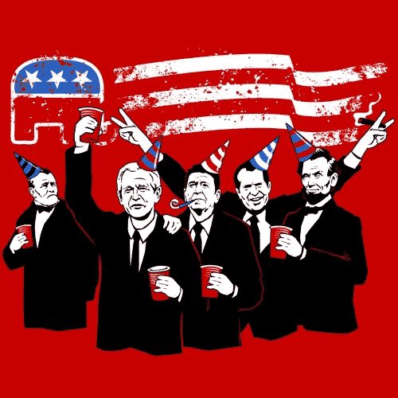
Main Causes of the Civil War
4. The Republican Party
  Creation
  Supporters
  Election of 1860

Slide 38
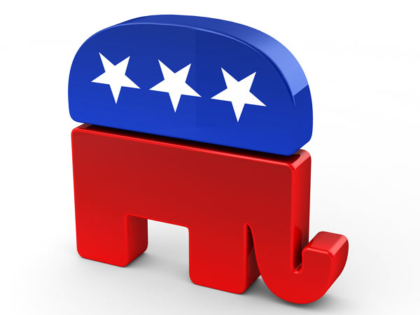
Birth of the Republican Party
Founded in the Northern states in 1854 by anti-slavery activists, modernizers, and ex-Free Soilers.
The main cause was opposition to the Kansas–Nebraska Act; the Northern Republicans saw the expansion of slavery as a great evil.
By 1858, the Republicans dominated nearly all Northern states.

Slide 39
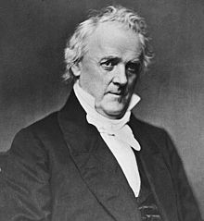
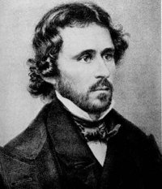
Election of 1856
The election was ugly, complete with mudslinging and charges of conspiracy and scandal. Fremont was accused of being Catholic which hurt his votes.
James Buchannan (D)
John C. Fremont (R)
Had considerable experience
Not affiliated with the growingly unpopular Kansas-Nebraska Act
Hero of the Mexican War
Staunch abolitionist

Slide 40
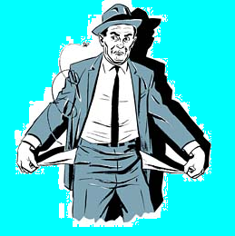
Panic of 1857
Causes:
  inflation caused by California gold
  over-production of grain
  over-speculation of land and railroads
North hit hardest.
South largely unaffected

Slide 41
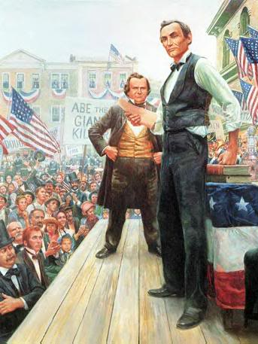
Lincoln – Douglas Debates (1858)
Illinois Senate race between Sen. Stephen Douglas (D) and Abraham Lincoln (R)
"Lincoln-Douglas debates”
“Freeport Doctrine”
    Lincoln asked Douglas if the people of a territory voted slavery down, despite the Supreme Court saying that they could not do so, which side would he support, the people or the Supreme Court?
    Put Douglas in a lose-lose situation
    Douglas straddled the issue popular sovereignty
    Lost popularity with pro-slave Democrats

Slide 42
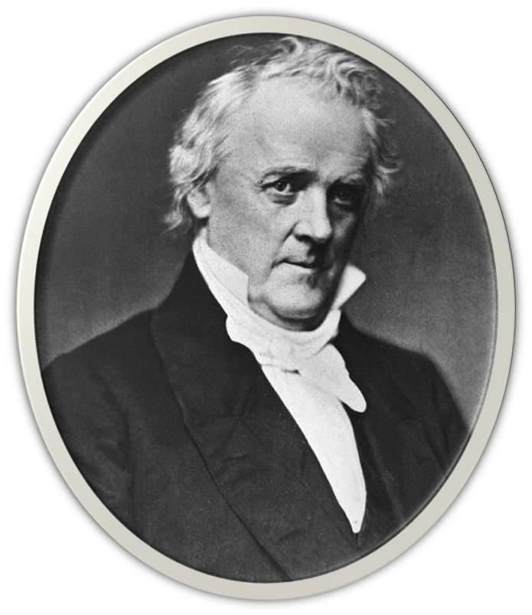
James Buchanan
Dates in Office: 1857–1861
Nicknames: Ten-Cent Jimmie
Political Party: Democrat
Major Events:
  Pony Express
  Dred Scott v. Sanford
  Southern Secession
  Establishment of the Confederate States of America (CSA)
  A. Jackson “Miss Nancy” “Aunt Nancy” – William R. King AL Senator

