Slide 1
Bell Ringer
What are some of the problems you think America will experience as it grows in size and population?

Slide 2
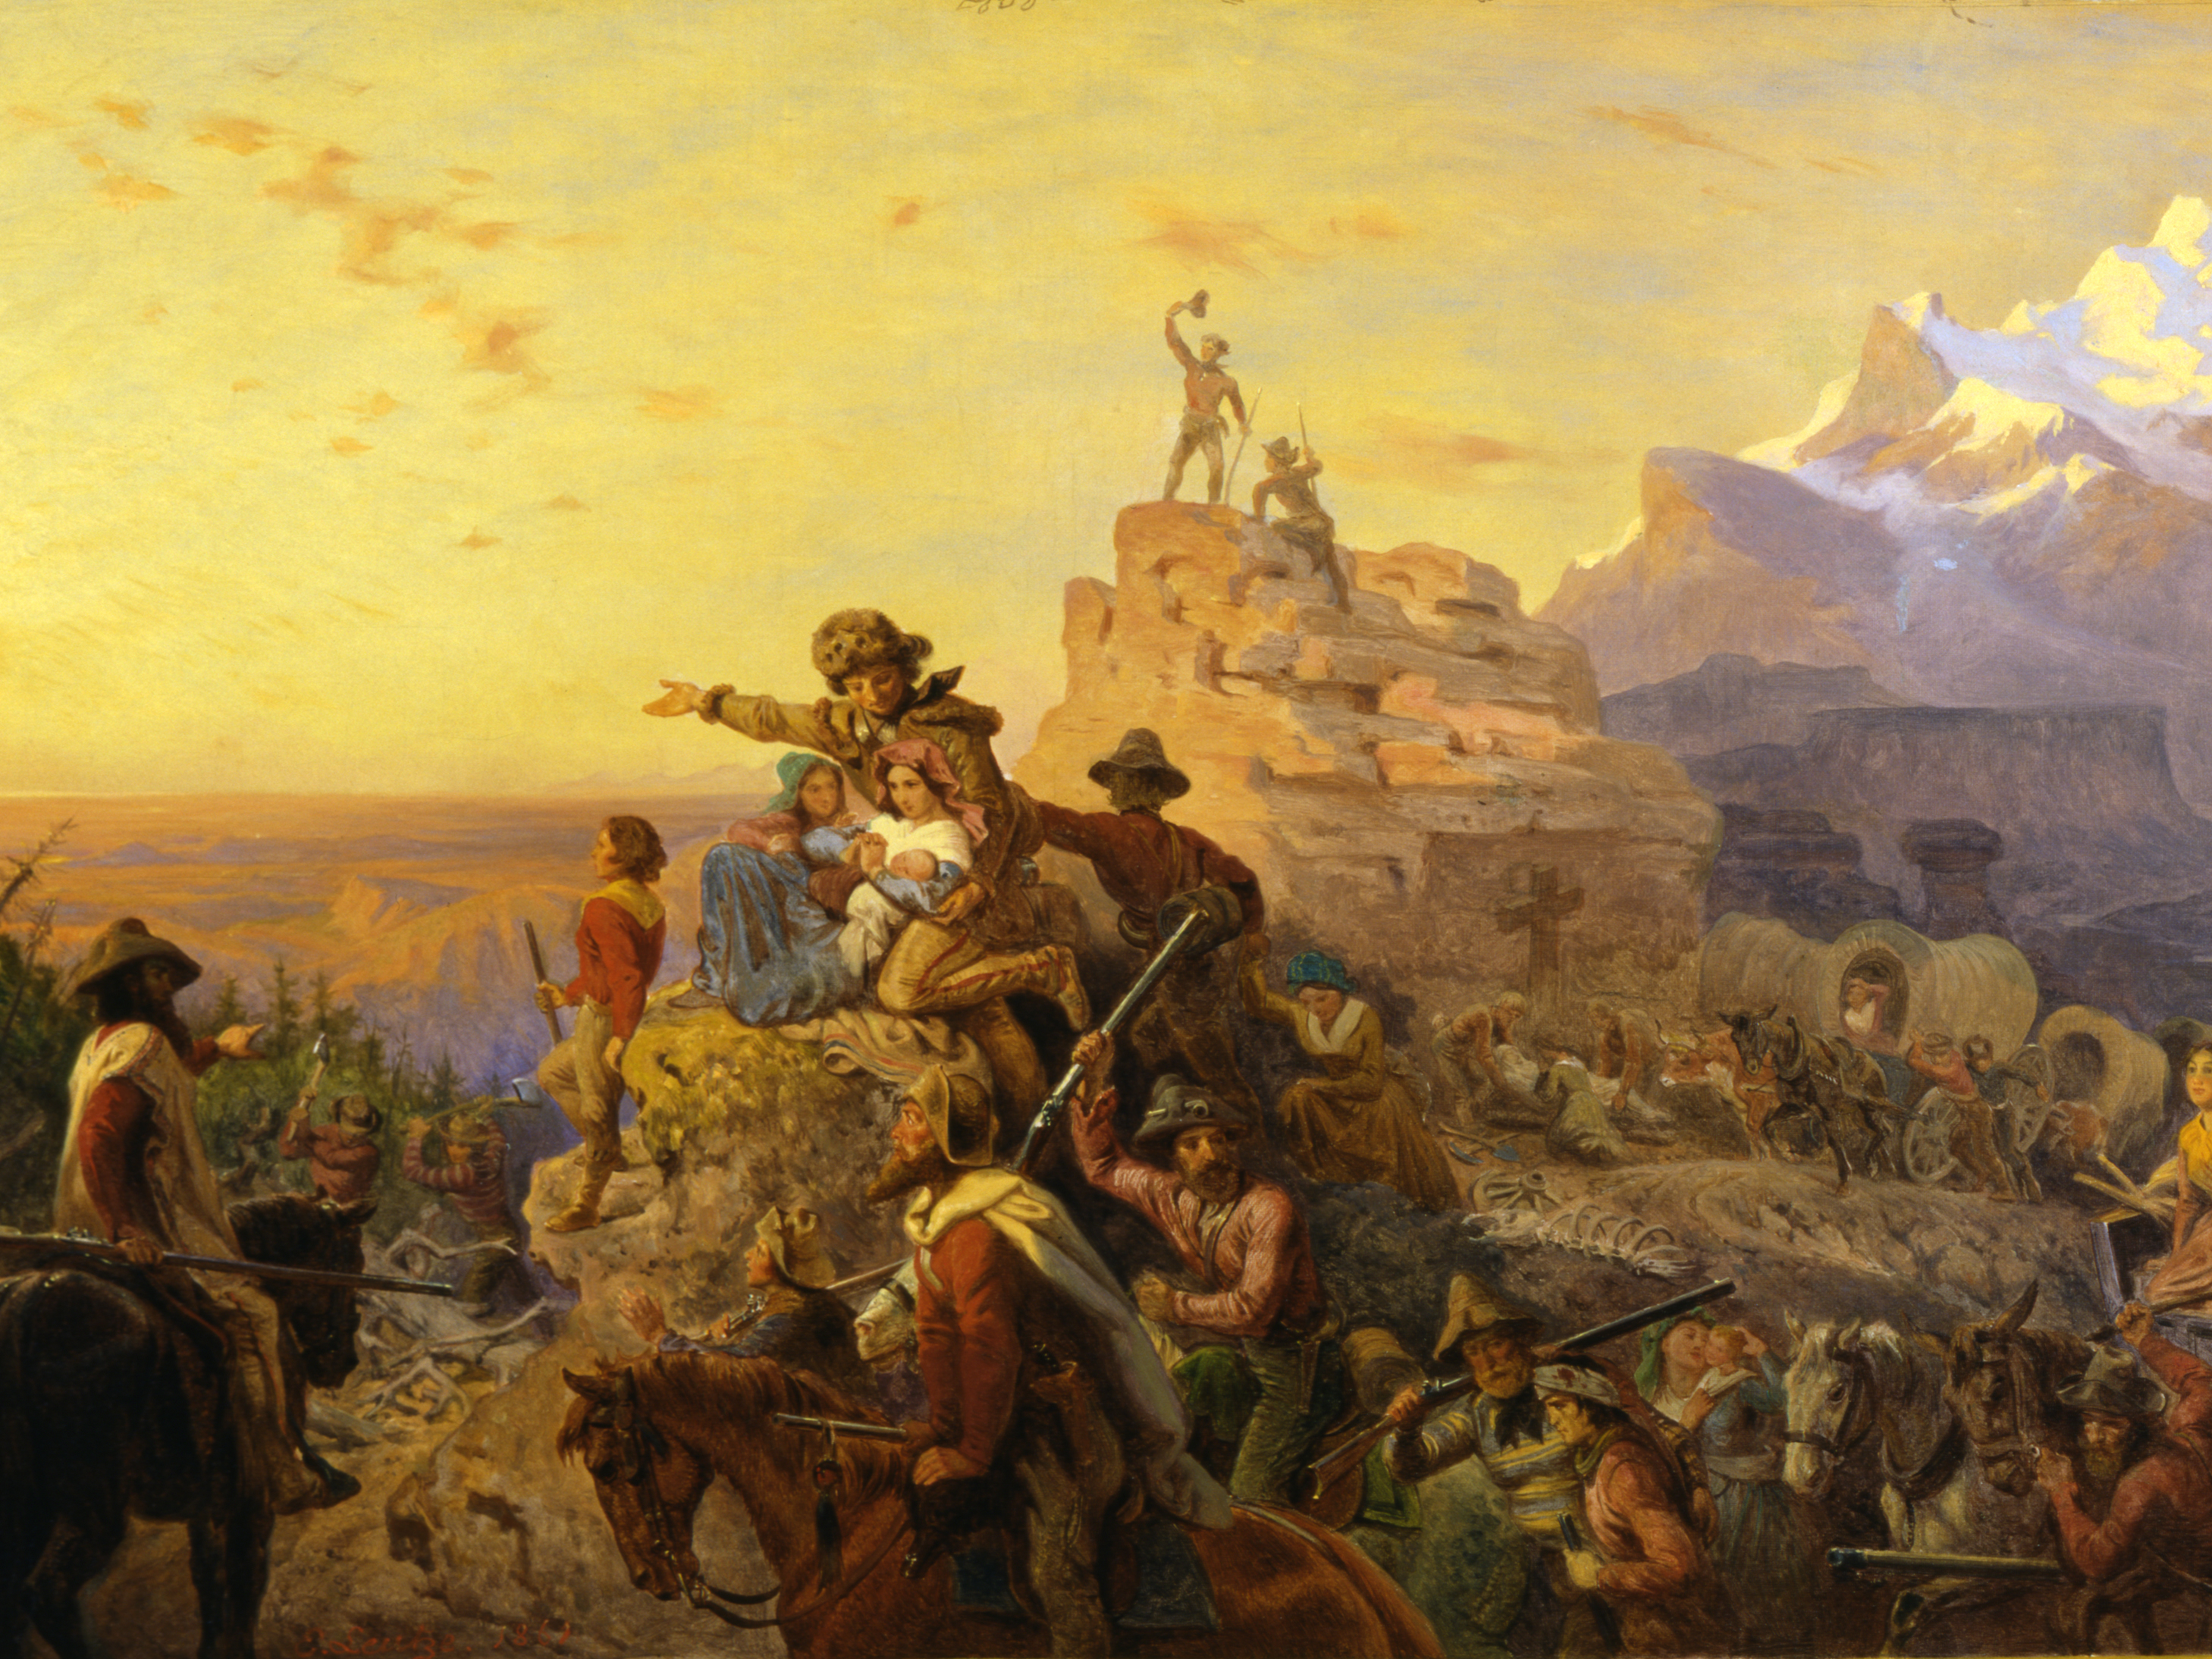
Manifest Destiny
From Sea to Shining Sea!

Slide 3


Slide 4
Rise of a “New” Democracy

Slide 5
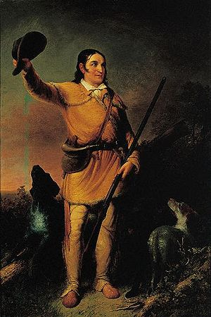
The People’s Politics
The “New Democracy” (an effect of Jacksonian Democracy)
  Respected men who rose up from poverty, not born elite.
  Common men voted for men like themselves
  Frontiersmen were elected for their “real-world” know-how; called “coonskin Congressmen” (e.g. Davy Crockett)

Slide 6
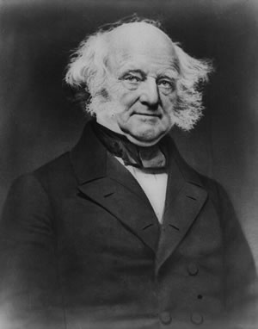
Martin Van Buren’s Administration
VB hand-selected by Jackson; easily defeated the Whigs
  Smart, crafty, experienced
  Not the “man of the people” like Jackson
  First “American-born”/
  National president

Slide 7

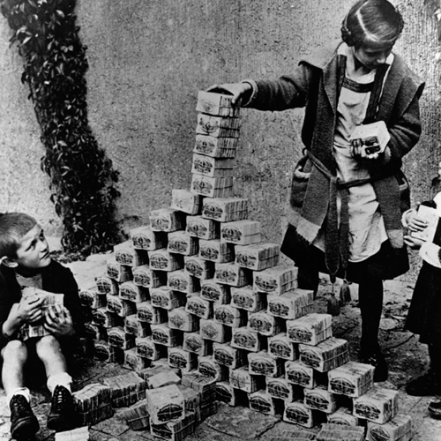
The $pe¢ie ¢ir¢ular
Over-speculation of former Indian land
  Land purchased with state-printed paper money not backed by silver or gold (specie)
Specie Circular
  E.Ordered at end of Jackson’s admin.
  Required that government owned land be purchased using hard specie (silver/gold).
  Devalued paper money, which caused wild inflation

Slide 8


Panic of 1837
Causes of the Panic
  Over-speculation, esp. land
  Bank War
  Specie circular
  Crop failure
  Failure of two British banks
Van Buren is blamed
"Divorce Bill“: Set up an independent treasury
  Provides stability outside of the banking world

Slide 9
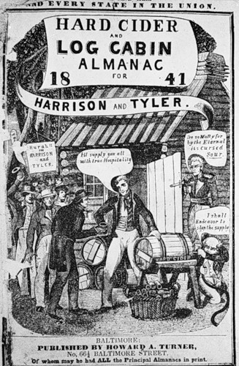
Election of 1840
WHH nicknamed “Old Tippecanoe”
Lampooned in newspapers as a poor old farmer who should be content with a pension, log cabin, and a barrel of hard cider.
Whigs’ response: WHH is a “man of the people”, VB is a pompous aristocrat
  Tippecanoe and Tyler Too!

Slide 10
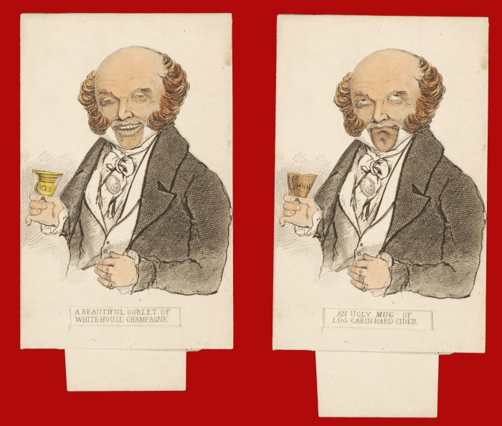

Slide 11
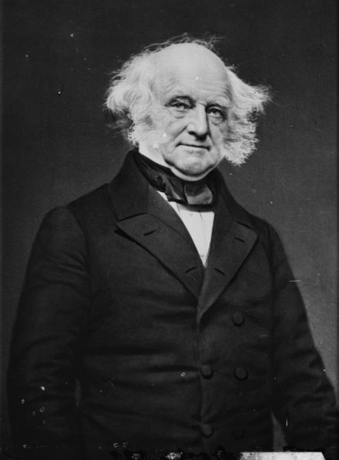
Martin Van Buren
Dates in Office: 1837-1841
Nickname: “Little Magician”
Political Party: Democratic
Major Events:
Panic of 1837
Divorce Bill
Texas Revolution

Slide 12
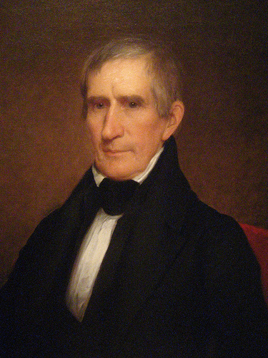
William Henry Harrison
Dates in Office: 1841
Nickname: “Old Tippecanoe”
Political Party: Whig
Major Events:
He was the first President to die in office (forced us to figure out Presidential succession)

Slide 13
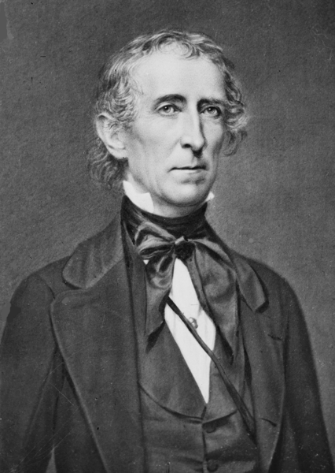
A President Without A Party
John Tyler: a Democrat at heart and contradicted many of the Whig Party ideas.
Changes under the Whigs
  Ended the independent treasury
  Suggested a “fiscal bank” (a new BUS); Vetoed by Tyler
  Suggested a "Fiscal Corporation“; Vetoed by Tyler
President Tyler rejected by his party

Slide 14
John Tyler
Dates in Office: 1841 - 1845
Nickname: “The Accidental President”
Political Party: Whig
Major Events:
First born under the current Constitution
First Presidential Succession
Expelled from the Whig party
Annexation of the Republic of Texas
Aroostook War
Webster-Ashburton Treaty

Slide 15
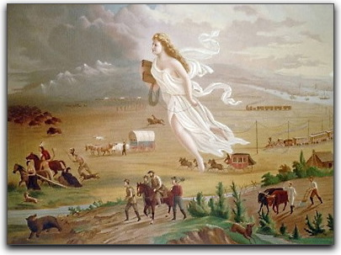
Manifest Destiny

Slide 16
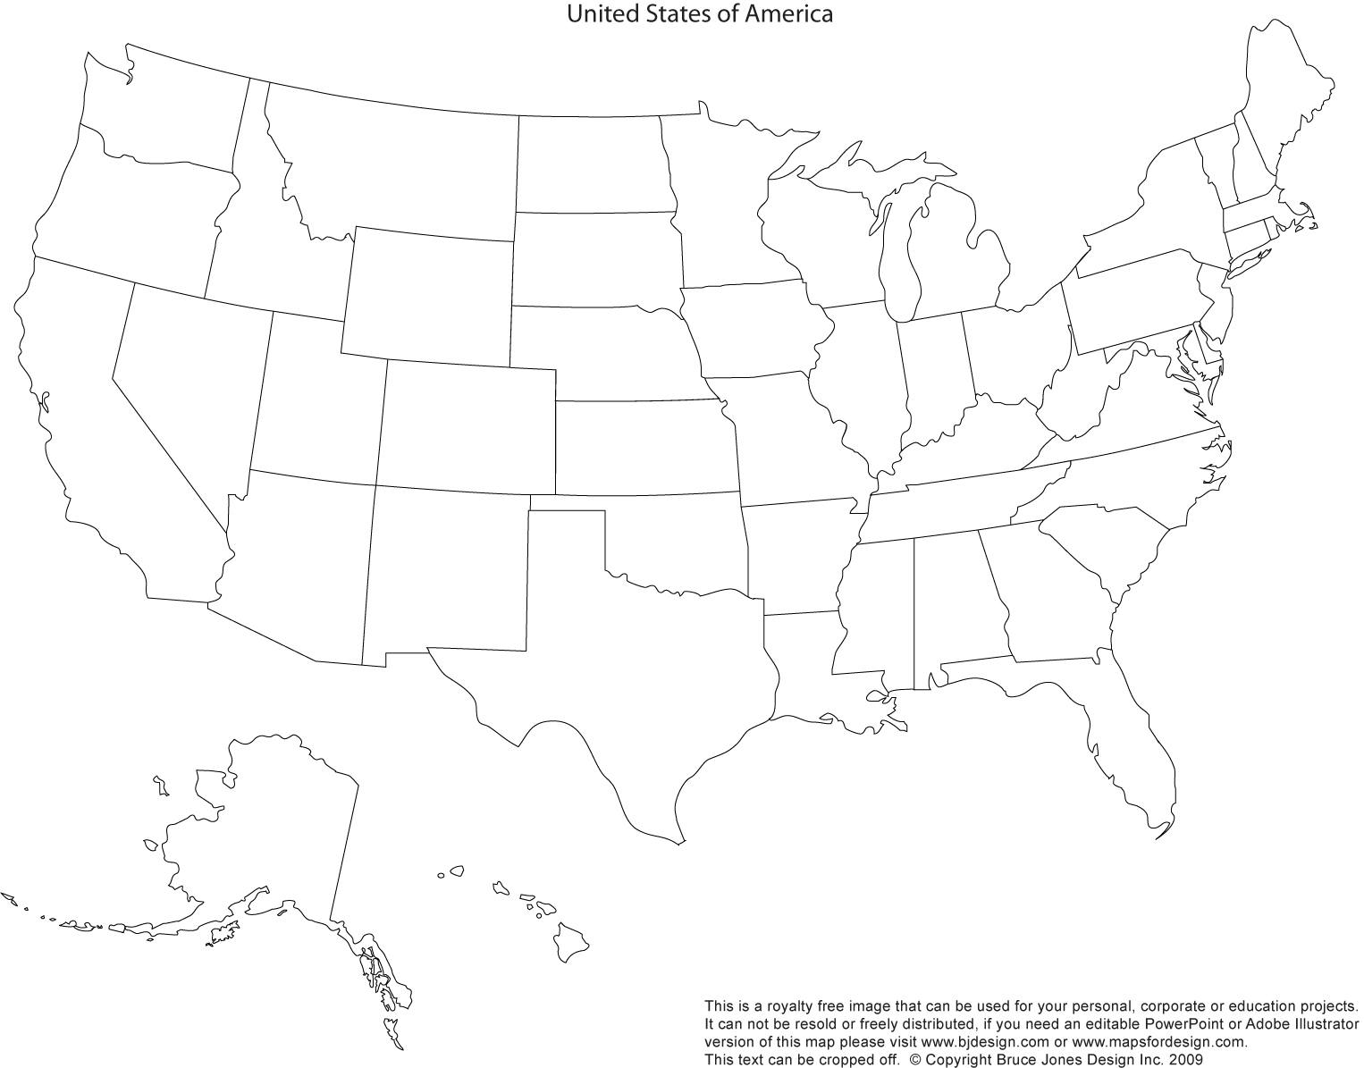

Slide 17
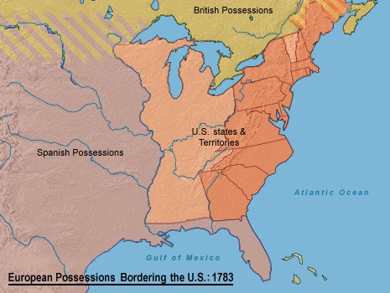
Thirteen colonies and ceded land

Slide 18
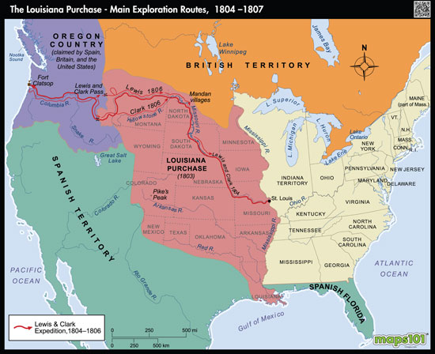

Slide 19
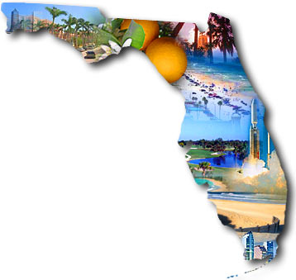

The Florida Cession
FL a refuge for pirates, escaped slaves, fugitives; Native Americans raiding across the border
Monroe sends Gen. Andrew Jackson to solve the raid issue
  Jackson leads army into FL (an act of war)
Spain offers to sell for $5m instead of go to war
Thanks!
De nada….
>:(

Slide 20
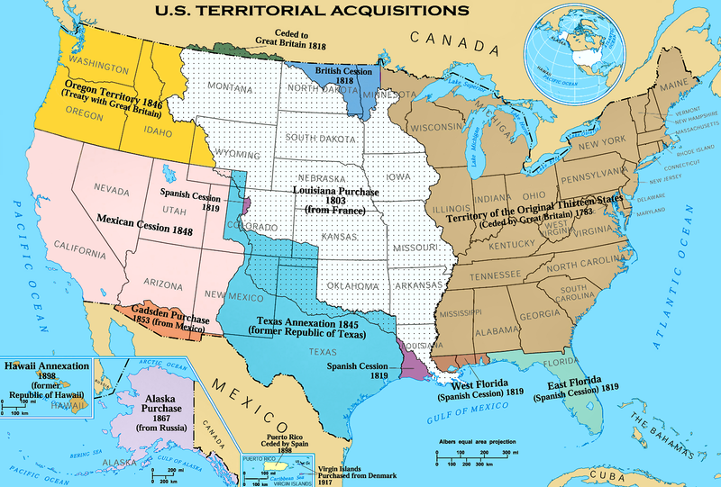
1818 - 49°
1819 – Adams-Onis Treaty

Slide 21

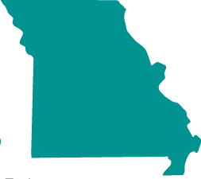
Missouri is a Sticky Subject
MO asks to join the U.S. as a slave state (1819)
Tallmadge Amendment: Proposed amendment to MO’s statehood that would limit slavery
  No more slaves imported into MO
  Slave children would be gradually emancipated
  Voted down in the Senate
The Missouri Compromise:
  MO admitted as slave, ME admitted as free
  Future slave territory:
  Free
  36°30’ ----------------------------
  Slave

Slide 22
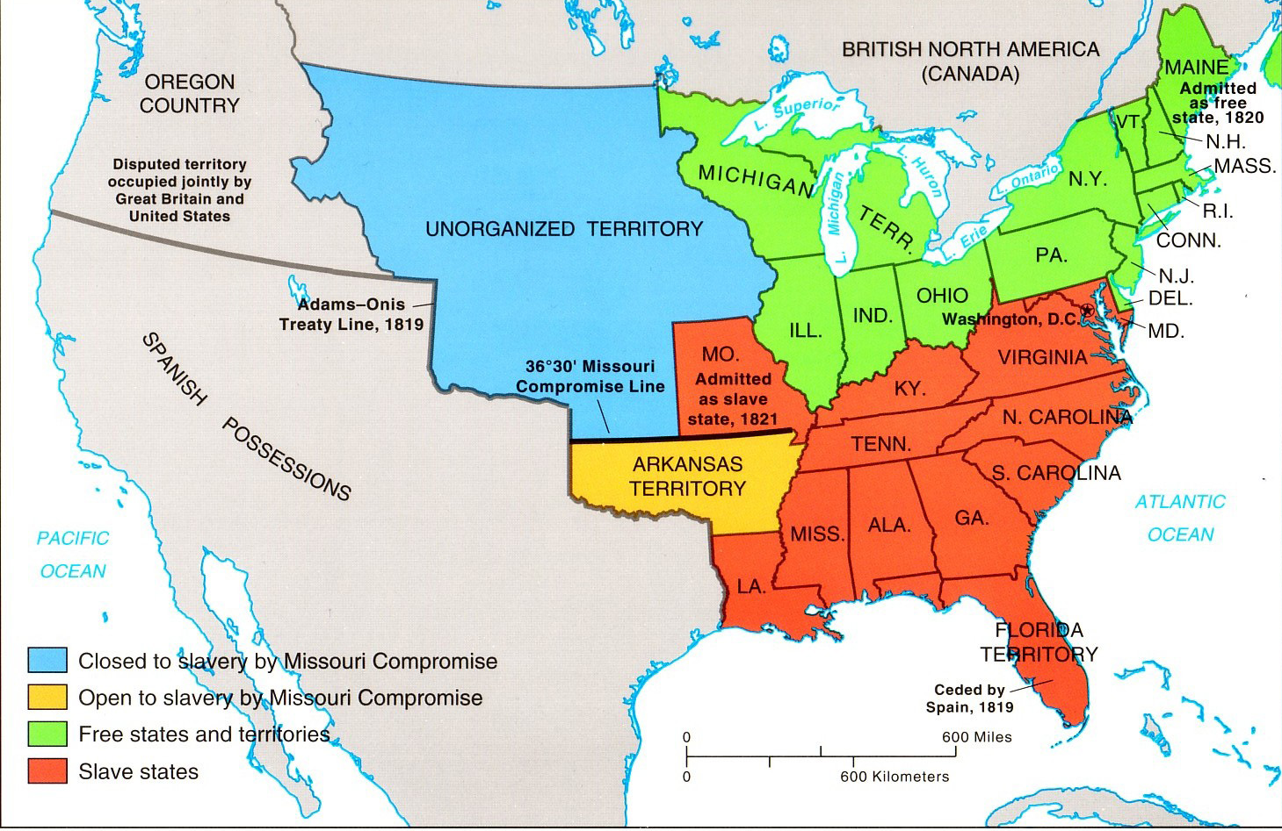

Slide 23
Influenced by John Calvin, many Puritans
  envisioned reformed Christian society the authority in the magistrates and not in the congregation.
  did not believe in receiving God’s grace and being “born again”.
  embraced predestination, the idea that God saved only a few chosen people.
  worked to restore religious dissidents to a Christian state of being.
Which of the following sources would be most useful in studying the development of democratic institutions in the early colonial period?
  The Albany Plan
  The Mayflower Compact
  The Treaty of Tordesillas
  The Virginia Company Charter
Which of the following was the primary reason for the creation of the colony of Georgia?
  commercial profit
  religious freedom
  equal rights for all
  as a penal colony for debtors
Historians have labeled the period of colonial history before 1763 as a time of “Salutary Neglect” because
  British inattention to enforcing colonial policy led to growth and prosperity.
  Colonists ignored Indians needs during this time and the response was continual warfare.
  Individual colonies focused on their own concerns, and not those of other colonies, promoting economic prosperity.
  Royal governors were the most interested in seeking fortunes and thus neglected colonial politics.
The Federalists made a last gasp attempt to maintain power by
  repealing the Alien and Sedition acts
  Supporting Aaron Burr for president
  creating new federal courts and judges
  Scheming to secede from the Union
Notes:
1 C
2 B
3 D
4 A
5 C

Slide 24
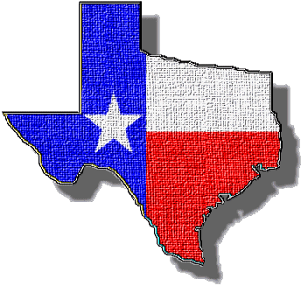
Bienvenido a Tejas!
Mexico = Broke; sought to entice wealthy Southern planters to the Tejas Territory
  Must become Mexican citizens
  Must become Catholic
  No slavery

Slide 25
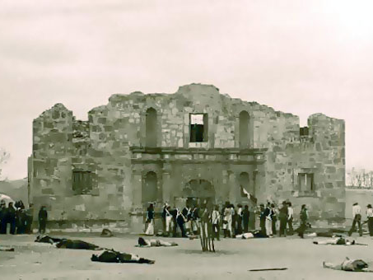

THE TEXAS REVOLUTION
Animosity b/w Texian settlers and MX government under President/General Antonio López de Santa Anna
  Slavery and religion
Texians defeated at the Alamo
  Santa Anna’s cruelty inspired many Americans to join the fight; Remember the Alamo!
Ended at the battle of San Jacinto; created the Republic of Texas
Notes:
According to many accounts of the battle, between five and seven Texians surrendered.[Note 15][115][116] Incensed that his orders had been ignored, Santa Anna demanded the immediate execution of the survivors.[117] Weeks after the battle, stories circulated that Crockett was among those who surrendered.[116] However, Ben, a former American slave who cooked for one of Santa Anna's officers, maintained that Crockett's body was found surrounded by "no less than sixteen Mexican corpses".[
Most Alamo historians place the number of Mexican casualties at 400–600 Mexicans. Most eyewitnesses counted between 182–257 Texians killed
Mexican soldiers were buried in the local cemetery, Campo Santo.[Note 18][122] The Texian bodies were stacked and burned.

Slide 26
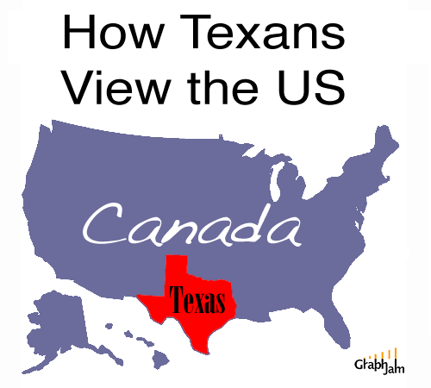
“Deep in the heaaaart of Texas!”
TX asks to be annexed by the US
Denied entrance for nine years
  Wanted to enter as a slave state
  Would tip the Senate balance
Annexed by President Tyler (1845)

Slide 27
Synthesis
States Rights
  Slavery: (free states, slave states)
    -Dred Scott
  Marriage: (interracial, gay, polygamy)
-Obergefell v. Hodges (5-4)
  Marijuana: 5 states, how many more come 2016?
    Gonzales v. Raich
    Raich v. Ashcroft- See Note
  In THREE sentences, compare slavery in the United States to either Marriage or Marijuana related issues. You must Include the aspect of states rights into your argument.
Notes:
Introduction: The Case
In case you haven’t been following this case at all, here it is in outline:
California is one of the eleven states (most recently with Montana) currently that allows some kind of medical marijuana by law, (in this case, through the mechanism of Proposition 215).
Federal law, through the Controlled Substances Act, does not recognize medical marijuana
The federal government was so opposed to medical marijuana that they regularly sent armed squads of federal agents into California to break up medical marijuana coops, and seize their assets and medicine, claiming that federal law trumped state law. (Read about one of those raidshere.)
The federal government felt it important enough to divert resources that could have been used to fight terrorism or go after violent traffickers, in order to arrest sick people
Angel Raich of Oakland, CA (who was also raided), and Diane Monson Monson of Oroville, CA along with two anonymous caregivers sued the federal government on October 9, 2002 to prevent the feds from interfering with their right to use medical marijuana. Read Angel’s own statement about the case and her use of medical marijuana.
Three factors add particular interest to this case.
What the respondents are doing is completely legal under state and local law.
It is asserted by Angel Raich and her doctors that she would die without marijuana, and that has not been disputed.
Their marijuana was grown as part of a cooperative of patients and no money changed hands. Therefore it had no direct impact on interstate activity or commerce. (see Commerce Clause below)
On December 16, 2003, the 9th Circuit Court of Appeals granted a prelimary injunction to stop the federal government based in part on this ruling:
We find that the appellants have demonstrated a strong likelihood of success on their claim that, as applied to them, the CSA is an unconstitutional exercise of Congress’ Commerce Clause authority.
On April 20, 2004, the Federal government appealed the decision to the Supreme Court. Oral arguments were heard on November 29, 2004 and the case will be decided some time in the Spring of 2005.
The Commerce Clause
The Constitution of the United States specifically does not give police powers to the federal government. That kind of power was considered a state function. However, there is one clause in the constitution which gives the government the following “limited” power…
to regulate commerce with foreign nations, and among the several states, and with the Indian tribes;
This is generally known as the commerce clause. As intended, in the early years of this country’s history, the commerce clause allowed only minimal instrusion on the activities within states. For example, federal alcohol prohibition was not considered constitutionally possible without an amendment because of the commerce clause, and judges also regularly placed the tenth amendment in the path of congressional regulation of “local” affairs.
However, over the course of years, the commerce clause was consistently weakened, giving federal government more leeway in regulating and enforcing federal laws within the states.
It was a gradual expansion, from limited border functions, to accepting that interstate commerce can be regulated as it travels through the states, to expanding it to include transactions that affect interstate commerce, to almost meaning anything that Congress decides is interstate commerce.

Slide 29


A War of Words with Britain
Caroline Affair: American ship attacked by British-Canadian force
Creole Case: British officials offer asylum to 130 VA slaves who had overtaken their ship
“Aroostook War”: clash between American and British lumberjacks in disputed Maine territory
  Webster-Ashburton Treaty: Solved conflicts between Britain and the US; settled the boundary between Canada and Maine.

Slide 30
Webster-Ashburton Treaty
Ceded by Britain
(1842)

Slide 31
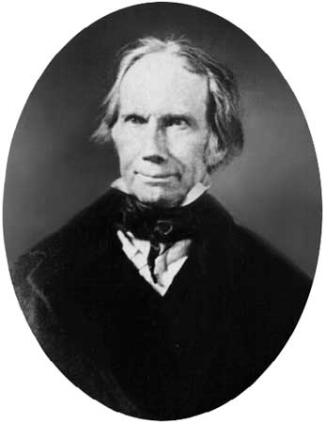
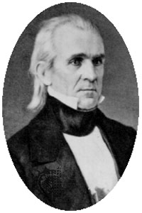
Election of 1844
The annexation of Texas would be the biggest issue in the election of 1844.
Whigs - Henry Clay
Democrats - James K. Polk
Straddled the issue whether or not to annex Texas.
Said he would protect Texas; he avoided the issue of slavery.

Slide 32
Goals of James K. Polk
A lower tariff
Restore the independent treasury
The settlement of the Oregon dispute without violence
Acquisition of California

Slide 33
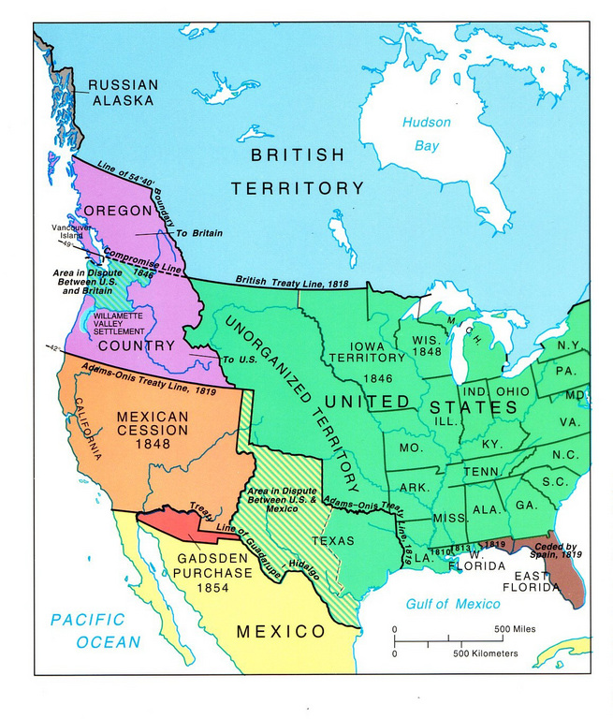

Oregon Fever
Dispute between US and Britain over Oregon Territory
  5,000 Americans in the territory
  “54°40’, or fight!”

Slide 34
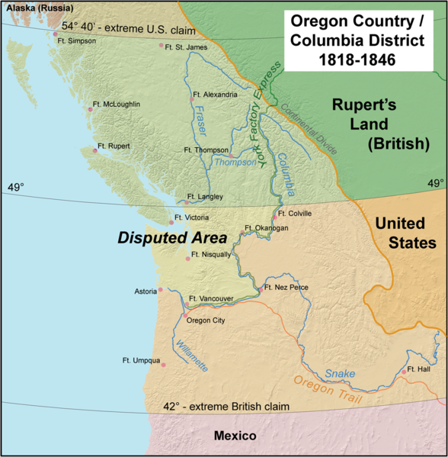
54°40’ or FIGHT!

Slide 35
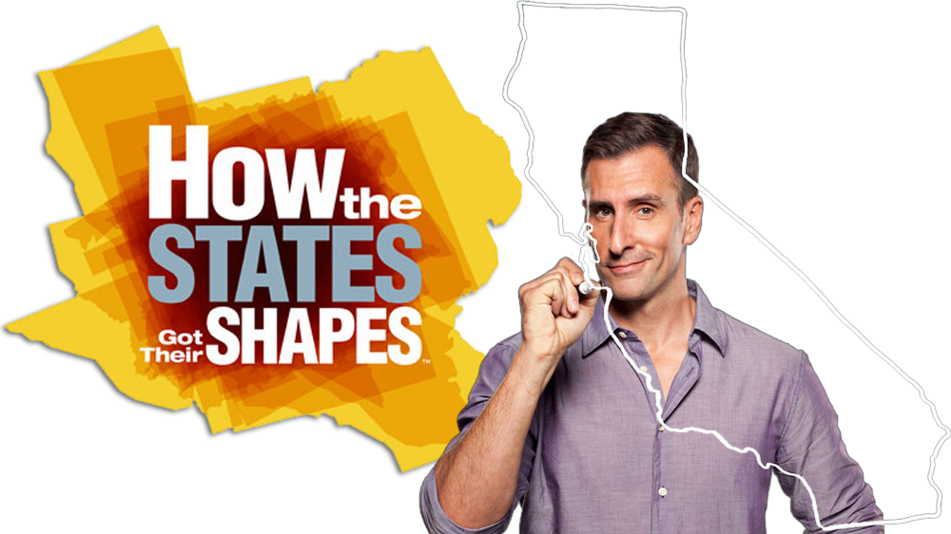
TEXAS AND CALIFORNIA
“Big States”
(51:50-56:00)

Slide 36
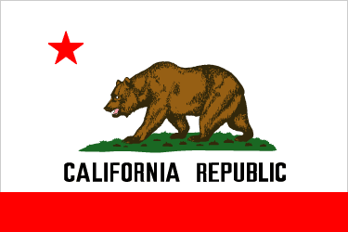
Mexican American War
Polk offers to buy CA from MX for $25m.
  Rejected due to issues over TX
Polk prepares to take by force to “protect American interests”
  MX beats him to it
MEANWHILE…. American settlers in CA fight for independence from MX
  Led by John C. Frémont
  Est. a “Republic”, and supported annexation by the U.S.

Slide 37
Results of the Mexican American War
Treaty of Guadalupe Hidalgo: Gave Texas (officially) and California to America for $15 million.
Wilmot Proviso: Proposed amendment that stated that the territory from Mexico should remain slave-free.
  Crushed by Southerners in the Senate
1848 – CA gold rush; allows for CA to bypass the territorial stage and apply for statehood
  Wanted to join as a free state
  Would have disrupted the 15-15 balance in the Senate

Slide 38
Compromise of 1850
Stricter Fugitive Slave Law (“Bloodhound Bill”): Whites that aided escapees fined or jailed, $5 for freedom-$10 for return for officials.
Popular sovereignty in Mexican Cession lands (negates MO Comp.)
Admission of CA as a free state
The slave trade was abolished in D.C., symbolically shows that the nation is taking a stance on the subject

Slide 39
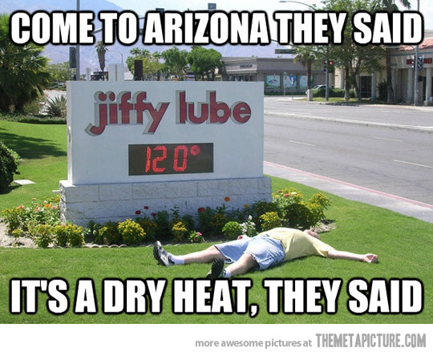
Manifest Destiny: Complete
The Gadsden Purchase: A thin strip of land purchased from Mexico to complete southern Arizona and New Mexico
It was purchased for the intent of building a trans-continental railroad.

Slide 41
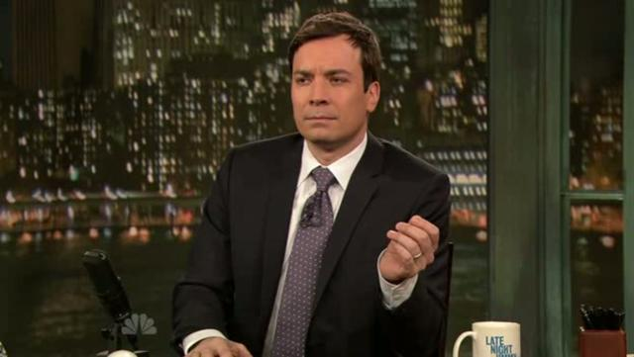
Best Treaty in the World!

