Slide 1
The Southern Colonies
17th and 18th Centuries

Slide 2
General Characteristics of the South
The Big Ideas

Slide 3
General Characteristics of the South
Dominated by a plantation economy: tobacco & rice
Slavery in all colonies; begins as indentured servants, develops into African chattel slavery
Large land holdings in the hands of the favored few = aristocratic atmosphere
Sparsely populated: churches & schools too expensive for very small towns.
Church of England most prominent, but religious toleration is common

Slide 4
Virginia

Slide 5
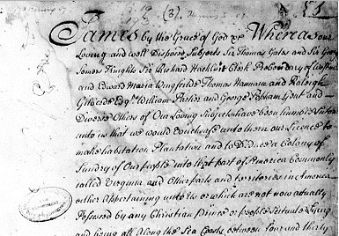
Jamestown
Founded by Virginia Company (a joint-stock company)
Virginia Charter
Overseas settlers given same rights of Englishmen in England
Foundation for American liberties; rights extended to other colonies.

Slide 6
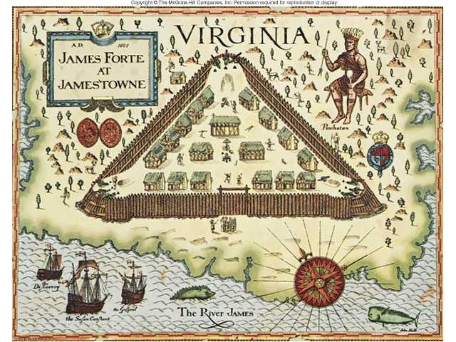
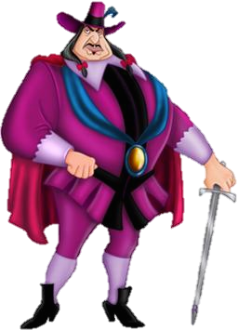
Jamestown
Founded by 104 English men and boys
Wealthy adventurers and second-sons
Later brought women and children with the intention to set up a permanent colony.

Slide 7
The REAL John Smith
Captain John Smith organized the colony beginning in 1608:
"He who will not work shall not eat."
Smith kidnapped in Dec. 1607 by Chief Powhatan
Smith perhaps "saved" by Pocahantas, Powhatan's daughter, but evidence is shaky at best.

Slide 8
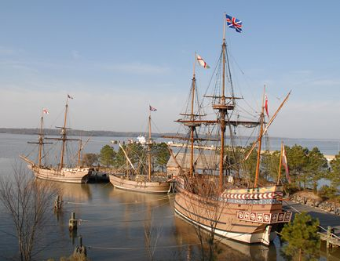
The Jamestown Nightmare
Only 40 survived the first year
Only 60 out of 400 settlers survived "starving time" of 1610-1611
1610 – 1624: 10,000 immigrants arrive, 1,200 survive
Adult life expectancy: 40 years
80% of children died before 5y/o

Slide 9
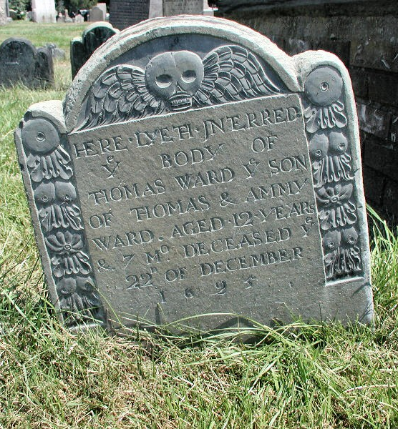
Survivors of the “Starving Time”
Men: Able to buy larger tracts of land, but there were fewer to work it. Increased the need for indentured servants or Indian slaves.
Women: unusual autonomy and wealth due to High mortality among husbands and fathers (Widowarchy)
Children: Fewer children to help on family farms also contribute to the need for servants.

Slide 10
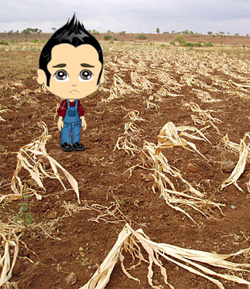
Reading: “Our Plantation is Very Weak”
HIPPO TIME
Take 10-15 minutes and think historically as you complete one of your HIPPO Assigned Readings.

Slide 11
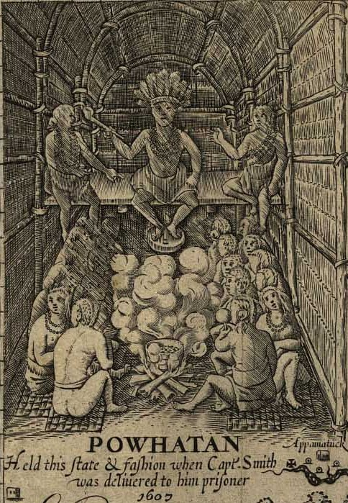
Powhatan Confederacy
Powhatan dominated a few dozen small tribes in the James River area
The English called all Indians in the area Powhatans.
Powhatan probably saw the English as allies in his struggle to control other tribes in the region.

Slide 12
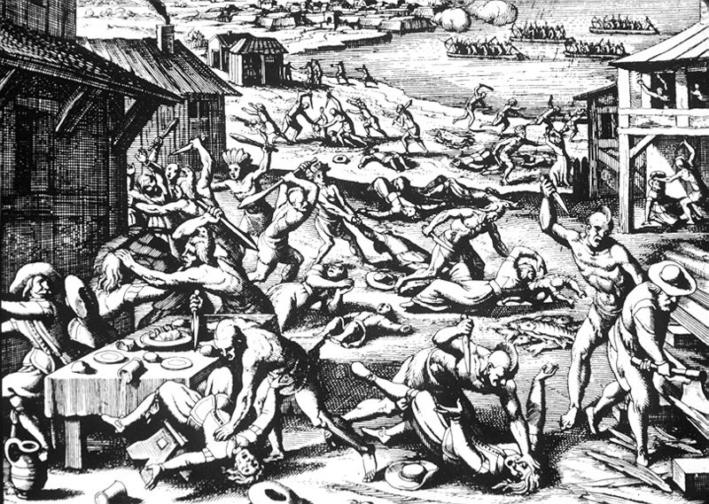
Culture Clash in the Chesapeake
Anglo-Indian relations deteriorate
General mistrust because of different cultures & languages.
English raided Indian food supplies during the starving times.
1610-1614 → First Anglo-Powhatan War
Peace solidified with marriage of John Rolfe and Pocahontas
Powhatan uprising of 1622
Powhatan warriors burned settlements and plantations, nearly destroying Jamestown completely
1644-1646 → Second Anglo-Powhatan War
Last effort of natives to defeat English; Indians defeated again.
Peace Treaty of 1646
Removed the Powhatans from their original land.
Formally separated Indian and English settlement areas

Slide 13
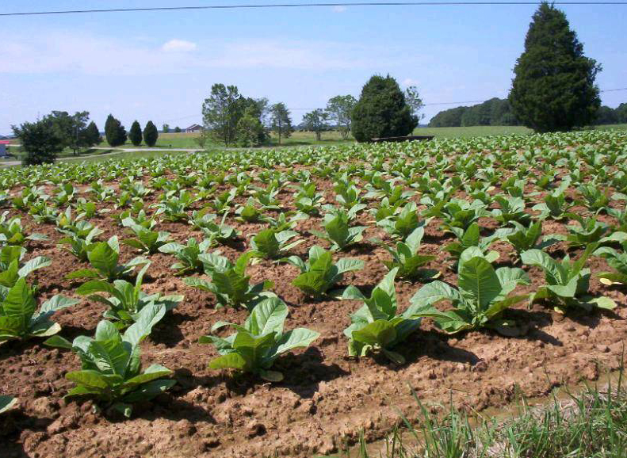
John Rolfe
John Rolfe introduced new tough strain of tobacco given to him by the Powhatans
“Colony built on smoke”
Europeans become addicted
Tobacco economy grew
Plantation system emerged

Slide 14
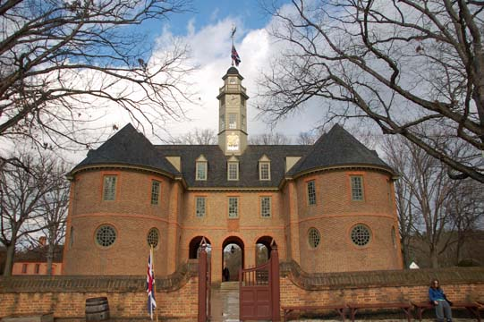
The House of Burgesses
The House of Burgesses (1619): Assumed the role of the House of Commons in England
Control over finances, militia, etc.
Able to initiate legislation by end of 17th century
Governor’s Council appointed by royal governor
Mainly leading planters.
Functions like House of Lords.
High death rates ensured rapid turnover of members.

Slide 15
Maryland
A Refuge for Catholics

Slide 16
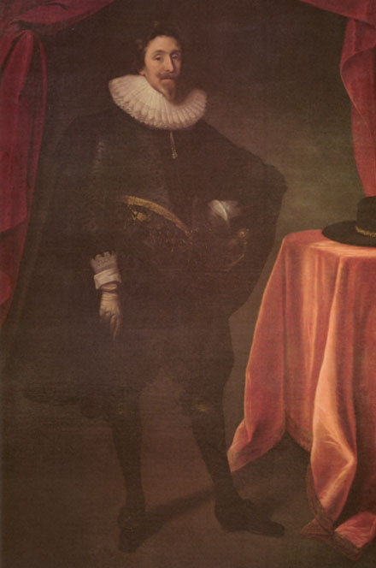
Maryland is Founded
Land granted to Sir George Calvert (Lord Baltimore)
Proprietary colony
Refuge for Catholics
Baltimore's governed as an absentee proprietor in a feudal relationship
Huge tracts of land granted to his Catholic relatives
Smaller plots of land were given to Protestant settlers
Notes:
The Anglican Church was the official religion of England at the time. Catholics paid double taxes, could not worship in public, or hold political office. A couple could not be legally married by a Catholic priest.

Slide 17
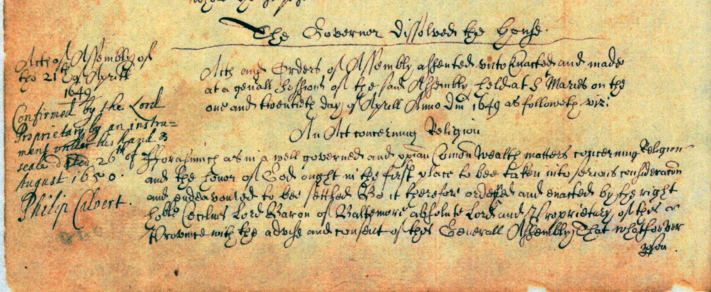
Act for Religious Toleration
Guaranteed toleration to all Christians.
Decreed death to those who denied the divinity of Jesus [like Jews, atheists, etc.].

Slide 18
Carolina

Slide 19
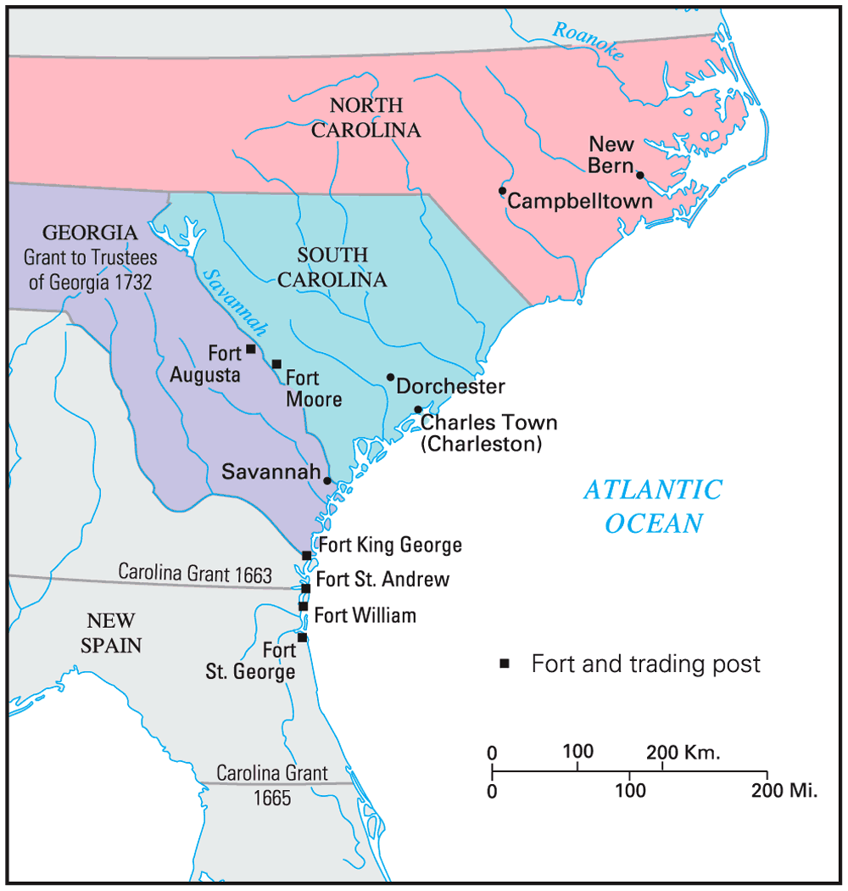
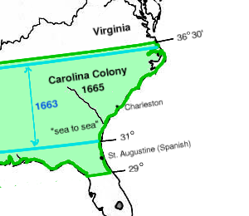
The West Indies: Way Station to the Americas
Founded in 1670
Proprietary colony – given in return for assistance in restoring Charles II to the throne
Settled by a group of British small farmers from the W. Indies
Brought a few black slaves and the Barbados slave system with them

Slide 20
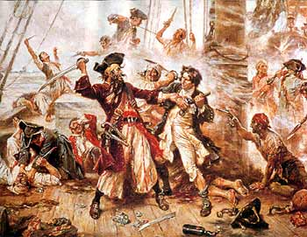
The Carolinas
South: Suffered from raids by Spanish and their Indian allies
North: Drew poor farmers who disliked the aristocracy of VA and Charleston
1712 – NC separates from SC

Slide 21
Georgia

Slide 22
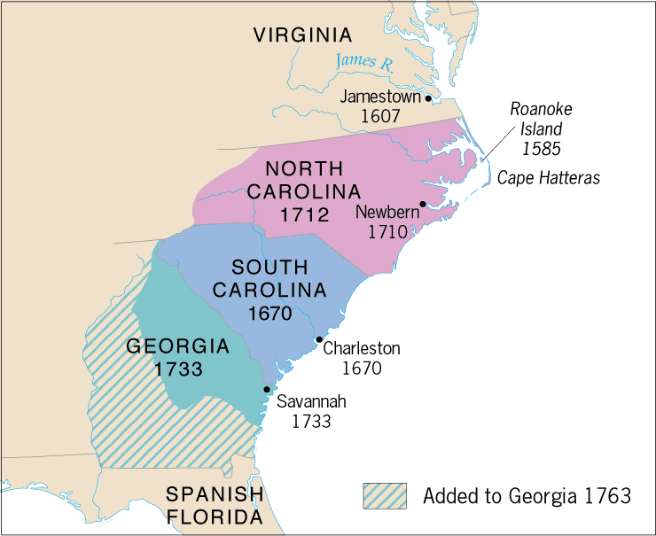
Late-Coming Georgia
Founded by James Oglethorpe (1733)
Created as a “buffer” between English colonies and Spanish Florida and French Louisiana
A haven for debtors
Originally had no slaves
Religious toleration for all Christians

Slide 23
Why does it matter?

