Slide 1
Bell Ringer
What are some of the qualities you think are important for a president to have?

Slide 2
Precedents of Presidents
Establishing what it means to be Mr. President

Slide 3
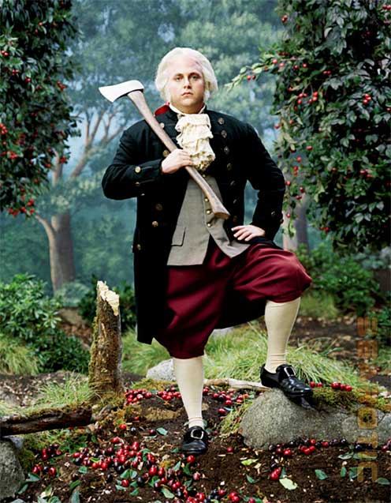
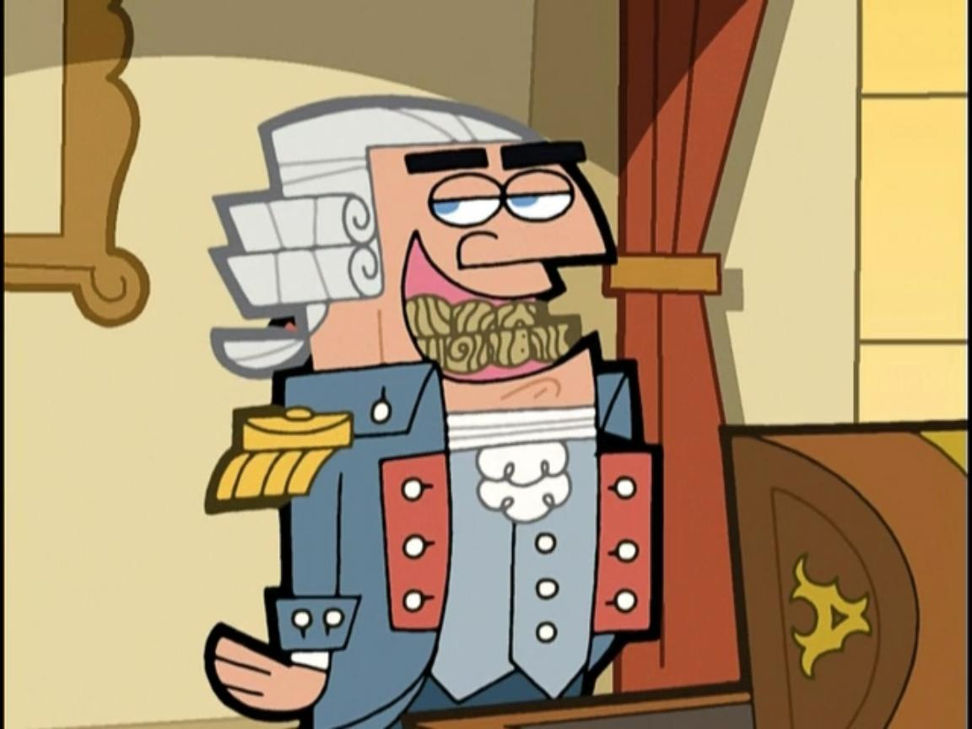
Lies My Teacher Told Me

Slide 4
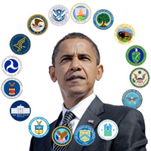
Presidential Precedent
Served only two terms
Accepted the title of Mr. President
Created the Cabinet - Consulting of department heads in order to make decisions; part of the “unwritten Constitution”
Secretary of State -- Thomas Jefferson
Secretary of the Treasury -- Alexander Hamilton
Secretary of War -- Henry Knox

Slide 5
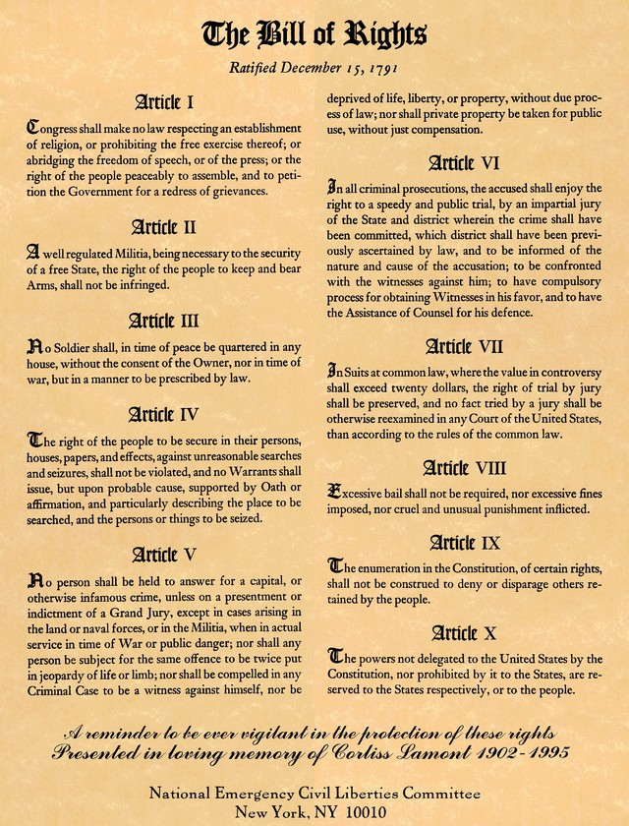
Bill of Rights
One of first priorities facing the new government
Antifederalists had sharply criticized the Constitution for not having one.
Many states had ratified under the condition that one be included.
Bill of Rights -- First ten amendments to the Constitution adopted in 1791.

Slide 6
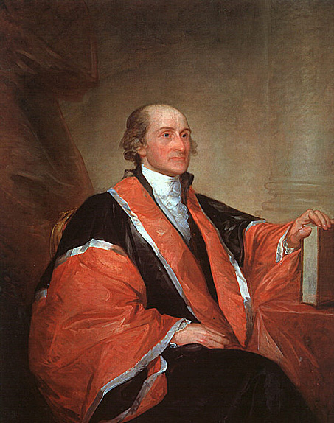
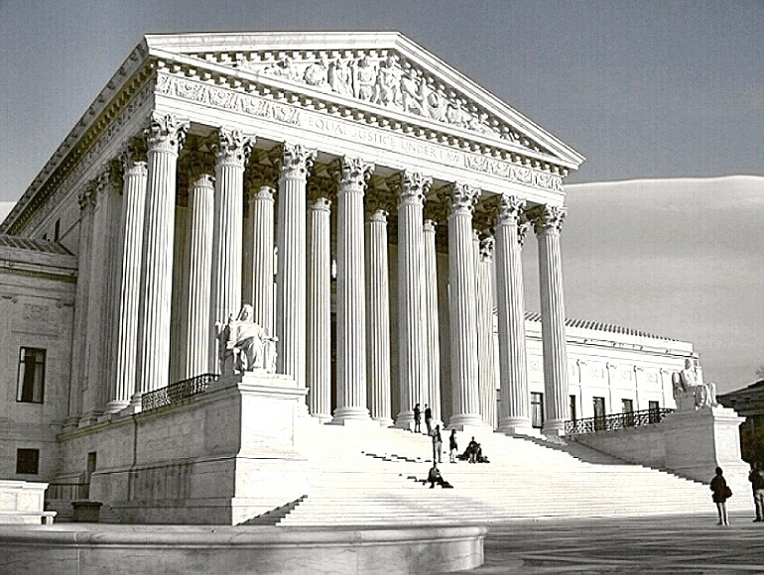
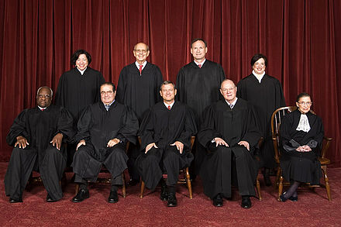
Judiciary Act of 1789
Organized the federal court system
Chief Justice John Jay + five associate justices
Organized federal district and circuit courts
Allowed for the enforcement of national laws within each state
Established the office of attorney general (4th cabinet position)

Slide 7
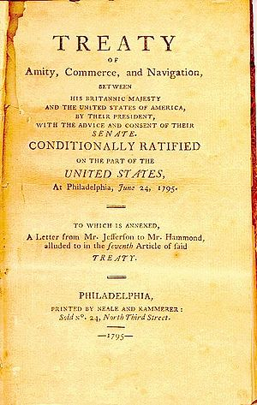
Washington’s Foreign Policy
Neutrality Proclamation of 1793: Declared the nation neutral in the conflict between France and Great Britain.
Threatened prison for any American providing assistance to any country at war
Jay’s Treaty: Treaty with Britain; averted war and increased 10 years of peaceful trade.
Pinckney’s Treaty: Treaty with Spain; defined the boundaries of the U.S. and Spanish FL, and guaranteed navigation rights on the Mississippi River.

Slide 8
Effects of Foreign Trade on U.S. Economy
This graph shows how completely the American shipping boom was tied to European events. Exports surged when Britain and France were at war and America could take advantage of its neutral status. Exports slumped in the brief period of European peace from1803 to 1805 and plunged following the Embargo Act of 1807 and the outbreak of the War of 1812.
American Export Trade, 1790–1815

Slide 9
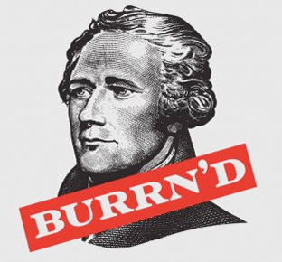
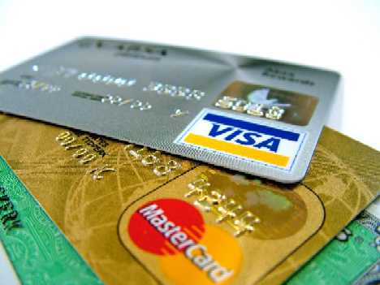
Hamilton’s Financial Plan
Revolution left America in severe financial debt
Alexander Hamilton’s economic philosophy
Report on Public Credit (1790)
Fiscal policies to favor the wealthy ➔ lend $ to the government ➔ $ would trickle down to the masses
Report on Manufactures (1791)
Advocated promotion of a factory system in U.S. so the nation could exploit its national resources and strengthen capitalism.
Hamilton’s financial plan became the cornerstone of America's financial system

Slide 10
Memory Aid for Hamilton’s Financial Plan:
BE FAT

Slide 11
Hamilton’s Financial Plan
Bank of the United States
Excise Taxes
Funding at Par
Assumption of State Debts
Tariffs

Slide 12
Assumption of State Debt
Would obligate states to the federal government
States with huge debt were delighted (esp. Mass.)
States with less debt or no remaining debt were unhappy
Compromise through “logrolling” (“You scratch my back, I’ll scratch yours”)
Federal government would assume all state debt
South would get new federal district (Washington D.C.)
A!

Slide 13
Funding At Par
Purpose: Bolstering national credit
Function: Taking in Revolutionary War bonds and issuing new ones at the face value of the old bonds.
Wealthy investors bought up the cheap bonds in rural areas
Common folk desperate for cash;
sold unknowingly
F!
Notes:
13

Slide 14
Tariffs and Excise Taxes
T!
Tariffs (customs/import duties): Source of revenue for paying the national debt [tax on foreign goods]
Help protect infant industries
Excise Taxes: Taxes paid for a specific good (usually a luxury item)
Whiskey tax
E!

Slide 15
Bank of the United States (BUS)
A national bank for the Treasury to deposit surplus monies
20 year charter
Seen as necessary to stabilize and improve the nation's credit
Government would print urgently needed paper money, providing a sound & stable national currency
B!

Slide 16
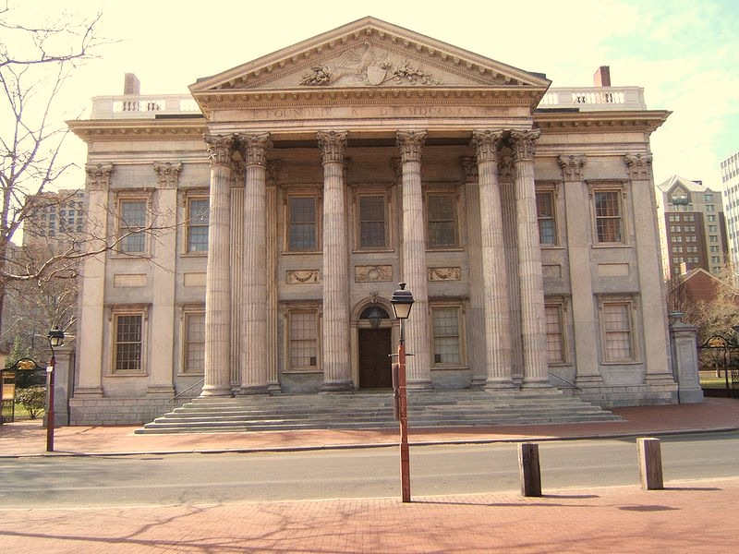
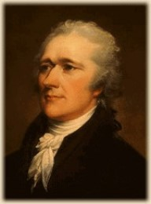
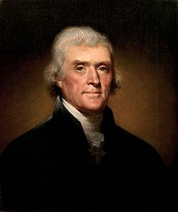
Bank of the United States
Arguments for the BUS
Loose construction –Broad interpretation of the Constitution
“necessary and proper clause”/“elastic clause” – Expands Congress’ implied powers
Bank would be "necessary" to store collection of taxes & trade monies (both in Constitution)
Arguments Against the BUS
Strict construction - strict interpretation of the Constitution
Fears of a huge central bank
Wealthy would benefit at the expense of farmers
Bank located in North; South suspicious

Slide 17
The First Political Parties
Political parties seemed disloyal and against the spirit of national unity
Rule by upper class; distrusted the common people
Supported a strong central government
Government should foster business, not interfere with it
Pro-British
Rule by the people (middle class and yeoman farmers)
Majority of power held by the states
Were mostly agrarians
Pro-French
Federalists
Democratic-Republicans

Slide 18
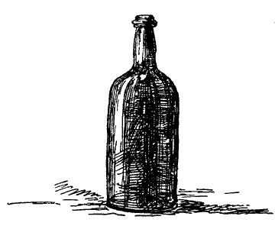
The Whiskey Rebellion
PA backcountry folks hard hit by Hamilton's excise tax
Washington summoned the militia of several states resulting in 13,000-man army.
Significance: Washington's government showed another Shays’-type rebellion could not succeed under the new Constitution
Notes:
18

Slide 19
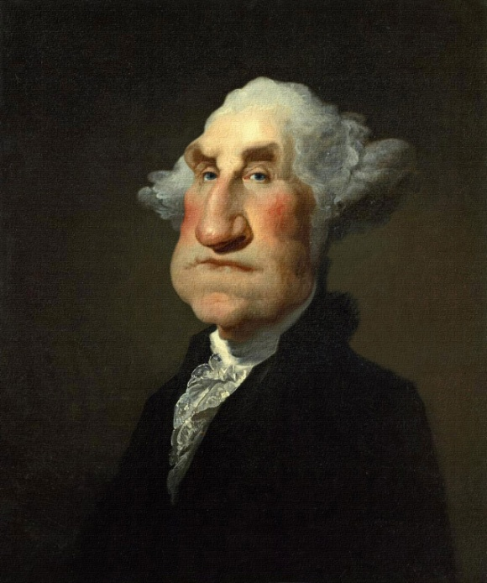
Adios Washington!
Washington refused to accept a third term as President
Washington’s Farewell Address
Warned against permanent foreign alliances (like treaty with France)
Warns against political parties
Stresses the importance of religion and morality
Stresses the importance of stable public credit
Laters!

Slide 20
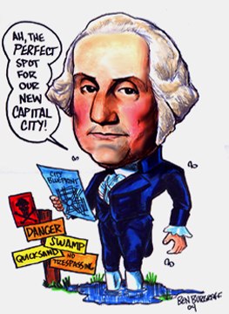
George Washington
Dates in Office: 1789 - 1797
Nicknames: Father of Our Country
Political Party: “Federalist”
Major Events:
First President under Constitution
Bill of Rights ratified
Neutrality Act
Judiciary Act
Jay and Pinckney’s Treaties
Hamilton’s Economic Plan
Whiskey Rebellion

Slide 21
John Adams
America’s 2nd President

Slide 22
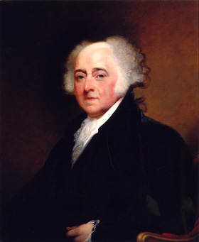
Adams’ Administration
Election of 1796 – Beats Hamilton and Jefferson, Jefferson named as VP
Different political ideologies = conflict!
War with France
French Revolution – Reign of Terror
Quasi-War with France
Impressment
XYZ Affair
Notes:
Election of 1796
John Adams became the Federalist candidate: experienced leader from Massachusetts. -- Hamilton too unpopular among the masses to be a serious candidate
Democratic-Republicans gathered around Thomas Jefferson -- Assailed the crushing of the Whiskey Rebellion and Jay's Treaty
Adams d. Jefferson 71 to 66 in the Electoral College -- Jefferson, as runner-up, became V.P.
War with France
French Directory government infuriated by Jay Treaty
Condemned it as an initial step towards alliance with Britain
Saw it as a flagrant violation of the Franco-American Treaty of 1778
French warships began seizing U.S. merchant vessels (about 300 by mid-1797)
Refused to receive America's newly appointed envoy; threatened him with arrest.
XYZ Affair
President Adams sent a delegation to Paris in 1797 (incl. John Marshall).
Secretly approached by three go-betweeners (agents"X,Y, & Z") -- French demanded a large loan of $32 million florins and a bribe of $250K for U.S. privilege of merely talking to foreign minister Talleyrand.
Negotiations broke down and Marshall came home—seen as a hero
War hysteria swept the U.S. -- Federalists encouraged that the Jeffersonians' ally (French) was now hated
Undeclared Naval Warfare, 1798-1799 -- “Quasi -War”
U.S. war preparations set in motion
Navy Department at the cabinet level was created: 3 ship navy expanded
Marine Corps established
Army of 10,000 men was authorized (not fully raised) -- Washington was top general but gave active command to Hamilton
Adams suspended all trade with France and authorized American ship captains to capture armed French vessels
Undeclared hostilities ensued for 2 1/2 years between 1798-1800
principally in the West Indies.
U.S. privateers + U.S. navy captured over 80 French armed vessels
Several hundred Yankee merchantmen lost to the French.
Full-blown war loomed imminently and Adams sought to keep U.S. out
Convention of 1800 (Adam's “Finest Moment”)
French Foreign Minister Talleyrand became eager to negotiate a peace -- Did not want another enemy on the side of the British
Adams shockingly submitted to the Senate a new foreign minister to France
Hamiltonian "High Federalists" enraged by designs for peace; sought military glory
Jeffersonians and moderate Federalists favored one last try for peace
Envoys arrived in 1800 to negotiate with Napoleon (who was bent on European conquest)
Convention of 1800
France agreed to end the 22-year Franco-American alliance with the U.S.
U.S. agreed to pay the damage claims of American shippers.
Thus, America's only peacetime military alliance for a century and a half was ended
Significance:
Major war with France avoided
Rapprochement made possible the Louisiana Purchase 3 years later. -- If war had occurred, Napoleon would not have sold Louisiana
Adams felt this to be his finest achievement.
Alien and Sedition Acts (1798)
Purpose: Federalists passed a series of oppressive laws in 1798 that would reduce power of Jeffersonian foes and silence anti-war opposition
Alien Acts
Attack on pro-Jeffersonian "aliens"
Most immigrants lacked wealth and were welcomed by Jeffersonians.
Scorned by Federalists who did not want the "dregs" of Europe voting in U.S.
Raised residence requirements for U.S. citizenship from 5 yrs to 14 yrs.
President empowered to deport "dangerous" foreigners in time of peace and to deport or imprison them in time of hostilities.
Laws in some ways seemed sensible
Some foreign agitators were coming into the country (Citizen Genet)
Many from France sought anti-British policies
Others were foreign agents who should have been expelled.
Alien Acts never enforced but some frightened foreign agitators left
Sedition Act
Anyone who impeded the policies of gov't or falsely defamed its officials, incl. the president, would be liable to a heavy fine and imprisonment.
Direct violation of the 1st Amendment to the Constitution -- Federalist Supreme Court not interested in declaring it unconstitutional.
Many outspoken Jeffersonian editors were indicted; 10 brought to trial & convicted
Law expired in 1801 the day before Adams left office. -- Demonstrated dubious intentions of bill (in case a Federalist was not elected in 1800, Republicans would not have the Sedition Act to prosecute Federalists.)
Popular support for Alien and Sedition Acts significant
Anti-French hysteria played into the hands of the Federalists
Largest ever Federalist victory in 1798-99 congressional elections
22

Slide 23
The XYZ Affair
President Adams sent envoys to France to deal with the impressment issue
France refused to meet with them unless they paid a “tribute” (bribe)
Many Americans called for war over the poor treatment by the French
Adams negotiated with them instead, but it hurt his credibility as a powerful leader.

Slide 24
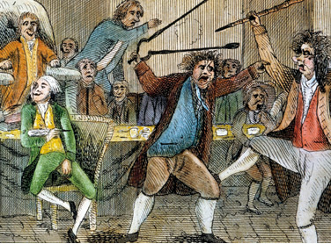
Alien and Sedition Acts
Alien Act: Increased the amount of time to become a citizen to 14 years; trying to keep French immigrants from influencing American politics.
Sedition Act: Made it a crime to print anything negative about the government or its officials.
Caused massive conflict between political parties, including an actual fight in Congress!
Destroyed the reputation of the Federalists

Slide 25
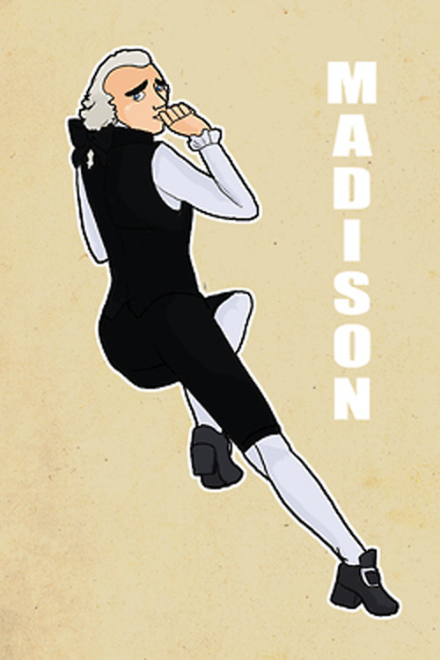
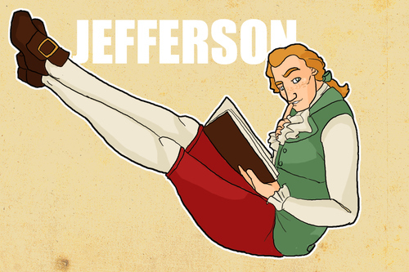
Virginia and Kentucky Resolutions
Virginia and Kentucky Resolutions
Written by Jefferson and Madison in response to Alien and Sedition Acts
Declared that the States had the right to nullify (void) unconstitutional laws passed by Congress
Based on the Compact (social contract) Theory
Significance: Later used by southerners to support nullification and ultimately secession prior to Civil War.
Notes:
25

Slide 26
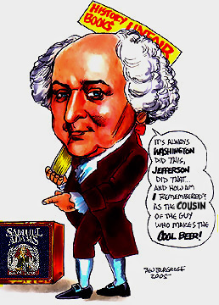
John Adams
Dates in Office: 1797-1801
Nicknames: The Colossus of Independence, His Rotundity
Political Party: Federalist
Major Events:
Quasi-War
XYZ Affair
Alien and Sedition Acts
Virginia and Kentucky Resolutions
Midnight Judges

Slide 27
Musical Interludes

Slide 28
Bell Ringer
What was the most controversial element of Hamilton’s economic plan? What were the major arguments for and against it?

Slide 29
Bell Ringer
What events/characteristics caused John Adams to be a one-term president?

Slide 30
Thomas Jefferson
America’s 3rd President

Slide 32
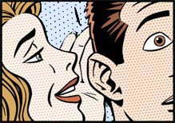
Election of 1800
“Whisper Campaign” by Adams:
Jefferson had robbed a widow and her children of a trust fund
False
Jefferson fathered numerous mulatto children
True-ish (Fathered a child with slave Sally Hemmings)
Jefferson was an athiest
False – he was a deist (faith + science; proof of a Supreme Being can be observed in nature)

Slide 33
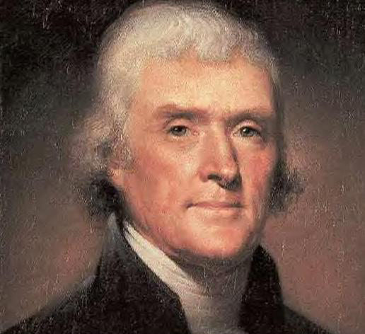
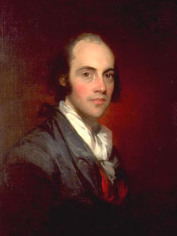
Election of 1800
Jefferson defeats Adams
Most electoral support in South and West (agrarian)
The 3/5 Compromise gave the South more electoral votes, earning him the nickname of “the Negro President”
Problem: Aaron Burr and Jefferson got the same number of electoral votes for President
Goes to HoR; SotH Hamilton throws his support to TJ

Slide 34
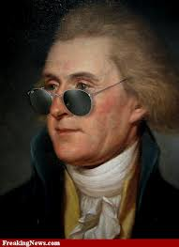
Revolution of 1800
Jefferson emphasized unity in his inaugural address
“…the minority possess their equal rights, which equal law must protect, and to violate would be oppression… We are all Republicans, we are all Federalists.”
“Revolution of 1800”
Showed a peaceful transfer of power could exist
Led to the 12th Amendment
Separate ballots for Pres. and VP
Notes:
34

Slide 35
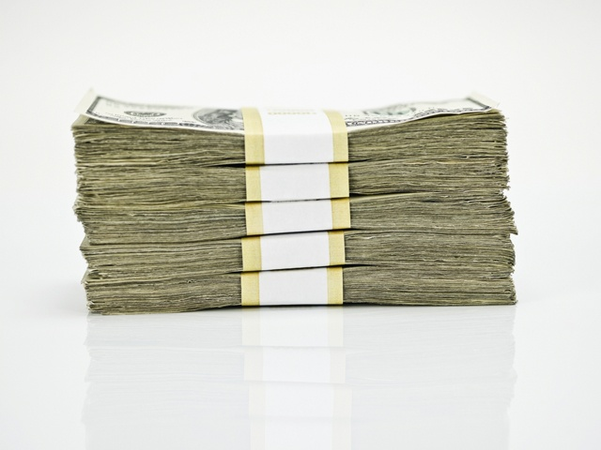
Changes made by Jefferson
Slashed Navy budget
Reduced size of the Army
Pardoned seditionists
Reduced citizenship back to 5 years
Eliminated the whisky excise tax
Successfully reduced the national debt while balancing the budget

Slide 36
Judiciary Jumble
Judiciary Act of 1801: Created 16 new federal judgeships and other judicial offices
Adams’ “midnight judges”
Lifetime appointments = Federalists in positions of power for a long time
Ignored by new Democratic-Republican Congress

Slide 37
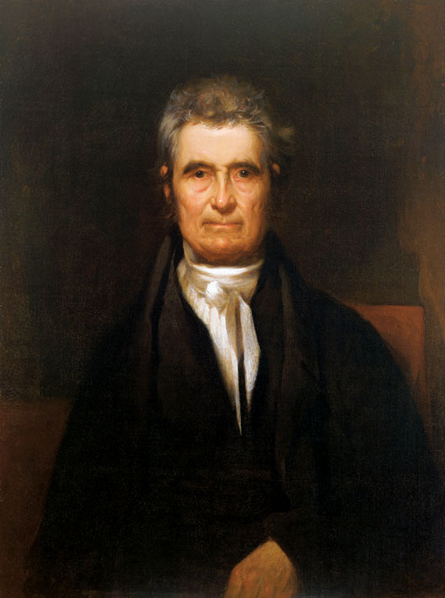
The Most Important Case
William Marbury learned his position was being shelved and sued to have it delivered.
Marbury v. Madison
Established the policy of judicial review (SCOTUS can review laws and the actions of the other branches in terms of their constitutionality.)
Decisions strengthen the federal government over the states
Chief Justice
John Marshall

Slide 38
The Marshall Court
Court Case | Decision and Result
Marbury v. Madison | Declared congressional act unconstitutional; Court asserts power of judicial review.
Fletcher v. Peck | Protected contracts from legislative interference; Court could overturn state laws that opposed specific provisions of the Constitution.
McCulloch v. Maryland | Upheld constitutionality of the Bank of the United States; doctrine of “implied powers” provided Congress more flexibility to enact legislation.
Cohens v. Virginia | Reasserted federal judicial authority over state courts; argued that when states ratified the Constitution, they gave up some sovereignty to federal courts.
Gibbons v. Ogden | Revoked an existing state monopoly; Court gave Congress the right to regulate interstate trade.
Dartmouth College v. Woodward | Court protected the separation of private and public contracts

Slide 39
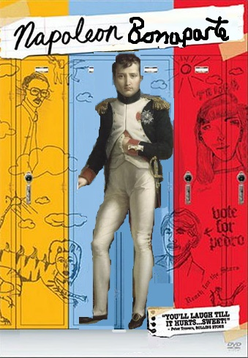
The loui$iana Pur¢ha$e
Backstory: France is BROKE!
Jefferson paid $11.25 million for 828,800 square miles
That's about $13 per square mile!
2 cents per acre!!

Slide 40
Doubles the size of the U.S.!
Control the Mississippi River
Preserve an agrarian society for future generations

Slide 41
Mixed Reactions on Louisiana
TJ criticized for breaking from his “strict constructionist” views
Privately admitted it was unconstitutional
Widely supported by land-hungry Americans
Criticized by Federalists
Argued for strict construction (ironic!)
Too costly
Worried that western lands would be loyal to D-R

Slide 42
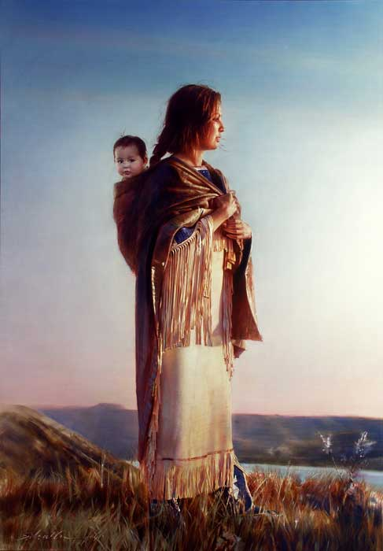
Lewis and Clark… and Sacagawea too!

Slide 43
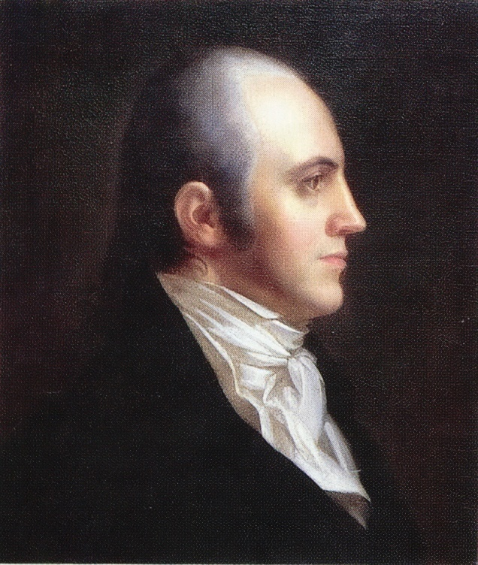
The Burr Conspiracy
Angry about losing to TJ, Aaron Burr plans to seize MX from Spain to create a Western country (where he’d be president)
Tried for treason, but acquitted
Removed from TJ’s second cabinet
Essex Junto: A group of NE Federalist extremists who plotted to secede from the union.
Conspiracy exposed by Alexander Hamilton
Challenged to a duel by Burr

Slide 44
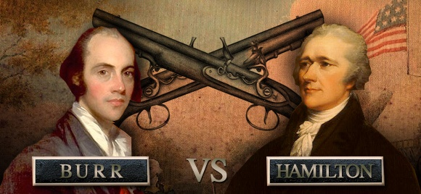
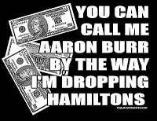
July 11, 1804

Slide 45
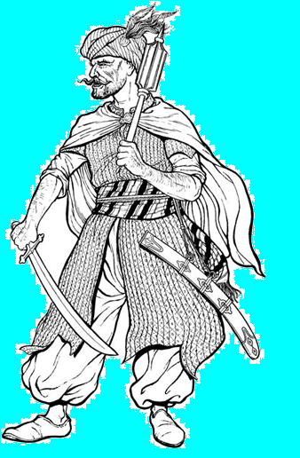
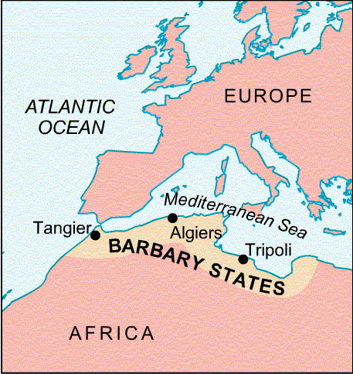
Jefferson’s Foreign Policy
Barbary pirates the most feared
Ruthless
Enslaved or ransomed crews
Protected by N. African Muslim rulers
US ships had been protected by British flag pre-Revolution
Congress pays tribute to Barbary pirates (1784); price goes up.
Yarrrr!!! Pirates!

Slide 46
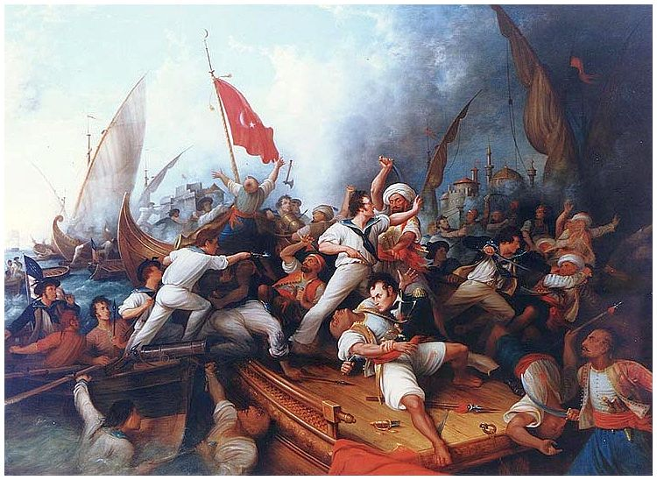
The Barbary Wars
Jefferson elected ⇨ Pasha of Tripoli demands $225k in tribute ⇨ TJ refuses ⇨ Pasha declares war (cuts down flag of U.S. Consulate)
TJ sends ships to defend American interests; informs Congress
Congress authorized the President to instruct the Navy to seize all vessels and goods of the Pasha of Tripoli
Wearied of the blockade and raids, and an American scheme to restore the former ruler to power, the Pasha signed a treaty ending hostilities on June 4, 1805.

Slide 47
Results of the First Barbary War
The Marines Hymn
From the Halls of Montezuma,
To the shores of Tripoli;
We fight our country's battles
In the air, on land, and sea;
First to fight for right and freedom
And to keep our honor clean;
We are proud to claim the title
Of United States Marine.

Slide 48
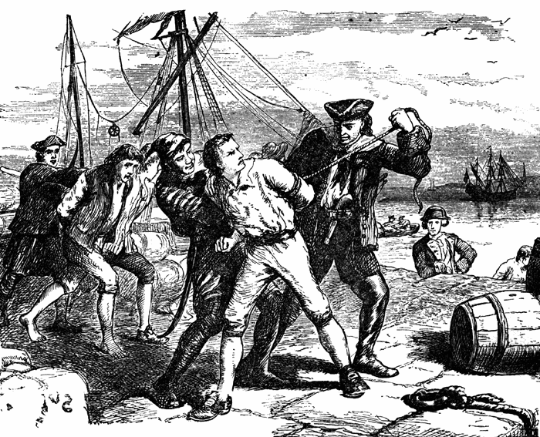
Jefferson’s foreign policy
War between GB and France
French Continental System
British Orders in Council
American ships unable to trade with either nation
Impressment: Forcible enlistment of sailors into a foreign navy
Over 6,000 American sailors were impressed into British navy

Slide 49
Jefferson’s Foreign Policy
Embargo of 1807: Cut off all trade to foreign countries
Aimed to hurt GB and France
Force them to respect our neutrality and stop impressments
Had harmful economic consequences
Northern shipping was immediately halted
Southern planters had surpluses of crops
Replaced by Non-Intercourse Act – only forbade trade with France and England

Slide 50
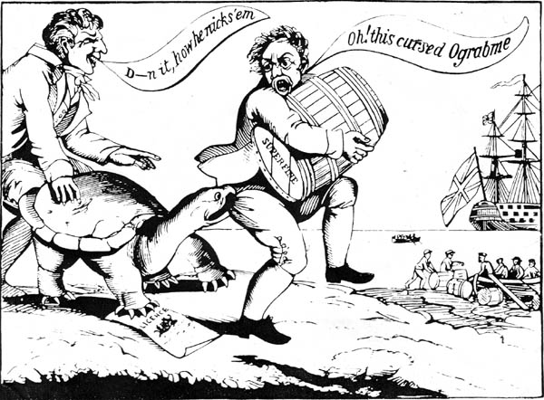
"O Grab Me"
"Go Bar 'Em"
"Mobrage"
"Dambargo"

Slide 51
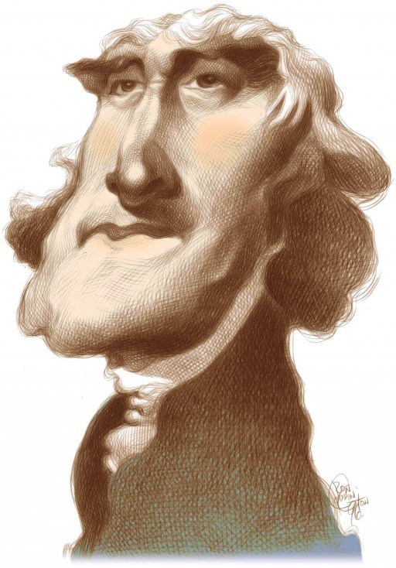
Thomas Jefferson
Dates in Office: 1801-1809
Nicknames: “Long Tom,” “The Pen of the Revolution,” or “The Negro President”
Political Party: Democratic-Republican
Major Events:
Revolution of 1800
12th Amendment
Marbury v. Madison
Louisiana Purchase
Lewis & Clark expedition
First Barbary War
Embargo Act of 1807
Non-Intercourse Act

