Slide 1
Bell Ringer
What does it mean to conform? What are the benefits of conformity?

Slide 2
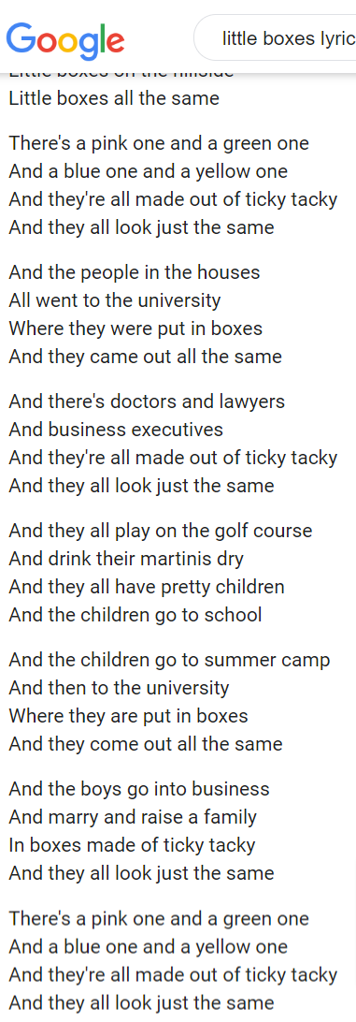

Slide 3
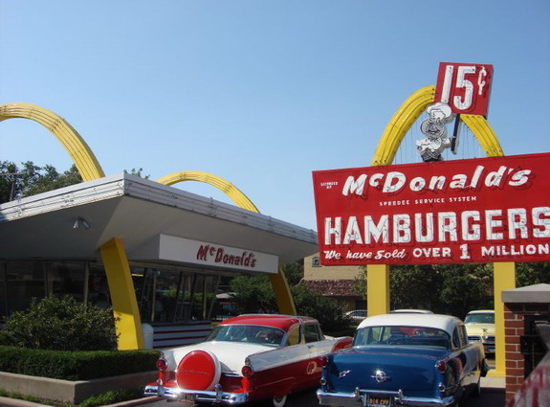
The Affluent Society
Making America the Best Place to Live

Slide 4
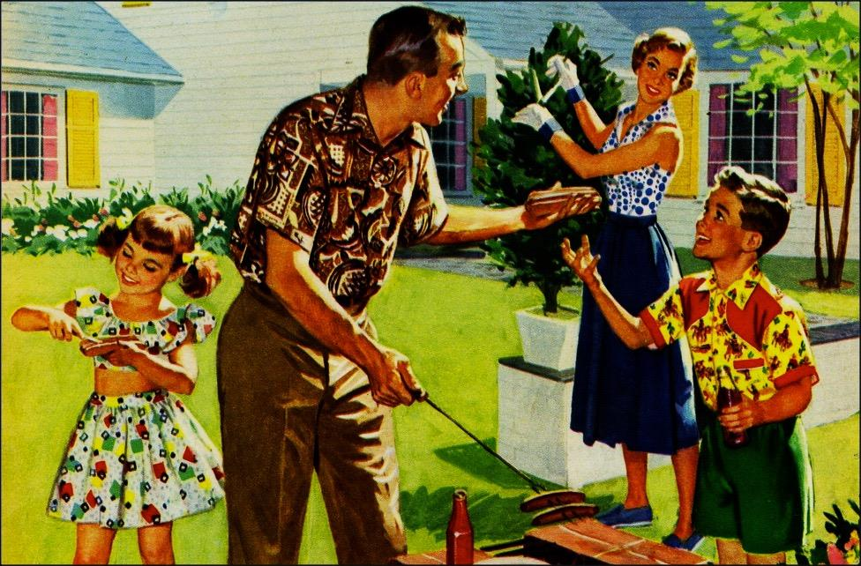
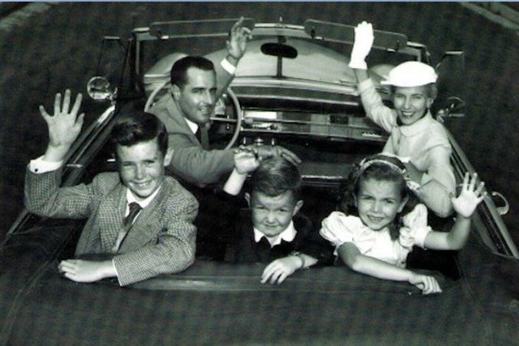
Conformity as the new “normal”
Reaction to upheaval of WWII
Fears of communist infiltration
Conformity = unity
American Dream
Nuclear Family
Ideal, not necessarily reality
A New Normalcy

Slide 5
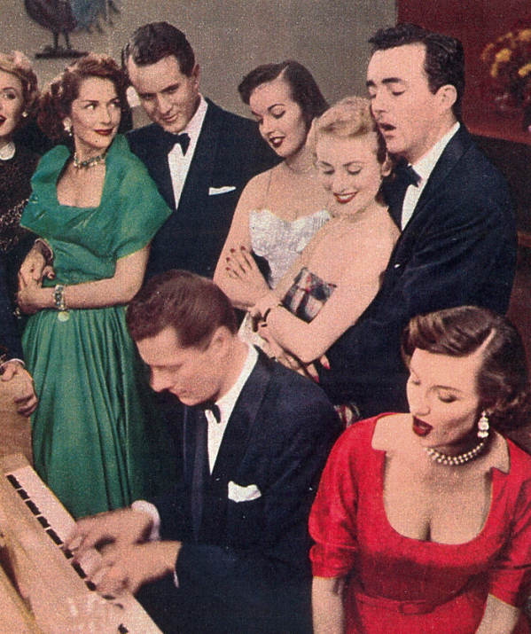
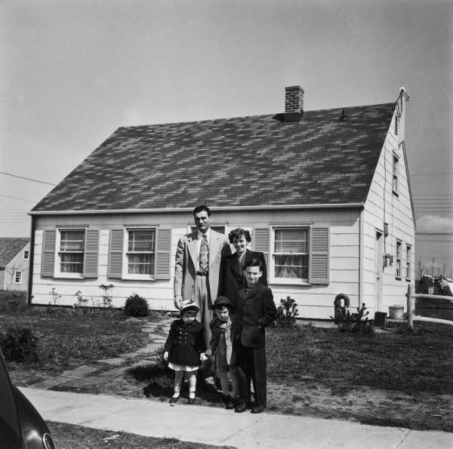
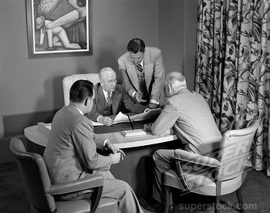
The Affluent Society
Average income triples between 1940-60
Home ownership increases (GI Bill)
Americans move to white collar and service jobs

Slide 6
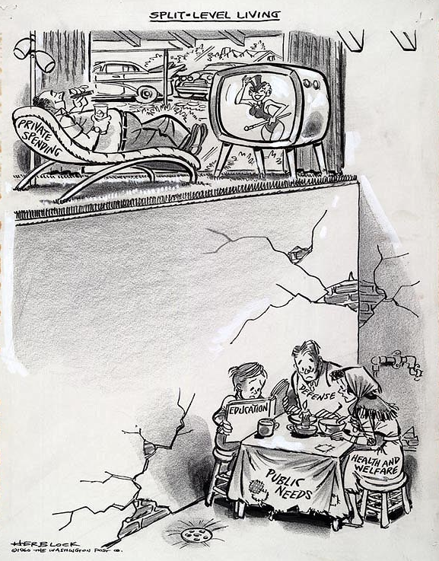
The Affluent(?) Society
30 million in poverty, mostly minorities
Most prevalent in inner cities
“White Flight”
Racial discrimination was prominent
Discrimination in schools, housing, and hiring (only earned an average 51% of what whites earned)

Slide 7
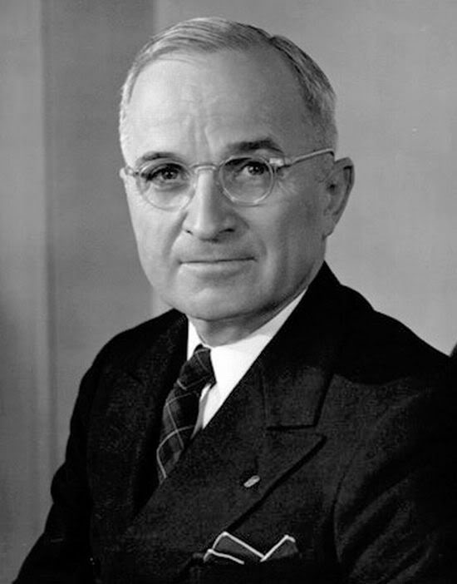
“The Buck Stops Here”
Presidents of the 1950s

Slide 8
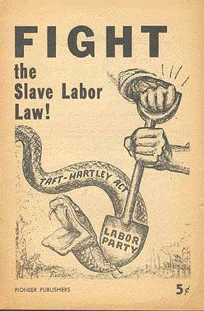
Labor Issues
Labor unrest post-WWII
Wartime non-strike agreements void
Taft-Hartley Act: Restricted the activities and power of labor unions
Vetoed by Truman; overridden by Congress
Called “Slave labor bill” by critics
Notes:
After World War II, 25 percent of the workforce was unionized, and with the war now over, their promise not to strike so as not to impede the war effort had expired.
Taft-Hartley Act: Prohibited certain kinds of strikes and boycotts, closed shops, and monetary donations by unions to federal political campaigns
Required union officers to sign non-communist affidavits with the government

Slide 9
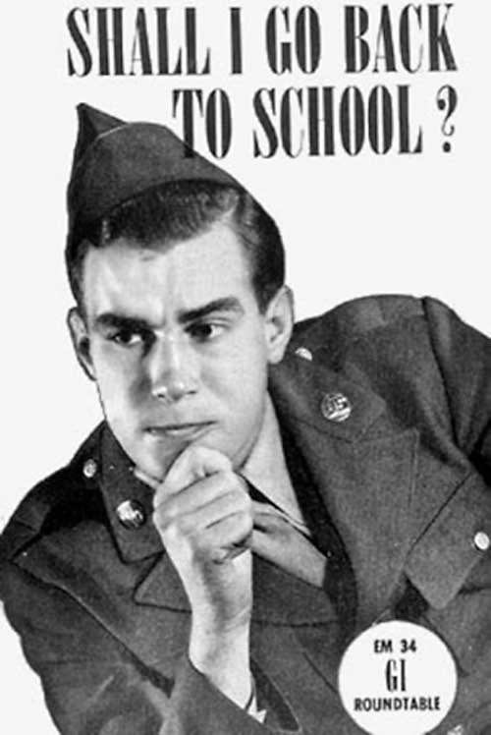
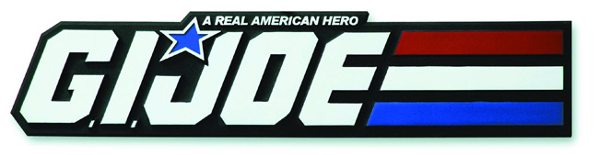
Changes for
The Servicemen’s Readjustment Act (AKA: GI Bill,1944): Provided a range of benefits for returning World War II veterans
Low-cost mortgages & loans, college/vocational education tuition, unemployment compensation
Executive Order 9981: Abolished racial discrimination in the armed forces and eventually led to the desegregation of the armed services

Slide 10
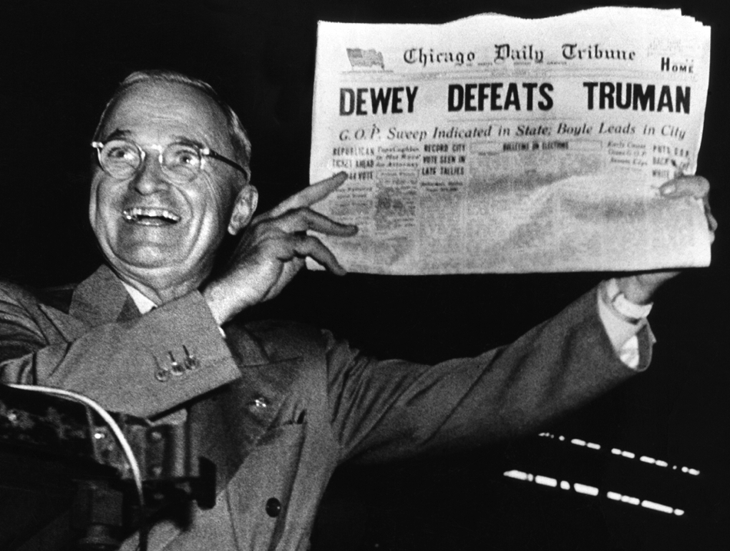
Election of 1948
Attacked the Republican “do nothing” Congress
Supported by labor, African Americans, and farmers
Won by a narrow margin

Slide 11
Truman’s Fair Deal
“Every segment of our population, and every individual, has a right to expect from his government a fair deal.”
--President Truman, 1949 State of the Union Address
Plan focused on civil rights, health, welfare, labor, education, housing, veterans, and agriculture
Federal aid to education
Tax cuts for low-income earners
Abolition of poll taxes and an anti-lynching law
Farm-aid programs
Increased public housing
New TVA-style public works projects
New Department of Welfare
Repeal of the Taft-Hartley Act
Increase in the minimum wage from 40¢ to 75¢/hr.
Universal health insurance
Expanded Social Security coverage

Slide 12
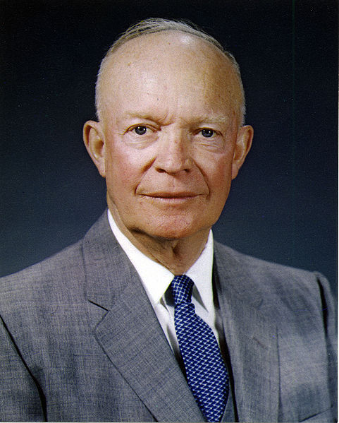
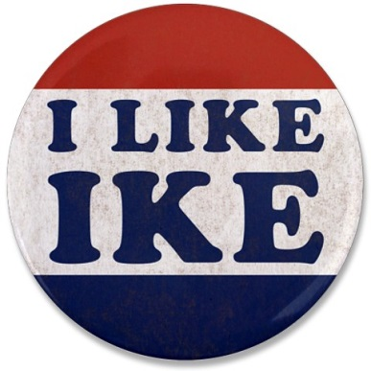
Election of 1952
Truman not nominated in 1952
Dwight D. Eisenhower wins in a landslide
Success in D-Day invasion
Strict justice in liberation of concentration camps
Strong, competent leader
Took advantage of a new medium - television
Notes:
President Truman was surprisingly not nominated for the 1952 election – Korean War, McCarthyism, and corruption within his administration.
Eisenhower vs. Gov. Adlai Stevenson of Illinois

Slide 13
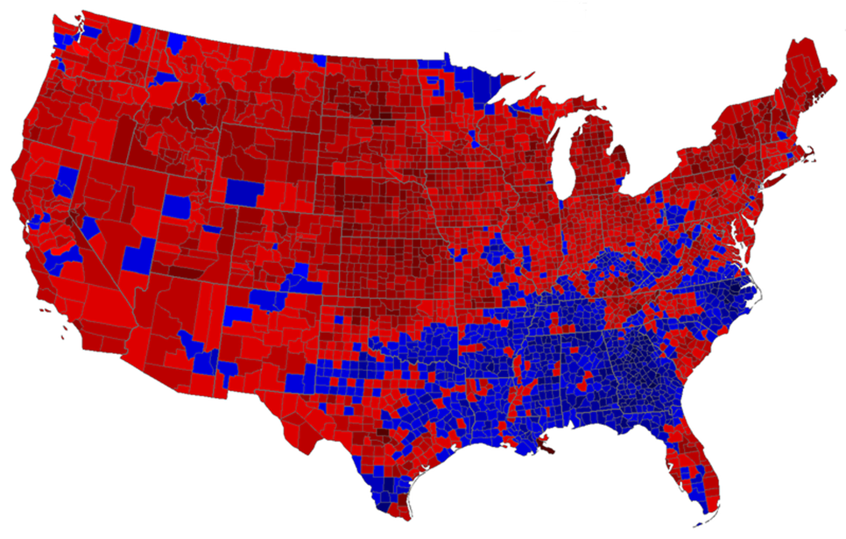
442 Electoral votes to
89 Electoral votes

Slide 14
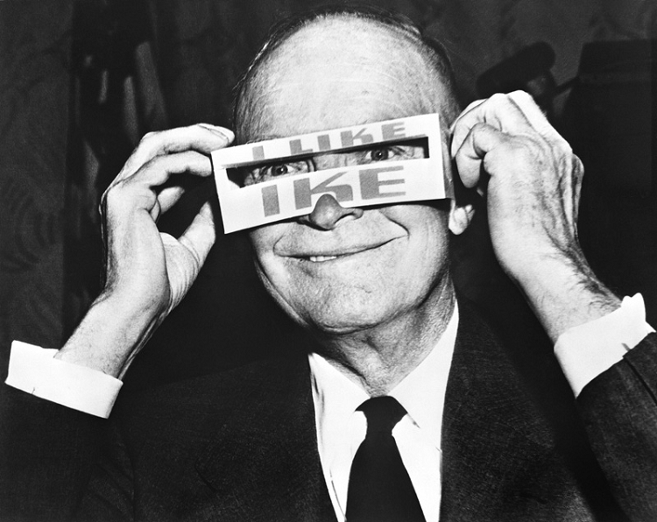
1950s Republicanism
Pro-business
Cut social programs
Modest tax cuts
Anti-Communist
Increased military spending

Slide 15
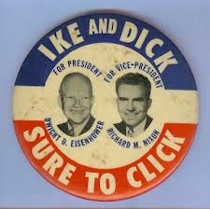
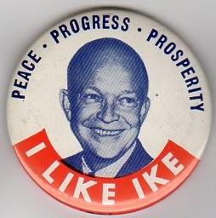
Election of 1956
The 1956 election was a re-match of 1952
Eisenhower wins in another landslide
Had ended the Korean War
Nation was prosperous
Continued use of TV ads – this time directed at housewives

Slide 16
457 Electoral votes to
73 Electoral votes

Slide 17
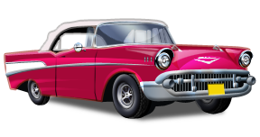
Life is a Highway
America’s Obsession with the Open Road

Slide 18
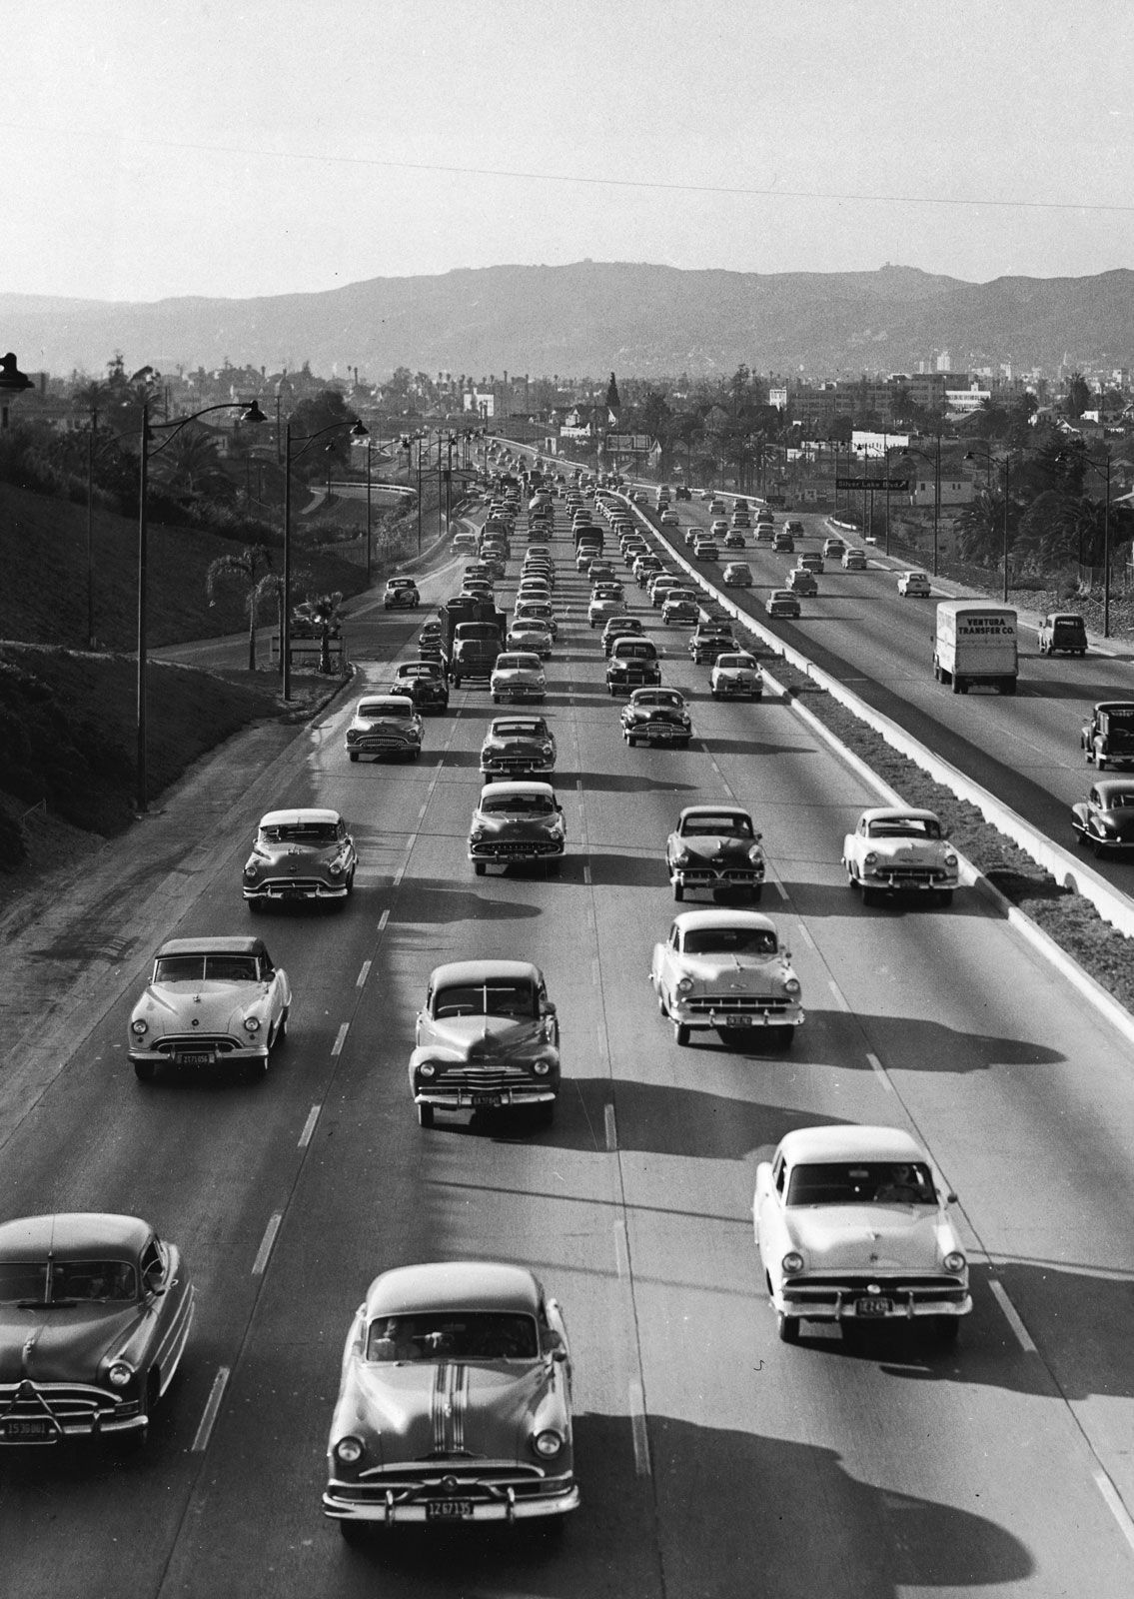
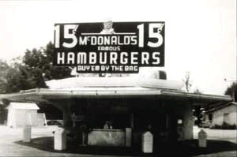
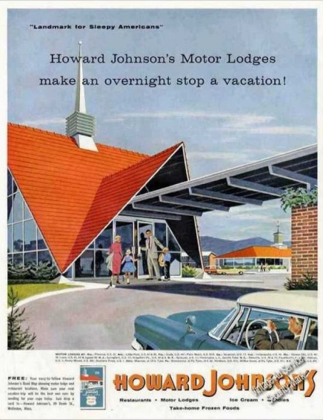
The Culture of the Car
Automobile boom post-WWII
Materials no longer rationed
National affluence
2-car homes doubles from 1951-1958
Created a new desire for driving-related businesses (e.g. drive-thru’s)

Slide 19
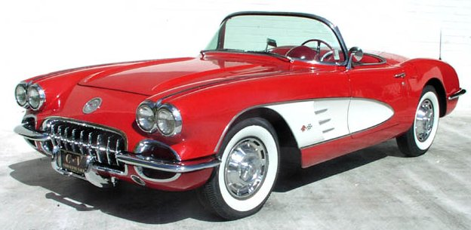
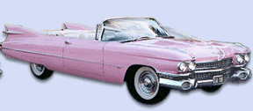
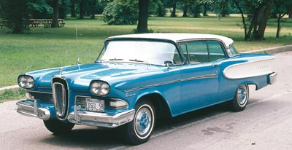
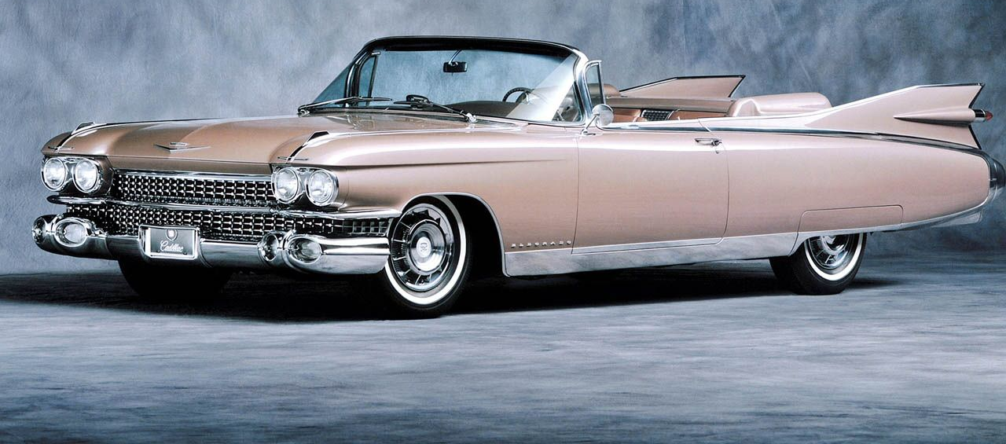
The Culture of the Car

Slide 20
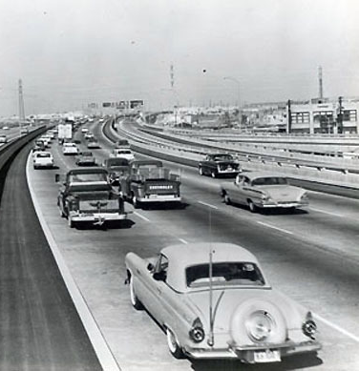
Federal Highway Act
Federal Highway Act: Authorized the construction of 41,000 miles of the Interstate Highway System
Largest public works project to that time
Paid for by new taxes on fuel, rubber, and automobile purchases
Purpose was to allow military vehicles to move quickly across the country in the event of national emergency.
More efficient distribution of goods
Suburbanization and urban sprawl
Speed/ease of travel
New road culture
Notes:
It was expected that the money would be generated through new taxes on fuel, automobiles, trucks, and tires.

Slide 21
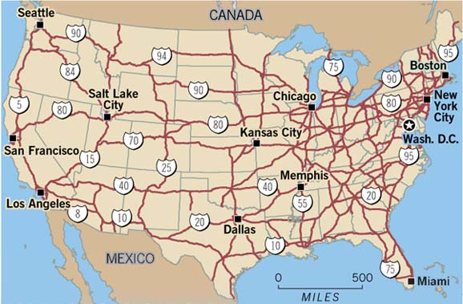
Odd Numbered
Highways
Even Numbered Highways

Slide 22
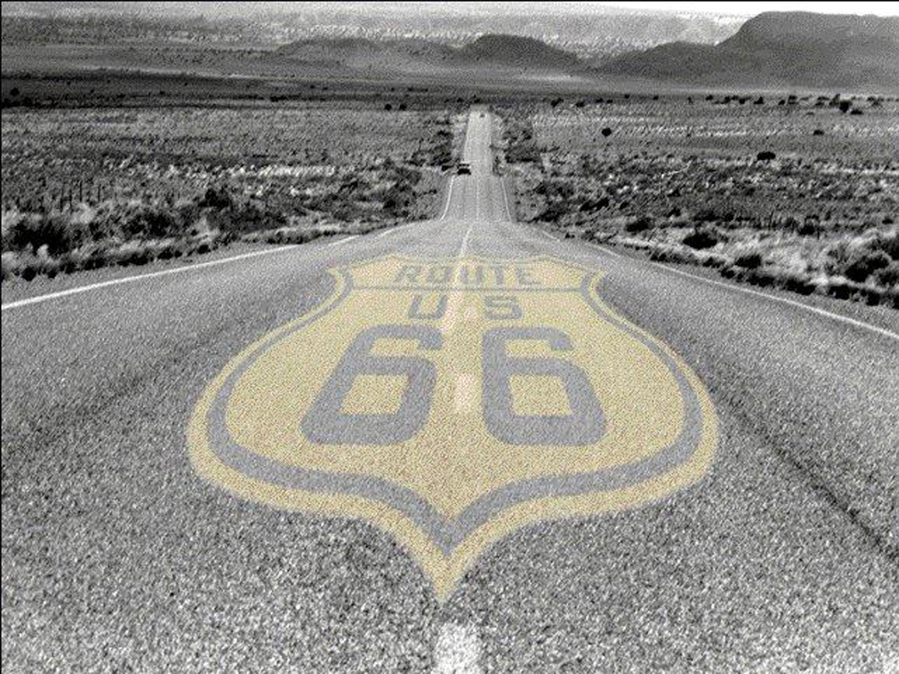
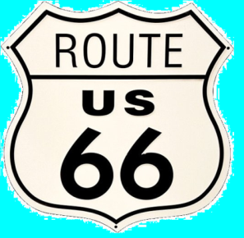
Route 66
Well if you ever plan to motor west Travel my way that the highway that’s the best Get your kicks on Route 66 Well it winds from Chicago to L.A. More than 2000 miles all the way Get your kicks on Route 66
Well it goes from St Louis, Joplin, Missouri And Oklahoma City looks mighty pretty You’ll see Amarillo and Gallup, New Mexico Flagstaff, Arizona don't forget Winona Kingman, Barstow, San Bernardino
Would you get hip to this kindly tip And go take that California trip Get your kicks on Route 66
Well it goes from St Louis, Joplin, Missouri And Oklahoma City looks mighty pretty You’ll see Amarillo and Gallup, New Mexico Flagstaff, Arizona don't forget Winona Kingman, Barstow, San Bernardino Would you get hip to this kindly tip And go take that California trip Get your kicks on Route 66 Get your kicks on Route 66?

Slide 23
Route 66
Route 66 (AKA: Main Street USA and the Mother Road)
Ran from Chicago to Los Angeles
Only direct route linking east and west before the Interstate Highway System
The road created and supported entire cities along the route
Communities relied on commuting traffic to support their economy
Quirky shops, restaurants, hotels, and attractions dotted along the way – the road was part of the trip itself

Slide 25
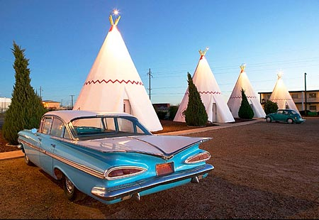
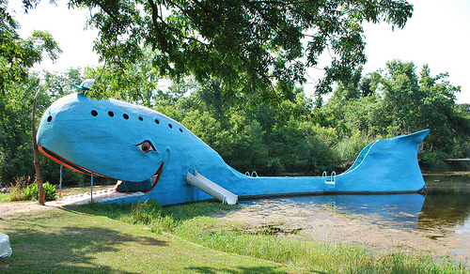
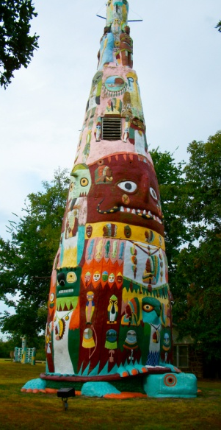
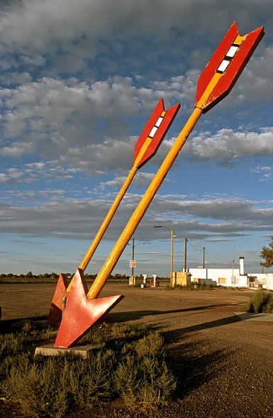
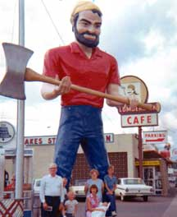
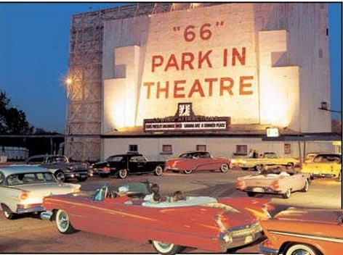
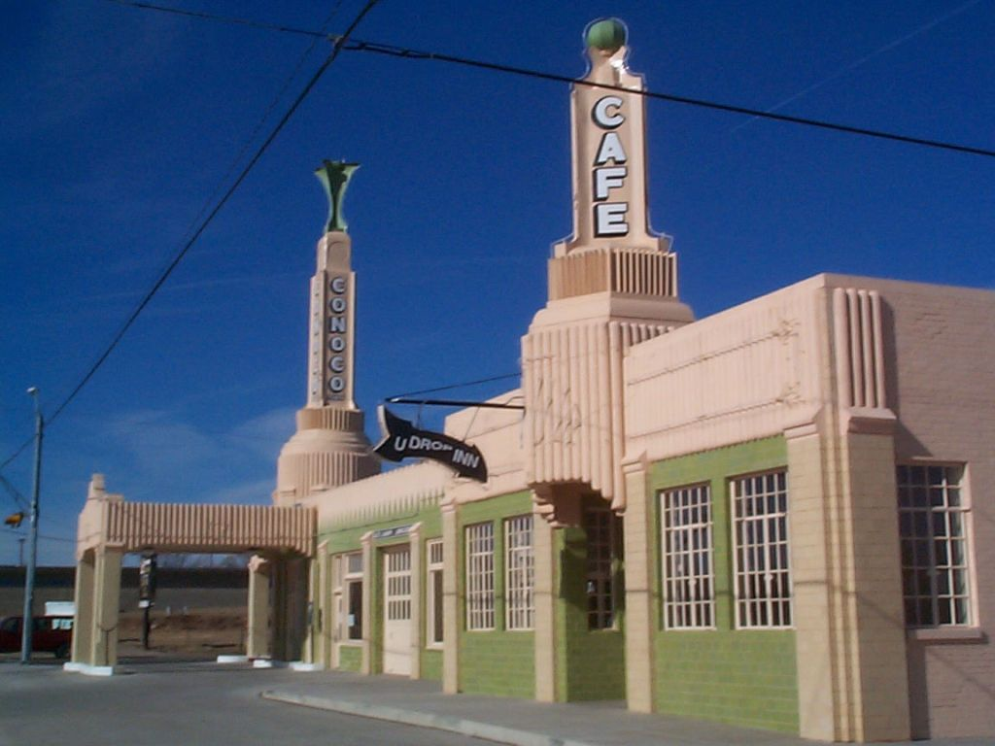
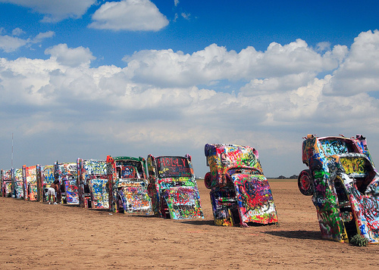
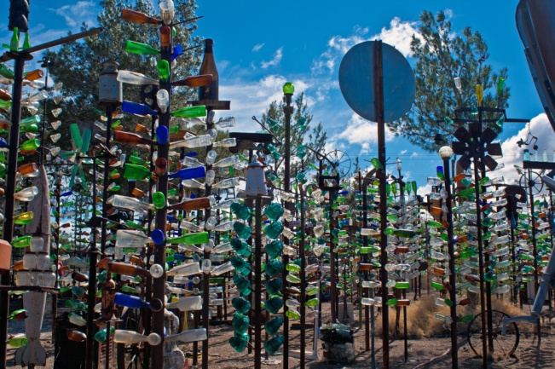
Catoosa, OK
Flagstaff,
AZ
Rogers County,
OK
Carthage, MO
Barstow, CA
Shamrock,
TX
Amarillo, TX

Slide 26
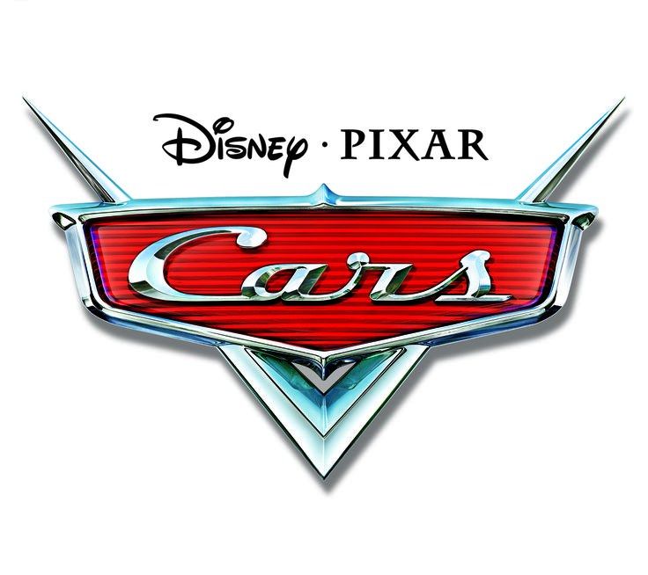
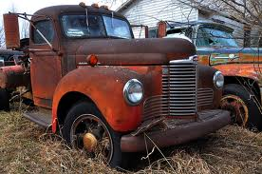
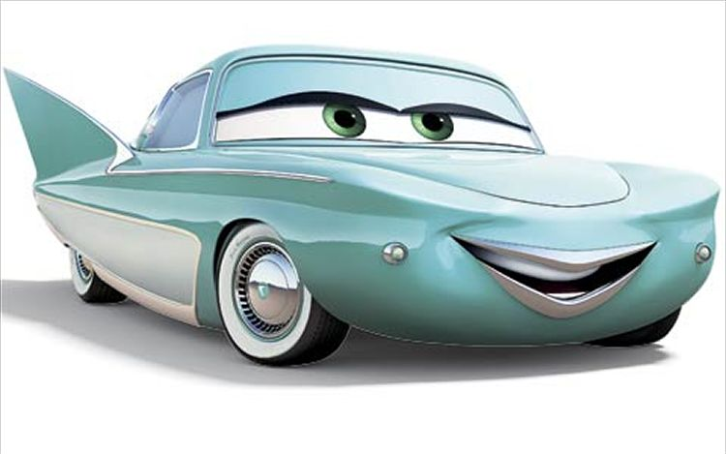
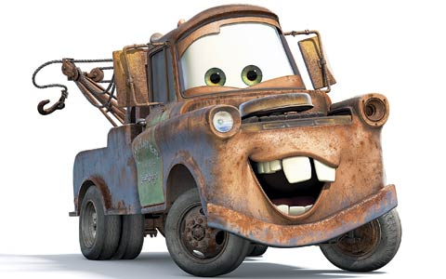
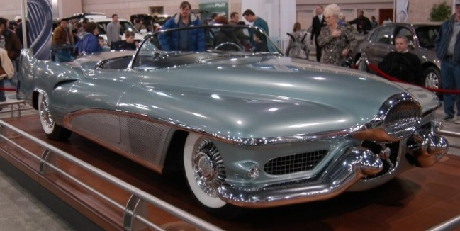
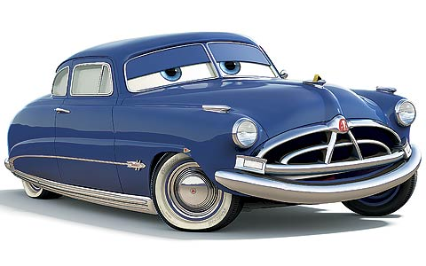
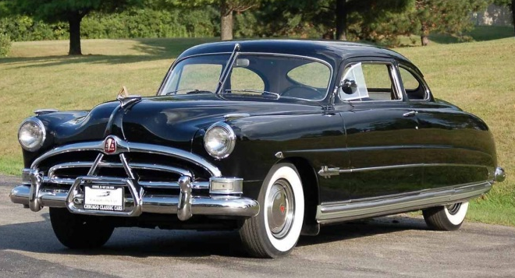
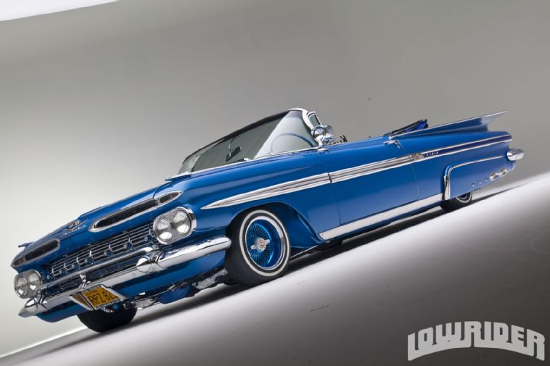
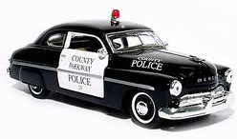
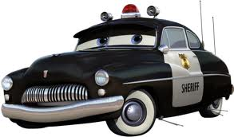
Flo: 1951 Le Sabre
Mater: 1951 International Harvester boom truck
Doc: 1951 Hudson Hornet
Sheriff: 1949 Mercury police car
Ramone: 1959 Chevrolet Impala Lowrider
Luigi: 1959 Fiat 500

Slide 27
THE REAL
The 1950s Workplace

Slide 28
The 1950s Workplace
Chain store: Stores share a brand and central management; have standardized business practices
Franchise: A supplier allows an operator to use the supplier’s trademark in return for a fee.
Uniformity
Consistency

Slide 29
The 1950s Workplace
“The Organization/Company Man”: A man completely and totally dedicated to his company
His identity and worth is directly linked to the company, its reputation, and its success
The Man in the Gray Flannel Suit, by Sloan Wilson (1956) – showed the secret discontentment of American businessmen

Slide 30
Postwar Consumerism
Keeping up with the Joneses

Slide 31
Post-War Consumerism
Fordism
Consumerism
“Keeping up with the Joneses”
More wealth = more luxury items
Consumer and household items
Ease, comfort, effort
Highly influenced by print and television advertising

Slide 32
Post-War Consumerism
Introduction of the “Diner’s Club Card” – the first credit card (1950)
Zenith introduces "lazy bones" tuning - change all television stations from the comfort of your easy chair. Hand held device plugs into TV
Telephone Answering Machine created by Bell Laboratories and Western Electric
Chrysler Corporation introduces power steering, which they called Hydraguide
Dow Chemical creates Saran Wrap
General Electric introduces colored kitchen appliances
Secretary Bette Nesmith Graham invented "Mistake Out" later renamed, Liquid Paper

Slide 33
Notes:
Change this page next year.

