Slide 1
The Cold War
50 Years of “Not-Fighting”

Slide 2
“It was a Cold War of words -- a time when nations were rallied by stirring speeches and trembled by ominous warnings.”

Slide 3
“We Didn’t Start the Fire”
Billy Joel condenses the Cold War in under five minutes

Slide 4
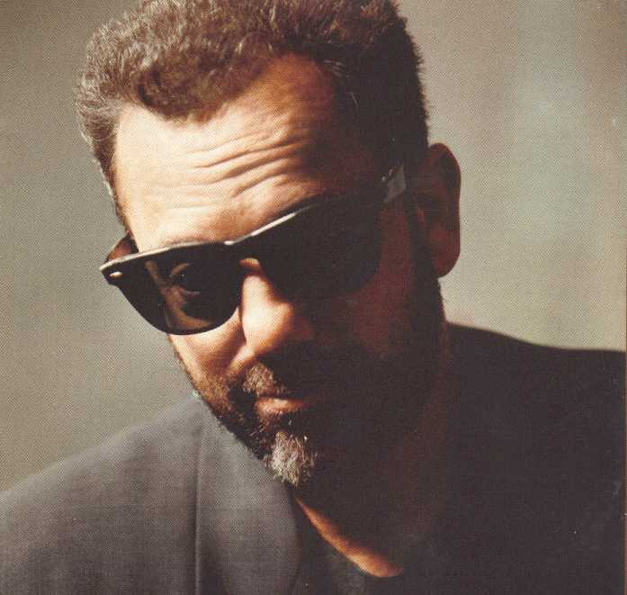
“We Didn’t Start the Fire”
Joel explained that he wrote this song due to his interest in history. He commented that he would have wanted to be a history teacher had he not become a rock and roll singer.

Slide 5
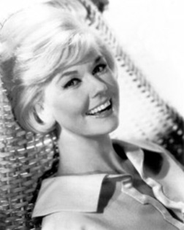
1949
Harry S. Truman
Doris Day
Red China
Johnny Ray
South Pacific
Walter Winchell
Joe Dimaggio

Slide 6
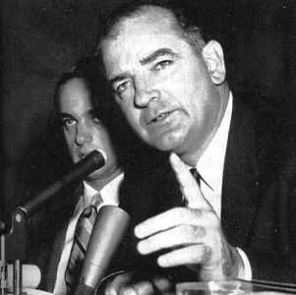
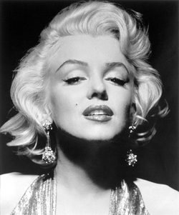
1950
Joe McCarthy
Richard Nixon
Studebaker
Television
North Korea
South Korea
Marilyn Monroe

Slide 7
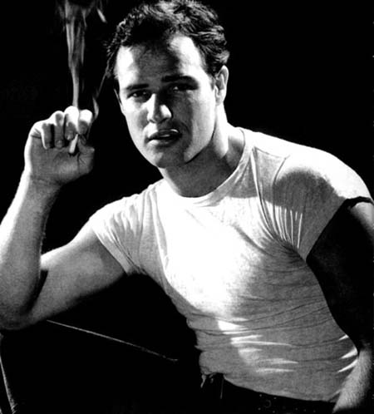
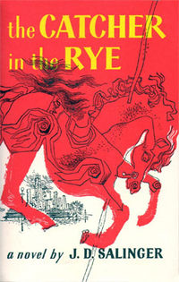
1951
Rosenburg
H-Bomb
Sugar Ray
Panmunjom
Brando
The King and I
The Catcher in the Rye

Slide 8
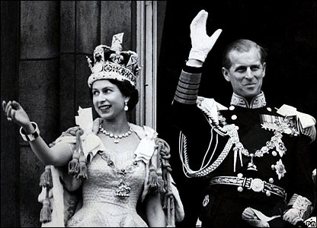
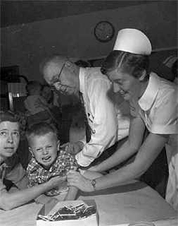
1952
Eisenhower
Vaccine
England’s got a new Queen
Marciano
Liberace
Santayana good-bye

Slide 9
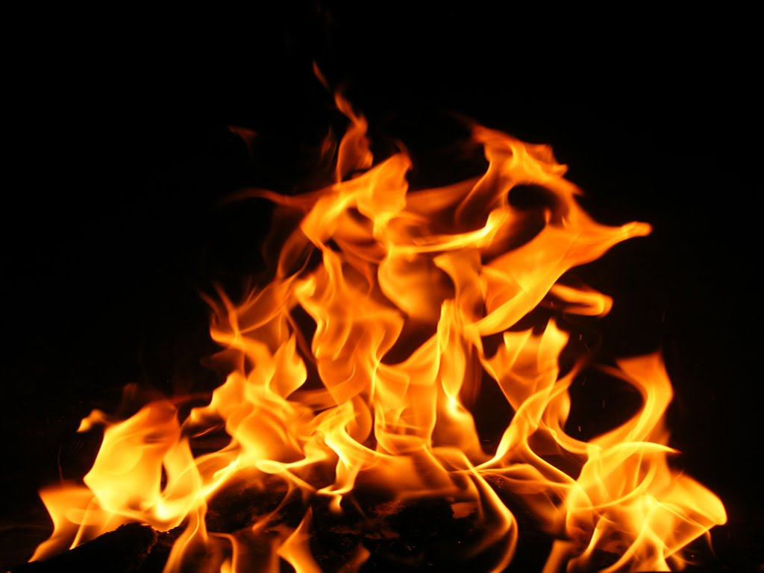
Chorus
We didn't start the fire It was always burning, Since the world's been turning. We didn't start the fire Well we didn't light it, But we tried to fight it.

Slide 10
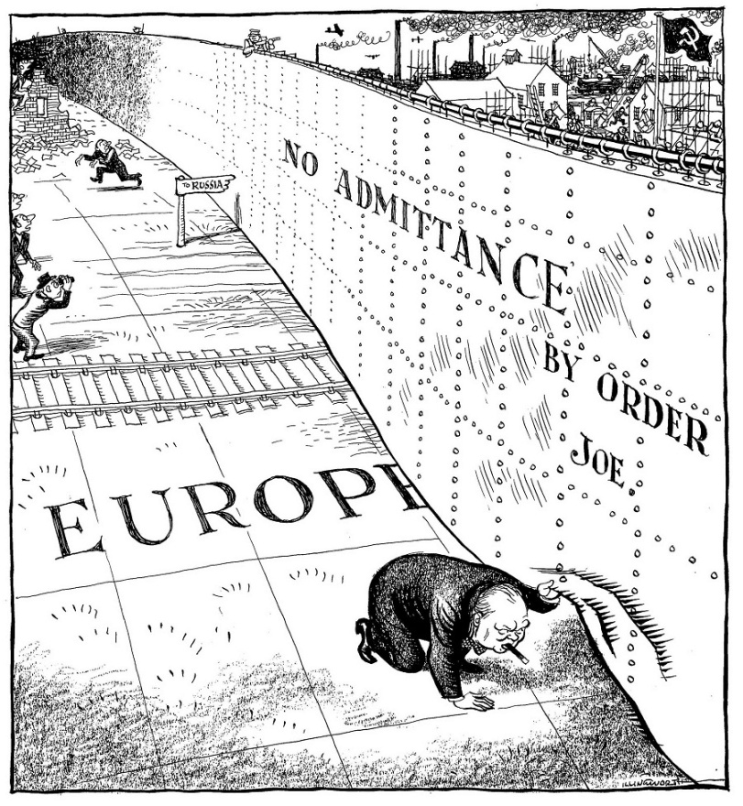
1953
Joseph Stalin
Malenkov
Nasser
Prokofiev
Rockefeller
Campanella
Communist Bloc

Slide 11
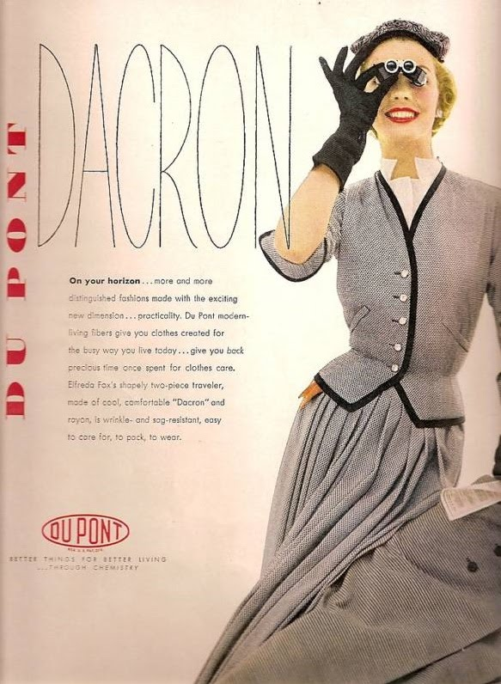
1954
Roy Cohn
Juan Peron
Tosconini
Dacron
Dien Ben Phu falls
Rock Around the Clock

Slide 12
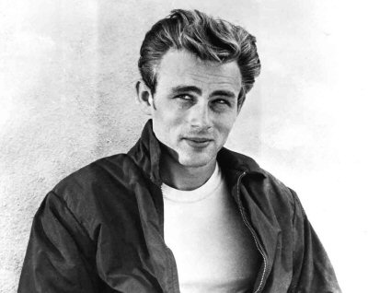
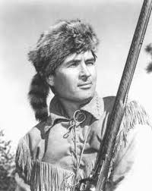
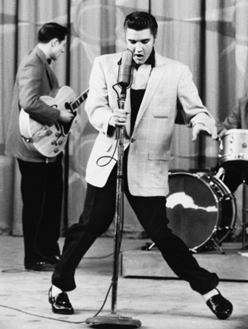
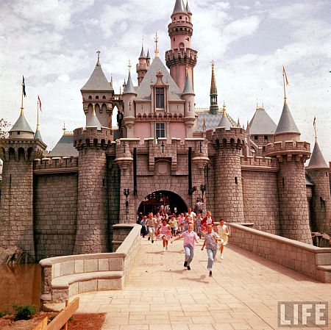
1955
Einstein
James Dean
Brooklyn’s got a winning team
Davy Crockett
Peter Pan
Elvis Presley
Disneyland

Slide 13
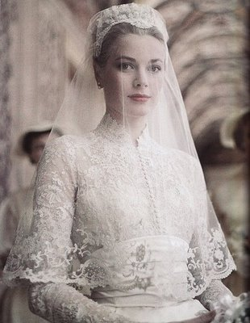
1956
Bardot
Budapest
Alabama
Kruschehev
Princess Grace
Peyton’s Place
Trouble in the Suez

Slide 14
Chorus
We didn't start the fire It was always burning, Since the world's been turning. We didn't start the fire Well we didn't light it, But we tried to fight it.

Slide 15
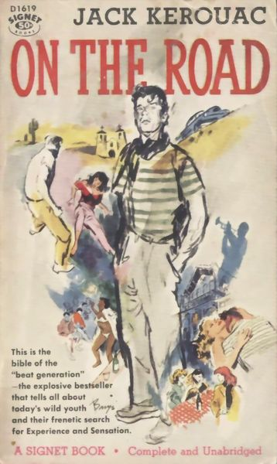
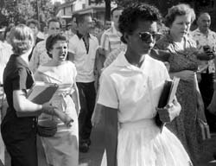
1957
Little Rock
Pasternok
Mickey Mantle
Kerouac
Sputnik
Chou En-Lai
Bridge on the River Kwai

Slide 16
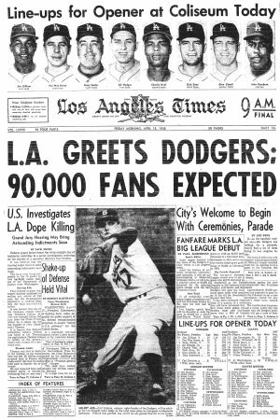
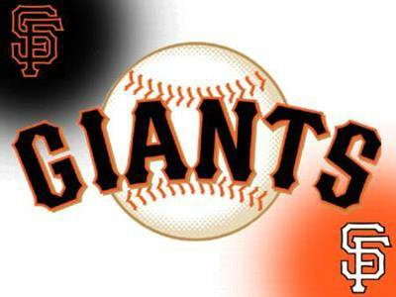
1958
Lebanon
Charles de Gaulle
California Baseball
Starkweather Homicide
Children of the Thalidomide

Slide 17
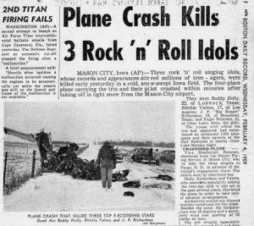
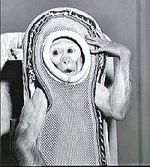
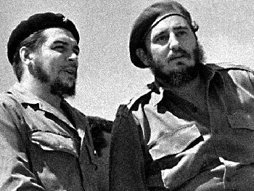
1959
Buddy Holly
Ben Hur
Space Monkeys
Mafia
Hula Hoops
Castro
Edsel is a no go

Slide 18
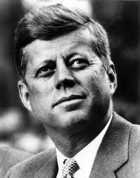
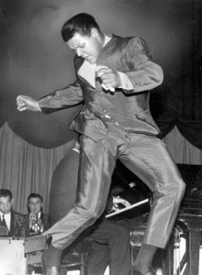
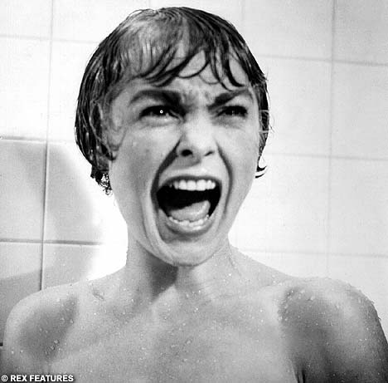
1960
U-2
Syngman Rhee
Payola
Kennedy
Chubby Checker
Psycho
Belgians in Congo

Slide 19
Chorus
We didn't start the fire It was always burning, Since the world's been turning. We didn't start the fire Well we didn't light it, But we tried to fight it.

Slide 20
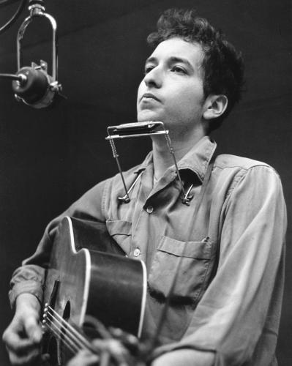
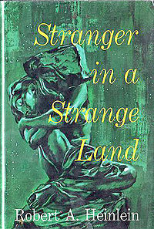
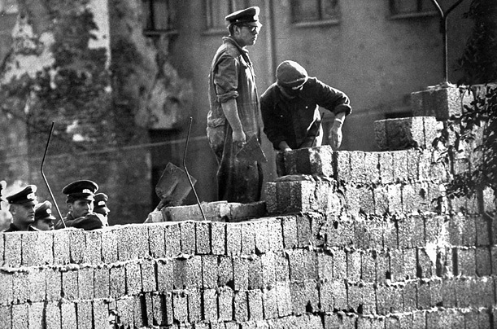
1961
Hemingway
Eichmann
Stranger in a Strange Land
Dylan
Berlin
Bay of Pigs Invasion

Slide 21
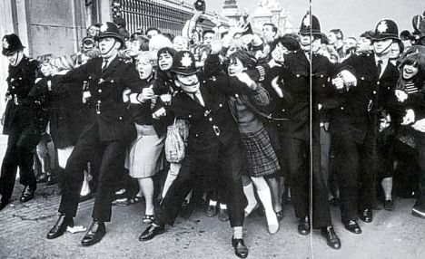
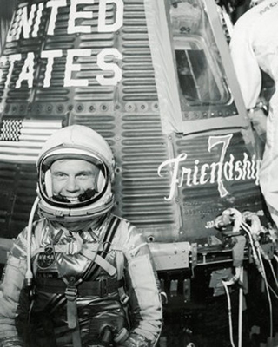
1962
Lawrence of Arabia
British Beatlemania
Ole Miss
John Glenn
Liston beats Patterson

Slide 22
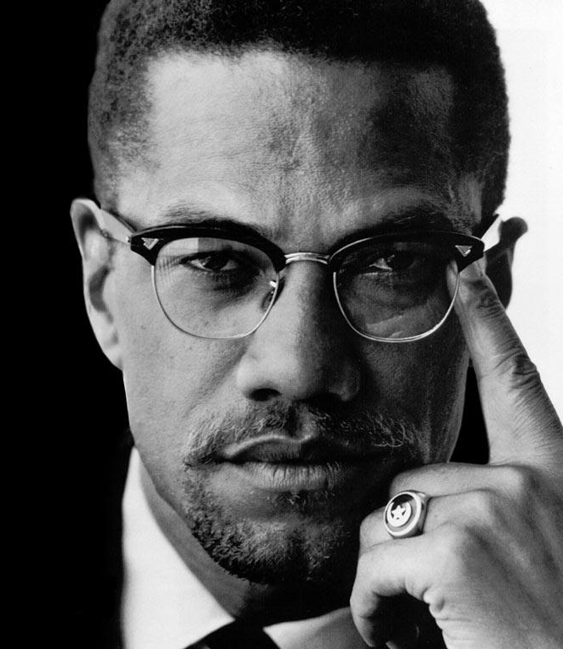
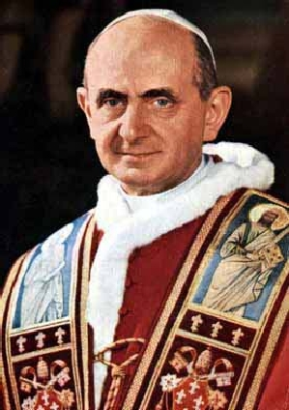
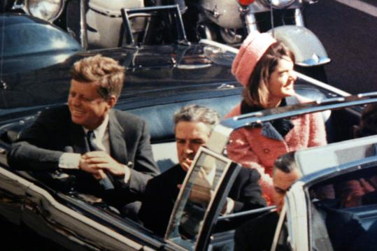
1963
Pope Paul
Malcolm X
British Politician Sex
JFK blown away

Slide 23
Chorus
We didn't start the fire It was always burning, Since the world's been turning. We didn't start the fire Well we didn't light it, But we tried to fight it.

Slide 24
1964-1989
Birth Control
Ho Chi-Minh
Richard Nixon back again
Moonshot
Woodstock
Watergate
Punk Rock
Begin
Reagan
Palestine
Terror on the airlines
Ayatollahs in Iran
Russians in Afghanistan
Wheel of Fortune
Sally Ride
Heavy Metal Suicide
Foreign debt
Homeless vets
AIDS
Crack
Bernie Goetz
Hypodermics on the shore
China’s under Martial Law
Rock and Roller Cola Wars

Slide 25
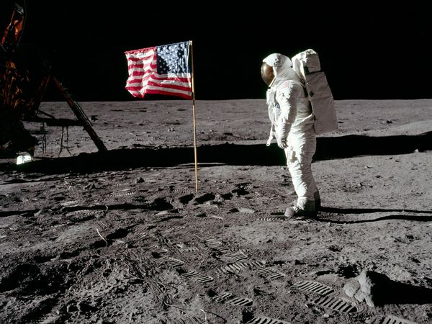
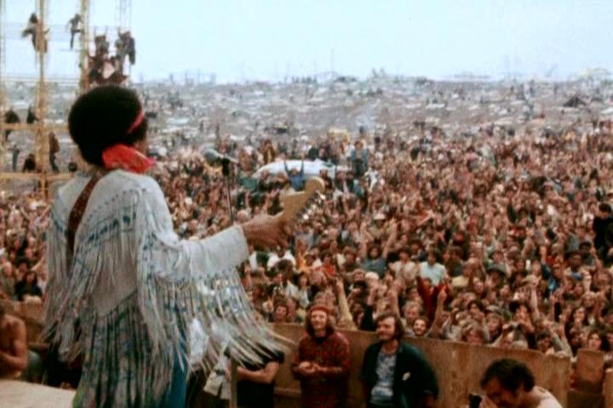
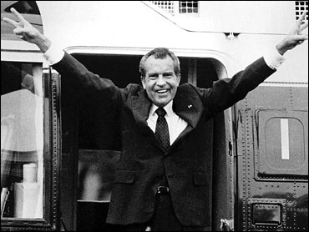
Notes:
Birth Conrtol “The Pill”
Landing on the Moon 1969
Woodstock
Nixon

Slide 26
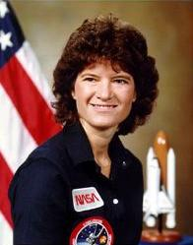
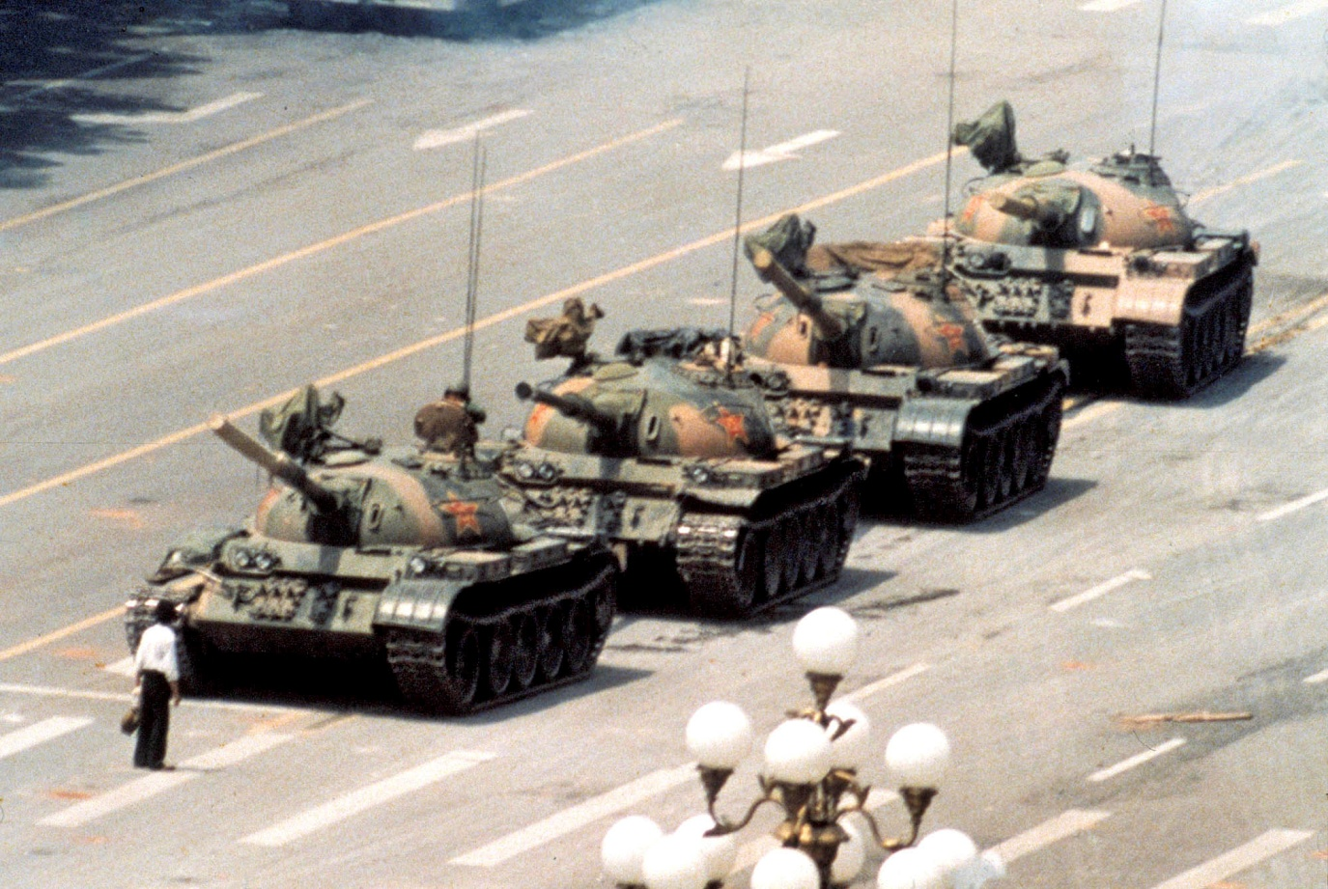
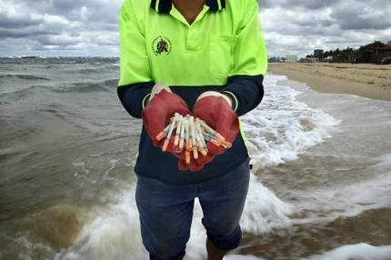
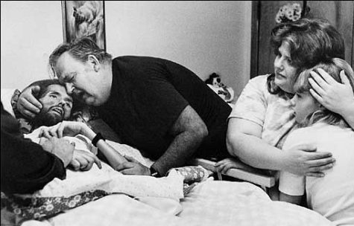
Notes:
Tiananmen Square
Aids

Slide 27
Cold War Review

Slide 28
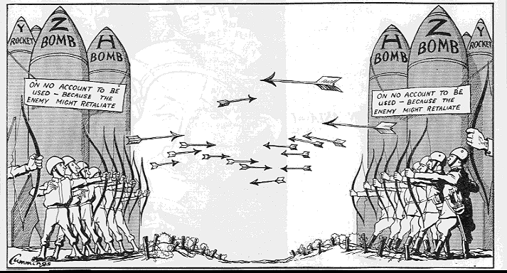
The Cold War 1945-1991

Slide 29
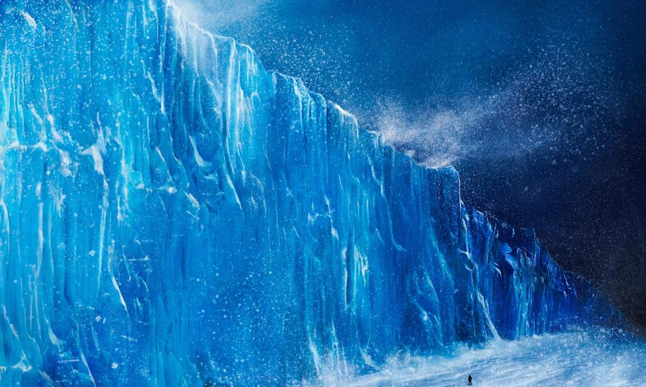
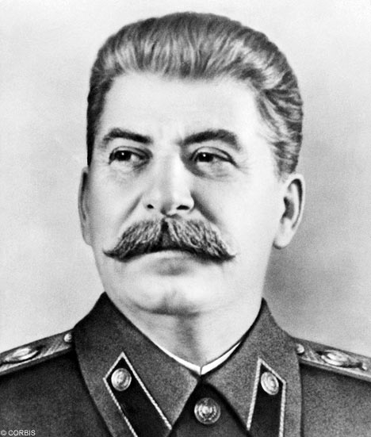
Cold War Review
The Cold War was an economic, political, technological, scientific, and military confrontation and competition between the United States and the Soviet Union.
USA
USSR

Slide 30
A Conflict of Interests
Capitalism
Free enterprise
Laissez faire
Democracy
Ultimate power rests with the people
Communism
No private ownership
Planned production
Centrally Planned
Government controls all aspects of life
Classless society
-Everyone on same level
USA
USSR

Slide 31
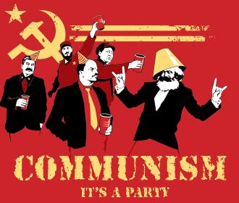
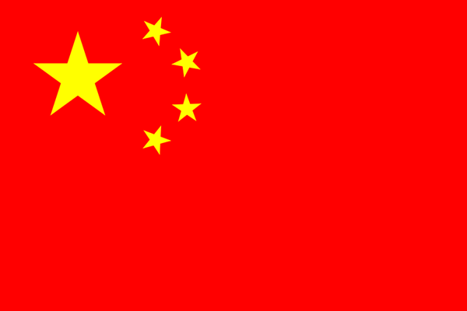
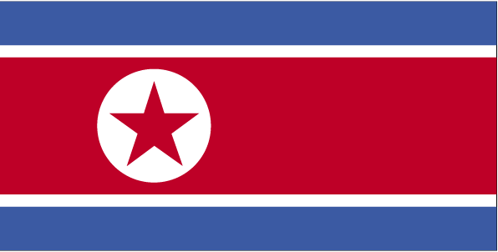
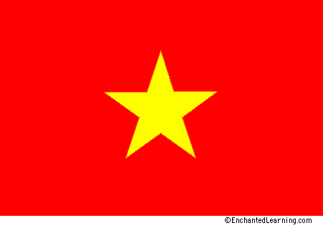
Remaining Communist Countries

Slide 32
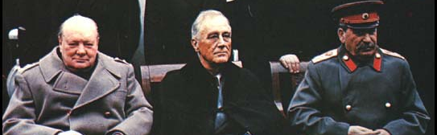
Beginning of the Cold War
Yalta Conference
Allies would each occupy and rebuild a part of Germany, and reunify once no longer a threat.
USSR demanded heavy reparations from East Germany
Atomic Bomb
Increased tension between Us and USSR

Slide 33
Crash Course

Slide 34
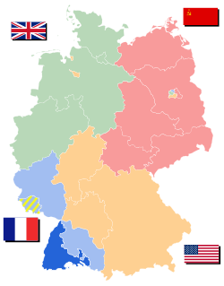
Division of Germany
Democratic Allies merge occupation zones
USSR occupied zone known as East Germany
West vs. East

Slide 35
Choosing Sides
Soviets occupied lands they had liberated during WWII
Set up pro-Communist governments
Satellite nations

Slide 36
“From Stettin in the Baltic to Trieste in the Adriatic an iron curtain has descended across the Continent. Behind that line lie all the capitals of the ancient states of Central and Eastern Europe. Warsaw, Berlin, Prague, Vienna, Budapest, Belgrade, Bucharest and Sofia; all these famous cities and the populations around them lie in what I must call the Soviet sphere, and all are subject, in one form or another, not only to Soviet influence but to a very high and in some cases increasing measure of control from Moscow.” ~Winston Churchill

Slide 37
Containment and the Long Telegram
George Kennan, U.S. ambassador in Moscow
Long Telegram: 8,000 word telegram outlining the Soviet situation
If the U.S. could prevent the Soviets from expanding, their system would eventually fall apart impenetrable to pain
Soviets impervious to logic, but sensitive to force
“containment policy”: Plan to keep communism from spreading by diplomatic, economic, and military force.

Slide 38
Marshall Plan
Truman Doctrine: U.S. gave $400 million to stop Communist aggression in Greece and Turkey
Marshall Plan: Massive aid package to help Europe recover from the war
Purpose: Prevent communism from spreading into economically devastated regions
Result: Western and Central Europe recovered economically
Soviets refused to allow U.S. aid to countries in eastern Europe

Slide 40
The Berlin Airlift
Soviets close access to W. Berlin (1948) in hopes of forcing the democratic half of the city to fall
Berlin Airlift: Cargo planes sent by Truman to W. Berlin to drop food, supplies, medicine, etc.
Continued for 11 months

Slide 41
West vs. East
North Atlantic Treaty Organization (NATO): Military alliance between the US and W. Europe (1949)
Agreed to aid any member nation that was attacked
Goal was to curb communism and vs. protect democracy
Warsaw Pact: Mutual defense treaty of 8 communist states
Under Soviet control
Both political and military control
Created to counter NATO

Slide 42
The Eastern Bloc
Repairs were slow and uneven; slowed to a halt by mid-1960s
Stalin’s 5-year plans failed to improve economy and food sources
Re-established harsh dictatorship
Forced labor camps, purging of culture and art
Notes:
42

Slide 43
Back to the Bomb
The Nuclear Arms Race

Slide 44
The Arms Race: Beginnings
Nuclear arms race: A competition for supremacy in nuclear warfare between U.S. and USSR during the Cold War
Atomic attacks in WWII
US monopoly on atomic weapons gave Americans sense of superiority
USSR began developing its own atomic program
“Joe One” detonated in 1949; almost an exact copy of “Fat Man”

Slide 45
The Arms Race: Politics
Brinkmanship: Willing to go to the brink of nuclear war to maintain peace.
U.S. vows to destroy USSR with nuclear weapons if it tries to expand
“massive retaliation”: If USSR attacks, the US will retaliate with atomic weapons
Resulted in a cut in traditional military spending and an increase in America’s nuclear arsenal
Mutually assured destruction: If one side attacks, the other will retaliate with equal atomic force
Both sides knew that any attack upon the other would be devastating to themselves, thus in theory restraining them from attacking the other

Slide 46
The Arms Race: Technology
The B-52 bomber could fly across continents and drop nuclear bombs anywhere in the world
Submarines capable of launching nuclear missiles were also created
ICBMs: Intercontinental Ballistic Missiles – allowed for nuclear bombs to be delivered without threat to human life
H-Bomb – “Ivy Mike” was detonated by the United States on November 1, 1952
Notes:
H-Bomb – “Ivy Mike” was detonated by the United States on November 1, 1952
It created a cloud 100 miles wide and 25 miles high, killing all life on the surrounding islands.

Slide 47
How big are today’s
nuclear bombs?

Slide 48
Little Boy: 15 kilotons
Fat Man: 21 kilotons
Ivy King: 500 kilotons
B53: 9,000 kilotons
How big are today’s
nuclear bombs?
Castle Bravo: 15,000 kilotons
Tzar Bomba: 50,000 kilotons

Slide 49
Living Under the Threat of the Bomb
Constant threat of nuclear attack
Americans prepared themselves for an “eventual” surprise attack
Government tried to calm fears, but also used atomic threat to gain government support
Some families built fallout shelters and schools performed air raid drills in an effort to prepare children for an attack

Slide 50
We can survive anything those dirty commies throw at us in our nifty new bomb shelter!

