Slide 1
"The colonizers brought along plants and animals new to the Americas, some by design and others by accident. Determined to farm in a European manner, the colonists introduced their domesticated livestock--honeybees, pigs, horses, mules, sheep, and cattle--and their domesticated plants, including wheat, barley, rye, oats, grasses, and grapevines. But the colonists also inadvertently carried pathogens, weeds, and rats… In sum, the remaking of the Americas was a team effort by a set of interdependent species led and partially managed (but never fully controlled) by European people.” Alan Taylor, historian, American Colonies, 2001
The export of New World crops to the Old World transformed European society by
Encouraging enclosure of open lands and pushing workers off farms
Promoting greater exploration of the interior of the American continent
Improving diets and thereby stimulating population growth
Fostering conflicts among major powers over access to new food supplies
The patterns described in the excerpt most directly foreshadowed which of the following?
The spread of maize cultivation northward form present-day Mexico into the American Southwest
The gradual shift of European economies from feudalism to capitalism
The emergence of racially mixed populations in the Americas
The population decline in Native American societies
Notes:
C, D

Slide 2
New England Colonization
Northern Colonies

Slide 3
General Characteristics of New England
Low mortality (70+ years) = large families
Smaller, close-knit communities; centered around church and the family
Practiced democratic forms of government
Emphasis on education
Economy largely tied to fishing, shipping, farms were small (rocky soil, no need for slaves)
Least ethnically diverse region

Slide 4
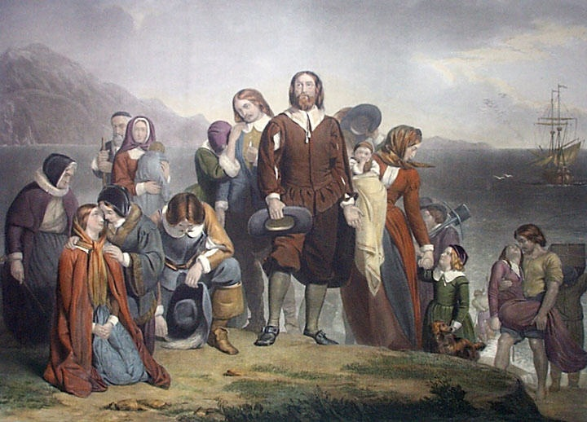
Puritans vs. Separatists
Separatists separate: The purest of Puritans (extremists)
Puritans purify: Move away from the traditions of Catholicism

Slide 5
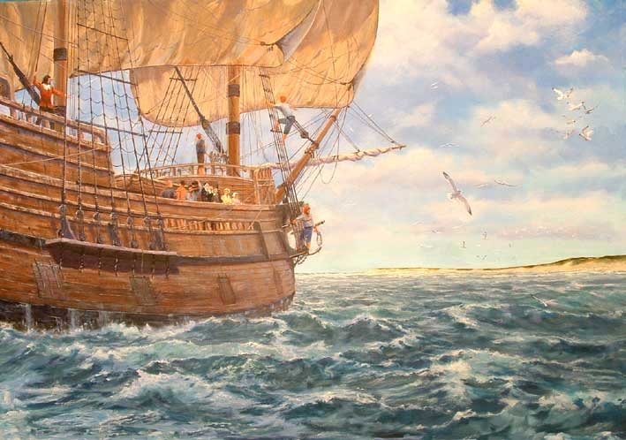
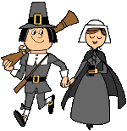
Who were the Pilgrims?
Separatists who believed they were “spiritual wanderers”
Plymouth Colony (1620): a group of 102 people [half Separatists, half “strangers”] set sail upon the Mayflower
Supposed to settle in Virginia
Caused potential destruction before they even landed

Slide 6
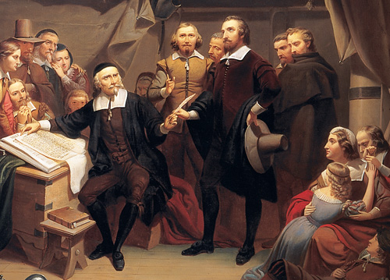
Not a constitution, but an agreement to form a crude govt. and submit to majority rule.
Led to adult male settlers meeting in assemblies to make laws in town meetings.
First democratic institution in America.
The Mayflower Compact

Slide 7
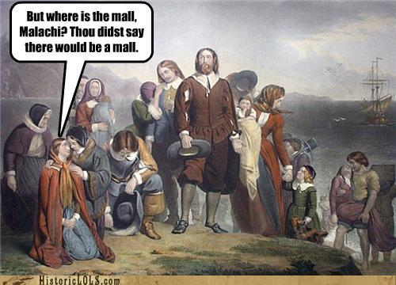
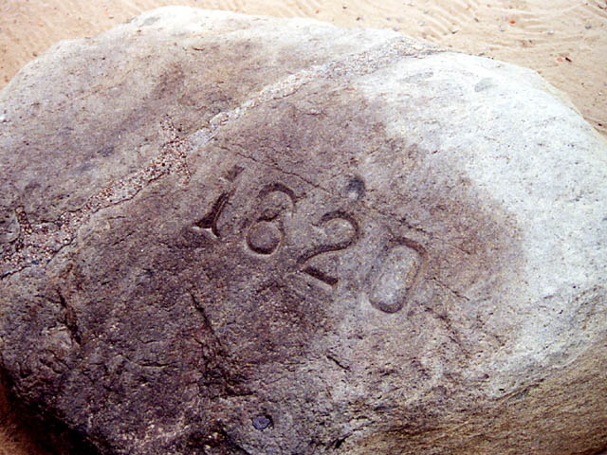
Life in Plymouth
Led by William Bradford
<half survived the first winter
“The Beaver and the Bible”: one to nourish the body, the other to nourish the soul
Small (<7,000) and economically unimportant
Merged with Massachusetts Bay Colony
Notes:
Play 1620 Rock Song

Slide 8
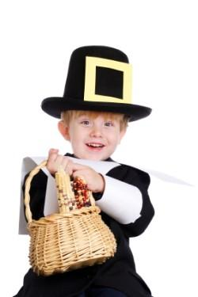
The Pilgrims and the First Thanksgiving
Notes:
8

Slide 9
LIES!

Slide 10
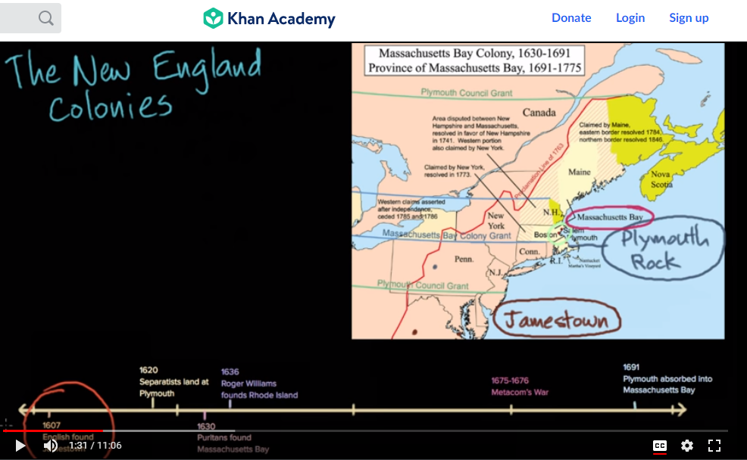
Watch the video and answer the questions before exploring this helpful resource.

Slide 11
Massachusetts Bay Colony (1629)
Created a “Bible Commonwealth” – a democracy based on Biblical principles
Top priorities: Protect the institutions of marriage and family; would result in strong communities.
“Social Covenant”
No tolerance of deviation or disorder
No privacy!
Notes:
Hypocritical and strict social constructs of the Patriarchal society at the time as well.

Slide 12
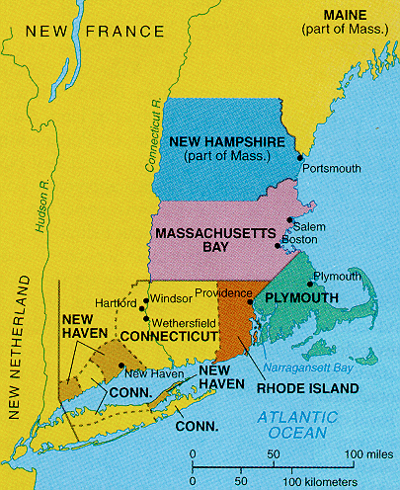
The Great Migration
Turmoil in England [leading to the English Civil War] sent about 70,000 Puritans to America.
Not all Puritans → 20,000 “others” migrated

Slide 13
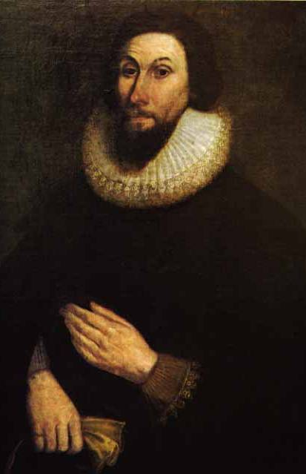
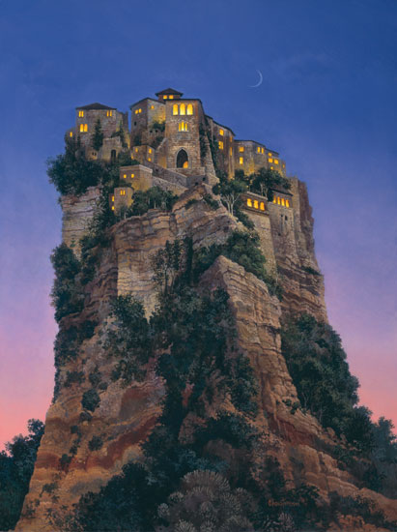
John Winthrop
1st governor of MA; led for 19 years
Believed that he had a “calling” from God to lead there.
Modell of Christian Charity – “We shall be as a city on a hill…”

Slide 14
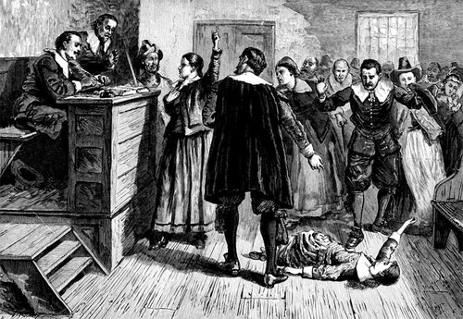
Salem Witch Trials
In 1692, a few girls claimed to have been bewitched by a Caribbean woman practicing voodoo.
Hysteria took hold and twenty people were executed.
By 1693, the Salem residents saw the recklessness for what it was and called it off.
A fear of women? Ergot poisoning?

Slide 15
The Northern Colonies
MASSACHUSSETTS
PLYMOUTH (1620)
Separatists
Mayflower Compact
MASSACHUSSETTS BAY
Puritans
Absorbs Plymouth colony
Bible Commonwealth
RHODE ISLAND
Roger Williams
Anne Hutchinson
Political and religious freedom
CONNECTICUT
Fundamental Orders of Connecticut

Slide 16
The Middle Colonies
The Middle Way in the Middle Colonies

Slide 17
General Characteristics of the Middle Colonies (Pennsylvania, New York, New Jersey)
Held a mix of NE and Southern colonies
Had a mixed economy – some agriculture (like South), some industry and shipping (like NE)
Landholdings were smaller than the South, bigger than NE
More ethnically and religiously mixed than other colonies
Most metropolitan region (Philadelphia)

Slide 18
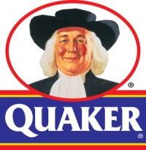
England’s Outsiders
The Religious Society of Friends (AKA: Quakers): Given the nickname because they shook or quaked when moved by religious emotion
Refused to take oaths
Pacifists
Gender equality
Separation of church and state
Anti-slavery

Slide 19
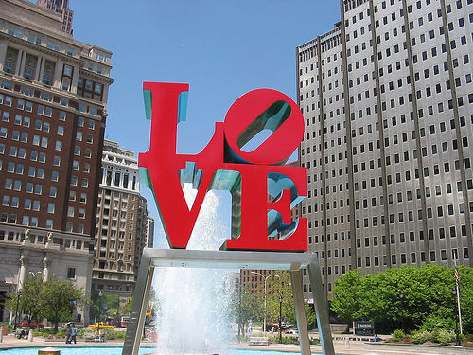
Pennsylvania
Founded by William Penn
Haven for Quakers; the “Holy Experiment”
Best advertised colony in England
Good relationship with Indians
Religious toleration for all (except Catholics and Jews)
Death penalty only for murder or treason
Philadelphia, the “City of Brotherly Love,” was the most metropolitan city in the Americas

Slide 20
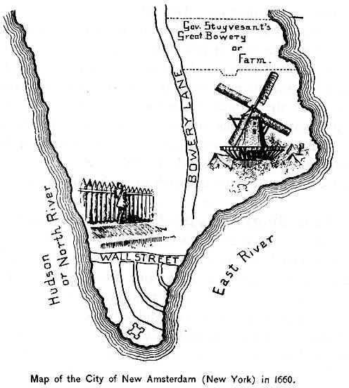
“New Netherland” Becomes “New York”
Founded by the Dutch (DEIC)
Led by Peter Stuyvesant
“New Netherland” and “New Amsterdam
Patroonships (large tracts of land) were awarded to promoters who’d settle 50+ people in the territory
Created an aristocratic environment
English take control
English king gives to the Duke of York
Took over without bloodshed (intimidation)
Renamed New York
Dutch influence: Aristocratic environment of Manhattan, place names (e.g. Breuckelen = Brooklyn), raised home entryways, Santa Claus, Easter eggs, bowling, and waffles
Keep Indians Out

